Slide 1
Agribusiness in New Zealand Secondary Schools 3
Conference April 2017

Slide 2
Introduction
Re-contextualising existing standards
Immense school (over 100 secondary schools) and sector interest
The integrated approach in the teaching of the new Agribusiness standards supports “de-towering of the silos” and encourages teacher collaboration
The initiative provides better links between secondary schools, tertiary institutions and the agribusiness sector.

Slide 3
Defining Agribusiness in the School Setting
Agribusiness is defined as a course of study that integrates all the primary industries and businesses that comprise primary production.
Agribusinesses include companies that are involved along the whole value chain including the manufacture, production operations, storage, processing, distribution of product and supplies, marketing of primary products and items made from them, along with support industries such as fertiliser companies, veterinarians, rural consultants and accountants.
Agribusiness programmes can focus on any or all of the primary industries such as agriculture, aquaculture, dairy manufacturing, equine, forestry, horticulture, seafood, or sports turf.

Slide 4
Studying Agribusiness in Schools
We have developed Achievement Standards based courses with these key features:
Focus is mainly beyond the farm gate
Taught across all primary industry sector contexts
For students strong in Sciences and / or Commerce
Experiential real time learning, using sector resources
Linked to Agribusiness university courses
Linked to careers and opportunities in Agribusinesses

Slide 5
Lead Schools Trialling Agribusiness Achievement Standards:
Mt Albert Grammar School
St Paul’s Collegiate School
Feilding High School
New Plymouth Boys High School
Lindisfarne College
Christchurch Boys High School
John McGlashan College and Columba College
Southland Boys High School and
Southland Girls High School

Slide 6
Agribusiness Achievement Standards
A matrix has been developed, covering fours strands at NCEA Levels 2 and 3,
Innovation,
Science and Technology
Management and Finance,
Marketing
Underlying themes of growing value, future proofing, sustainability
Seven new standards - 4 at Level 2 and 3 at Level 3

Slide 7
Strand | Level 2 | Level 3
Innovation | 2.1 Demonstrate understanding of future proofing influences that affect business viability. 4 credits Internal | 3.1 Analyse future proofing strategies to ensure long term viability of a business. 4 credits Internal
Science & Technology | 2.2 Conduct an inquiry into the use of organisms to meet future needs. 4 credits Internal
Management & Finance | 2.3 Demonstrate understanding of a primary industry business structure that meets the strategic needs of a business. 3 credits Internal | 3.2 Analyse the effect of a strategic capital expenditure decision on a business. 4 credits Internal
 | 2.4 Demonstrate understanding of cash flow forecasting for a business. 4 credits Internal
Marketing |  | 3.3 Analyse how a product meets market needs through innovation in the value chain. 4 credits Internal
 | 15 credits | 12 credits

Slide 8
Unpacking a Standard
Integrated Studies 2.1 - Demonstrate understanding of future proofing influences that affect business viability.
Demonstrate understanding involves explaining future proofing influences and how these influences could affect the viability of an identified business.
Demonstrate, in-depth, understanding involves giving a thorough explanation of the short and long term impact of future proofing influences that could affect the viability of an identified business.
Demonstrate comprehensive understanding involves evaluating the short and long term impact of future proofing influences, predicting impacts both within and beyond the identified business and the consequences of these impacts.

Slide 9
Future proofing refers to understanding the influences on a business that could affect viability. Examples of influences include:
economic
environmental
political
cultural
social
ethical
technological
biological
scientific
legal
Viability refers to ensuring the continuity of a business to meet current and future needs.

Slide 10
Integrated Studies 3.3 - Analyse how a product meets the market needs through innovation in the value chain.
Analyse involves explaining how a product meets the market needs through innovation in the value chain. This includes:
selecting a product
explaining the value chain for a product
explaining the innovation that may occur at a stage of the value chain
explaining how the innovation meets market needs
Analyse, in-depth, involves giving a thorough explanation of how a product meets the market needs through innovation in the value chain. This includes:
selecting a part of the value chain, identifying the innovation and examining how it meets the market
identifying an opportunity in the value chain
examining how the identified opportunity can add greater value better meet market needs
Comprehensively analyse involves evaluating how a product meets the market needs through innovation in the value chain. This includes:
evaluating how the identified opportunity can better meet market needs
evaluating the impact and consequences of the suggested opportunity on the whole value chain and the ability to meet future needs.

Slide 11
Designing your Course
There are 3 ways in which to design your course;
Teach the new Agribusiness Achievement Standards in a Level 2 or 3 Agribusiness programme as standalone courses.
Teach individual standards from the new Agribusiness Achievement Standards Level 2 and 3 Agribusiness programmes within their own existing courses.
Teach existing Achievement Standards from other domains (i.e. Geography, Science, Accounting etc.) that have been re-contextualised into new Agribusiness contexts written for them.

Slide 12
Re-contextualised Achievement Standards
https://www.agribusiness.school.nz/
Level 2 examples
AS90811 Education for Sustainability 2.2 - Explain how human activity in a biophysical environment has consequences for a sustainable future. (I,4).
AS91481 Accounting 2.5 - Demonstrate understanding of a contemporary accounting issue for decision-making. (I,4).
AS91163 Chemistry 2.3 - Demonstrate understanding of the chemistry used in the development of a current technology. (I,3).

Slide 13
Re-contextualised Achievement Standards
Level 3 examples
AS91411 Earth and Space Science 3.2 - Investigate a socio-scientific issue in an Earth and Space Science context. (I,4).
AS91428 Geography 3.3 - Analyse a significant contemporary event from a geographic perspective. (I,3).
AS91389 Chemistry 3.3 - Demonstrate understanding of chemical processes in the world around us. (I,3).

Slide 14
Possible Externals
Level 2.
AS90844 Business Studies 2.2 - Demonstrate understanding of how a large business responds to external factors. 4 credits.
AS90845 Business Studies 2.3 - Apply business knowledge to a critical problem(s) in a given large business context. 4 credits.
Level 3.
AS91530 Agricultural and Horticultural Science 3.3 - Demonstrate understanding of how market forces affect supply of and demand for NZ primary products. 5 credits.
AS91380 Business Studies 3.2 - Demonstrate understanding of strategic response to external factors by a business that operates in a global context. 4 credits.
AS91381 Business Studies 3.3 - Apply business knowledge to address a complex problem(s) in a given global business context. 4 credits.

Slide 15
University Entrance
Status of new Level 3 Agribusiness Achievement Standards in relation to University Entrance.
Once the Agribusiness Achievement Standards are listed, they are able to be used to meet the NCEA Level 3 requirement for UE.
UE requirements allow at least 18 Level 3 credits over & above those required to meet the 14 credits in each of the 3 approved subjects, the 10 credits literacy & the 10 credits numeracy, to be used towards the total of 80 credits for NCEA Level 3.

Slide 16
Approved subjects list.
Moratorium on UE and therefore approved subjects list until UE has been through its review.
Will then request Agribusiness to be added to this list.
In the interim, NZQA to work with St Paul’s and UNZ to consider adding the Level 3 Agribusiness Achievement Standards to the Business Studies matrix of standards.

Slide 17
What Subjects Should Students Take with Agribusiness?
What subjects are good to take in earlier years to prepare students for Agribusiness at Y12?
Level 1 Sciences and /or
Commerce subjects (Accounting, Economics)
Maths
What subjects are good to take alongside Agribusiness at Years 12 and 13?
Level 2 and 3 Sciences (Chemistry, Biology) and/or
Level 2 and 3 Commerce subjects (Accounting, Economics, Business Studies)
Maths
Level 3 Agricultural/Horticultural Science
Notes:
Having these gentlemen on board really gave this project authenticity- and made the students realise this was for real and gave them some insight into the realities of a good idea. They all learnt a huge amount during this process.

Slide 18
What kind of activities have we done in Agribusiness?
Field trips
Speakers
Cheese, wine, honey, biltong
Setting up a company
The Crocodile Pit,

Slide 19
Embarked on several fieldtrips…
Several dairy, beef and sheep farms
Waikato Milking Systems, Greenlea Meats
Waikato Innovation Park, including the goat milk spray drier
Fonterra, PGG Wrightsons Head Office and Grain Silos
Seen embryos flushed and examined under microscopes on Fullerton Farm
Visited a kiwifruit orchard
Ports of Tauranga
Visited robotic cowshed and wintering barn
Mystery Creek Winery
Attended the Fieldays
Zespri International
Notes:
We’ve enjoyed tremendous support from the sector, especially in their willingness to host us for visits. We have attended a large number of places and have many more up our sleeve when time permits

Slide 20
We talked about and made value added products like ……..
Camembert and Cheddar cheese!
Notes:
It looked better than it tasted –to be fair- so we brought in a cheese maker to come and tell us where we had gone wrong –and bring us some real ones to taste!

Slide 21
Then we tasted the real thing!

Slide 22
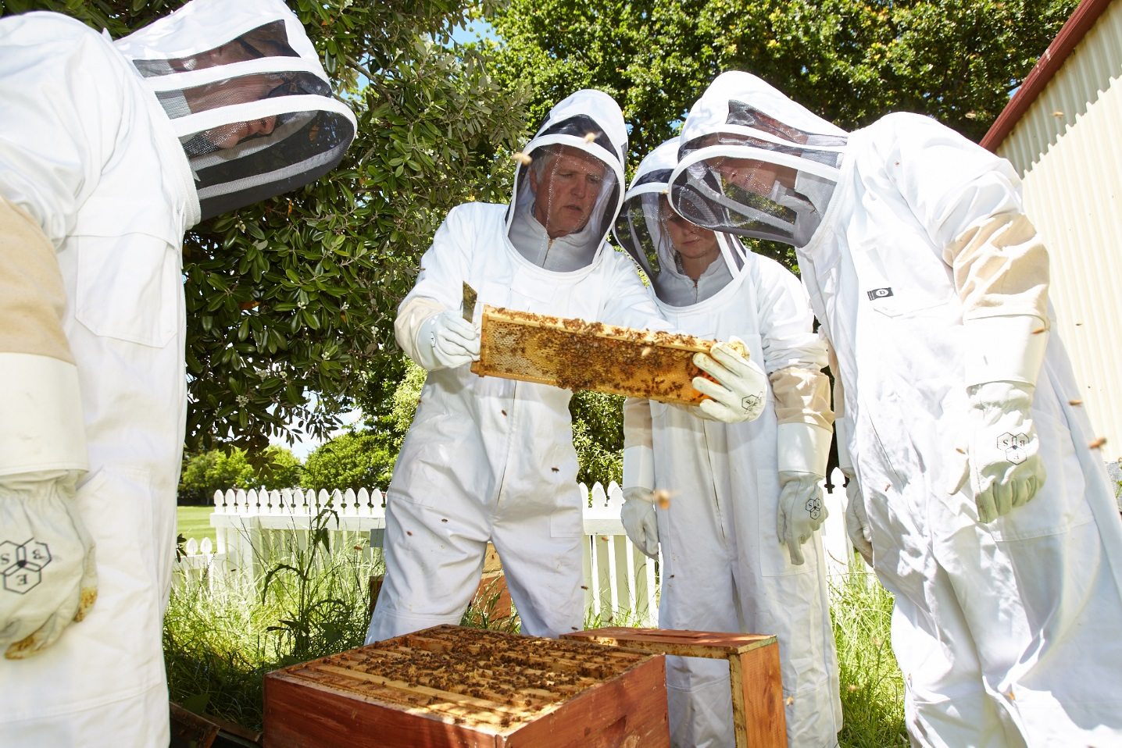
We’ve started keeping bees!

Slide 23
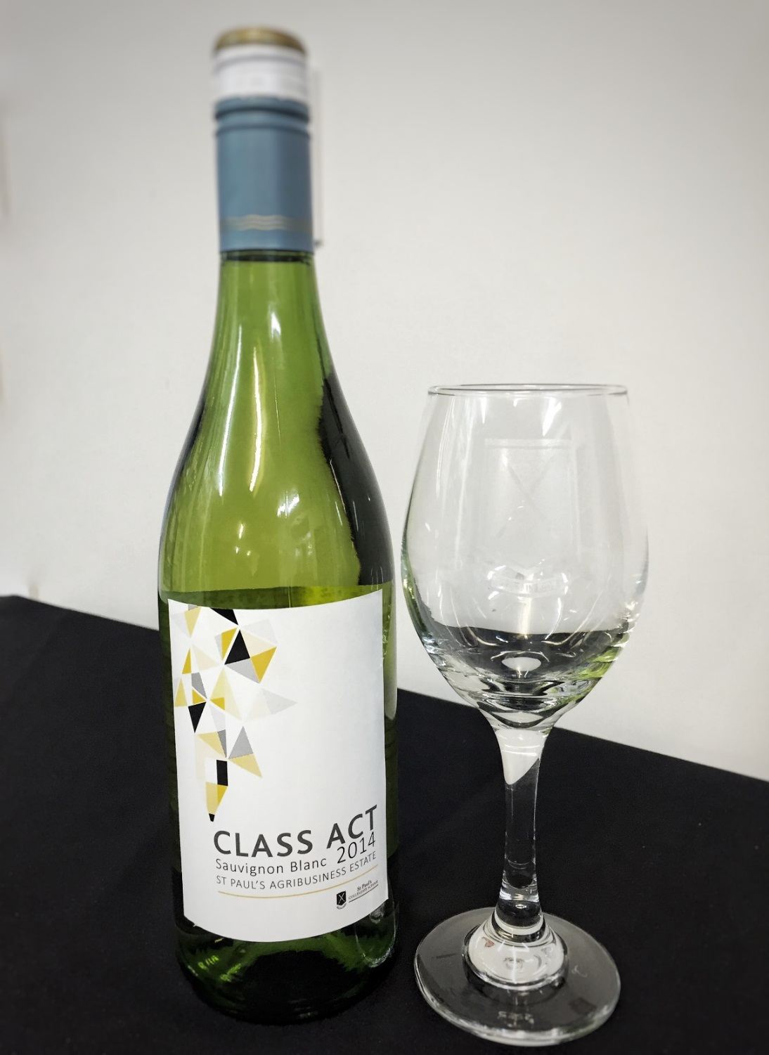
..and produced fine wines!!

Slide 24
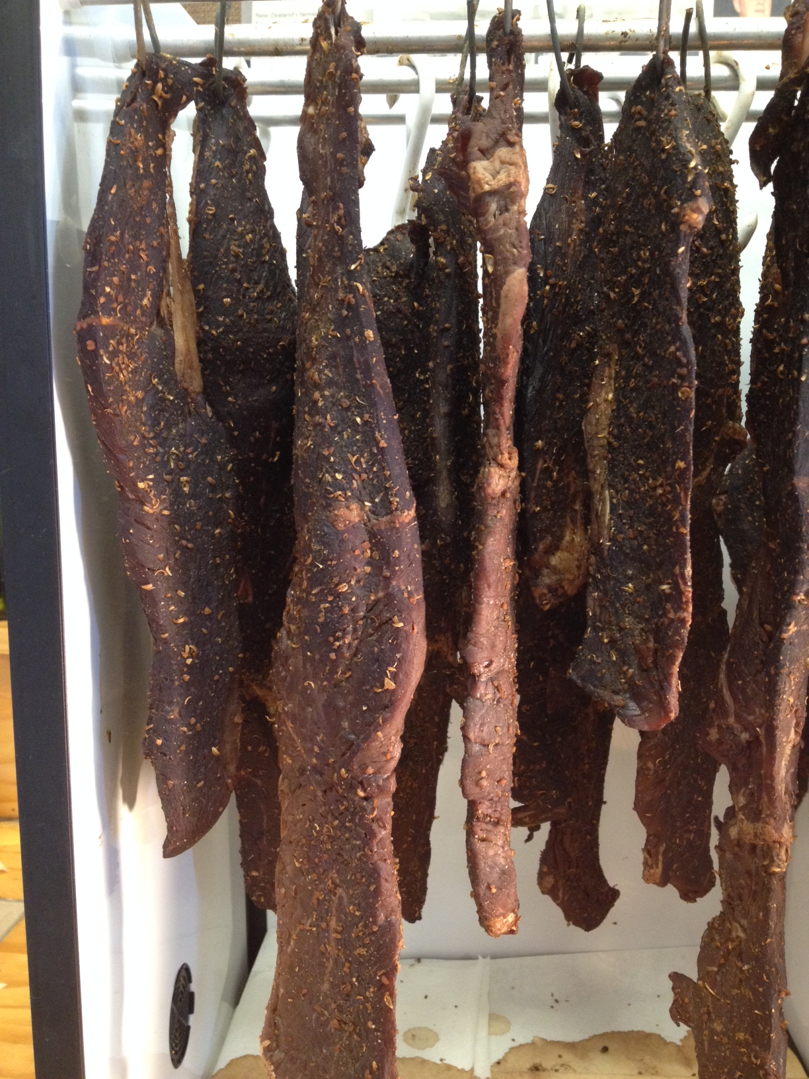
More value-adding….. Biltong!

Slide 25
Exposing them to crocodiles!

Slide 26
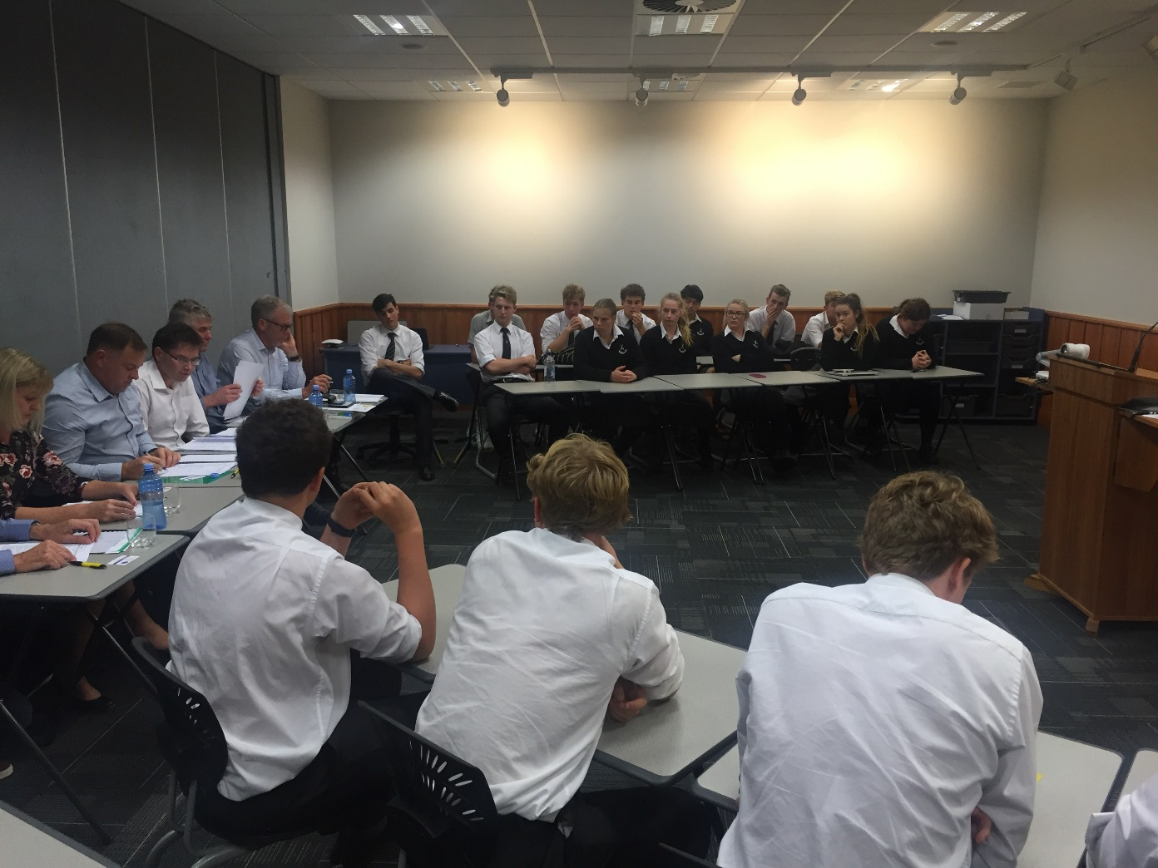
The Crocodile Pit
Students formed a company and had to come up with an Innovative concept that will benefit the Ag sector.
Needed to prepare and present a 4 min pitch to the Crocodiles, hoping for a financial investment.
The Crocodiles were then given 4 minute question time - generally assessing the substance and validity of their pitch.
Pitches judged by the Crocodiles and the winners invited to enter the Grassroots Fieldays Innovations Awards which we won!
Notes:
Having these business people on board really gave this project authenticity- and made the students realise this was for real and gave them some insight into the realities of a good idea. They all learnt a huge amount during this process.

Slide 27
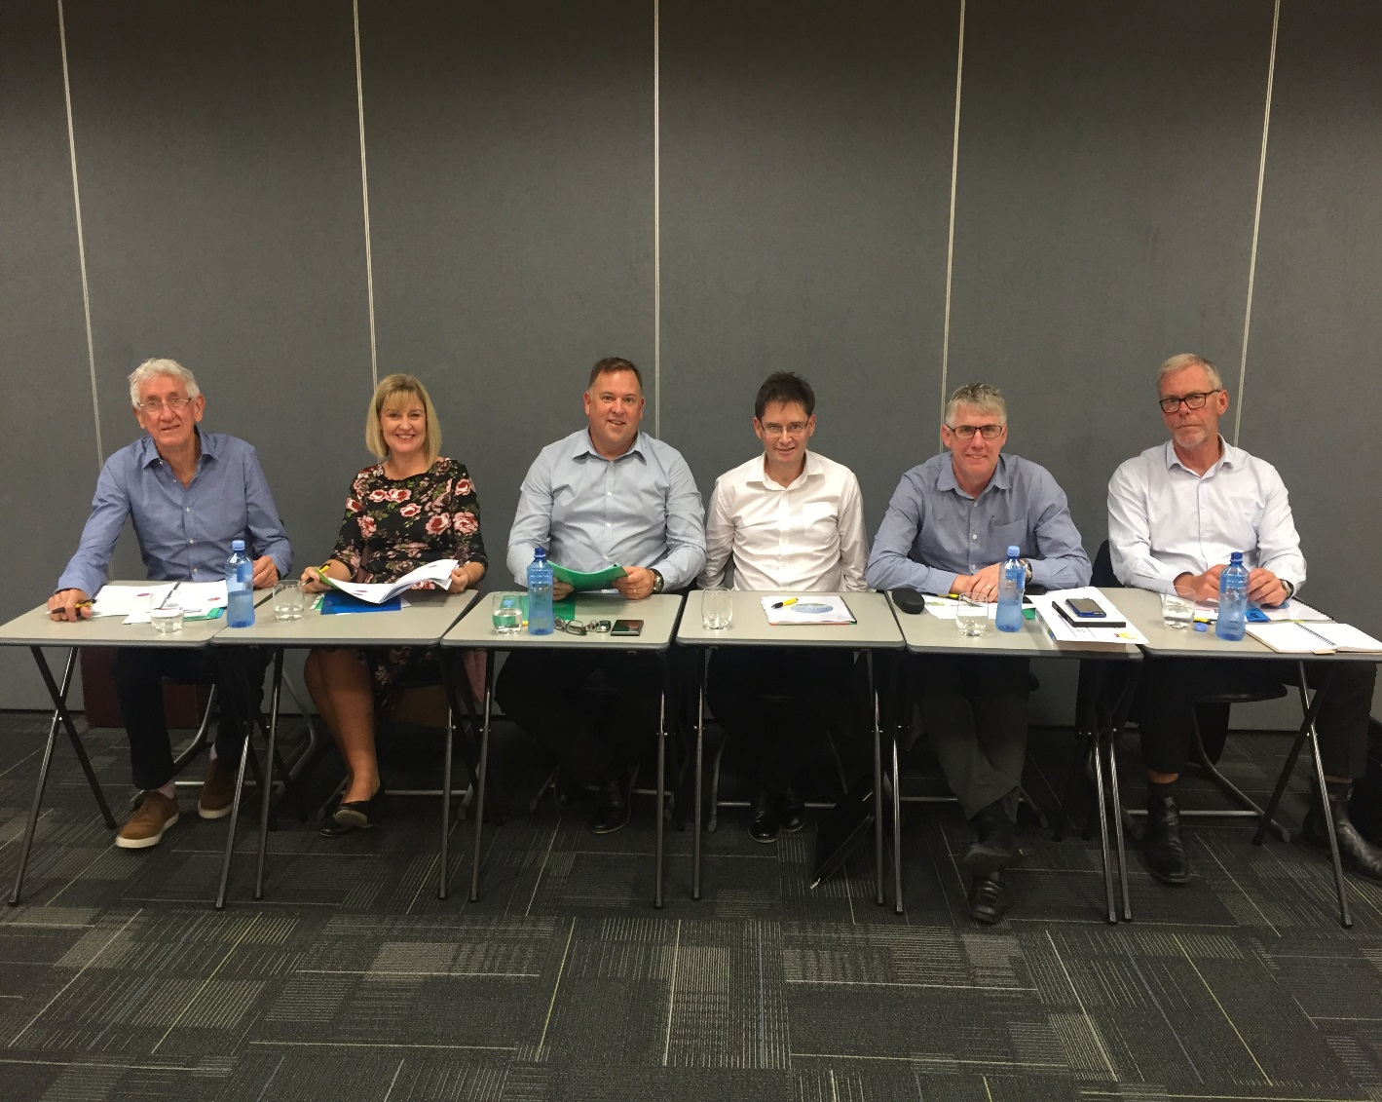
Very nice- but successful leaders
Geoff Laurent (Shoof Int)
Elaine Cook (Board of Directors for DairyNZ)
Dean Bell (Waikato Milking Systems)
Tony Egan (Greenlea Meats)
Bob Weir (Pinpoint Business Consulting)
Nick Dromgool (GM Fieldays)
Notes:
These were our crocodiles in the Crocodile Pit

