Slide 1
Event management from a geographic perspective

Slide 2
EVENT MANAGEMENT FROM A GEOGRAPHIC PERSPECTIVE
Geography is the study of people and their interaction with their natural and cultural environments. Studying event management from a geographic perspective involves looking at the spatial component of the event and how people interact with the environment (this can be either/or/both cultural and natural. The study will include key geographic concepts such as perspectives, change and sustainability.
As geographers we are interested in the where the event takes place, the processes involved in planning the event and the social, economic/ environmental impacts of the event.
TASK:
1 Write a definition of all the terms in red and draw an representative symbol for each.

Slide 3
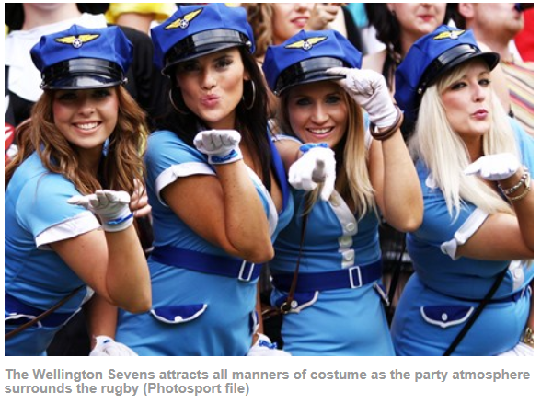
Write a description of the Wellington 7’s
from a Geographical perspective:
Include concepts such as location,
perspectives, interaction, sustainability

Slide 4
Event management involves studying the intricacies of the brand, identifying the target audience, devising the event concept, planning the logistics and coordinating the technical aspects before actually launching the event. Post-event analysis and ensuring a return on investment have become significant drivers for the event industry
The recent growth of festivals and events as an industry around the world means that the management can no longer be ad hoc. Events and festivals, such as the Olympics have a large impact on their communities and, in some cases, the whole country.
The industry now includes events of all sizes from the Olympics down to a breakfast meeting for ten business people. Many industries, charitable organizations, and interest groups will hold events of some size in order to market themselves, build business relationships, raise money or celebrate.

Slide 5
Perspectives impact on planning
Perspectives are made up of 3 parts:
What a person thinks
Why they think this
The world view that shapes this perspectives
Perspectives include but are not limited to:
Scientific, Maori/ethnic, gender, age, feminist, cultural, humanitarian, environmental, socialist, capitalist.

Slide 6
For schools who have Click View:
Event Management : A case study .

Slide 7
What type of resources are required in event management?
Money
People – both paid and volunteers
Machinery
Infrastructure

Slide 8
Leadership
Key characteristics:
Good interpersonal skills
Good informational skills
Knowledge of decision making strategies
Ability to keep the vision alive

Slide 9
Event planning components
Seeing the want/need - setting goals and objectives
Forming an organising committee
Allocating committee responsibilities
Deciding on dates and plan a time-line
Budgeting – grants/sponsorship/fundraising
Location/venue
Risk management, security plan, traffic management

Slide 10
Essential services, contractors, food vendors
Cleaning & maintenance
Waste management
Marketing and promotion
Invitations/ticketing
On the day
After the event
Post event evaluation

Slide 11
Decision making tools
1 Cost benefit analysis:
Cost-benefit analysis (CBA) is the assessment of the benefits and costs (i.e., pros and cons, advantages and disadvantages) associated with a particular choice.
Benefits and costs may be monetary or
non-monetary.

Slide 12
Steps in Cost - Effectiveness and Cost - Benefit Analysis
1. Set the framework for the analysis
2. Decide whose costs and benefits should be recognized
3. Identify and categorize costs and benefits
4. Project costs and benefits over the life of the program, if applicable
5. Monetize (place a dollar value on) costs
6. Quantify benefits in terms of units of effectiveness (for CEA), or monetize benefits (for CBA)
7. Discount costs and benefits to obtain present values
8. Compute a cost - effectiveness ratio (for CEA) or a net present value (for CBA)
9. Perform sensitivity analysis
10. Make a recommendation where appropriate

Slide 13
Decision making tools 2 Decision making matrix
Factors/criteria
 | Seating capacity *3 | Parking *2 | Acoustics *2 | Sound System *1 | Availability *3 | Hire Charges *2 | Score
Venue 1 | 200 =1
Venue 2 | 500=2
Venue 3 | 1000=5
2 Decision making matrix:
Steps:
1 Give each venue a score of 1-5 ( 5 high) for
each criteria.
Add up the totals – highest score = best
venue
3 Criteria can be weighted and details added in each box to give a more in depth information.

Slide 14
Spatial planning exercise
Go to http://www.topomap.co.nz/ using this resource select a location for a marathon.
Select a suitable site.
Draw a précis map to show: start point, administration area, facilities, parking, route of marathon, 1st aid stations, water stations, finish point etc

