Slide 1
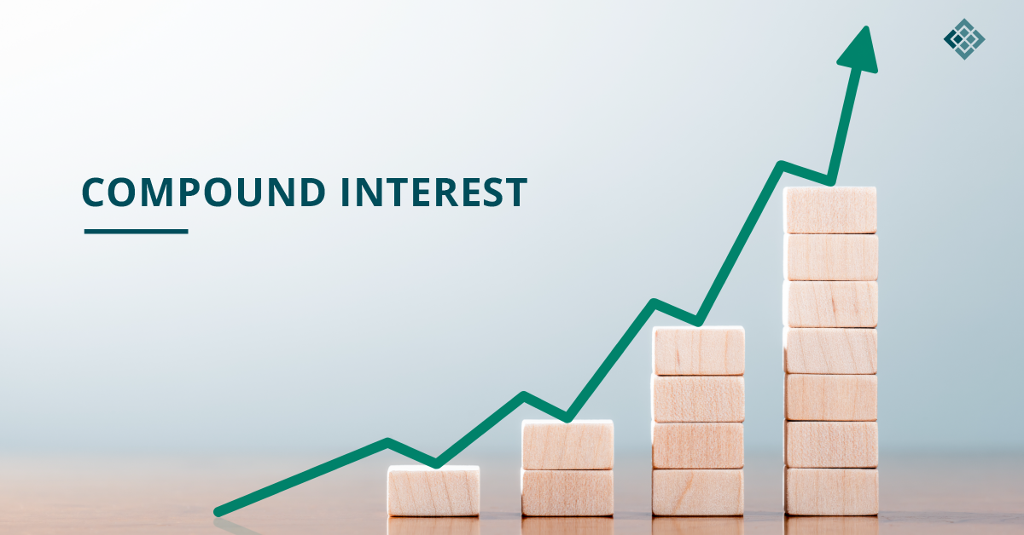
Compounding Interest Webinar
Presenter: Paul Bird
Lead Business and Farm Solutions Advisor
DairyNZ

Slide 2
Compounding, the 8th wonder of the world
Compounding interest
What is it?
How does it work?
How does it help savings grow over time?
Practical examples to work through with students.

Slide 3
Compounding interest - do this on the whiteboard
100 + 10 = 110
110 + 11 = 121
121 + 12.10 = 133.1
This is showing 100 compounding at 10% interest
Present value = 100, future value 133.10, interest rate 10% and years = 3
Write formula up but emphasise you don’t have to know this – this is just for the people who like maths 😊 FV=PV x (1 + i)^{n}
FV = future value; PV = present value; i = interest rate or return on investment; n = number of years

Slide 4
Compounding $20,000 invested for 10 years at 10%
Formula: Future Value = Present Value x (1 + interest rate )^{years}
Using your phone calculator
Enter Present Value | $20,000
Multiply the Present Value by 1 plus the interest rate How: Turn the interest rate into a decimal and add 1 to it | $20,000 x 1.10 10% + 1 = 0.10 + 1 = 1.10
Press the ‘equals’ button for number of years Or x 1.1 10 times | = (ten times)
Answer | $51,875

Slide 5
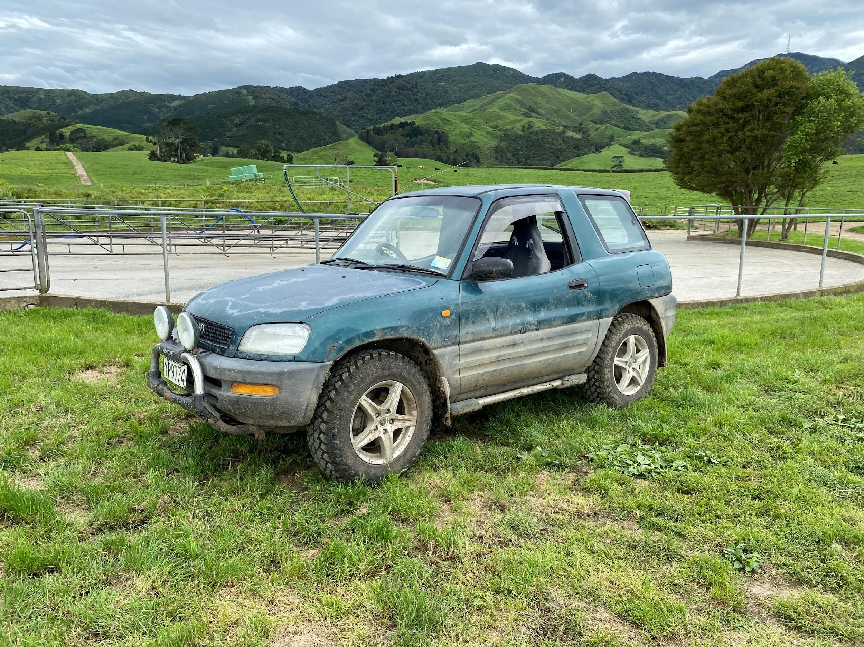
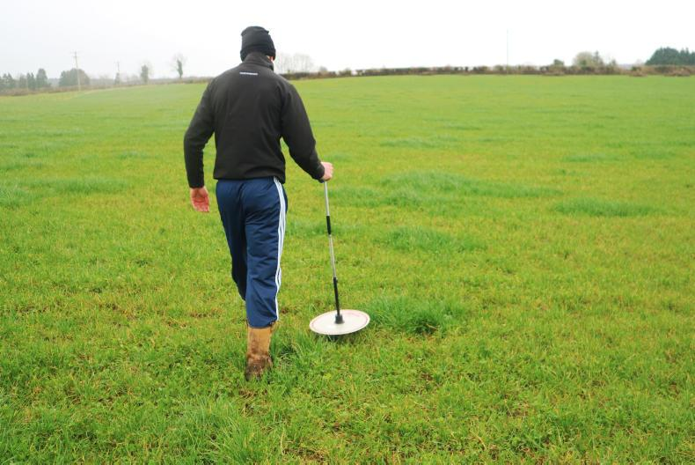
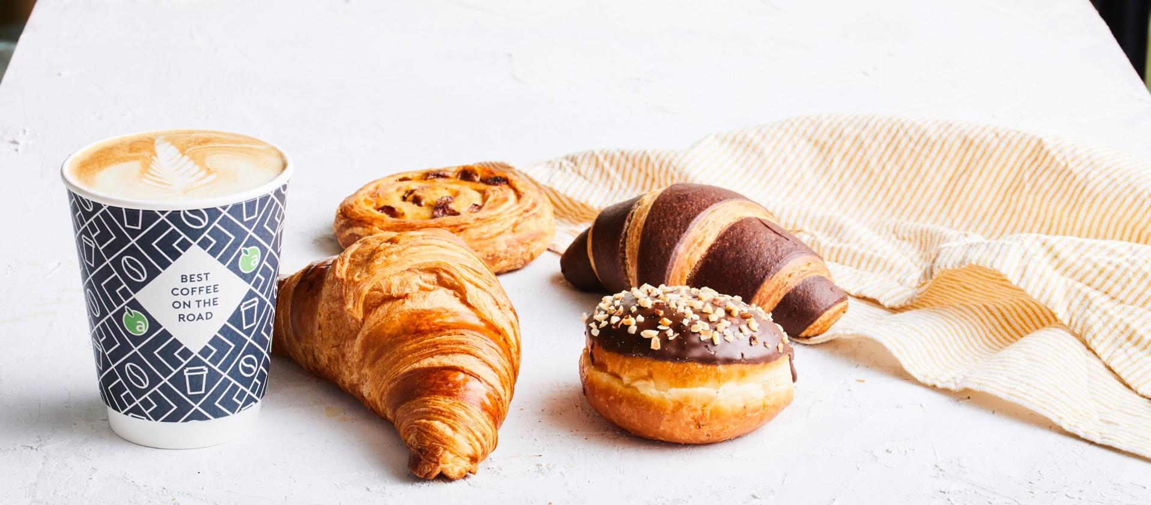
The true power of compounding
Those who truly understand compounding connect daily decisions with long term wealth creation.
`$150/ha X 75ha = $11,250/yr
$11,240 @ 10% X 30 years = $1.8 mill
$10,000 lower capital cost
+ cheaper servicing
@ 10% X 40 years = $400,000
$5/day X 365 days = $1,825/yr
@ 10% X 40 years = $800,000
Notes:
Ask group if they bought 1 coffee per day for $6 over a 45 year period how much money would that add up to… wait for 2 or 3 answers….
Answer $96,000 but if you saved that $6 and invested it over time at 10% return it equals $1.6 million – that’s compounding – it’s almost unbelievable
So key point is if you can mentally think about small daily decisions in terms of long term impact it will have a massive positive affect on you – one coffee isn’t $6 – it is a $1.5 million decision
Surprisingly, small changes can have dramatic changes

Slide 6
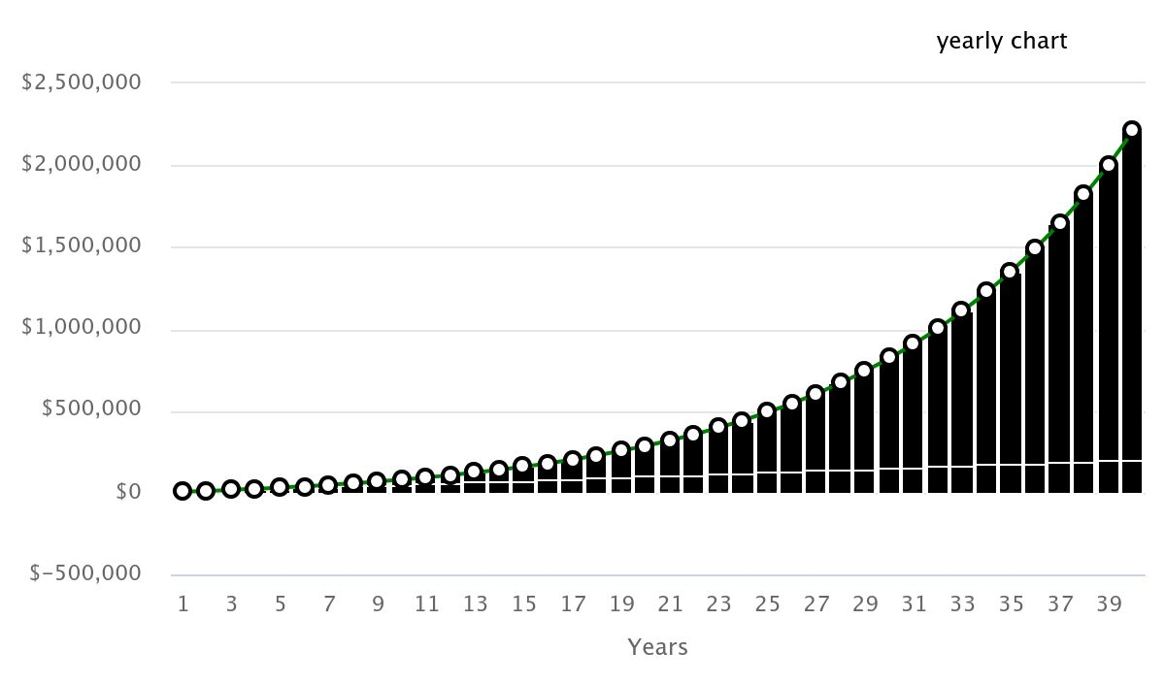
$5000 saved/yr @ 10% return x 40 years
zone of amazement
The ‘compounding’ component!
zone of disappointment
$5000 saved with no interest

Slide 7
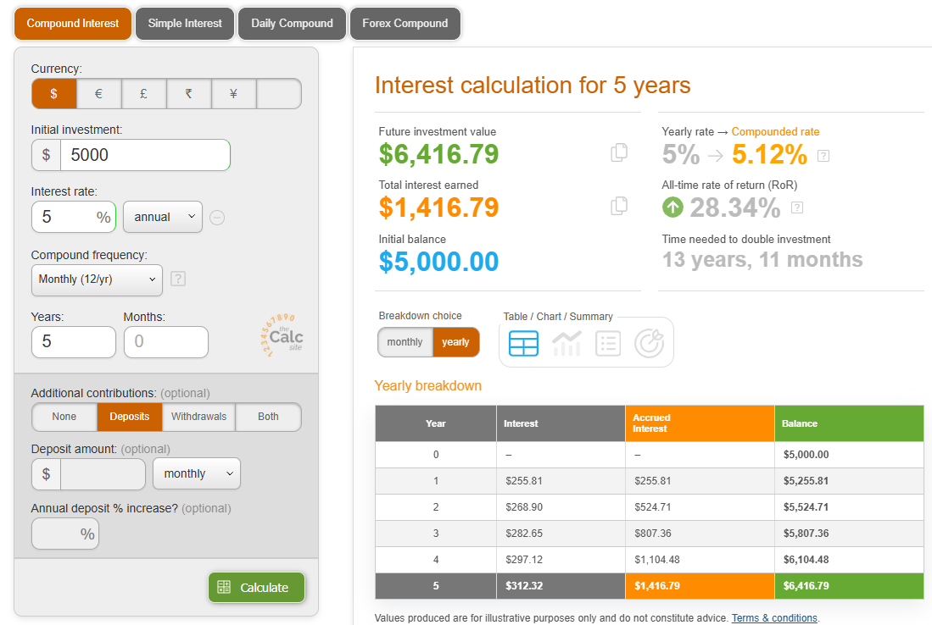
‘Quick’ Financial Plan
Compound Interest Calculator - Daily, Monthly, Yearly Compounding (thecalculatorsite.com)
Three time periods - example
Age 18-25: zero starting equity, and save $5,000/year X 5%
Age 25-50: equity and save $10,000/year X 8% return
Age 50-65:equity and save $15,000/year X 8% return
Use on-line tool
Graph the example
Graph your equity growth forecast
Notes:
PRINT

Slide 8
Scenario 1:
25 years of age (people are just starting out)
0 deposit
With a 5% yearly interest rate over 7 years
with a compounding frequency of yearly,
with a $5,000 deposit yearly.
Work through this scenario.

Slide 9
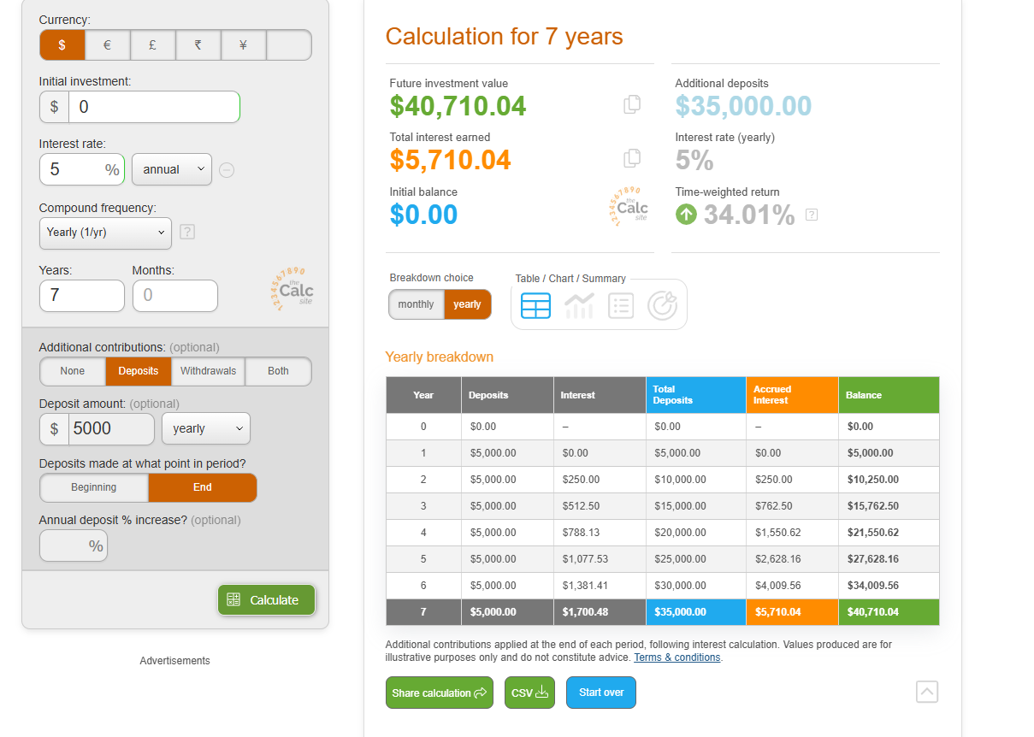
Scenario 1: 18-25 years of age (people are just starting out) - 0 deposit – 5% yearly over 7 years, with a compounding frequency of yearly, $5,000 deposit yearly. Answer = $40,710

Slide 10
Scenario 2:
25-50 years of age (people who have saved a deposit and bought a business or a house or just investing in investment funds)
using the $40,710 as initial investment
with 8% yearly interest rate over 25 years,
with a compounding frequency yearly,
with a deposit of $10,000 yearly.
Your turn.
Work out the compounding interest for this scenario.

Slide 11
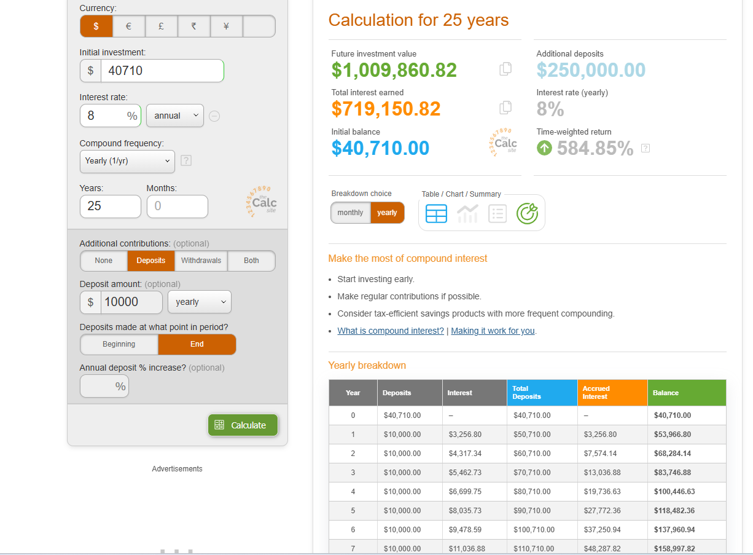
Scenario 2: 25-50 years of age (people who have saved a deposit and bought a business or a house) = $40,710 with 8% interest rate over 25 years, with a compounding frequency yearly, with $10,000 yearly deposits = $1,009,860

Slide 12
Scenario 3:
50-65 years of age (people are now investing into the business)
Using the $1,009,860
with 8% yearly interest rate over 15 years,
with a compounding frequency yearly,
with $15,000 yearly deposits.
Your turn.
Work out the compounding interest for this scenario.

Slide 13
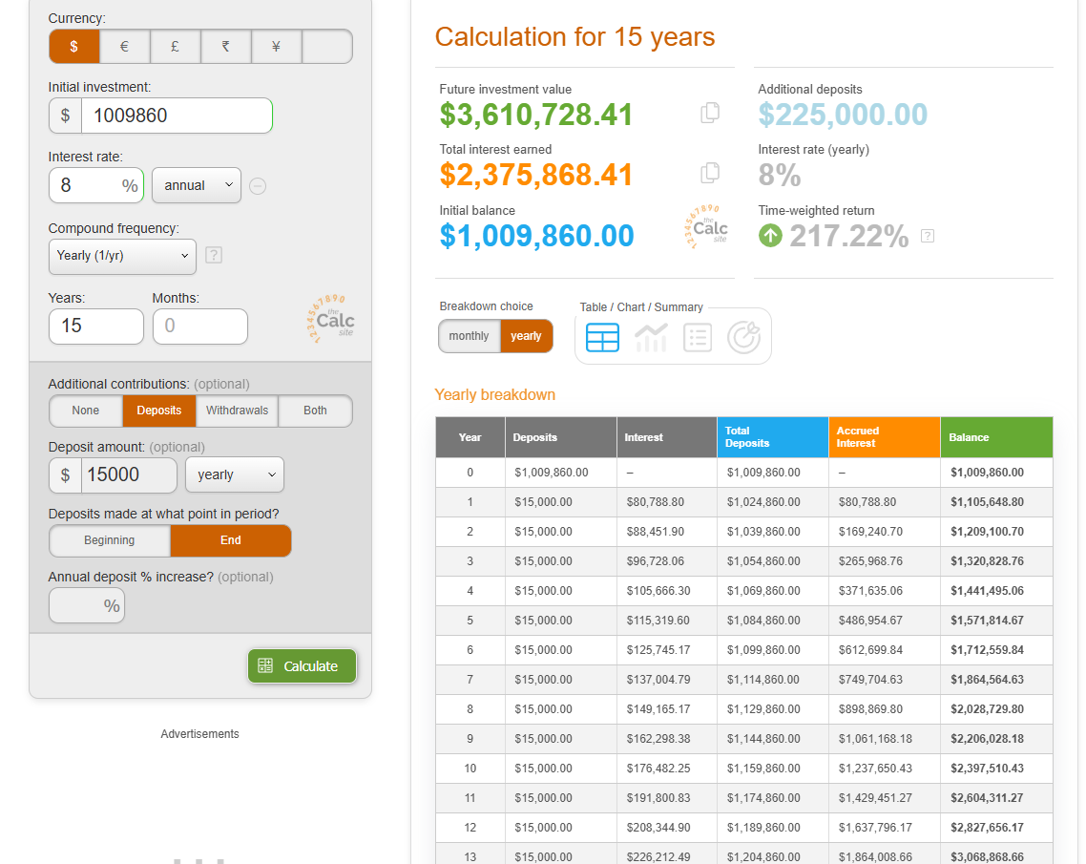
Scenario 3: 50-65 years of age (people are now investing into the business) = $1,009,860 with 8% interest rate over 15 years, with a compounding frequency yearly, with $15,000 deposits = $3,610,728

Slide 14
Results - graph results on the whiteboard
18-25 years of age (people are just starting out) - 0 deposit – 5% yearly over 7 years, with a compounding frequency of yearly, 5000 deposit yearly = $40,710
25-50 years of age (people who have saved a deposit and bought a business or a house) = $40,854 with 8% interest rate over 25 years, with a compounding frequency yearly, with $10,000 yearly deposits = $1,009,860
50-65 years of age (people are now investing into the business) = $1,063,756 with 8% interest rate over 15 years, with a compounding frequency yearly, with $15,000 deposits = $3,610,728.

Slide 15
Equity Growth - Example

Slide 16
My Equity Growth Plan

Slide 17
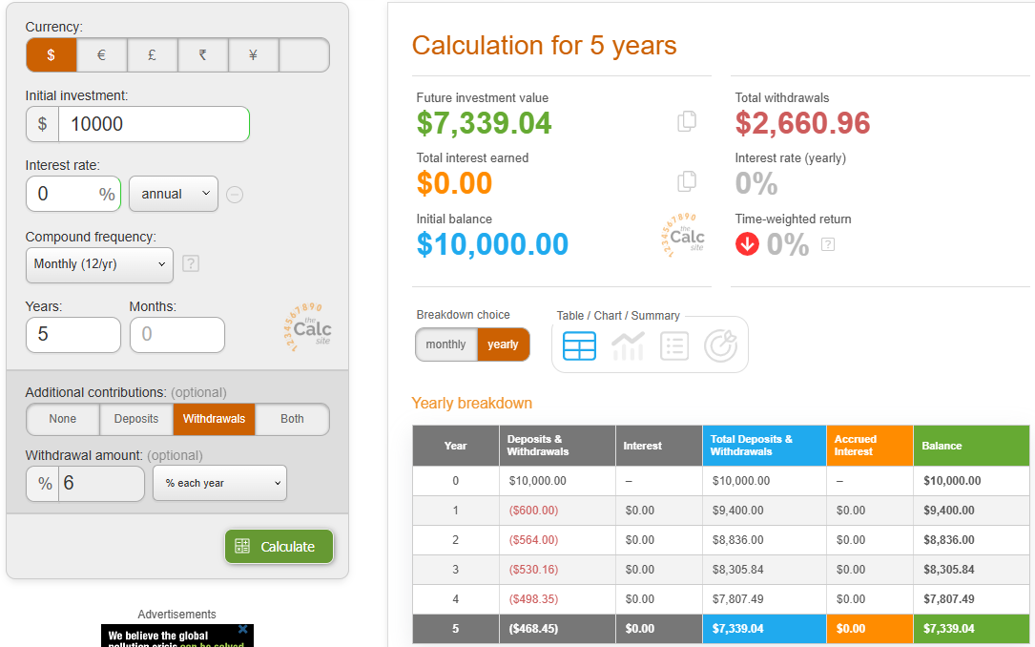
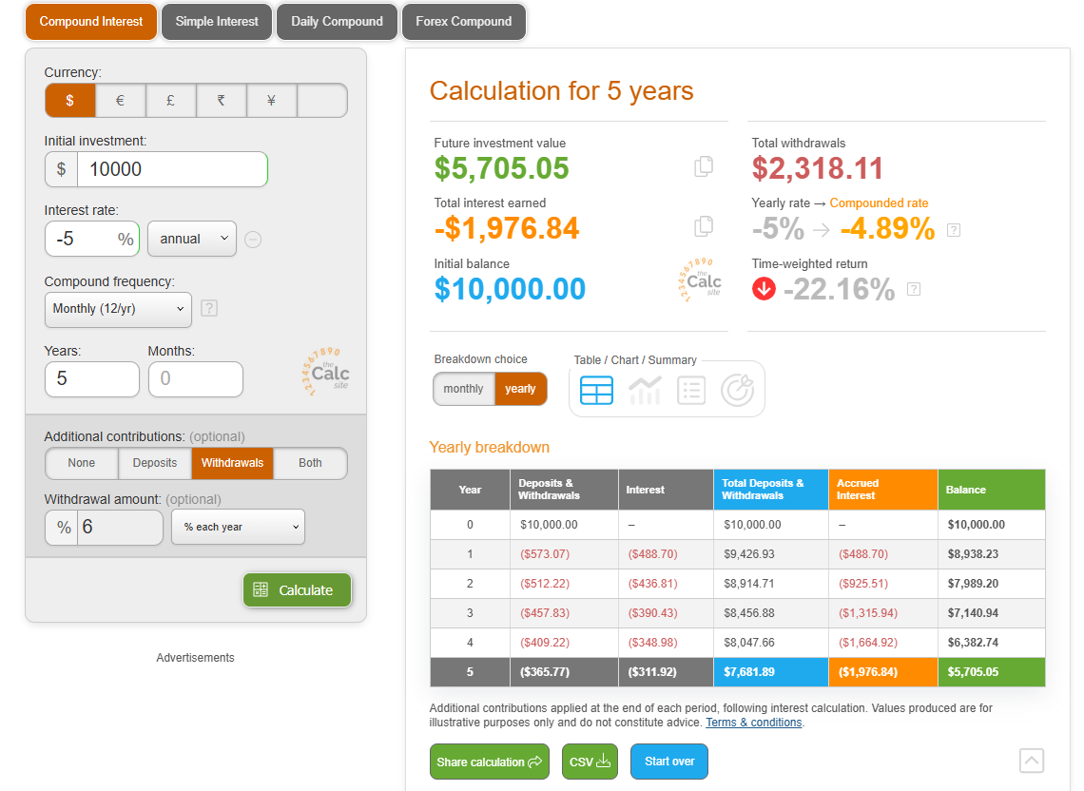
Using the calculator.
1. Compare buying a $10,000 car versus a $20,000 ute.
 | Deposit $ | Years | Depreciation (Withdrawal) | Interest rate | Investment $
Car Saved $10k | $10,000 | 5 | 6% | 0 | 7,339 (-)
Car Borrowed $10K |  | 5 | 6% | -5% | 5,705 (-)
Ute Saved $20k | $20,000 | 5 | 6% | 0 | 14,678(-)
Ute Borrowed $20K |  | 5 | 6% | -5% | 11,168 (-)
Car versus Ute | $10,000 | 5 |  | 8% yearly | 14,693
 | $10,000 | 40 |  | 8% yearly | 217,245

Slide 18
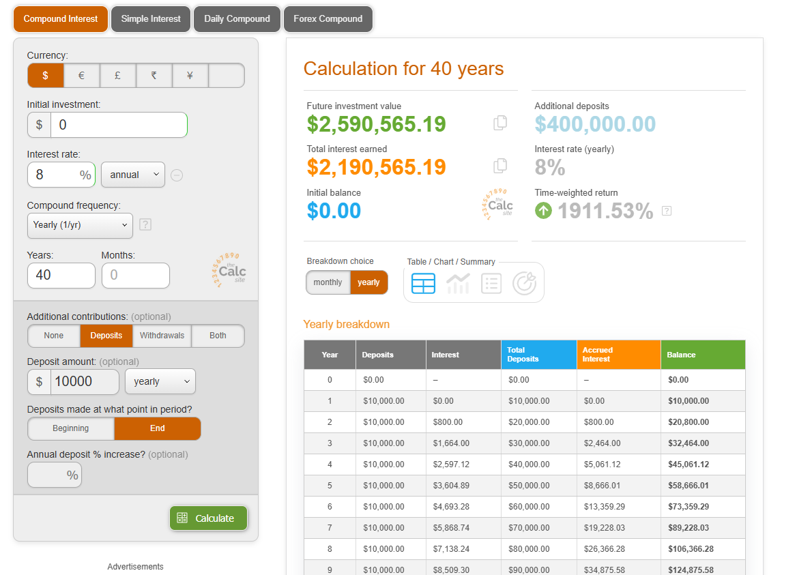
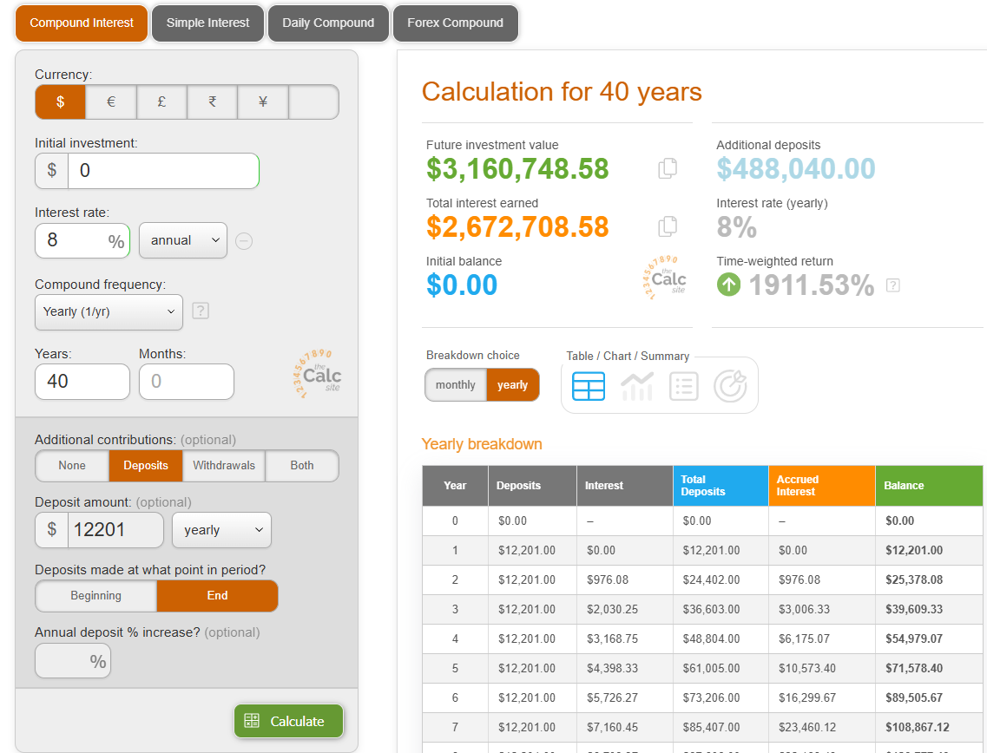
2. KiwiSaver: An extra $545,000
Compare KiwiSaver and Investment fund.
Investment fund option:
Initial investment is = 0
8% interest rate over 40 years, depositing $10,000 annually with a compounding frequency of yearly = $2,590,565
KiwiSaver option: (same investment amount but 3% into KiwiSaver)
3% KiwiSaver contribution based on salary of $80,000 = $2,400
Matched by employer (3% = $2,400 less tax $720 = $1,680)
$1,680 plus $521 government contribution = $2,201 extra savings
$2,201 + $10,000 = $12,201 annual savings / investment amount
Replace $10,000 in the calculator with $12,201
Equity in 40 years = $3,160,749
The difference between investing $10,000/yr in a fund outside KiwiSaver vs in a KiwiSaver when an employee contribution occurs is: $3,160,749 - $2,590,565 = $570,184
*Assume the same returns of 8% from KiwiSaver & non KiwiSaver investment fund

Slide 19
Compounding applies to non financial factors
Learning
Reputation / personal brand
Relationships
Smart choices
etc – are there others – ask group

Slide 21
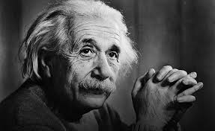
Compounding

Slide 22
Compounding, the 8th wonder of the world
Notes:
PRINT

