Slide 1
Agribusiness in New Zealand Secondary Schools 1
Conference April 2017

Slide 2
St Paul’s Collegiate School Centre of Excellence for Agricultural Science and Business ™
Introduction
The Concept
About St Paul’s
Independent Schools and Educational Leadership

Slide 3
St Paul’s Collegiate School Centre of Excellence for Agricultural Science and Business ™
Our Journey
Agricultural and Horticultural Science
Survey results
The Advisory Group
Private-Public Partnerships

Slide 4
The Advisory Group
Glen Beal Campbell Tyson
Dean Bell Waikato Milking Systems
Alan Cottington AGrowQuip
Jason Cowan BNZ Business Partners
Tony Egan Greenlea Premier Meats
Darrell Jones Gallagher Group
Peter Hampton Deputy Headmaster St Paul’s Collegiate
David Hemara Dairy Goat Co-operative NZ
John Jackson Farmer, St Paul’s Board member and current parent
Grant Lander Headmaster, St Pauls Collegiate
Doug Macredie Beef + Lamb New Zealand
Tony Moffat Lincoln University
Allen Waide Tetrapak
Peter Nation NZ National Fieldays Society
Malcolm Nitschke AGMARDT
William Oliver Farmer and current parent
James Ormsby Waitomo Petroleum
Martyn Phillips Zoetis
Dr Tom Richardson AgResearch (Chair)
John Reeves Farmer, St Paul’s Board member
Prof Jacqueline Rowarth University of Waikato
Michael Spaans Board of director at DairyNZ, Board of director at Fonterra and current parent
Susan Stokes DairyNZ
David Walker Spark
Terry Youngman Anexa Animal Health & Cognosco

Slide 5
The Partnership Model
St Paul’s put together a three tier partnership structure
Three principal partners (DairyNZ, Beef + LambNZ, St Paul’s)
10 business partners
Naming rights partner

Slide 6
Forming Partnerships
Principal partners
DairyNZ, Beef + Lamb New Zealand, St Paul’s Collegiate School
Business partners
Potential specific partnership leverage opportunities
The co-investment
The relationship type
Nationally distributed business or regional business
One business partner from each key agribusiness sector
Business synergies
Scholarships
Naming Rights partner

Slide 7
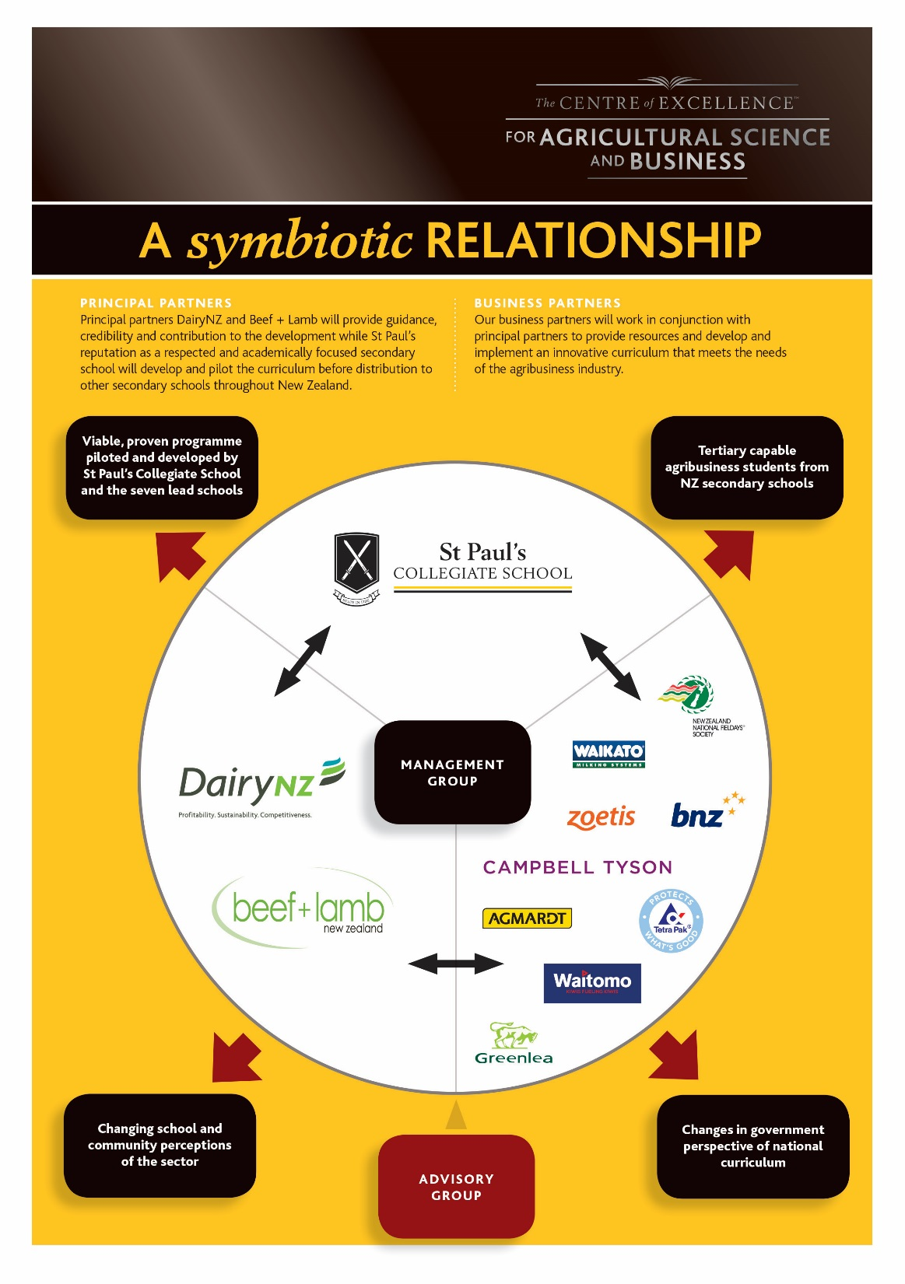

Slide 8
Partner Benefits for Schools
Roll growth
Meeting the needs of parents and students
Raising school profile as a leader in this sector
Networks established/reinforced
Tertiary scholarship and employment opportunities
Moral high ground
Leading a curriculum development of national significance
Key profiling opportunities

Slide 9
Benefits to Partners
Acknowledgement through taking leadership in the sector and being aligned with a project of national significance
Industry good criteria met (for some)
Advice on selection of lead schools
Quality control on the initial programmes developed and ongoing input through Advisory Group
Use in future of the longitudinal research results
Involvement in a quality brand
Use of school facilities (COE) for functions/seminars
Advertising / branding / recognition / profiling opportunities
Access to students and families

