Slide 1
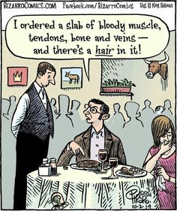
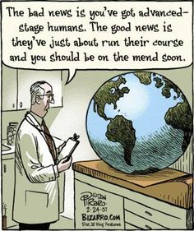
Notes:
Consider what each of these cartoons is saying about people. Do you agree or disagree? Can you think of different members of society that might have a different opinion about these cartoons than you. What might their opinion be.

Slide 2
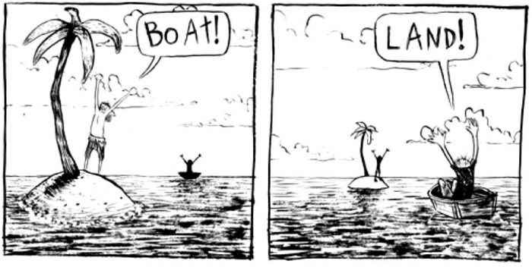
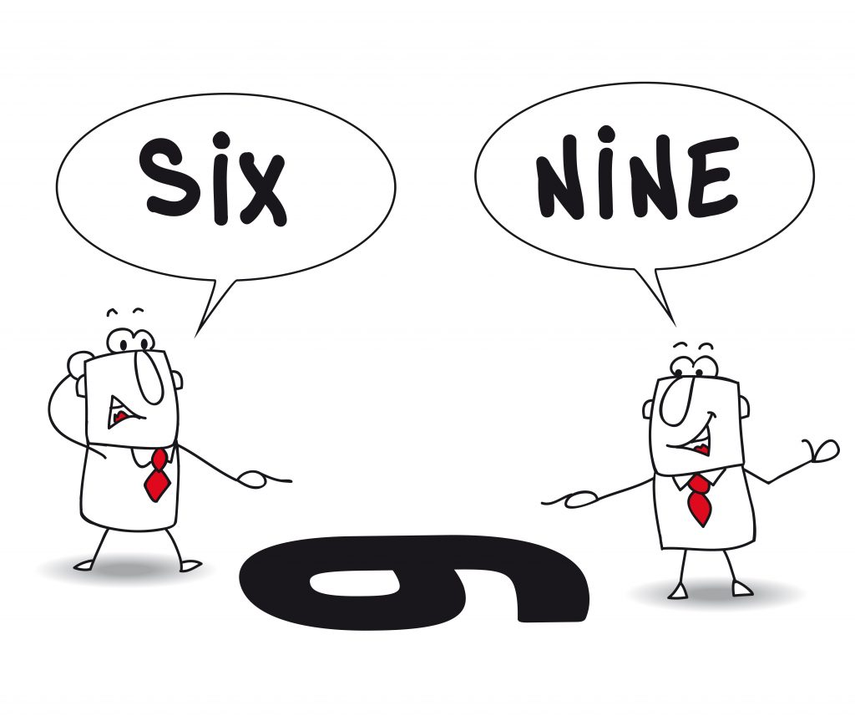

Slide 3
Woman shouldn’t be bosses
Maori should be compulsory in primary schools
Climate change
1080
Child Labour
Dirty Dairying

Slide 4
What is a Social Inquiry?
Basically, students ask questions, gather information, and examine the background to important societal ideas and events. They are able to explore and analyse values and perspectives relating to these ideas and events; and develop understandings about issues and the ways that people make decisions and participate in social action.
Social Inquiry (SI) courses focus on probing question that are of social nature; for example pertaining to social arrangements, human behaviour, and forms of social, political, and economic organization.

Slide 5
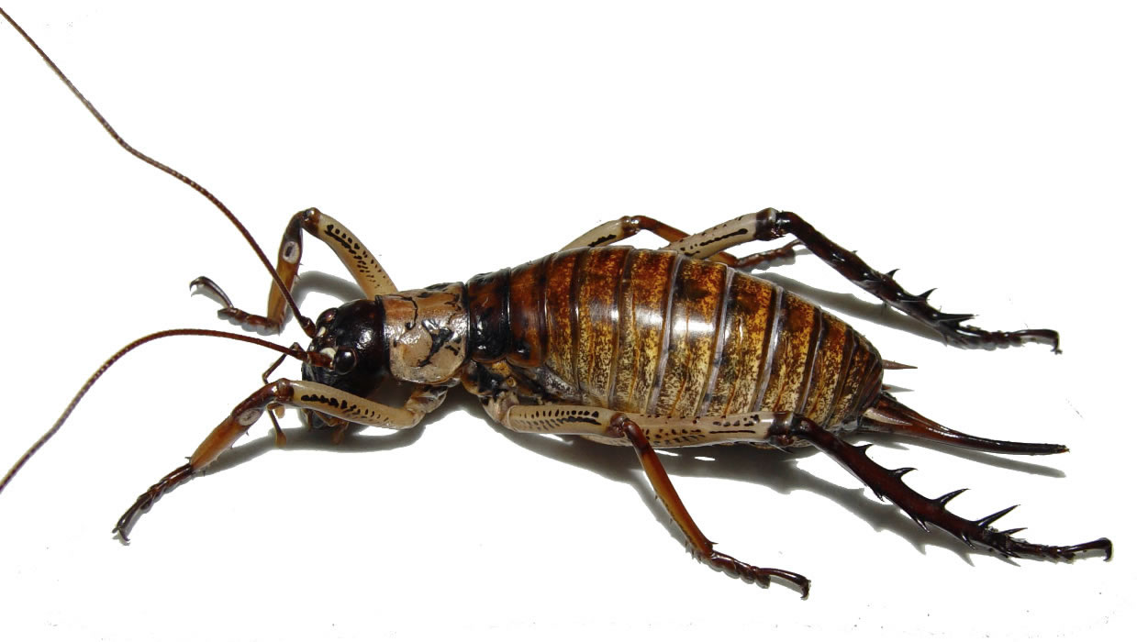
Notes:
Would you eat this insect? Why / Why not? Why do you think you have this opinion, what is it about your upbringing that might have helped shape your answer/opinion.

Slide 6
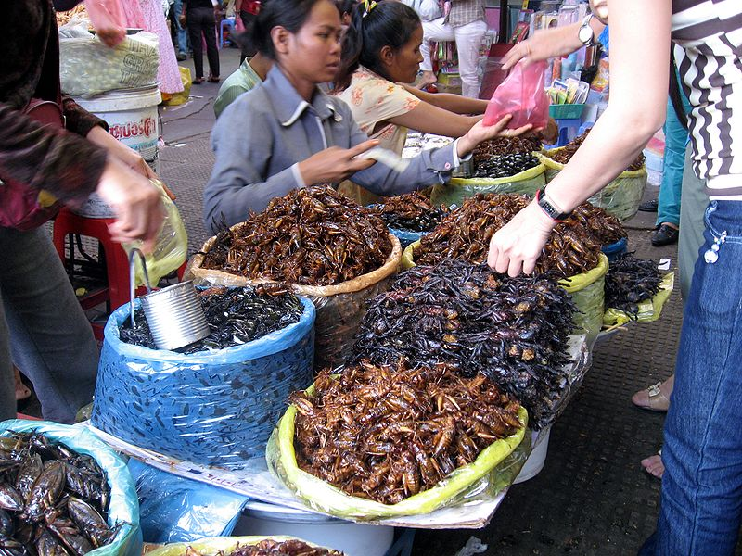
Notes:
Insects are popular and nutritious food in many parts of the world. Would you eat these?

Slide 7

Notes:
What about this? This cake contains cricket flour, would you eat it? Why / Why not? If you would rather eat this than the insects on the slide before what is it that has changed your opinion?

Slide 8
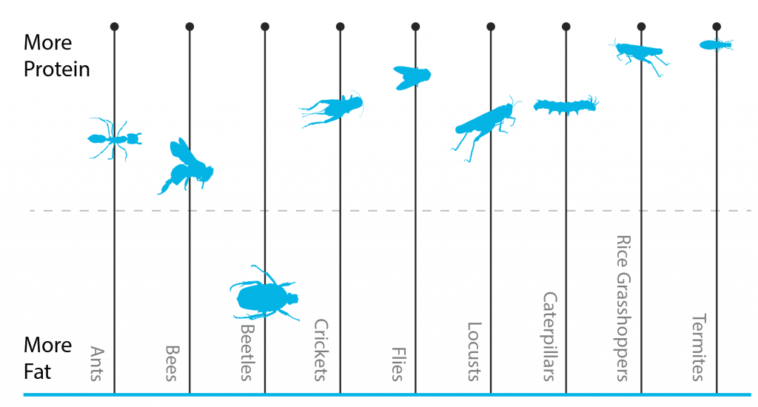
Notes:
Study this graph. Describe what it is showing – you will need to first see that it is illustrating the protein and fat content of different insects. Which one has the highest fat content, which one the lowest? Which one do you think would be the most nutritious? Why? Is there an insect or insects on this graph that you think people should not eat? Why or why not? Do you think your answer is based on your opinion or facts?

Slide 9
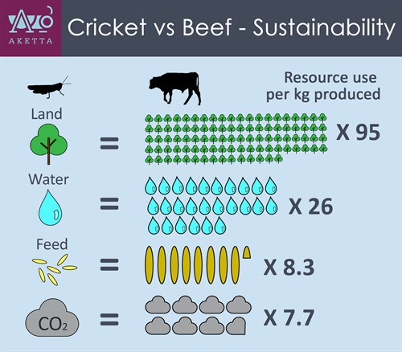
Notes:
Look at this diagram. What is it telling you about the resources needed to grow 1kg of crickets verses 1kg of beef. Write a paragraph that explains this and the next slide (this will take you some time if you are to word it properly). Test that you have understood the slides by reading your paragraph aloud to someone else. Do they understand what you have written about these two slides? If not go back and reword it.

Slide 10
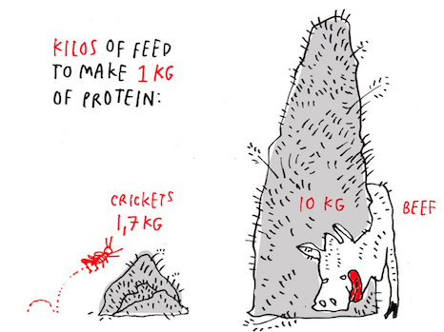
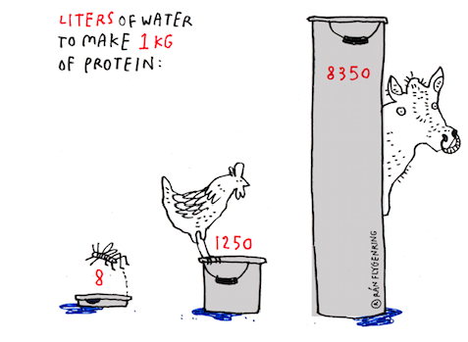

Slide 11
Using Crickets to meet Our Future Needs
What are our future needs?
Says who?

Slide 12
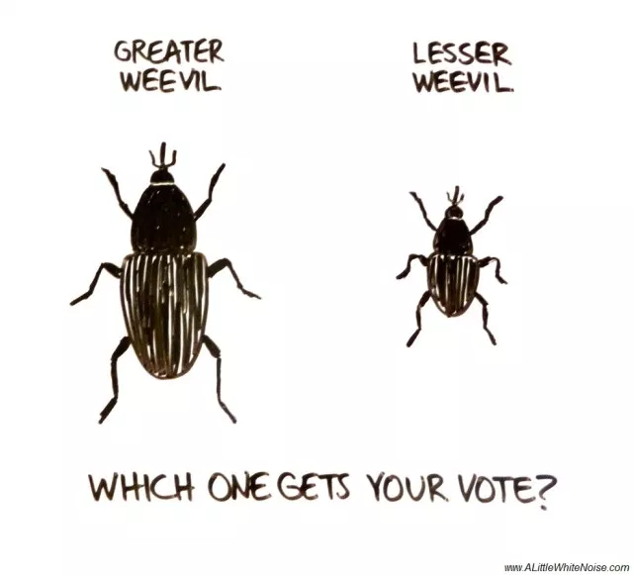
Read the article: ‘The Lesser of two weevils’
What are some of the viewpoints and opinions in this article?

Slide 13
Ethical Influences
What are some different beliefs
people hold about using insect protein
for food?
How do these different beliefs lead to
different responses?
Why would using insects for protein
Affect people’s beliefs or values?
Would you eat insects as a regular
part of your diet?
Why/why not?
Article:
Demand for meat will continue

Slide 14
Biological Influences
Is eating insects good for us?
Will we still get a balanced diet?
Will health conscious people (bodybuilders and gym junkies) have a different perspective on if eating insects is good for their diet?
Articles:
Eating bugs is the protein of the future
Creepy crawlie superfood we should be eating

Slide 15
Scientific Influence
How many insects in NZ are actually edible?
Do the different insects taste different?
Do different insects have different health advantages and disadvantages?
How much testing has actually been done on insects and the above information?
Articles:
Edible Insects

Slide 16
Legal Influences
Do they meet food safety laws.
Do insects have the same animals rights as other animals? Will people feel bad for the insect if they eat them

Slide 17
Social Influences
How does the media portray eating insects? How will this affect people's views and perspectives on eating insects
How much are we influenced by the peoples views and perspectives around us?
Are different social groups more open to eating insects than others?
Articles:

Slide 18
Environmental Influences
Who is responsible for the use of insects for protein in NZ? Globally?
Who is responsible for introducing new species of insects into NZ?
What actions & decisions are being made by governments? organisations? biosecurity experts?
What have people done to ensure introduced species do not damage NZ’s flora or fauna? (in the past & present)?
Articles:
Eat insects to fight world hunger
Crickets sustainable protein

Slide 19
Economical Influence
Can this help people in countries that don’t have enough food? Or people that can’t afford meat?
Is it affordable and viable to farm large amounts of insects
Countries that contain a lot of edible insects and could potentially make lots of money from this are they likely to want to eat and promote eating insects?
Article:
Left on the shelf

