Slide 1
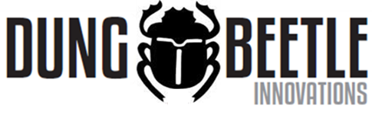
Getting to know dung beetles
Shaun Forgie

Slide 2
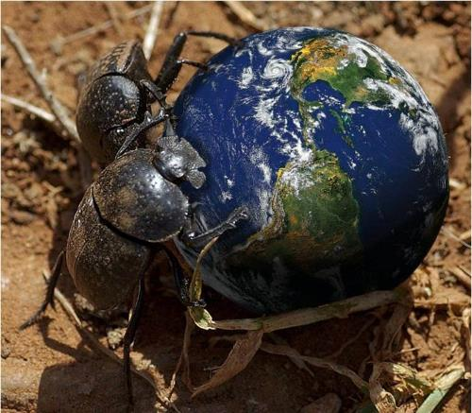
7,000 species around the world ……. except antarctica!
That’s more than all known species of mammals (c. 4,500)

Slide 3
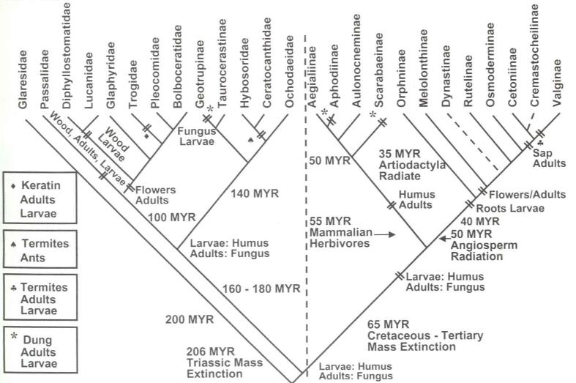
Evolution
Scarabaeinae
Fossil evidence indicates the earliest ancestors date back to at least Lower Cretaceous (ca. 98-144 mya).
Scholtz & Chown (1995)

Slide 4

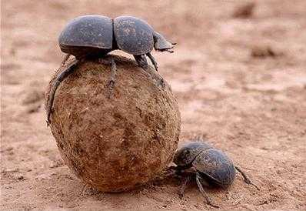
Dung beetles are among most well studied groups of insects in the world because of their mating behaviour and the ecological services they provide

Slide 5
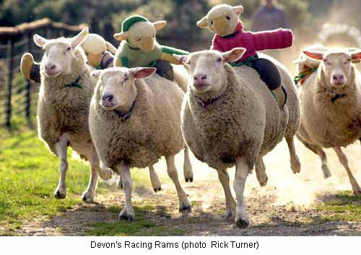
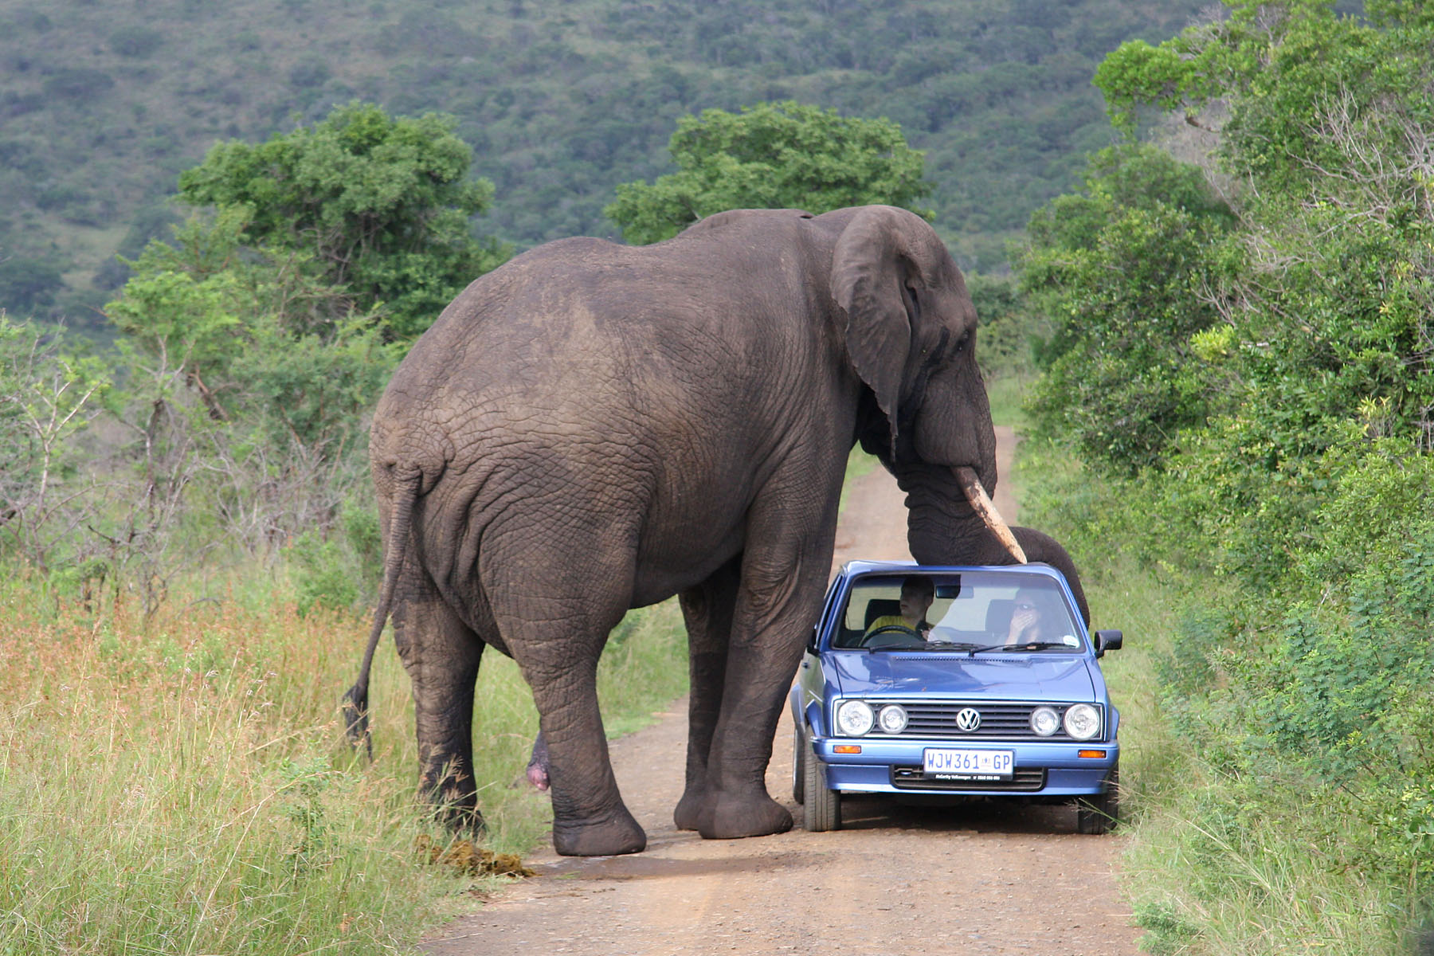
Dung beetles we use for BioControl are species that evolved to utilise dung of herbivores that forage in open grassland habitats
Particularly…………..
Ruminants Non-Ruminants

Slide 6
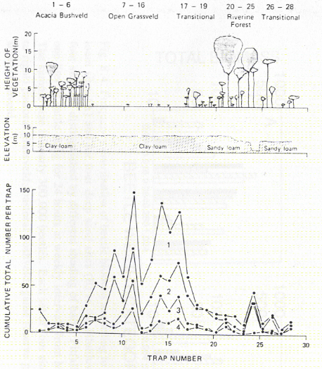
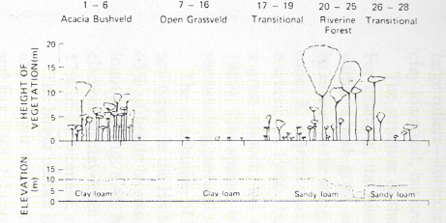
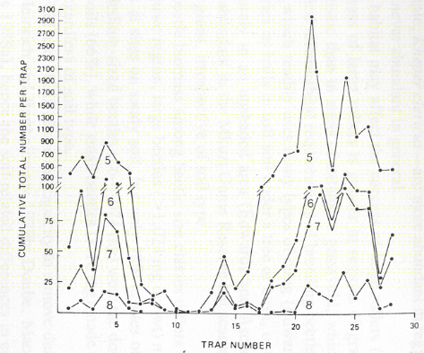
Dung beetles are habitat specific
There are dung beetles specific to
open grassland habitat.
And dung beetles specific to
scrub, bush & forest habitat.

Slide 7
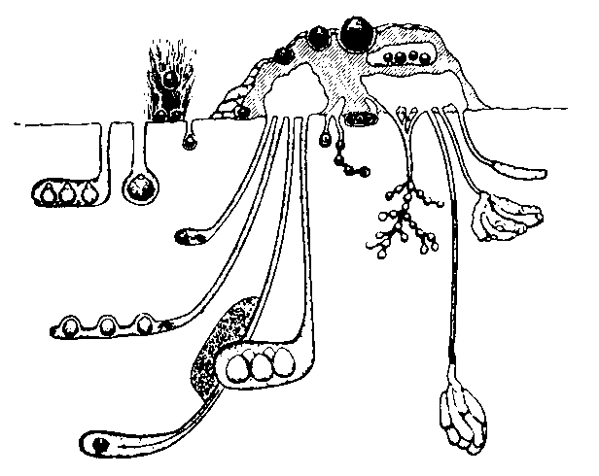
Rollers
(10min - 24hrs)
Dwellers
(several weeks)
90 cm
Fast-burying tunnelers
(6 -24hrs)
Slow-burying tunnelers
(up to 6 weeks)

Slide 8
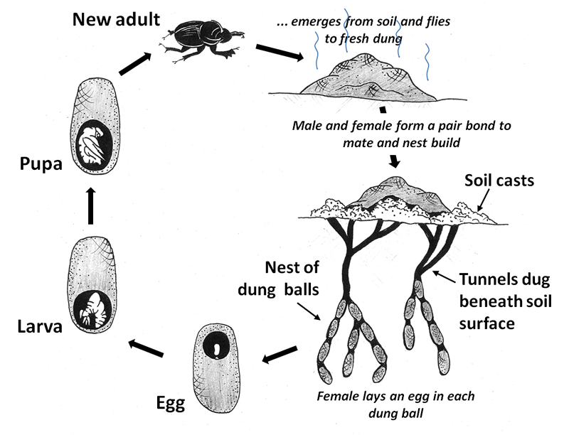

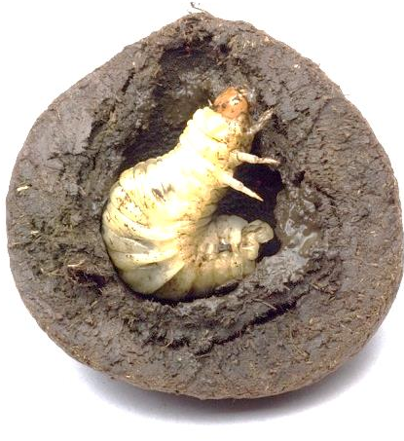
6 weeks – 6 months
depending on species
larva

Slide 9
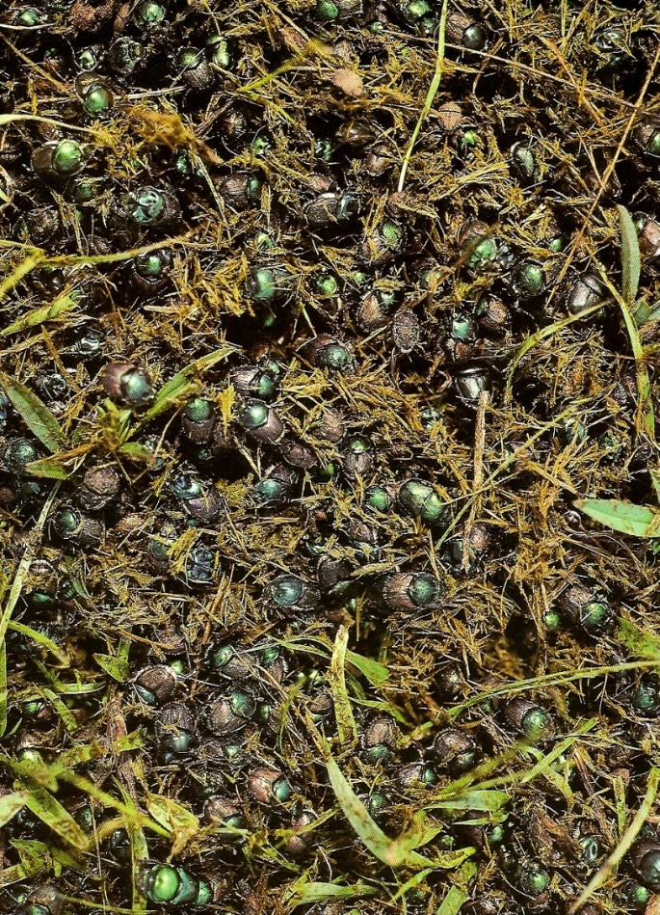
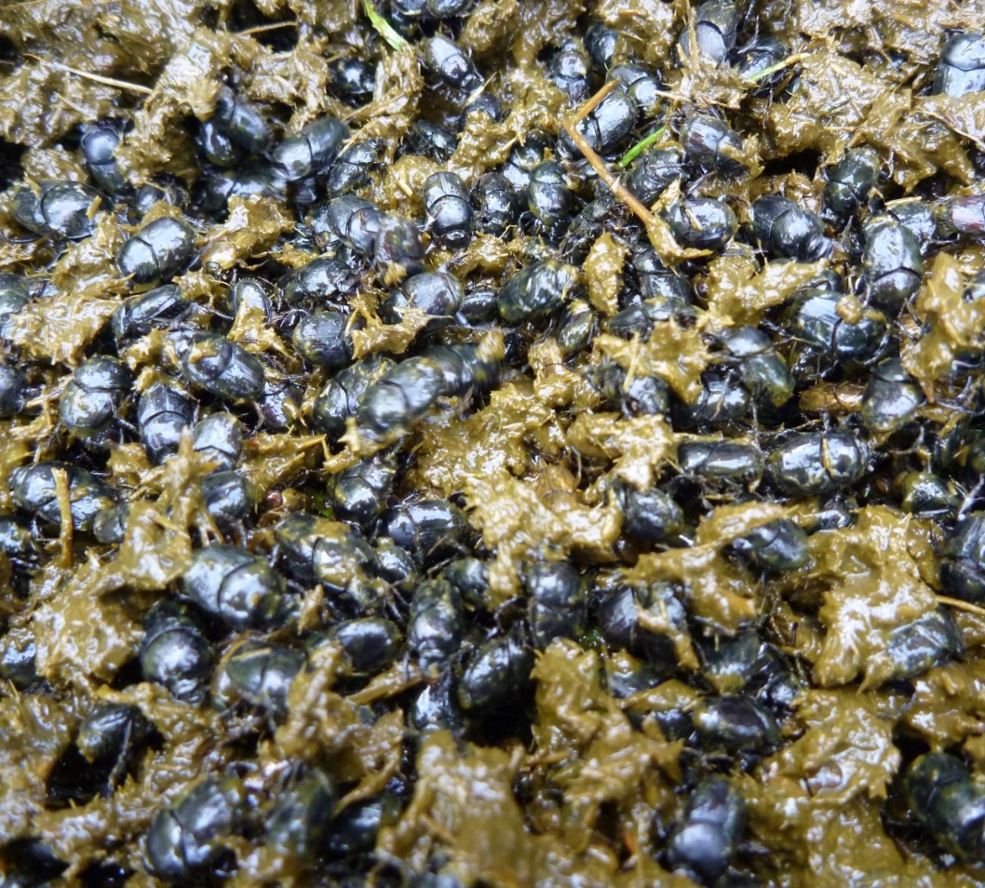
Tunnelers are:
by far the most abundant

Slide 10
What dung beetles do we already have in NZ?
Native dung beetles.
NZ has only 15 species.
All live in native forests and don’t live in livestock pastures.

Slide 11
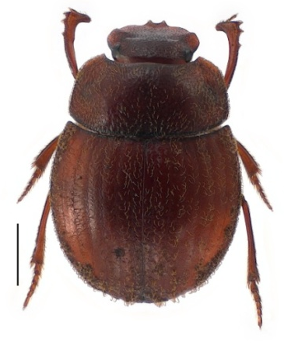
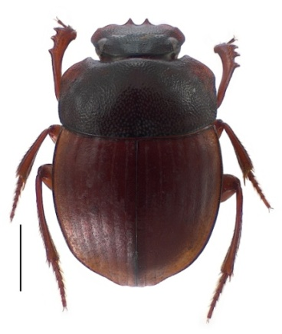
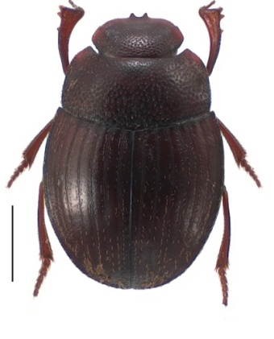
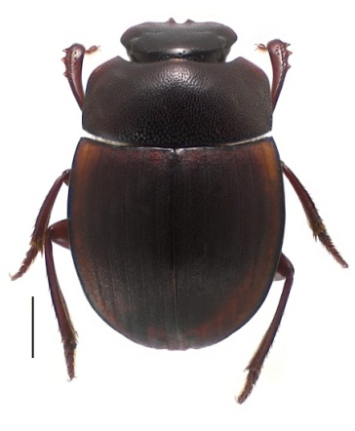
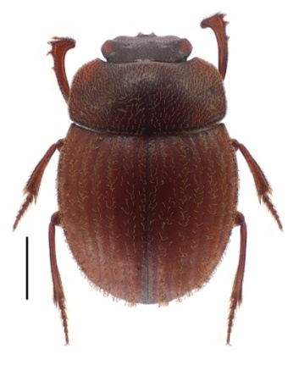
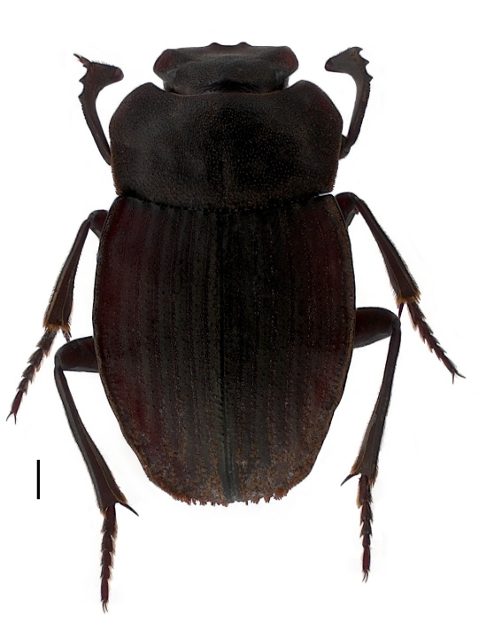
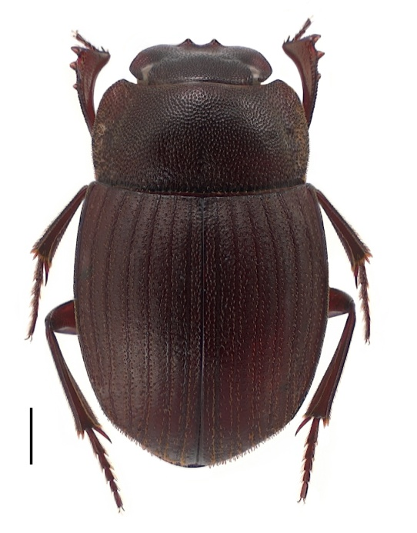
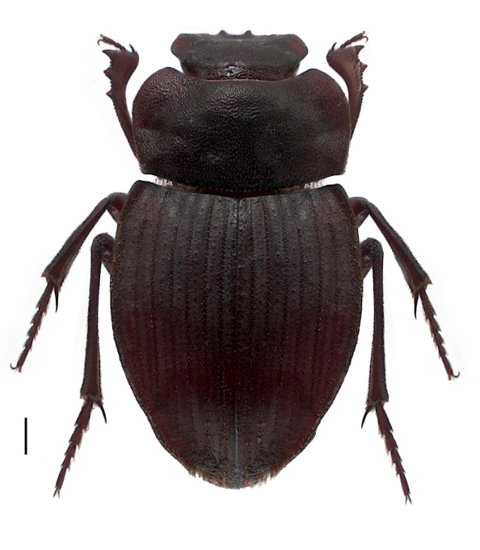
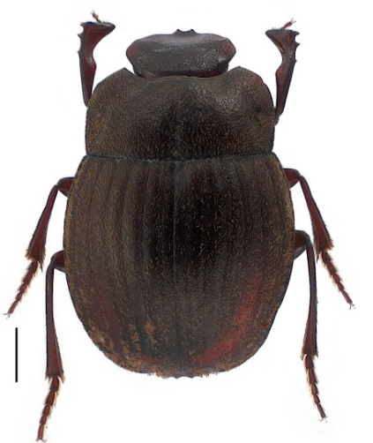
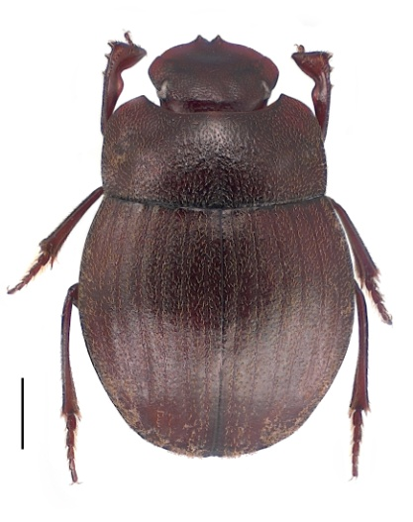
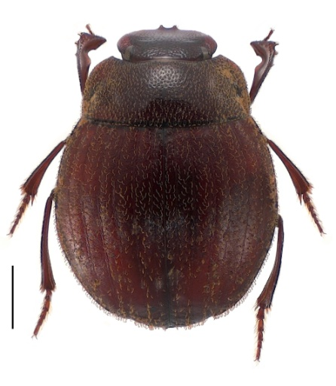
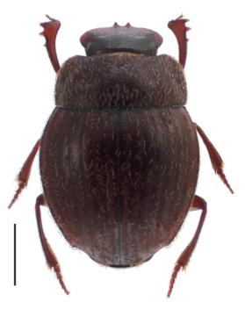
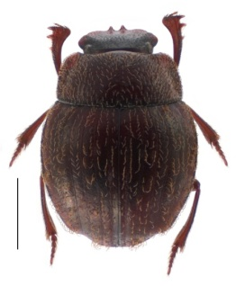
Native NZ
Dung Beetles
Scale bar = 1mm

Slide 12
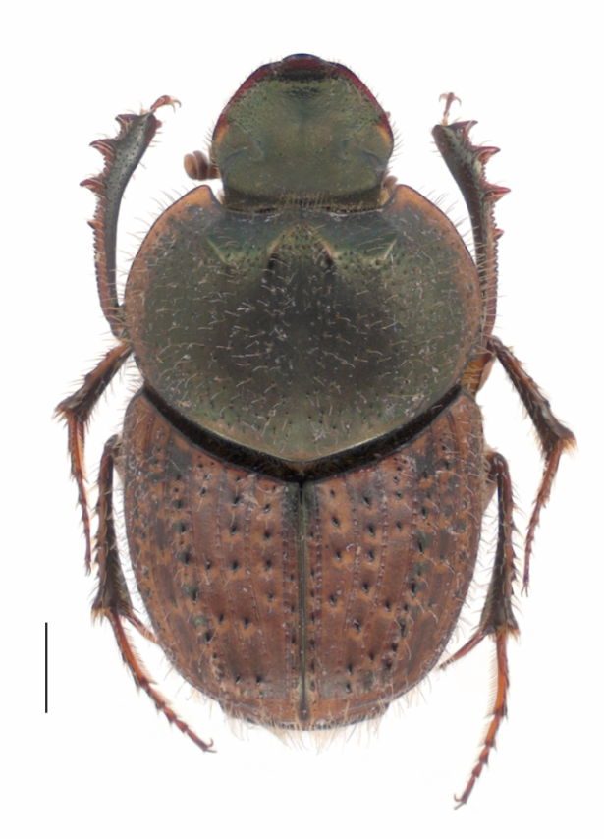
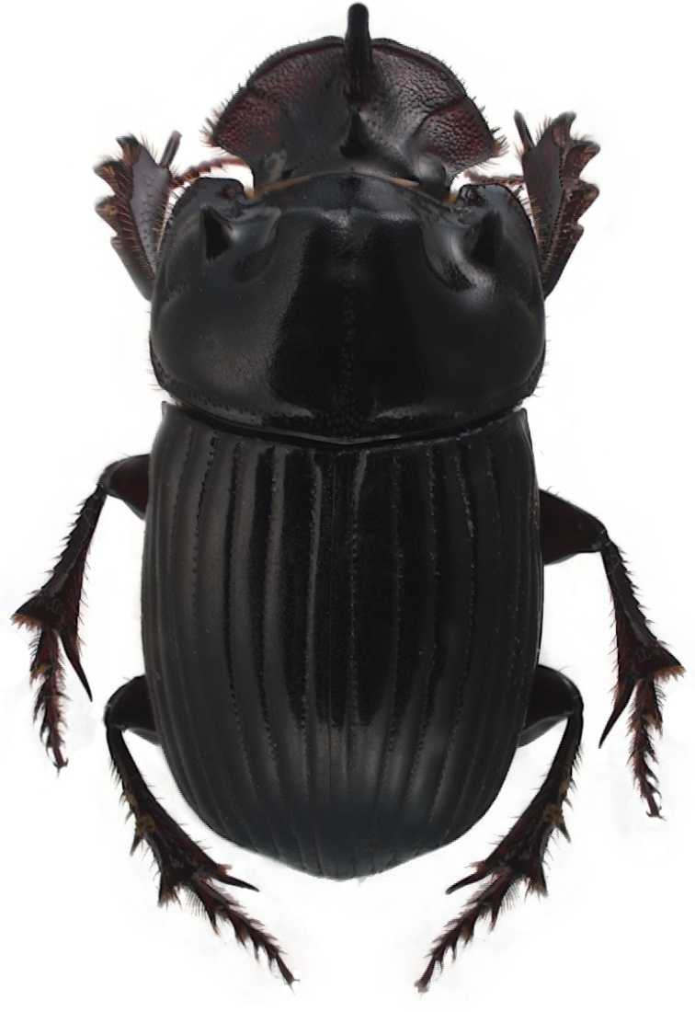
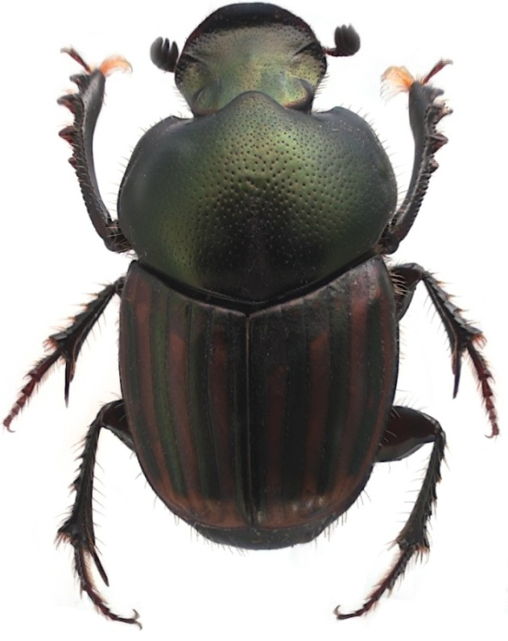
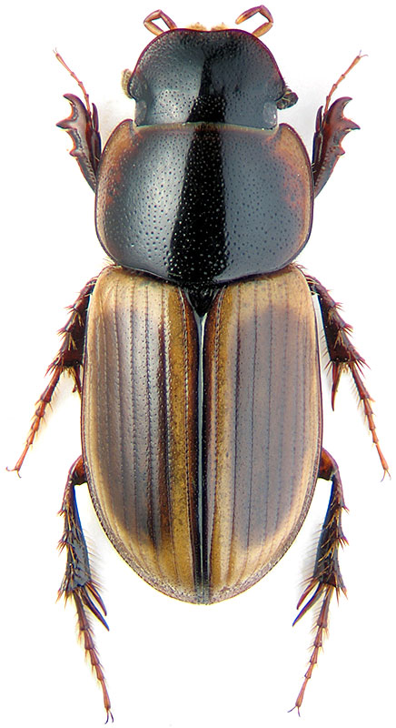
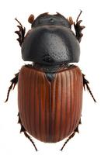
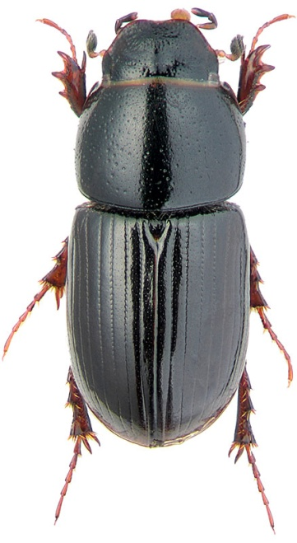
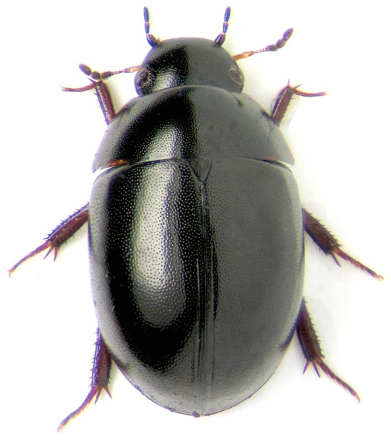
Exotic pastoral dung beetles already in NZ

Slide 13
Why are we introducing dung beetles
What’s the problem?

Slide 14
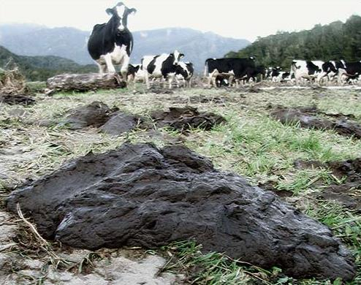
Many livestock farming problems stem from............
Intensive farming
Excess faeces. 9.5 million cows !
Soil compaction and therefore reduced soil health
An absence of a dung beetle fauna

Slide 15

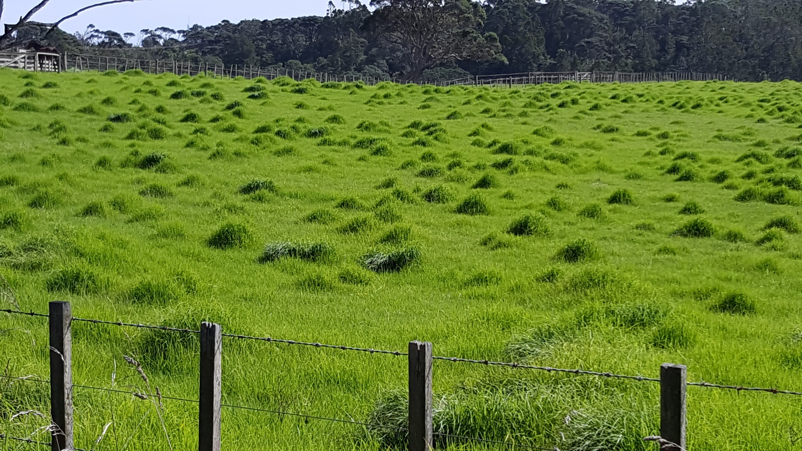
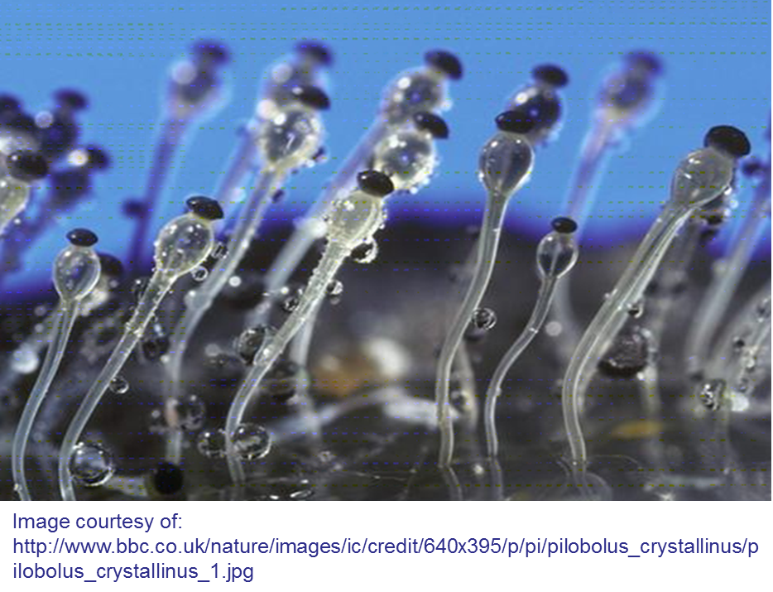
Forage fouling/avoidance
Rank growth
zone of repugnance is an area 5x the size of the dung itself that is avoided by grazing animals.
Notes:
Pasture fouling by dung can significantly reduce the area available for grazing and with it reduced pasture availability and reduced productivity.
Calculations for dung coverage area were provided by Haynes and Williams ( 1993) for cattle and sheep.
IN combining both, we estimate up to 15% of all pasture in New Zealand is rendered unusable by at any one time from these livestock alone. Each dung patch occupies its original coverage area for at least one week!
CLICK: We know there is a zone of repugnance because of live stock avoidance of an area far greater than the dung itself.
Fincher 1981 calculates this to be an area 5x the size of the dung itself.
Hence the practice of break-feeding to force livestock to feed around their own excrement and thereby graze all the pasture. While unproven, such practices can only contribute negatively to livestock wellbeing and health ( esp. Increase diseases uptake and rates of parasitic infection).
The loss associated with cattle pasture fouling and resulting rank growth is substantial. It is estimated that five cows will decrease the effective area of pasture by one acre over one year (Bornemissza, 1960). For a herd of 100 cattle this equates to a loss of 20 acres per year. An American economic analysis estimated that pasture fouling causes an annual loss of 7.63 kg of beef per head of cattle and places the cost of reduced pasture fouling at $122 million per annum (Losey & Vaughan, 2006).

Slide 16
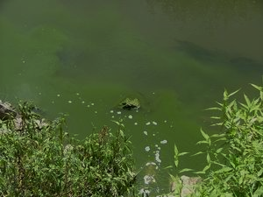
Key problems……………….
Surface runoff
dependent on slope, soil texture and soil structure
Reduced water quality
nitrogen and phosphorus
faecal coliforms and pathogens
(Cryptosporidia, Giardia)
Degradation in soils
compaction reduces soil airspaces and structure; root growth; soil microorganisms; water and nutrient uptake; and, infiltration of surface water/urea/solid fertilisers
“A nation that destroys its soils destroys itself.”
- Franklin Rooseveldt

Slide 17
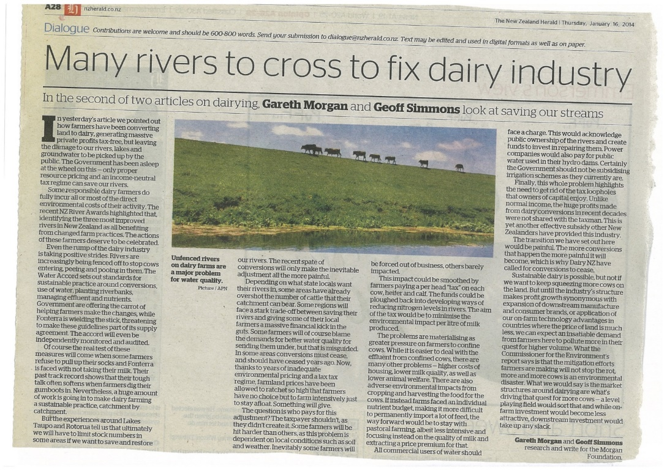
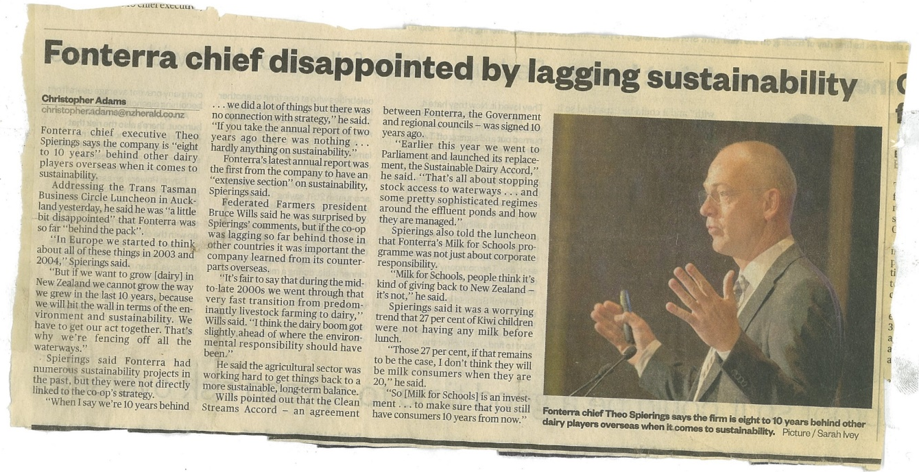
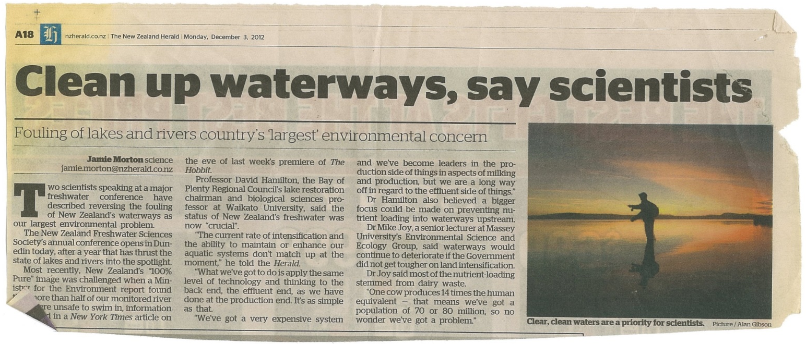
Media

Slide 18
Benefits
Some key benefits that can mitigate adverse effects of dung on:
Soil structure and function
Tunnelling beetles increase levels of plant nutrients in the subsoil at similar levels to typical application rates of solid fertiliser inputs.
Tunnels increase aeration, reduce compaction, bring subsoils to the soil surface (bioturbation)
Burying dung increases the amount of organic matter in the soil, stimulates microbial activity, and nutrient cycling
Burying dung provides a food source for soil organisms such as earthworms
Notes:
SOIL STRUCTURE & FUNCTION:
Williams and Haynes (1995) found that for every 100 kgs of dry cattle dung there was 0.82 kgs of phosphorus and 2.7 kgs of nitrogen.
When considering the amount of available dung accumulating on pastoral surfaces, this represents a significant under-utilised resource of fertiliser.

Slide 19
Benefits
Water quality
Tunnelling and improvements to the physical structure of soils have a “flow-on” effect which can include:
Improved water infiltration reduces surface ponding, assists agricultural inputs (lime, fertilisers) to enter the upper soil profile and reduce the level of contaminants entering the waterways… (Waterhouse 1974; Bormemissza 1976; Doube 2005; Brown et al. 2010; Ryan & Doube 2011)
…which leads to improved water quality (Doube 2008)

Slide 20
Benefits
Pasture quality
Dung beetles can make a substantial contribution to ensuring that forage fouling is kept to a minimum
Several studies show “dung + beetles” results in significant increases in:
plant height
above ground biomass
grain production
protein levels
nitrogen content
Root biomass and growing depth is significantly increased improving water holding capacity and drought tolerance

Slide 21
Benefits
Reducing pest species
Many studies have shown significant reduction in numbers and/or reinfection rates of gut parasites
Miller et al. (1961)
Fincher (1973a, 1975)
Waterhouse (1974)
Bryan (1973, 1976)
Fincher & Stewart (1979)
Bergstrom (1983)
Gronvold et al. (1992)
Mathison & Ditrich (1999)
Le Jambre (2009)
Forgie, Paynter et al. (In prep.)
Many studies have shown significant reduction in numbers dung breeding pest flies
95% in Hawai’i (Bornemissza 1970)
88% in Australia (Ridsdill-Smith & Matthiessen, 1988)
Notes:
Phoretic macrochelid mites carried between dung pads also predatory on fly eggs etc (Nichols et al 2008).

Slide 22
Benefits
Carbon
Removal of decomposing organic matter (dung) from the soil surface leads to……
increase in soil carbon content through the burial of dung
increased plant root production through improvements to soil physical, biological and chemical properties (Doube 2008)
By rapidly manipulating fresh dung, dung beetles will aerate wet dung pads, thereby reduce anaerobic conditions needed for methane production (Jarvis et al 1995; Holter 1996)

Slide 23
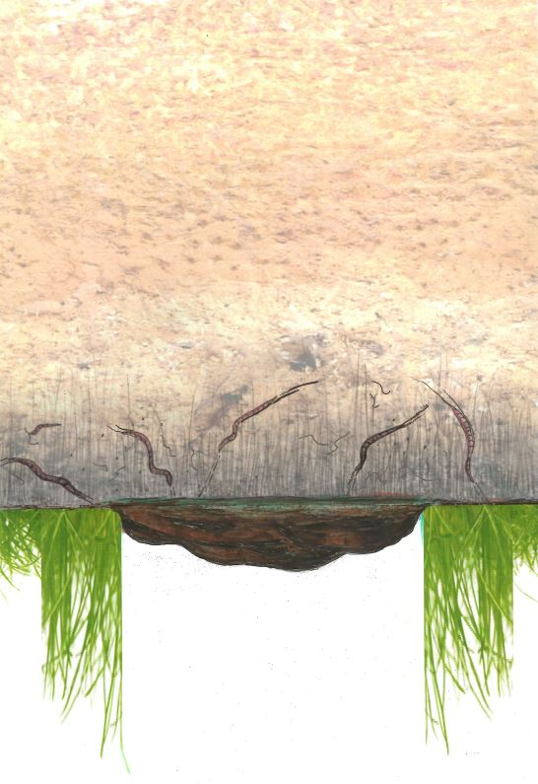
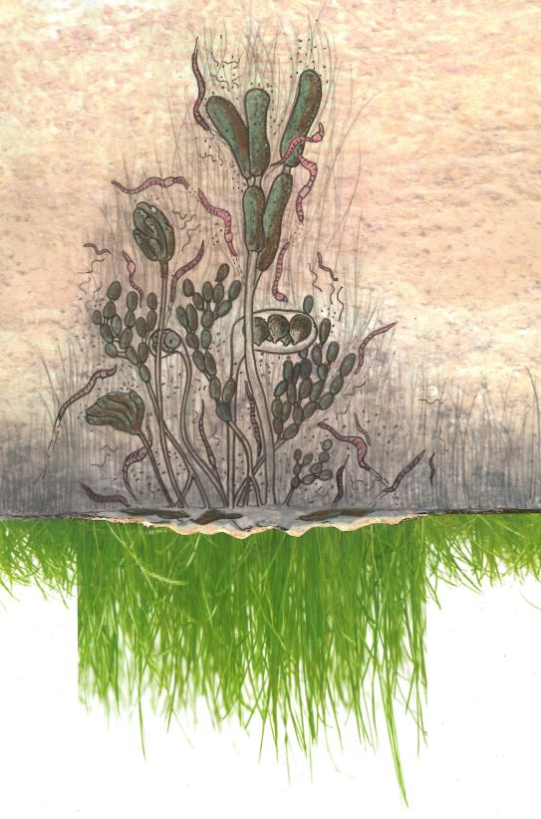

NO Dung-Burying Beetles
With Dung-Burying Beetles
Services provided by dung beetles can be summarised this way……..
Reduced:
soil structure & health
nutrient recycling
infiltration rates
pasture productivity
grass root biomass & depth
micro organisms
earthworm biomass & depth
water & nutrient conservation
water quality – leachate & non leachate
Increased:
pasture productivity
Plant nitrogen content, protein levels, height & biomass
soil structure & health
water & nutrient conservation
organic carbon capture
nutrient recycling
micro organisms
earthworm biomass & depth
grass root biomass & depth
water quality – leachate & non leachate
Increased:
forage foul
surface runoff
water pollution
Reduced:
forage foul
surface runoff

Slide 24
History
Country | Deliberately introduced (irrespective of establishment success) | Source
Australia | 52 | Edwards 2007, Pers comm. J. Wright 2012
USA (Hawai’i) | 29 | Harris et al. 1982; Funasaki et al., 1986
USA (Mainland) | 23 | Fincher 1986
Vanuatu | 3 | Hanski & Cambefort 1991
New Caledonia | 3 | Hanski & Cambefort 1991
Norfolk Island | 5 | Hanski & Cambefort 1991
Chile | 2 | Pers comm. H. Valenzuela 2011
Canada | 3 | Pers Comm. K. Floate 2011
New Zealand | 1 | Thomas 1960
Dung beetles and the ecological services they provide is not a new concept
Dung beetles have been in existence for millions of years
Dung Beetles were used as biological control agents as early as 1906

Slide 25

CSIRO dung beetle project
Rationale:
European settlement permanently changed the nature of the Australian landscape.
Introduction of pasture plants, sheep, cattle and other domesticated livestock.
Virtually all native Australian dung beetles not adapted to
exotic dung or pastoral habitat.
This gave rise to various problems…..

Slide 26
CSIRO dung beetle project
Pastoral rangeland across the country was becoming heavily fouled by slowly decomposing dung.
In addition, this dung provided breeding site for several species of dung breeding pest flies and midges

Slide 27
CSIRO dung beetle project
Solution:
Between 1968 and 1982, CSIRO imported 51 species of dung beetles for release in Australia.
Twenty-one species became established and spread via mass rearing programmes & catch and re-release.
Huge farming community support.
Populations of the bush fly have been reduced by 80% following dung beetle introductions in some areas.

Slide 28
CSIRO dung beetle project….. 2017
CSIRO dung beetle project….. 2012
Successfully introduce 2 additional species to southern Australia (with support money from DBRSG).
May 15, 2017, Barnaby Joyce (Deputy PM for Australia) announces a new dung beetle project with $9.2 Million of government support.

Slide 29


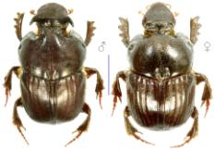
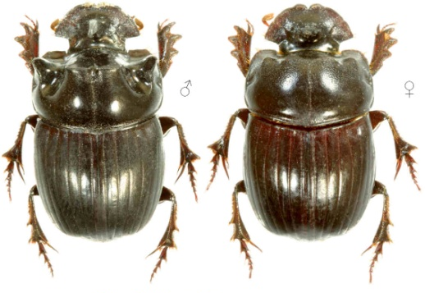
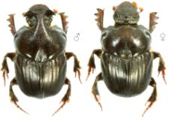
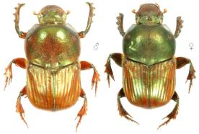
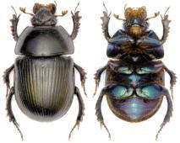
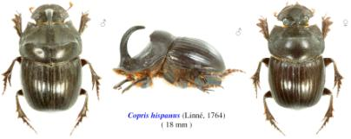
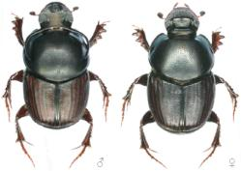



History of introduction effort to New Zealand
1956: DSIR
1995: J. Dymock
2011: Dung Beetle Release Strategy Group
♂
♂
♀
♂
♀

Slide 30
Founded in 2014
Mission: To rebalance New Zealand’s pastoral farming systems; through the sale, management and research of dung beetles.

Slide 31







Commercial-scale mass rearing
A
B
Shelly Beach Farm, 142 Shelly Beach Rd, South Kaipara. A, Plastic hothouse (32 x 1 cubic meter rearing bins); B, Sheep Shed (18 x 1 cubic meter rearing bins).
B
A
119 Shelly Beach Rd. A, Shed with concrete pad (50 x 1 cubic meter rearing bins, 50 x35L fish bins, 3 x Incubators; B, Barn used as a soil shelter

Slide 32










Research
MPI SFF:
1. Landcare Research Subcontracted to DBI to investigate over time water quality percolation through compact prone soils subjected to dung beetle activity beneath one cow pat per core sample.
2. DBI objective to investigate over time soil chemistry, biological loading ( incl. organic carbon), and soil bulk density compact prone soils subjected to dung beetle activity beneath one cow pat per cage.
Collaborations:
INIA Chile, Dr Hernán Felipe Elizalde Valenzuela, Dr Liz Nichols, Swarthmore College. Martin Biological Laboratories, Swarthmore PA, USA . Dr Jackie Dabrowski, Managing Director, Confluent Environmental, RSA. Dr Mark Hoddle, UCR, USA

Slide 33







Species currently in production
a
b
c
d
e
a. Onthophagus taurus
b. Onthophagus binodis
c. Digitonthophagus gazella
d. Copris incertus
e. Geotrupes spiniger (Paua beetle)

Slide 34




Species currently in production
Onitis alexis alexis

Slide 35



2016 Imports
Bubas bison
Mass rearing in 2017
Copris hispanus
Mass rearing in 2017

Slide 36

♂
♂
♀
Bubas bubalus
17mm
Bubas bison
16mm
Copris hispanus
18mm
♀
♂
Copris lunaris
18mm
Euoniticellus fulvus
10mm
Onitis alexis
20mm
Geotrupes spiniger
22mm
♂
♂
Onthophagus taurus
9mm
O. (Digitonthophagus) gazella
11mm
Onthophagus binodis
12mm
O. (Paleonthophagus) vacca
10mm

Slide 37

Economic Benefits

Slide 38


Graphic representation of cost ($) per hectare of existing and new mitigating measures for reductions in nutrient run-off from pastures.
Dung Beetle figures based on whole farm package ($6,000 + GST).
Source of fencing/riparian costs: http://www.waikatoriver.org.nz/wp-content/uploads/
* Clean: mitigation measures … wetlands, rafts (below), and lake-bottom dredging.

Slide 39


Dung growth rate between seeding and reaching a farm’s full carry capacity

Slide 40



Dairy
Economic assessment

Slide 41
Dairy
Based on the assumptions above, a dairy farm purchasing a Whole Farm Package ($6,000) for an average sized dairy farm has a net present value of $41,200 and an internal rate of return of 37%.
A 600 cow farm purchasing two Whole Farm Packages for $10,000 would have a NPV of $57,600 and an internal rate of return of 34%.
In addition there will be reduced operating costs for fertiliser (particularly nitrogen) and drench.

Slide 42
Pouarua Farms: Proposed release options
*
*
Total = 15 -16 Herds
Option 1: walking into the future
1x Whole Farm Pack/Herd = $75,000
Option 2: running into the future
2+ Whole Farm Pack/Herd = $150,000+
Both options discounted from $6,000 to $5,000/pack

Slide 43





Pouarua B Dairy Unit

Slide 44

Pouarua J Dairy Unit
1
4
2
3

Slide 45


Pouarua Farms: monitoring
Establishment: Delimiting surveys
Localised testing within Pouarua Farms water catchment…
Water Quality
…rather than broader community water catchment testing

Slide 46
Pouarua Farms: monitoring
Localised testing within Pouarua Farms water catchment…
Establishment: Delimiting surveys
…rather than broader community water catchment testing
Water Quality

Slide 47
Pouarua Farms: monitoring
Establishment: Delimiting surveys
Water quality
Soil health
Biologicals, Chemistry, Physics

