Slide 1
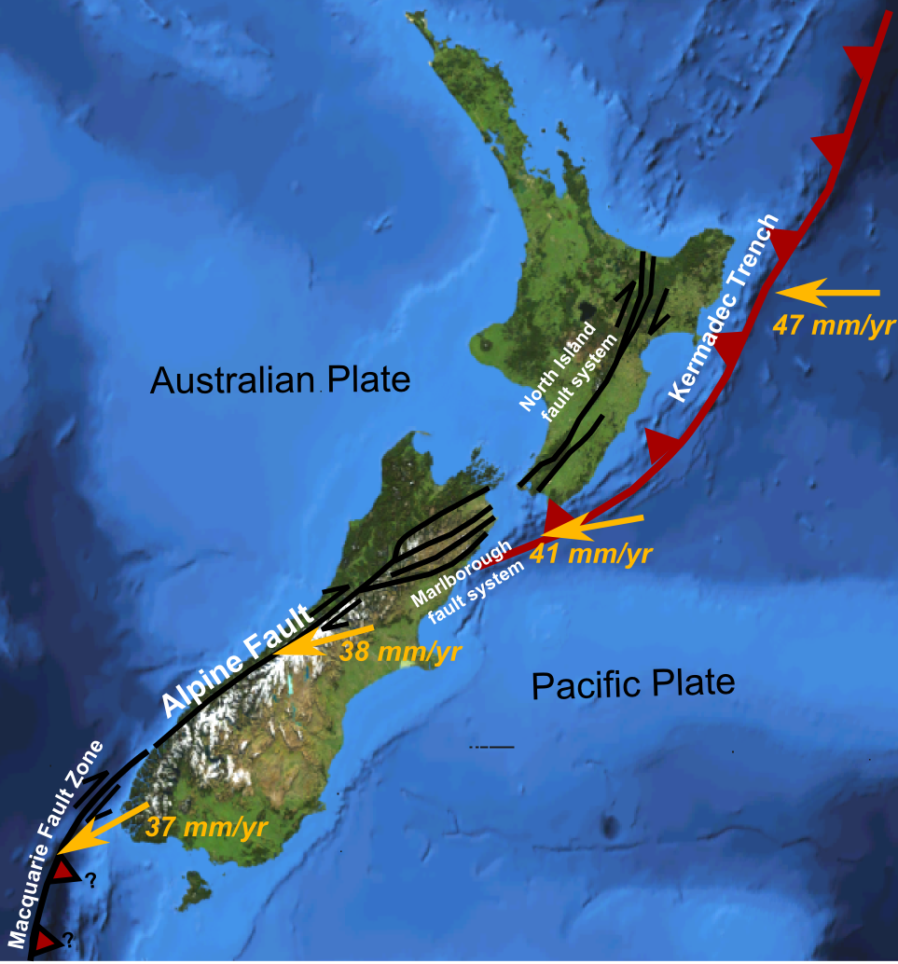
Effects of Plate Tectonics in NZ
Taupō Volcanic Zone

Slide 2
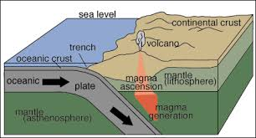
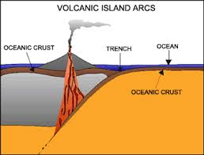
Subduction (review)
When plate boundaries push together (converge), one will slide under the other, known as subduction. The place where this occurs is called a convergent margin.
Either the oceanic plate (dense) will subduct under the continental (less dense)
Or one oceanic plate can subduct under another oceanic plate, one will be denser than the other.

Slide 3
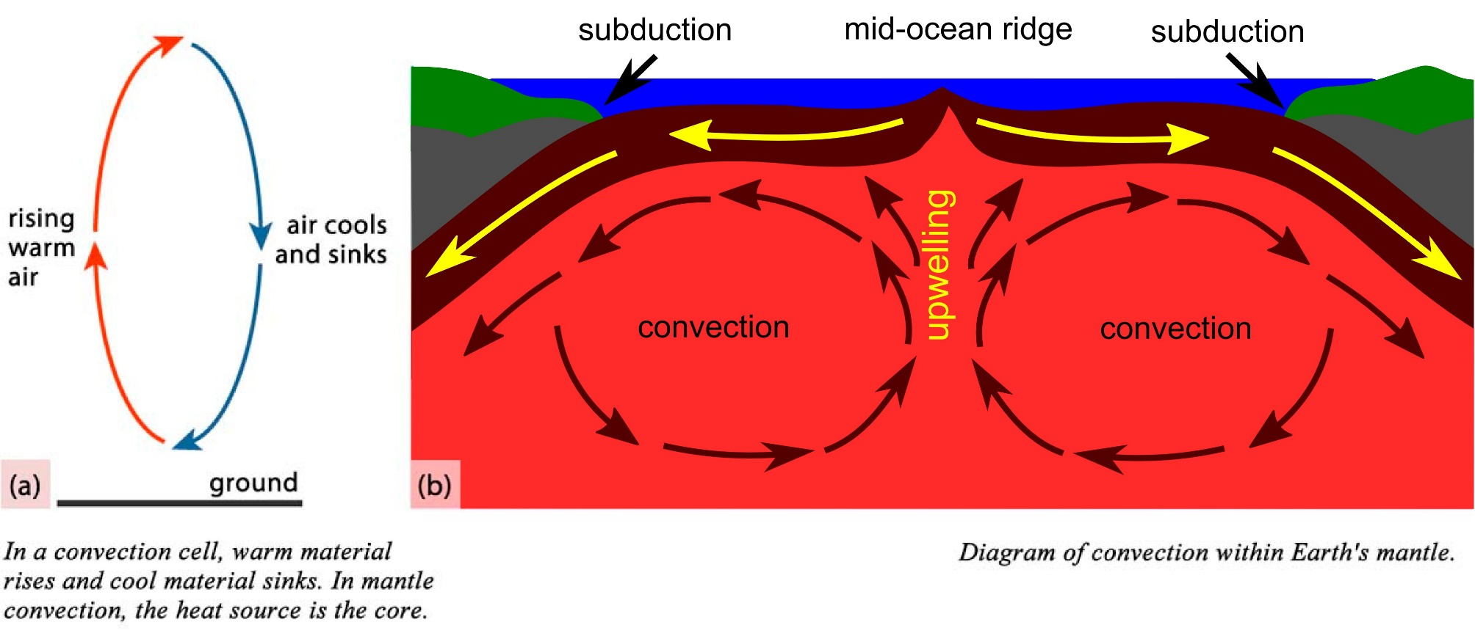

Slide 4
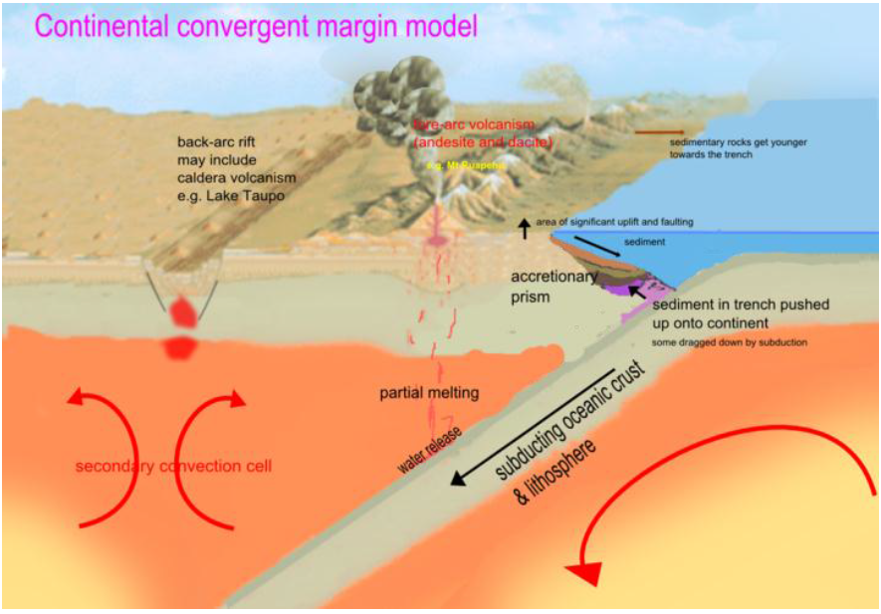

Slide 5
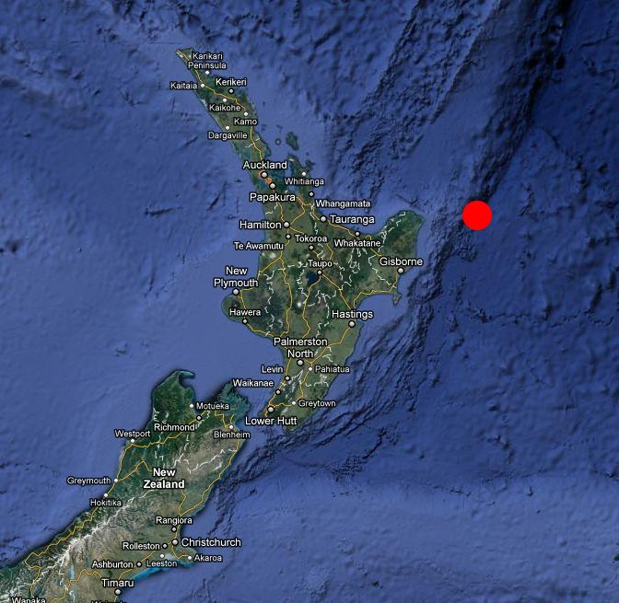
Subduction and Trenches
Where there is subduction there will ALWAYS be a trench
Above some places where subducting crust releases water, you get VOLCANOES, which are usually composed of andesite or similar rocks.

Slide 6
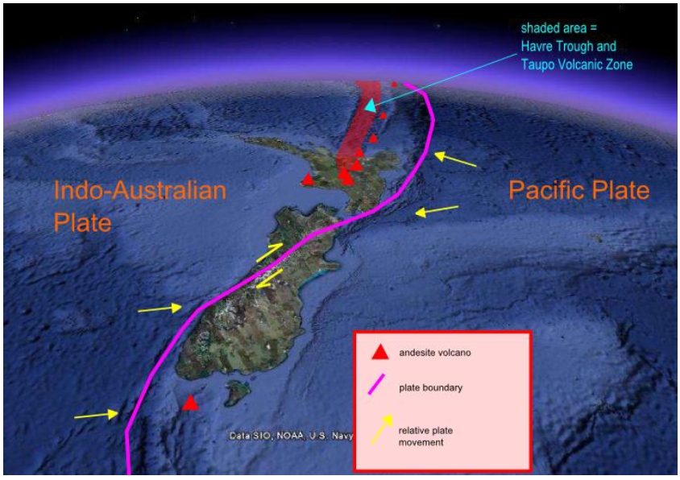

Slide 7
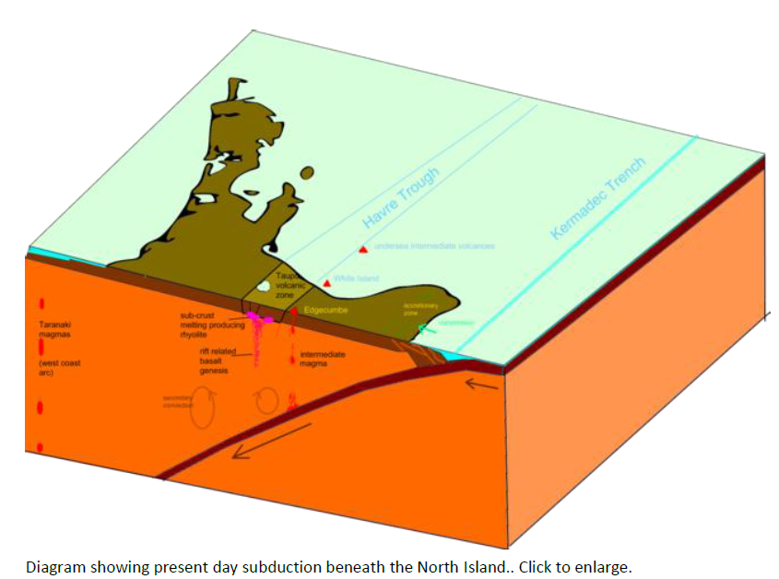

Slide 8
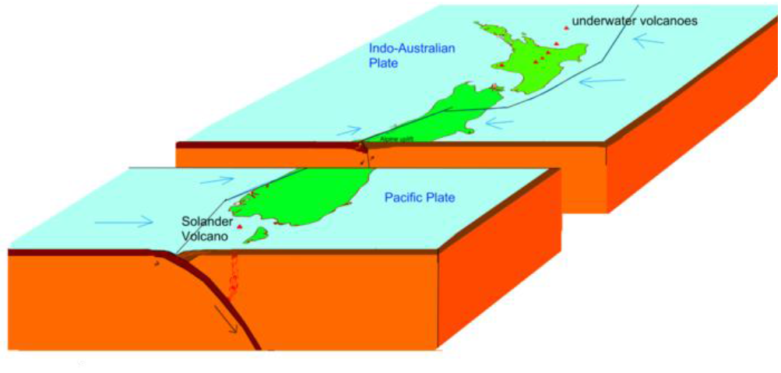

Slide 9
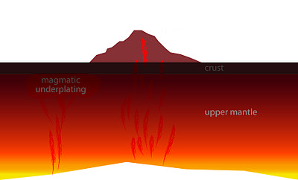
Magma
Magma is molten rock found UNDER the crust of the earth
Can be produced by melting of the crust or mantle
Partial melting of rock results in magma that is not chemically identical to the rock that produced it.
Different magmas are produced in different places and different ways

Slide 10
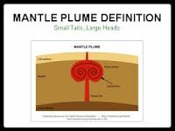
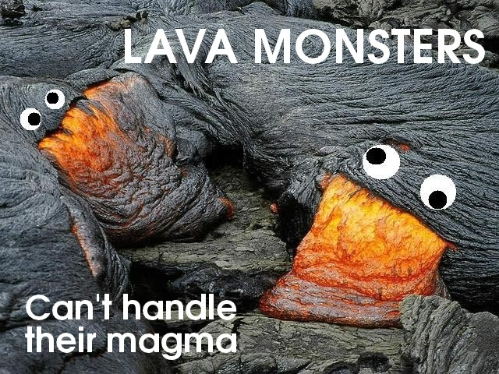
Basaltic
Produced by dry melting of mantle material, usually through pressure release or heat from mantle plumes. They mostly form at mid oceanic ridges and hotspots

Slide 11
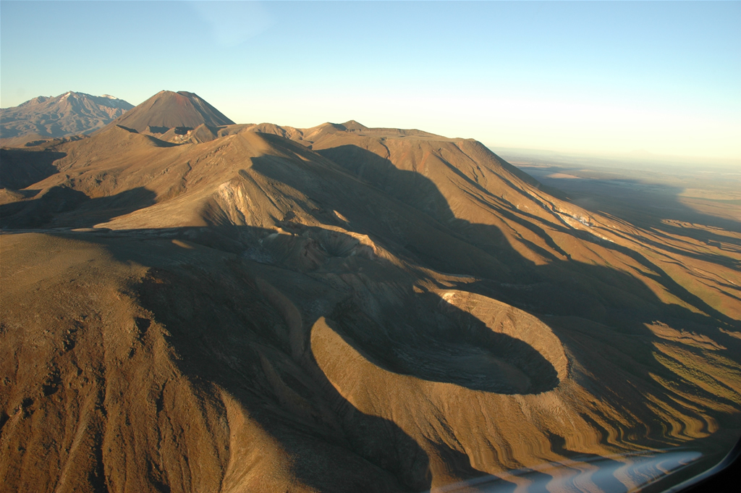
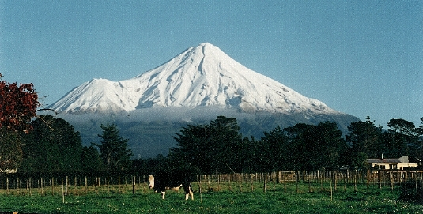
Andesitic
Produced in subduction zones
probably caused by reactions between the magma and water released from the crust (known as wet melting)
There are also lots of different andesites. The Taranaki andesite is different to that of Tongariro etc

Slide 12
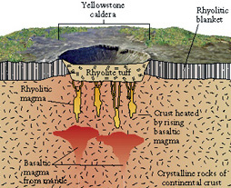
Rhyolitic
Produced by melting of crustal rock, or mixing of crust and basalt to andesite magma, or when andesite magmas are modified by partial crystallization.
A rock called Dacite is in-between rhyolite and andesite
Most Rhyolite in the TVZ are produced by crustal melting and partial mixing with large volumes of basalt magma.

Slide 13
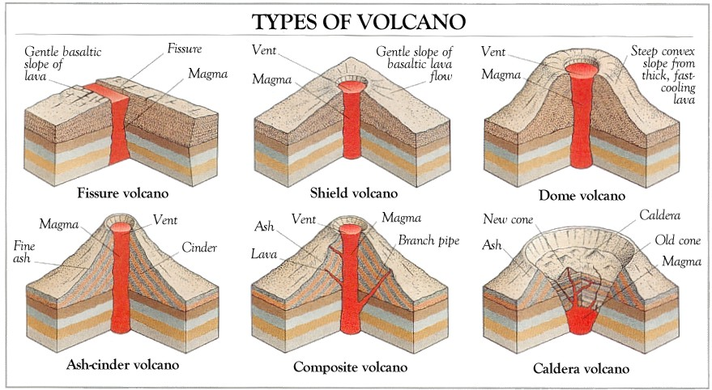
Volcanoes
Magma which reaches the surface is erupted to form a volcano.
The now lava cools quickly to form extrusive volcanic rock.
The appearance of different volcanoes depends on four factors
  Viscosity (runniness)
  Amount of dissolved gas
  Encountering ground water
  Volume of magma

Slide 14
What makes Magma Viscous?
Silica Content
  Silica is a mineral (SO₂ or molten quartz)
  Viscosity Increases as silica increases
Silica Content | Magma | Viscosity
Low ( 45-55%) | Basalt | Low Can flow easily (liquid honey)
Intermediate (55-64 %) | Andesite | Medium Can flow, but not as easily as basalt (plum jam)
High Silica (>70%) | Rhyolite | High Can barely flow (marmite)

Slide 15
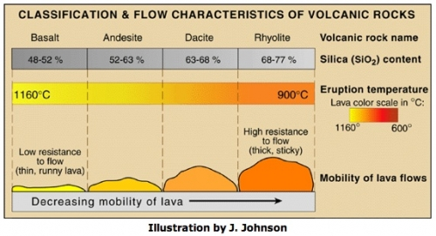

Slide 16
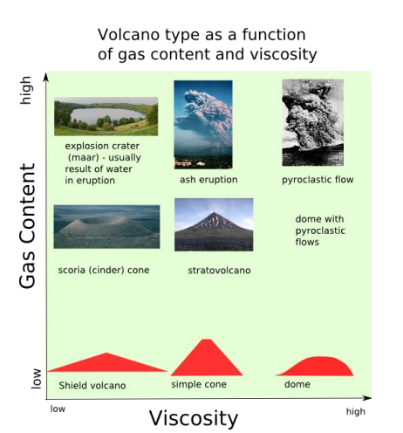

Slide 17
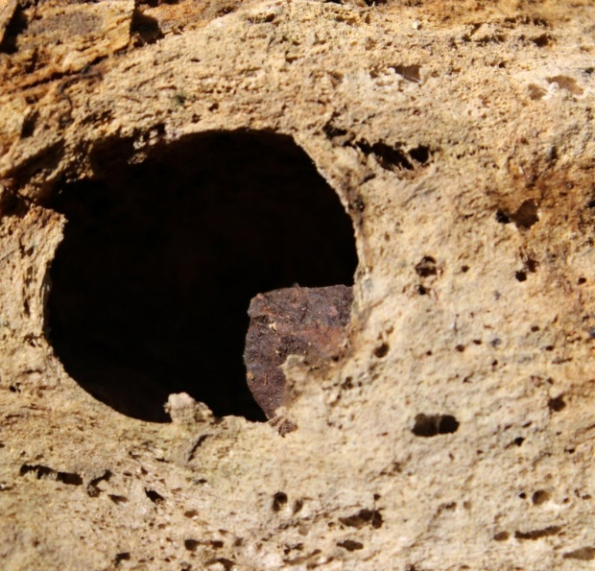
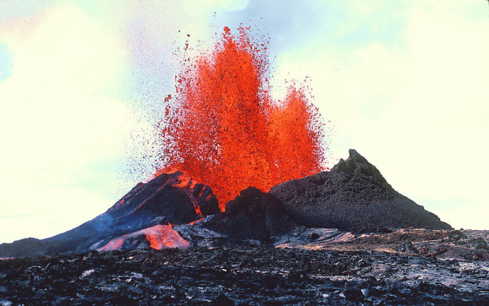
What happens when magma reaches the surface?
Dissolved gas (mostly H₂O and CO₂ ) begin to form bubbles due to pressure released .
  Like opening a bottle of soft drink, pressure is released and you can see bubbles rising.
This can have a different effect with different magmas
  Low viscosity magma will foam out similar to adding Mentos to diet coke
  High viscosity gas bubble cant escape fast enough, pressure increases and it explodes (violently) instead of fountaining

Slide 18
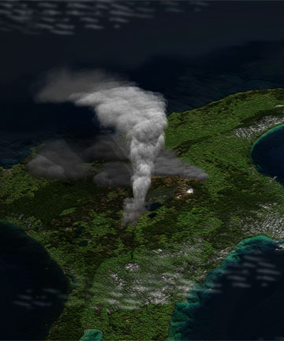
Super – Volcanoes
Super-eruptions are caused by the pooling of magma under the surface with no available domes or vents to release tension.
Pressure builds to a saturation point, triggering explosive eruptions thousands of times more powerful than standard eruptions.
Super-volcanoes collapse into calderas, where the ground falls into the space left by the erupted magma. Lake Taupo and Lake Rotorua are both calderas.

Slide 19
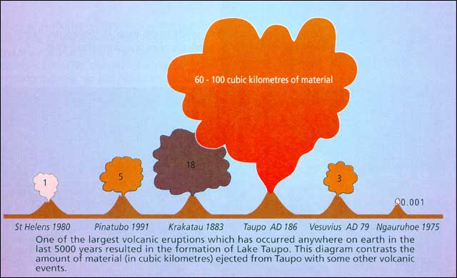

Slide 20
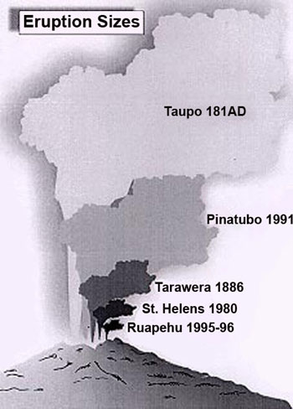
Taupō Eruption
Formed from Ōruanui eruption, about 26,500 years ago
formed the 30-kilometre wide depression at the northern end of Lake Taupō Since then there have been 28 separate eruptions, ranging greatly in size.
The Ōruanui eruption was so enormous that it is hard to visualise. In only a few days or weeks it ejected enough material to construct three Ruapehu-sized cones.
After the eruption, the new lake gradually filled to a level 140 metres above the present lake. The lake broke out to the north, resulting in a huge flood. For several thousand years the Waikato River flowed northwards into the Hauraki Gulf, but it later changed its course to flow through the Hamilton lowlands to the Tasman sea.
If you could spread out that volume of debris, it would cover the entire North Island in a layer 10 metres thick! Eighteen centimetres of ash from the Oruanui eruption has been found on the Chatham Islands, over 800 kilometres away.
Notes:
http://www.stuff.co.nz/dominion-post/news/6784815/Taupo-super-eruption-secrets-revealed

Slide 21
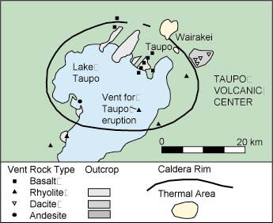

Slide 22
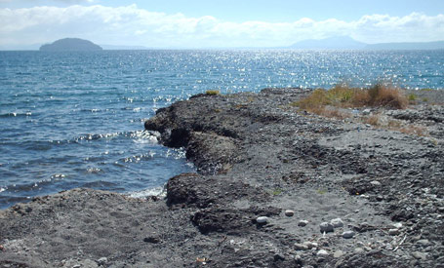
Caldera Formation
To most New Zealanders, Taupo is a big, beautiful lake. To geologists, it’s one of the worlds most formidable volcanoes a caldera. A caldera is a huge volcanic depression created when the ground collapses after a massive eruption.
The Earth’s crust at Taupo is unusually thin because it is being stretched as New Zealand is twisted between the Australian and Pacific Plates. Below Lake Taupo, the rocks are melting, and the magma is rising.

Slide 23
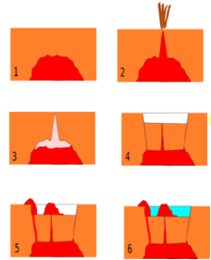

Slide 24
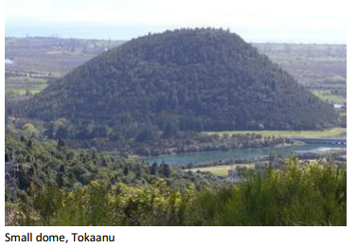
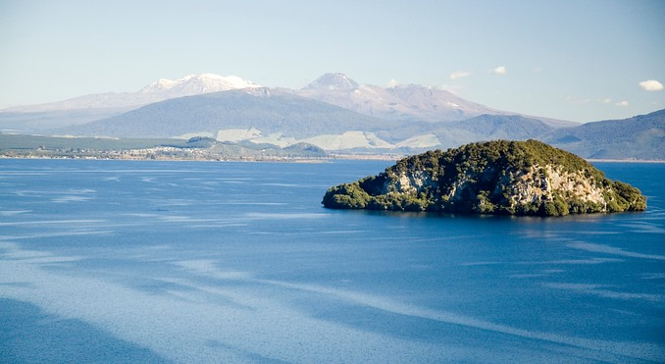
Dome formation
Once the caldera has collapsed into the empty magma chamber, some magma is erupted out of the vents or magma chamber,
The magma has lost most of its gas so it oozes out (like squeezing toothpaste from a tube)
The oozing magma can form shield domes, like Tokaanu that sits on the south side of lake Taupō .
The second picture shows what may potentially be a lava dome in the centre of the lake.

Slide 25
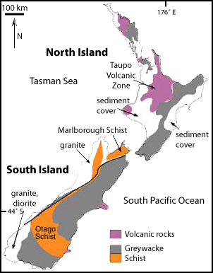
Rocks of Taupō

Slide 26
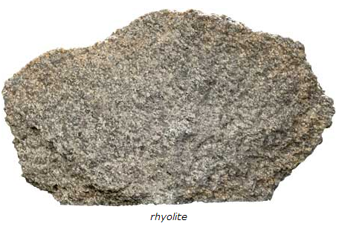
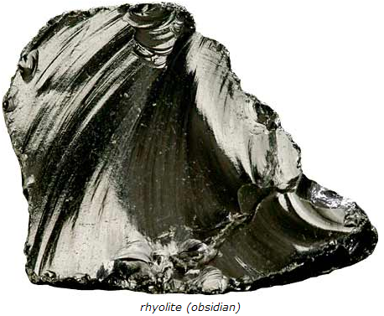
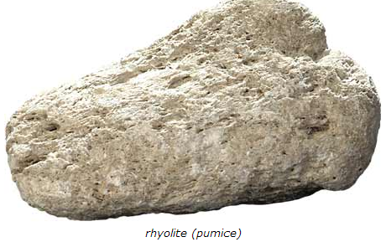
Volcanic Rock: Rhyolite
Rhyolite is an extrusive rock.
Due to the high silica content, rhyolite lava is very viscous.
It flows slowly, like tooth paste squeezed out of a tube, and tends to pile up and form lava domes.
If rhyolite magma is gas rich it can erupt explosively, forming a frothy solidified magma called pumice (a very lightweight, light-coloured, vesicular form of rhyolite) along with ash deposits, and / or ignimbrite.
In certain situations extremely porous rhyolite lava flows may develop. The extreme porosity of such flows allows degassing and subsequent collapse of the flow, forming obsidian (dark coloured volcanic glass). Rhyolite is the volcanic equivalent of granite.

Slide 27
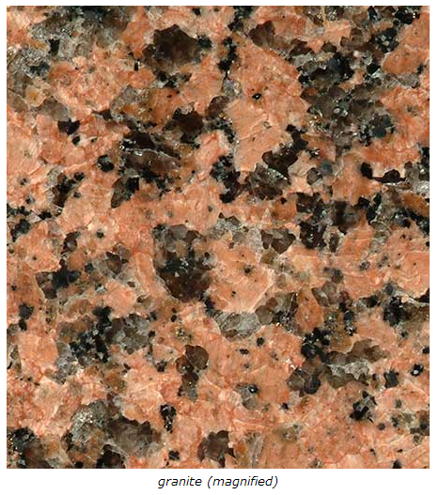
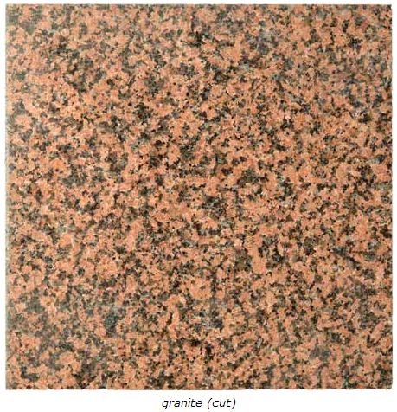
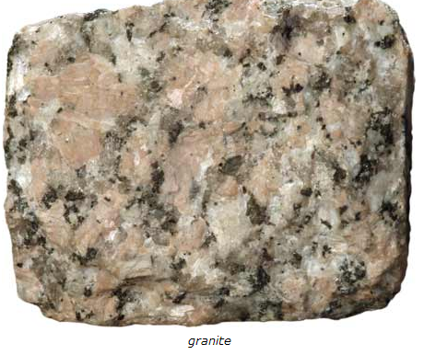
Plutonic rock: Granite
Granite is the plutonic equivalent of rhyolite.

