Slide 1
Value Chain
A process or activity by which a company adds value to an article, including production, marketing and the provision of after sales service

Slide 2
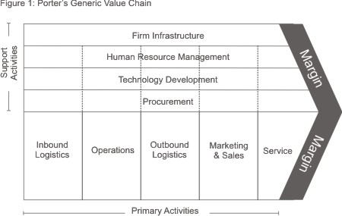
Who was Michael Porter?

Slide 3
Apply the value chain to Agribusiness:
Input supply
Agricultural production
First level Handling
Processors
Wholesalers/Distributors
Consumers
Retailers

Slide 4
Exercise to be completed over two periods
Each company to choose four of the following primary products:
Sheep, Beef cow, Dairy Cow, Deer, Pig, Kiwi fruit, Tomatoes, Chickens, Wheat, Barley, Maize, Oats, Apples, Grapes (input supplies)
Identify what other input supplies are needed for the product.
Establish as many value added products from each chosen primary product as you can.
Find out how the product is processed.
Ascertain a name of a company that wholesales and retails the processed product.
Who is the main consumer of the processed product?
Any other facts that you find out about the processing/value adding of each product.

Slide 5
Suggested report format
Headings for each primary product with egs
Inputs Bees, pollen, beehives
Ag production Honey
1st handling Collection, extraction, bottling, labelling
Processors Beetech NZ and many others
Wholesalers/Distributors NZ honey producers cooperative
Retailers Summerglow apiaries, Manuka honey Co.
Consumers NZ public, Europeans (esp Manuka)
Other facts Manuka honey has special antobiotic properties, and is used for well being products. Wax is used for candles.

