Slide 1
Marketing mix: Promotion
Objectives:
To understand the purpose of promotion
To know the different methods of promotion

Slide 2

Starter
My favourite advert......
http://www.youtube.com/watch?v=TVblWq3tDwY&feature=related
What’s your favourite advert? Why?
What might be some reasons for a business advertising their product?

Slide 3

Why?
Businesses promote to increase AWARENESS.
They may also wish to persuade, remind or strengthen brand image.
What was the purpose of the Cadbury advert?

Slide 4

Methods of promotion
You have 30 seconds to list as many ways as possible a business may use promotion. The winner gets a star.....
HINT: Think of what small businesses might do as well as larger ones!

Slide 5
Choice of promotion
How might a business choose which type of promotion to use??
Cost of the advertising
Size of the market being targeted
Nature of the product
Who the target consumers are

Slide 6
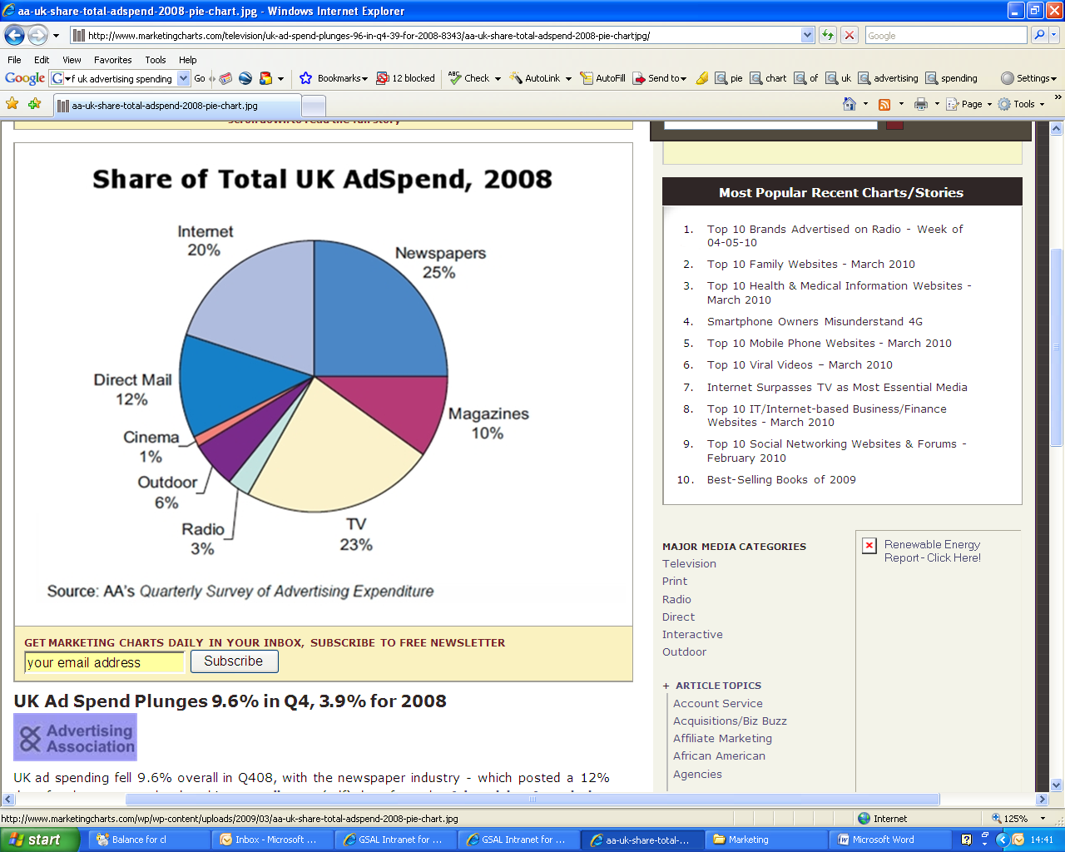
1. Media advertising (above-the-line)

Slide 7

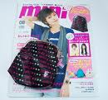


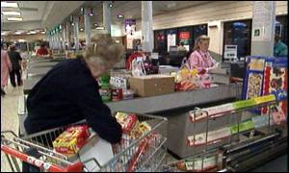
2. Sales promotions
These give short term boosts to sales

Slide 8
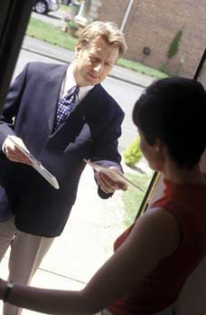

3. Direct selling
PERSONAL SELLING
DIRECT MAIL
Now often done on internet; JUNK MAIL.

Slide 9


4. Public relations
5. Sponsorship
Try to place good news about the business in the media. This can be a very cheap way of getting a lot of corporate exposure
What might be some of the problems of sponsorship? Think of Tiger Woods!

Slide 10


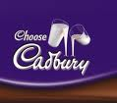

6. Branding
What do you think the biggest brands in the UK are?

Slide 11
To finish.....
Suggest the most effective method of promotion for the following businesses/products and explain why.
The new James Bond Movie
A new boutique opening in Lippomall
KFC are launching a new chicken burger
A small printing company are introducing a new printing technique

