Slide 1
Making Camembert
And Growing Value by adding probiotics
Slides first created by Julia Liefting, Ngaruawahia High School

Slide 2
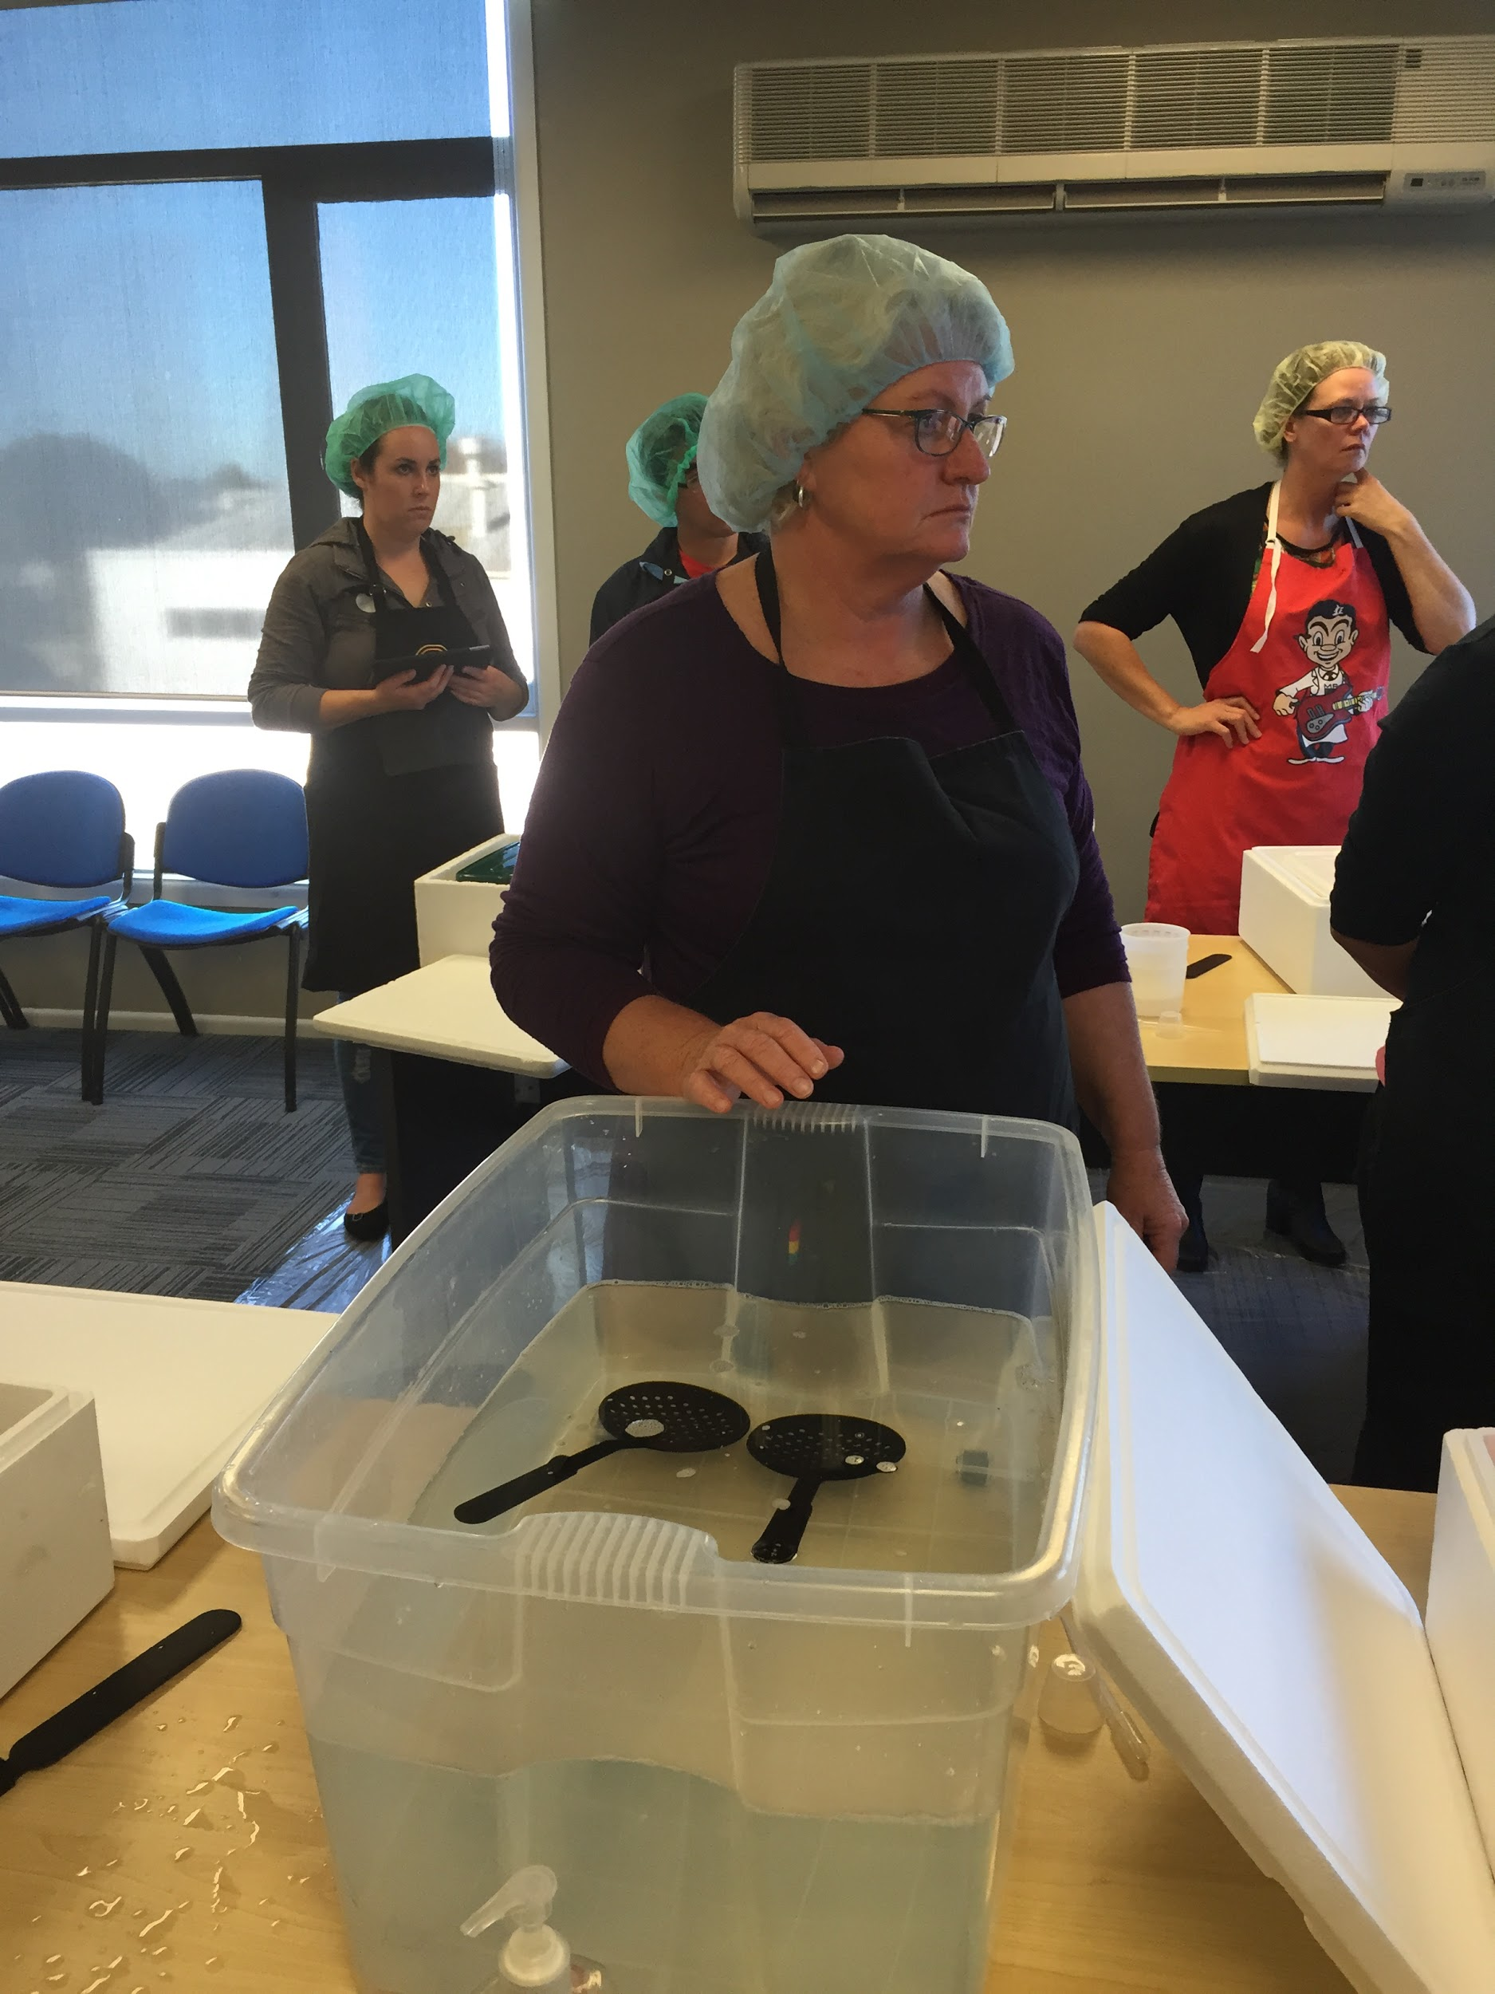
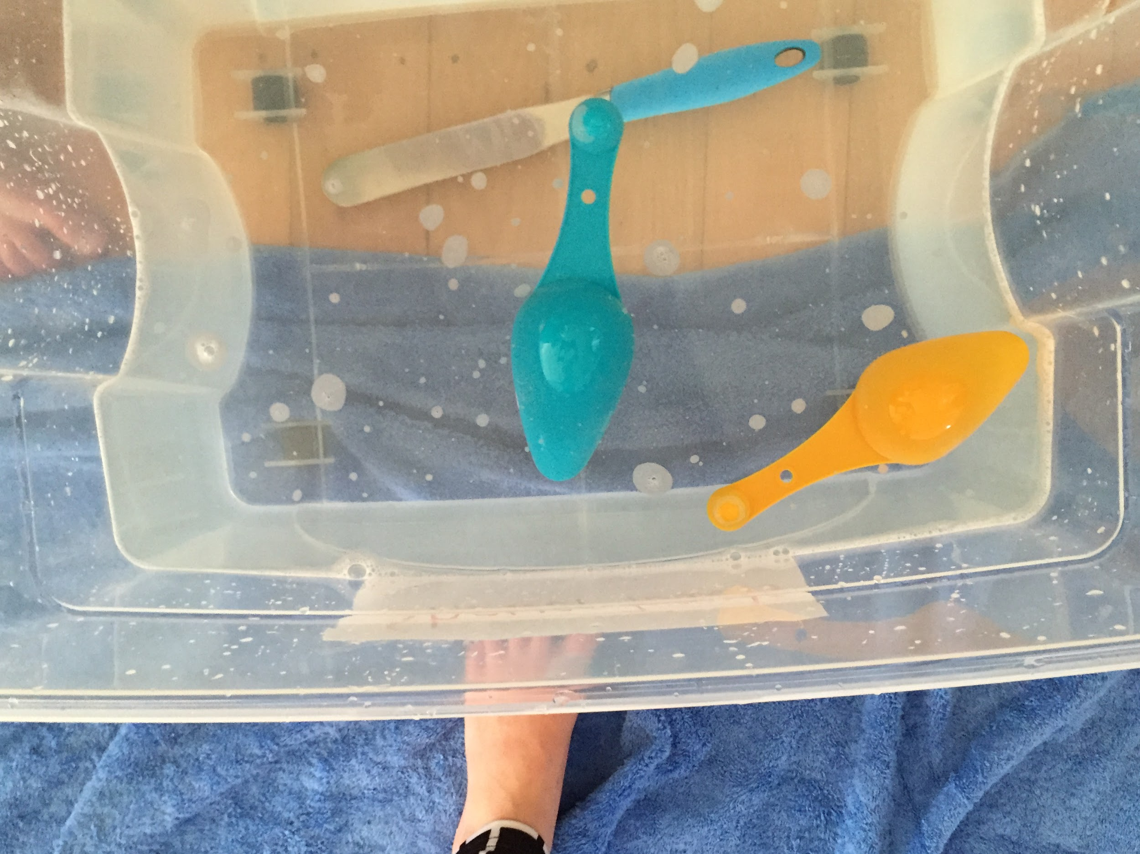
Step 1: Sterilize the equipment
Use 5 mL Janola to each litre of water.
Soak the equipment for at least 2 minutes.

Slide 3
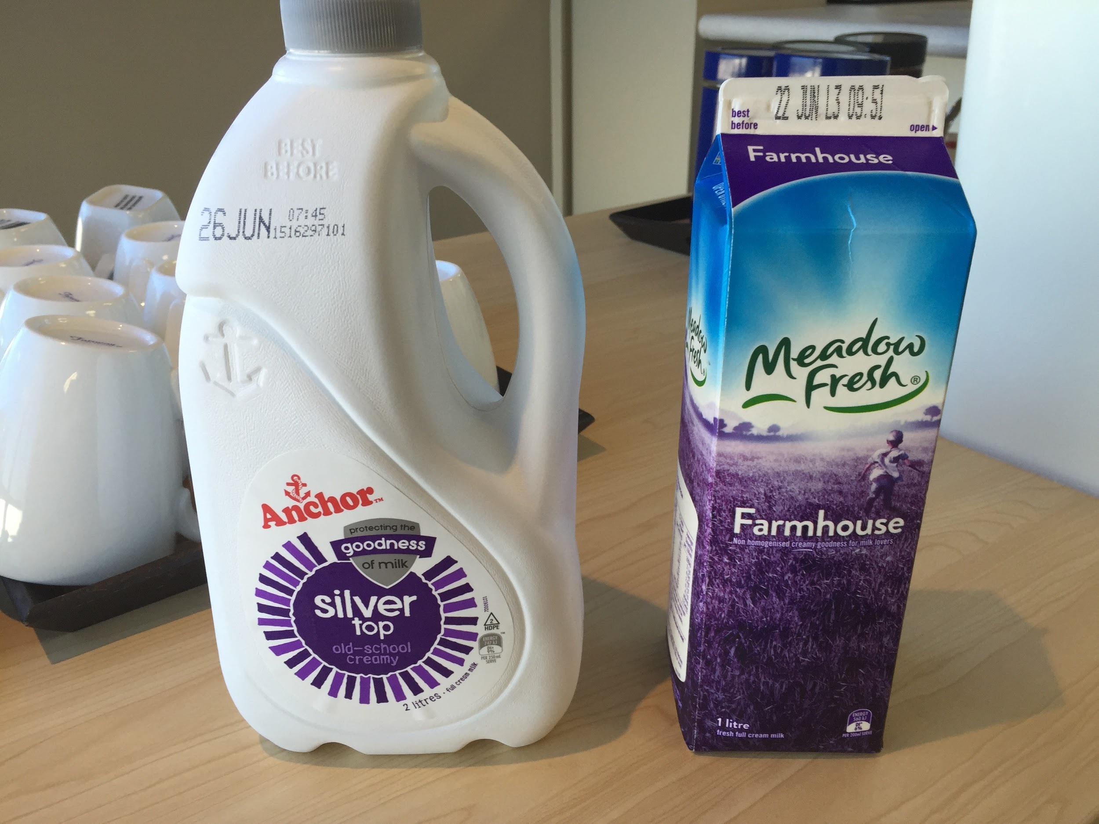
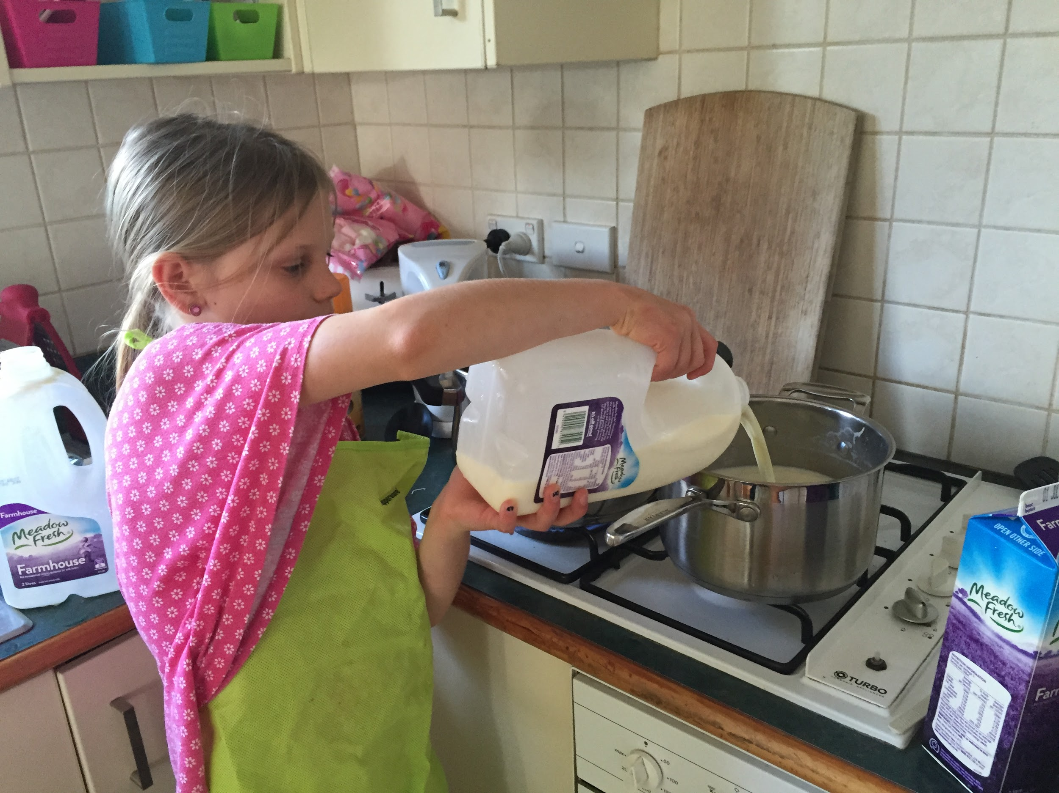
Step 2: Prepare the milk
Use silver top un-homogenised milk: (6L per group)
All Meet in the school kitchen @ 7.40am

Slide 4
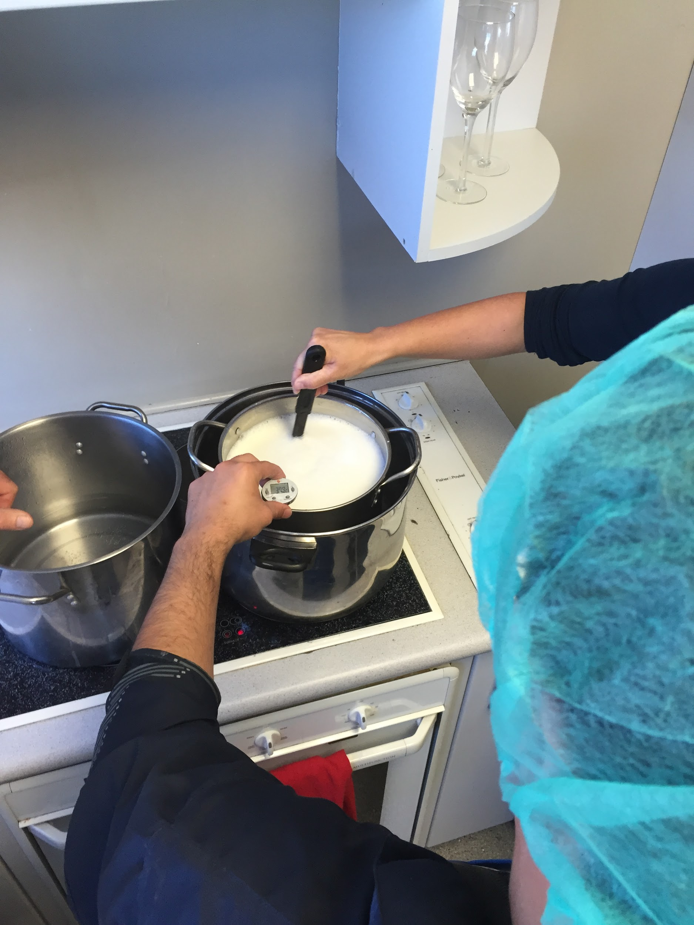
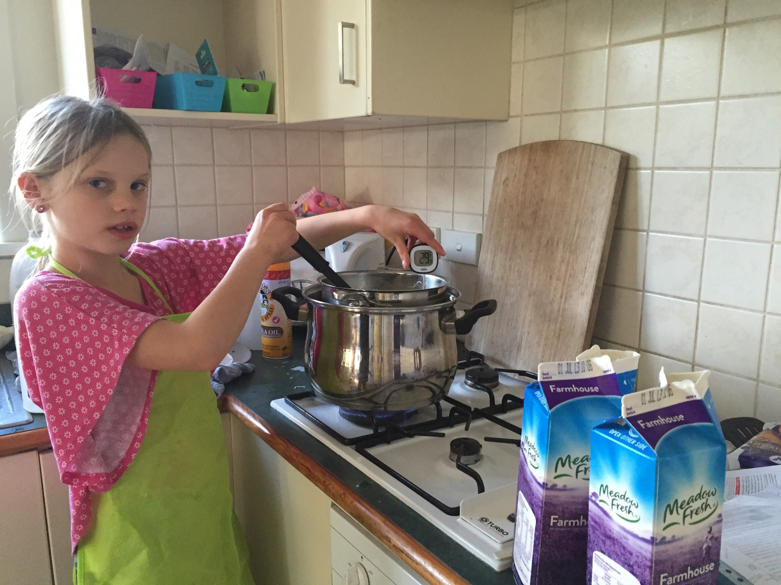
Step 3: Heat the milk
Heat all the milk in a large “steam” cauldron. Stirring essential. Bring the milk to 41ºC.

Slide 5
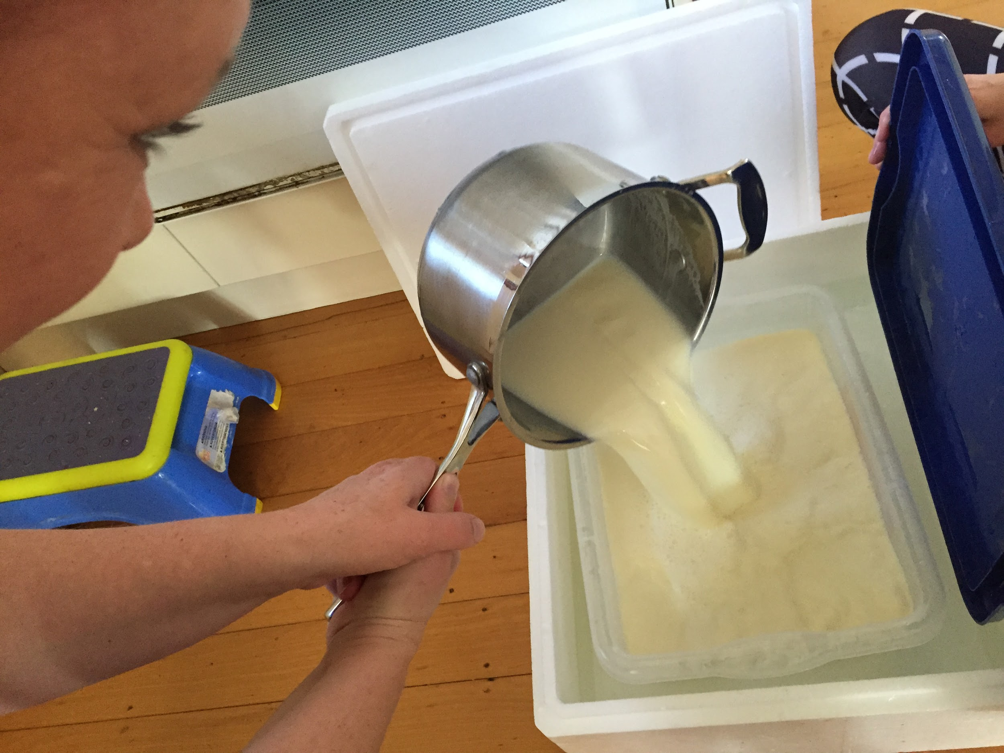
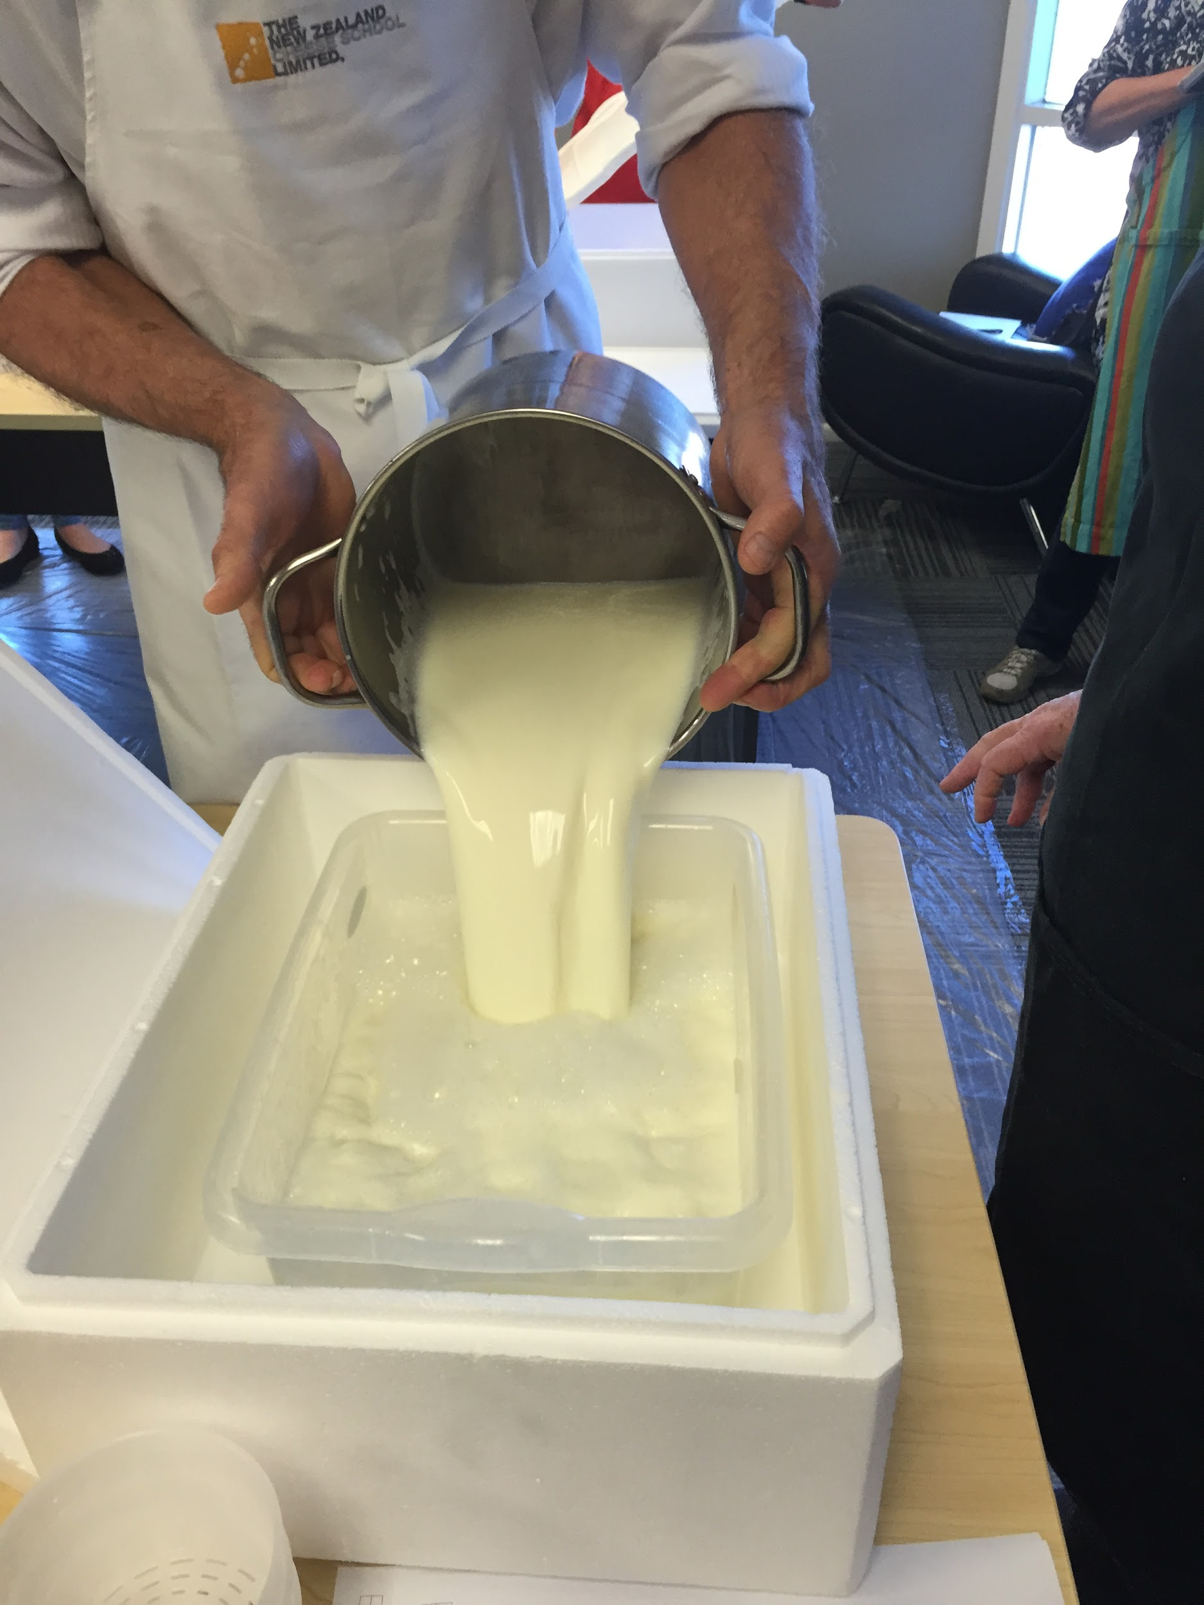
Step 4: Pour milk into milk vat
Pour 6L in plastic container inside the polybox - both with lids on.
Return your group’s milk to COE

Slide 6
Step 5: Add starter powder
Add Camembert starter powder at rate of ¼ teaspoon every 6L and mix well
ADD PROBIOTICS NOW.(3g per 6L –pre-weighed)
The starter powder has two types of bacteria.
Streptococcus thermophilus likes warm temperature (low 40’s) so is most active at warmer temperatures.
Lactococcus lactis likes temperatures between 30 and 40 degrees Celcius.
There is also the white mould (fungi) Penicillium camemberti that grows on the outside of the cheese.

Slide 7
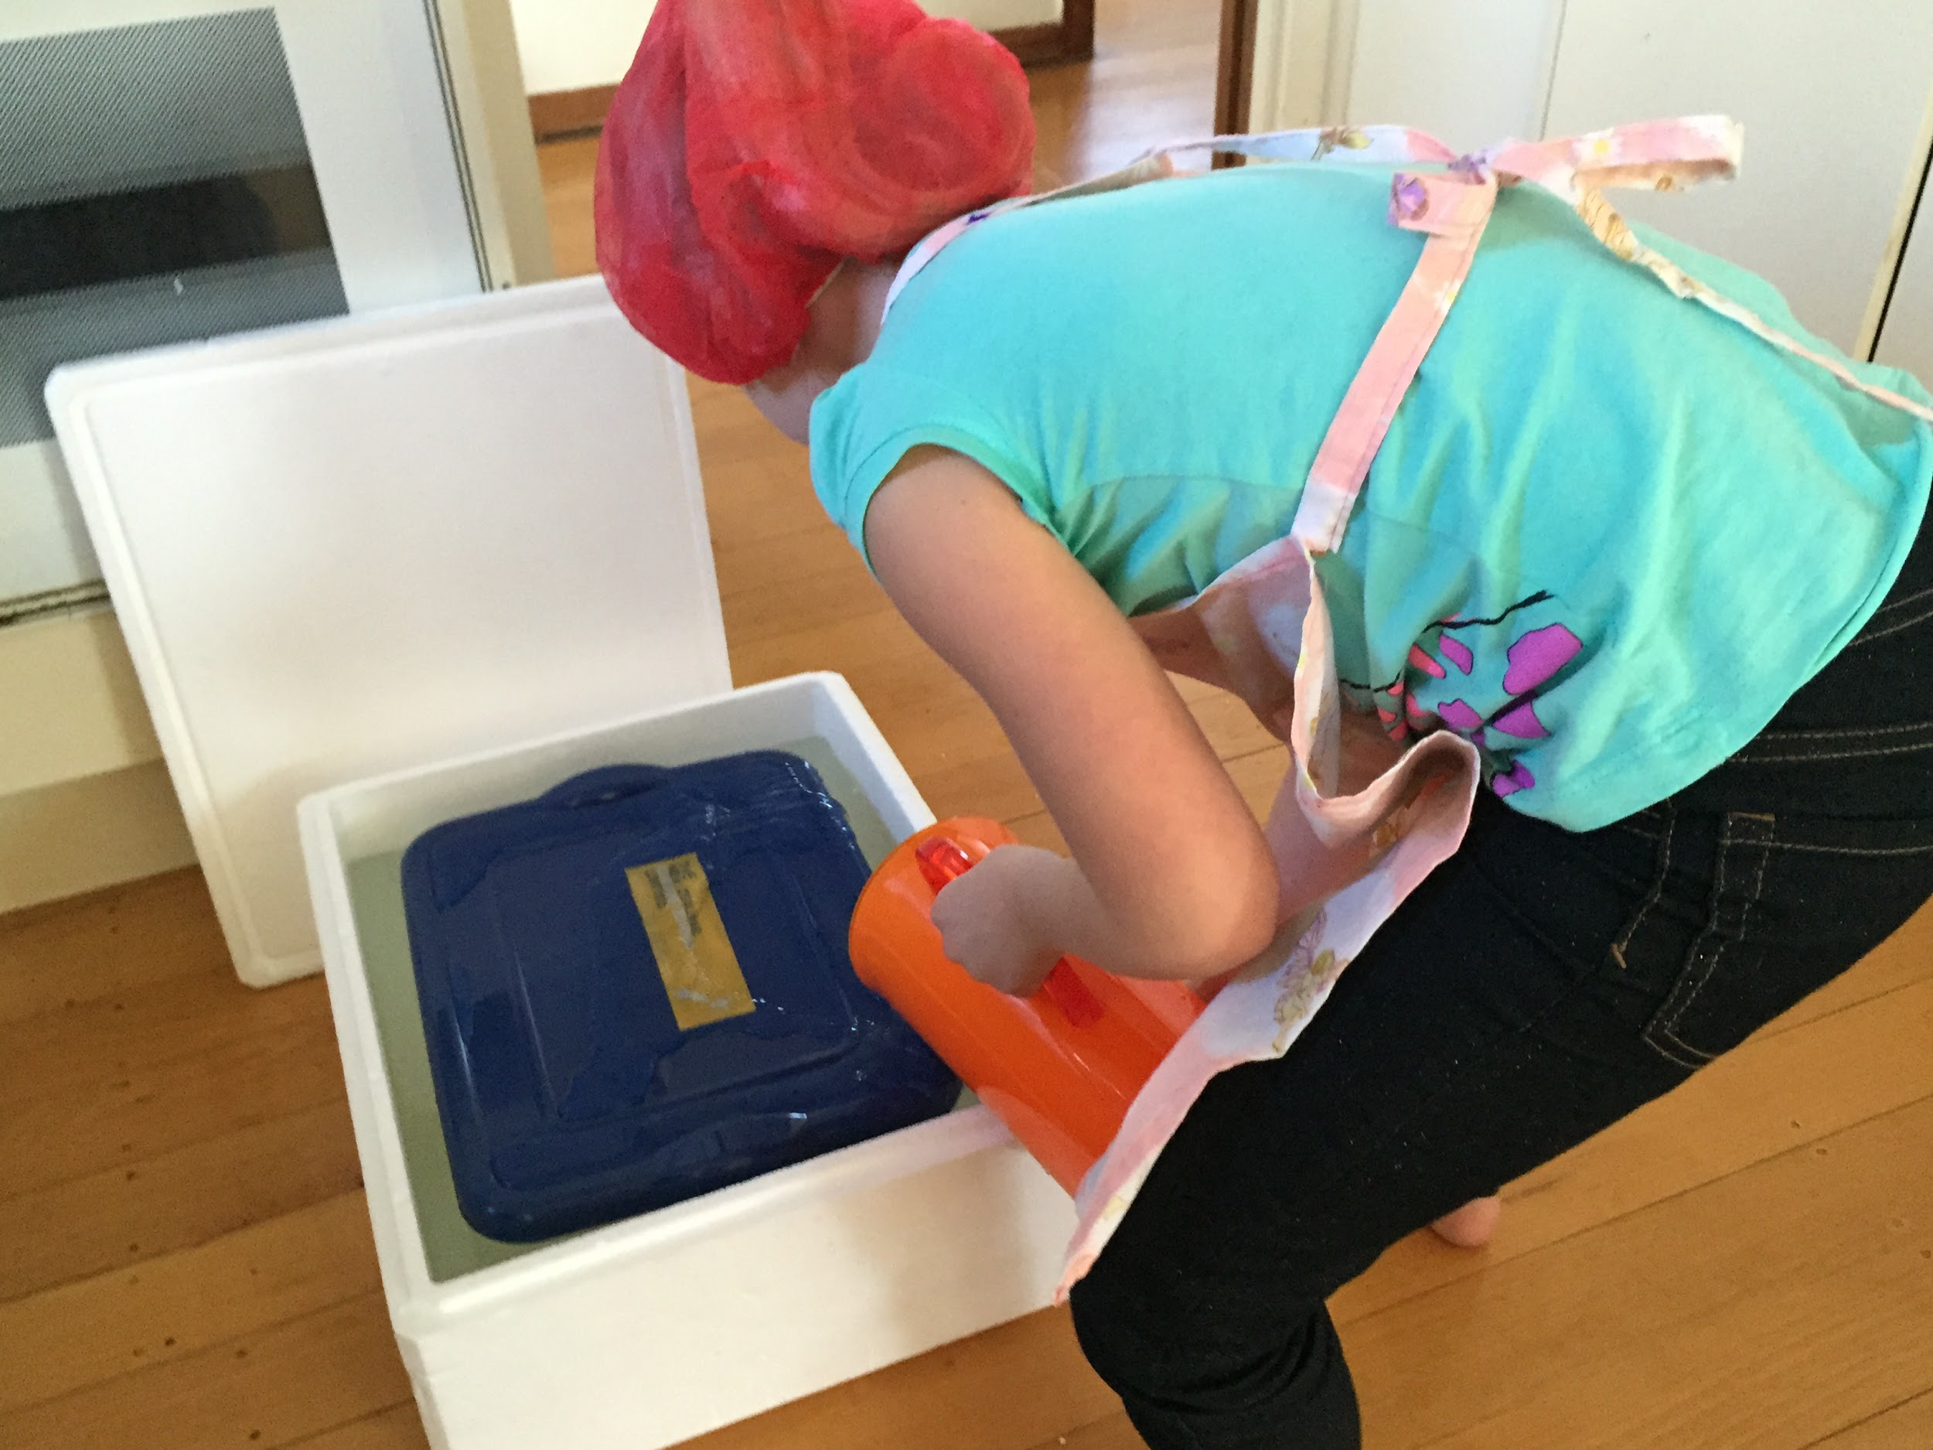
Step 6: Make a water bath
To maintain the setting temperature, add warm water (41-43 ºC) around the plastic container.

Slide 8
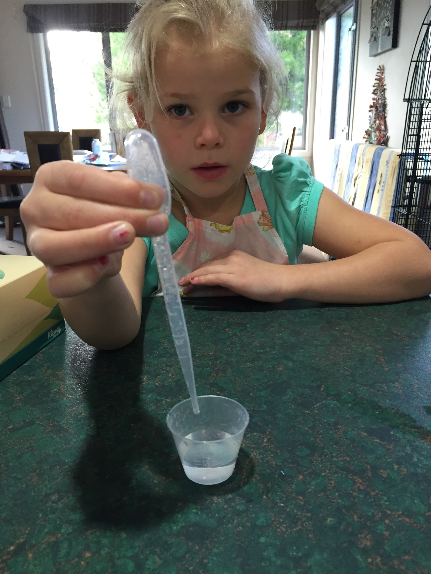
Step 7: Add the rennet solution
Beginning of Interval: add rennet. 0.375 mL premixed in 10 mL of cooled boiled water.
Pour the rennet mix immediately into the milk.
Pour it over as much of the surface as possible, stirring all the time while pouring.
Mix in well for 1 minute, no more.
Allow the milk to set for 1 hour.

Slide 9
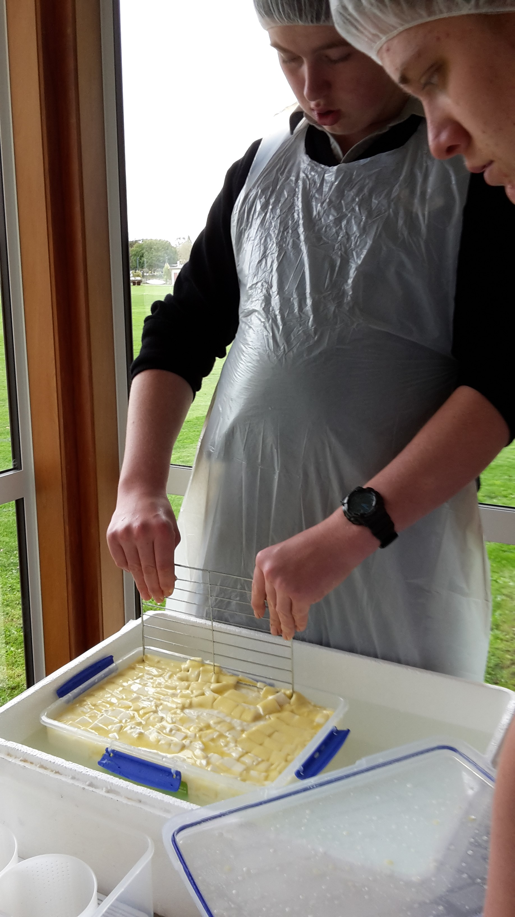
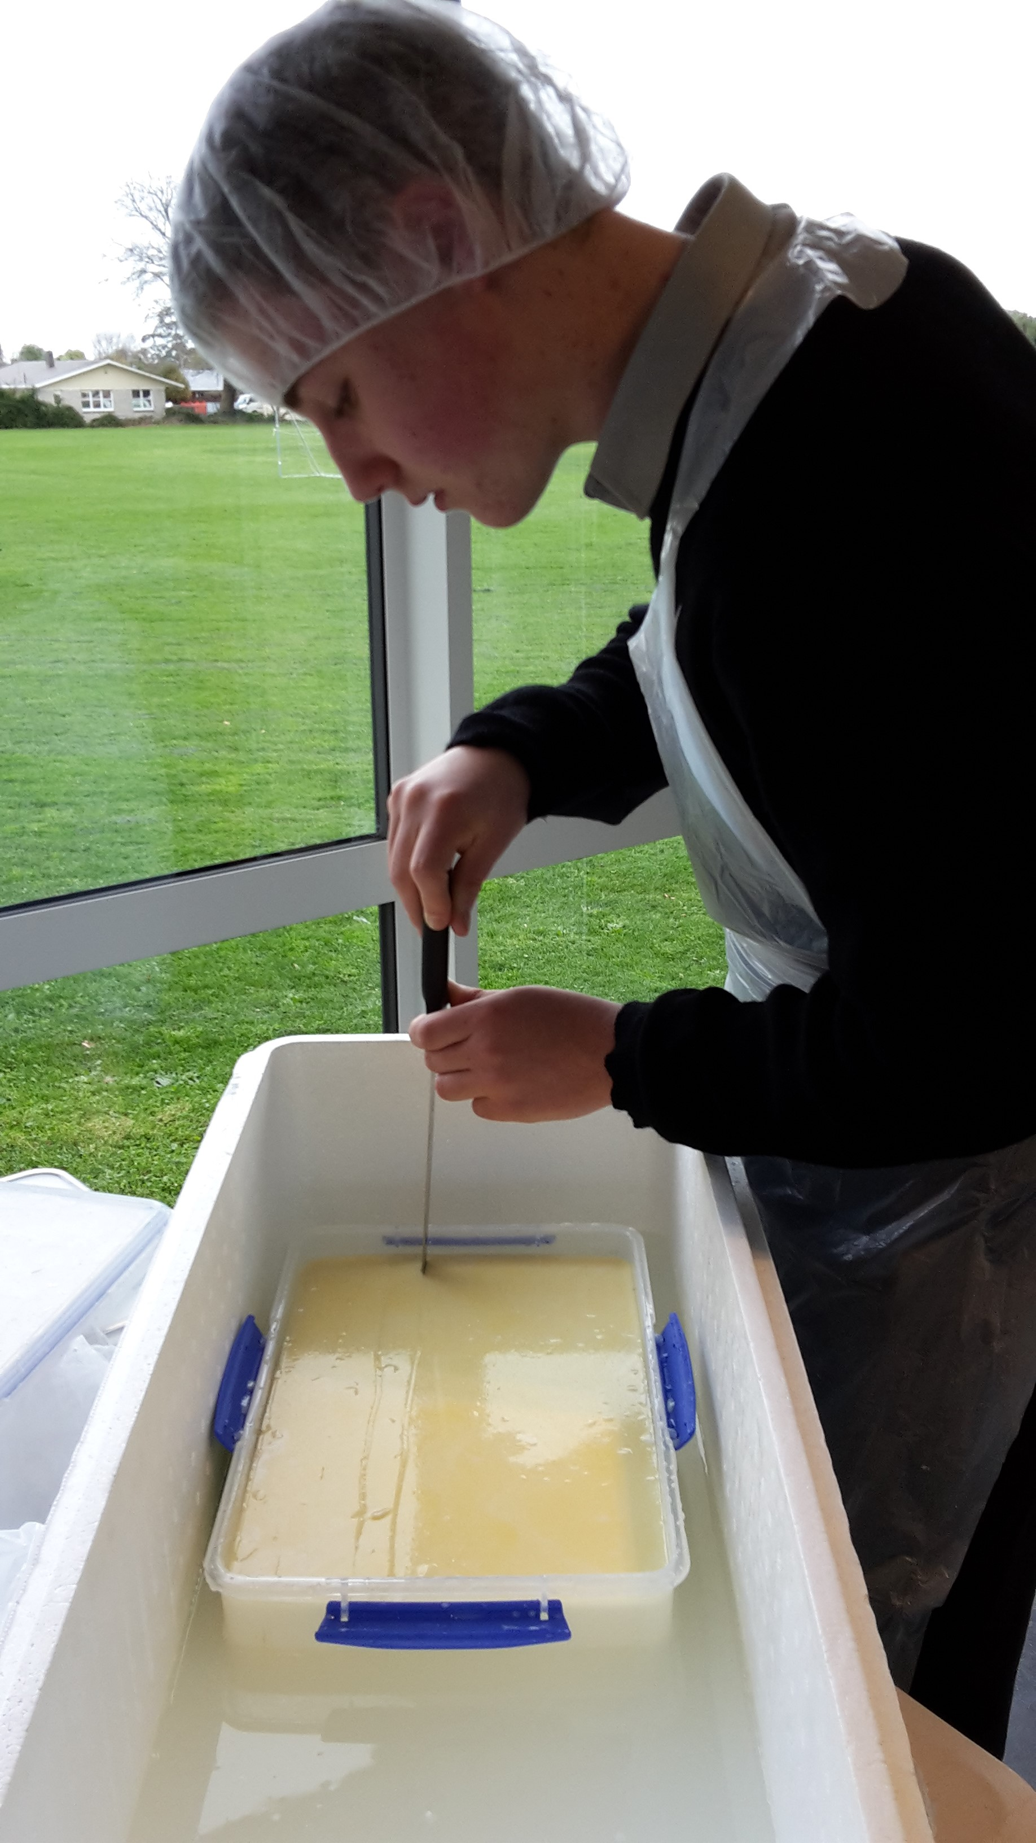
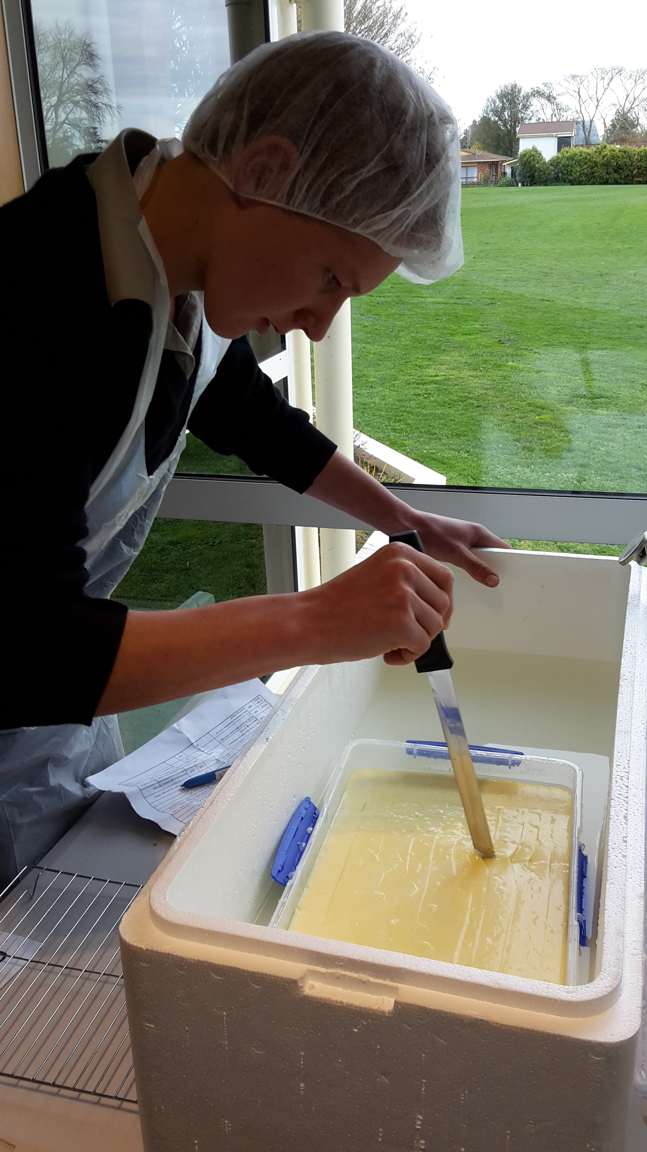
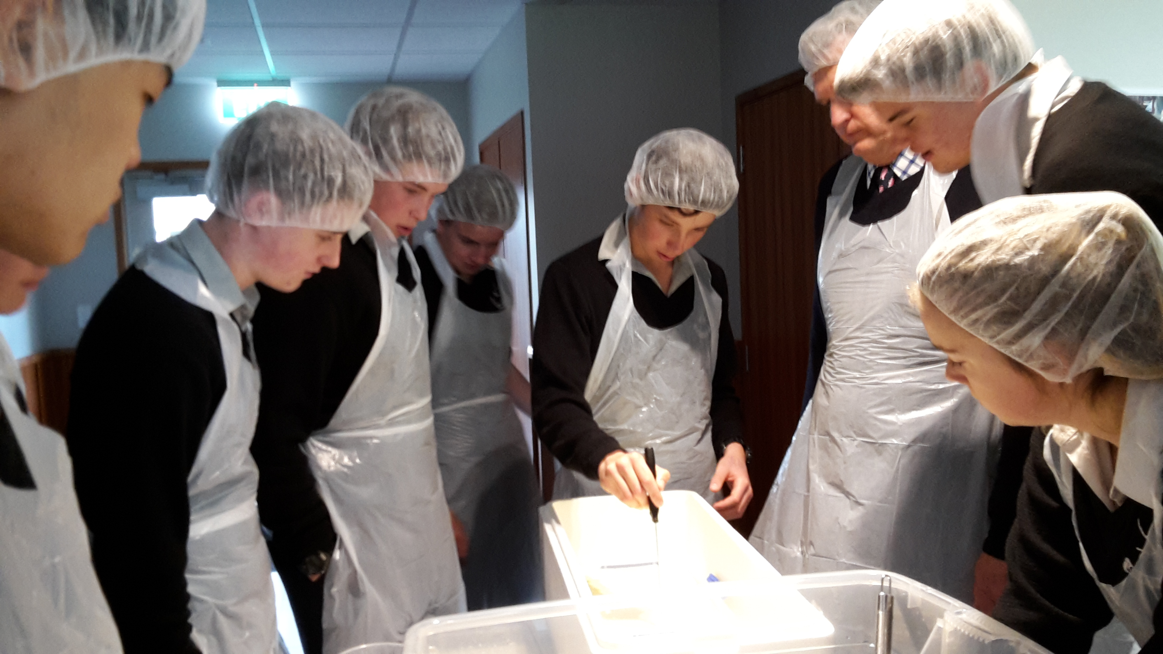
Step 8: Cut the curd
At start P4: Cut the curd into 2cm cubes - length, width and across (use a wire rack, or cutting knife).
Allow the curd to sit for 30 minutes.

Slide 10
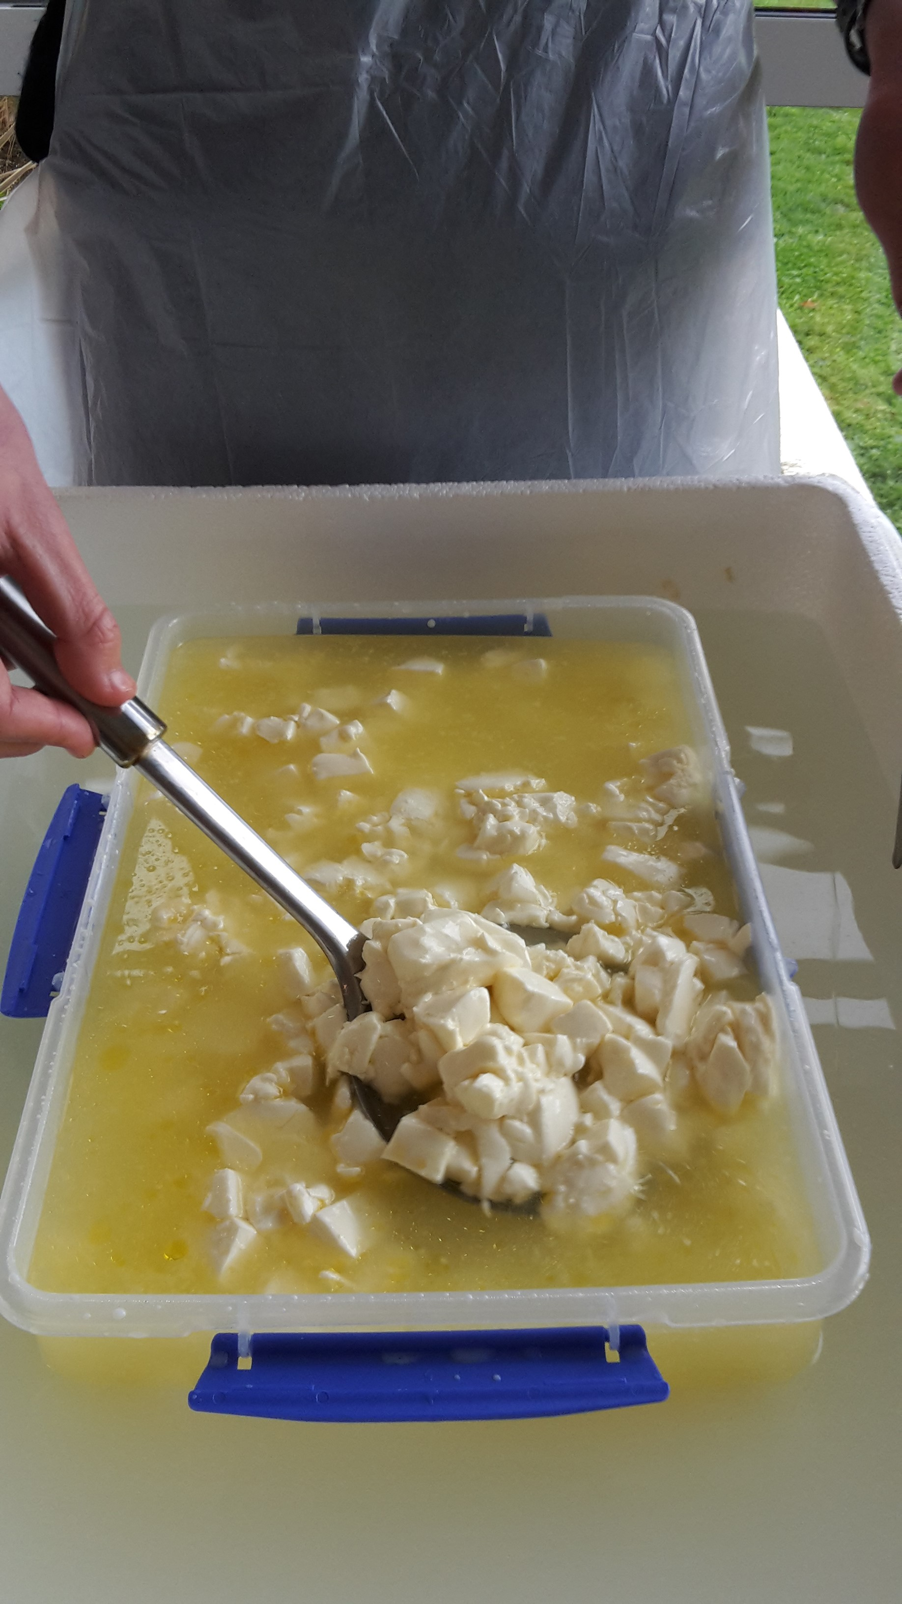
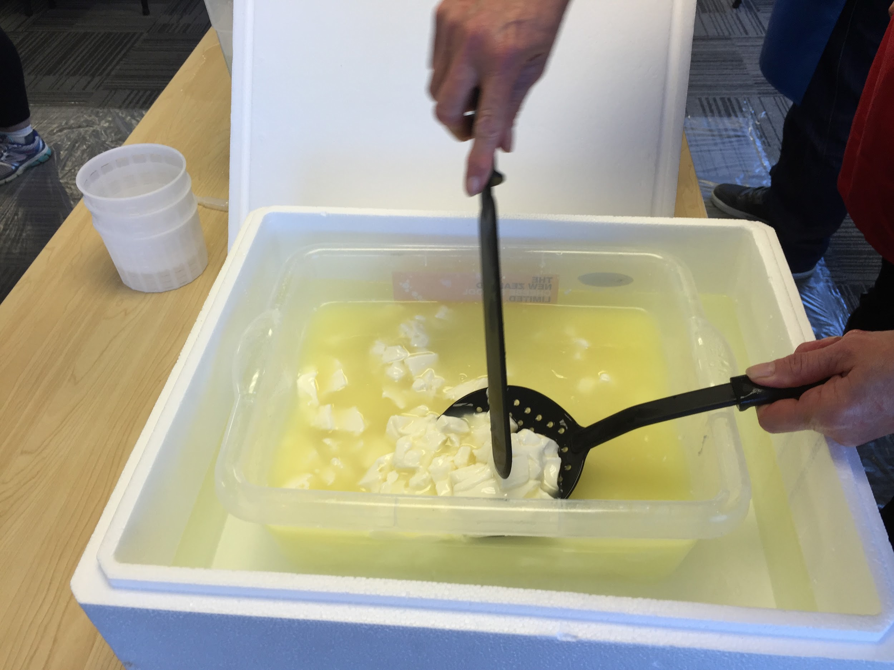
Step 9: Stirring
Turn all the curd over gently once with a large, flat ladle.
Try to stir them under the whey (unlike pic on right) so they don’t cool off.
60 minutes after cutting, stir again.

Slide 11
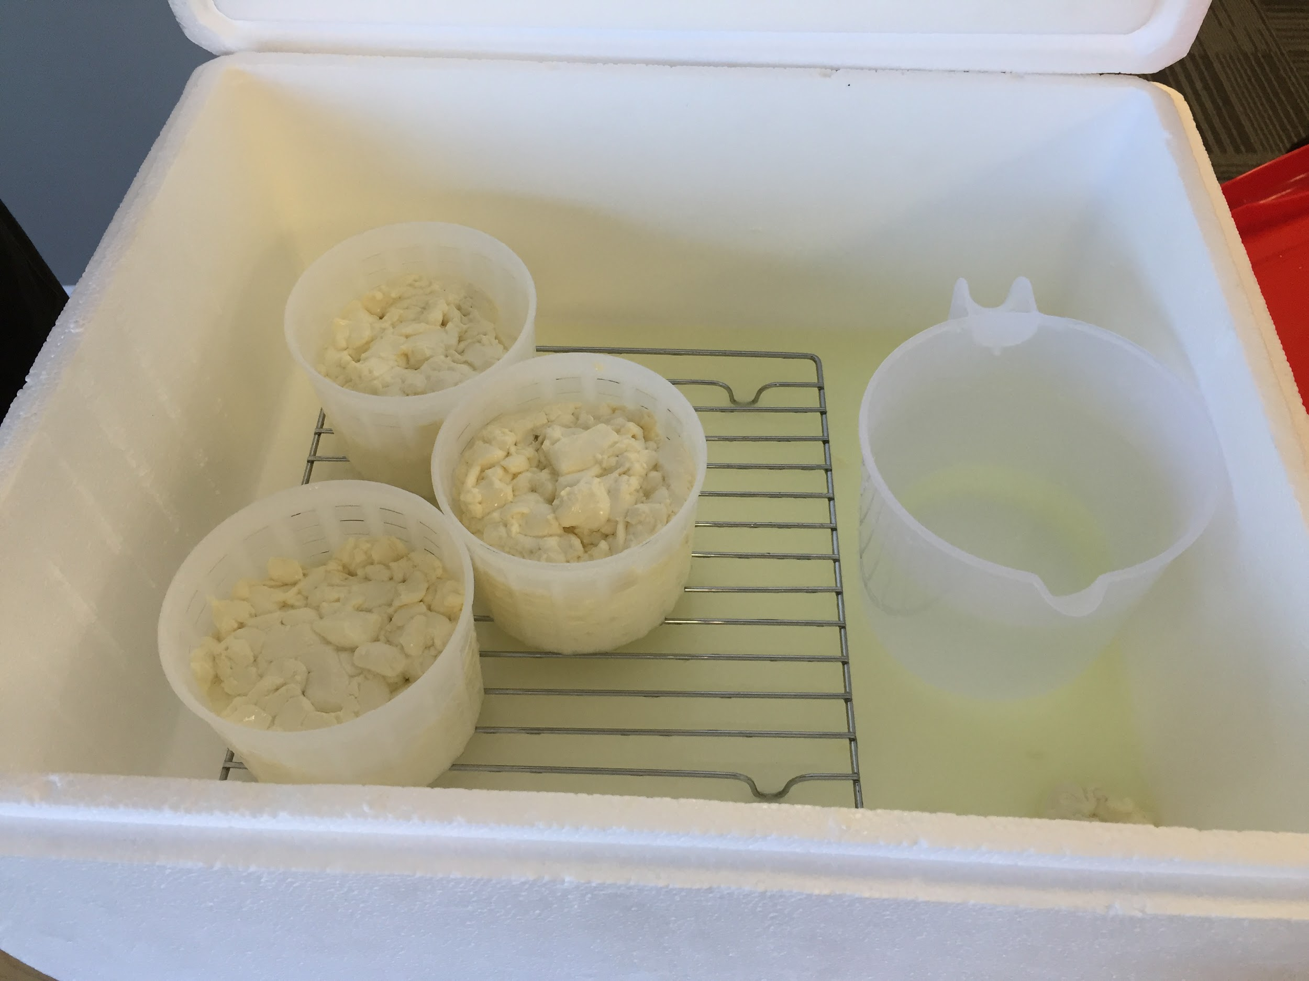
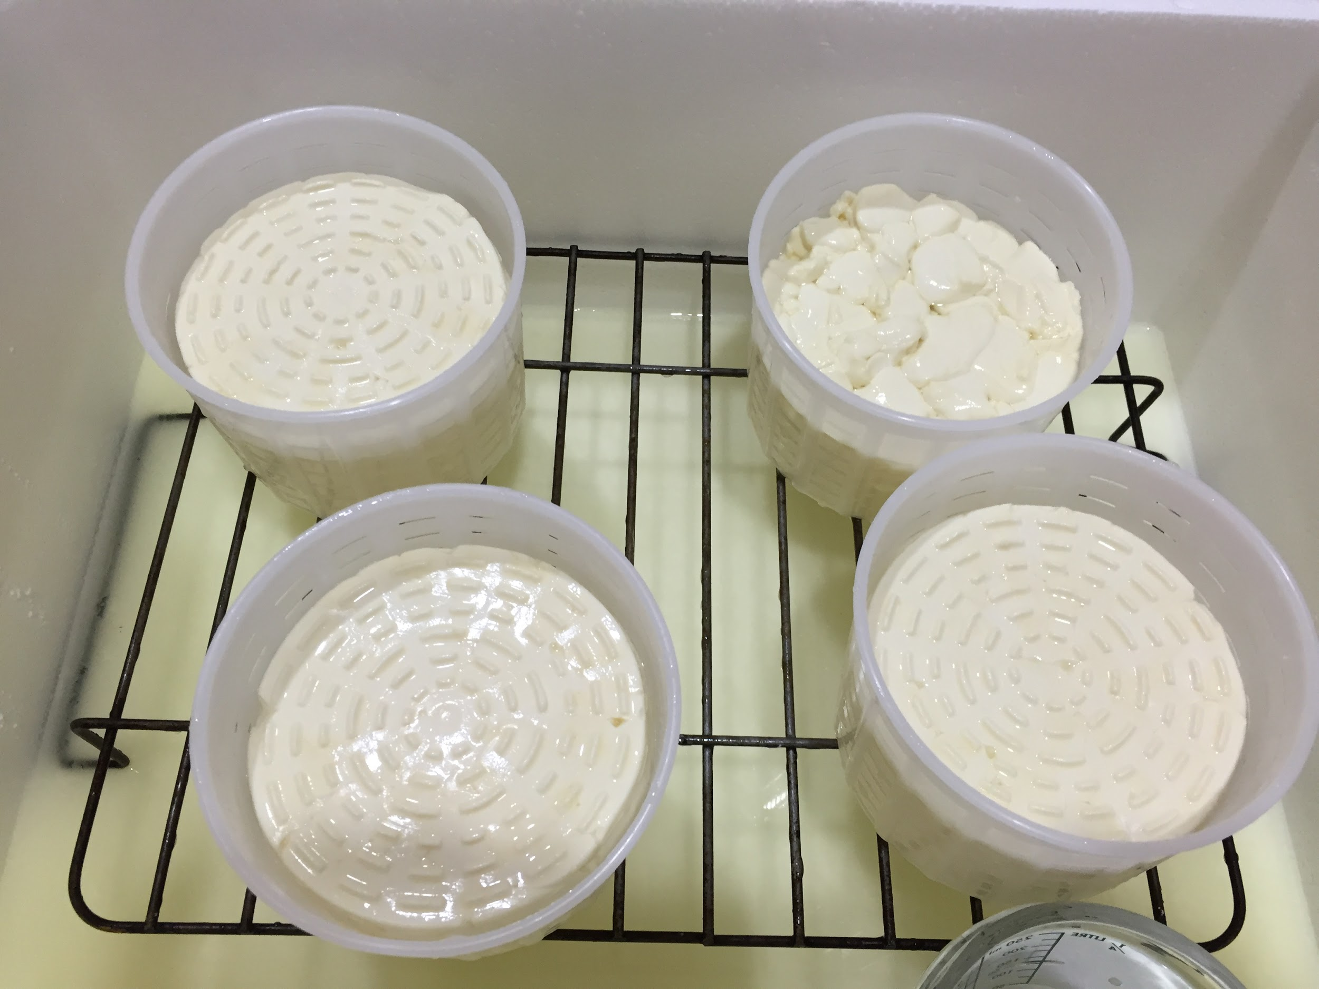
Step 10: Put into cheese moulds
90 minutes after cutting, decant off the whey and ladle the curd evenly into the 3 cheese moulds.

Slide 12
Step 11: Place in the chilly bin
Place in the chilly bin on a rack.
Also put 800 mL jug of hot water (above 60ºC) at the opposite end of the chilly bin to keep the temperature above 28ºC
Keep the cheese in an environment above 28ºC for 4 hours in the sanitised poly box overnight.

Slide 13
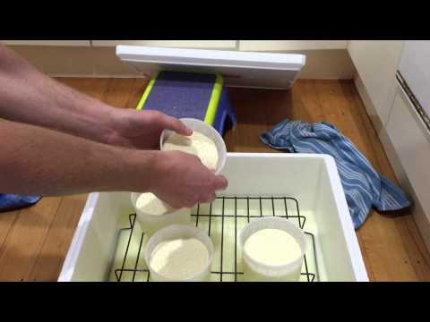
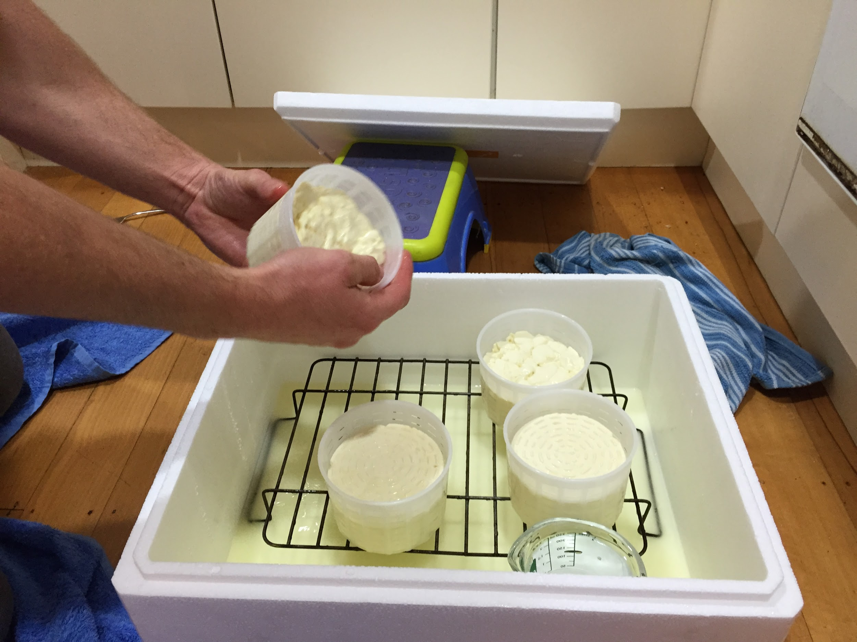
Step 12: Turning in the hoops
Invert the hoops after 30 min, 1 hour, 2 hours and 4 hours - as often for as long as you can manage.

Slide 14
Step 13: Make the brine
Make up a brine by stirring 300g of salt per litre of boiling water, stirring to dissolve the salt.
Allow to cool and add 5 mL vinegar to acidify the brine.
Store the brine in the fridge overnight.
Take it out of the fridge a couple of hours before using to warm up to 7-8ºC.

Slide 15
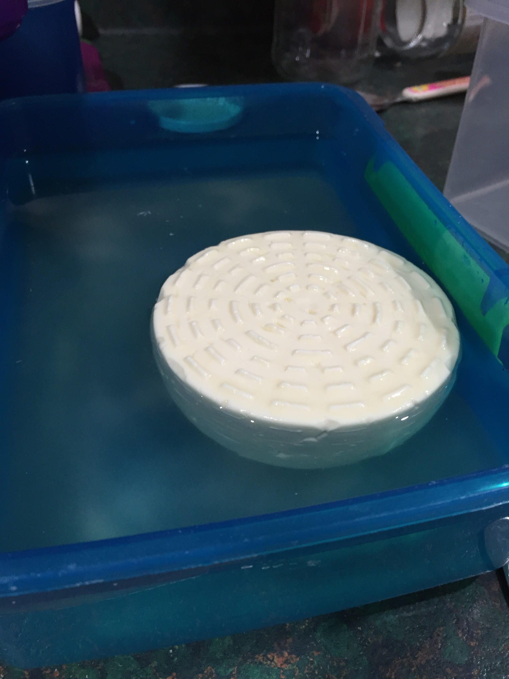
Step 14: pH test and brine
The next morning, pH test the whey. It must be between 4.8 and 5.2.
If the pH is above 5.2, throw the cheese out!
Once the pH is checked, sanitise your hands, take the cheese out of the hoop and place in the brine.
If the salt concentration is correct, the cheese will float.
Leave for 20 minutes, then turn the cheese over. Brine for another 20 minutes.

Slide 16
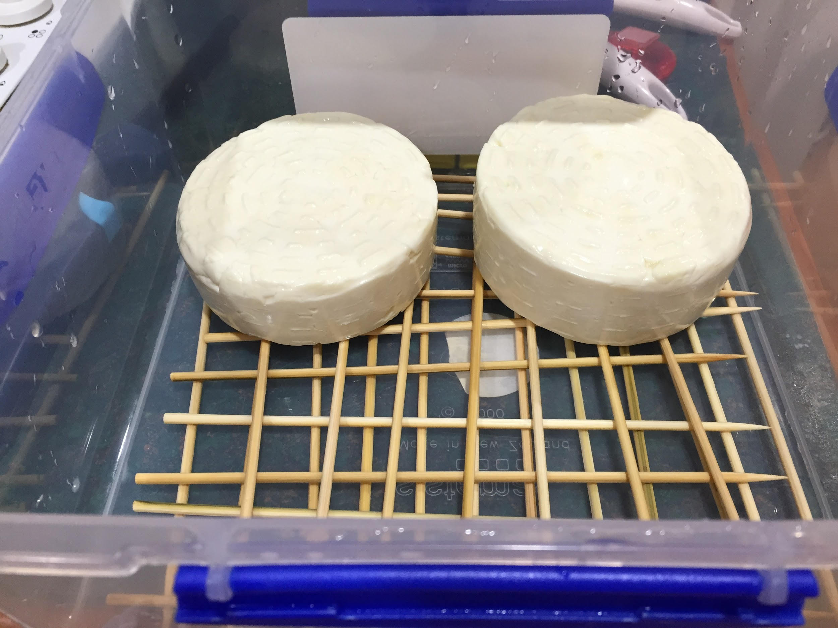
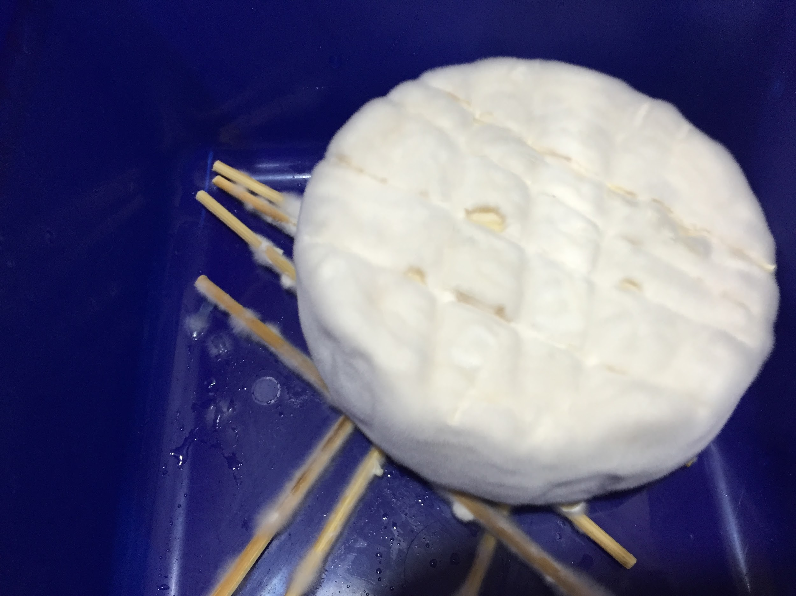
Step 15: Mature
Remove cheese from brine and place on a rack in a sealed container. This will create a humid environment so the cheese doesn’t dry out.
Place the container at 11-15ºC and store for 8 to 10 days.
Turn the cheese on days 3, 6 and 8.
The cheese should be fully covered with mould by the end of this time.

Slide 17
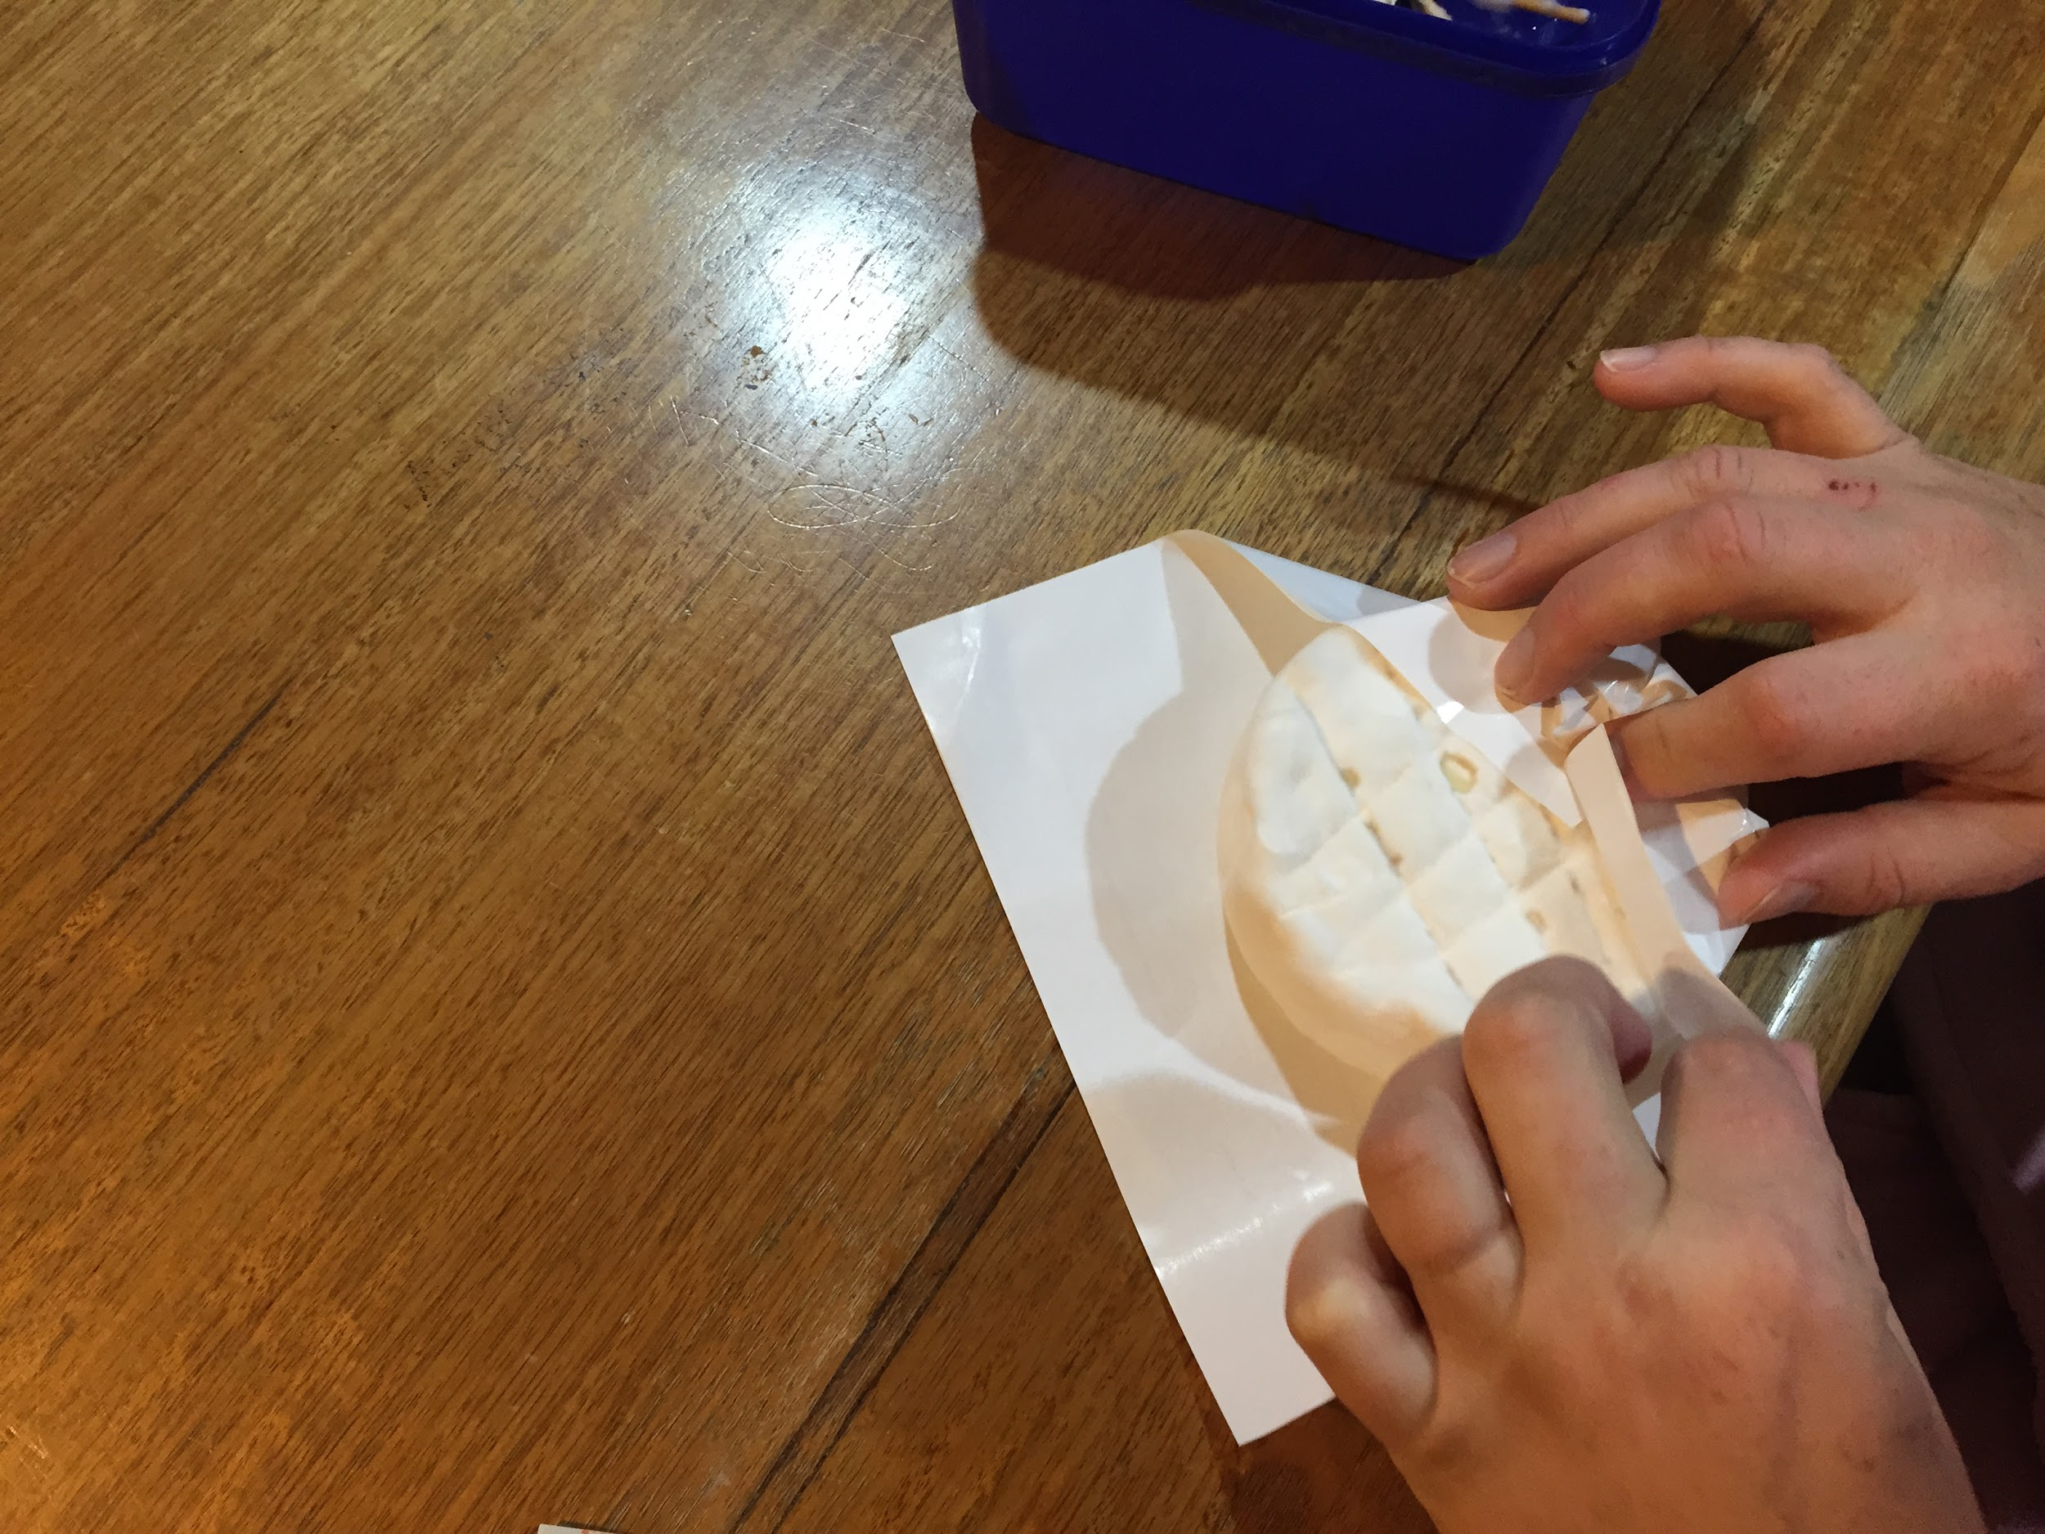
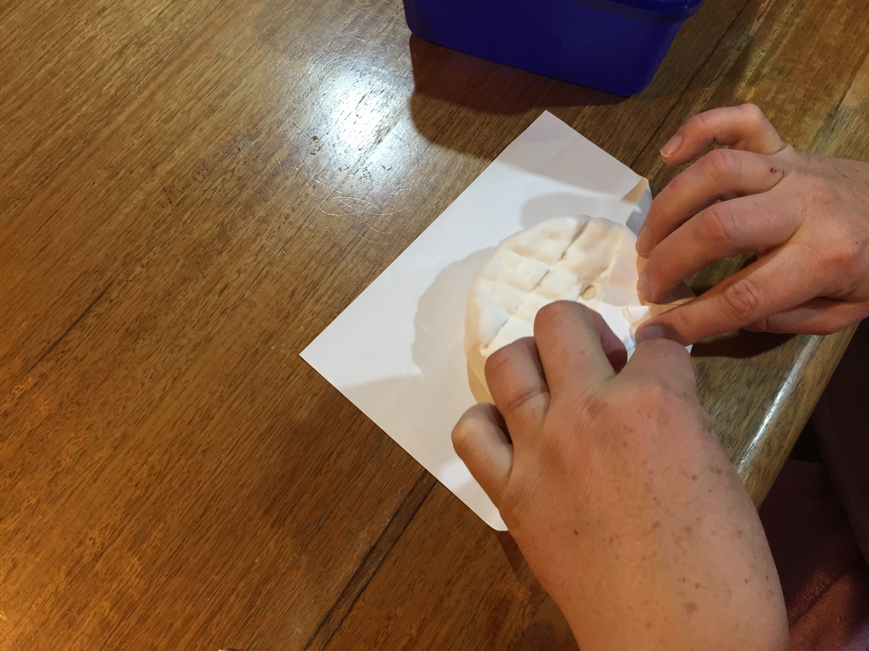
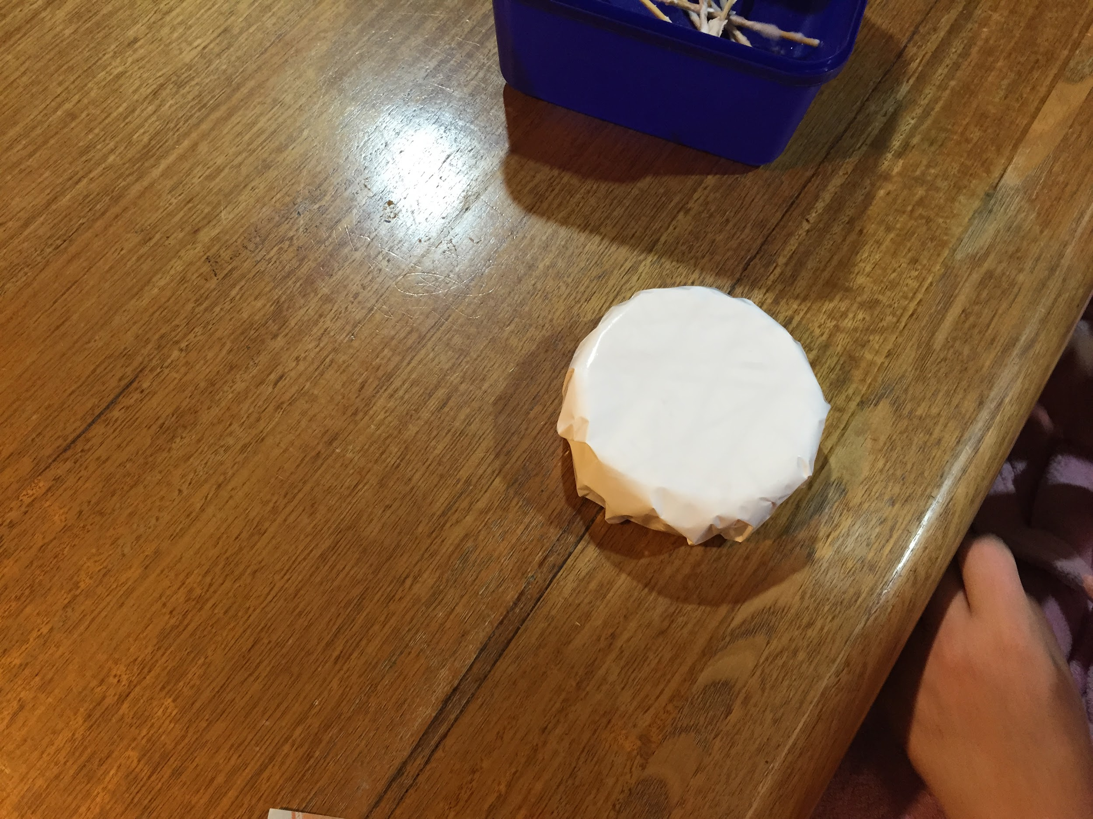
Step 16: Wrap and mature
After 8-10 days, when the cheese has a good covering of white mould, wrap the cheese.
Keep between 4-8ºC for 4-6 weeks for optimum ripeness and great cheesy flavour!

