Slide 1
What is a forecast?

Slide 2

What forecasts would a farmer need,
and why would they need them?

Slide 3

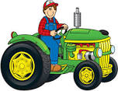
Would a farmer be interested
in forecasting cash?

Slide 4
Why would they be interested in doing this?

Slide 5
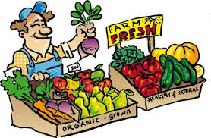
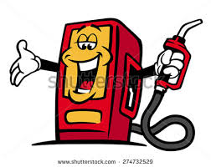
What information would they need for
a Cash Flow Forecast?

Slide 6

Would all farms have the same
sort of cash receipts?
List some cash receipts for:
A dairy farm
A beef farm
An orchard
A salmon farm

Slide 7
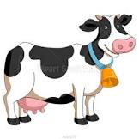
Would all farms have the same sort
of expenditure?
List several different items of
expenditure for:
A dairy farm
A beef farm
An orchard
A salmon farm

Slide 8

Would Cash Flow be the
same throughout the year?

Slide 9
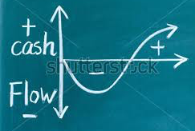
What might cause farming
cash inflows to fluctuate?

Slide 10
What might cause farming
cash outflows to change?

Slide 11

If a farmer wanted to buy a new
tractor costing $150,000, how would
they know when in the year would be
the best time to buy it?

Slide 12
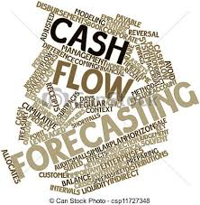
SUMMARY – What have we learnt:
A Cash Flow Forecast is a projection
of cash the business expects to
receive and pay next year. It shows
the expected cash position for each
month during the year.

Slide 13
The purpose of a Cash Flow Forecast is to predict shortages or excesses of cash in the next year, so the business can be prepared to deal with each situation, eg:
For shortages arrange ……… WHAT?

Slide 14
(More money from owner, loans, increased selling price, less credit sales, increase bank overdraft, decrease stock levels, sell idle assets, reduce expenses, etc)

Slide 15
For excess funds arrange ………. WHAT?

Slide 16
(Put idle money to work, eg arrange term deposit, or other investment, investigate in case of excessive borrowing, etc)

Slide 17
Plan when would be the best month to buy expensive capital equipment

Slide 18

What equipment would businesses
use to do a Cash Flow Forecast?
What type of program would be used?

Slide 19
A spreadsheet provides a system to record estimates of receipts and expenditures, which can be compared with the actual figures once they are known, eg

Slide 20
Cash Flow Forecast for A Business for year ended 20XX
Month | April |  | May |  | June |  | July
 | Forecast | Actual | Forecast | Actual | Forecast | Actual | Forecast | Actual
 | $0 | $0 | $0 | $0 | $0 | $0 | $0 | $0
Cash in: includes GST Cash Sales Cash from debtors etc | 1,000 10,000 4,000 | 980 11,200 3,700 | 1,200 14,000 4,500 |  | etc
Total Cash in | 26,000 | 31,500 | etc
Cash out: includes GST ACC payments Accounting costs Advertising etc | 500 500 100 100 | 350 500 80 160 | etc |  | etc
Total Cash out | 15,000 | 16,200
Surplus/Deficit | 11,000 | +15,300
Monthly Variance |  | +4,300
Open Bank Bal | 2,000 | 13,000 | 28,300 | etc
+ Surplus/Deficit | +11,000 | +15,300
Closing Bank Bal | 13,000 | 28,300

Slide 21
Why would you compare the two
figures for each month?

Slide 22
(Cash position at the end of each month should be able to cover the cash needed for the next month. If there is too little cash, then extra cash will need to be found or the expenses reduced. If there is too much cash on hand, then this money is not working for the business.)

Slide 23
Before a Cash Flow Forecast can be done, you need to know some information. Possible questions could be:
What is the direct cost of each service/product/litre etc produced?
What is the sales price of the above?

Slide 24
What are the monthly or yearly costs of running the business?
What pricing structure do we need to make sure we breakeven (plus a reasonable profit) when conservative sales goals are met?
What are the sources available for cash, other than from sales?

Slide 25
(loans, equity capital, rent etc)

