Slide 1




Value add from NZ products

Slide 2
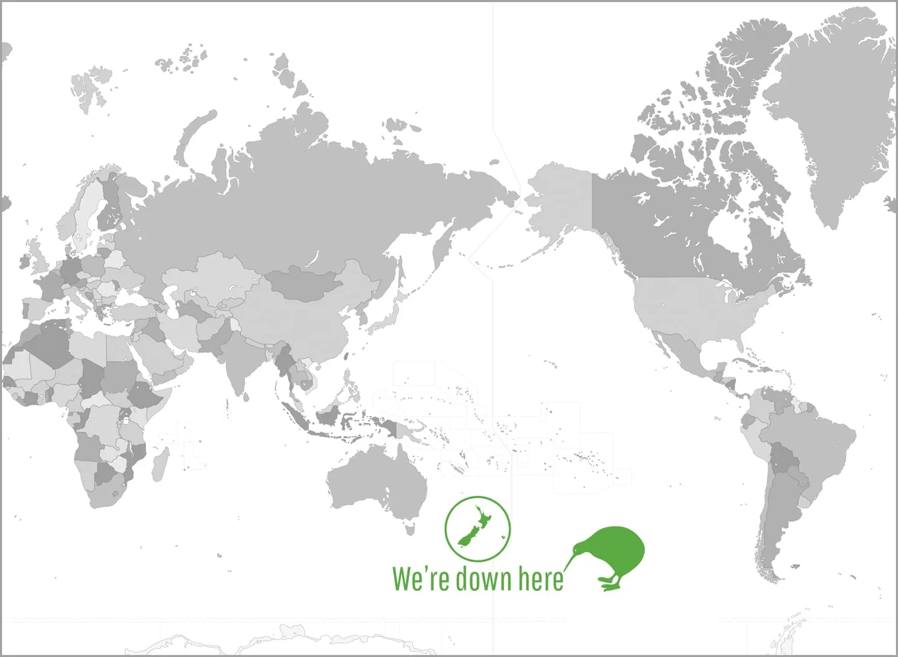
Which of these countries does NZ export lamb to? https://outthere.kiwi/wp-content/uploads/Where-is-new-zealand-world-map.jpg

Slide 3
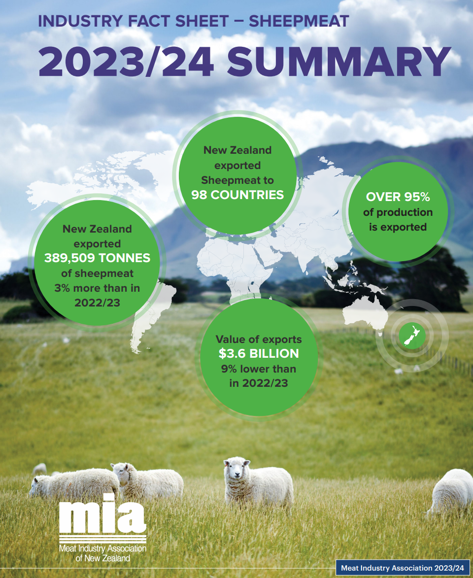
There are 195 countries in the world 98/195 = 50%
Why so many countries?
*Need both commodity and high value markets for different parts of carcass (somewhere for all the different parts of carcass)
*Sheep meat is not a common meat to eat, the consumers are in different countries across the globe
*Mitigate risk – ensure there is always a market, diverse markets

Slide 4
Meeting requirements
~23% of the world is Muslim
  Traditionally a group who enjoy sheep meat
  Require Halal slaughter
NZ requires all animals to be stunned prior to slaughter
  Stunning means the animal must be able to “revive” if left alone
  Has lead to research into this in New Zealand
Almost all NZ slaughter plants are certified Halal
  Allows access to these markets

Slide 5
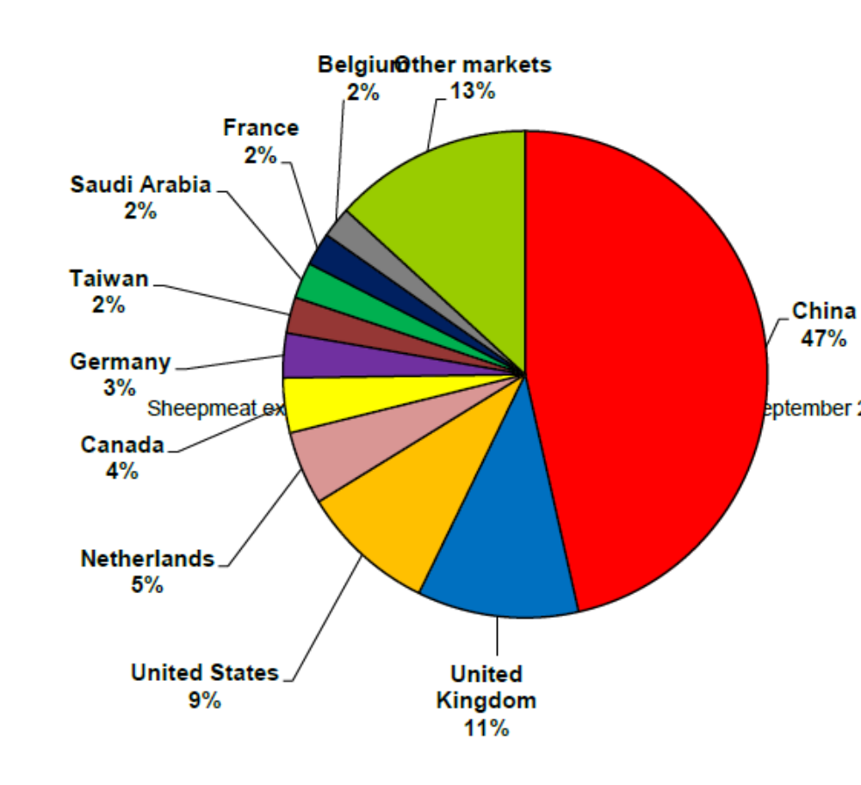
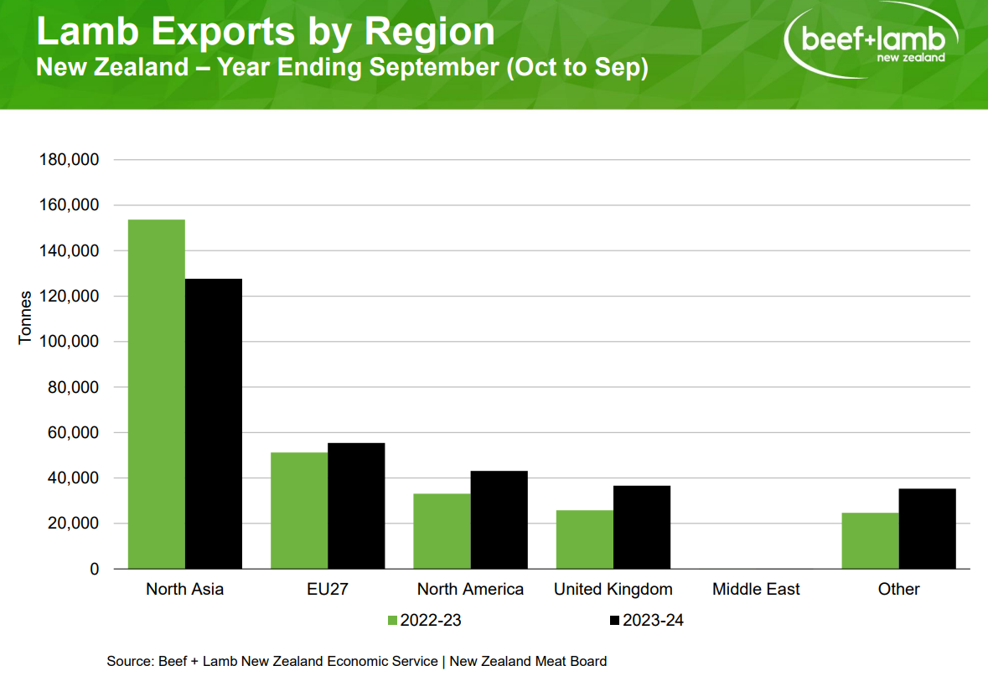
Markets by volume
Source: https://mia.co.nz/wp-content/uploads/2024/12/Red-meat-export-trends-in-selected-markets-up-to-September-2024.pdf

Slide 6
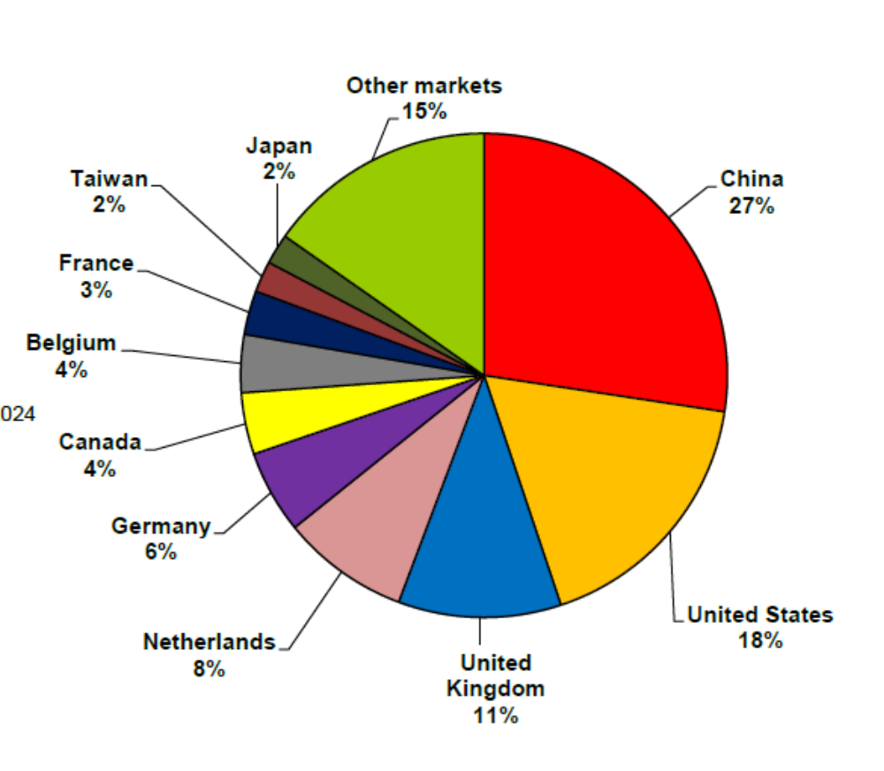
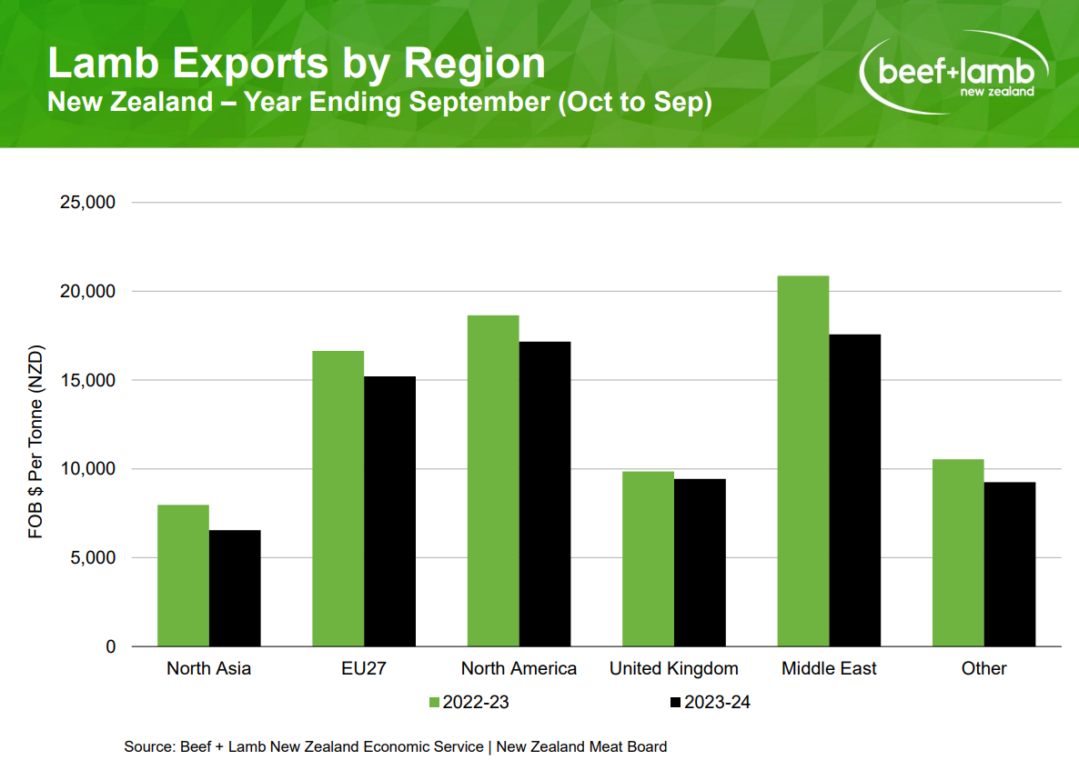
Markets by value
Source: https://mia.co.nz/wp-content/uploads/2024/12/Red-meat-export-trends-in-selected-markets-up-to-September-2024.pdf

Slide 7
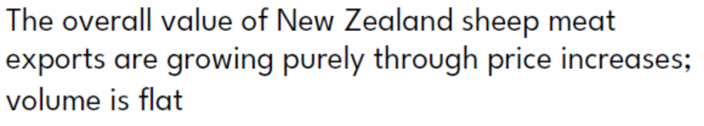
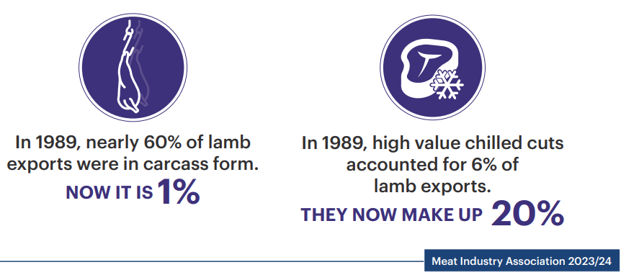
Value vs. volume… where to for NZ lamb?
“Value added”
(what does this mean for NZ lamb? )
PRODUCT DIVERSIFICATION The industry has made major improvements in adding value to our exports – cuts rather than carcasses and more chilled exports
Coriolis Report : Meat 2024 The Investors Guide to the New Zealand Meat Industry
MIA: Sheepmeat-Factsheet-2024.pdf
Sheepmeat-Factsheet-2024.pdf

Slide 8
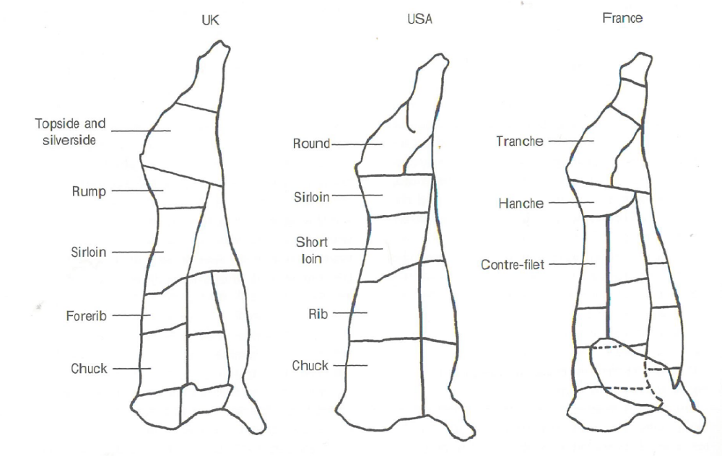
Different markets and countries prepare carcasses in different ways

Slide 9
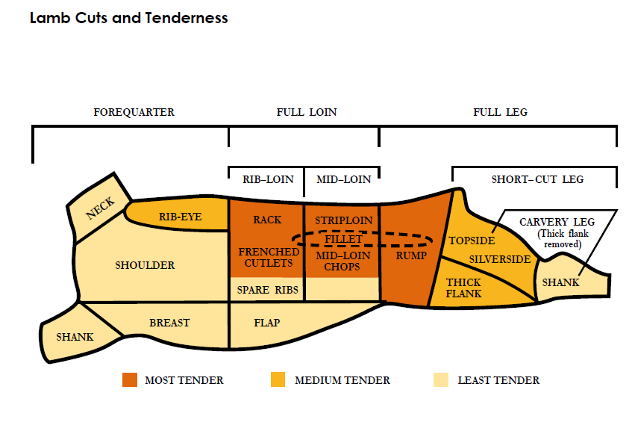
How the sheep carcass is divided
B+L NZ Reference Guide

Slide 10
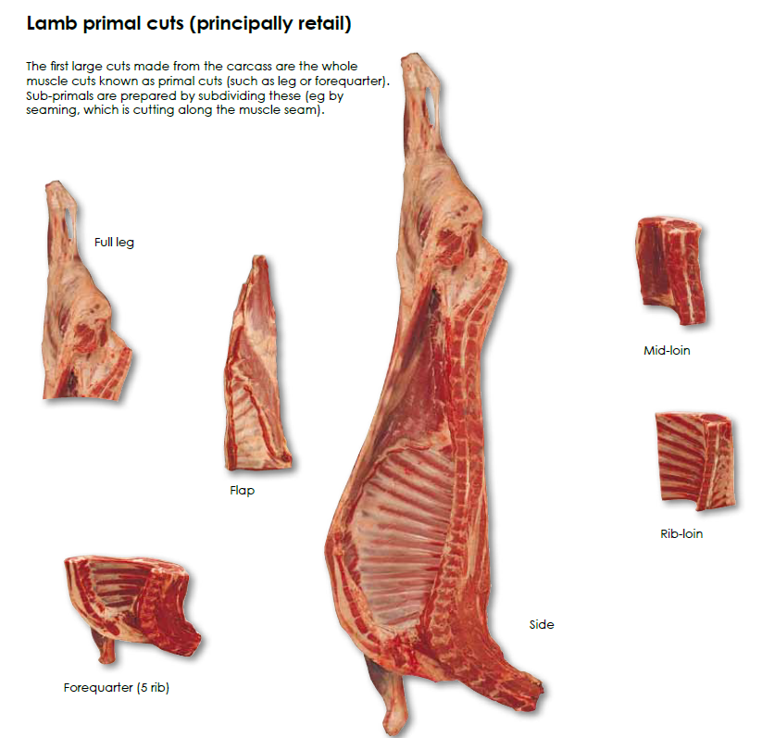
PRIMALS
B+L NZ Reference Guide

Slide 11
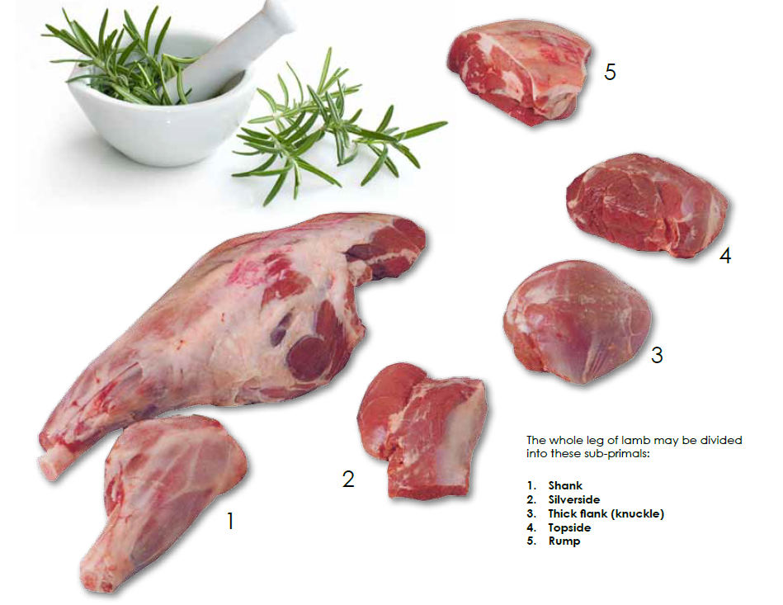
SUB-PRIMALS
B+L NZ Reference Guide

Slide 12
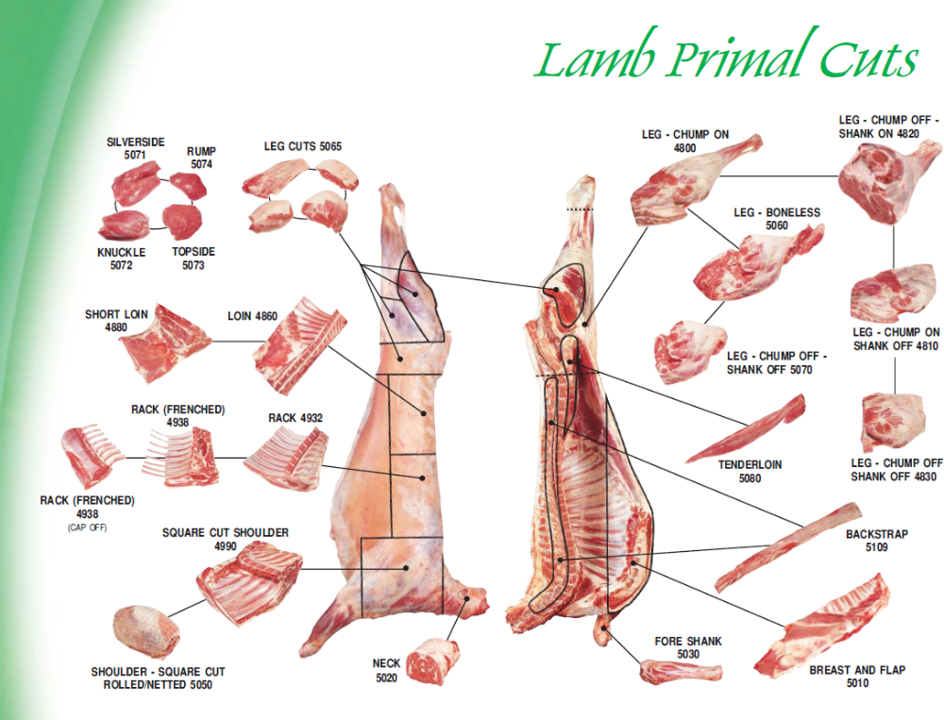

Slide 13
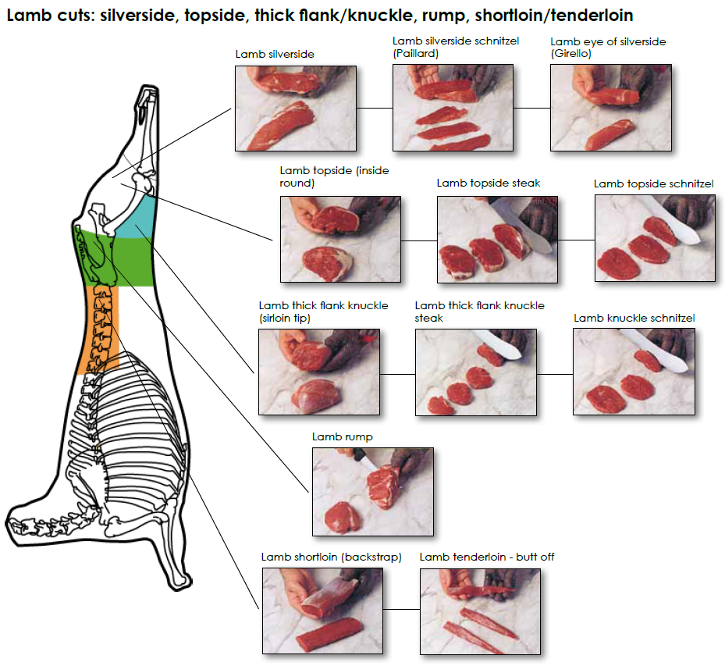
B+L NZ Reference Guide

Slide 14
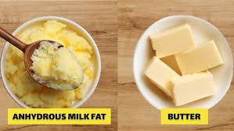
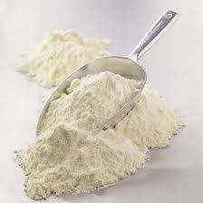
Dairy production
Dairy products are split into commodity and value-add streams
Core commodity products:
Whole and Skim Milk Powders
Butter, Butter Milk Powder, Anhydrous Milk Fat
Cheese can be in both categories

Slide 15
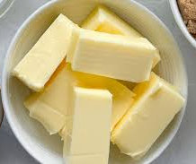
Farmers get paid on commodity price
Farmers are paid for milk fat and protein dependent on the value of there respective commodities
It also means that the Value-add products must cover this price to be economically viable
This often reflects a move from bulk product to consumer packaged

Slide 16
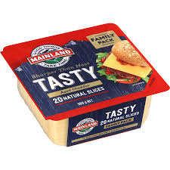
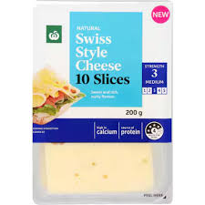
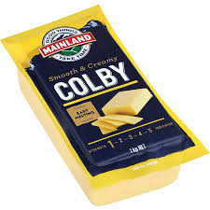
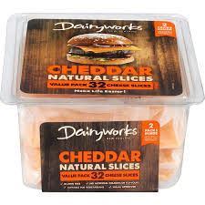
Value add opportunities
The first set of value-add propositions are repackaging bulk products
The “value” added to the company is in part through removal of agent operators

Slide 17
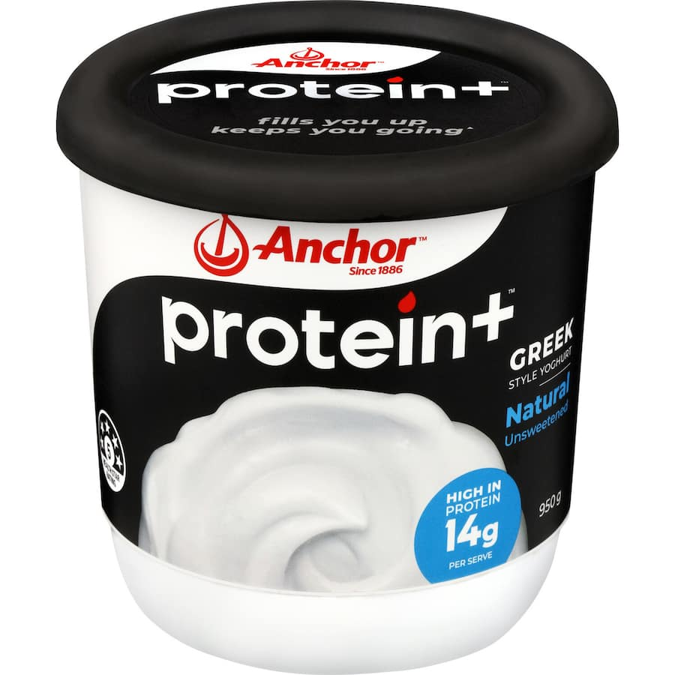
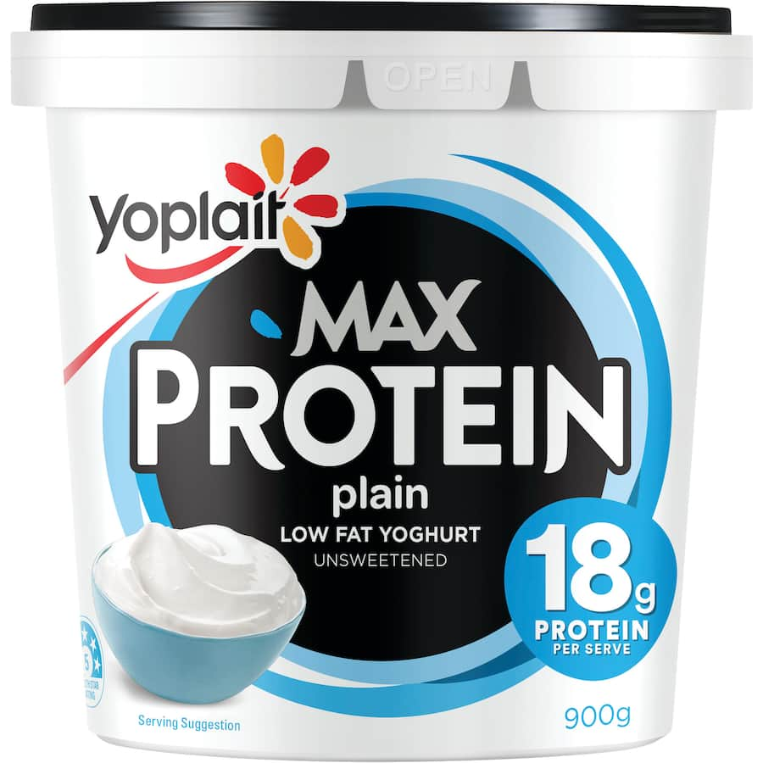
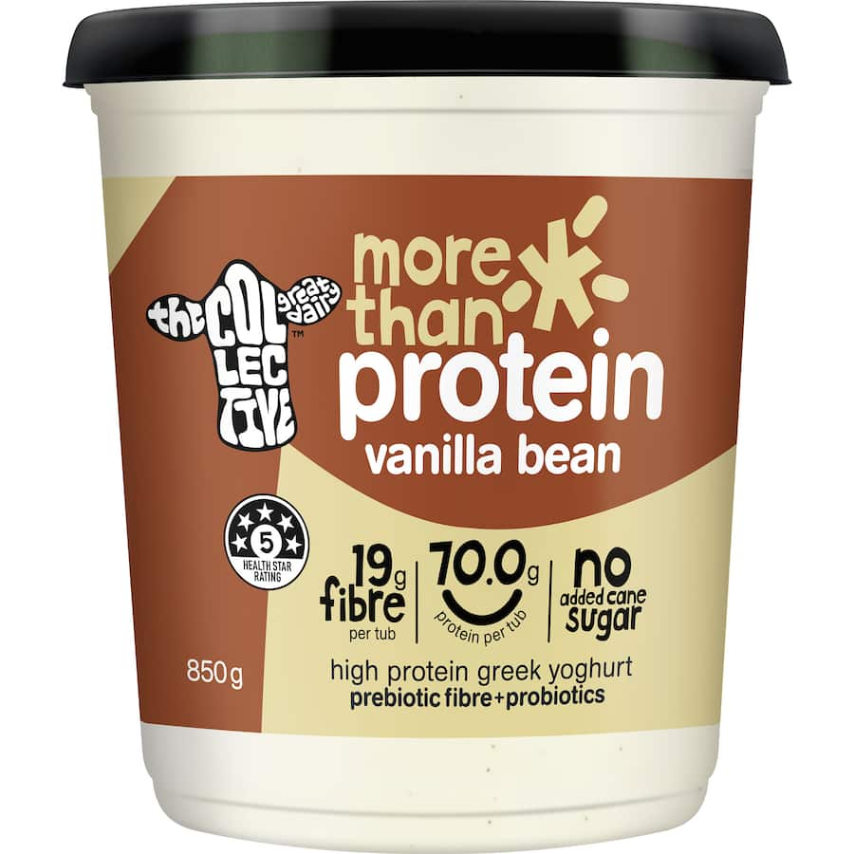
Modified formulations

Slide 18
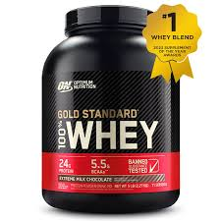
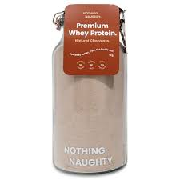
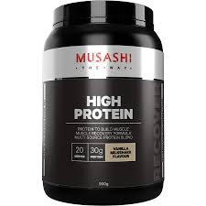
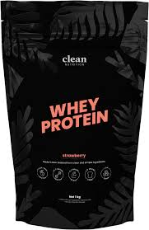
Upselling a by-product

Slide 19
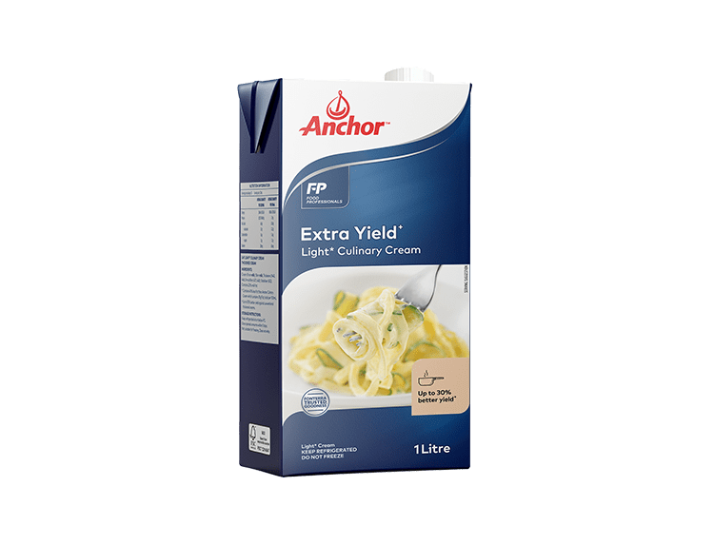
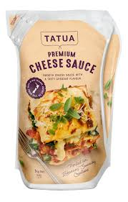
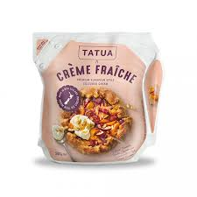
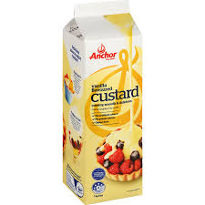
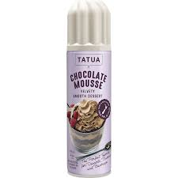
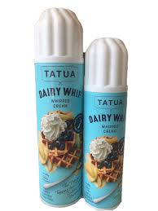
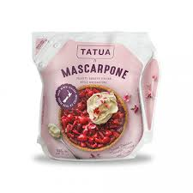
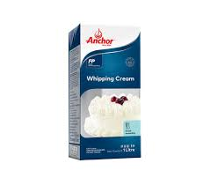
Making your product premium

Slide 20
Benefits of Value-add
Value-add increases the returns to the company above the commodity values
Can increase profits and dividends
Increases public good – seen as a company supporting local products
Greater utilisation of product produced
Less wastage if conducted on “waste” or “by-product” streams

