Slide 1
Mandarin production
Kerikeri

Slide 2
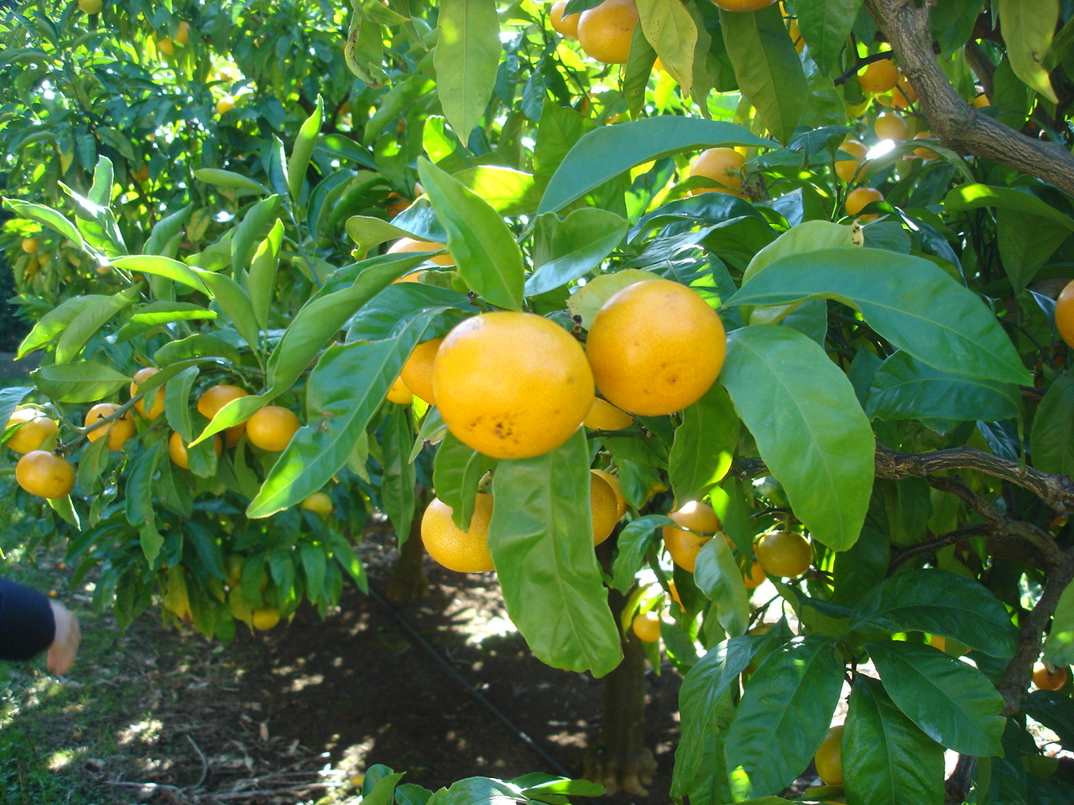
Kwan Orchard

Slide 3
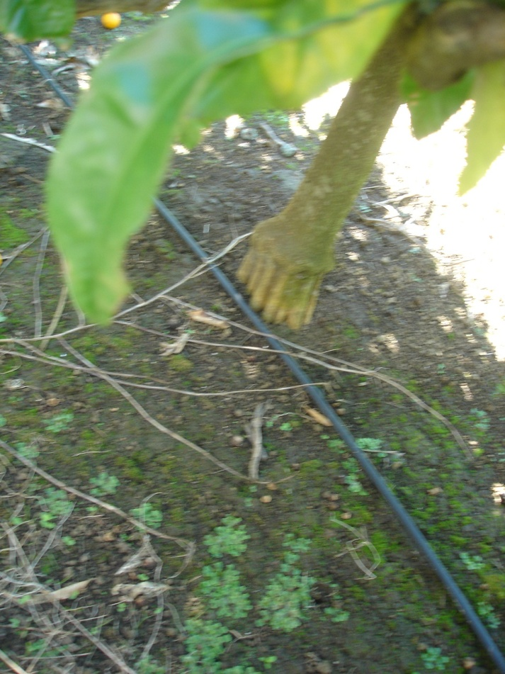
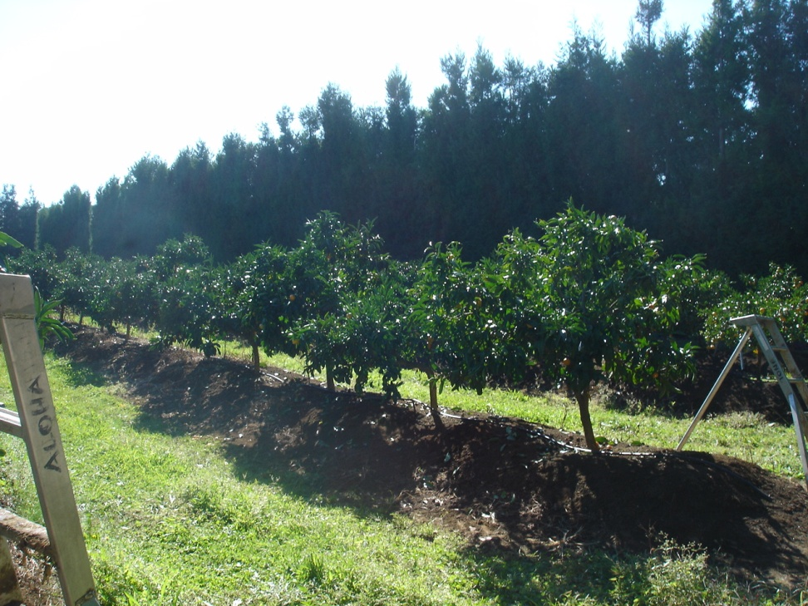
Management practices
Growing trees on Ridges for drainage to prevent root rot (phytophthora)
Trifoliata rootstock - wet feet tolerant, semi-dwarfing , disease resistant, cold hardy, low tree vigour, small fruit size

Slide 4
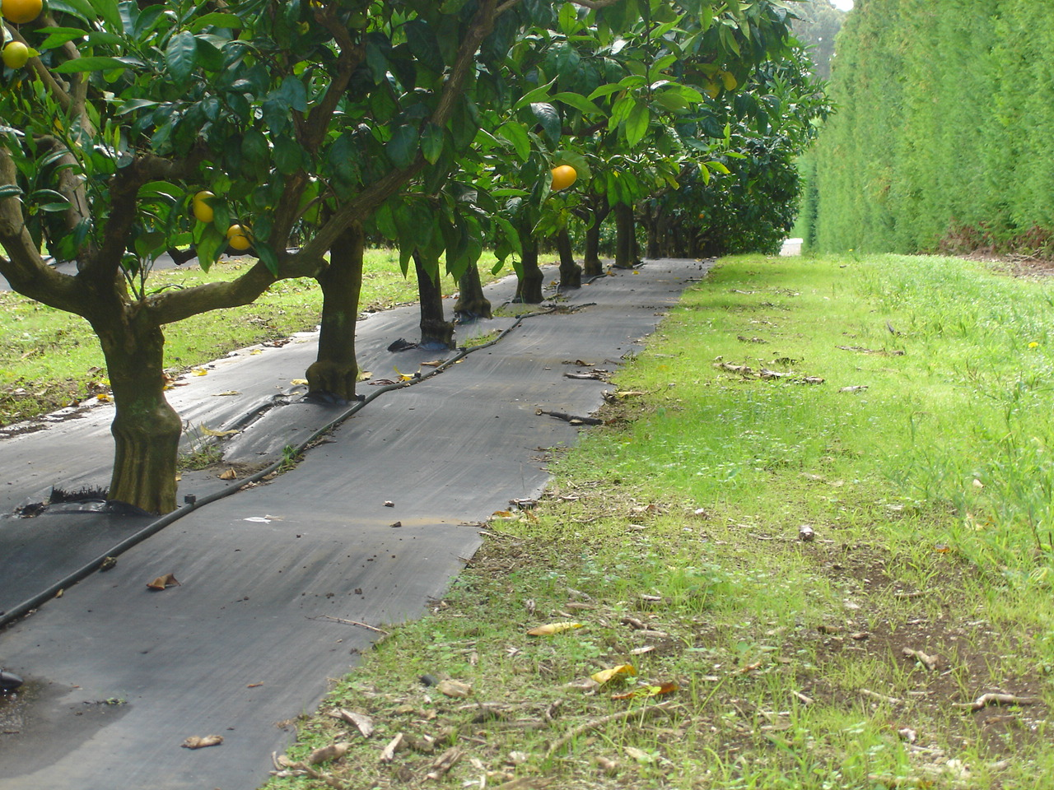
Weed control using weed mat
This is removed in April as the dark soil absorbs and stores the sun’s heat which reflects back into the tree and increases the rate of sugar build up and ripening.

Slide 5
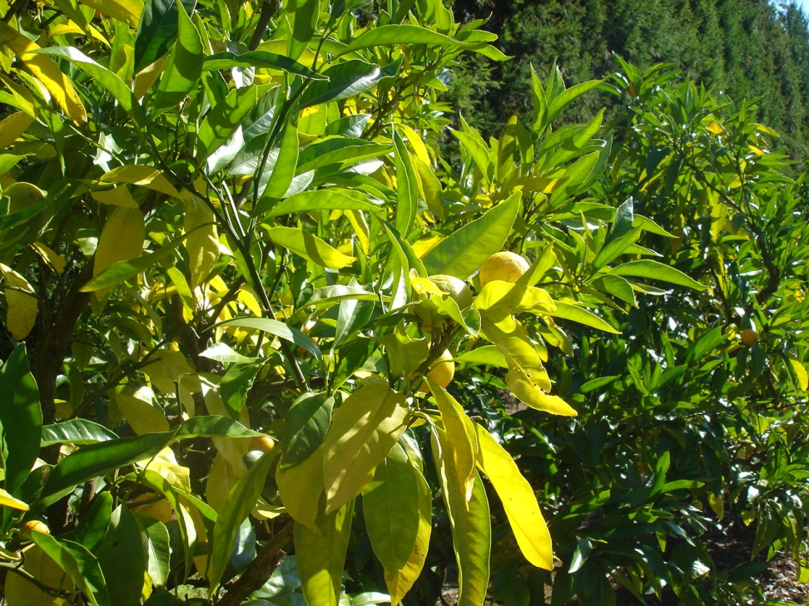
Management practices
Nitrogen stressing
Effect on crop
Not adding nitrogen stresses the tree which pumps sugar into the fruit making it sweeter
The same effect is gained from reducing irrigation after December through “deficit “ irrigation. Trees are allowed to dry out and then flooded with 70KPa Jan-end March.

Slide 6
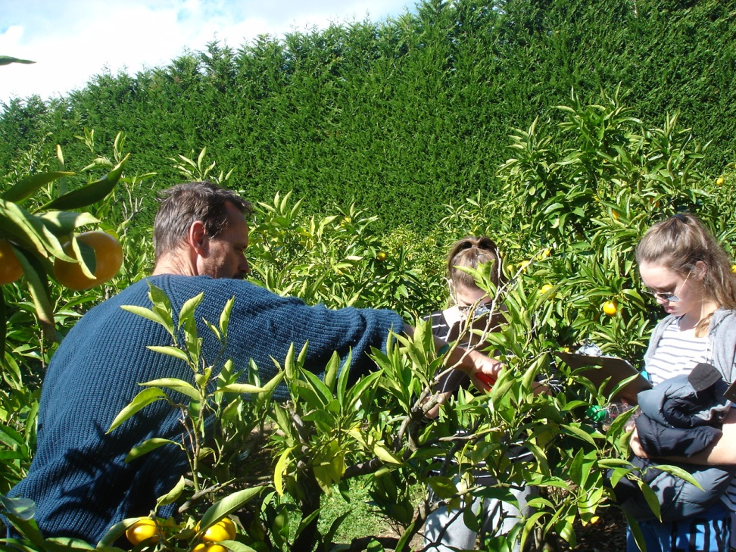
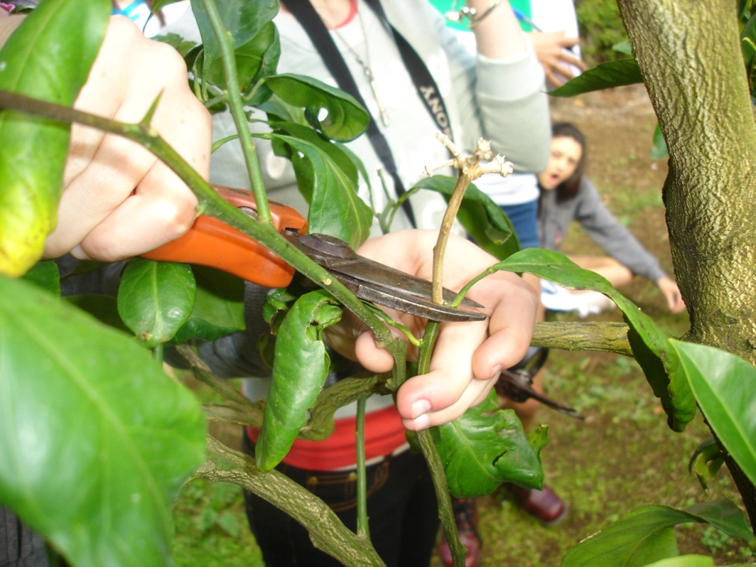
Pruning
Gaining a “Y” shape and easy access for the picker and light for photosynthesis
Pruning away dead wood to reduce Glomerella infection, reduces whitefly attack

Slide 7
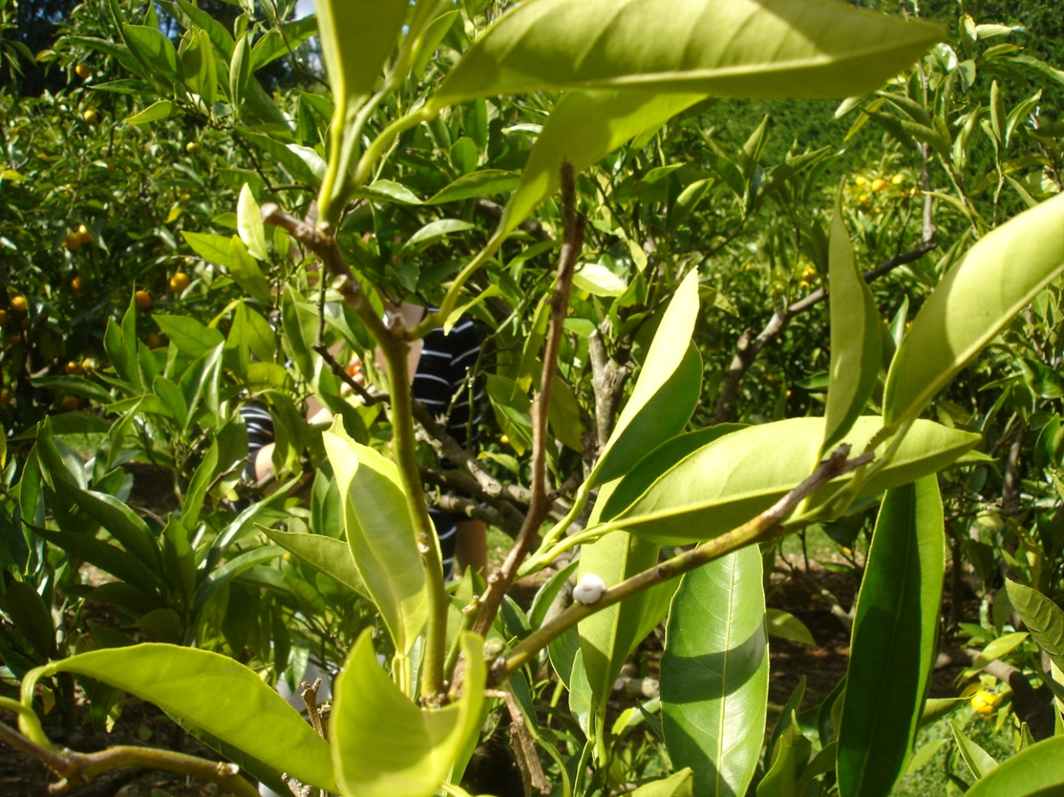
Pests
Waxy scale can infect the tree and leave wounds for Glomerella to get in.
Control: which suffocates it and Movento which is systemic and travels through the plant.
Thrips and Australian whitefly also a problem attacking leaves and reducing photosynthesis, scaring skins and causing sooty mould.
Soft spray Ovation stops insects moulting and they die.

Slide 8
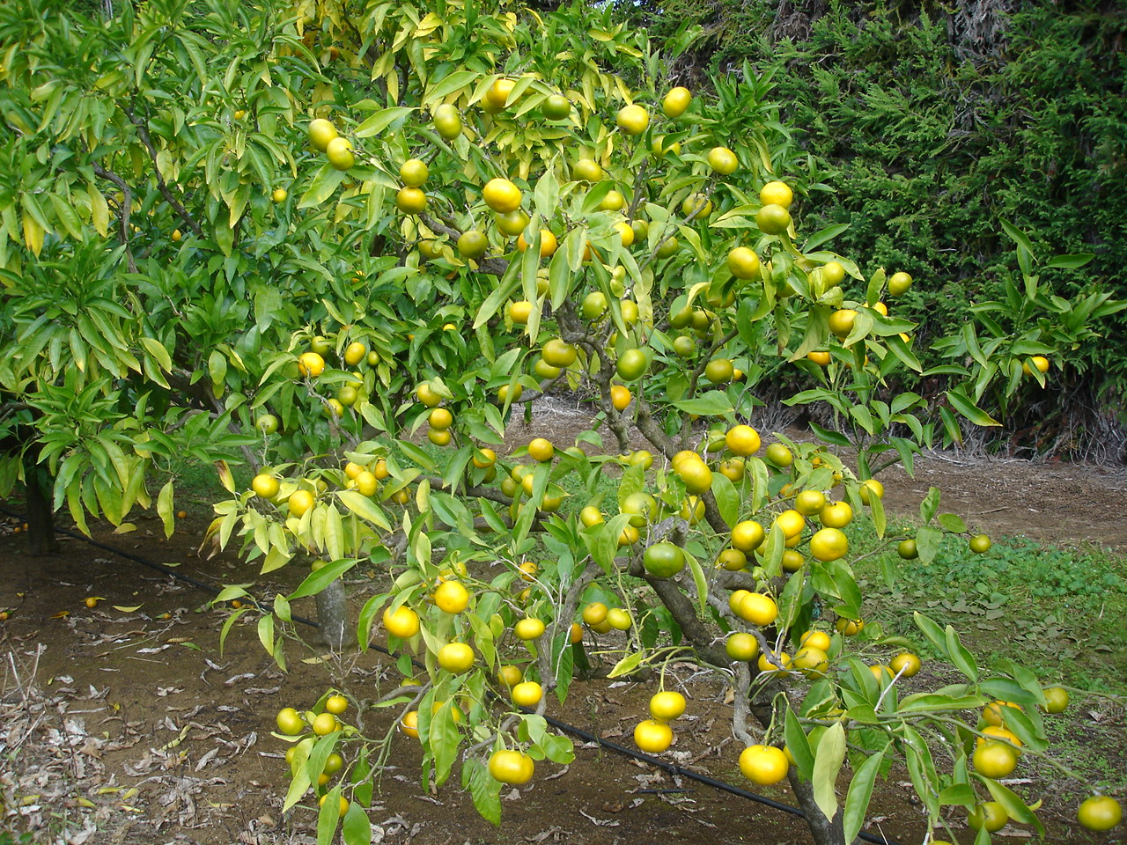
Controlled thinning
Reasons for thinning:
Quality: To ensure the fruit is the right size - small for export – 48mm – 63mm diameter
Larger for local NZ – 65mm – 75mm
Quantity: Stop biennial bearing which can cause large crops and lower prices. Then not enough crop the next year.
Prices: Large volumes - lower prices $1-3.50/Kg
Smaller volumes higher prices $3.50 - $4-5.00/Kg (Export)

Slide 9

Thinning
GA sprayed June/July – Inhibits flower bud formation
NAA applied December thinning fruitlets. Easier to assess the crop load than GA. And how much to apply.
Fruit is hand thinned Jan – Early Feb
2-3 fingers apart (1:25 fruit to leaf ratio)

Slide 10
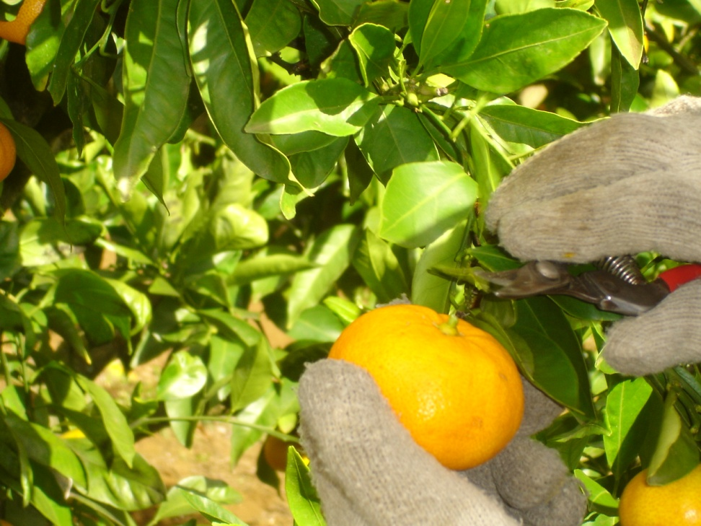
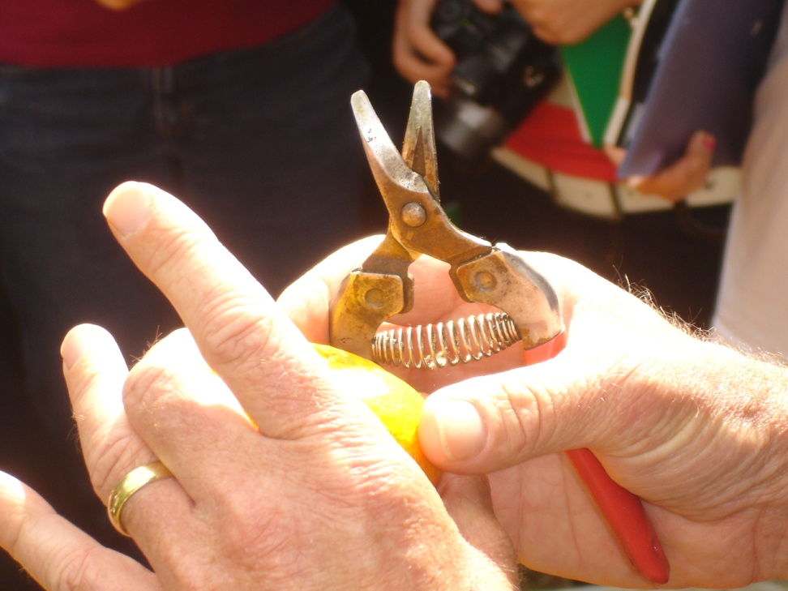
Harvesting
Export April – May Double - click method
Stalk removed to leave a flat button to stop the skin being pierced in the crate

Slide 11
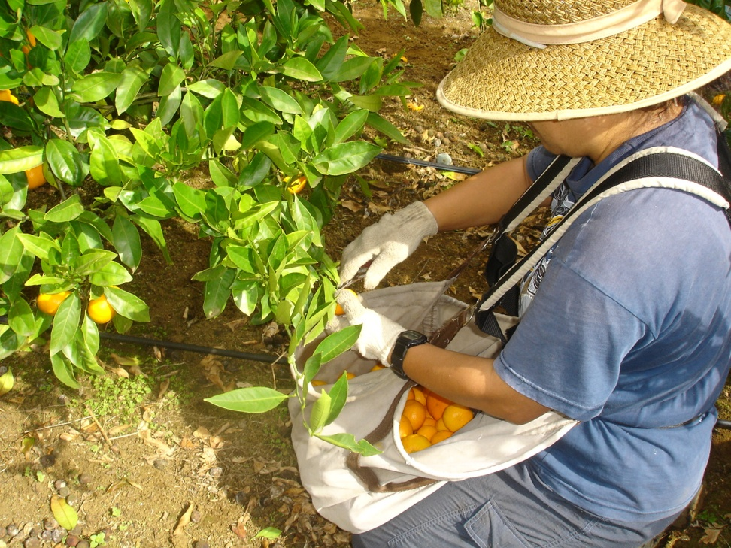
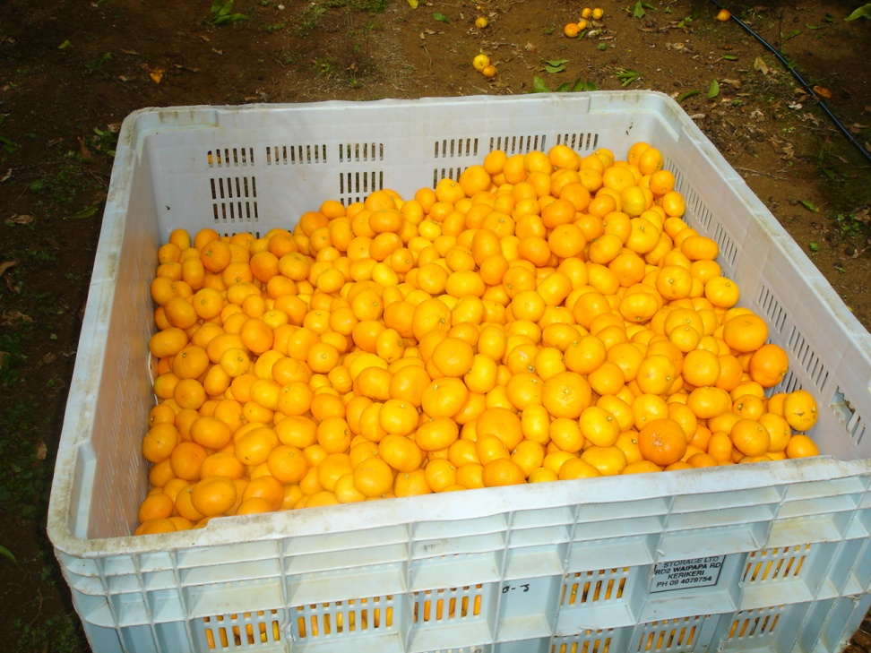
Harvesting
Pickers wear gloves to protect the fruit
Fruit is removed from the block in large bins to be sent to the packhouse

Slide 12
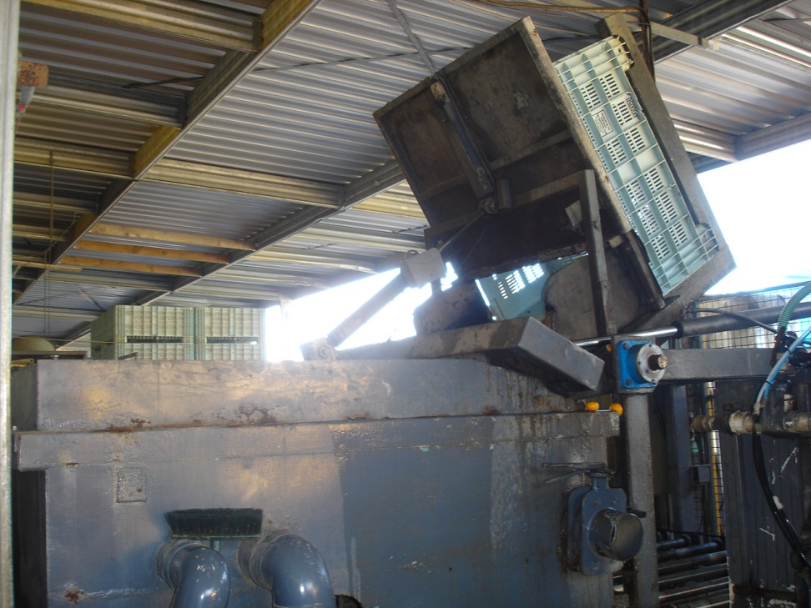
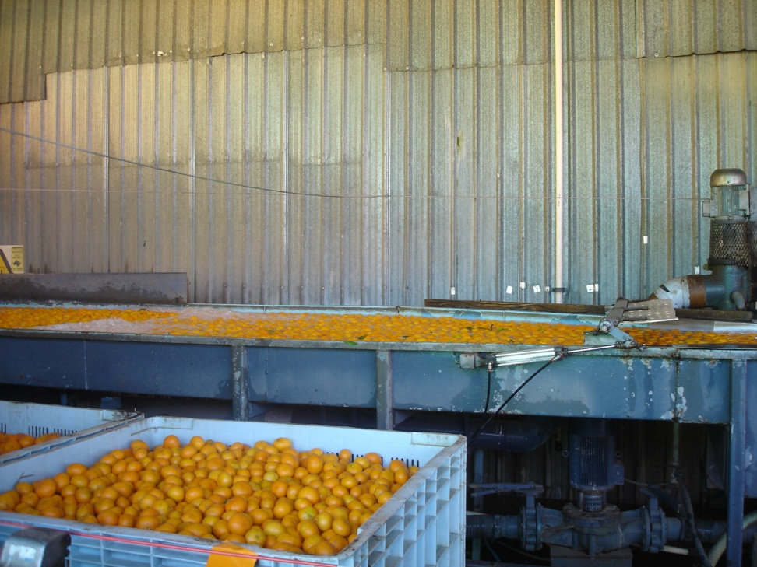
At the Packhouse
The mandarins arrive in their field bins
They are washed in chlorinated water sterilize the skins and the fruit float to the surface

Slide 13
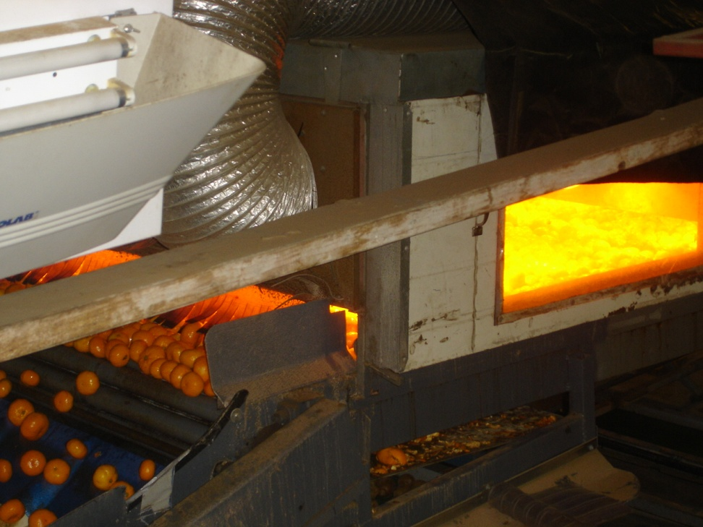
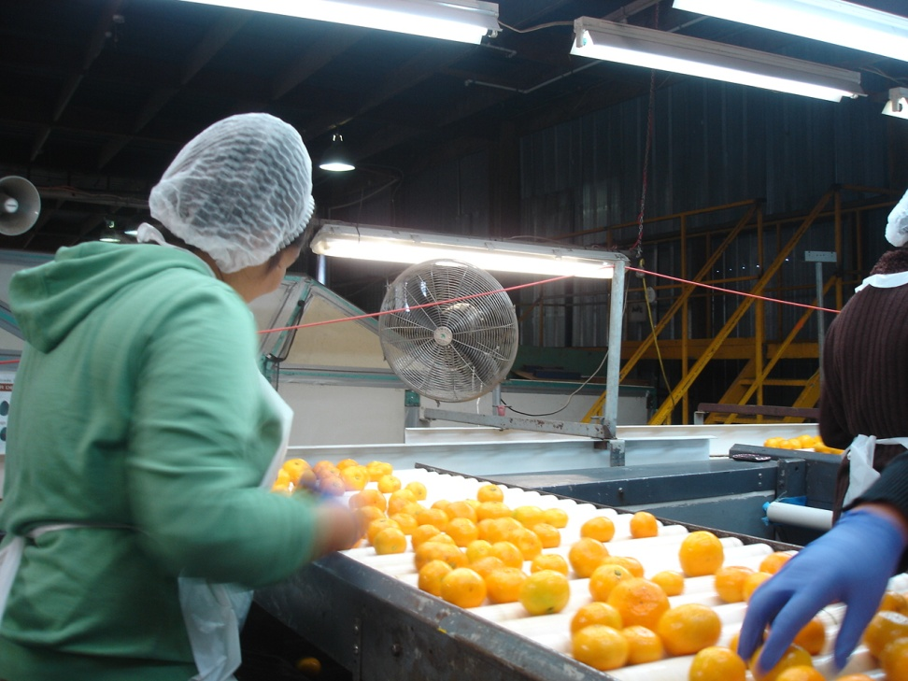
Fruit preparation
The mandarins are dried and waxed to make them shiny and seal the skins from disease
They are then hand sorted to remove fruit with obvious defects e.g. bird pecks and marked skins

Slide 14
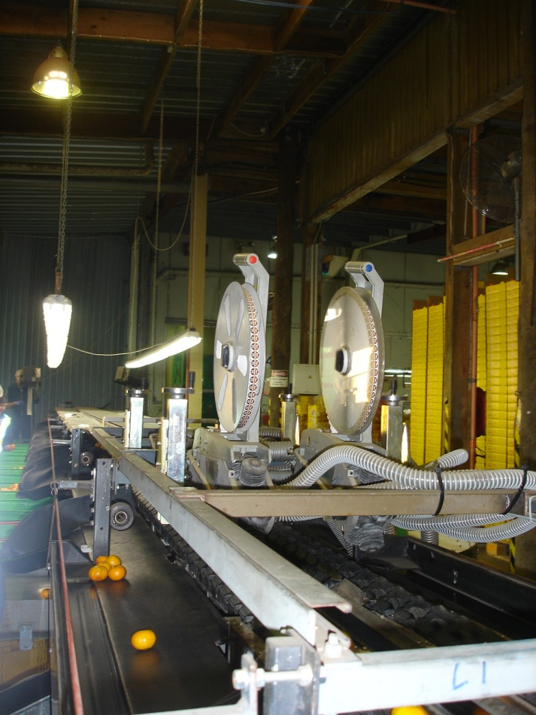
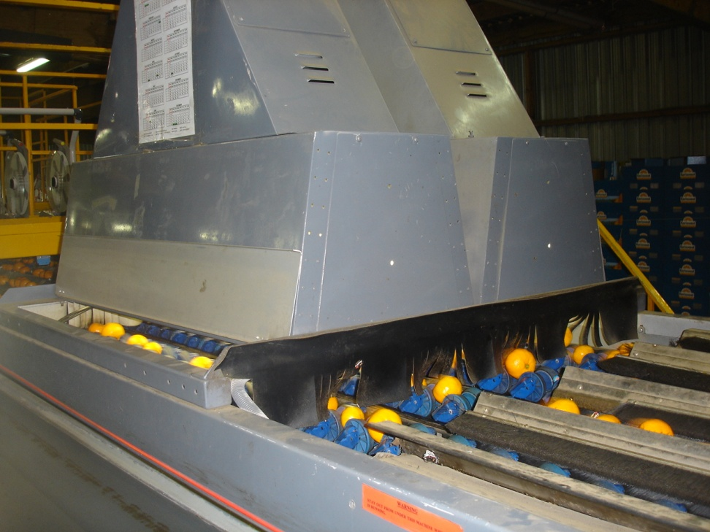
Grading
The fruit is scanned and weighed by computer. Stickers are automatically applied to the fruit
The weighing cups tip the correct size fruit into the right box ensuring that each box has uniform size fruit

Slide 15
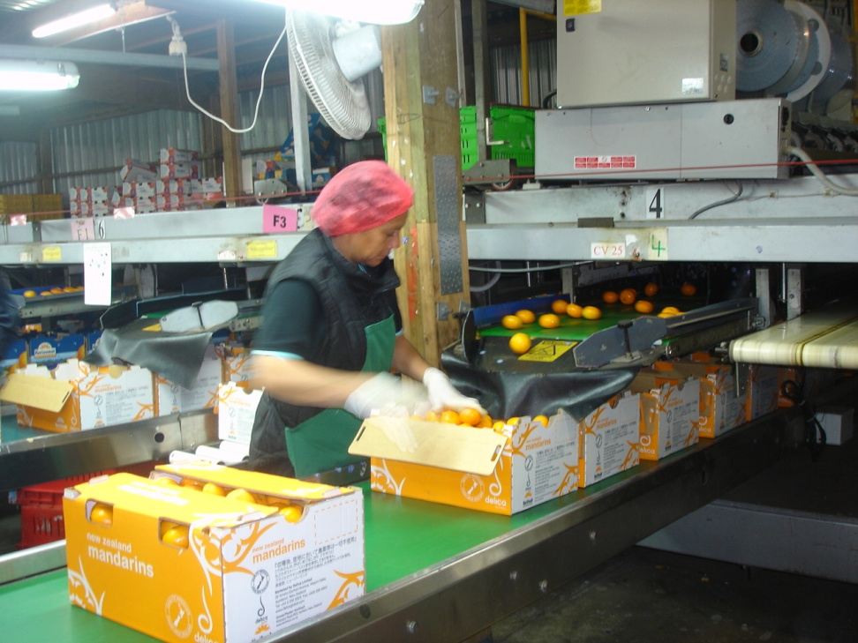
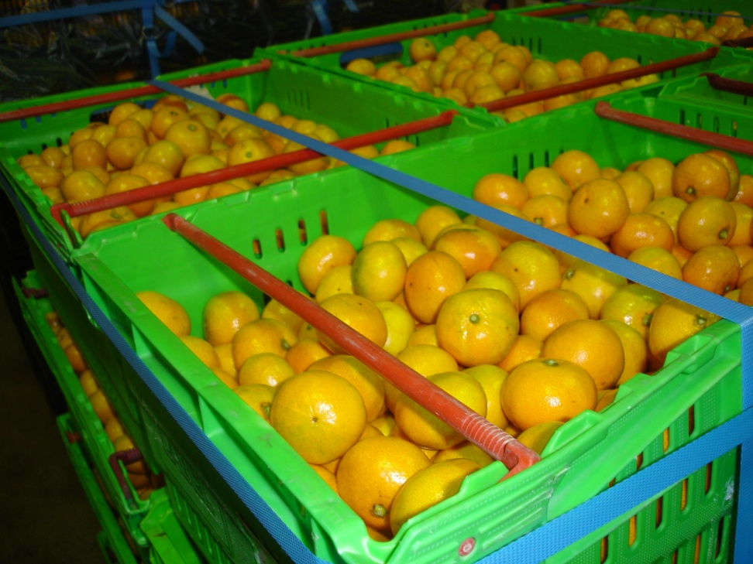
Packing
Uniform size mandarins are packed into the same box for export
Local fruit going to supermarkets may be sent in bins

Slide 16
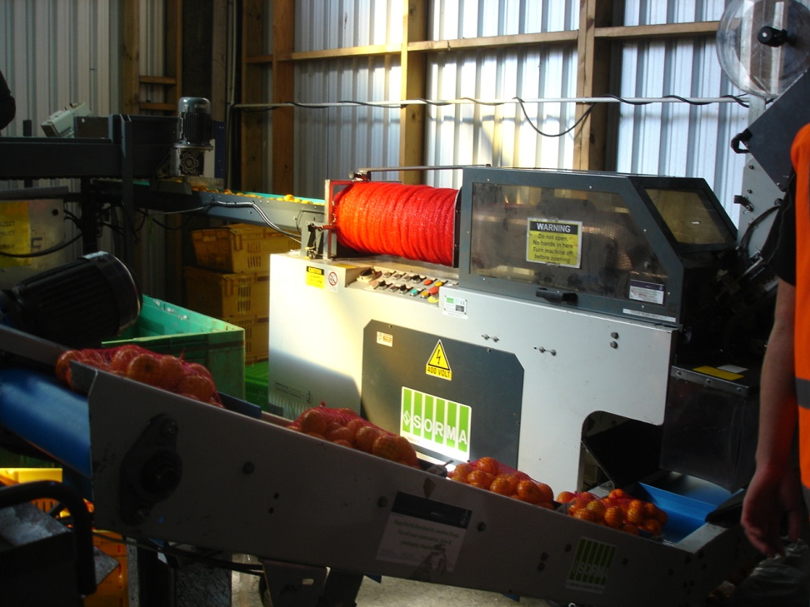
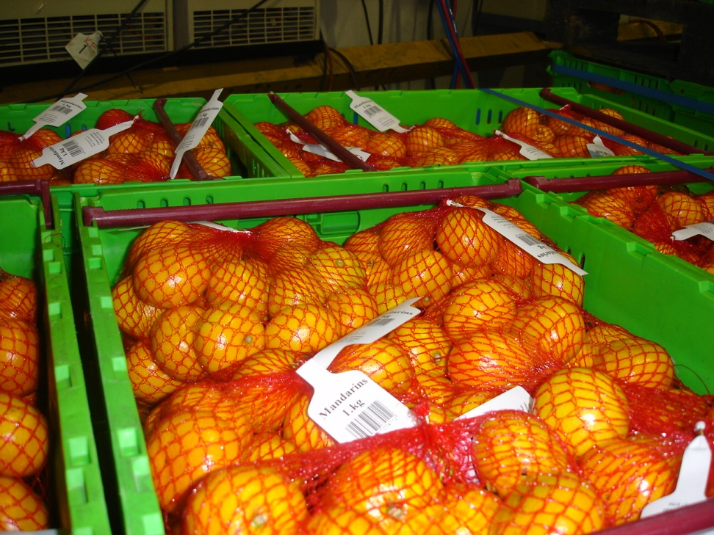
Packaging
Some fruit are packed in net bags
These hold approximately 1 Kg of fruit

Slide 17
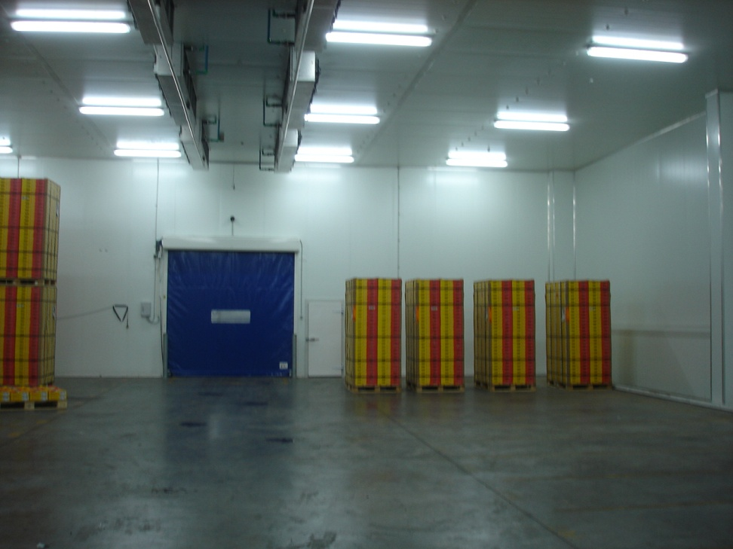
Storage and Transport
Mandarins are stored briefly to get their temperature down to 7°C
Transport
Export mandarins picked in mid April are flown to Japan and get on to the shelves in 48hours to gain the early high prices
Mandarins picked from early to mid May are sent sea freight which takes 12-13 days. These fruit are picked with lower brix so that they can finish ripening in transit.

