Slide 1

Toblerone

Slide 2
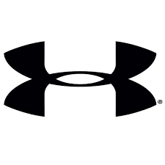
Under Armour

Slide 3

ENZA – exporting premium pip fruit

Slide 4

Liverpool Football Club

Slide 5

Banana’s

Slide 6

Rolls Royce

Slide 7

Xbox

Slide 8

Hewlett Packard

Slide 9

Mizuno

Slide 10

Wools of New Zealand is a sales and marketing company owned by New Zealand sheep farmers

Slide 11

NZ Herald

