Slide 1


Slide 2


STEEPLE ANALYSIS
Conscious Valley
Level 2
Future Proofing Influences

Slide 3

Teachers Note:
Level 2: Future Proofing Influences
This power point is STEEPLE analyse activity based on “Conscious Valley”.
Conscious Valley is a premium, ethical red meat brand based on a family farm in the Ohariu Valley, just outside Wellington, New Zealand. Founded by Hamish Best, it focuses on producing local, sustainable, and high-quality lamb and beef that reflect strong values around animal welfare, environmental responsibility, and transparency.
Rather than exporting meat, Conscious Valley aims to supply the Wellington region directly through farmers’ markets, restaurant partnerships, and soon, an online sales platform. The business uses licensed processors and butchers to ensure food safety and traceability, while its local model reduces food miles and supports conscious consumption.
Resources
Link to Country Calendar episode on Conscious Valley https://www.tvnz.co.nz/shows/country-calendar/episodes/s2025-e26
Link to “Conscious Valley” website
PDF article
This activity can be used as prior learning for the Level 3 worksheet on Future Proofing Strategies base on “Conscious Valley”.

Slide 4
Activity 1
Read the PDF article “Conscious Valley”. Use this article to help you answer the questions.
What is a STEEPLE Analysis?
Why would an agribusiness like Conscious Valley carryout a STEEPLE Analysis?
Divide the class into 7 groups. Give each an influence. Using the article, “Conscious Valley”, each group identifies and describes the influence impacting Conscious Valley.
Then; bring the class back together to discuss the influences impacting Conscious Valley

Slide 5
Activity 2
Divide the class into groups. Allocate each group one STEEPLE influence. Each group is to use their influence to answer the questions below.
Then, bring the class back together to discuss their answers.
Describe the short and long term impacts on Conscious Valley.
Using the influence you have discussed in your group, explain the impact beyond the business e.g. on the local community.
What are the consequences of these impacts on the business?
Using these consequences, explain how each consequence might affect the viability of the business.

Slide 6
Answers to Questions 1-3
Activity 1
NOTE: Answers are a guide, there are other answers.

Slide 7
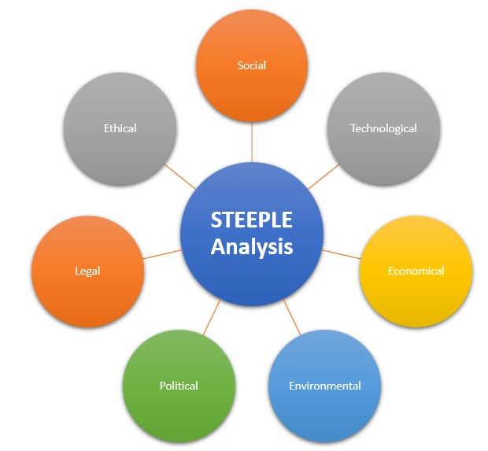
1. What is a STEEPLE Analysis?
A STEEPLE Analysis is a strategic planning tool used by businesses to analyse external factors that can impact their business.
It helps businesses identify opportunities and threats in their environment and prepare strategies to stay competitive and sustainable
The acronym stands for:
S – Social
T – Technological
E – Economic
E – Environmental
P – Political
L – Legal
E – Ethical

Slide 8
2. Why would an agribusiness like Conscious Valley carryout a STEEPLE Analysis?
Conscious Valley would use a STEEPLE analysis to:
Understand external influences that affect the farming and meat retail business.
Plan for the future by identifying risks (e.g. climate change, market shifts).
Stay aligned with consumer expectations (e.g. ethical and sustainable food).
Adapt to changes in law, technology, or market demand.
Make strategic decisions about investment, production, and marketing.
Help ensure long-term business viability and competitive advantage.

Slide 9
3. Make a list of the future proofing influences impacting Conscious Valley using STEEPLE
S – Social
T – Technological
E – Economic
E – Environmental
P – Political
L – Legal
E – Ethical

Slide 10

Social Influence
Growing demand for ethical, local, traceable and sustainable food.
Growing customer loyalty built through direct relationships, storytelling, fostering trust.
Demographic shift toward conscious consumption and sustainability.

Slide 11

Technological Influence
Need for e-commerce and online sales platform.
Use of social media marketing to boost brand visibility and customer engagement and reach.
Need to investment in cold chain and storage tech to ensure food safety and freshness of meat products.

Slide 12

Economic Influence
Fluctuating meat schedule prices.
Rising processing and butchery costs.
Limited land restricts production scale.
Consumer spending trends as meat is a premium product.
Logistics and cold chain costs for direct sales, markets and delivery.

Slide 13

Environmental Influence
Climate change and sustainability concerns drive consumer choices.
Need for sustainable practices to meet the needs of environmentally conscious consumers.
Introduction of lucerne improves sustainability and productivity.
Impact of climate change on production e.g., droughts.
Local distribution minimises food miles and reduces carbon footprint.
Involvement in Capital Kiwi Project strengthens environmental commitment.

Slide 14

Political Influence
The need to meet and follow strict meat processing and food safety regulations.
Potential regulatory changes in agriculture and environment e.g., emissions standards, land use regulations.

Slide 15

Legal Influence
Must comply with meat processing regulations including food safety, licensing, and traceability.
Need for licensed abattoir and butchers.
Need to understand and comply with food labeling and transparency laws for marketing meat products.
Strictly follow animal welfare legislation that aligns with brand values to avoid reputational risk.

Slide 16

Ethical Influence
Commitment to;
Animal welfare regulations.
Meeting environmental regulations and standards.
Transparency and traceability in production.
Promoting conscious consumption.

Slide 17
Answers to Questions 1-4
Activity 2
Describe the short and long term impacts on Conscious Valley.
Using the influence you have discussed in your group, explain the impact beyond the business e.g. on the local community.
What are the consequences of these impacts on the business?
Using these consequences, explain how each consequence might affect the viability of the business.
NOTE: Answers are a guide, there are other answers.

Slide 18
Social Influence
Short and long-term impacts on Conscious Valley.
Short-term:
  Selling directly at markets and to local restaurants is building a loyal customer base and raising brand awareness.
  Balancing farm operations with weekly market sales and logistics is demanding on Hamish and Caroline’s time.
Long-term:
  Opportunity to build a strong, loyal customer base that values transparency and supports local businesses.
  Wellingtonians may adopt Conscious Valley as their local premium red meat brand.
Impact beyond the business:
  Keeping meat production, processing, and sales local supports nearby businesses strengthening the local economy.
  Builds a community food culture where people care about where their food comes from.
  Hamish’s weekly market presence creates community bonds and inspires others to support local producers.
  Encourages other producers to adopt similar ethical practices.

Slide 19
Social Influence
Consequences on the business:
  Loyal customers will continue to buy and recommend Conscious Valley meat strengthening brand reputation.
  Ethical, traceable, local meat distinguishes Conscious Valley from mass-produced alternatives which is a point of difference and builds resilience.
  Risk if values are not maintained e.g. supply issues or lack of transparency.
Effect on viability:
  Customer Loyalty builds a stable revenue base; loyal customers can offset fluctuations in broader market prices leading to stronger cash flow and market confidence which will help the business grow and thrive.
  If Hamish cannot supply meat regularly, he risks losing restaurants and customer trust this will damage brand reliability and hurt long-term sales and relationships negatively impacting revenue limiting opportunities to scale the business and its long term viability.

Slide 20
Technological Influence
Short and long-term impacts on Conscious Valley.
Short-term:
  Investment pressure for setting up an online store, managing social media professionally, and upgrading cold storage requires upfront capital and time.
  Improved brand awareness: Social media posts featuring the farm, animals, or farmers' markets can build emotional connection and trust increasing brand awareness and reaching more local and regional customers.
Long-term:
  E-commerce enables year-round sales, broadening the reach beyond the local farmers market to subscription boxes, home delivery, and pre-orders.
  With a stronger digital presence, Conscious Valley could become a well-known, trusted brand, both locally and nationally.
  Cold chain tech supports compliance with food safety laws and extends shelf life ensuring product quality.

Slide 21
Technological Influence
Impact beyond the business:
Makes local, quality meat accessible to more consumers, including those who cannot attend the market.
Expansion could create roles in logistics, digital marketing, delivery, or butchery, supporting local employment.
Consequences on the business:
Online selling will expand the customer base and improve retention. Email newsletters, order history, and personalised promotions will help build stronger relationships and brand recognition, ultimately increasing sales and improving the business's viability.
High capital and operational costs managing -commerce platforms, refrigeration, delivery logistics, and digital marketing all cost money and require ongoing management which if not managed well could put financial pressure on the business limiting scalability and or viability.
Effect on viability:
Investment in technology is essential for Conscious Valley’s growth, visibility, and efficiency, but they come with costs and complexities. If managed well, they enhance the brand, increase revenue, and make the business more scalable and resilient. However, without proper planning, the technology requirements could strain the small team and affect the business’s long-term viability.

Slide 22
Economic Influence
Short and long-term impacts:
Short-term:
  Unstable meat schedule prices and rising processing, butchery, and logistics expenses reduce the profitability of selling to Conscious Valley from the farm.
Long-term:
  Financial pressure if Conscious Valley cannot charge enough to cover processing and retail costs.
  Without more land, increasing supply to meet growing demand is limited.
  If red meat becomes too expensive for consumers during economic downturns, demand could drop.
Impact beyond the business:
  If premium prices rise further, some locals may be priced out of buying locally-sourced meat.
  If the business grows despite economic pressures, it could support local jobs e.g. butchers, delivery, logistics. However, if it struggles, these potential opportunities might not occur.

Slide 23
Economic Influence
Consequences on the business:
  Risk to profitability and long-term sustainability of the direct-to-consumer model.
  Rising costs and fluctuating prices make it harder to maintain healthy margins.
  With limited land and economic pressure, meeting growing demand consistently may be difficult.
Effect on viability:
  Economic pressures present real challenges for Conscious Valley from cost increases to scaling limitations. However, with the right strategies (e-commerce platform, social media marketing, diversifying products, improving efficiency, targeting high-value customers), the business can remain viable and resilient.

Slide 24
Environmental Influence
Short and long-term impacts:
Short-term:
  Consumers are increasingly choosing products that reflect their environmental values, so Conscious Valley’s local, low-impact model aligns with demand.
  Investment in lucerne helps maintain productivity during dry periods and improves soil health.
  The story of local meat with low food miles and sustainable practices is a strong selling point.
Long-term:
  Sustainability focus builds a loyal customer base that values Conscious Valley as an environmentally responsible producer..
Impact beyond the business:
  Conscious Valley promotes the idea of low-carbon, sustainable food systems, encouraging the community to think more about what they eat and where it comes from.
  Supports regional biodiversity and contributes to local environmental health, e.g. involvement in Capital Kiwi Project.

Slide 25
Environmental Influence
Consequences on the business:
  Environmentally conscious consumers are more likely to stick with brands that reflect their values.
  As a sustainable brand, any perceived slip (e.g. lack of transparency, missed environmental claims) may lead to loss of customers.
  Staying ahead of environmental challenges may require continued investment in infrastructure, technology, or land management.
Effect on viability:
  Environmental factors are a core strength and challenge for Conscious Valley. The brand's identity aligns with consumer demand for local, sustainable food, providing market advantage and long-term loyalty. However, climate risks and the cost of ongoing environmental improvements must be carefully managed to maintain the business’s viability and trust.
  Ensures Conscious Valley remains environmentally compliant and resilient, is essential for long-term business success.

Slide 26
Political Influence
Short and long-term impacts:
Short-term:
  Ensuring all meat is processed and butchered legally requires working with licensed facilities, which adds expense and logistical steps.
  Tracking regulations, ensuring food safety, and maintaining traceability requires time and effort, especially for a small team.
Long-term
  Exposure to policy changes e.g., environmental laws could introduce new costs or restrictions (e.g., land use limits, methane targets).
Impact beyond the business:
  Strict regulation ensures the local community receives high-quality, safe meat products.

Slide 27
Political Influence
Consequences on the business:
  Already sustainable practices may position Conscious Valley well as environmental expectations tighten.
  Compliance with food safety and environmental rules adds to processing, logistics, and operational expenses.
  Sudden changes in regulation (e.g., a new emissions cap or restricted land use) could force unexpected changes in farming operations.
Effect on viability:
  Political influences present both challenges and opportunities for Conscious Valley. While strict regulations increase costs and complexity, they also ensure consumer trust and encourage environmentally responsible practices. Long-term viability will depend on the business’s ability to adapt to regulatory changes while using its ethical and local positioning as a competitive advantage.

Slide 28
Legal Influence
Short and long-term impacts:
Short-term:
  Managing licensing, traceability, and labelling requirements adds complexity and cost.
  Legal compliance especially with food safety and animal welfare helps strengthen brand trust with consumers.
Long-term:
  Continued legal compliance reinforces Conscious Valley’s image as a responsible, ethical brand.
  Following welfare and labelling laws protects the business from legal or public backlash.
Impact beyond the business:
  Legal compliance ensures local customers are receiving safe, ethically produced food.

Slide 29
Legal Influence
Consequences on the business:
  Legal compliance, especially with food safety and welfare, supports the premium and ethical brand positioning.
  Using licensed processors and butchers increases expenses.
  The need to rely on third-party facilities reduces flexibility and adds logistical complexity.
Effect on viability:
Legal compliance is both a requirement and a strength for Conscious Valley. While it introduces costs and operational complexity, it also builds consumer trust, protects the brand, and supports long-term viability. The business’s strong alignment with animal welfare and transparency means legal adherence not only protects them but also enhances their brand credibility in a market increasingly driven by ethics and safety.

Slide 30
Ethical Influence
Short and long-term impacts:
Short-term:
  Ethical values help differentiate Conscious Valley in the premium red meat market.
  Transparency and ethical messaging attract customers who care about where their food comes from.
Long-term:
  Ethical consumers often become repeat customers and brand ambassadors, strengthening market position over time.
  A transparent and ethical approach builds public trust, making the business more resilient to criticism or industry changes.
Impact beyond the business:
  Raises awareness of ethical food choices, encouraging consumers to think critically about food origins, animal welfare, and sustainability.
  Conscious Valley can influence nearby farms to adopt more ethical and sustainable practices.

Slide 31
Ethical Influence
Consequences on the business:
  A clearly ethical brand appeals to a growing segment of conscious consumers.
  Satisfied customers are more likely to return and recommend the brand to others increasing the customer base.
  Meeting welfare, environmental, and traceability standards requires investment in time, labour, and infrastructure.
  Any perceived drop in ethical standards could damage trust and reputation.
Effect on viability:
  Ethical influences are at the heart of Conscious Valley’s identity and marketing. While they introduce higher costs and pressure to maintain high standards, they also create loyalty, brand strength, and a clear competitive edge. In the long run, these ethical commitments make the business more resilient and relevant especially as consumers continue to prioritise sustainability, animal welfare, and conscious consumption.

Slide 32
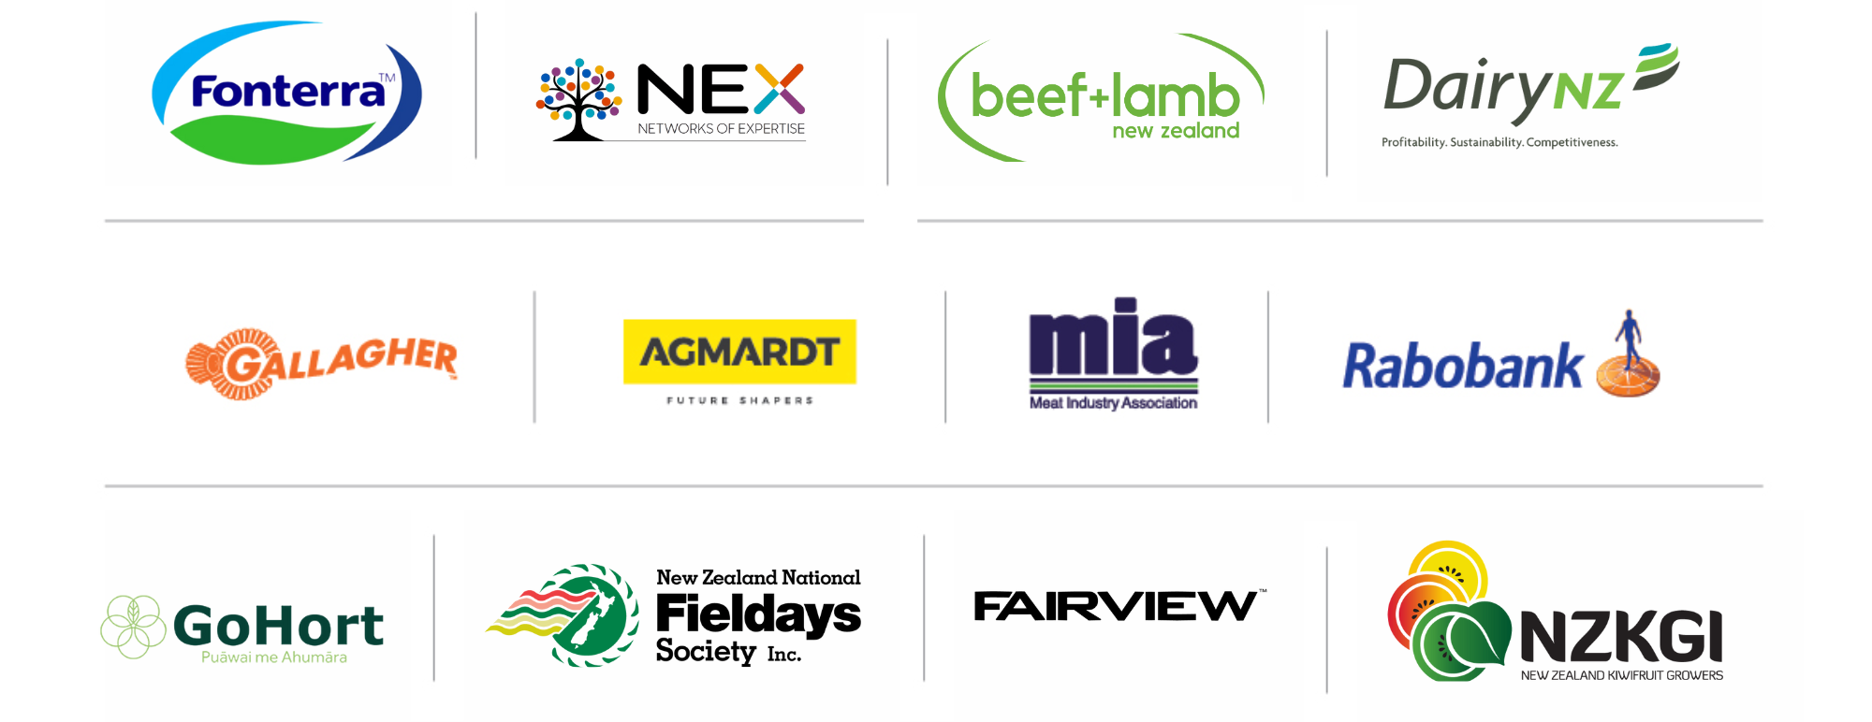
PARTNERS IN THE DELIVERY OF THE NATIONAL AGRIBUSINESS IN SCHOOLS PROGRAMME

