Slide 1


Slide 2
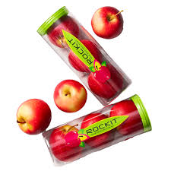


STEEPLE plus Biological and Scientific ANALYSIS
Rockit
A Burgeoning Apple Industry in Canterbury
Level 2
Future Proofing Influences

Slide 3
Teachers Note:
Level 2: Future Proofing Influences
This power point is STEEPLE plus Biological and Scientific analysis activity based on Rockit “A burgeoning apple industry in Canterbury”
Rockit Apples are a genetic mix between a Gala apple and a Gala Splendour cultivar apple to make a small-sized apple that you can snack on.
Resources
Rockit Website
Article: A burgeoning apple industry in Canterbury”
Watch
Rockit Apples Rural delivery -beginning of Rockit.
Video Turley Farms/Rockit Apples
LEARNZ Rockit Apples

Slide 4
Activity 1
Read the article “A burgeoning apple industry in Canterbury”.
Watch the videos
Use these resources to help you answer the questions.
What is a STEEPLE PLUS Biological and Scientific Analysis?
Why would an agribusiness like Conscious Valley carryout a STEEPLE plus Biological and Scientific Analysis?
Divide the class into 9 groups. Give each an influence. Using the article, “A burgeoning apple industry in Canterbury” each group identifies and describes the influence impacting Rockit.
Then; bring the class back together to discuss the influences impacting Rockit.

Slide 5
Activity 2
Divide the class into groups. Allocate each group one STEEPLE plus Biological and Scientific influence. Each group is to use their influence to answer the questions below.
Then, bring the class back together to discuss their answers.
Describe the short and long term impacts on the Rockit.
Using the influence you have discussed in your group, explain the impact beyond the business e.g. on the local community.
What are the consequences of these impacts on the business?
Using these consequences, explain how each consequence might affect the viability of the business.

Slide 6
Answers to Questions 1-3
Activity 1
NOTE: Answers are a guide, there are other answers.

Slide 7
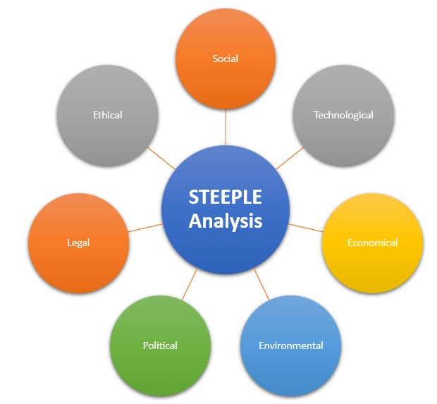
1. What is a STEEPLE Analysis?
A STEEPLE Analysis is a strategic planning tool used by businesses to analyse external factors that can impact their business.
It helps businesses identify opportunities and threats in their environment and prepare strategies to stay competitive and sustainable
The acronym stands for:
S – Social
T – Technological
E – Economic
E – Environmental
P – Political
L – Legal
E – Ethical
In addition other external influences are B - Biological and S - Scientific

Slide 8
2. Why would an agribusiness like Rockit carryout a STEEPLE plus
Biological and Scientific Analysis?
Rockit would carry out a STEEPLE + Biological and Scientific analysis to:
Strategically evaluate opportunities, risks, and success factors for expanding into Canterbury.
Future-proof its operations against potential challenges.
This analysis helps Rockit to:
Make informed, data-driven decisions.
Assess external macro-environmental factors such as social, technological, economic, environmental, political, legal, and ethical influences.
Understand internal business capabilities and dynamics.
Evaluate stakeholder relationships including partners, investors, customers, and regulators.

Slide 9


3. Make a list of the future proofing influences impacting Rockit using STEEPLE plus Biological and Scientific.
S – Social
T – Technological
E – Economic
E – Environmental
P – Political
L – Legal
E – Ethical
B – Biological
S – Scientific

Slide 10


Social Influence
Understanding labour availability in Canterbury (e.g. Rolleston has a large labour pool).
Consumer trends for snack-sized and organic apples.
Supporting regional employment and rural community development.
Opportunity for family farm diversification.
Rising local interest due to tightening environmental laws.

Slide 11

Technological Influence
Need for post-harvest infrastructure like packhouses and coolstores.
Advanced logistics and storage techology for varieties like Honeycrisp and Rockit.
Innovation in orchard management (e.g., in-house agronomists at Turley Farms).
Use of climate modeling to assess long-term viability.

Slide 12

Economic Influence
Rockit's high market value (US$7.79/kg) compared to other varieties.
Diversification from traditional dairy/arable farming to pipfruit as a high-return crop.
Attracting bank and private investment in a region historically cautious with apples.
Potential for job creation and economic resilience.
Export infrastructure expansion planned near Rolleston.

Slide 13

Environmental Influence
Apples use less water and nutrients than dairy or cropping.
Canterbury’s low rainfall and cool temperatures support organic and small-sized apple production.
Climate change modelling shows Canterbury may benefit agriculturally.

Slide 14

Political Influence
New Zealand government support for horticultural diversification.
Post-Cyclone Gabrielle, there is policy interest in geographical risk-spreading.
Support from bodies like NZ Apples & Pears and New Zealand Trade and Enterprise.
Encouragement of export-focused agribusinesses.

Slide 15

Legal Influence
Increasing environmental regulations affecting dairy/cropping.
Compliance with biosecurity laws, especially using natural separation (e.g. Cook Strait).
Zoning and land-use laws for new orchard developments and infrastructure.
Ongoing need to comply with export regulations and biosecurity standards.

Slide 16

Ethical Influence
Sustainable use of land and water.
Providing family farming opportunities and regional economic development.
Ethical branding of organic or low-input apples to global consumers.

Slide 17

Biological Influence
Selection of apple varieties suited to Canterbury’s cooler climate (Rockit, Honeycrisp).
Pest and disease pressures unique to the region.
Soil health and nutrient management.
Pollination requirements and orchard biodiversity.
Impact of perennial crop biology on water and nutrient use.

Slide 18

Scientific Influence
Climate modelling supports Canterbury’s suitability for apples.
Research on apple varieties (Rockit, Honeycrisp) suited to region’s cooler climate.
Trials proving small fruit size benefits.
Agronomic data guiding irrigation and nutrient use.

Slide 19
Answers to Questions 1-4
Activity 2
Describe the short and long term impacts on Rockit.
Using the influence you have discussed in your group, explain the impact beyond the business e.g. on the local community.
What are the consequences of these impacts on the business?
Using these consequences, explain how each consequence might affect the viability of the business.
NOTE: Answers are a guide, there are other answers.

Slide 20
Social Influence
Short and Long Term Impacts on Rockit:
Short term:
Rockit immediately benefits from access to a local labour pool, particularly in areas like Rolleston, which supports orchard establishment and operations such as pruning, and harvesting.
Consumer demand for snack-sized and organic apples gives Rockit a market edge.
The rise in interest from family farms looking to diversify due to tightening environmental laws creates new partnership opportunities.
Long term:
Rockit can develop a stable, skilled, and loyal workforce from the region.
The growing awareness and preference for healthy, convenient fruit options like Rockit apples supports long-term brand loyalty and demand.
Collaborating with multi-generational family farms creates sustainable, locally integrated supply chains that strengthen Rockit’s establishment in the region.
Impact beyond the business:
The development of Rockit’s orchards creates employment opportunities in pruning, harvesting, and post-harvest operations, which contributes to rural economic development.
By offering an alternative crop with lower environmental impact, Rockit supports sustainable farming transitions for Canterbury’s arable and pastoral farmers facing pressure from environmental regulations.
The brand’s success could inspire other horticultural ventures, boosting the region’s reputation and strengthening community resilience through diversification.

Slide 21
Social Influence
Consequences on the business:
A reliable local workforce reduces the risks of labour shortages and high turnover, which is especially important during peak harvest seasons.
Strong community ties and partnerships with local farms enhance operational flexibility and social licence to operate.
Meeting consumer trends around health, sustainability, and convenience improves Rockit’s ability to position itself as a premium product, especially in international markets.
Supporting rural development and diversification can lead to positive brand perception, not just in New Zealand but globally.
Effect on viability:
A dependable workforce and positive community relationships help ensure operational continuity, reducing the risk of labour disruption supporting long term viability.
Alignment with consumer trends increases market viability and demand stability, supporting a reliable cash flow.
Regional partnerships reduce capital investment pressure and make expansion more efficient and scalable, improving financial sustainability supporting long-term viability.
Rockit's image as a socially responsible, community-integrated company can attract ethical investors and strengthen its long-term brand equity, improving resilience in a competitive global market ensuring the long-term viability of the business.

Slide 22
Technological Influence
Short and Long Term Impacts on Rockit:
Short-term
Rockit faces a critical need for investment in post-harvest infrastructure, such as packhouses and coolstores. Without these facilities in Canterbury, fruit must be transported to Nelson, increasing logistical costs and complexity.
There is a need to integrate advanced logistics and cold chain systems, particularly for sensitive apple varieties like Honeycrisp.
In-house agronomy expertise and the use of climate modelling support site and variety selection, reduces risk in the early stages of expansion.
Long-term impact on Rockit:
When post-harvest facilities are established, Rockit will benefit from greater efficiency, reduced fruit loss, and higher product quality.
Continued innovation in orchard management, supported by data and technology will lead to improved yields and better use of resources.
Climate modelling enables long-term planning and helps future-proof operations against environmental changes.
Impact beyond the business:
Investment in infrastructure like packhouses and coolstores creates local employment in construction, operations and logistics.
Advanced agricultural technology and best practices can increase regional horticultural standards, encouraging innovation among other growers.
Establishing high-tech operations can attract talented professionals e.g., agronomists, logistics managers, engineers to the region, increasing skill levels and career opportunities in rural areas.

Slide 23
Technological Influence
Consequences on the business:
The absence of immediate post-harvest facilities leads to higher operational costs and possible delays in getting fruit to market.
Developing infrastructure requires significant upfront capital investment, which may affect cash flow in the short term.
The integration of advanced tech will ensure high-quality, consistent product delivery, supporting Rockit’s premium market positioning.
Climate modelling reduces the risk of investing in unsuitable land or varieties, increasing the effectiveness of long-term decision-making.
Effect on viability:
High initial costs may strain resources or delay expansion if not carefully managed or funded through strong partnerships which could put the business at risk.
When the infrastructure is established, operational efficiency improves, reducing long-term costs and increasing profitability and viability.
Consistently high product quality, enabled by technological precision, strengthens Rockit’s global reputation, increasing customer loyalty and export opportunities increasing returns ensuring long term business viability.
Strategic use of technology e.g., climate modelling and agronomy improves Rockit’s ability to adapt to changing environmental and market conditions, which is key to long-term business viability.

Slide 24
Economic Influence
Short and Long Term Impacts on Rockit:
Short term:
Rockit’s premium market value (US$7.79/kg) allows it to generate strong cash flow, attracting interest from banks and private investors even in a region historically cautious about apples.
The move into pipfruit enables diversification from traditional dairy and cropping, helping spread financial risk and bring in new income streams.
Long term:
As operations grow and infrastructure is developed near Rolleston e.g. packhouses Rockit will contribute to building a stronger regional export economy. This creates ongoing economic resilience and positions Rockit as a long-term business in Canterbury.
Impact beyond the business:
The growth of a high-value crop like Rockit apples promotes job opportunities in orchards, post-harvest processing, logistics, and export services.
Diversification into pipfruit helps reduce regional reliance on dairy and arable farming, which are increasingly impacted by environmental regulations and global price fluctuations.
The establishment of export infrastructure boosts economic development in the region.
Investment confidence in apples may encourage other growers and agribusinesses to invest, expanding the overall economy.

Slide 25
Economic Influence
Consequences on the business:
Increased investor confidence and funding options support scaling up operations and developing required infrastructure.
Economic diversification creates a more stable and resilient business model that is less exposed to commodity volatility like milk or grain prices.
Job creation and regional growth strengthen Rockit’s local support base, reducing potential social or political pushback.
Infrastructure development around Rolleston supports faster, more cost-effective exports, improving competitiveness.
Effect on viability:
Greater access to capital and investor support allows Rockit to expand more quickly and securely, improving long-term financial security and business viability.
A diversified business model is more resilient to economic shocks, making Rockit better positioned to adapt during downturns or global market changes, this resilience supports long term viability of the business.
Strong local economic contributions improve Rockit's social licence to operate, helping it maintain smooth operations without community resistance. This consumer and community support and trust ensures the long term viability of the business.
Efficient export systems enhance profit margins and supply chain reliability, boosting Rockit’s global viability and competitiveness in premium markets.

Slide 26
Environmental Influence
Short and Long Term Impacts on Rockit:
Short term:
Rockit benefits from the fact that the Rockit variety, require less water and nutrients than traditional dairy or arable farming. This reduces input costs and supports environmental compliance, especially as regulations tighten.
Canterbury’s low rainfall and cool temperatures also make it ideal for producing the small-sized apples Rockit is known for, helping the company meet quality and size standards.
Long term:
Climate change modelling suggests Canterbury may become even more suitable for pipfruit in the future.
The region’s suitability for organic production opens up new markets and supports sustainable branding efforts, increasing future competitiveness.
Impact beyond the business:
Encouraging crops that use less water and fewer nutrients helps protect regional water resources and reduce pressure on the environment.
Transitioning land from intensive dairy or cropping to lower-impact apple production contributes to better environmental outcomes and helps the region meet government environmental goals.
Organic apple production will support environmentally-conscious consumers.
Success in sustainable horticulture could serve as a model for other farmers, driving wider land-use changes in Canterbury.

Slide 27
Environmental Influence
Consequences on the business:
Reduced input requirements help lower costs and improve profit margins, especially under tightening environmental restrictions.
Rockit’s alignment with sustainability goals boosts its brand reputation among consumers and regulators.
Canterbury’s favourable climate reduces risk from pests, diseases, and extreme weather, supporting consistent yield and quality.
Environmental suitability improves opportunities for organic certification, which can lead to higher price premiums in key markets.
Effect on viability:
Lower environmental impact and input costs make Rockit’s business more financially and environmentally sustainable, increasing resilience and viability.
Strong environmental performance enhances Rockit’s appeal to investors, exporters, and environmentally conscious markets, supporting long-term consumer growth and viability.
Reduced climate risk and strong yields improve supply reliability, which is crucial for fulfilling export contracts and maintaining customer trust ensuring continued demand, revenue flow and therefore viability.
The ability to operate successfully in Canterbury under future climate conditions positions Rockit as a future-proof agribusiness, strengthening its long-term viability and competitive edge.

Slide 28
Political Influence
Short and Long Term Impacts on Rockit:
Short term:
Rockit benefits from strong political support for horticultural diversification, particularly as the government looks to shift land use away from environmentally intensive practices like dairy.
Agencies such as NZ Apples & Pears and NZ Trade and Enterprise are actively supporting new pipfruit ventures, helping with access to market data, funding, and export guidance.
Post-Cyclone Gabrielle, there’s a growing policy interest in geographical risk-spreading, which aligns with Rockit’s move to establish orchards in Canterbury.
Long term:
Long-term political backing may result in continued support through grants, infrastructure development, and trade agreements especially for export-focused agribusinesses.
Government emphasis on regional diversification could mean more streamlined regulatory pathways for companies like Rockit.
Impact beyond the business:
Political support for horticultural diversification encourages economic development in rural areas, providing new income streams for Canterbury landowners.
Infrastructure and export-related investment benefits multiple stakeholders beyond Rockit, including other growers, transport providers, and port authorities.
Policy support for spreading risk geographically increases regional resilience, ensuring local economies are less vulnerable to events like Cyclone Gabrielle.
Government and industry body support help build long-term confidence in pipfruit as a viable alternative to traditional farming.

Slide 29
Political Influence
Consequences on the business:
With policy and institutional backing, Rockit can access funding, expertise, and networks that reduce the costs and risks of expansion.
Supportive regulations and diversification strategies improve market access and operational flexibility.
Government-endorsed diversification makes Rockit’s Canterbury expansion part of a national priority, potentially fast-tracking approvals and attracting strategic partners.
Effect on viability:
Political support helps lower entry barriers and de-risk the investment, improving long-term sustainability and reducing vulnerability to setbacks.
Access to trade assistance and export development improves Rockit's international competitiveness and profitability.
Being aligned with national and regional policy goals improves Rockit’s social and regulatory licence to operate, securing ongoing community and government support.

Slide 30
Legal Influence
Short and Long Term Impacts on Rockit:
Short term:
Rockit must ensure strict compliance with zoning and land-use laws when establishing new orchards and developing post-harvest facilities in Canterbury.
They need to adhere to biosecurity laws..
The natural separation of the Cook Strait offers a legal and practical biosecurity advantage, but still requires careful planning and documentation.
Long term:
Ongoing compliance with environmental regulations especially those affecting nutrient runoff and water use becomes a strategic advantage, as apples require fewer inputs than dairy or cropping.
Rockit will need to maintain export compliance, including meeting biosecurity and traceability standards, to continue accessing premium overseas markets.
Impact beyond the business:
Legal pressure on dairy and cropping under new environmental regulations may encourage more farmers to transition to lower-impact crops like apples.
Strict biosecurity and zoning laws protect not just Rockit’s crops, but also local ecosystems and neighbouring farms, improving the region’s overall resilience.
Export compliance and strong legal standards help maintain New Zealand’s reputation for high-quality, safe produce.

Slide 31
Legal Influence
Consequences on the business:
Legal compliance requires additional investment in legal advice, planning, and monitoring, increasing short-term setup costs.
By choosing apples over dairy or crops, Rockit benefits from a lower environmental impact, aligning with regulations and reducing the risk of penalties or legal pushback.
Legal adherence to export and biosecurity laws ensures continued market access and helps protect brand reputation in overseas markets.
Effect on viability:
Upfront legal compliance costs are outweighed by the long-term reduction in regulatory risk, supporting more stable operations.
Choosing a crop aligned with environmental laws ensures Rockit is future-proofed against tightening land and water use rules, protecting profitability therefore long-term business viability.
Strong legal standing in export and biosecurity builds trust with international buyers, strengthening Rockit’s position in global premium markets and ensuring long-term business viability.

Slide 32
Ethical Influence
Short and Long Term Impacts on Rockit:
Short term:
Rockit’s focus on the sustainable use of land and water allows it to align with increasing public and industry expectations around ethical and responsible agriculture. This supports its image as a premium, low-impact brand, helping it stand out in both domestic and international markets.
Working with local landowners and offering family farming opportunities, Rockit builds goodwill and partnerships that help with orchard establishment.
Long term:
Rockit’s commitment to sustainability and regional development fosters an ethical brand identity, increasing appeal to environmentally -conscious global consumers.
The promotion of low-input or organic apple production enhances Rockit's position in premium markets where ethics and environmental impact influence purchasing decisions.
Impact beyond the business:
Supporting sustainable practices supports long-term environmental goals in the Canterbury benefiting current and future generations.
Creating opportunities for local families to diversify into pipfruit supports intergenerational farming and rural livelihoods, strengthening regional economic and social stability.

Slide 33
Ethical Influence
Consequences on the business:
Rockit gains a positive reputation as an ethically responsible brand, which helps attract customers, investors, and partners who value sustainability.
Strong community relationships and partnerships with family farms result in more stable, locally supported operations.
Ethical branding of low-input or organic apples gives Rockit a competitive edge in export markets that prioritise environmental and social responsibility.
Effect on viability:
A strong ethical reputation increases consumer trust and loyalty, leading to long-term demand for Rockit's products.
Community support enhances Rockit’s social licence to operate, reducing risks of opposition and improving collaboration.
Positioning as a sustainable and ethical business opens access to premium markets and funding sources (e.g. ESG-focused investors), making Rockit more financially and reputationally resilient.
Overall, these factors contribute to long-term business viability, especially in a global economy that increasingly favours ethical, transparent and sustainable businesses

Slide 34
Biological Influence
Short and Long Term Impacts on Rockit:
Short term:
Rockit must carefully select apple varieties that perform well in Canterbury’s cooler climate, such as Rockit and Honeycrisp.
Trial orchards are used to test pest and disease pressures, soil health, and pollination success.
Rockit needs to address the biological needs of perennial crops, including nutrient and water management, which differ significantly from annual crops.
Long term:
Investing in the right varieties and biological management practices leads to healthier orchards, better yields, and consistent fruit quality over time.
Rockit can build long-term resilience by improving soil health, orchard biodiversity, and integrated pest management, all of which support sustainable production in a changing climate.
Impact beyond the business:
Local growers benefit from Rockit’s biological research and orchard trials, helping them select suitable varieties and adopt effective biological management practices.
Emphasising biodiversity and pollination improves ecosystem health, which benefits both orchards and the wider environment.
A focus on soil and water sustainability supports responsible land use across the region, helping meet community environmental goals.

Slide 35
Biological Influence
Consequences on the business:
Choosing climate-appropriate varieties like Rockit and Honeycrisp improves yield reliability and fruit quality, especially in cooler seasons.
Understanding local pest and disease challenges leads to better control strategies and fewer crop losses.
Managing pollination and biodiversity ensures long-term orchard productivity, reducing dependence on synthetic inputs.
Improved soil health and lower water use make the business more environmentally efficient and compliant with regulations.
Effect on viability:
Higher and more consistent yields make the business more predictable and profitable, supporting long-term success.
Reduced crop loss and better pest management decrease operational costs and increase sustainability, strengthening Rockit’s market competitiveness ensuring Rockit’s long-term viability.
Enhanced biodiversity and soil health improve orchard resilience, ensuring that Rockit can adapt to climate change and environmental events which contribute to a sustainable, efficient, and future-ready business model, increasing Rockit’s long-term viability.

Slide 36
Scientific Influence
Short and Long Term Impacts on Rockit:
Short term:
Scientific tools like climate modelling help Rockit make evidence-based decisions on site selection and variety choice, reducing risks.
Initial variety trials show that Canterbury’s cooler climate is well-suited to growing small-sized apples, which is a key market requirement.
Access to agronomic data allows precise management of irrigation and nutrient inputs, improving efficiency and reducing waste.
Long term:
Ongoing scientific research supports continuous improvement in orchard management, helping optimise yield, fruit quality, and sustainability.
As new data becomes available, Rockit can further refine its practices and stay ahead of climate or soil-related challenges. This long-term use of science helps future-proof the business against environmental change.
Impact beyond the business
Sharing trial data and agronomic insights contributes to regional knowledge, helping other farms improve productivity and sustainability.
Scientific validation of Canterbury’s potential for apples strengthens the region’s horticultural identity, leading to new opportunities for landowners and rural communities.
Reduced water and nutrient use, guided by science, benefits environmental outcomes for the region.

Slide 37
Scientific Influence
Consequences on the business:
Improved crop selection and orchard practices reduce the risk of crop failure or poor-quality yields, ensuring reliable supply.
Efficient resource use guided by science results in cost savings, particularly in water and fertiliser inputs.
Strong scientific foundations enhance Rockit’s credibility and brand reputation in both local and export markets.
Ongoing scientific research supports innovation and adaptability, giving Rockit an edge over competitors.
Effect on viability:
Reliable yields and quality support stable cash flow, essential for long-term business sustainability.
Cost efficiencies and reduced environmental impact improve Rockit’s profit margins and regulatory compliance, increasing financial and operational viability.
A reputation for science-led innovation makes Rockit more attractive to investors, partners, and premium consumers, boosting market confidence and enhancing Rockit’s resilience, adaptability, and long-term competitiveness and viability.

Slide 38
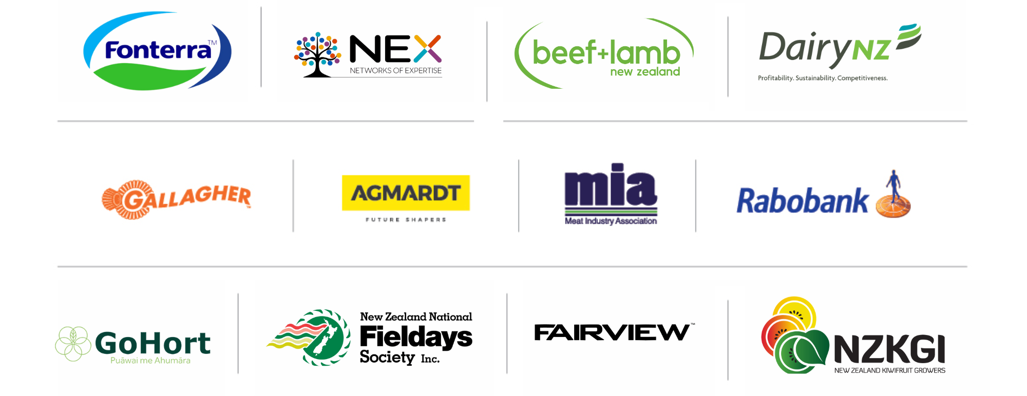
PARTNERS IN THE DELIVERY OF THE NATIONAL AGRIBUSINESS IN SCHOOLS PROGRAMME

