Slide 1
Agribusiness Banking
Chris Horan – Senior Partner Agribusiness, Waikato
Nick Coster – Partner Agribusiness, Morrinsville
Laura Brown – Senior Associate, Hamilton

Slide 2
BNZ Background
What does a bank do?
  Relationship Building
  Asset purchasing
  Cash flow lending
  Development or capital projects
  Strategic planning
  Succession Planning
  Connecting people

Slide 3
Information Required by the bank
Finance requirement - purchase of property plus initial and future development costs.
Financial analysis.
Timing - when do key events take place?
Operational outline – staffing, trading, product mix etc.
Marketing strategy & target market.
Key risks and mitigates.
Contingency plan, what are our fall back options and what triggers them?
Goals and aspirations, how do we measure success?

Slide 4
Strategic Capital Project – Farm Purchase
What is required?
Land & Buildings
  100ha @ $45,000/ha = $4,500,000
Stock
  350 cows @ $1500/cow = $525,000
Machinery
  Tractor = $50,000
  4 Wheeler + 2 x 2 Wheeler = $20,000
Shares
  100,000 Fonterra shares @ $6/share = $600,000
Other
  Sundry tools, legal costs etc = $15,000
  Total loan required = $3,210,000
  Cash Savings
  $2,500,000

Slide 5
Strategic Capital Project – Farm Purchase
Statement of Position - Farmer Brown Limited
Assets |  | Liabilities
Land & Buildings | $ 4,500,000 | Term Loan | $ 3,210,000
Stock | $ 525,000 | Working Capital | $ 100,000
Plant & Machinery | $ 70,000
Investments/Shares | $ 600,000
Sundry | $ 5,000
Total Assets | $ 5,700,000 | Total Liabilities | $ 3,310,000
Total Equity | $ 2,390,000
Total Equity % | 42%

Slide 6
Debt Servicing – Farmer Brown Limited
Milk Income 100,000 kgms @ $6/kgms = $600,000
Stock sales = $35,000
Less: Farm expenses = $350,000
Less: $3,210,000 loan - Principal & Interest payments p.a = $290,000
Less: Capital Expenditure = $25,000
Surplus/Deficit (less tax) = - $30,000

Slide 7
Finance Options
Loan Types
Table Loan
Revolving Credit Loan
Reducing Loan
Interest Only Loan
Working Capital/Overdraft

Slide 8
Finance Options
Different Interest Rates
Floating
Fixed
Capped
Range

Slide 9
Questions…..?

Slide 10
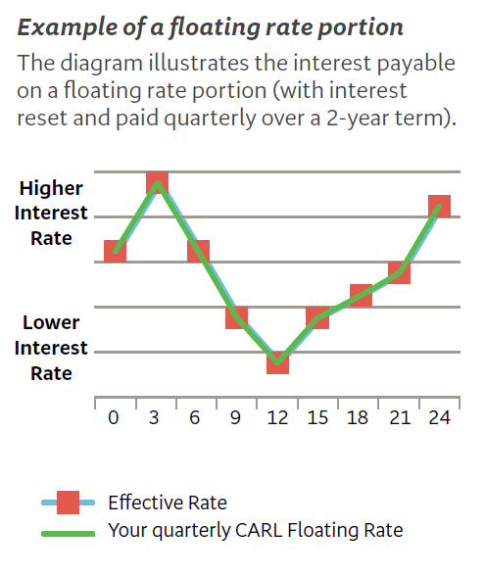

Slide 11
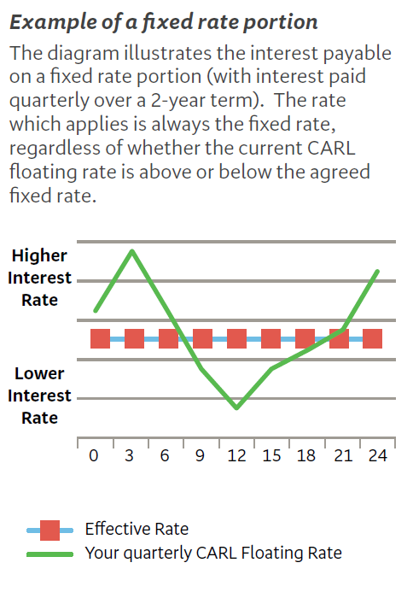

Slide 12
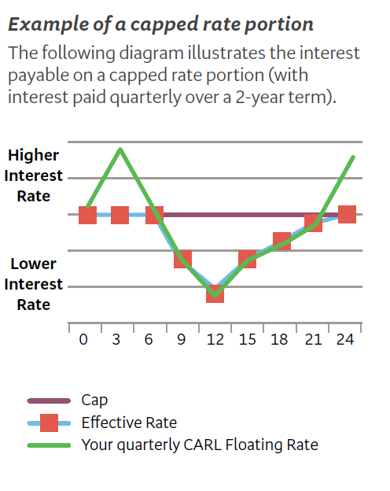

Slide 13
