Slide 1
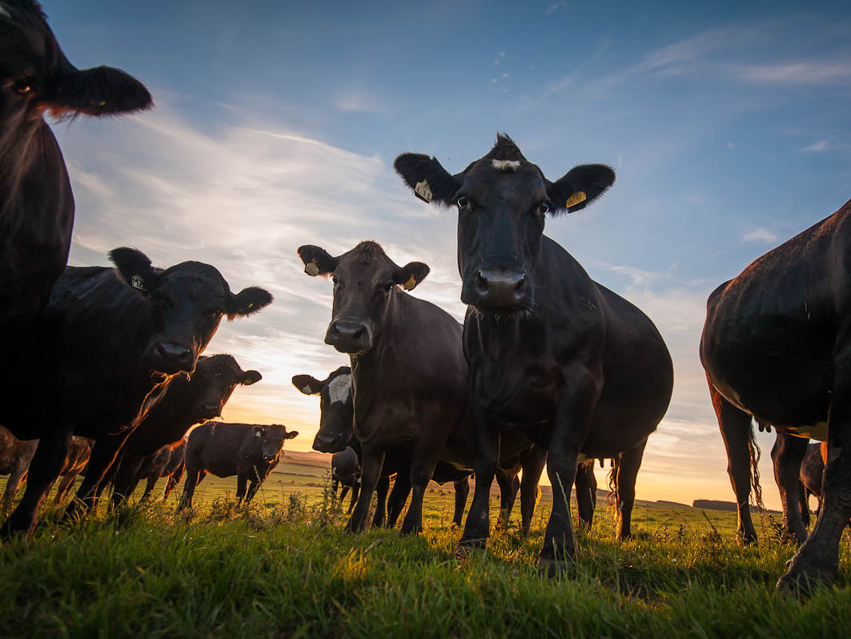
Agricultural Microeconomics
Lesson 8: Advanced Spreadsheet Modeling
This course developed by The Environmental Finance Center at UNC Chapel Hill for The North Carolina School of Science and Math and NCDPI is licensed under a Creative Commons Attribution-NonCommercial-ShareAlike 3.0 Unported License
Notes:
Now that you have learned the basics of using computer spreadsheet software to develop financial models, you can use your model to analyze the effect of a new innovation and prepare a three year income projection (a “pro forma”) income statement that financial institutions and other lenders will frequently request as part of a loan application or business plan.

Slide 2
What is a “Pro-Forma”?
A projection or estimate of what a business might look like in the future.
It is based on assumptions for how a business might operate.
When a new innovation or product is added to the business operation, a farmer will prepare a 3 or 5 year “pro-forma” income statement.
Notes:
A pro-form statement is a business owner’s best guess of what the business will look like over the next three to five years based on actions taken in the present. For example, if Piedmont Farm decides to invest in the Solar Panels, it will have an effect on both the revenue and the costs of the farm. In order for the farmer to get a complete picture of how the farm’s actual operations in the future if certain assumptions are achieved, a farmer should always prepare a pro-forma statement before making a decision about an investment or new venture. Using Piedmont Farm’s Net Earnings Statement from the case study, this lesson will help you create a three-year pro-forma income projection for the farm – something that Martha might be able to use in her business plan or in her loan application. The pro forma will also enable the farmer to look at different scenarios – increasing or decreasing variables - like product pricing or the number of cattle harvested – to choose the most appropriate path for the future.

Slide 3
Developing a Three-Year Income Projection for Piedmont Farm
Notes:
Using the same student groups as in the last lesson, ask the students to open up the “Piedmont Farm Pro Forma” worksheet. They might also want to have either a print or computer version of the “Cash Flow Worksheet” that they developed in Lesson 7 and the “Cost Benefit Worksheet” from Lesson 6. Although a template for the pro forma statements has been provided, the students will need to use information from the case study and the other lessons to project (or estimate) the revenue and cost assumptions for the farm over the next three years.

Slide 4
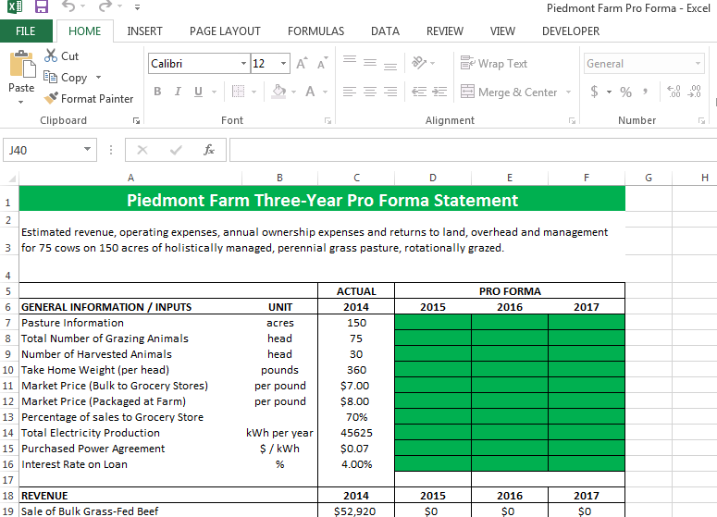
Notes:
Once the students have been able to pull up the file, ask them to look through it. It should look a little familiar. The General Information/Inputs section is the same as what was found in the Piedmont Farm Case Study. And, the “Actual” financials for 2014 (our base year) have also been added. You will notice that three additional columns have been added. These are the three pro forma years. These are the cells (in green) that the students will use to input different scenarios.
Give the students 5-10 minutes to go through the spreadsheet and become comfortable with the numbers provided in the “Actual” column (Column C). Also, point out that the revenue and expenses (the cost and benefit) of the solar panel investment has also been added in so the farmer has a complete picture of farm operations.
Answer any questions for the students

Slide 5
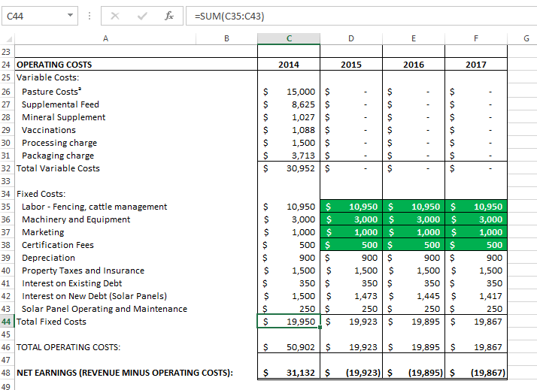
Notes:
Ask the students to scroll down to the second half of the spreadsheet (Rows 24 through 48). These are the farm’s operating costs. Again, the numbers for 2014 have already been input as have the fixed costs for 2015 – 2017. However, sometimes fixed costs change, so these are numbers that the students can change to see the impact on Net Earnings. For example, if the farmer wants to increase the price of her product, she may need to do additional marketing about it’s high quality attributes. The student might consider increasing marketing in year 2015 and beyond.
Give the students 5-10 minutes to go through the spreadsheet and become comfortable with the numbers provided in the “Actual” column (Column C). Also, point out that the revenue and expenses (the cost and benefit) of the solar panel investment has also been added in so the farmer has a complete picture of farm operations.
Answer any questions for the students. Point out that they can see the underlying formulas for some of the calculations by clicking on the cell and looking at the formula in the ribbon bar above. These cells have been protected so they cannot be changed by the student, but it will be useful to know the formulas when the students begin to develop their own financial statements for their capstone project.

Slide 6
Projecting Revenue and Expense
Amount of “harvest” (# of cattle sold)
Pricing considerations
Percentage of sales to grocery stores vs. local sales.
Amount of electricity produced declines
Labor cost increase
Marketing cost increase
Increase in equipment repair or maintenance
Notes:
Give the students 45 minutes to input their own scenarios and come up with the scenario that they think will be best for Piedmont farm. Ask them to enter and change only the numbers in the green input boxes. As they change these numbers, they will see the calculations in the spreadsheet change. The number they will want to keep an eye on is the “Net Earnings” calculation in Row 48 of the spreadsheet.
I’ve listed a few considerations for the students to think about. There are many different combinations that they can use and they should try all of them. Once the students are comfortable with their projections, bring the class together for a final class discussion.

Slide 7
Discussion Questions
How much did changing the price of the product impact net earnings?
Did the amount of cattle harvested change net earnings?
What types of expenses seems to have the largest impact?
Did you change anything that resulted in a Net Loss (negative earnings)?
What other factors did you change?
Notes:
Guide the students through a discussion of their results. Again, there are not right or wrong answers in this discussion. It is an exercise designed to help them feel comfortable with financial statements and using scenarios to guide their decision making process.
For their capstone project, they might wish to consider developing a similar spreadsheet to analyze their own farms’ operations.
NOTE TO TEACHER: Much of this spreadsheet has been protected so the formulas can not be accidentally changed. If you wish to make a change to the spreadsheet, click on the “Unprotect Sheet” button on the “Review” tab and type “microag” in the password box. This will unlock the spreadsheet and you can make changes. It is recommended to “Protect” the sheet again once you have made the changes.

Slide 8
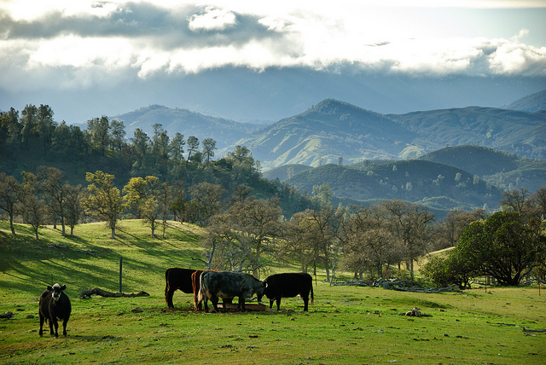
Next Class:
Developing a Business Plan
This course developed by The Environmental Finance Center at UNC Chapel Hill for The North Carolina School of Science and Math and NCDPI
is licensed under a Creative Commons Attribution-NonCommercial-ShareAlike 3.0 Unported License
Notes:
In the next class, we will start discussing the key components that are needed to develop a business plan for your farm.

