Slide 1
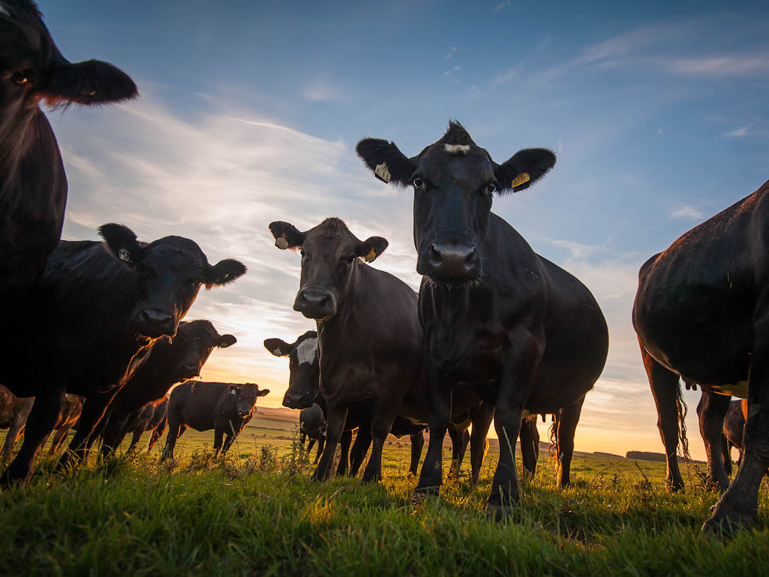
Agricultural Microeconomics
Lesson 6: Cost - Benefit Analysis
This course developed by The Environmental Finance Center at UNC Chapel Hill for The North Carolina School of Science and Math and NCDPI is licensed under a Creative Commons Attribution-NonCommercial-ShareAlike 3.0 Unported License
Notes:
In this lesson, we will start discussing a new innovation for Piedmont Farm – a solar panel installation – and begin to look at how to prepare a cost-benefit analysis to determine if the farm should move forward with the investment. This is the type of analysis the students will want to do when considering the innovation for their capstone project.

Slide 2
Why Do a Cost-Benefit Analysis?
Decide whether to undertake a project.
Define project objectives.
Develop appropriate before and after measures of project success.
Prepare estimates of the resources required to perform the project work.
Notes:
The purpose of a cost-benefit analysis is to examine both the costs and the financial benefits of a project to determine if it is beneficial to actually do the project. If the benefits (or the return) outweighs the costs, then it is a profitable project to invest in. In addition to helping with the decision to move forward with a project, there are a number of other reasons that a farm might want to do a cost-benefit analysis for a new investment including:
Help defining project objectives. By considering all the estimated costs and revenues associated with a project, the farmer can ensure that all objectives are being met (for example, if an investment into a Solar High Tunnel is going to help with the farm’s objectives of being a year-round farming operation, then the seasonal increase in annual revenue will be included in the analysis.)
By establishing a “budget” of estimated costs and benefits, the farmer can track the success of a project. For example, if actual costs end up being higher than estimated, the farmer can re-evaluate the project and make changes for future project investments.
A cost benefit analysis can also help the farmer to estimate all associated costs of a project. Is additional labor needed to operate and maintain the system? Will the new solution (perhaps a more efficient tractor) reduce costs (fuel expense)?
For large capital expenditures and new ventures, a cost-benefit analysis is a critical piece of the decision process.

Slide 3
Piedmont Farm
100 panel solar PV system
$75,000 estimated cost
Sale of electricity generated
Availability of federal grants and loan guarantees to assist with financing.
Notes:
Let’s consider an example using the Piedmont Farm case study. Although the farm is profitable from an operational perspective, the owners would like to continue to invest in making the farm more environmentally sustainable. The owners are considering the installation of Solar Photovoltaic (PV) panels on the land and would like your help in assessing whether this type of investment makes financial sense. Read the “Solar Panel Analysis” companion piece to the case study.
Distribute the “Solar Panel Analysis” case study to the students. Give them 10 minutes to read through the material (it describes PV panels and sets up the costs associated with the investment). When the students are done reading, continue to the next slide.
Important Note: This is an overly simplistic example of how a renewable project like solar PV might work. It is designed to help the students think through the components of a cost-benefit analysis and it does not represent exactly how a solar PV analysis should be done for an actual project.

Slide 4
Calculating Benefits
How much electrical energy would a 100 panel solar PV system produce
each year?
100 panels x 0.25 kilowatts x 5 hours
x 365 days
=
45,625 kilowatt hours annually
Notes:
Using the case study, discuss the basics of solar photovoltaic systems. The electric energy generated from the solar panels will be the “benefit” of the investment. The farm has the ability to sign an agreement with the local utility (called a Purchased Power Agreement) to sell all the electricity generated from the solar panels for a fixed $ per kilowatt hour. This is considered revenue to the farm and is the investment’s “benefit.”
Renewable energy projects are complicated. The information provided in the case study is simplified and some assumptions are made for the amount of sun that the panels will receive and the amount of electricity they will produce. The number of kilowatt hours produced annually by the solar PV system will be used to calculate the farm’s expected revenue (benefit) from installing the panels.
The case study provides an estimate of the amount of energy produced each month by one panel (37.5 kilowatt hours each month). Ask the students to calculate how much energy 100 panels would produce in a year. Note: This slide has animation so you can ask the question without showing the answer. Once the students have shared the correct answer, click to the response.

Slide 5
Calculating Benefits
How much estimated revenue will the Farm receive each year?
45,625 kilowatt-hour
x $0.07 per kilowatt-hour
=
$3,194
Notes:
Now that we have a good estimate of how much electricity will be generated from the solar panels, we can estimate the total amount of revenue the farm might expect to receive from the local electric utility. The utility has offered to purchase (or buy) the electricity from the farm at a rate of $0.07 per kilowatt hour. Therefore, the 45,625 kilowatt-hours that the solar panels expect to generate will be worth approximately $3,194 to the farm each year.
Note: This slide has animation built in, so you can ask the question without showing the answer. Let the students find the information in the mini case study before moving on to the answers.

Slide 6
Calculating Costs
Costs of loan repayment:
  $37,500 REAP Guaranteed Loan
  4.0% interest rate
  30 year repayment term
  $173 monthly ($2,148 annually)
Operating costs:
  $250 each year
Notes:
Now that we have calculated the benefit piece of the analysis, let’s look at the cost side. What types of costs might the farm have for this new type of investment? What information has been provided in the case study?
1) Cost of loan repayment (also called a Principal and Interest or P&I payment) – This is the amount that will be repaid to the bank for the $37,500 loan. It includes an amount to pay the interest on the loan as well as an amount to reduce the loan amount (the principal). Using any basic loan calculator (https://www.vlender.com/cgi-bin/calc/simple.cgi is a good example), you can calculate that the monthly payment on this loan is $173 a month (or $2,148 annually).
2) The panels will also have operating and maintenance costs associated with them. This is an estimated cost to maintain the panels in working condition. From the case, this amount is estimated to be $250.
Note: This slide has animation built in, so you can ask the question without showing the answer. Let the students find the information in the mini case study before moving on to the answers.
Can you think of any other costs that the farmers might encounter?

Slide 7
Preparing Your Own Cost-Benefit Analysis
Notes:
In this part of the class, the students will use the information found in the Piedmont Farm Solar Panel Analysis to do their own Cost-Benefit Analysis. They will need a computer to do this work and use the spreadsheet found in the “Piedmont Farm Cost-Benefit Analysis Worksheet.” This is an excel file and the input values will be blank when the students open it.
Depending on the number of computers in class, divide the students into groups (or individually) so that each student has a computer to work on. Ask the students to open the worksheet and use the information in the case study to input the costs and benefits into the GREEN input boxes. Please note that the worksheet will automatically calculate certain numbers for the students, so the only numbers that need to be input are the GREEN INPUT numbers.
Give the students 20-30 minutes to work through the spreadsheet and enter the numbers. Once they have entered the information, they should review the actual cost-benefit analysis (found in the second part of the spreadsheet) and be ready to discuss with the class

Slide 8
What are your results?
Notes:
The Piedmont Farm cost-benefit analysis offers a quick summary of the revenue (benefits) and costs of the solar project. It calculates the costs and benefits for each year. Each column represents one type of cost or benefit and the year that it occurs. The project cost (the cash amount the farm will pay for the solar panels) is listed in Year Zero (before the project is actually implemented) because it is an upfront cost that must occur before any revenue is received. In the following years, both revenue from the electricity generated ($3,194) and the costs (loan repayment of $2,148 and operating costs of $250).
The Net Benefit column is a summary of benefits less costs that occur each year. The Cumulative Net Benefit column adds up all the net benefits from each year (it cumulates the total). As you can see in this example, the solar project starts to have a positive cumulative net benefit in year 24.

Slide 9
Discussion Questions
Should Piedmont Farm invest in the solar panels? Why or Why Not?
Are there any other costs that the farm owners might want to take into consideration?
Are there other types of projects that the farm might consider instead of solar?
Notes:
The following questions have no right or wrong answer – they are intended to prompt a discussion with the students about how a cost-benefit analysis might be used.
Should Piedmont Farm invest in Solar Panels? Depending on the student’s perspective, the answer could be yes or no. On the one hand, the project actually has a positive cost-benefit ($5,111 at the end of Year 30). On the other hand, it requires a large amount of upfront cash ($18,750) and does not have a positive cost-benefit until Year 24 which is quite a long way away! Does it make sense for the farm to invest in such a long term project?
Are there other costs that the farmers should consider? Since this is a basic cost-benefit analysis, it only takes the debt repayment (principal and interest) and operating costs into consideration. There might be other costs (or reduced revenue considerations) associated with the project. For example, since the solar panels are on part of the cattle pasture land, the number of cattle the farm might harvest each year might be reduced. This is not a new cost to the farm, but a reduction in revenue from the sale of beef. Other costs might include labor (for someone to check on the solar panels) and the opportunity cost of putting something else (like a food crop) on the land.
Other types of projects might include investing in additional head of cattle, investing in a piece of equipment to improve temporary fencing transition, or perhaps investing in equipment and materials to start a food crop on part of the land.

Slide 10
Other Scenarios
Notes:
If time allows, the students can input different scenarios and see how the results change. For example, what happens if the amount of the loan increases to $50,000? What happens if the Purchased Power Agreement provides the Farm with only $0.06 per kilowatt-hour? What happens if the Farm only invests in a 10 kilowatt project? What happens if the farm doesn’t get the USDA grant or doesn’t have enough cash on hand?

Slide 11
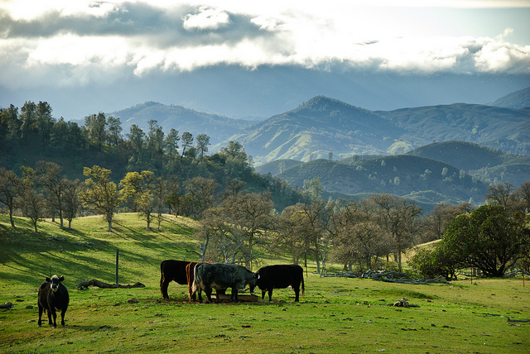
Next Class:
Intro to Spreadsheet Modeling
This course developed by The Environmental Finance Center at UNC Chapel Hill for The North Carolina School of Science and Math and NCDPI
is licensed under a Creative Commons Attribution-NonCommercial-ShareAlike 3.0 Unported License
Notes:
In this class, you learned how to use a spreadsheet model that was created to prepare a cost-benefit analysis of a proposed solar panel installation. In the next class, you will learn how to create your own spreadsheet to analyze your own project.

