Slide 1

Agricultural Microeconomics
Lesson 7: Intro to Spreadsheet Modeling
This course developed by The Environmental Finance Center at UNC Chapel Hill for The North Carolina School of Science and Math and NCDPI is licensed under a Creative Commons Attribution-NonCommercial-ShareAlike 3.0 Unported License

Slide 2
Using Spreadsheets
Net Earnings Statement
Cost-Benefit Analysis
Cash Flow Analysis
Pro-forma (future) statements
Scenario Analysis
Graphing
Notes:
Computer spreadsheet tools can be used by farmers to perform a variety of financial analysis for their operations. Successful farmers use spreadsheets to keep a record of the revenue and expenses of the operation as well as estimate or project earnings in future years. In Lessons 2 and 3 we used a spreadsheet to analyze Piedmont Farm’s Net Earnings Statement (Revenue less costs). In Lesson 6, we looked at a Cost-Benefit analysis of a new innovation. In the next two lessons, we will build a cash flow statement for Piedmont Farm and examine different types of tools that can do scenario analysis and graphing. All of these tools can be used by a farmer to gain a complete understanding of her farm operations.

Slide 3
Meet the Spreadsheet
Get to Know Excel 2010:
Meet the Spreadsheet
Notes:
For this lesson, students must know a few spreadsheet basics. Many students have probably already used spreadsheets in other classes, but to ensure that the entire class has basic spreadsheet skills, this lesson will walk through some basics using training videos on Microsoft Excel’s website. If your school uses a different type of spreadsheet software or if the spreadsheet skills of the students are more advanced, please adjust the lesson accordingly.
Depending on the number of computers in class, divide the students into groups (or individually) so that each student has a computer to work on.
Play the “Meet the Spreadsheet” video: http://office.microsoft.com/en-us/excel-help/meet-the-spreadsheet-RZ101773335.aspx?section=2
Ask the students to create a new spreadsheet and give it a title (any title is fine) in Cell “A1”.
The students are going to be preparing a Basic Cash Flow Analysis (an analysis of monthly cash coming into the farm and cash being paid out). In Cell “A2”, ask the students to type “Cash Flow Analysis.”
It should look something like the example on the next slide. Please note that all cells can be formatted using the tools in the ribbon bar (just like word processing software).

Slide 4
Notes:
The student’s spreadsheet does not have to look exactly like this, but each student should have a black worksheet open with some sort of title. Once all students have done this, proceed to the next slide.

Slide 5
Adding Column Titles
Get to Know Excel 2010:
Create Column Titles
Notes:
Next, the students will add column titles to the spreadsheet for each month of the year.
Play the “Create Column Titles” video: http://office.microsoft.com/en-us/excel-help/do-basic-math-in-excel-RZ101773335.aspx?section=4
When the video is done, go to the next slide

Slide 6
Adding Column Titles
Item Description
Months
  January
  February
  March
  etc.
12-Month Total
Notes:
Ask the students to add column titles to their spreadsheet starting in Cell “A4.” Since we will be looking at monthly financial data, they will need to add all 12 months to the spreadsheet and a “12-Month Total” column at the end.
They can apply any formatting or column widths that they would like to the columns. When they are done, it should look something like the screen shot on the next slide.

Slide 7
Notes:
The student’s spreadsheet does not have to look exactly like this, but each student should have something that looks a bit like this. The students may want to increase (or decrease) the width of some of the columns or format the cells as described in the video. Once all students have done this, proceed to the next slide.

Slide 8
Adding Row Titles
Revenue from Bulk Beef Sales
Revenue from Packaged Beef Sales
Total Revenue
Pasture Costs
Supplemental Feed
Mineral Supplement
Vaccinations
Processing Charge
Packaging Charge
Labor
Machinery and Equipment
Marketing
Certification Fees
Property, Taxes and Insurance
Debt Repayment
Total Operating Costs
Net Earnings
Notes:
Ask the students to now add row titles. This can be done in a similar way to adding column titles. Use the descriptions from the Piedmont Farm case study’s “Revenue and Expense Statement” to create the titles (or refer to the list above). For now, don’t worry about the formatting or spacing between rows.
Please note that because this is a cash flow statement (actual money coming in and going out), depreciation expense is not included (remember that depreciation is just a way for the farm to account for the deterioration of assets over time – it is not an actual cash expense).
When the students are done, it should look something like the screen shot on the next slide.

Slide 9
Notes:
The student’s spreadsheet does not have to look exactly like this, but each student should have something that looks a bit like this. If they want to left justify the “Total Revenue” and “Total Operating Cost” cells, they can use the formatting tools in the ribbon bar above (similar to how they would have centered the cell content.

Slide 10
Adding Rows and Columns
Get to Know Excel 2010:
Get More (or Less) Columns, Rows and Spreadsheets
Notes:
Next, the students will add rows to the spreadsheet (to improve the look and formatting).
Play the “Get More (or less) Columns, Rows and Spreadsheets” video: http://office.microsoft.com/en-us/excel-help/do-basic-math-in-excel-RZ101773335.aspx?section=6
When the video is done, ask the students to enter a row above Row 9 (above “Pasture Costs”) and another row above “Net Earnings”.
Also, ask the students to change the name of the spreadsheet to “Cash Flow.”
When the students are done, their spreadsheet should look similar to the one on the next slide.

Slide 11
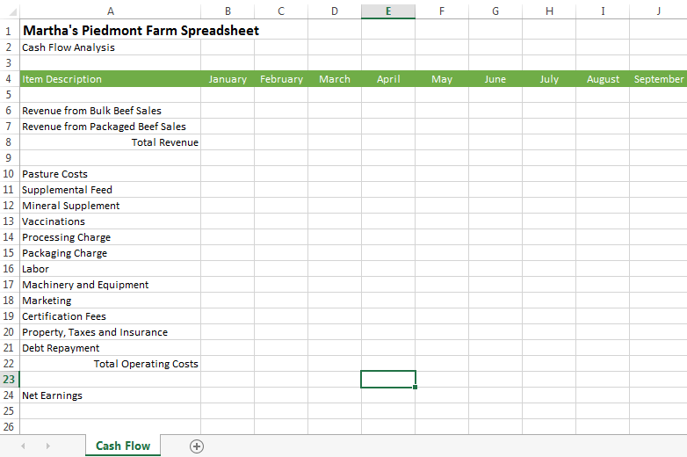
Notes:
Each student should now have something that looks a bit like this. Now, it is time to add some financial data to the spreadsheet.

Slide 12
Entering Data
Use data from Piedmont Farm Case Study (or make up your own).
Think about seasonality of revenue and expenses:
  Does all revenue come in equally during the year or is it different in some months?
  Do some expenses only occur during certain times of the year?
Don’t worry about adding up the numbers (for now).
Notes:
Now comes the fun part! Using the information provided in the Piedmont Farm Case Study (or the students can make up their own), enter financial data into the spreadsheet. Since the data is annual in the case study, the students will need to consider whether a revenue or expense item is fixed (the same) in all months or if will vary by month. For the purposes of this example, it doesn’t matter if they choose a fixed or different amount in the month (it also doesn’t matter if the numbers they enter result in the same amounts as in the case study). They just need to have some numbers that they can use for the next Excel lesson.
For now, just enter the numbers (don’t add or subtract anything). They will not need to input a number for “Total Revenue” (Row 8), “Total Operating Costs”, (Row 22) or “Net Earnings” (Row 24). We’ll let Excel do this for us in the next step.
Give the students 10-15 minutes to enter data and then go on to the next slide.

Slide 13
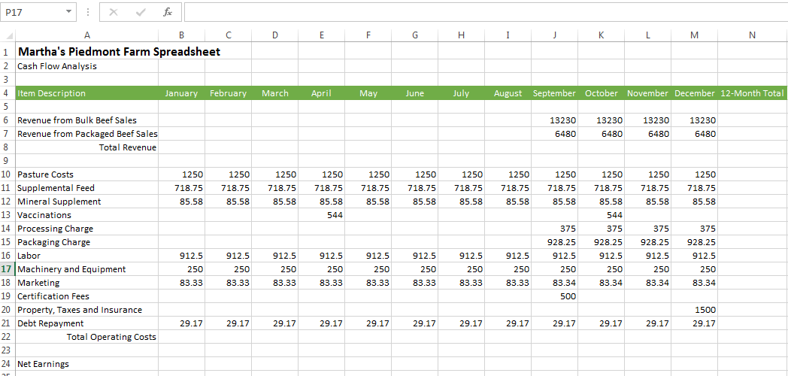
Notes:
Here is an example of how the data might look once it is input. Each student’s spreadsheet might look different and that is okay! The purpose of this exercise is to learn how to build the spreadsheet, so the numbers do not have to match. Next, let’s look at how to use Excel to add up the totals.

Slide 14
Do Basic Math
Get to Know Excel 2010:
Do Basic Math in Excel
Notes:
Play the “Do Basic Math in Excel” video: http://office.microsoft.com/en-us/excel-help/do-basic-math-in-excel-RZ101773335.aspx?section=3
After the video, ask the students to add up the information in the columns using the “Addition,” “Subtraction,” and “Sum” formulas they just learned in the video. Their formulas should do the following:
Add up (sum) Total Revenue in each month (Row 8).
Add up (sum) Total Operating Costs in each month (Row 22).
Calculate Net Earnings (Total Revenue minus Total Operating Costs) – Row 24
They should calculate this for each month (either re-entering the formula or dragging a formula as explained in the video).
Next, they should add up (sum) the information for each row in the “12-Month Total” column (Column N).
Give them 15 minutes to complete this part of the lesson and then go to the next slide.

Slide 15
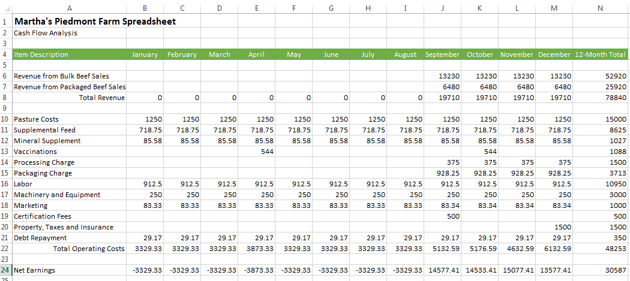
Notes:
Each student should now have something that looks a bit like this. This is also the spreadsheet provided in the “Student Worksheet” excel file. If there are questions on any formulas used, you can highlight the cell and see what the formula should be.
One more step …

Slide 16
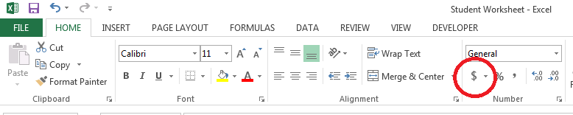
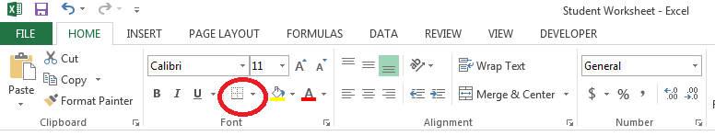
Formatting
Currency Formatting
Underline Formatting
Notes:
Our final step for this financial model will be to add a few final formatting details to make it easier to read.
Since this is a financial worksheet, we want to have all numbers in a currency format. In order to do this, highlight the cells that need to be formatted and then click on the “$” symbol in the ribbon above.
To indicate that numbers are calculated, it is often nice to add an underline in columns. Ask the students to add an underline before the “Total Revenue,” “Total Operating Costs,” and “Net Earnings” rows.
Continue to the next slide to see the end result.

Slide 17
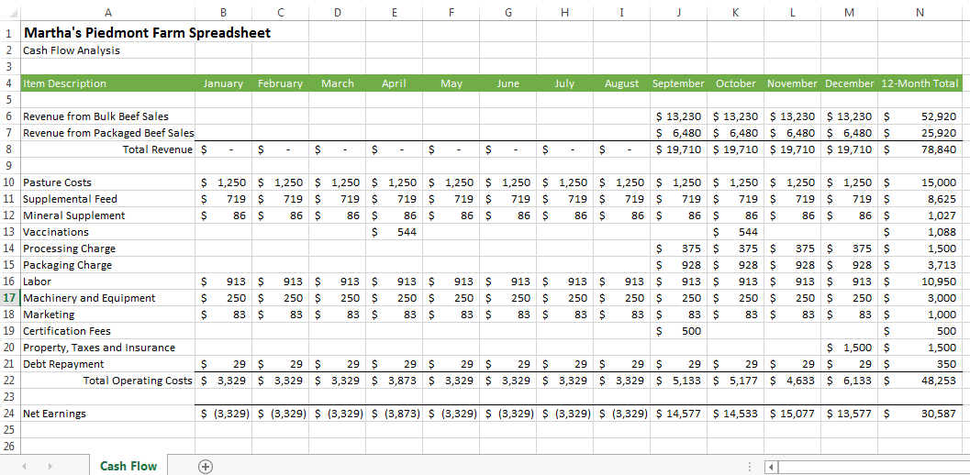
Notes:
Congratulations - you have successfully designed your own financial cash flow model!
Ask the students to save the spreadsheet to either a local or shared drive. They will be using this spreadsheet in the next lesson.

Slide 18
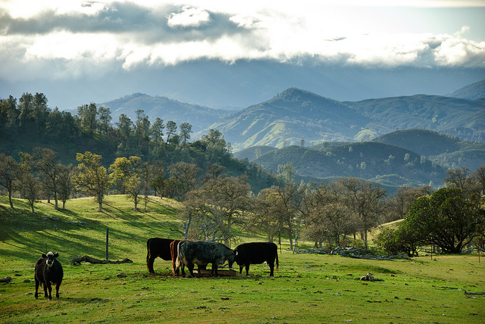
Next Class:
Advanced Spreadsheet Modeling
This course developed by The Environmental Finance Center at UNC Chapel Hill for The North Carolina School of Science and Math and NCDPI
is licensed under a Creative Commons Attribution-NonCommercial-ShareAlike 3.0 Unported License
Notes:
In the next class, we will continue to discuss using a computer spreadsheet to help a farmer run her business, looking at advanced modeling techniques like pro-forma income statements and scenario analysis.

