Slide 1
The land-based economy:
New Zealand’s future
Ross Hyland, Principal Advisor, Lincoln University

Slide 2
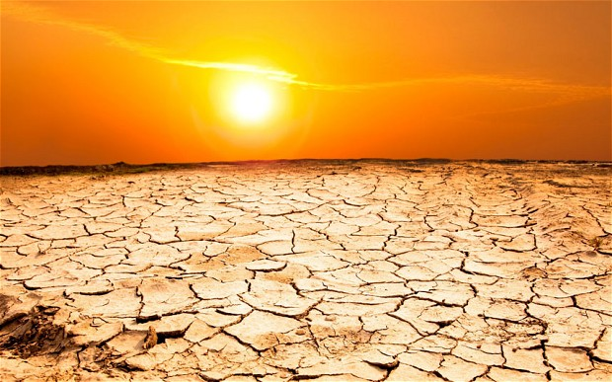
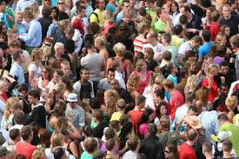
Global warming & 10bn people = a food security crisis
New Zealand’s core business – food - has a great future

Slide 3
NZ’s land-based economy
70% of NZ’s merchandise export revenue is from the primary sector & growing
Tourism contributes 15% of NZ’s total export earnings
Land-based sectors employ around 20% of the New Zealand workforce….

Slide 4
NZ’s land-based sectors
496,000
Tourism, Recreation & Hospitality
116,000
Support & Technical
41,300
Processing &
Distribution
114,000
On the Land
121,000
Property & Finance,
Water & Regulatory
104,000

Slide 5
Land-based Roles
On the Land – 114,000
Tourism, Recreation & Hospitality – 79,000
Management and Administration – 55,000
Distribution and Sales – 53,500
Production and Processing – 39,000
Facilities and Property Services – 35,000
Financial Support and Services – 20,000
Technical and Professional – 14,000
Planning and Regulatory – 9,000
Engineering and Trades – 8,500
ICT – 3,600 | Social Services – 2,800 | Educational – 2,700
Water and Waste – 1,000

Slide 6
Roles on the Land
Forestry Workers – 2,500
Fruit Growers – 4,000
Mixed Crop & Livestock Farmers – 29,000
Market Gardeners – 1,200
Dairy Cattle Farmers – 20,000
Sheep & Beef Farmers – 10,000
Machinery Operators – 3,500
Shearers – 2,000
Horticultural Workers – 3,000
Dairy Farm Workers – 3,000
Greenkeepers – 1,500
Arborists - 600
Vineyard Workers – 2,500
Pest Controllers - 500

Slide 7
Tourism & Hospitality
Sport & Recreation Roles
Chefs – 8,000
Park Ranger - 450
Fitness Instructor – 1,600
Hotel or Motel Manager – 4,700
Restaurant Managers – 5,500
Hotel Service Manager – 2,000
Conference or Event Organiser - 700
Sports Administrator - 550
Outdoor Guide - 500
Museum Guide - 200
Sports Centre Manager - 300
Outdoor Adventure Instructor - 250
Travel Consultant – 3,500

Slide 8
Technical & Specialist Roles
Agricultural Technicians - 900
Life Science Technicians - 800
Marketing Specialists – 1,000
Vets & Vet Nurses – 2,500
Management Consultants – 1,200
Agricultural Scientists - 500
Advertising & PR - 500
Environmental Research Scientists - 450
Agricultural Consultant - 400
Research Managers - 300
Food Technologists – 400
Wine Maker - 430
Graphic Designers - 200

Slide 9
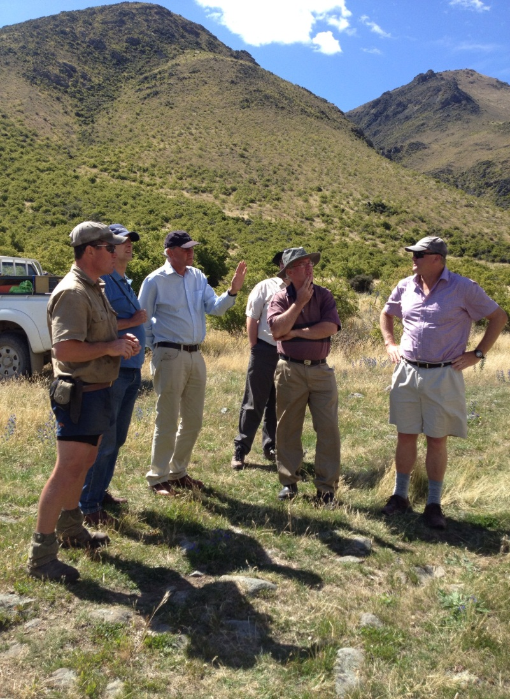
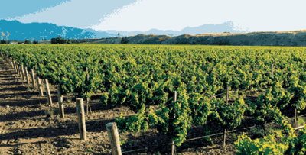
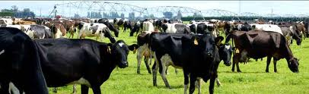
Careers, e.g., farming, horticulture, wine & forestry

Slide 10
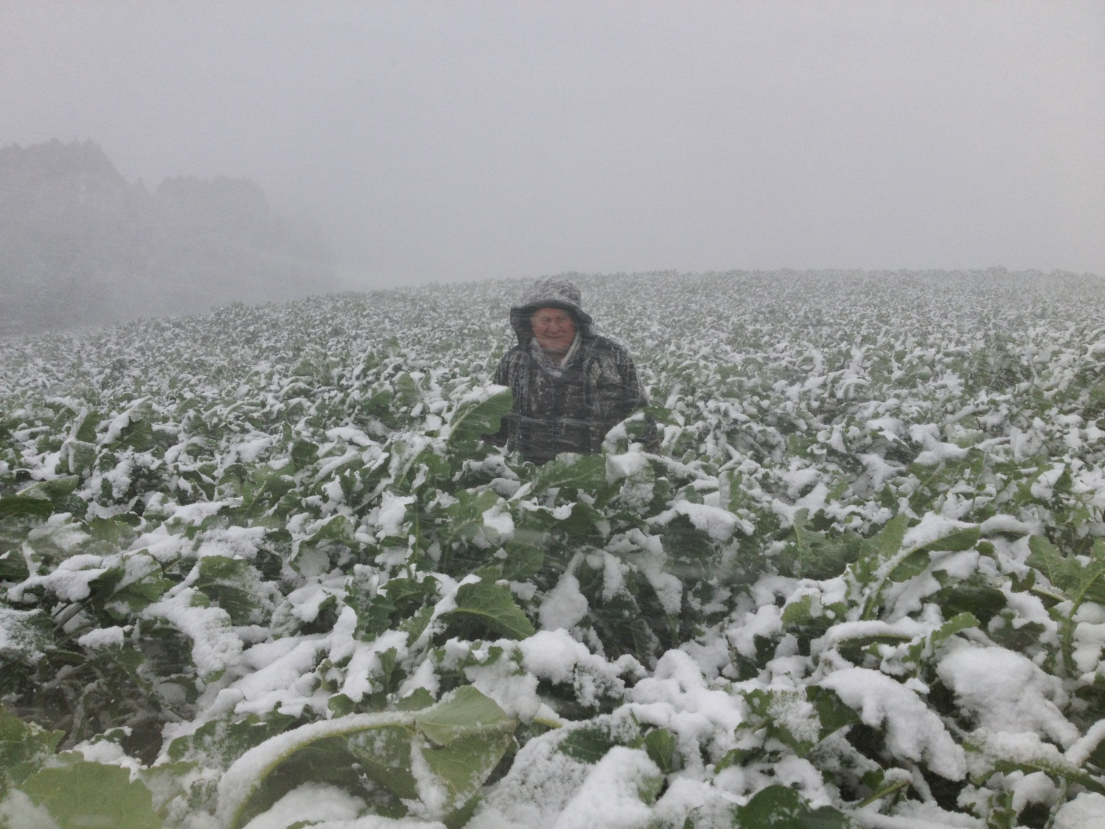
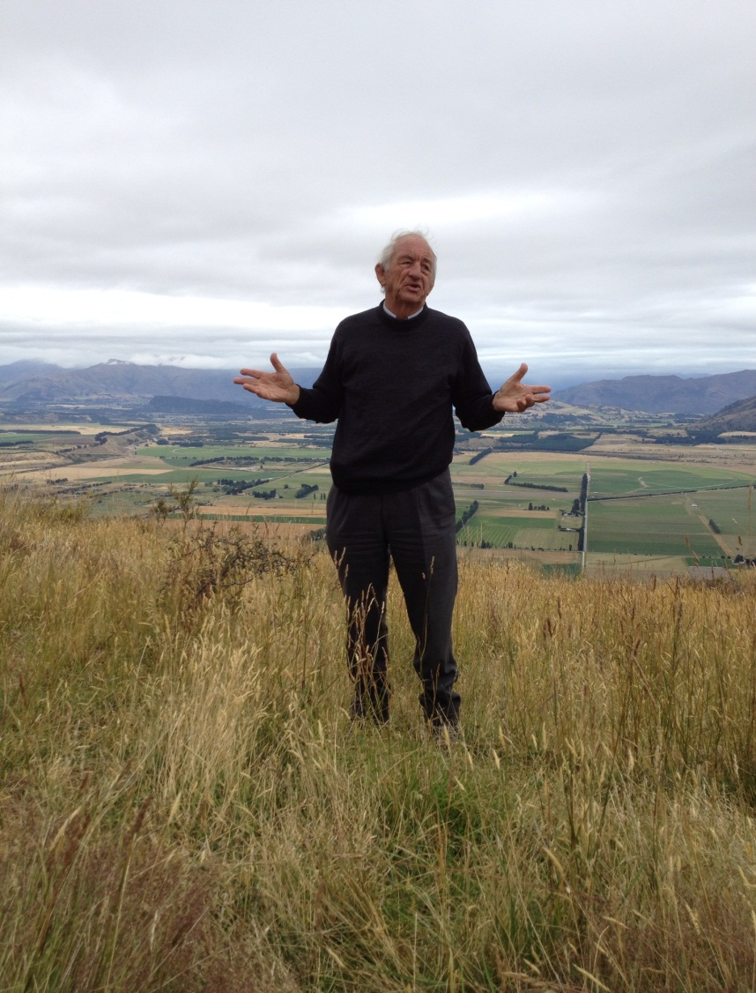
Careers e.g., professional advice
How to grow
Brassica in
Southland

Slide 11
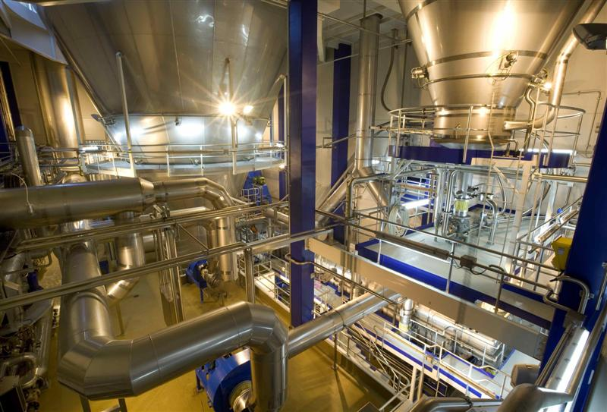
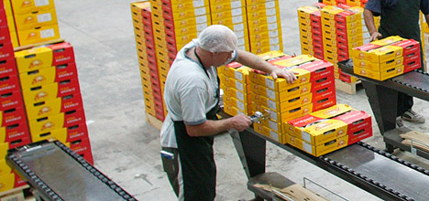
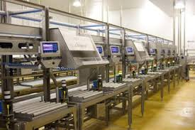
Careers e.g., food processing

Slide 12



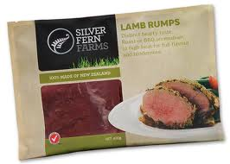
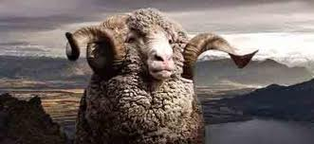
Careers e.g., marketing

Slide 13
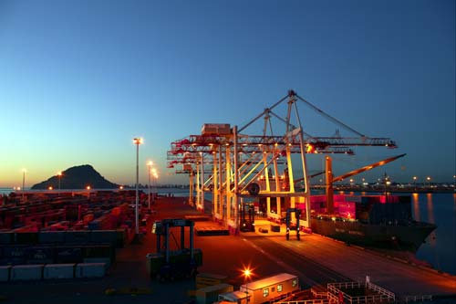
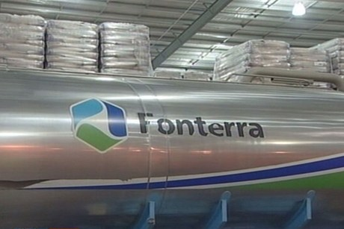
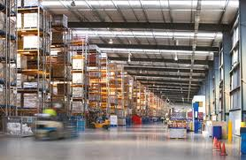
Careers e.g., logistics

Slide 14
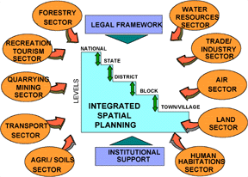
Careers e.g., planning

Slide 15

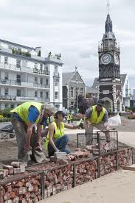
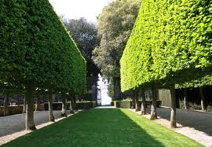
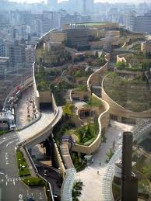

Careers e.g., landscapes

Slide 16

Careers e.g., rural banking

Slide 17
Lincoln’s contributions
Feeding the World
  supporting primary production, marketing and global supply chains
Sustaining the Future
  maintaining and enhancing our biophysical environment
Living Well
  balancing the demands of our economy, society and environment for everyone

Slide 18
Lincoln’s approach
Learning and Practice
  Learning at Lincoln is embedded in practice and connected to research
Research and Application
  Lincoln’s research is of international quality yet focussed on application
Partnership and Development
  Lincoln works in partnership to transform land, people and economies across NZ and the world

Slide 19
Lincoln’s qualifications
Reviewing all our qualifications to ensure they are fit for purpose; focus, co-ordination, depth
Focused on meeting the needs of NZ’s
land-based sectors
Ensuring that our graduates have the skills required by employers, and can make a lasting contribution; we don’t train for the first job, we educate for the career

Slide 20
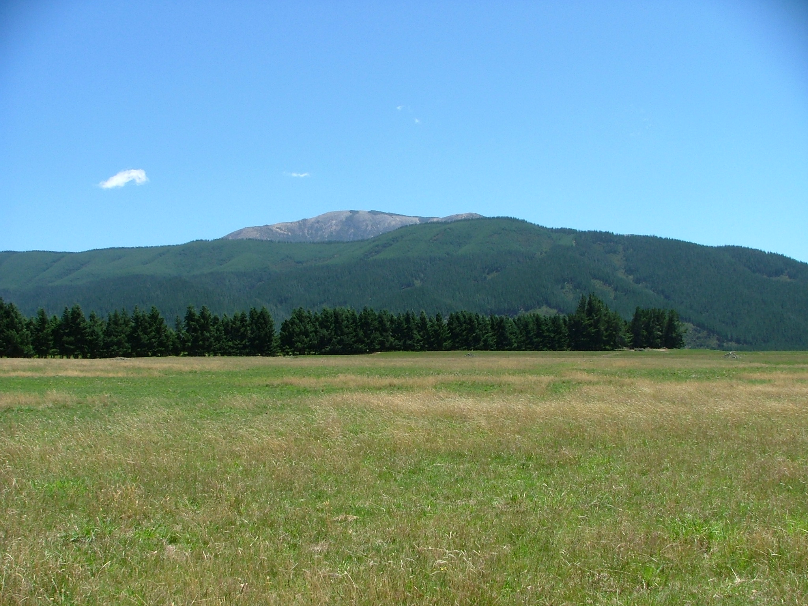
Lincoln’s Argyle Farm

Slide 21
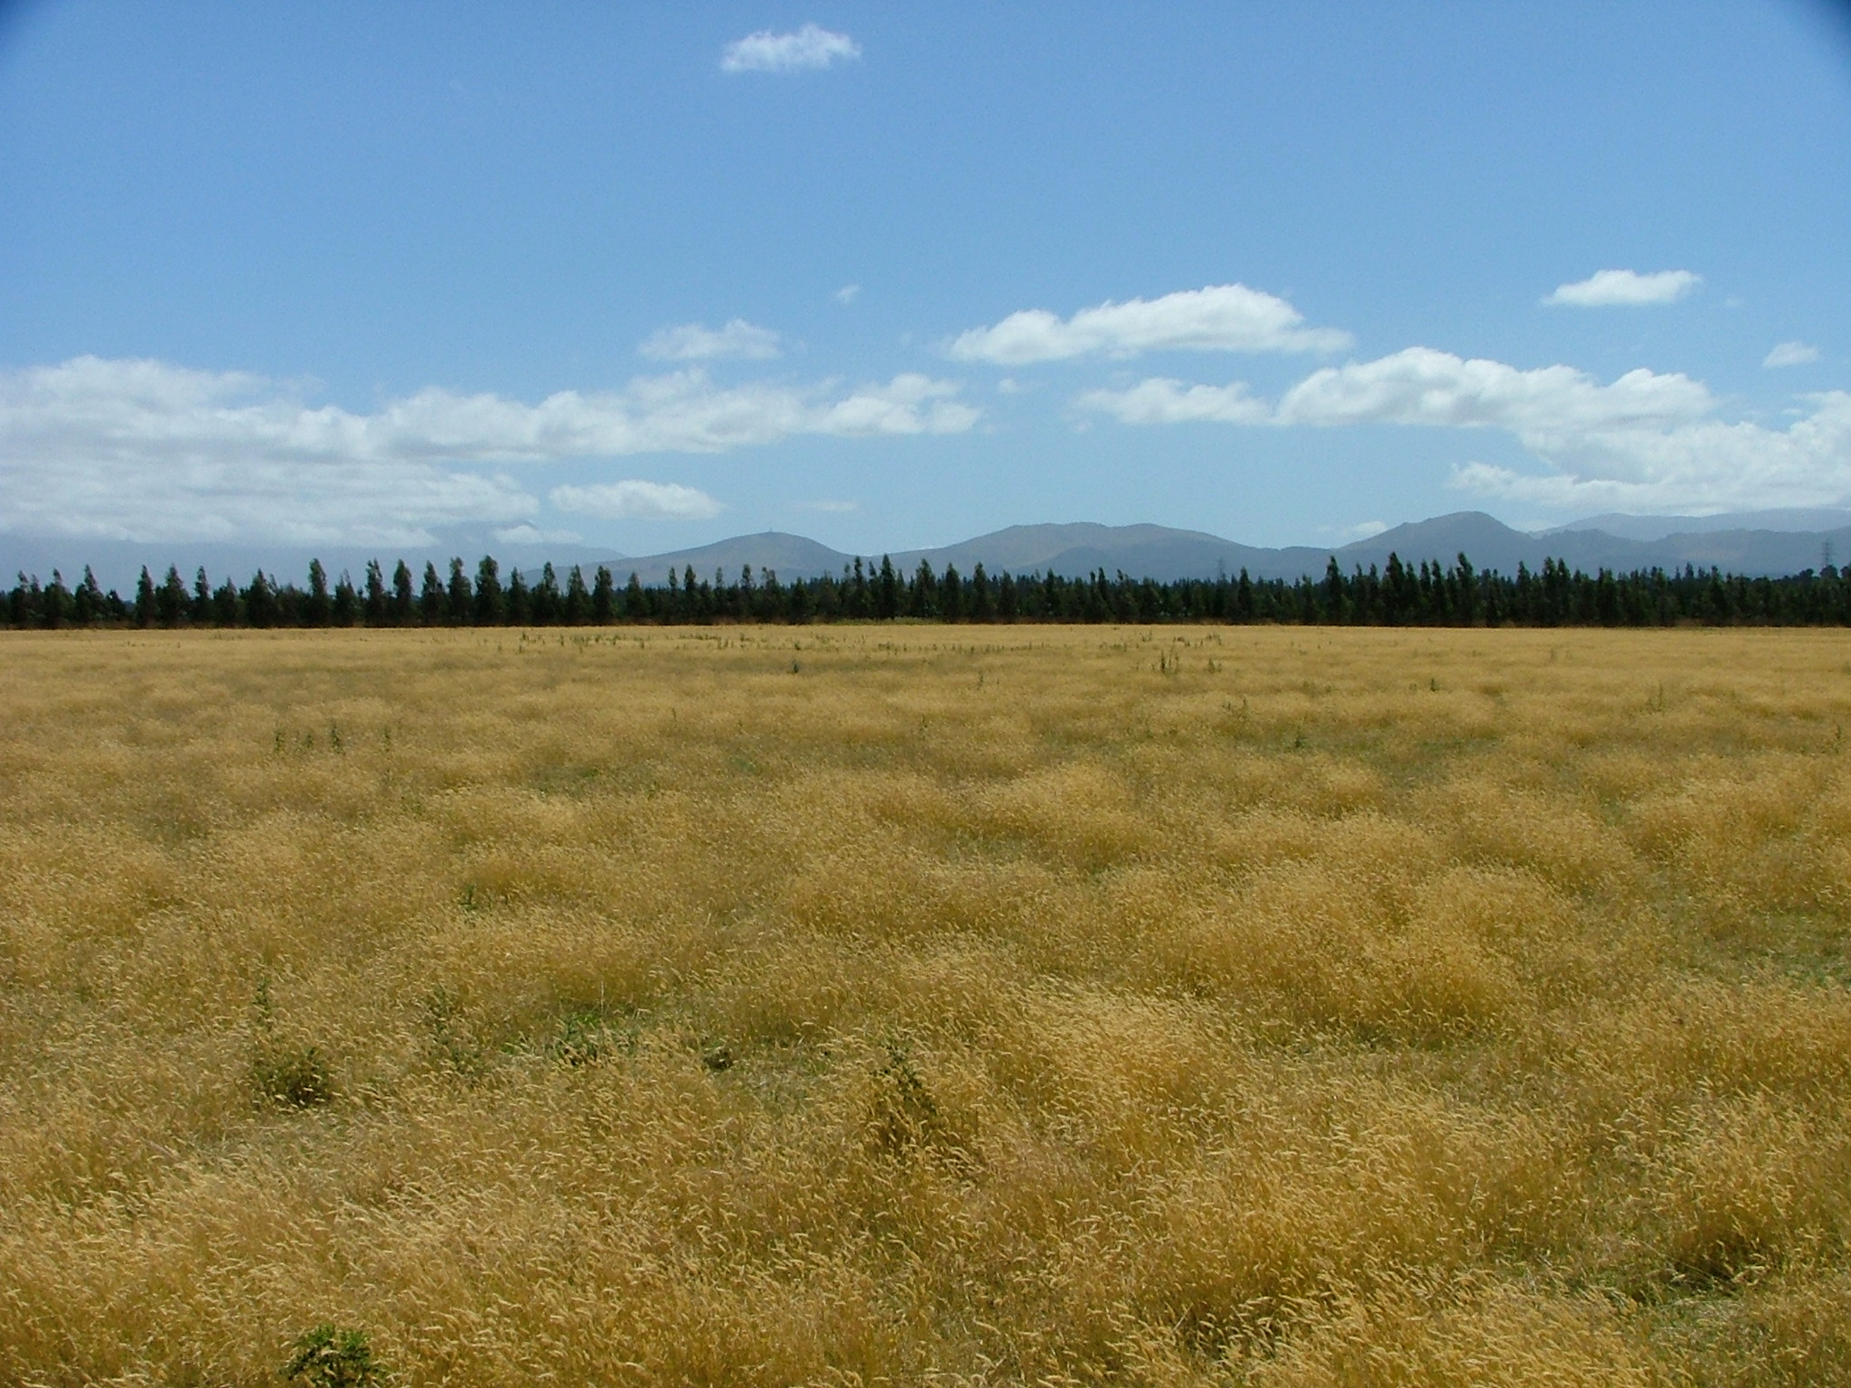
Lincoln’s Silverwood Farm

Slide 22
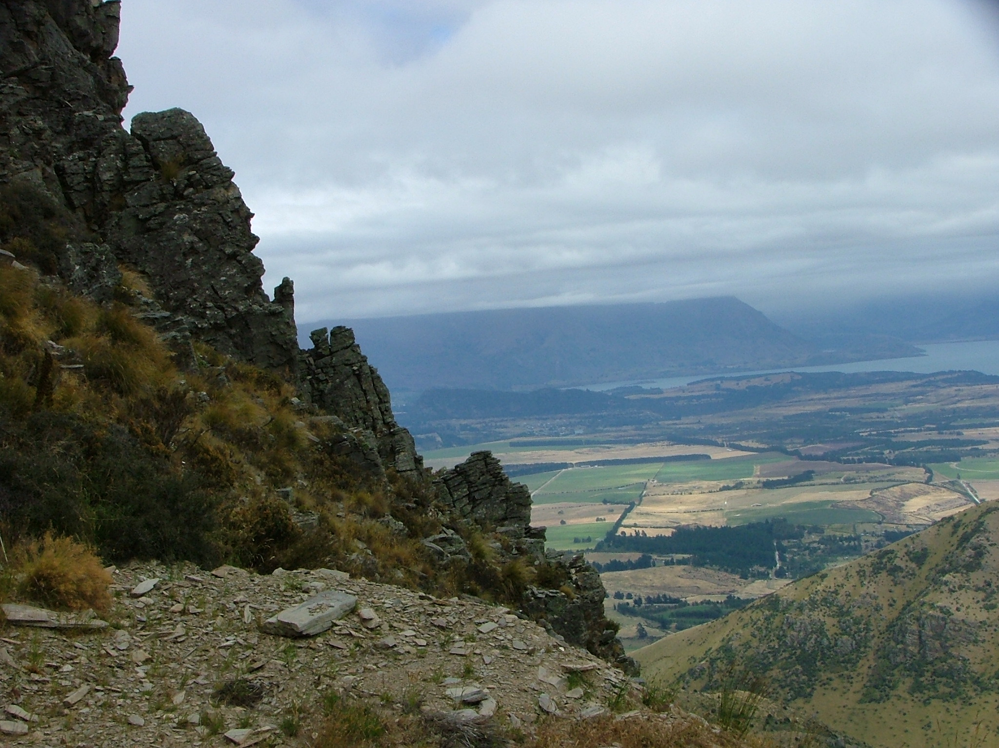
Lincoln’s Mt Grand Station

Slide 23
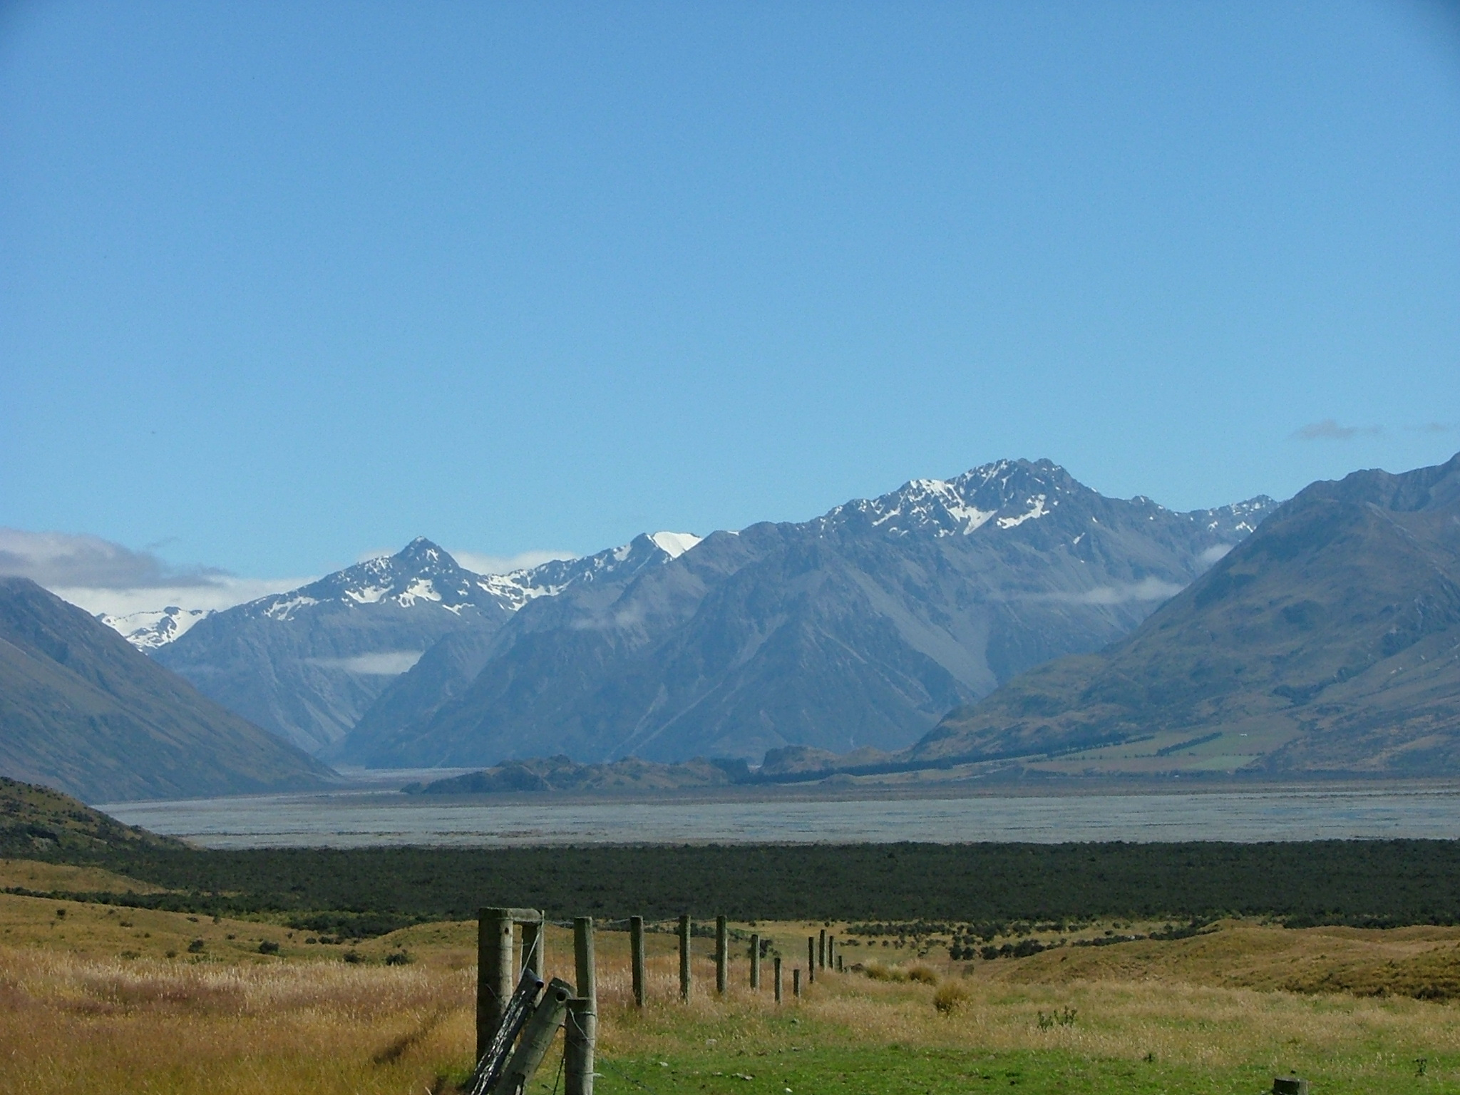
Lincoln’s Mesopotamia

Slide 24
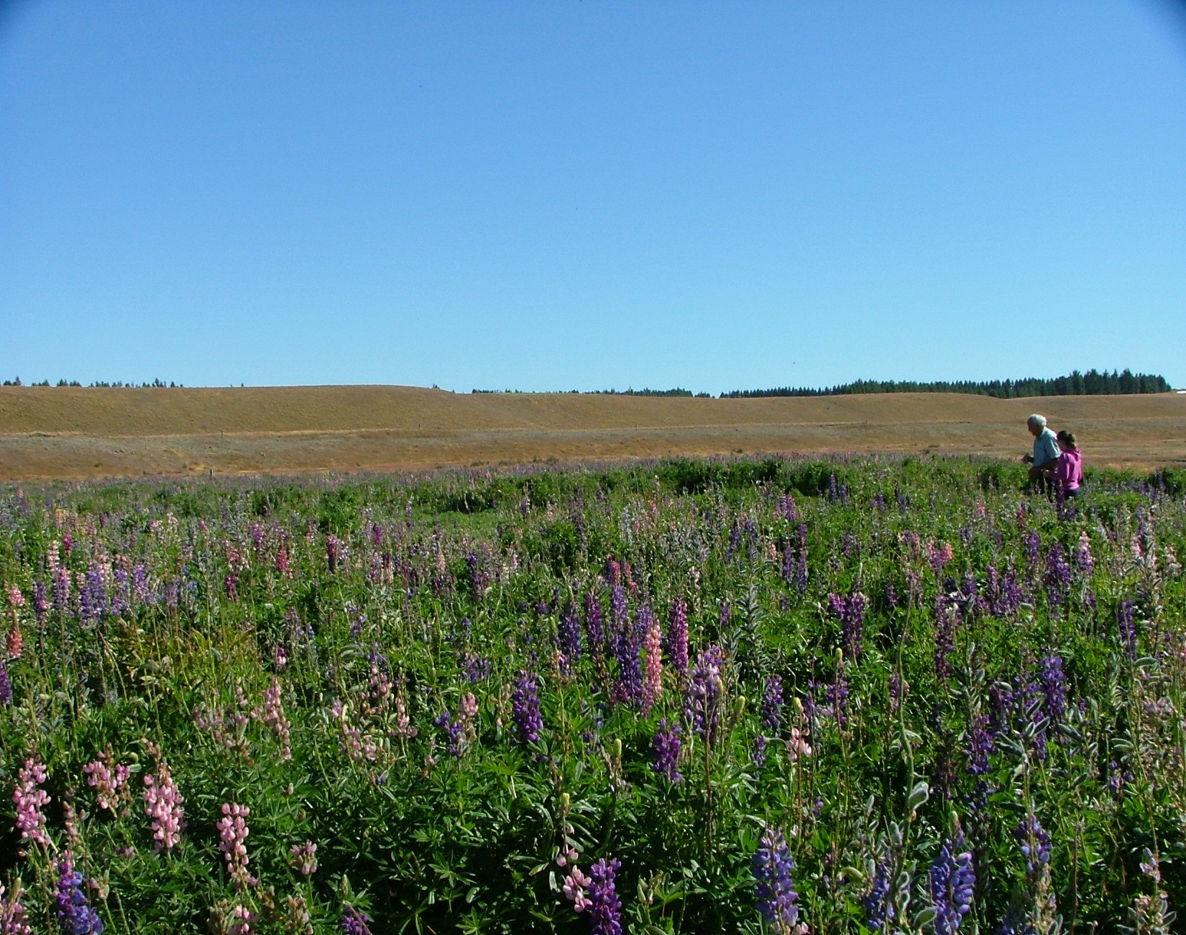
Lincoln’s field work (1) plants
Prof Lucas &
student on
research into
lupin establishment

Slide 25
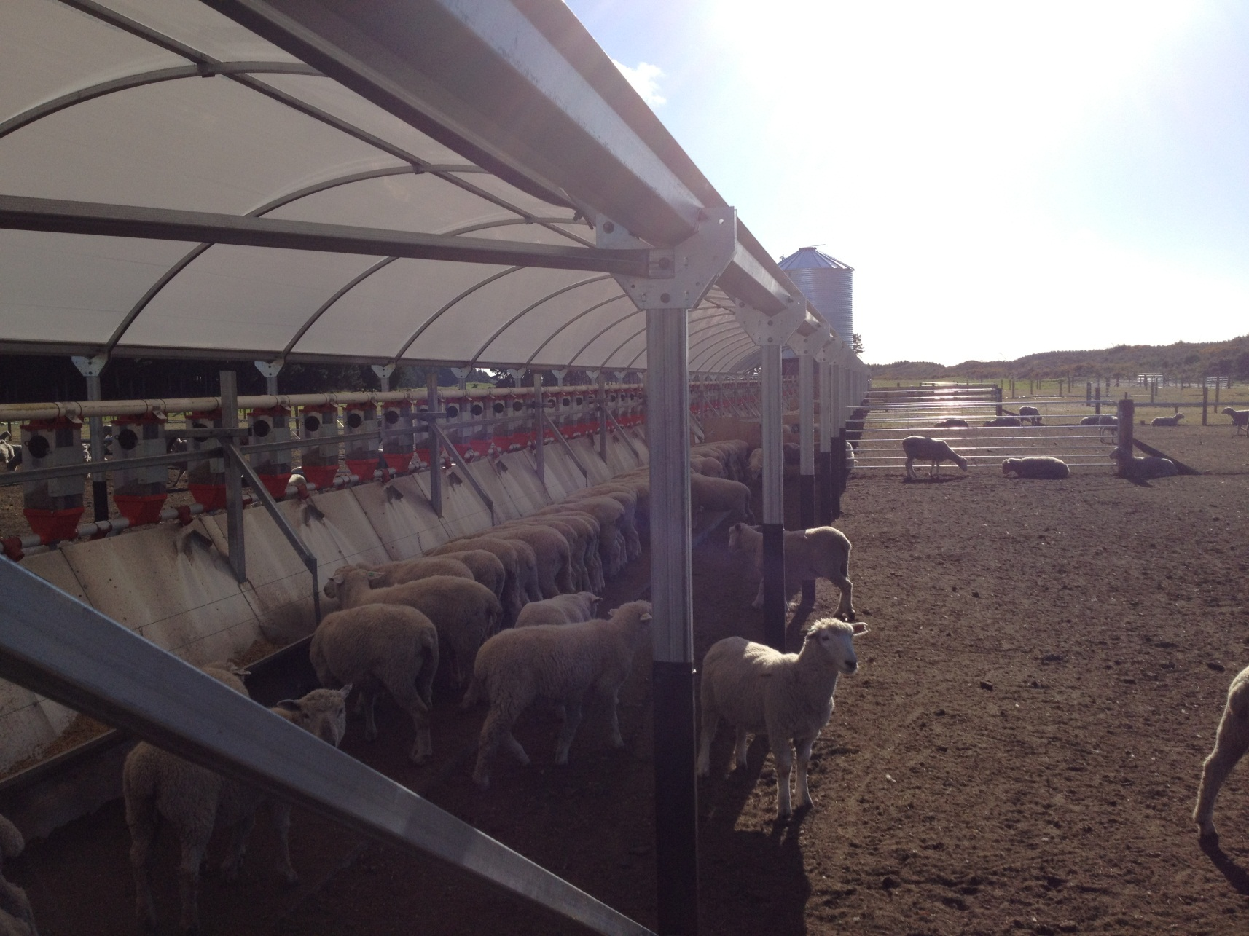
Lincoln’s field work (2) animals
Intensive lamb
finishing with
low footprint
and high
efficiency;
Lots of R&D,
commercially
sophisticated

Slide 26
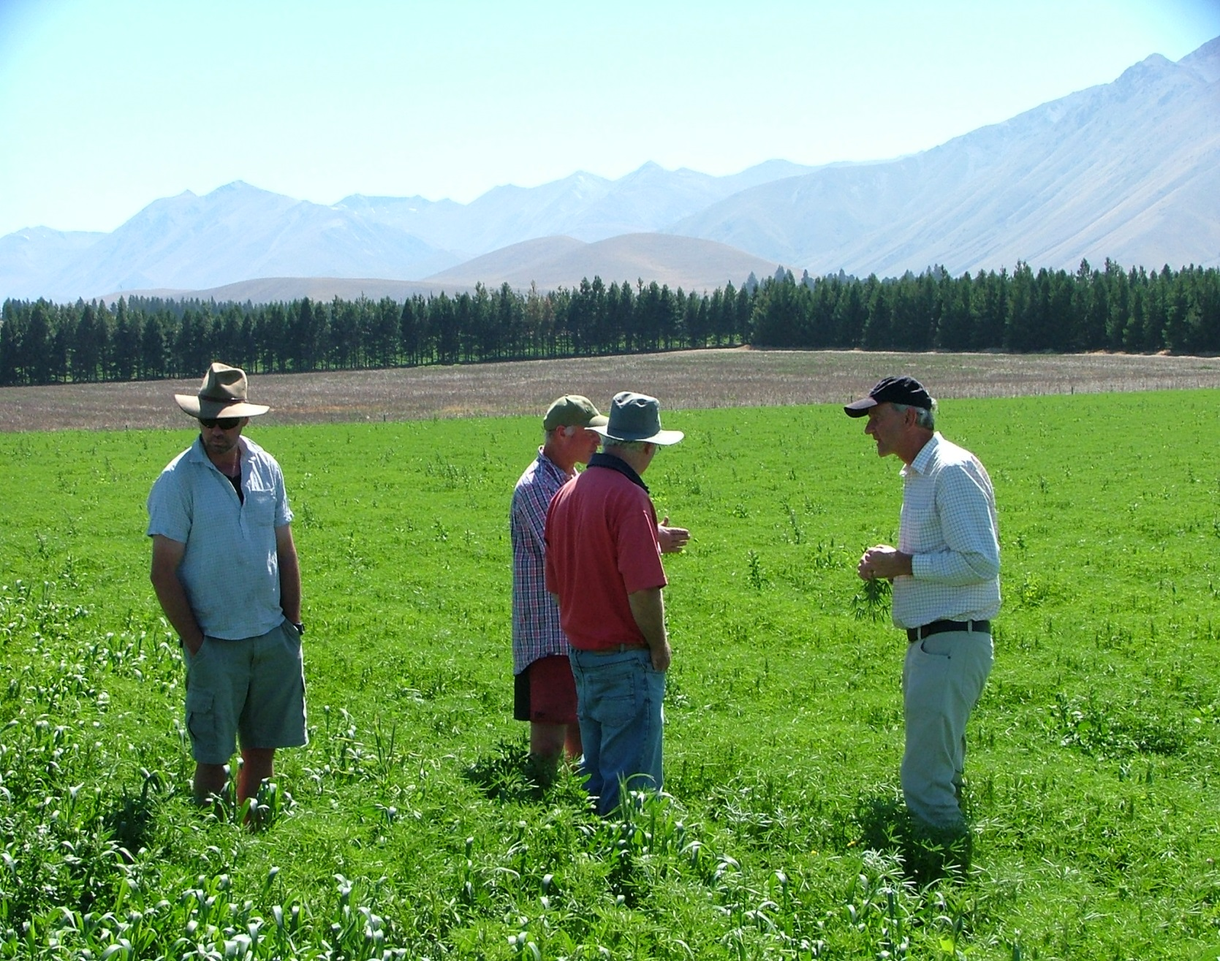
Lincoln’s field work (3) ecology
Two high country
station owners,
The Chancellor
and the Lincoln
Farms manager
discussing
complex
grassland swards

Slide 27
Lincoln’s school work
N4L
Preparing to implement major broad-band expansion
Telford distance education
STAR 1,000 students
Distance education via video-con c.800
Plans
Distance education into every high school that wants it –
agriculture, horticulture, equine etc
Support in running school farms (e.g., Northland College)

Slide 28
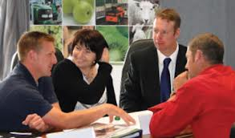

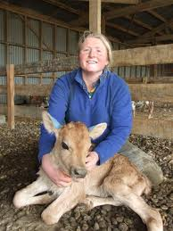
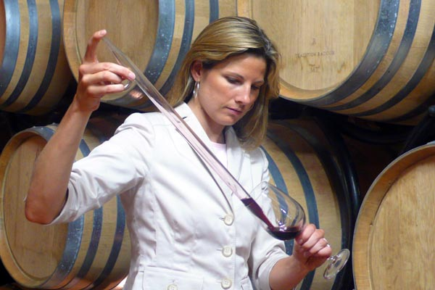
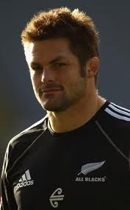
Levels 2-10 on the NQF

Slide 29
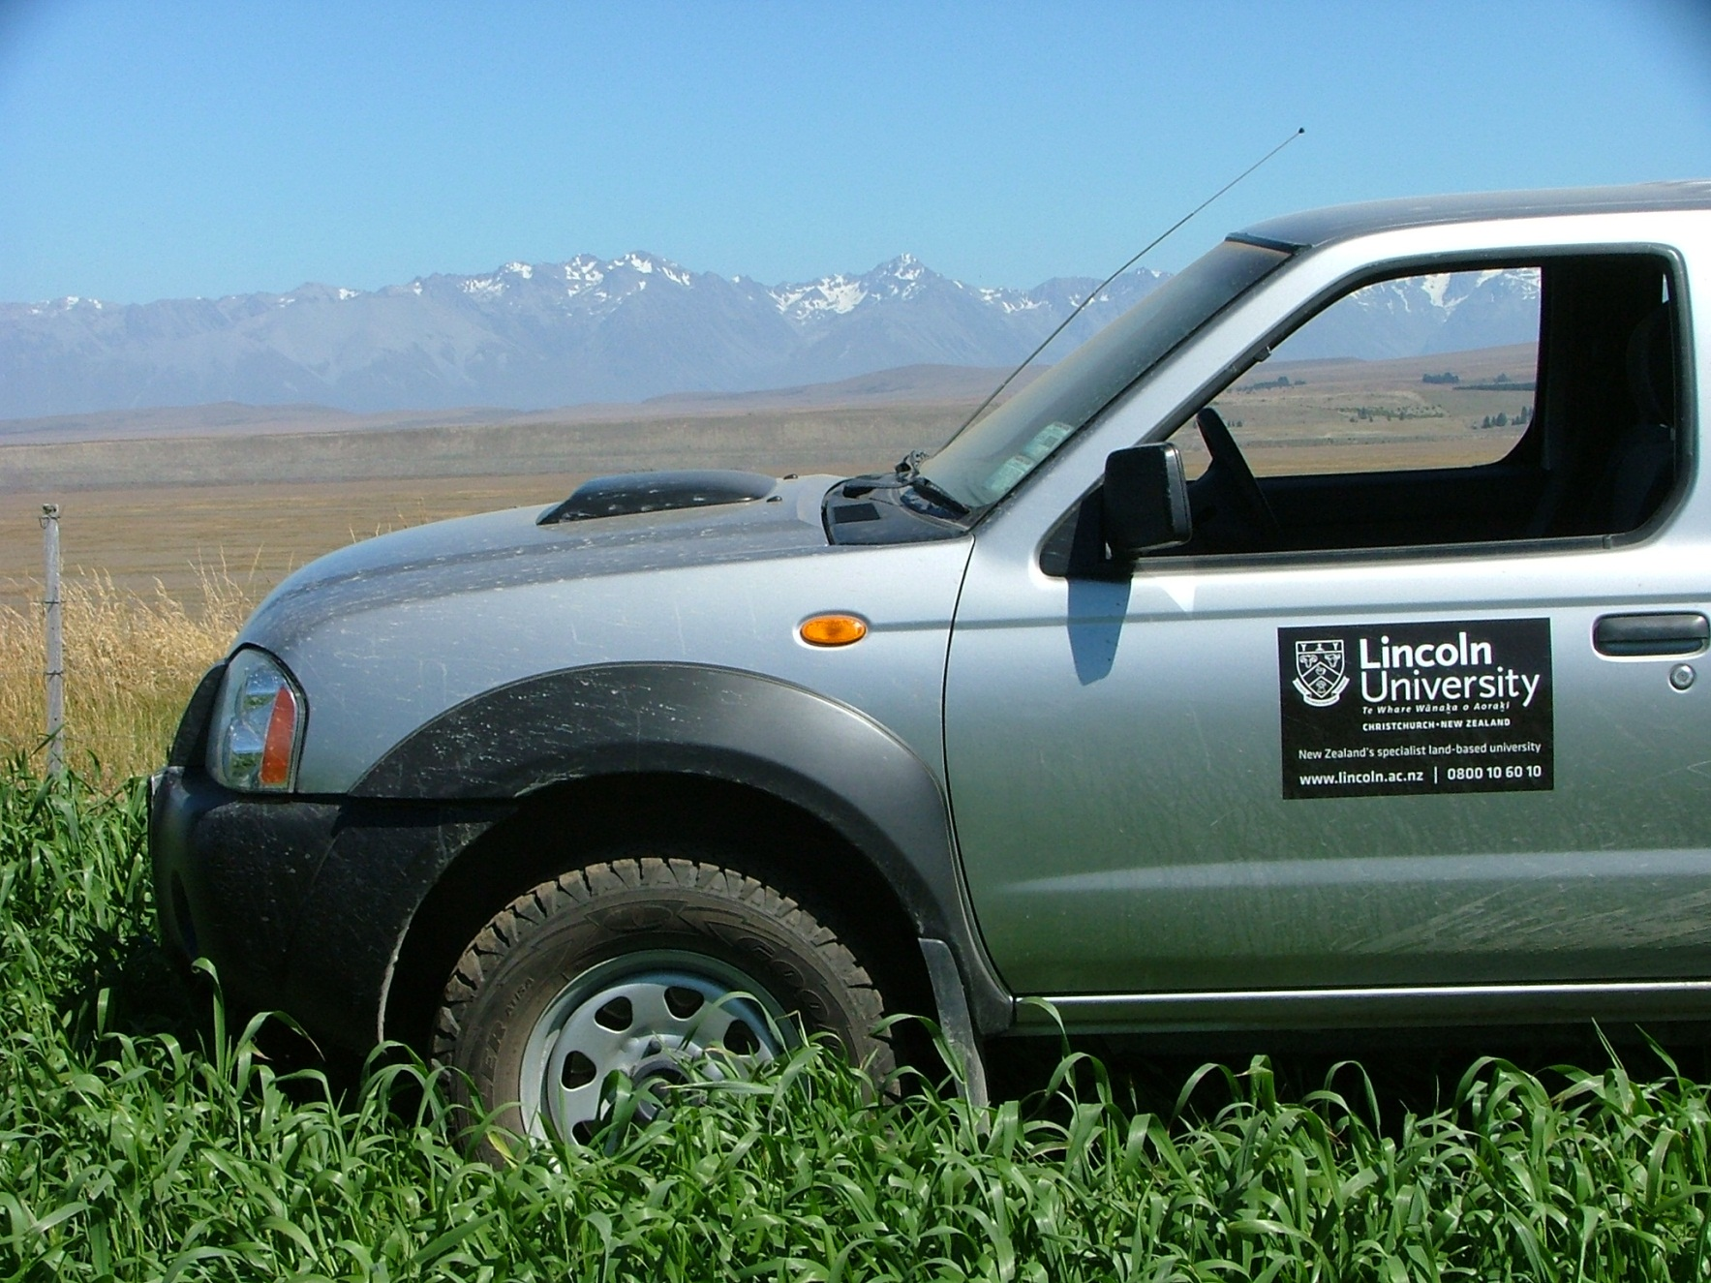
Thank you for the time!

Slide 30
Lincoln: New Zealand’s specialist land-based university

