Slide 1
Create a chart
In the message bar, click Enable Editing,
then press F5 or click Slide Show > From Beginning to start the course.
If the videos in this course don’t play, you may need to download QuickTime or just switch to PowerPoint 2013.

Slide 2
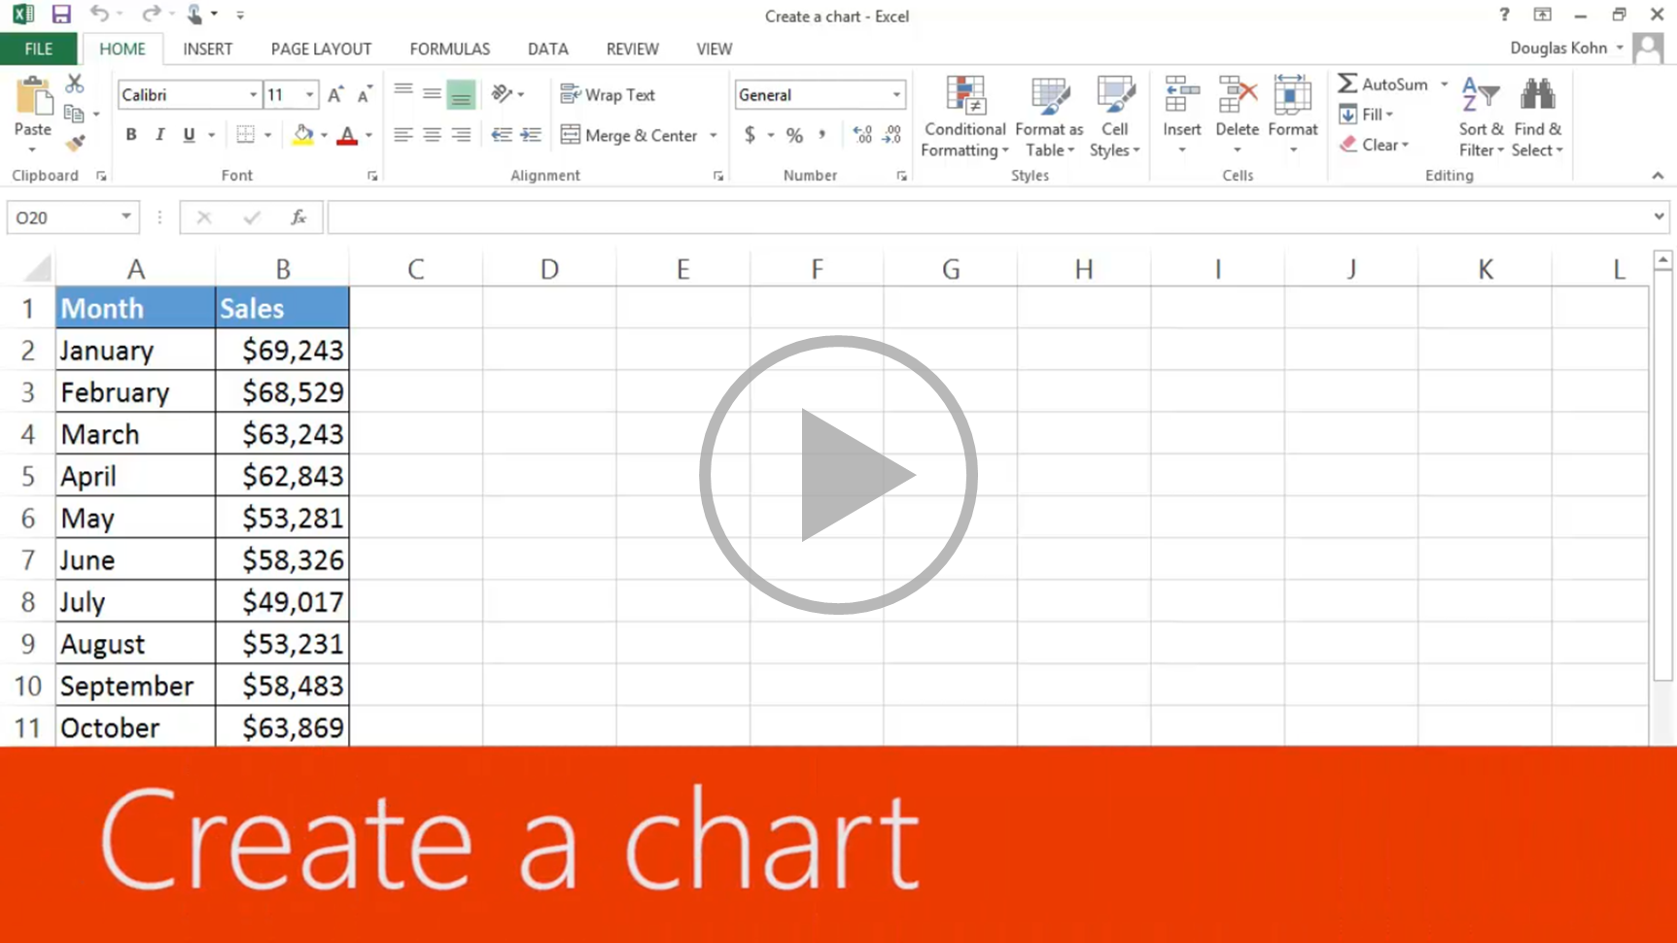
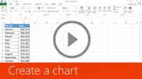
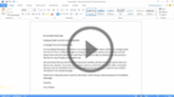
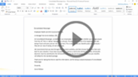
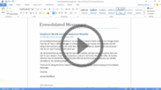
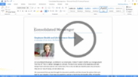
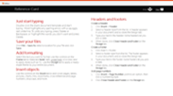
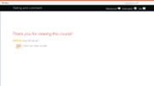
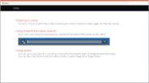

Create a chart
Closed captions
Charts provide a visual representation of your data, making it easier to analyze.
For example, I want to create a chart for sales, to see if there’s a pattern.
I select the cells I want to use for the chart, click the Quick Analysis button, and click the Charts tab.
Excel displays recommended charts based on the data in the cells selected.
You can hover over each one to see what looks good for your data.
Clustered Column is great for comparing data, so I click it.
And now I have an eye catching chart of the data. It looks like the summer months are slower and the winter months are busier.
Up next, Create pie, bar and line charts.
Press F5 to start, Esc to stop
1/5 videos
1:04
3:35
5:36
1:51
3:17
Create a chart
Pie, bar, & line
Customize
Combo charts
Copy a chart
Summary
Feedback
Help

Slide 3
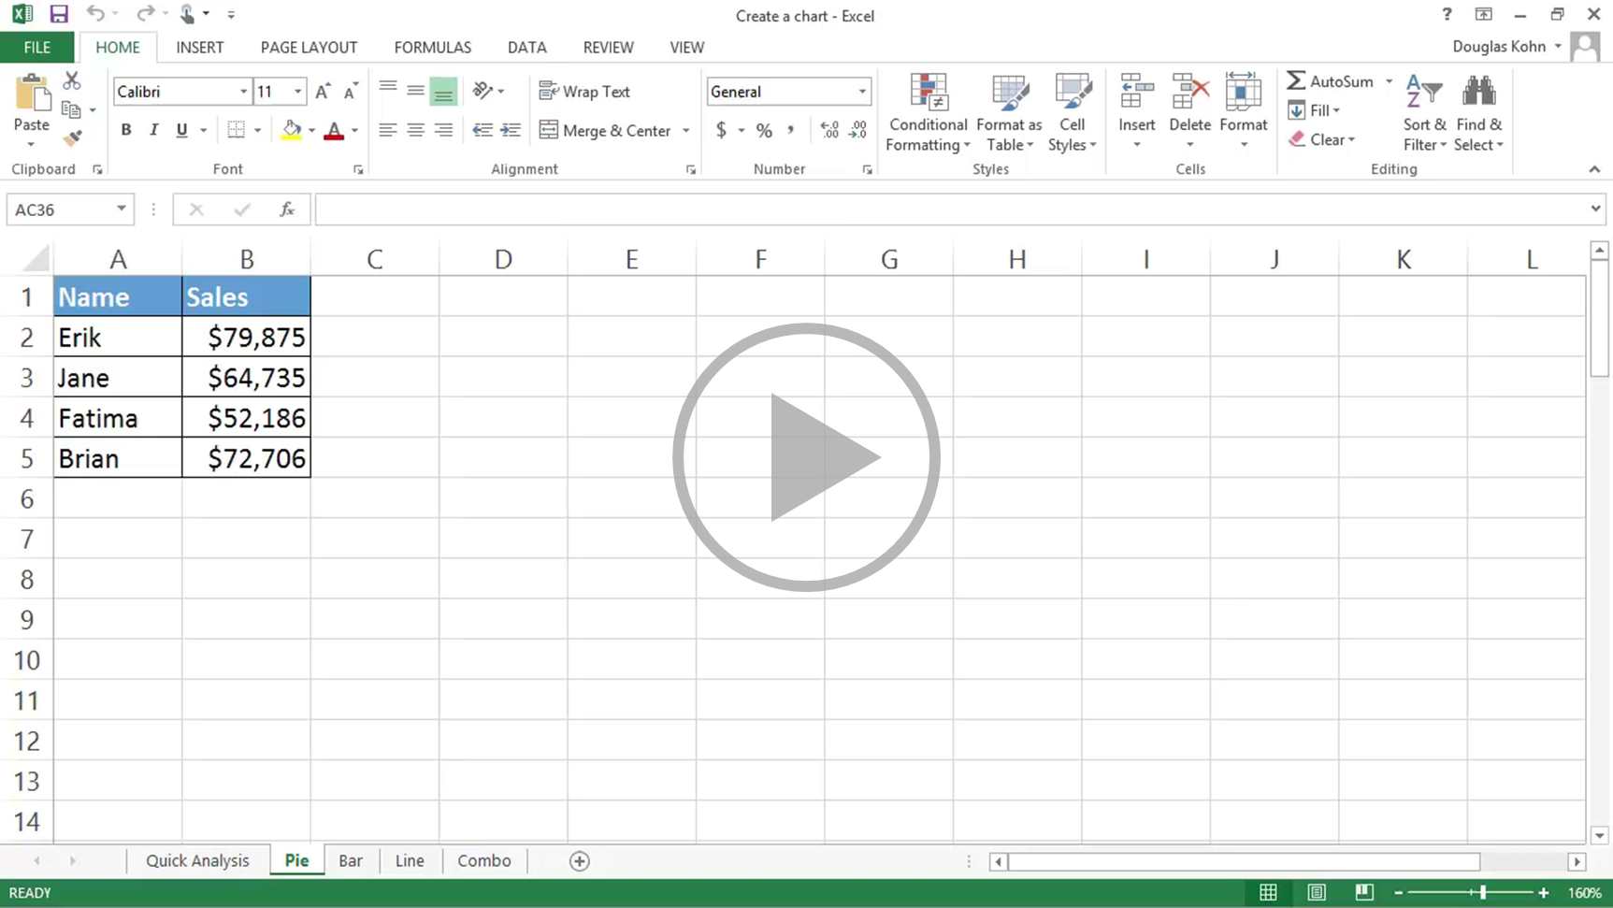

Create a chart
Closed captions
We created a clustered column chart in the previous video. In this video we’re going to create pie, bar, and line charts.
Each type of chart highlights data differently. And some charts can’t be used with some types of data.
We’ll go over this shortly.
To create a pie chart, select the cells you want to chart.
Click Quick Analysis and click Charts.
Excel displays recommended options based on the data in the cells you select, so the options won’t always be the same.
I’ll show you how to create a chart that isn’t a Quick Analysis option shortly.
Click the Pie option, and your chart’s created.
You can chart only one data series with a pie chart. In this example, those are the sales figures in cells B2 through B5.
I’m going to move and resize the chart so it displays without having to scroll, which will also make it easier to customize
(something we’ll look at in next video.)
I click the chart; hold down the left mouse button, and drag to move it.
I scroll down a little, click the bottom right-hand corner of the chart and drag it up and to the left to make it smaller.
Different data displays better in different types of charts.
If you try to graph too much data in a pie chart it looks like this, not very useful.
Now I’m creating a bar chart using the same data we used to create the pie chart.
Charting the same data different ways can provide you with a different perspective
that may help you discover different insights in the data.
We’re creating some of the more common chart types, but there are many more options.
To create charts that aren’t Quick Analysis options, select the cells you want to chart, click the Insert tab.
In the Charts group we have a lot of options.
Click Recommended Charts to see the charts that’ll work best with the data you’ve selected;
click All Charts for even more options.
These are all of the different types of charts you can create.
As I mentioned earlier, a pie chart isn’t a recommended option for the data we selected
because it can only display one data series.
We could make a Pie chart, but it would only show the first data series, the average precipitation for New York,
and not the second data series, the average precipitation for Seattle.
Instead, let’s make a Line with Markers chart.
Click Line, click Line with Marker, point to an option and you get a preview of the chart.
Click OK, and we’ve created our line chart.
Up next, Customize charts.
Press F5 to start, Esc to stop
2/5 videos
1:04
3:35
5:36
1:51
3:17
Create a chart
Pie, bar, & line
Customize
Combo charts
Copy a chart
Summary
Feedback
Help

Slide 4
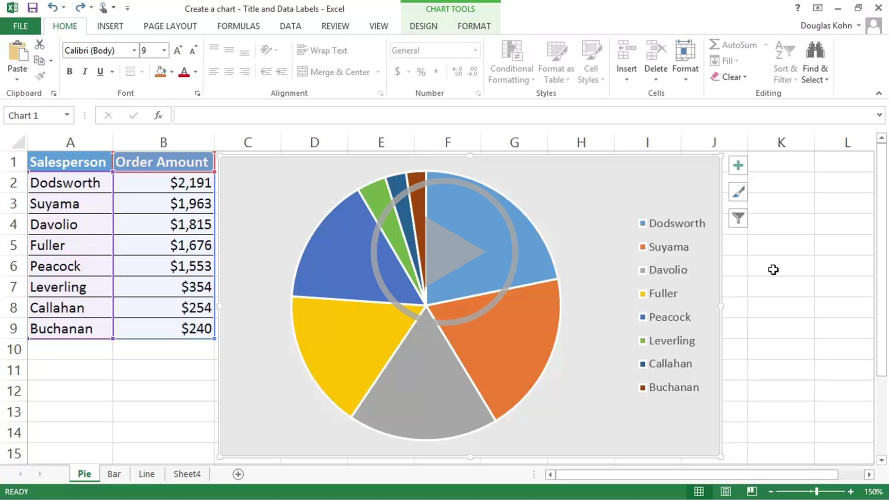
Create a chart
Closed captions
After you create your chart, you can customize it to show additional chart elements, such as titles and data labels,
or to make it look exactly the way you want.
We’re customizing the pie chart we created in the previous video.
To change the title, click it, and type the text you want.
When you select a title or label’s text you get a context sensitive menu that enables you to change its formatting,
such as font, font size, and font color.
If there isn’t a chart title, I’ll show you how to add one next.
To add elements to your chart, such as a title and data labels, select the chart.
The Chart Elements, Chart Styles, and Chart Filter buttons appear next to the chart.
Click the Chart Elements button and check or uncheck the elements you want to add or remove, such as Chart Title.
Different chart types have different elements, styles, and filters. To add data labels, you check Data Labels.
They look pretty good, but I want the labels to include Sales as a dollar value and as a percent of the total.
To do that, click the arrow beside Data Labels. I can point to each option and see a preview.
None of them give me what I want, so I click More Options. The Format Data Labels task pane appears.
A task pane provides you with more options for customizing elements.
I check Percentage and the data labels now contain what I want.
We’re almost done. But the overall look of the chart isn’t exactly what I want.
So I click the Chart Style button.
When you point to an option, you see a preview of what it’ll look like. I think this one looks good, so I click it.
And we have our finished pie chart.
Now we’re customizing the bar chart we created in the previous video.
Select the chart, click the Chart Elements button. The bar chart has more elements than the pie chart.
I check Data Table and it’s added to the chart.
To change the data series for the chart, right-click the chart,
click Select Data in the right-click menu, select the chart data range and click OK.
Now that I’ve seen the data charted, I think a column chart would work better.
But I don’t have to delete this chart and create a new one from scratch.
Instead, I right-click the chart, click Change Chart Type, click Column. It looks good, so I click OK.
And now we have a chart that does a great job of presenting the data.
Lastly, we’re customizing the line chart we created in the previous video.
I fill in the title.
I also want to add a title for the vertical axis of the chart, the numbers, so people will know what they represent.
I click the Chart Elements button, point to Axis Titles, click the arrow beside it,
check Primary Vertical, and type Inches into the title text box.
Data labels would make the chart easier to fully comprehend.
I click the Chart Elements button again.
If I checked Data Labels, it would put the values above the markers, which is a little confusing.
When I click the arrow beside Data Labels, I get options for where to place them.
I get a live preview when I point to an option. Right looks good, so I click it.
To filter the data in a chart, click the Chart Filter button, uncheck items you don’t want to display, and click Apply.
You check items and click Apply to display them.
You can double-click a chart or virtually any element in a chart for even more customization options.
I’m adding a finishing touch to the chart. I double-click the chart, expand Fill in the task pane, and select Gradient fill.
Lastly I make the chart a little bigger, and we’ve finished our chart.
Up next, Create a combo chart.
Press F5 to start, Esc to stop
3/5 videos
1:04
3:35
5:36
1:51
3:17
Create a chart
Pie, bar, & line
Customize
Combo charts
Copy a chart
Summary
Feedback
Help

Slide 5
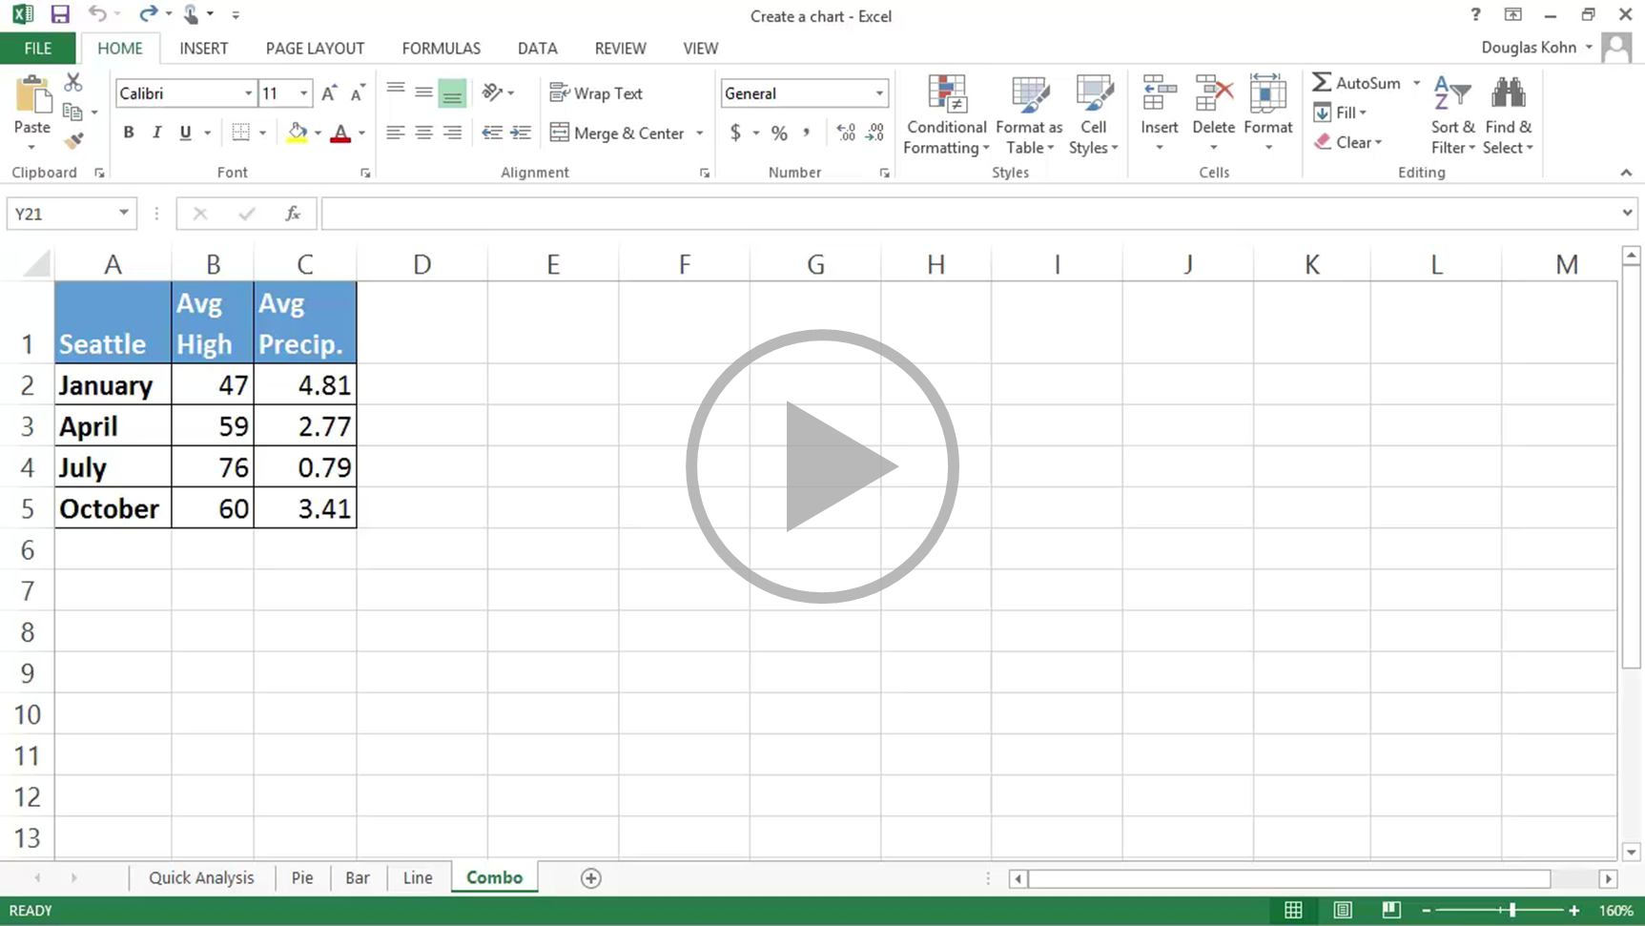
Create a chart
Closed captions
You can emphasize different types of data,
such as temperature and precipitation, by combining two or more chart types in one Combo chart.
Different types of data often have different value ranges and with a Combo chart you can include a secondary axis.
Select the cells you want to chart.
Combo chart isn’t a Quick Analysis option,
so we click the Insert tab on the ribbon, click the Combo button, and choose an option.
I’m moving and resizing the chart to make it easier to work with.
I give the chart a title.
Adding a secondary axis for precipitation will make the chart easier to understand.
I double-click the precipitation line in the chart and select Secondary Axis in the task pane.
It would make the chart even clearer if we added axis titles.
Click the Chart Elements button, click the arrow beside Axis Titles,
select Primary Vertical and Secondary Vertical, click the title text boxes and type the appropriate text.
Up next, Copy a chart.
Press F5 to start, Esc to stop
4/5 videos
1:04
3:35
5:36
1:51
3:17
Create a chart
Pie, bar, & line
Customize
Combo charts
Copy a chart
Summary
Feedback
Help

Slide 6
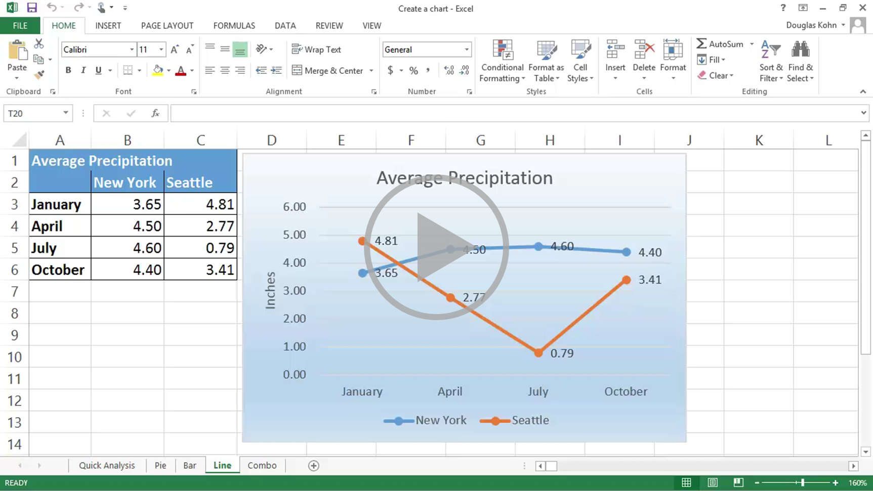
So check out the course summary at the end, and best of all, explore Excel 2013 on your own.
Create a chart
Closed captions
You can create a chart in an Excel worksheet and copy it to another worksheet.
You can also create a chart in Word or PowerPoint, but copying one from Excel is often more effective
because there are different ways to paste the chart into the other programs.
To copy a chart to another worksheet in the same or a different workbook, right-click the chart and click Copy.
I already have another workbook open, so I’m pressing the Alt and Tab keys to bring it to the forefront.
This workbook has a different theme applied.
Click the tab of the worksheet you want to paste the chart on to.
Click the cell where you want the upper left hand corner of the chart and right-click the cell.
There are three paste buttons, as well as Paste Special.
You can paste and use the destination workbook’s theme;
paste and use the formatting from the source workbook
(when you point to a button you get a live preview,
with both of these options, if you change the data for the chart the chart updates automatically);
you can also paste the chart as a picture.
With this option the chart can’t be updated or edited.
Paste Special provides more options for pasting as different picture formats.
I’m going to paste it using this workbook’s theme.
To paste the chart to another Office application, such as Word, copy the chart.
I already have a document opened; it also has a different theme applied.
Right-click the document.
If you want to keep the data with the chart, where you can edit it, but not have it linked to the source worksheet,
choose Use Destination Theme & Embed Workbook, or Keep Source Formatting & Embed Workbook.
If you want to keep the chart linked to the source worksheet,
so that changes you make to the data in the source worksheet updates the chart in Word,
choose Use Destination Theme & Link Data, or Keep Source Formatting & Link Data.
You can also paste the chart as a picture.
I’m going to select Use Destination Theme & Link Data.
This way it’ll blend with the document’s theme but update when I change the data in the source spreadsheet.
If the chart in Word doesn’t show the changes you’ve made to the data in the source worksheet,
in Word, click the chart, click the Chart Tools Design tab, and click Refresh Data.
Now you’ve got a pretty good idea about how to create charts. Of course, there’s always more to learn.
Press F5 to start, Esc to stop
5/5 videos
1:04
3:35
5:36
1:51
3:17
Create a chart
Pie, bar, & line
Customize
Combo charts
Copy a chart
Summary
Feedback
Help

Slide 7

Help
Course summary—Create a chart
Course summary
Create a chart
Select the data for which you want to create a chart.
Click Insert > Recommended Charts.
On the Recommended Charts tab, scroll through the list of charts that Excel recommends for your data, and click any chart to see how your data will look. If you don’t see a chart you like, click All Charts to see all available chart types.
When you find the chart you like, click it > OK.
Use the Chart Elements, Chart Styles, and Chart Filters buttons next to the upper-right corner of the chart to add chart elements like axis titles or data labels, customize the look of your chart, or change the data that’s shown in the chart.
To access additional design and formatting features, click anywhere in the chart to add the Chart Tools to the ribbon, and then click the options you want on the Design and Format tabs.
Create a combo chart with a secondary axis
In Excel 2013, you can quickly show a chart like the one above by changing your chart to a combo chart.
Click anywhere in the chart you want to change to a combo chart to show the Chart Tools.
Click Design > Change Chart Type.
On the All Charts tab, choose Combo, and then pick the Clustered Column - Line on Secondary Axis chart.
Under Choose the chart type and axis for your data series, check the Secondary Axis box for each data series you want to plot on the secondary axis, and then change their chart type to Line.
Make sure that all other data series are shown as Clustered Column.
See also
Copy an Excel chart to another Office program
Create a chart
Create a combo chart with a secondary axis
More training courses
Office Compatibility Pack
Press F5 to start, Esc to stop
1
2
3
4
5
6
7
8
1:04
3:35
5:36
1:51
3:17
Create a chart
Pie, bar, & line
Customize
Combo charts
Copy a chart
Summary
Feedback
Help

Slide 8

Help
Rating and comments
Course summary
How did we do? Please tell us what you think
Thank you for viewing this course!
Check out more courses
Press F5 to start, Esc to stop
1
2
3
4
5
6
7
8
1:04
3:35
5:36
1:51
3:17
Create a chart
Pie, bar, & line
Customize
Combo charts
Copy a chart
Summary
Feedback
Help

Slide 9

Help
Help
Course summary
Using PowerPoint’s video controls
  Point at the bottom edge of any video to start, stop, pause, or rewind. You drag to rewind.
Stopping a course
  If you’re viewing online, click your browser’s Back button. If you’re viewing offline, press Esc. If you’re watching a video, press Esc once to stop the video, again to stop the course.
Going places
  You can go to any part of a course by clicking the thumbnails (light or shaded) below the video. You can also click the forward and back arrows, or press Page Up or Page Down.
If you download a course and the videos don’t play
Click Enable Editing if you see that button. If that doesn’t work, you may have PowerPoint 2007 or earlier. If you do, you need to get the PowerPoint Viewer. If you have PowerPoint 2010, you need the QuickTime player, or you can upgrade to PowerPoint 2013.
Press F5 to start, Esc to stop
1
2
3
4
5
6
7
8
1:04
3:35
5:36
1:51
3:17
Create a chart
Pie, bar, & line
Customize
Combo charts
Copy a chart
Summary
Feedback
Help

