Slide 1
Basic math in Excel 2013
In the message bar, click Enable Editing,
then press F5 or click Slide Show > From Beginning to start the course.
If the videos in this course don’t play, you may need to download QuickTime or just switch to PowerPoint 2013.
j

Slide 2
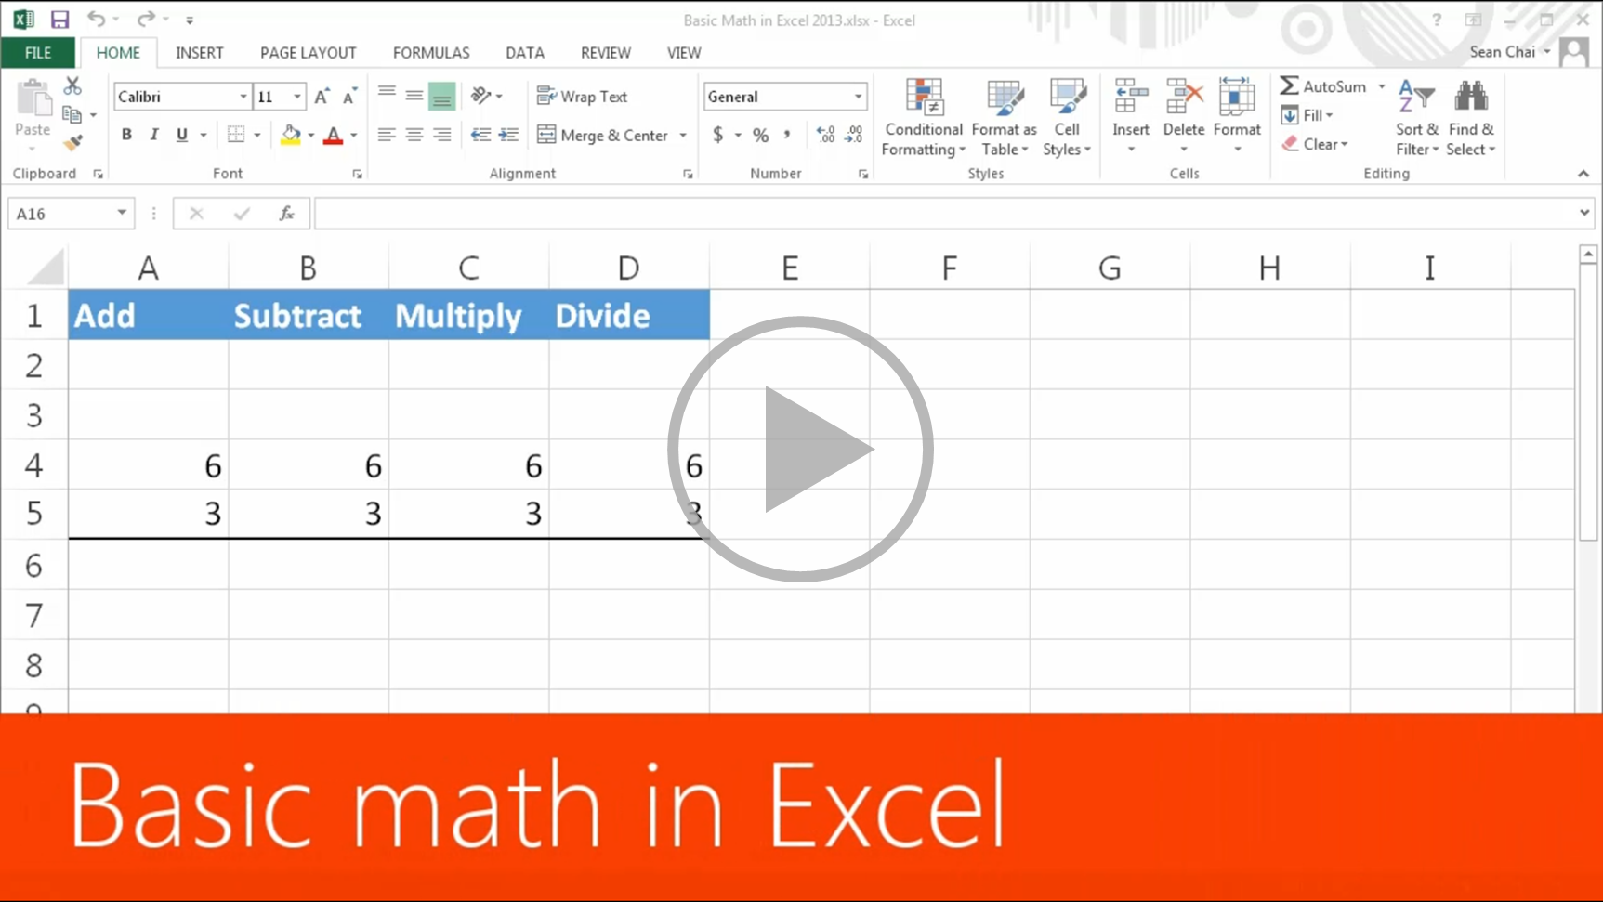
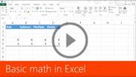





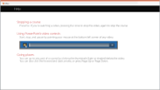

Basic math in Excel 2013
Closed captions
Let Excel be your calculator.
With a simple formula, Excel can perform calculations on numbers using operators,
such as the plus sign, and functions, such as SUM.
To add numbers, you use the plus sign.
A formula always starts with an equals sign.
If I then type a number, a plus sign, another number, and then press Enter, the cell displays the results.
You can add many numbers this way, not just two.
Instead of typing numbers in a formula,
you can reference cells that contain numbers to make adding a bit easier and more flexible.
A4 is equal to 6, A5 is equal to 3.
I’ll create a formula that adds the cells.
As with all formulas, I start again with the equals sign,
click a cell, type a plus sign, then another cell, and press Enter.
And if I change a number in a cell, the result of the formula automatically updates.
When you double-click a cell you can see right in the cell if it’s a formula, like A6,
or a number, like A4, or you can click a cell and look up here in the Formula Bar.
Subtracting is similar to adding, except you use the minus sign.
Click a cell, then a minus sign, then another cell, and press Enter.
Multiplying is similar to adding or subtracting, except you use an asterisk.
Don't use an X for multiplying; that won't work.
Click a cell, then an asterisk, then another cell, and press Enter.
Dividing is similar to multiplying, except you use a forward slash.
Click a cell, then a forward slash, then another cell, and press Enter.
Up next, Using functions
Press F5 to start, Esc to stop
1/4 videos
2:35
5:19
2:12
4:28
Basic math
Using functions
Operator order
More formulas
Summary
Feedback
Help

Slide 3
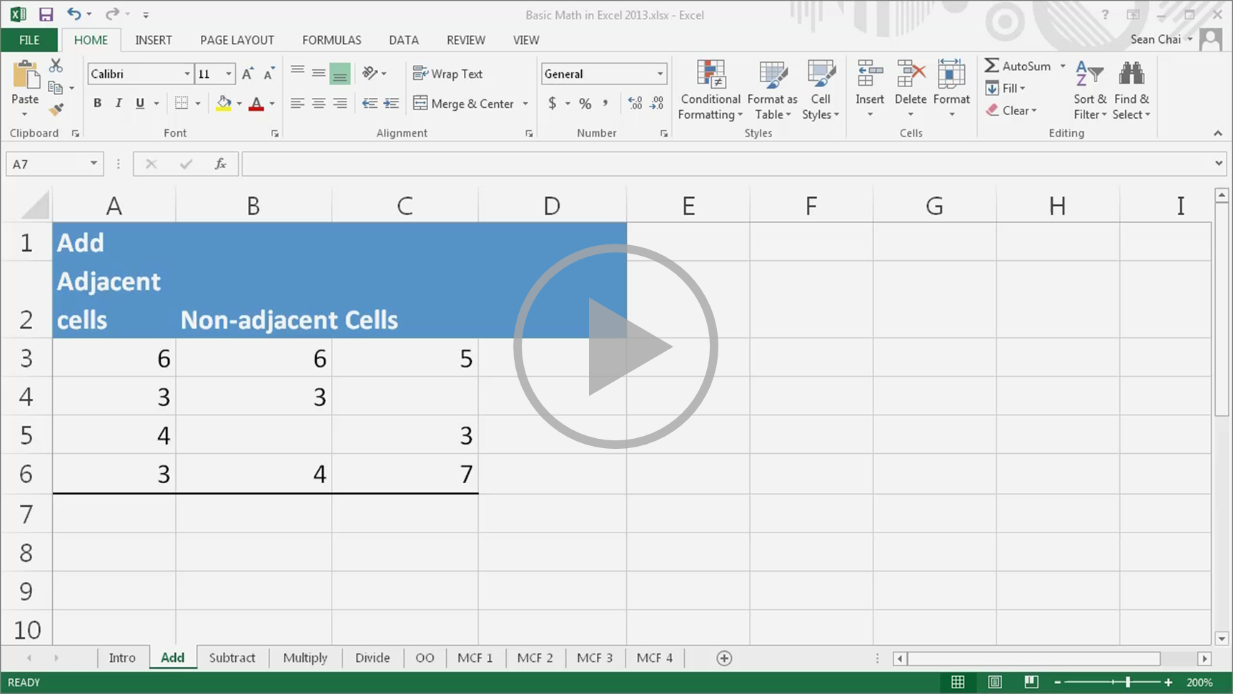

Basic math in Excel 2013
Closed captions
AutoSum makes it easy to add adjacent cells in rows and columns.
You could type out =A3+A4+A5+A6, but that’s tedious.
Instead, click the cell to the right of a row or below a column.
Then, on the Home tab, click AutoSum, verify that the formula is what you want, and click AutoSum again.
AutoSum adds the row or column automatically. It’s really handy.
When I double-click inside a cell where I'm using AutoSum, I see it’s a formula with the SUM function.
A function is a predefined formula. It helps save you time.
The syntax, or grammar, of the SUM function is SUM, open parenthesis,
arguments—like numbers or cell references separated by commas—and finally, close parenthesis.
This formula is SUM, A3, colon, A6.
The colon indicates a range of cells. This formula adds the cells from A3 through A6.
When adding a few cells, the SUM function saves you time. With larger ranges of cells it’s essential.
If I try to use AutoSum here, it only gets the adjacent cell, not the entire column.
Why? Because B5 is empty.
If B5 wasn't empty, B3 through B6 would be an adjacent range of cells that AutoSum could recognize.
To add cells and ranges of cells that aren’t adjacent:
SUM, hold down the Ctrl key, click the desired cells and ranges of cells, and press Enter.
The formula uses the SUM function to add the cells containing numbers and ignores the empty cells.
Subtraction is similar to addition, but there isn’t a SUBTRACTION function.
To subtract, you use a basic formula like: number or cell, minus, the next number or cell, and so on.
You can SUM numbers where some of them are negative.
The keyboard shortcut for AutoSum is Alt+=, and then I press Enter.
This is equivalent to 6 minus 3 plus 4 minus 5.
You can also subtract the results of one SUM function from another.
SUM, select a range of cells, minus, SUM, select another range of cells, and press Enter.
As I mentioned about adding earlier, to multiply cells, you could type out =A3*A4*A5*A6, but that’s tedious.
To speed things up, use the PRODUCT function to multiply numbers or cells.
PRODUCT is similar to the SUM function, but instead of adding numbers it multiplies them.
It’s another example of how functions help save you time.
The syntax of the PRODUCT function is PRODUCT, open parenthesis,
arguments—like numbers or cell references separated by commas—and finally, close parenthesis.
To multiply cells and ranges of cells in one formula:
PRODUCT, hold down the Ctrl key, select the desired cells and ranges of cells, and press Enter.
The formula uses the PRODUCT function to multiply cells containing numbers and ignores the empty cells.
Division is similar to multiplication, but there isn’t a DIVIDE function.
A basic formula would be: number or cell, forward slash, the next number or cell, and so on.
You can divide the results of one function, such as PRODUCT, by the results of another, such as SUM.
This formula divides the PRODUCT of the cells in B3 through B6, by the SUM of the cells in C3 through C6.
Up next, Operator order
Press F5 to start, Esc to stop
2/4 videos
2:35
5:19
2:12
4:28
Basic math
Using functions
Operator order
More formulas
Summary
Feedback
Help

Slide 4
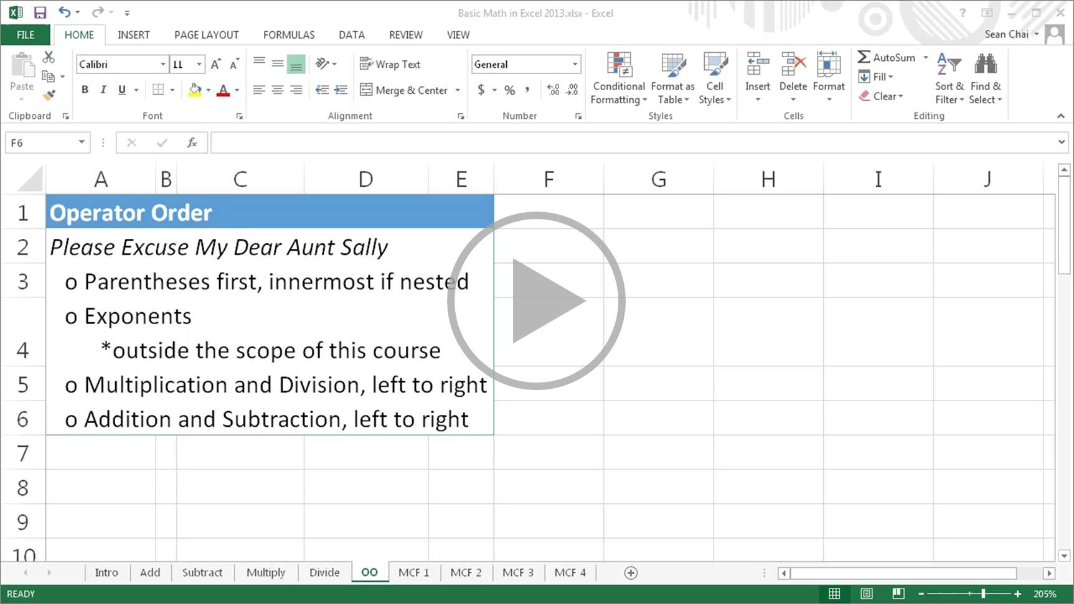
Basic math in Excel 2013
Closed captions
Excel uses the standard math rules of operator order in formulas.
I found the following mnemonic helpful in remembering these: Please Excuse My Dear Aunt Sally.
Parentheses first, innermost if nested.
Exponents.
Multiplication and Division, left to right.
And lastly, Addition and Subtraction, left to right.
Calculations in parentheses are evaluated first, inner to outer if they're nested.
In this example, 3 plus 3 is in parentheses, so those numbers are added first.
This leaves us with 6 times 5, which is 30.
This is an example of nested parentheses.
What’s in the innermost pair is evaluated first. 4 divided by 2 is 2, and that's added to 3 for a result of 5.
Exponents are evaluated next, but they’re outside the scope of this course.
Multiplication and division are evaluated next, working from left to right.
In this example, going from left to right, 30 divided by 5 is 6, and 6 times 3 is 18.
With parentheses around 5 times 3, this returns a different result.
5 times 3 is evaluated first, since it's in parentheses, returning 15. Then 30 is divided by 15, resulting in 2.
Last in operator order are addition and subtraction, working from left to right.
In this example, working from left to right, 5 plus 3 is 8, and 8 minus 6 is 2.
Up next, More complex formulas
Press F5 to start, Esc to stop
3/4 videos
2:35
5:19
2:12
4:28
Basic math
Using functions
Operator order
More formulas
Summary
Feedback
Help

Slide 5
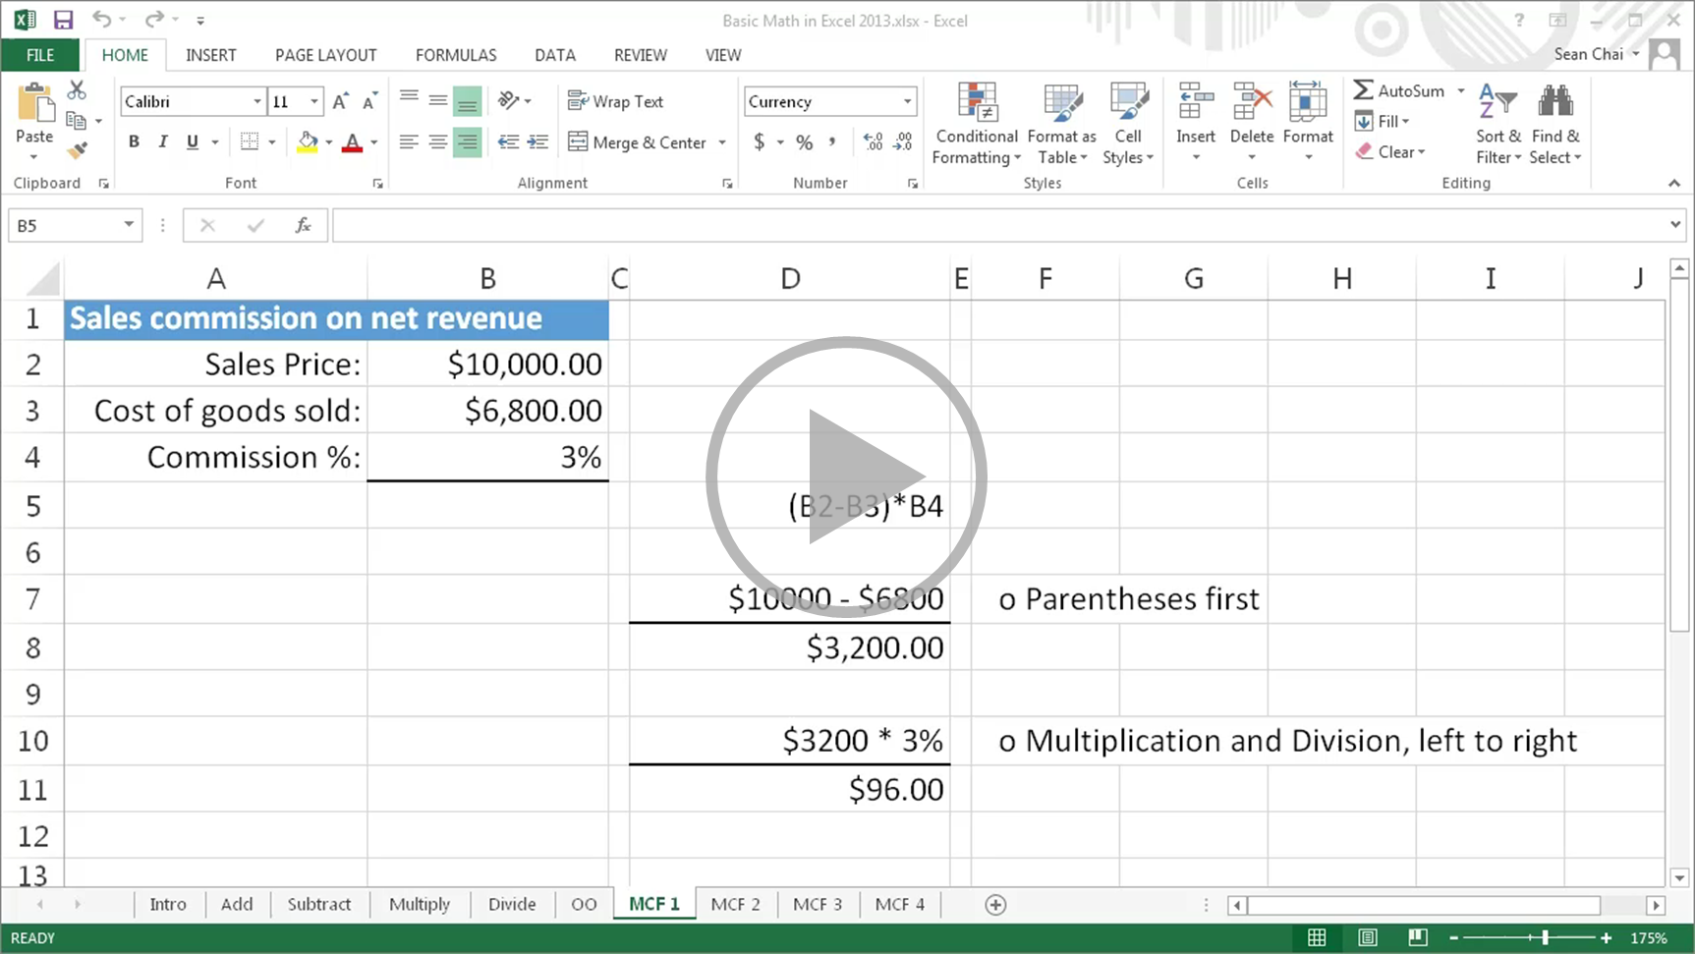
Basic math in Excel 2013
Closed captions
Now we’ll create more complex formulas using multiple operators, cell references, and functions.
We’re going to calculate the sales commission based off of the net revenue.
To do this, I take the sales price and subtract from it the cost of goods sold.
This is in parentheses to ensure it occurs first.
I then multiply the net profit by the commission percentage in B4, 3%. This returns the commission.
Let’s take a look at how this works in a formula.
Because the cell references are in parentheses, first the cost of goods sold is subtracted from the sales price.
This returns a net profit of $3,200.
This is then multiplied by 3%, returning a commission of $96.
Now we’re going to determine the weighted scores for students.
By weighted scores, I mean that different tests account for a different percentage of the students’ final grade.
Tests 1 and 2 each account for 10% and the mid-term and final tests each account for 40%.
To do this, I multiply the Test 1 score for Bob by its weight.
I press F4 after I select the weight value in B3 so that when I copy the formula,
the weight for test 1 will always remain cell B3.
This is referred to as absolute cell reference.
I then add Bob's mid-term score multiplied by its weight in B4, and press F4 again.
I follow the same steps for Test 2 and the Final test.
To copy the formula, I click the cell,
put the mouse pointer over the bottom right hand corner of the cell until I get a black + sign,
click the left mouse button, and drag the border to the right.
Here are the weighted scores for the students.
Let’s take a look at what’s happening in this formula for Bob's weighted score.
Each of the test scores and their weights are multiplied, resulting in this formula.
Then the numbers are added together, resulting in 74.5.
What’s the value returned by this formula?
First we do the inner most parentheses, 5 minus 3 is 2, resulting in this formula.
Next we do the remaining parentheses, 10 times 2 is 20 and 1 minus 4 is -3, resulting in this formula.
Now we do multiplication and division, from left to right. 6 times 20 is 120, divided by 3 is 40, resulting in this formula.
Lastly, we do addition and subtraction from left to right. 4 + 40 is 44, - 3 is 41.
You can use functions in formulas with multiple operators, including nested parentheses.
Functions and cell references are evaluated and treated as their resulting numbers.
The parentheses that follow a function name act only as a container for the function’s arguments,
such as numbers or cell references, and don’t affect the order of operations in a formula.
Let’s take a look at what’s happening in this formula.
The Functions and cell references are evaluated, resulting in this formula.
The operations in parentheses occur first, resulting in a formula of 12 minus 3, and this is 9.
Now you’ve got a pretty good idea about how to do basic math in Excel.
Of course, there’s more to learn.
So check out the course summary at the end, and best of all, explore Excel 2013 on your own.
Press F5 to start, Esc to stop
4/4 videos
2:35
5:19
2:12
4:28
Basic math
Using functions
Operator order
More formulas
Summary
Feedback
Help

Slide 6

Help
Course summary—Basic math in Excel 2013
Course summary
Let Excel be your calculator
With a simple formula, Excel can perform calculations on numbers using operators, such as the plus sign, and functions, such as SUM.
Add numbers
To add numbers, you use the plus sign (+). A formula always starts with an equals sign. Then type a number, a plus sign, another number, and then press Enter, and the cell displays the results.
Subtract numbers
Subtracting is similar to adding, except you use the minus sign (-). Click a cell, then a minus sign, then another cell, and press Enter.
Multiply numbers
Multiplying is similar to adding or subtracting, except you use an asterisk (*). Click a cell, then an asterisk, then another cell, and press Enter.
Divide numbers
Dividing is similar to multiplying, except you use a forward slash (/). Click a cell, then a forward slash, then another cell, and press Enter.
AutoSum
Click the cell to the right of a row or below a column. Then, on the Home tab, click AutoSum, verify that the formula is what you want, and click AutoSum again.
AutoSum adds the row or column automatically.
Operator order
Excel uses the standard math rules of operator order in formulas. Calculations in parentheses are evaluated first, inner to outer if they're nested. Exponents are evaluated next, then multiplication and division, working from left to right. Last in operator order are addition and subtraction, working from left to right.
See also
More training courses
Office Compatibility Pack
Use AutoSum to sum numbers
Sum numbers by creating a formula
Press F5 to start, Esc to stop
1
2
3
4
5
6
7
2:35
5:19
2:12
4:28
Basic math
Using functions
Operator order
More formulas
Summary
Feedback
Help

Slide 7

Help
Rating and comments
Course summary
How did we do? Please tell us what you think
Thank you for viewing this course!
Check out more courses
Press F5 to start, Esc to stop
1
2
3
4
5
6
7
2:35
5:19
2:12
4:28
Basic math
Using functions
Operator order
More formulas
Summary
Feedback
Help

Slide 8
Help
Help
Course summary
Using PowerPoint’s video controls
  Point at the bottom edge of any video to start, stop, pause, or rewind. You drag to rewind.
Stopping a course
  If you’re viewing online, click your browser’s Back button. If you’re viewing offline, press Esc. If you’re watching a video, press Esc once to stop the video, again to stop the course.
Going places
  You can go to any part of a course by clicking the thumbnails (light or shaded) below the video. You can also click the forward and back arrows, or press Page Up or Page Down.
If you download a course and the videos don’t play
Click Enable Editing if you see that button. If that doesn’t work, you may have PowerPoint 2007 or earlier. If you do, you need to get the PowerPoint Viewer. If you have PowerPoint 2010, you need the QuickTime player, or you can upgrade to PowerPoint 2013.
Press F5 to start, Esc to stop
1
2
3
4
5
6
7
2:35
5:19
2:12
4:28
Basic math
Using functions
Operator order
More formulas
Summary
Feedback
Help

