Slide 1
Use conditional formatting
In the message bar, click Enable Editing,
then press F5 or click Slide Show > From Beginning to start the course.
If the videos in this course don’t play, you may need to download QuickTime or just switch to PowerPoint 2013.
j

Slide 2
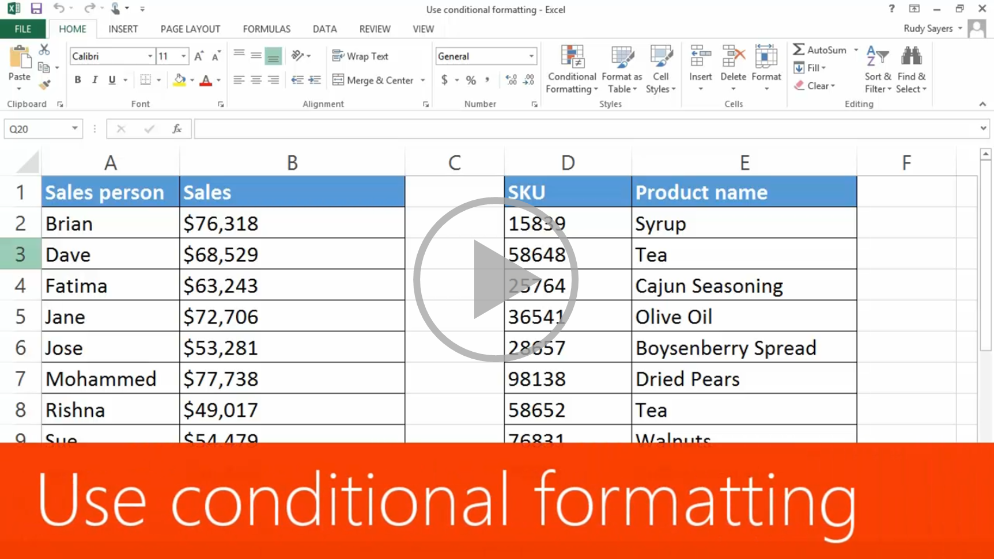
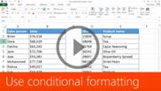







Use conditional formatting
Closed captions
Conditional formatting provides visual cues to help you make sense of your data.
For example, it’ll clearly show highs and lows, or other data trends based on criteria you provide.
I want to see how much each sales person sold.
I select the range of cells in Sales,
click the Quick Analysis button, use the default Formatting tab—when I move across the formatting options,
a live preview shows me what my data will look like.
Data Bars provides what I want, so I click it.
And now I have an eye catching visual representation of the data, making it easier to analyze.
You can apply multiple conditional formats to the same cells.
Select the cells, click the button, and click another formatting option, such as Icon Set.
By default, these indicate the upper third, middle third, and lower third of the values.
You can also apply conditional formatting to text.
Notice that the formatting options for text are different than those for money.
Formatting options differ between many different types of data.
I select Text Contains and enter Oil. I’m leaving the formatting set to the default.
And the cells that contain oil are formatted in red. They really stand out.
If you change the text in a cell so that it contains oil, the formatting automatically changes.
Up next, conditionally formatting dates.
Press F5 to start, Esc to stop
1/4 videos
2:03
2:44
2:12
1:22
Use formatting
For dates
For text
Copy and remove
Summary
Feedback
Help

Slide 3
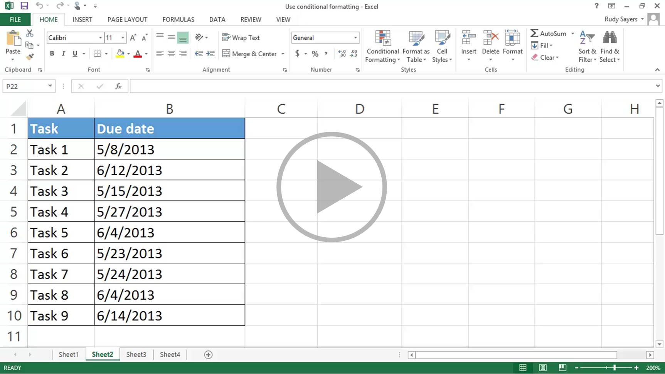

Use conditional formatting
Closed captions
I want to see at a glance what tasks in the list are late. In other words, those tasks with due date dates before today.
I select the cells in the Due date column, click the Quick Analysis button, click Less Than.
I could type todays date, but I’d have to update the conditional formatting every day.
That would get tedious really fast. Instead I type the TODAY function, which returns today’s date.
Equals sign, TODAY, opening parenthesis, and a closing parenthesis.
I’m going to leave the formatting set to the default red option.
And click OK.
Tasks that are overdue show in red and are easy to pick out at a glance.
I also want to see tasks that aren’t due for a week or more. These tasks are in good shape.
Configuring conditional formatting for this is similar to what we did for overdue tasks,
except I click Greater Than
I type the TODAY function, a plus sign, and 7. In other words, a week from today.
Notice that there are many formatting options, including Custom Format.
I’ll select the green option, and click OK.
Tasks that aren’t due for a week or more show in green.
I’d like to see at a glance what tasks are coming due over the next week, so I can keep a close eye on them.
Quick Analysis doesn’t have this option,
so I click the Conditional Formatting button on the Home tab where there is this option.
Point to Highlight Cell Rules, and click Between.
In the left date field, I type the TODAY function.
In the right date field I type the TODAY function, a plus sign, and 7.
I select the yellow formatting option, and click OK.
Tasks that are due within seven days are formatted in yellow.
Now I have a list of tasks that, at a glance, I can see how they’re doing against the schedule.
Up next, conditionally formatting text.
Press F5 to start, Esc to stop
2/4 videos
2:03
2:44
2:12
1:22
Use formatting
For dates
For text
Copy and remove
Summary
Feedback
Help

Slide 4
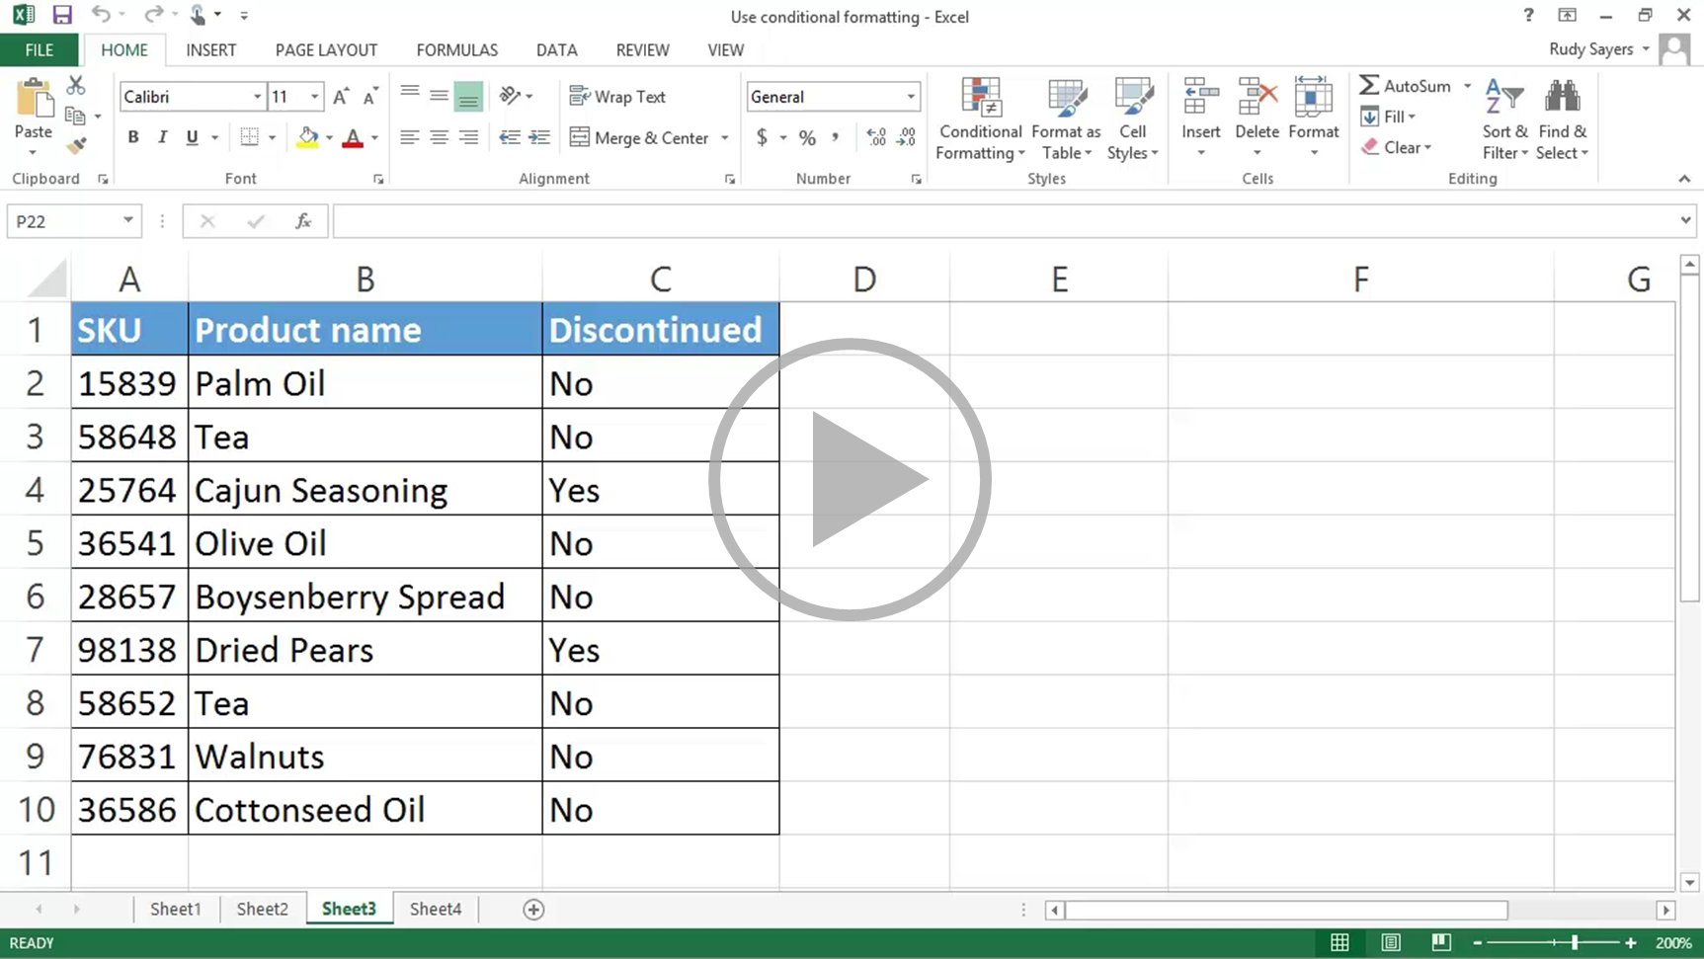
Use conditional formatting
Closed captions
In the first video in the course,
we went over how to conditionally format cells in a range that contained the text “oil” using Quick Analysis.
You can also use Quick Analysis to conditionally format cells in a range that have duplicate text,
unique text, and text that’s the same as text you specify.
But what if you want to conditionally format a row based on the text in one of the cells in the row.
In this example, I want a row to have a gray fill if Discontinued for the row is set to Yes.
To do this, select the cells you want to conditionally format. Note that A2 is the active cell; we’ll need that for later.
Click Conditional Formatting, and then click New Rule. Select Use a formula to determine which cells to format.
In the rule field, since the active cell is A2,
we need to type a formula that’s valid for row 2 and will apply correctly to all of the other rows.
To do this, we type =$C2=“Yes”
We use an absolute reference for column C, $C,
so that conditional formatting for each row evaluates the value in column C for that row.
And we put quotes around Yes. The quotes ensure that Excel evaluates the word Yes as text.
Next we click Format, select the fill color we want, click OK, and click OK again.
And the rows with products that have been discontinued are filled with gray.
Up next, copying and removing conditional formatting.
Press F5 to start, Esc to stop
3/4 videos
2:03
2:44
2:12
1:22
Use formatting
For dates
For text
Copy and remove
Summary
Feedback
Help

Slide 5
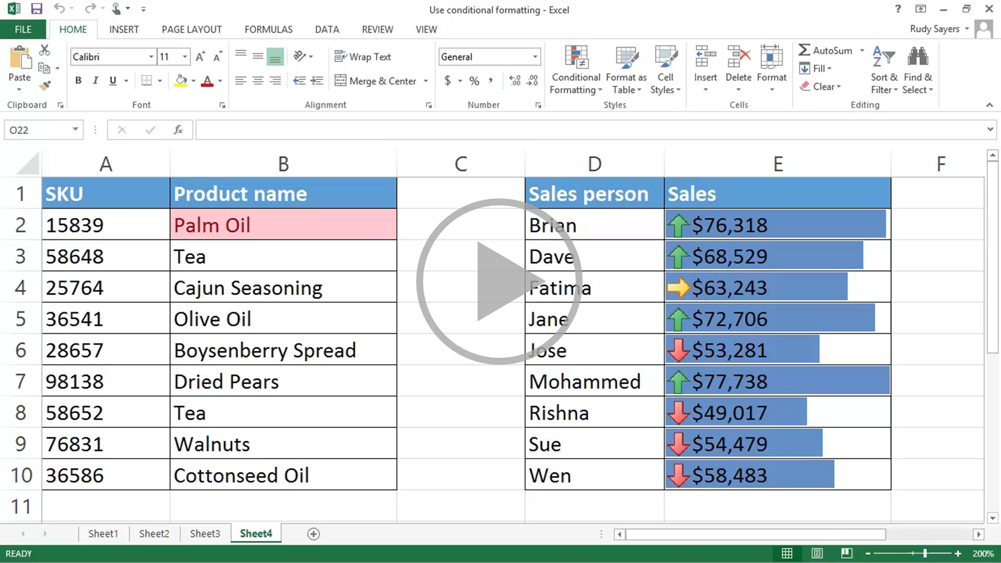
Use conditional formatting
Closed captions
I’ve already applied conditional formatting to cell B2. If the cell contains the text “oil”, the cell’s formatted in red.
To copy the cell’s formatting, I select the cell,
click Format Painter on the Home tab, and select the cells I want to format.
To remove conditional formatting from specific cells, select the cells, click the Quick Analysis button, and click Clear Format.
To remove all conditional formatting from the entire worksheet,
click the Conditional Formatting button on the Home tab, point to Clear Rules, and click Clear Rules from Entire Sheet.
Now you’ve got a pretty good idea about how to apply conditional formatting.
Of course, there’s always more to learn.
So check out the course summary at the end, and best of all, explore Excel 2013 on your own.
Press F5 to start, Esc to stop
4/4 videos
2:03
2:44
2:12
1:22
Use formatting
For dates
For text
Copy and remove
Summary
Feedback
Help

Slide 6

Help
Course summary—Use conditional formatting
Course summary
Find duplicate values fast
Finding duplicate values can be time consuming and frustrating. Leave the stress behind by applying conditional formatting and letting Excel do the work for you.
Select the range of cells you think might contain duplicates.
Click Home > Conditional Formatting > Highlight Cells Rules > Duplicate Values.
In the Duplicate Values box, make sure that Duplicate is selected in the first drop-down box.
Then select the format for duplicate values in the other drop-down box. Click OK. All the duplicate numbers or text are highlighted.
Apply conditional formatting based on text in a cell
Select the cells you want to apply conditional formatting to. Click the first cell in the range, and then drag to the last cell.
Click Home > Conditional Formatting > Highlight Cells Rules > Text that Contains. In the Text that Contains box, on the left, enter the text you want highlighted.
Select the color format for the text, and click OK.
Copy conditional formatting
If you have a conditional formatting rule you want to use for new data, copy the conditional formatting to the new data using the Format Painter.
Click a cell that has the conditional formatting you want to copy.
Click Home > Format Painter. The pointer changes to a paintbrush. Double-click Format Painter if you want to copy the formatting to multiple selections.
To copy the formatting, drag the mouse pointer across the cells or ranges of cells that you want to format.
To stop the formatting, press Esc.
See also
Apply conditional formatting to quickly analyze data
Add, change, find, or clear conditional formats
Take conditional formatting to the next level
More training courses
Office Compatibility Pack
Press F5 to start, Esc to stop
1
2
3
4
5
6
7
2:03
2:44
2:12
1:22
Use formatting
For dates
For text
Copy and remove
Summary
Feedback
Help

Slide 7

Help
Rating and comments
Course summary
How did we do? Please tell us what you think
Thank you for viewing this course!
Check out more courses
Press F5 to start, Esc to stop
1
2
3
4
5
6
7
2:03
2:44
2:12
1:22
Use formatting
For dates
For text
Copy and remove
Summary
Feedback
Help

Slide 8

Help
Help
Course summary
Using PowerPoint’s video controls
  Point at the bottom edge of any video to start, stop, pause, or rewind. You drag to rewind.
Stopping a course
  If you’re viewing online, click your browser’s Back button. If you’re viewing offline, press Esc. If you’re watching a video, press Esc once to stop the video, again to stop the course.
Going places
  You can go to any part of a course by clicking the thumbnails (light or shaded) below the video. You can also click the forward and back arrows, or press Page Up or Page Down.
If you download a course and the videos don’t play
Click Enable Editing if you see that button. If that doesn’t work, you may have PowerPoint 2007 or earlier. If you do, you need to get the PowerPoint Viewer. If you have PowerPoint 2010, you need the QuickTime player, or you can upgrade to PowerPoint 2013.
Press F5 to start, Esc to stop
1
2
3
4
5
6
7
2:03
2:44
2:12
1:22
Use formatting
For dates
For text
Copy and remove
Summary
Feedback
Help

