Slide 1


Slide 2
Pastoral Farming
Production Systems
Dairy farming
Sheep & Beef farming
Arable

Slide 3
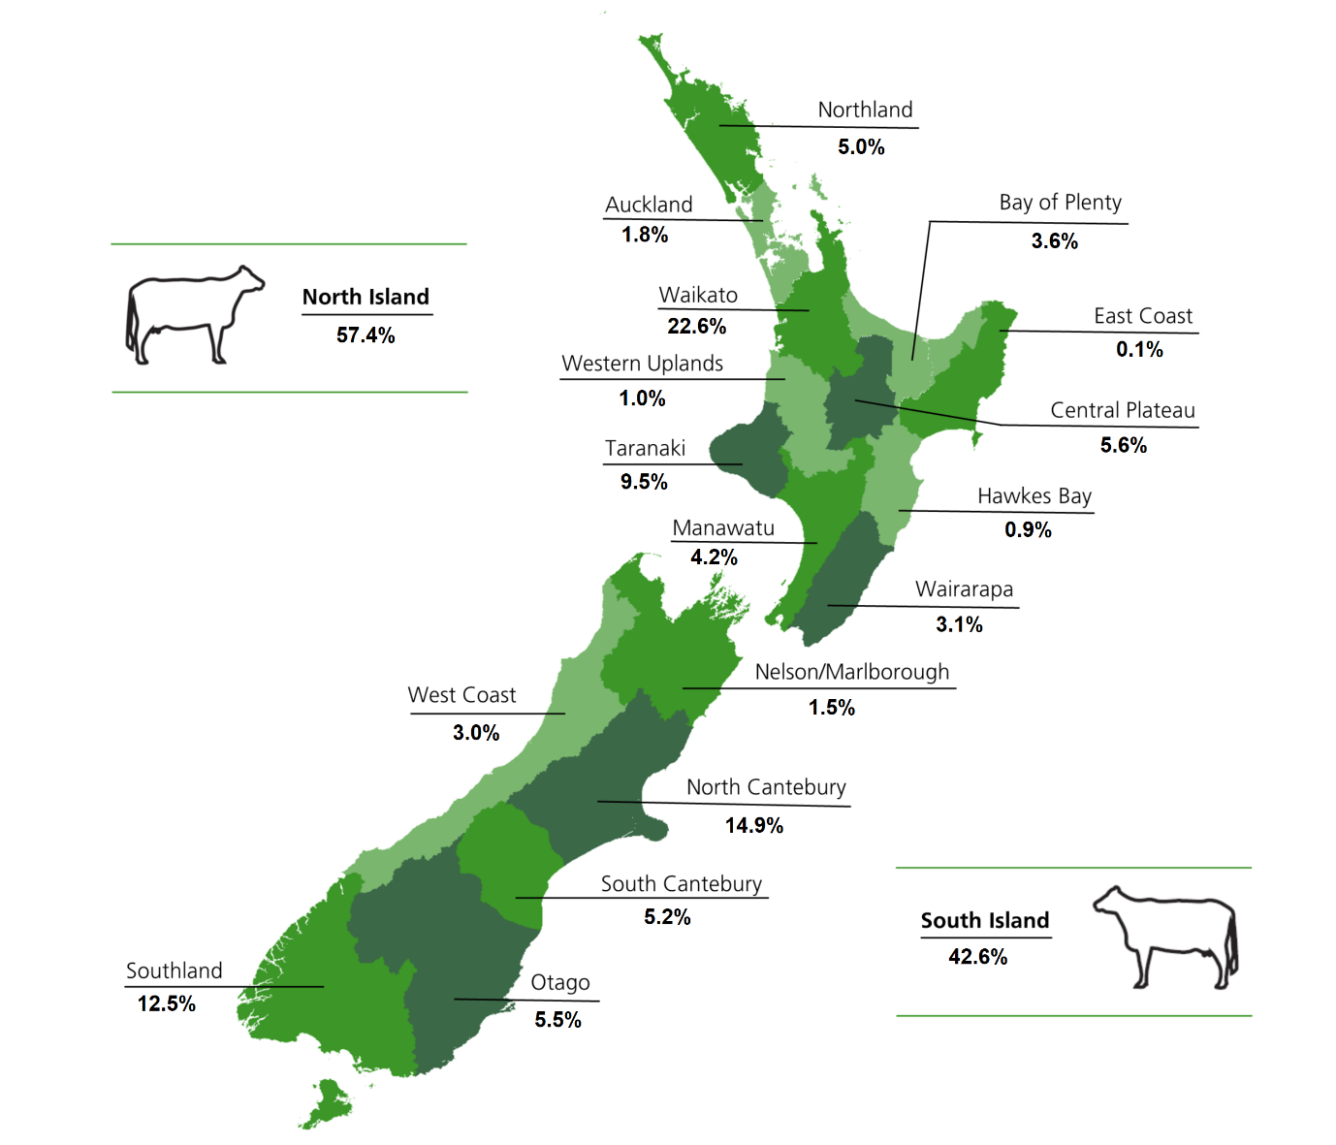
Dairy Farming
Dairy farms need to grow lots of grass all year to feed cows. Dairy farming is found in many regions. The biggest regions are Waikato, Taranaki, Canterbury and Southland. These regions have:-
Areas of flat to rolling country that is easily accessible by machinery.
Moderate temperatures for growing grass and crops to feed cow outside all year round.
Reliable rainfall either natural rain or from irrigation
Fertile soils.

Slide 4
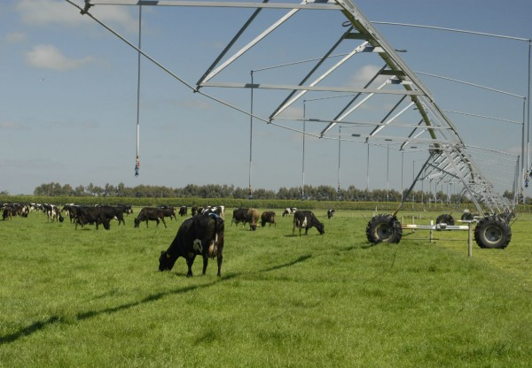
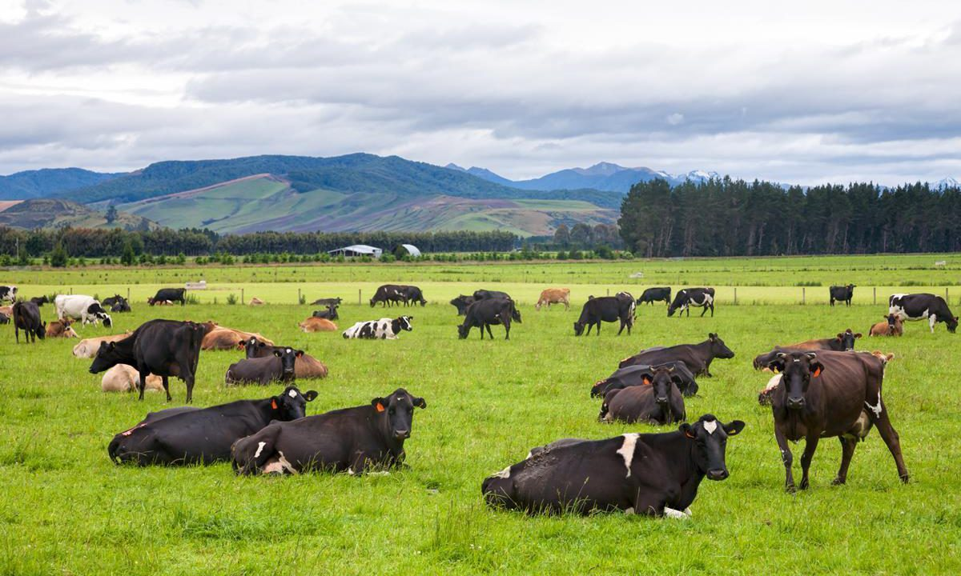
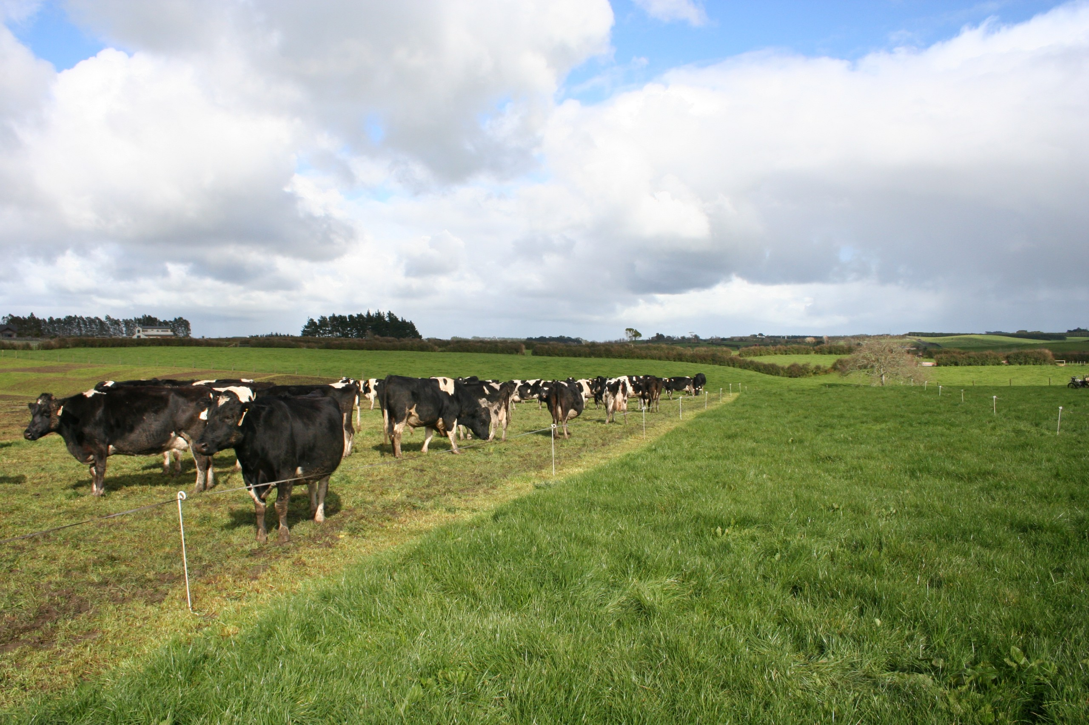
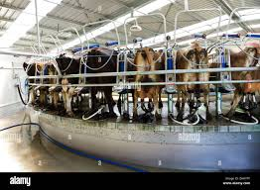
Intensive dairy farming

Slide 5
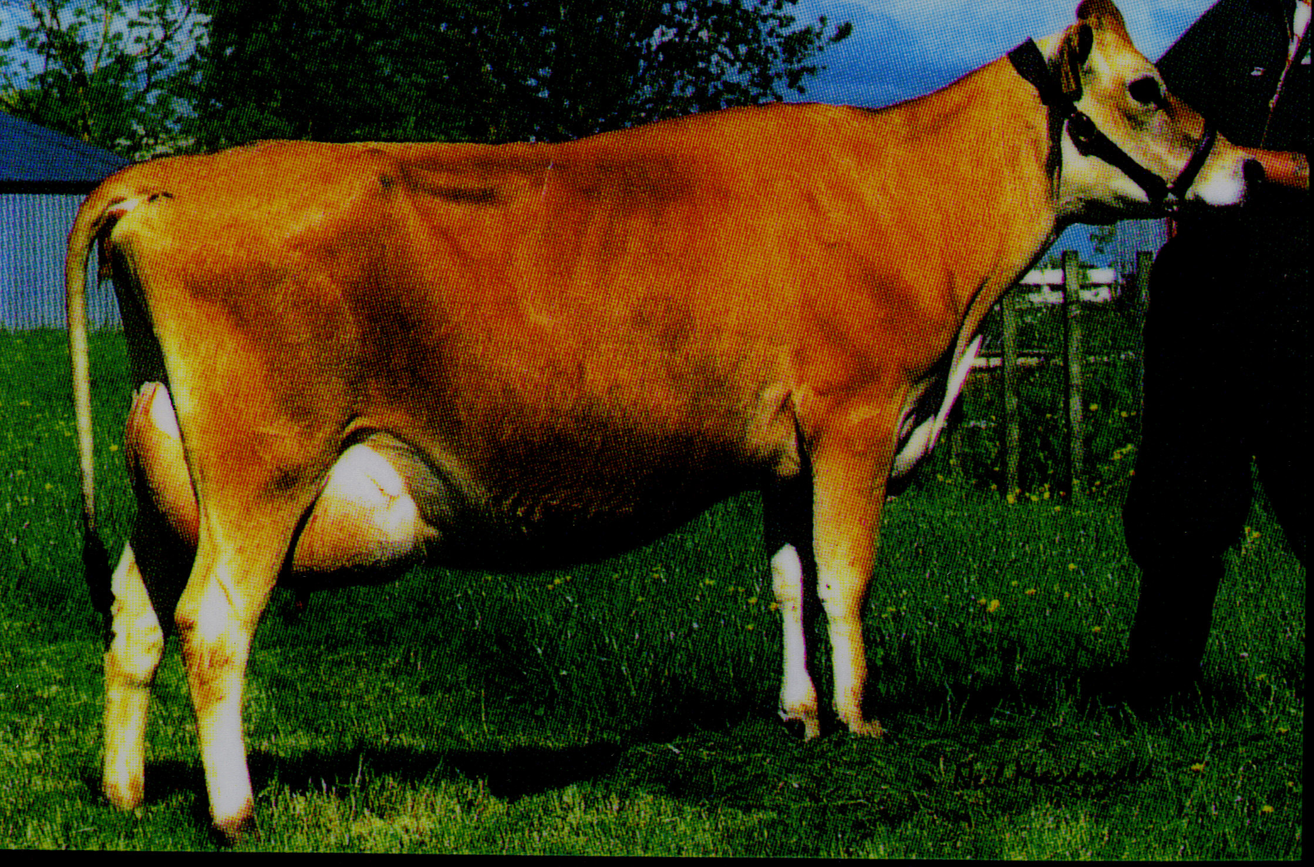
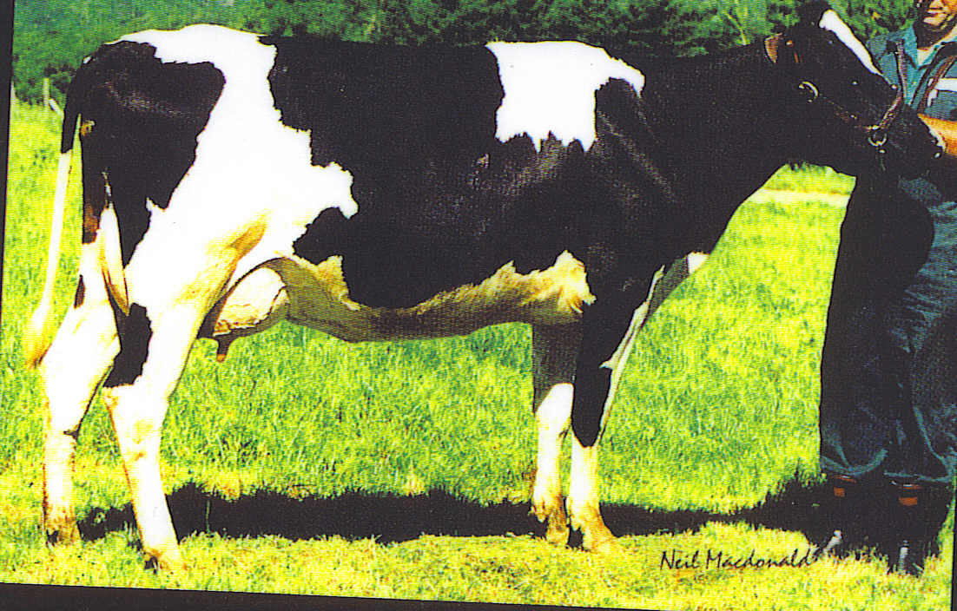
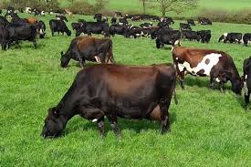
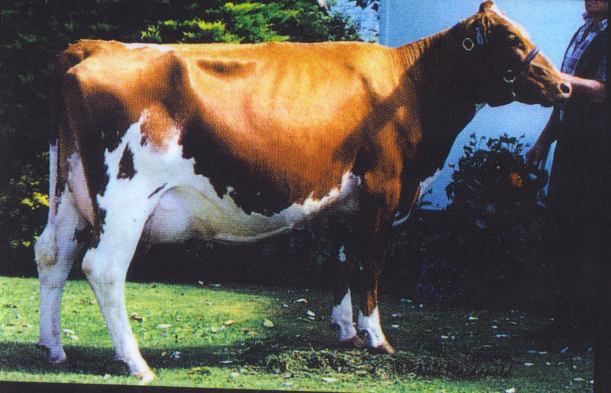
Jersey
Friesian
Dairy cattle breeds
Friesian Jersey X (Kiwi) Cross
Ayrshire

Slide 6
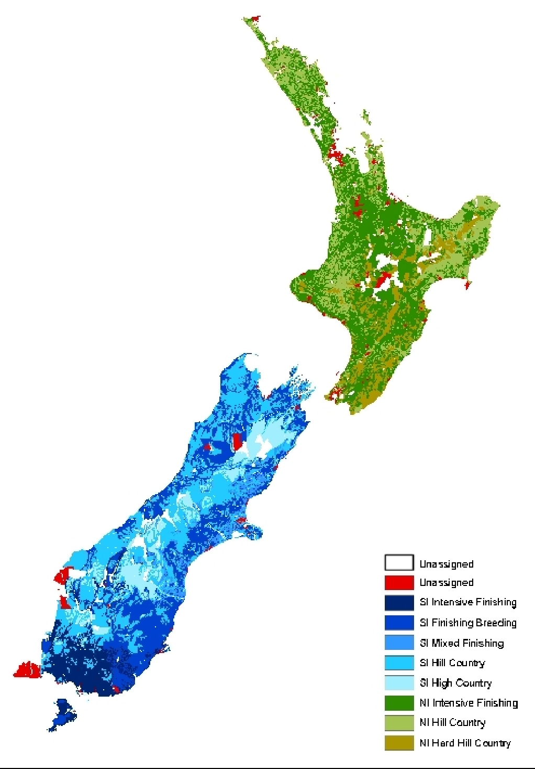
Sheep & Beef
Faming Systems
Sheep & beef farming is found in many regions throughout New Zealand.
They are predominantly found on easy to steep hill country in both islands. The summers are dry and winters are cold, limiting pasture growth.
High country sheep & beef farms are found in the central South Island. The climate is dry in summer, cold in winter with periods of snow.

Slide 7
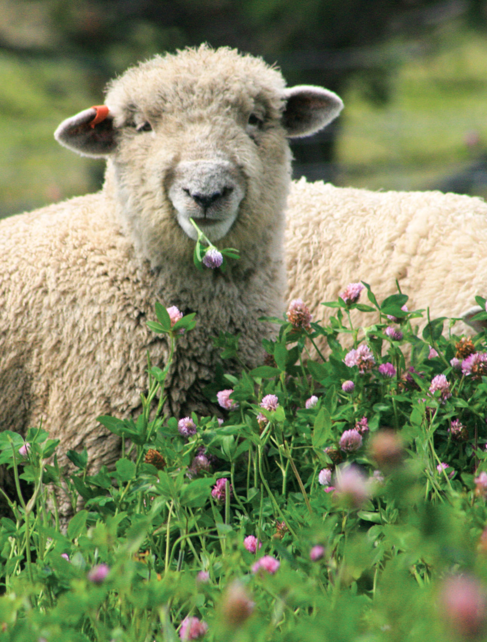
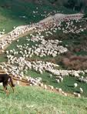
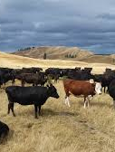
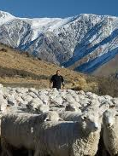
Sheep and beef farming systems
Semi- extensive
Extensive
Intensive finishing

Slide 8
Beef Cattle breeds on pastoral farming production systems
Beef Cattle Breeds | Main Breeds | Angus Hereford Angus Herford cross Dairy Beef (Friesian cow X Beef bull) Speckle Park | Semi- extensive- Intensive
 | Exotic Breeds | Murray grey Limousin Belgium blue Simmental Charolais Wagyu | Semi- extensive- Intensive

Slide 9
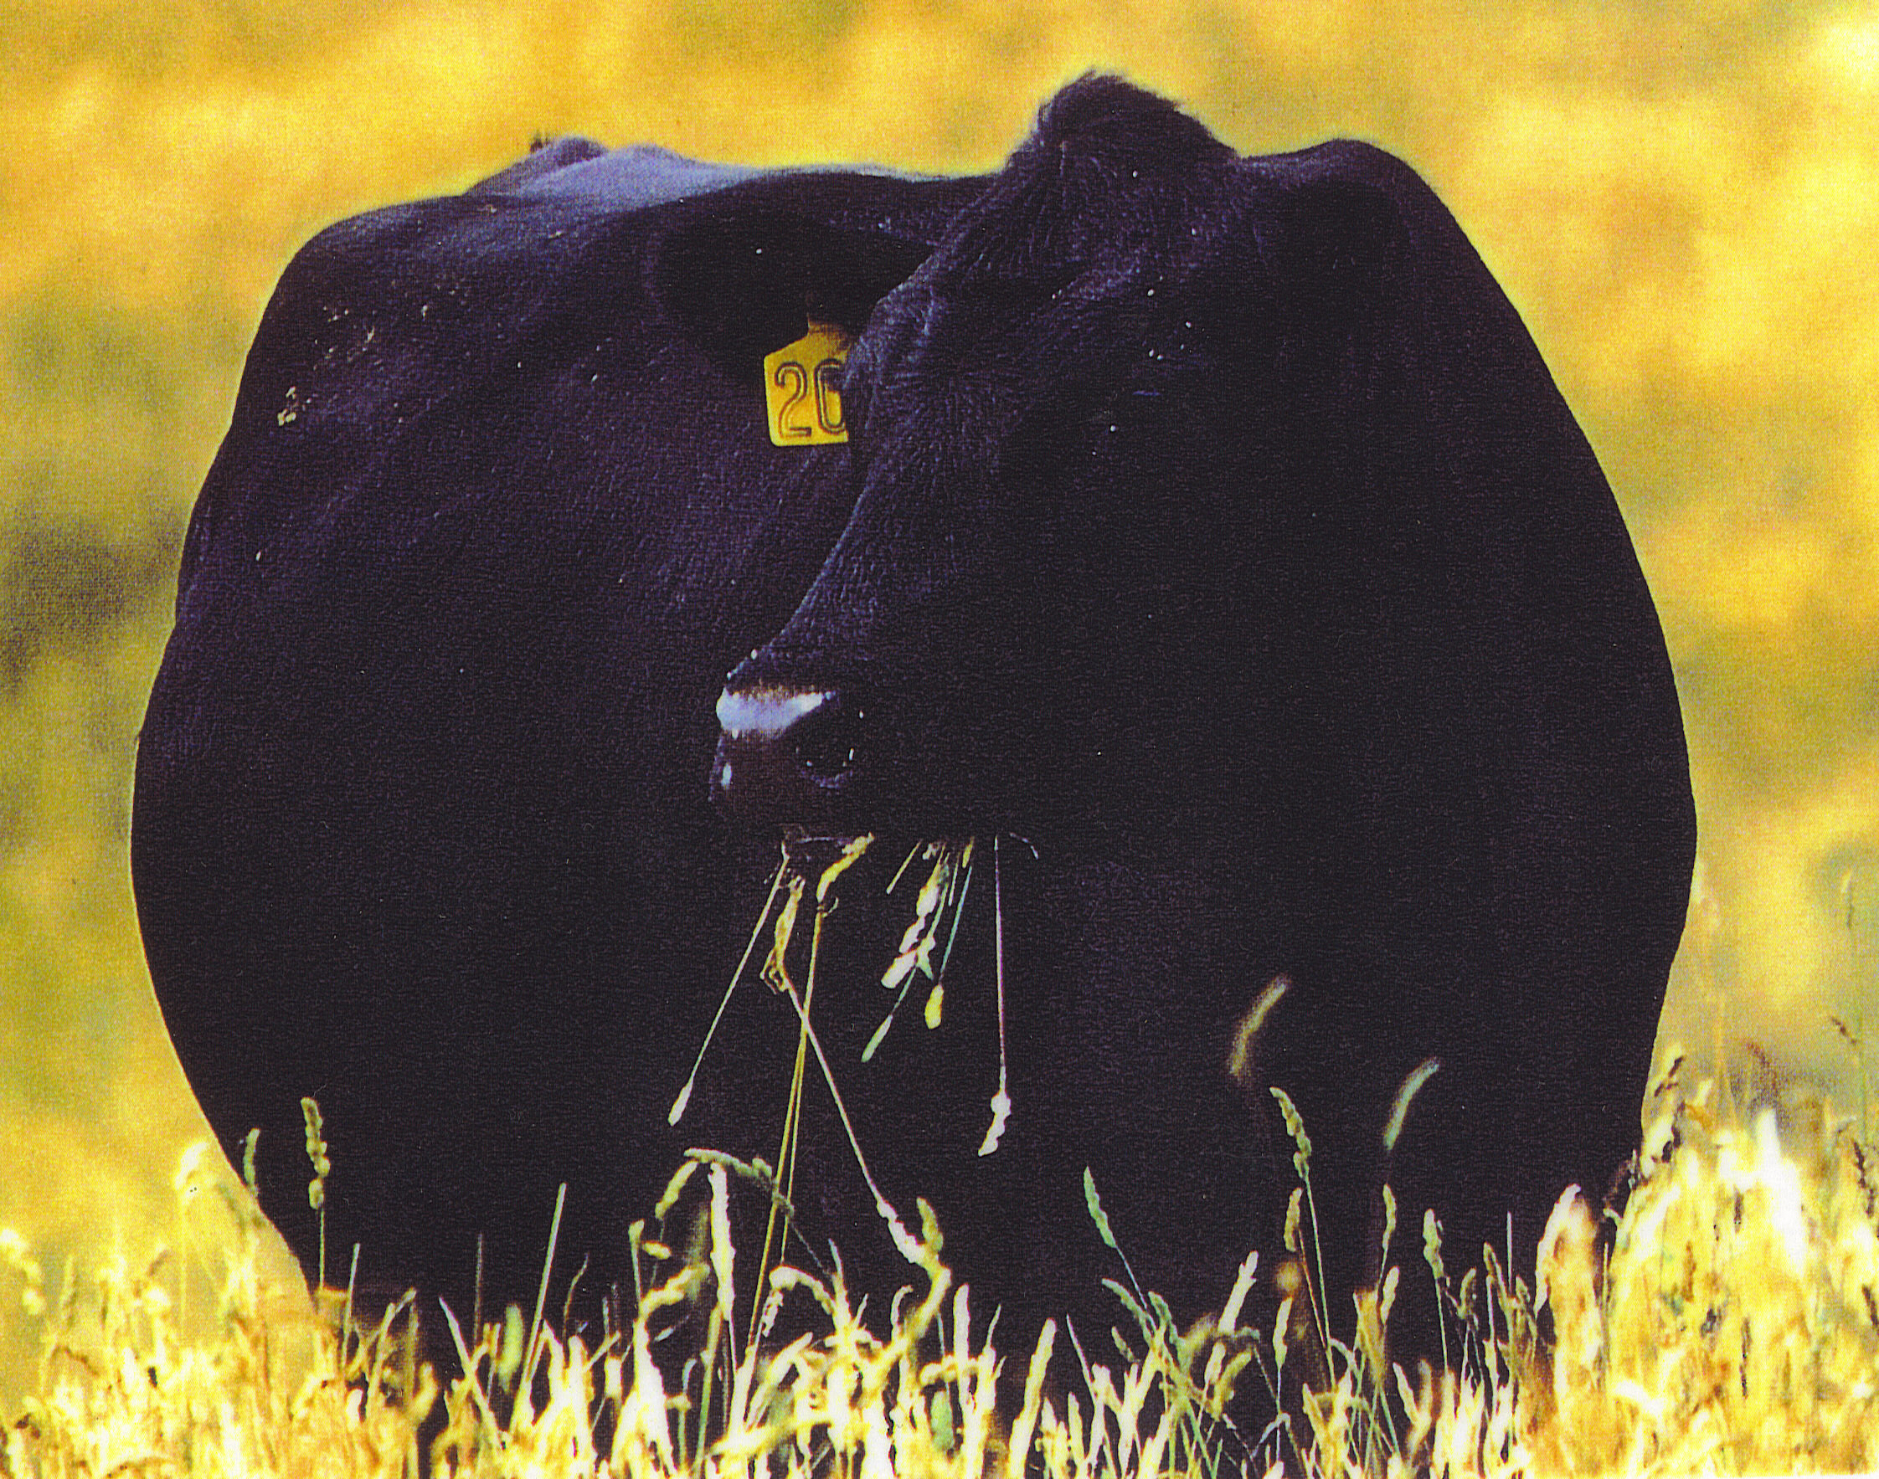
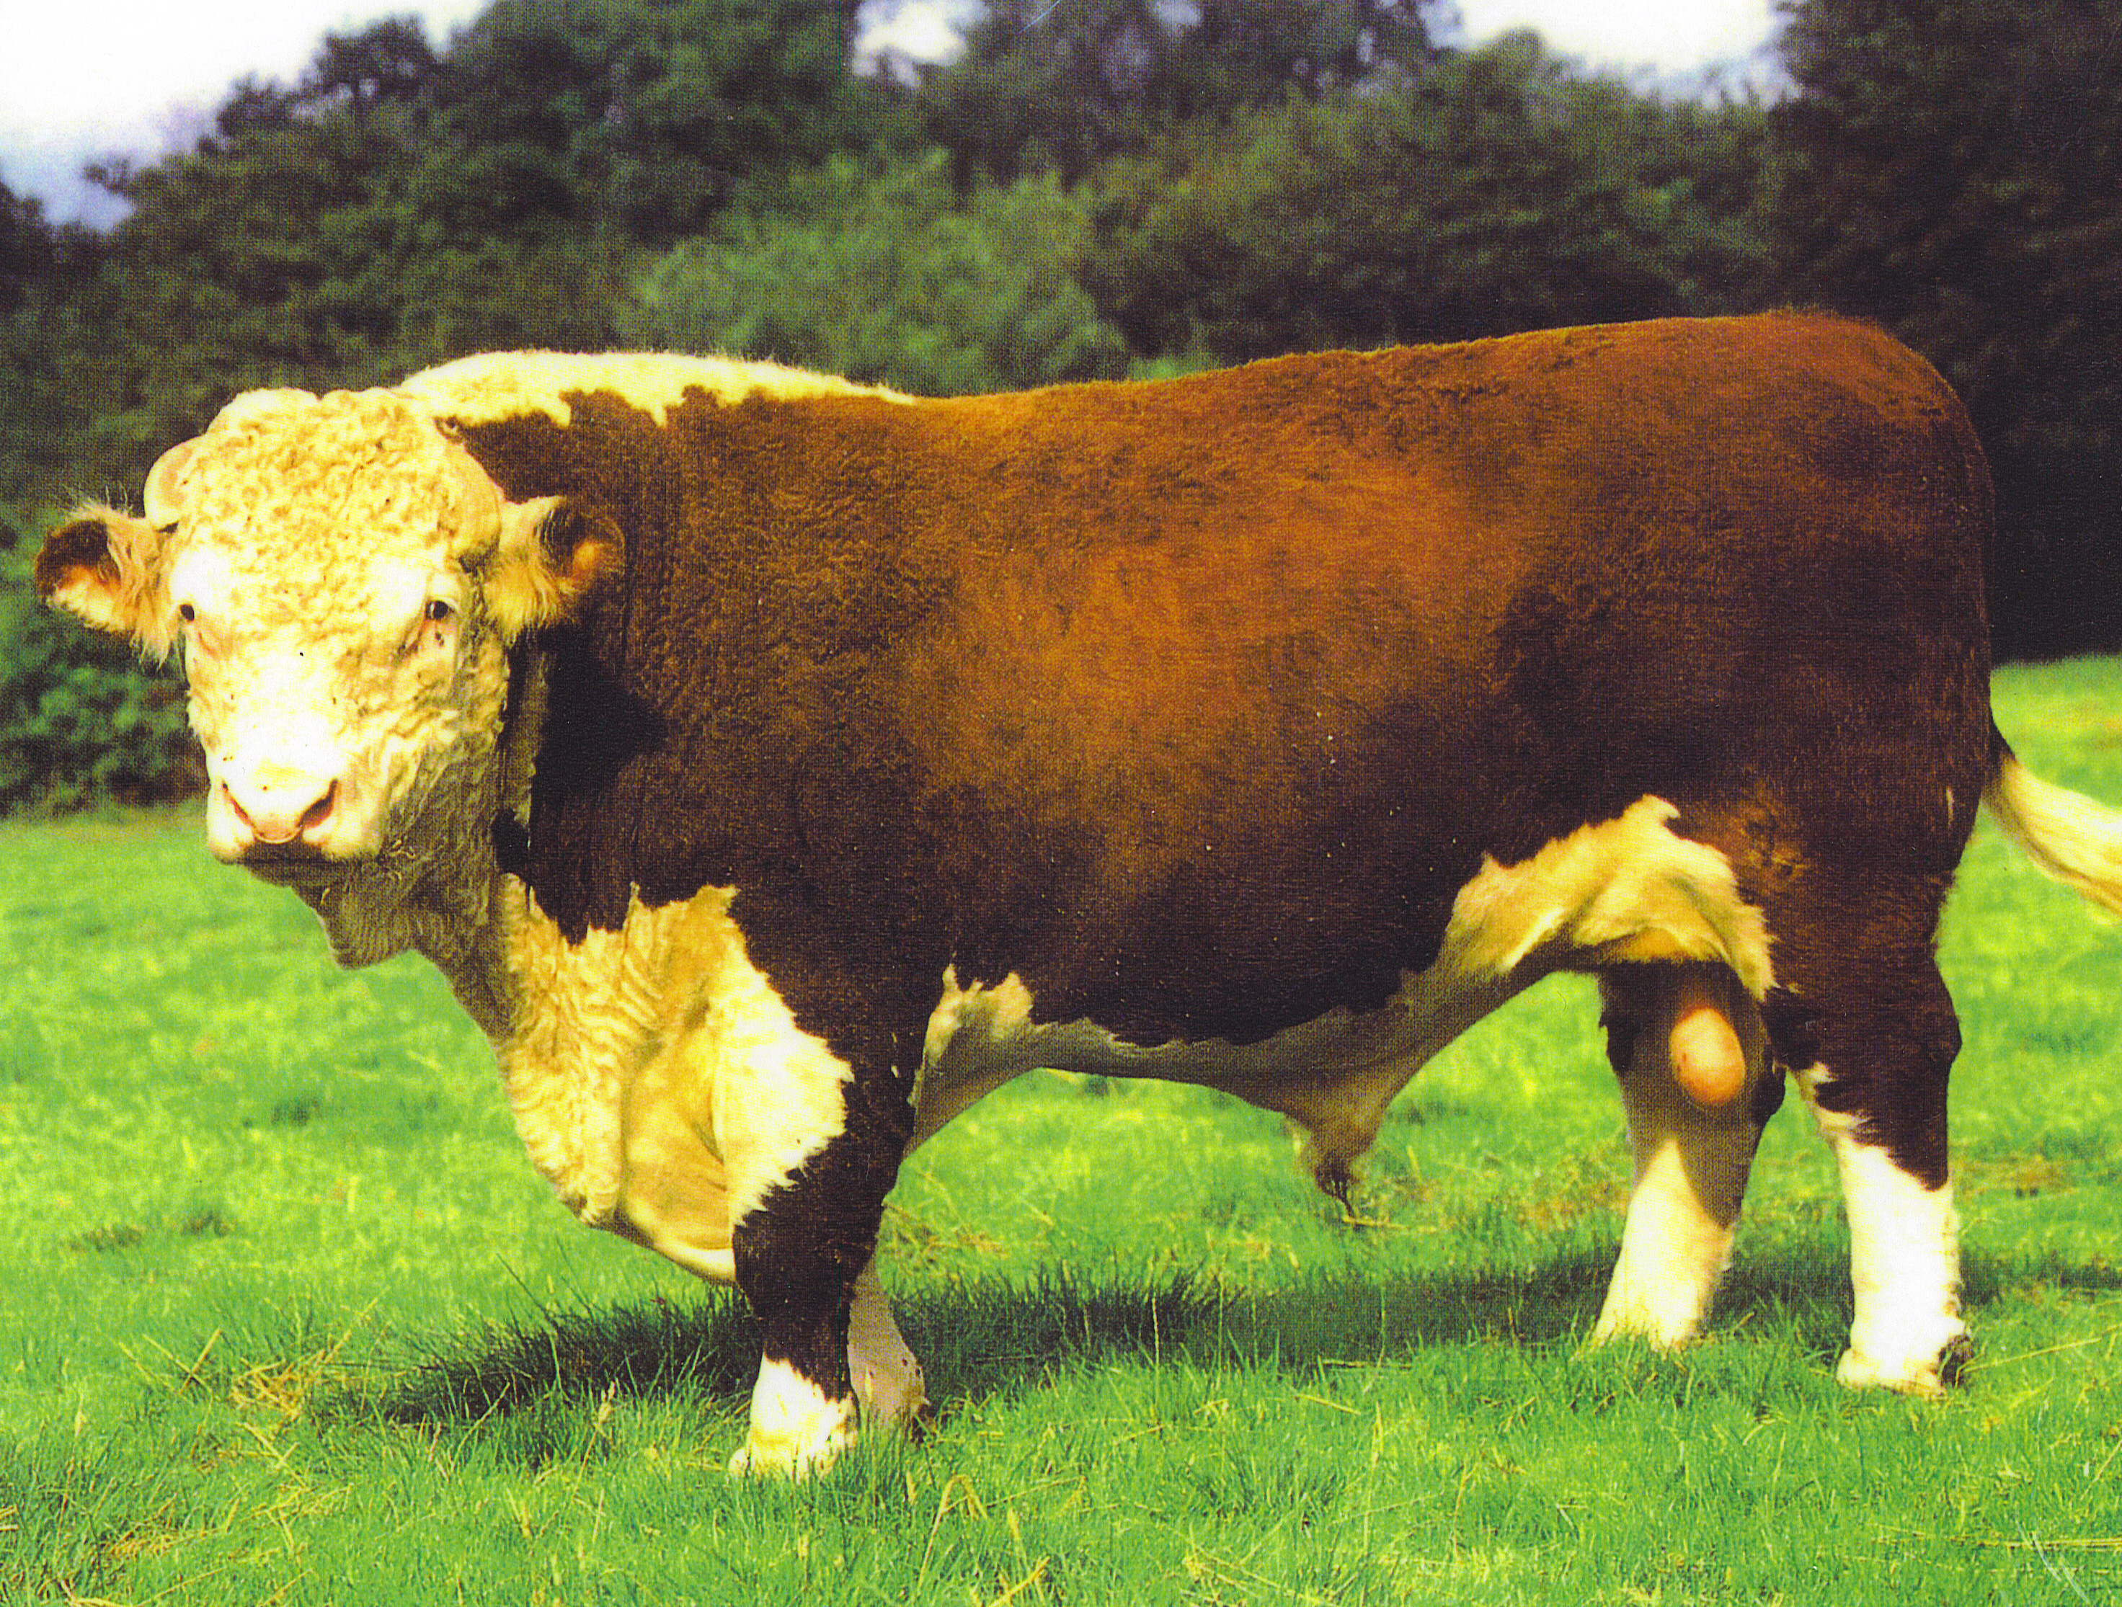
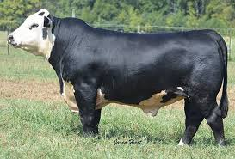
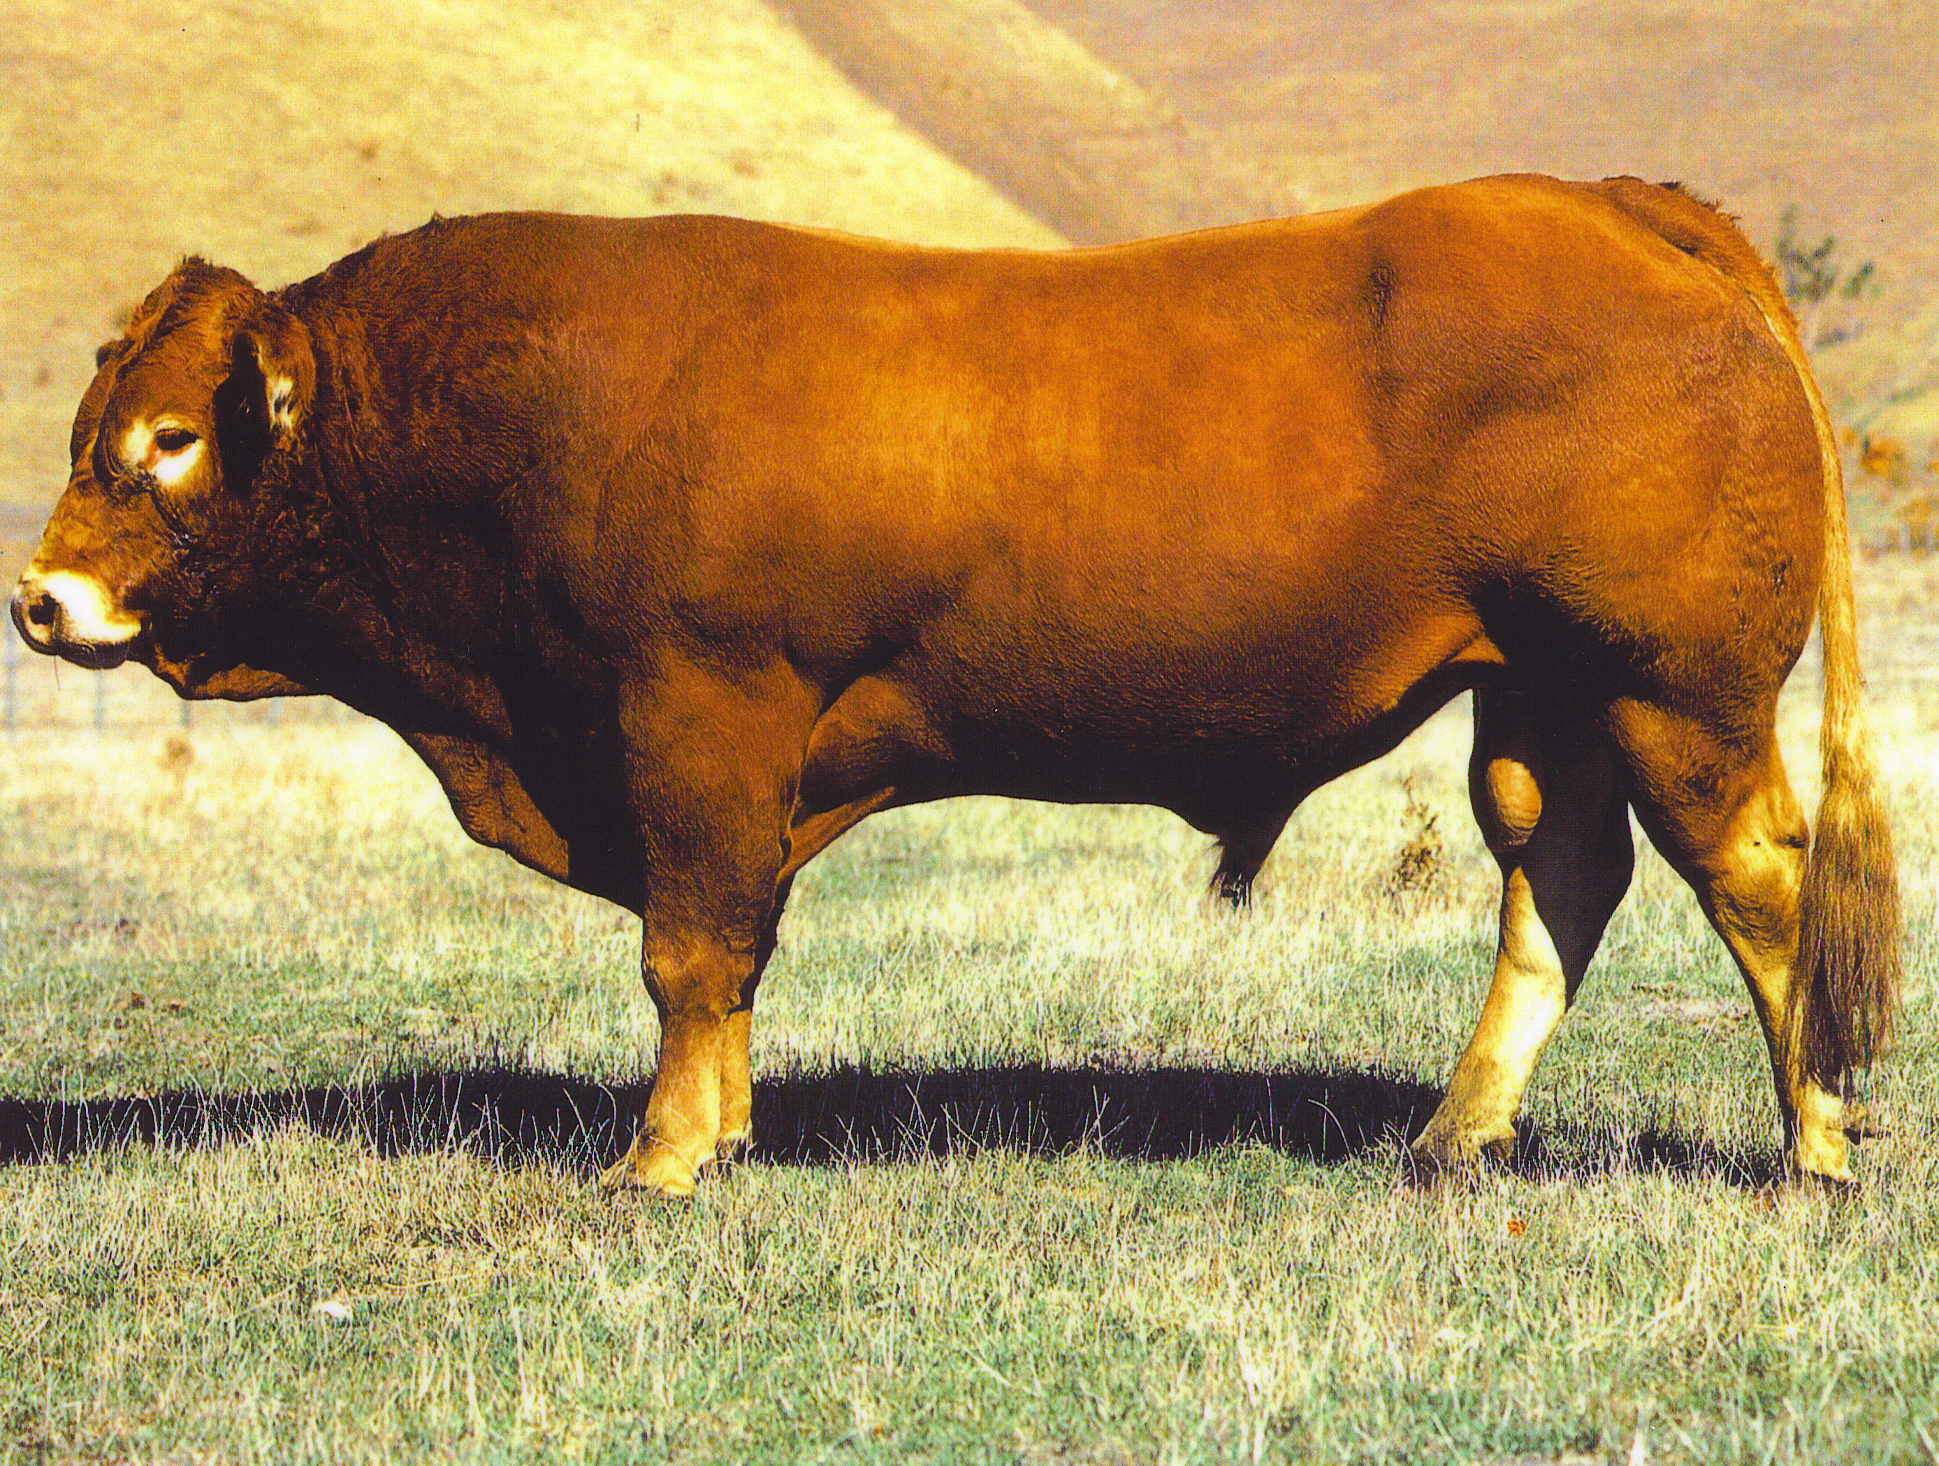
Angus
Hereford
Beef cattle breeds
Angus Hereford Cross
Simmental

Slide 10
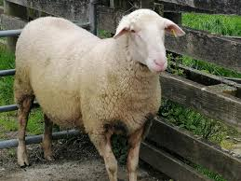
Sheep breeds on pastoral farming systems
Sheep Breeds | Wool | Merino Drysdale | Extensive Intensive
 | Dual Purpose | Romney Perendale Coopworth Border Leicester Corridale NZ halfbred | Semi- extensive
 | Meat | Suffolk South Suffolk Dorset horn Polled dorset Texel Wiltshire Dorper | Semi- extensive- Intensive
 | Milk | East Friesan | Intensive
East Friesian- bred for milking

Slide 11
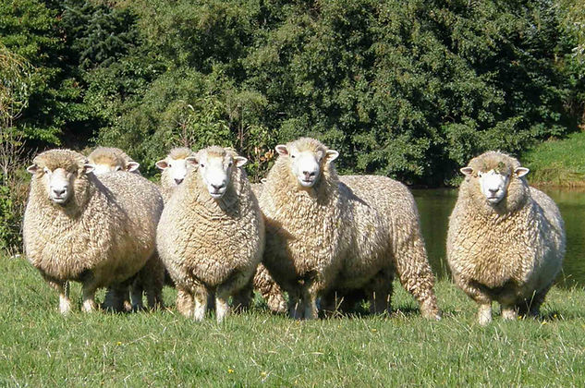
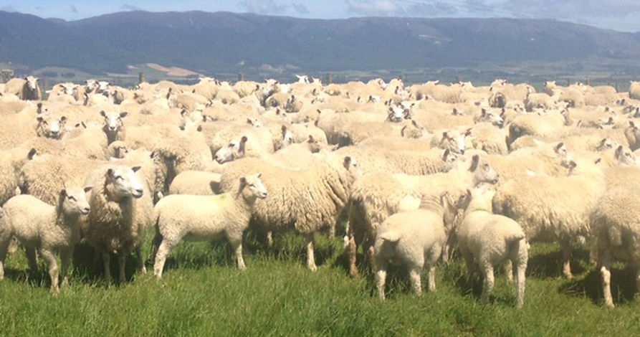
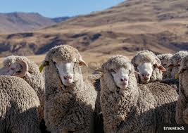
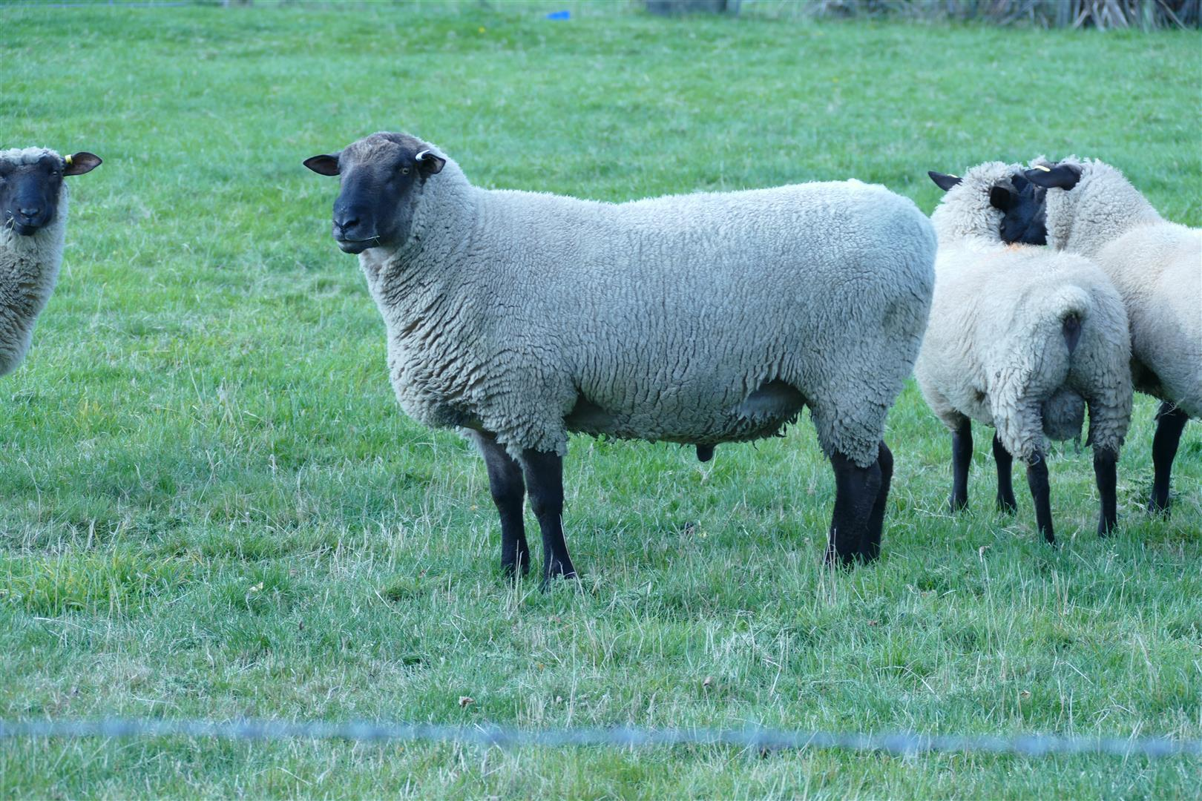
Romney
Perendale
Sheep breeds
Merino
Suffolk

Slide 12
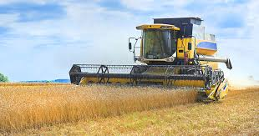
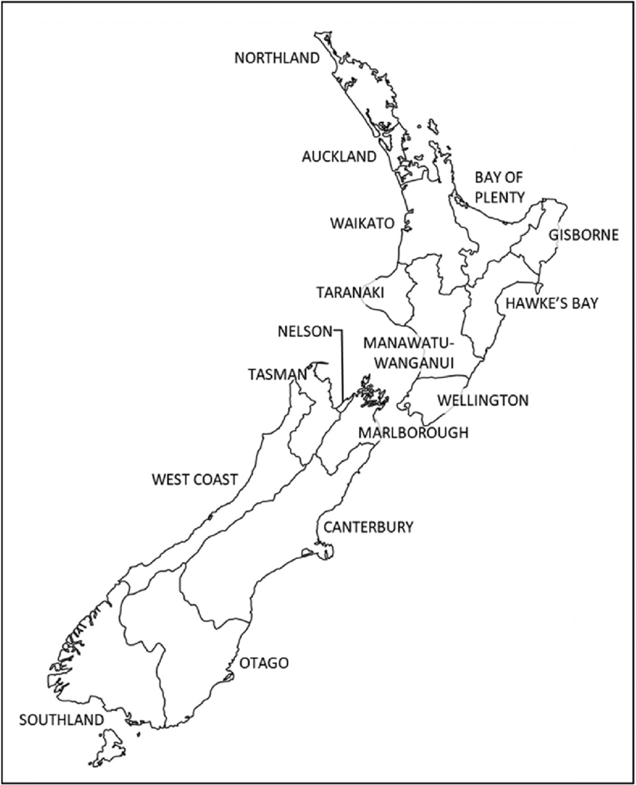
Arable farming
The Canterbury plains is the main region of arable farming.
The land is flat, providing easy access for big cultivating and harvesting machinery.
Soils are fertile and responds well to fertiliser.
Summers are dry to ripen grain crops.
Water is available for irrigating crops.

Slide 13
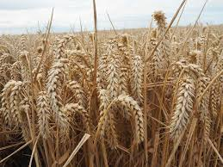
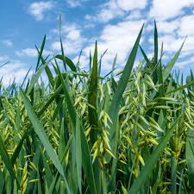
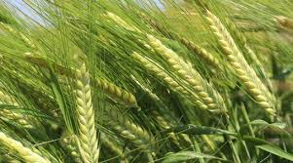
Arable crops
Wheat
Oats
Arable Crops
Wheat Barley Maize Oats Grass, crop & vegetable seed
Barley

Slide 14
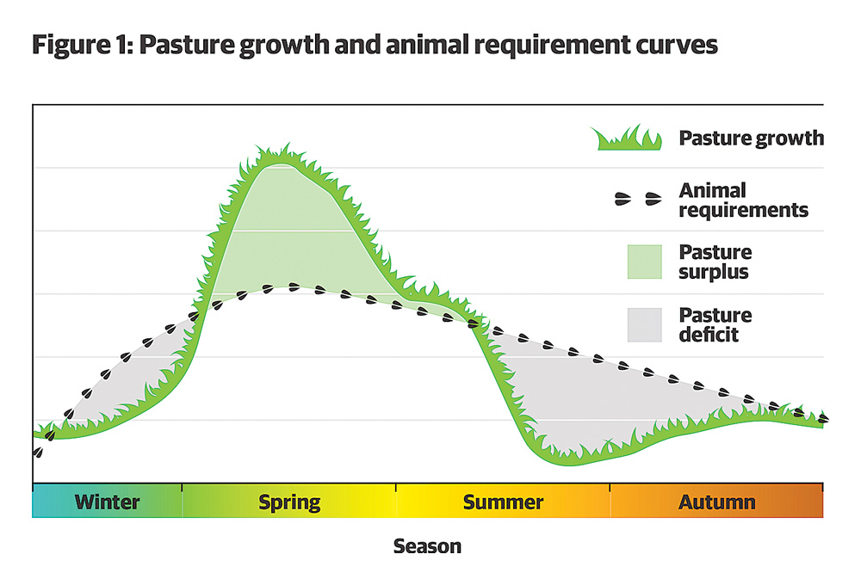
Crops grown to feed cattle and sheep
Fodder Cut & stored | Forage Self-feeding
Hay Silage Maize silage Balage | Pasture Lucerne Turnips Fodder beet Swedes Green feed oats Kale Rape
Fodder and forage crops are grown on dairy and sheep and beef farms to feed animals when there is not enough pasture.

Slide 15
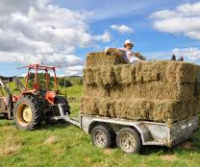
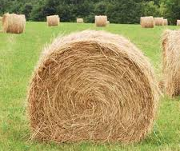
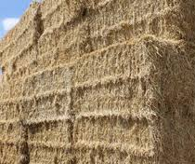
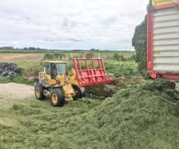
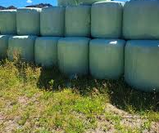
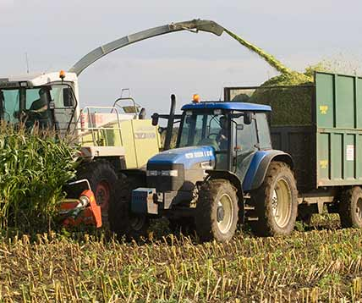
Hay
Pasture silage
Wrapped silage/ Bailage
Maize silage

Slide 16
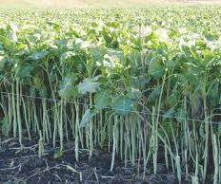
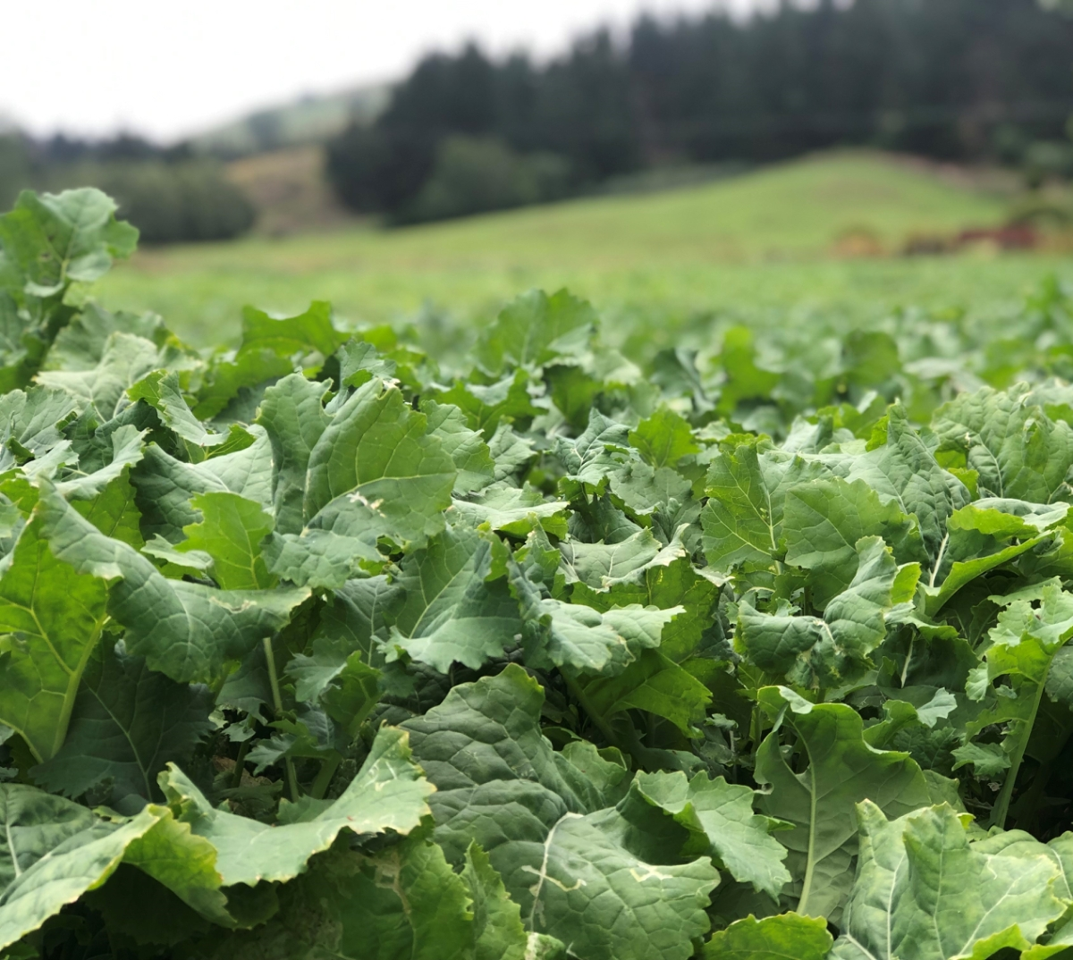
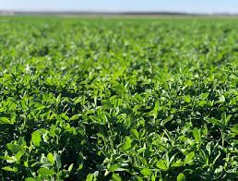
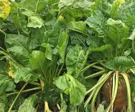
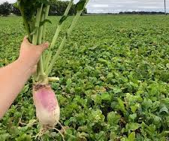
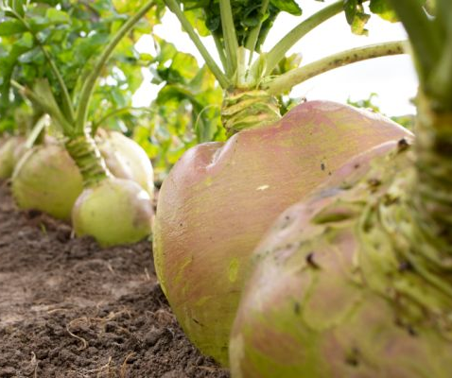
Forage Kale
Forage Rape
Lucerne
Fodder beet
Turnips
Swede

Slide 17
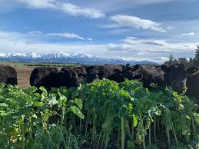
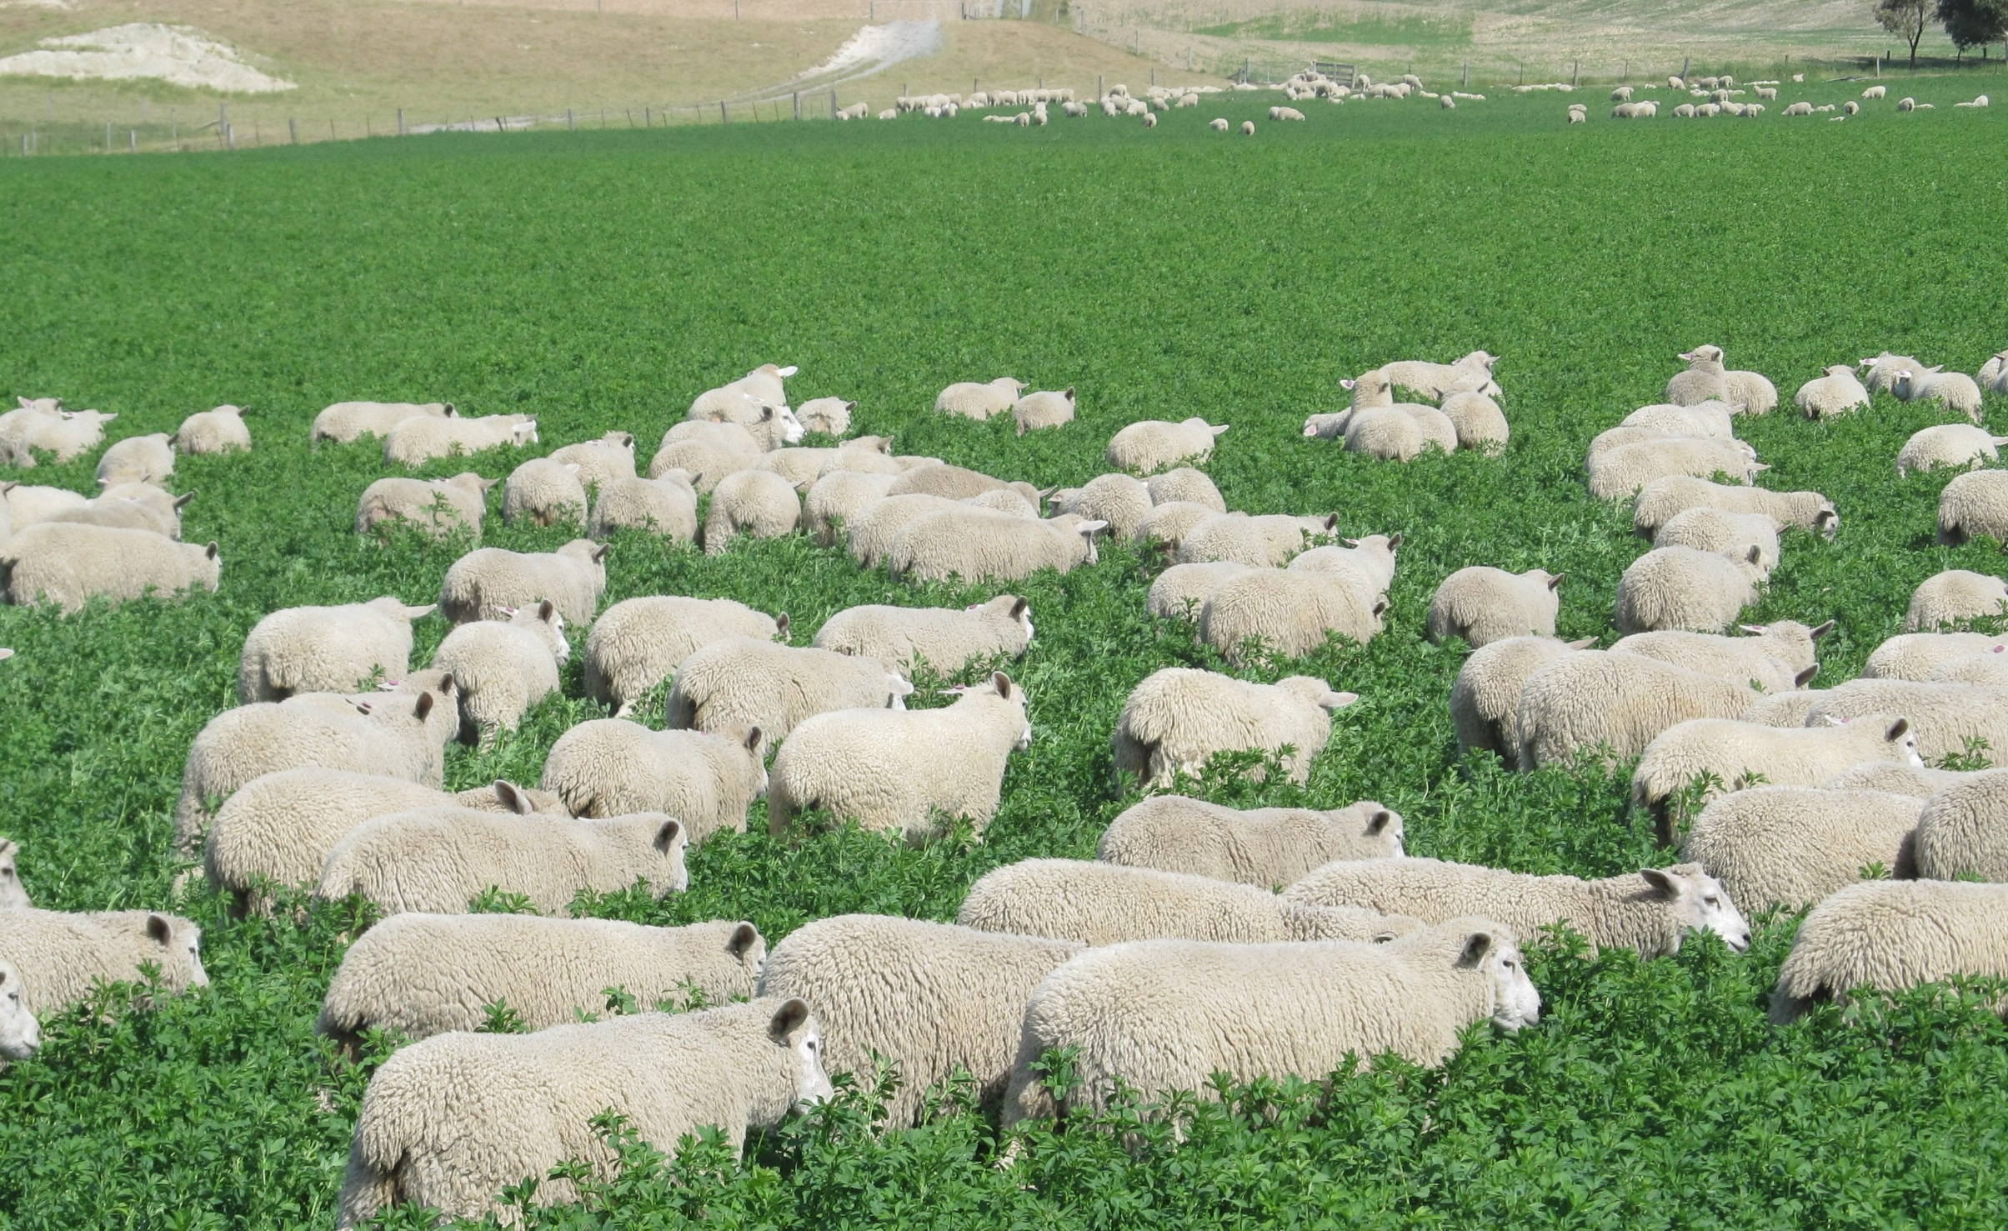
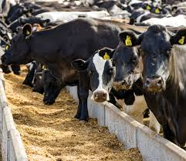
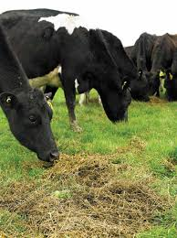
Forage Kale
Lucerne
Maize silage
Pasture silage

