Slide 1


Slide 2
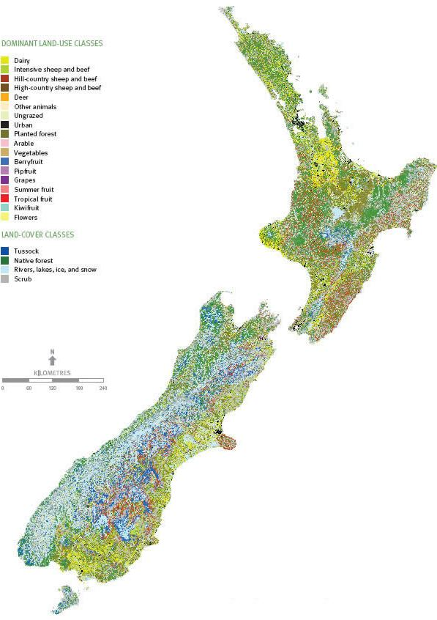
Location of
Horticulture Production Systems
in New Zealand

Slide 3
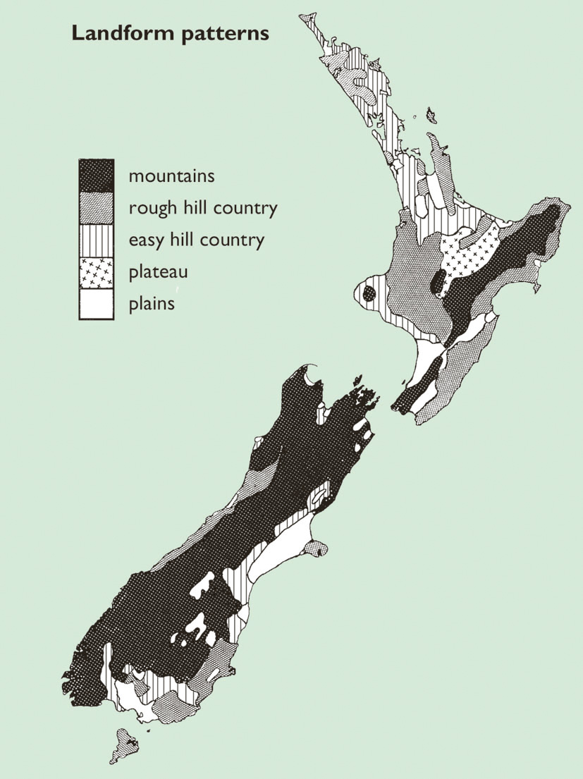
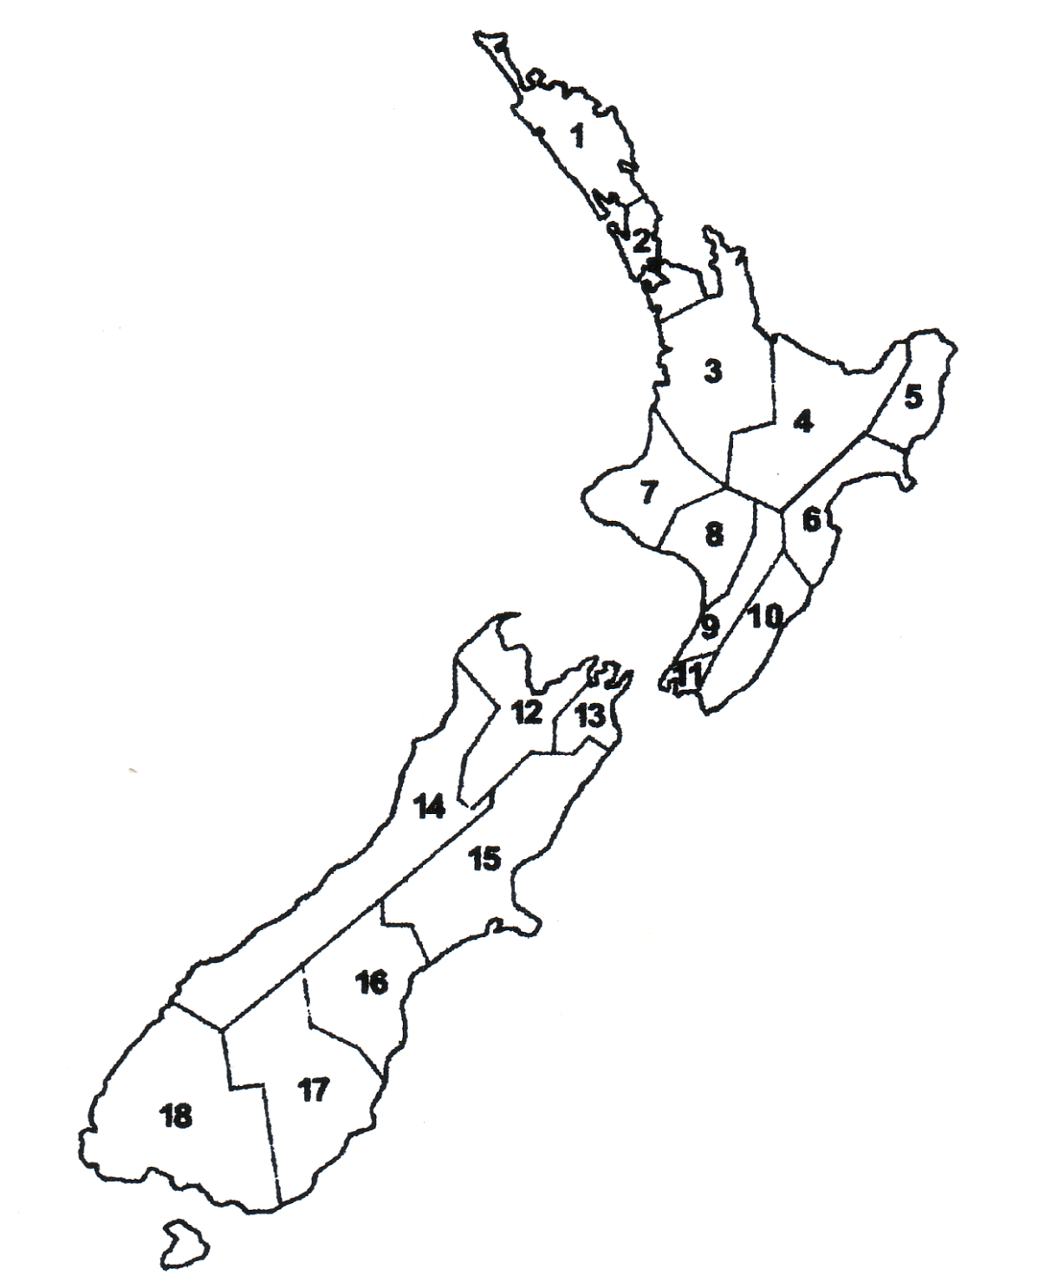
Regions of New Zealand
Northland
Auckland
Waikato
Bay of Plenty
Gisborne / East Coast
Hawkes Bay
Taranaki
Whanganui
Manawatu
Wairarapa
Wellington
Nelson
Marlborough
West Coast
Canterbury
South Canterbury
Otago
Southland

Slide 4
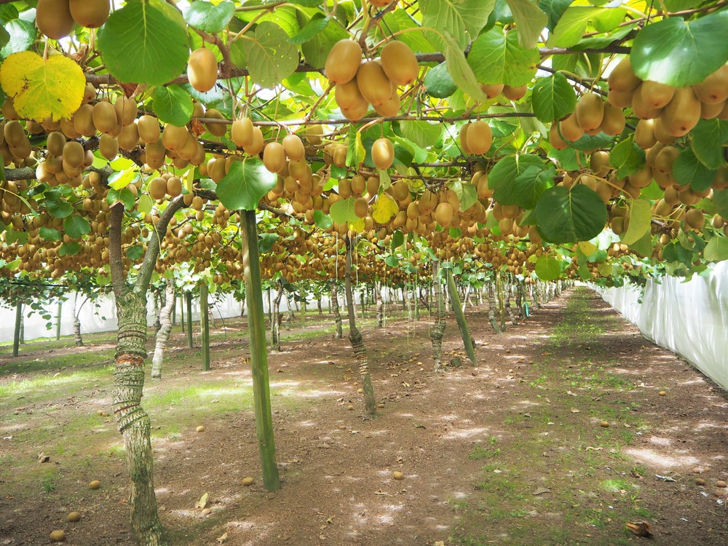
Factors that influence the location of horticulture primary production systems
Physical factors
Topography-slope of the land ( flat, rolling hills, hilly and mountainous)
Fertile soils
Climate factors
Rainfall
Temperature
Sunlight hours

Slide 5
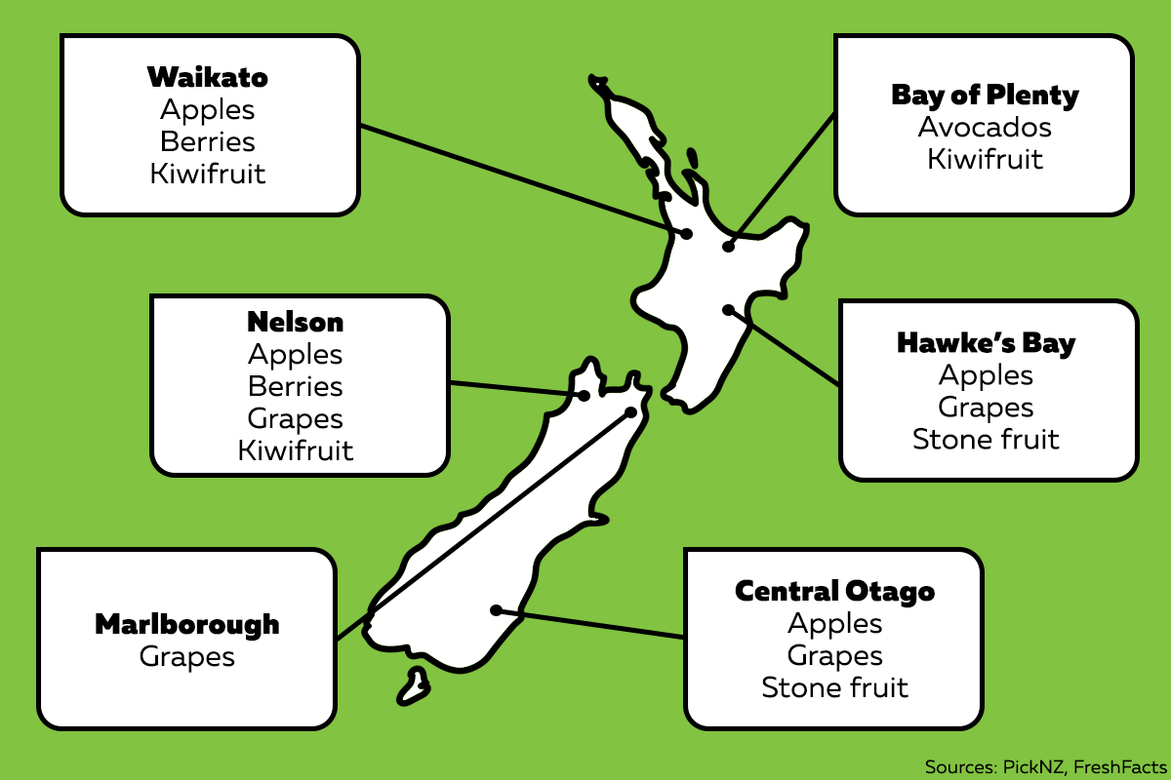
Horticulture
There are pockets of horticulture in both the North and South Islands. Horticulture is predominantly found on flat land with fertile soils and access to a good water supply for irrigation.
Crops are grown in regions that meet the temperature and sunshine hour requirements for good crop growth.

Slide 6
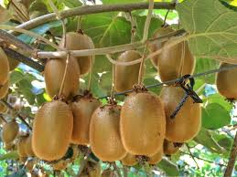
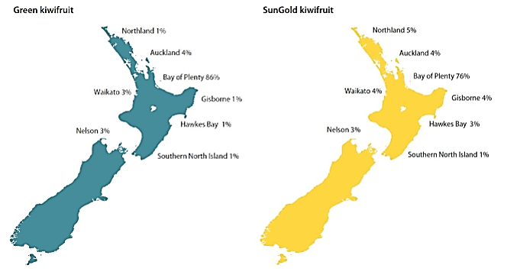
Kiwifruit
Over 80% of Kiwifruit produced in New Zealand is grown in the Bay of Plenty. Kiwifruit is grown on flat land, in fertile free draining soils. This region has a mean temperature of 14.5⁰C, high sunshine hours and has low risk of frosts.

Slide 7
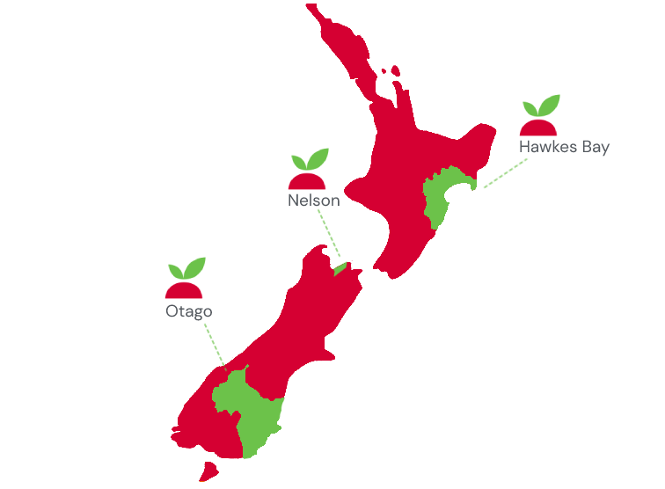
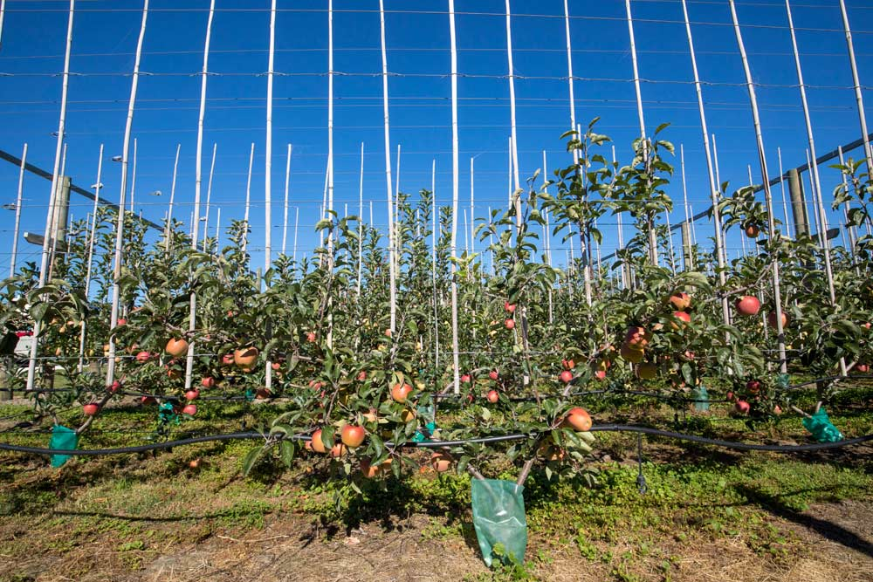
Pip fruit:- apples & pears
Pip fruit are predominantly grown in Hawkes Bay, Nelson and central Otago on flat land that has fertile free draining soils. These regions have long dry summers needed for colouring up and ripening fruit.

Slide 8
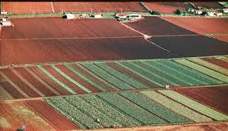
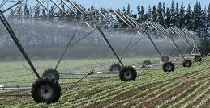
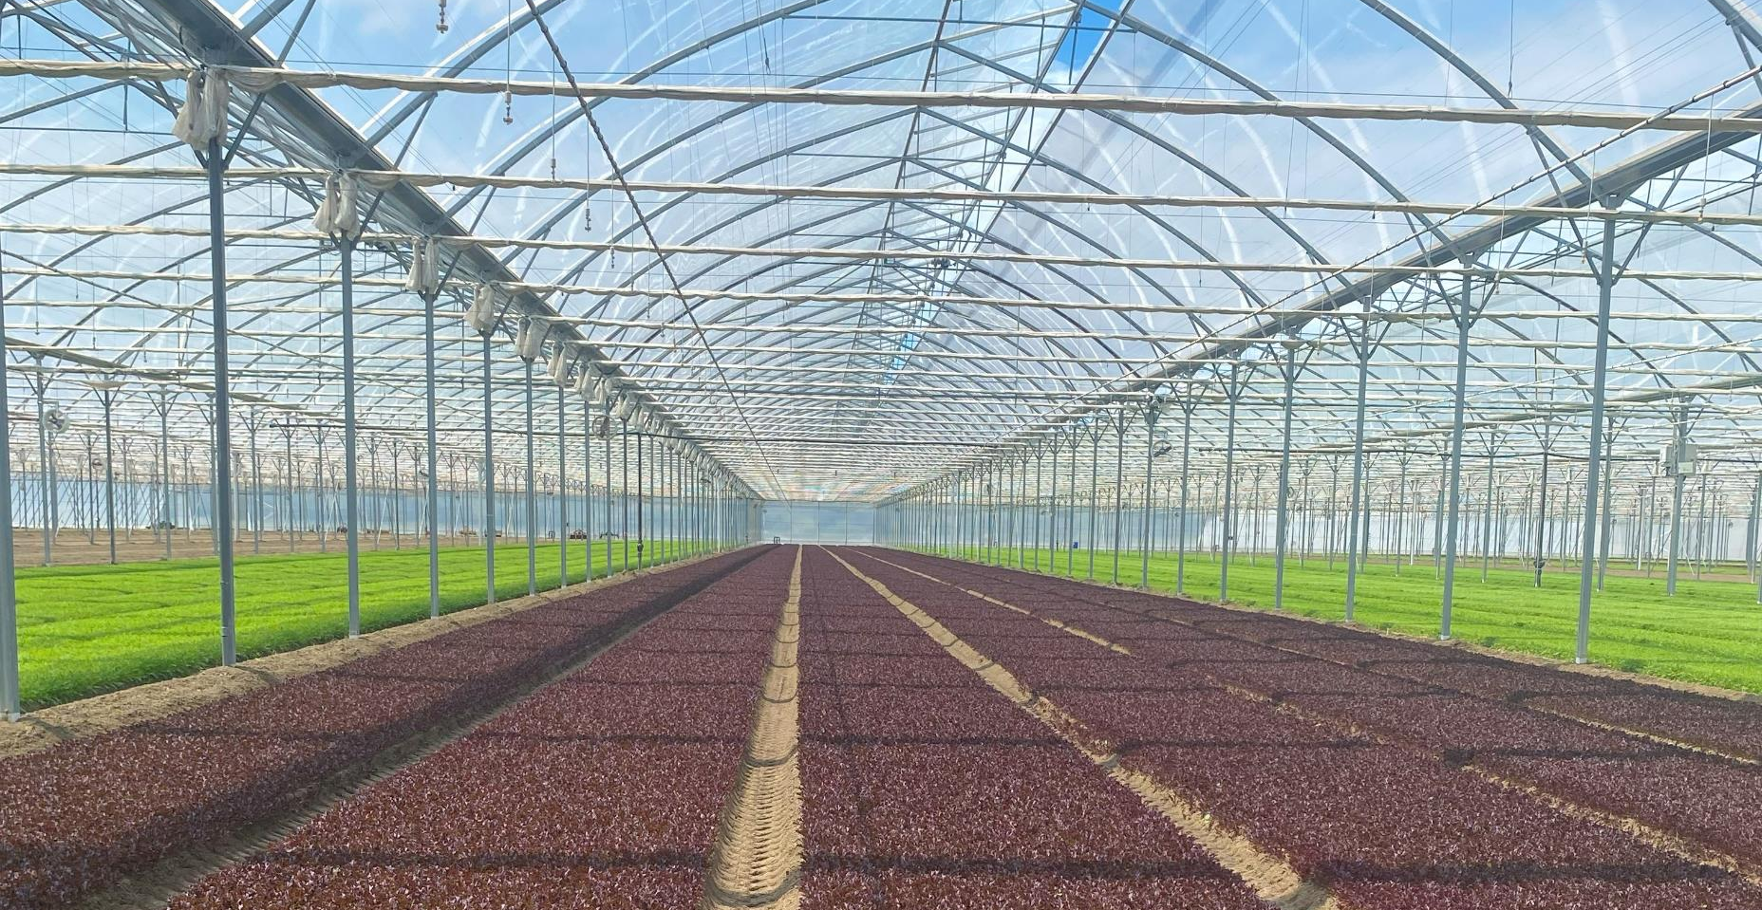
Commercial Vegetable Production
Commercial vegetable production is found in several regions
on flat to slightly rolling land with fertile soils suited to being cultivated.
on flat land with fertile soil where the infrastructure for large scale indoor commercial vegetable production can be built.
in areas where temperatures are warm, and frosts are rare.
where there is good annual rainfall or a good water supply for irrigation.

Slide 9
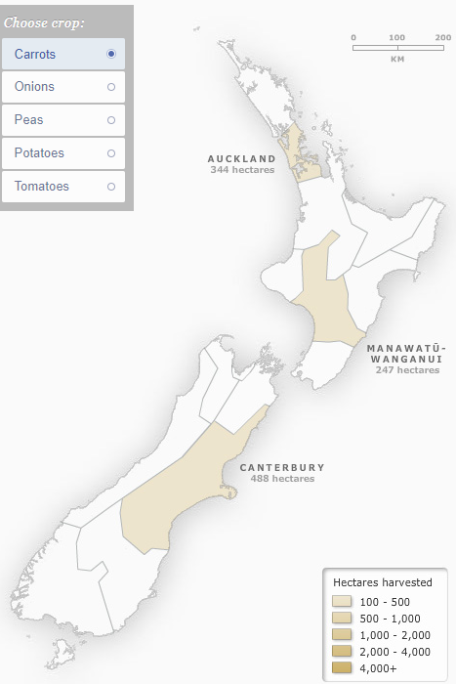
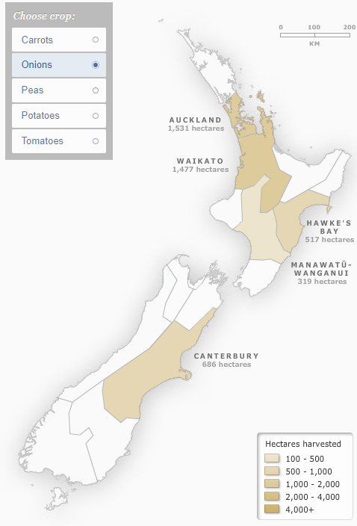
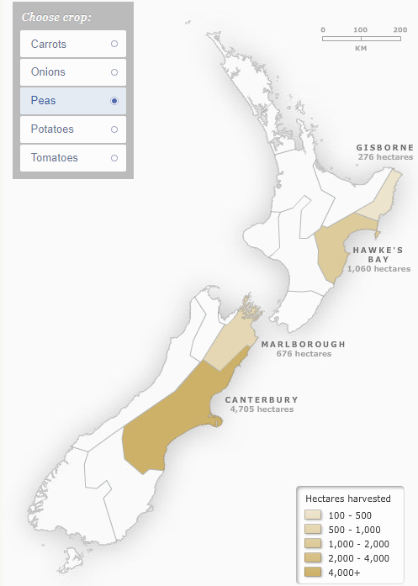
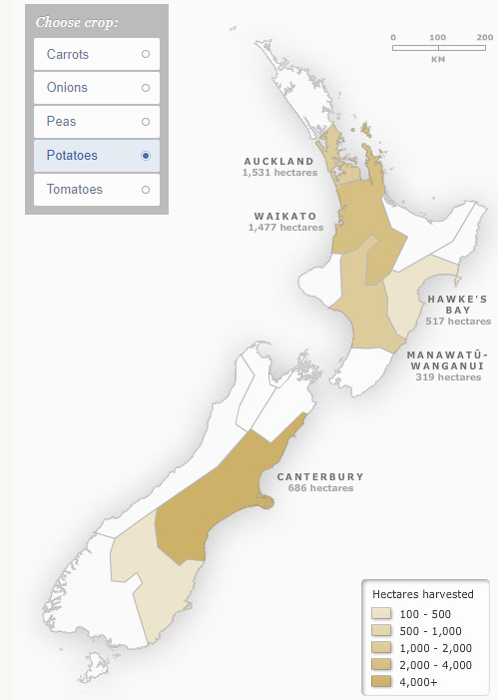
Major vegetable crops
Growing carrots
Growing onions
Growing peas
Growing potatoes

Slide 10
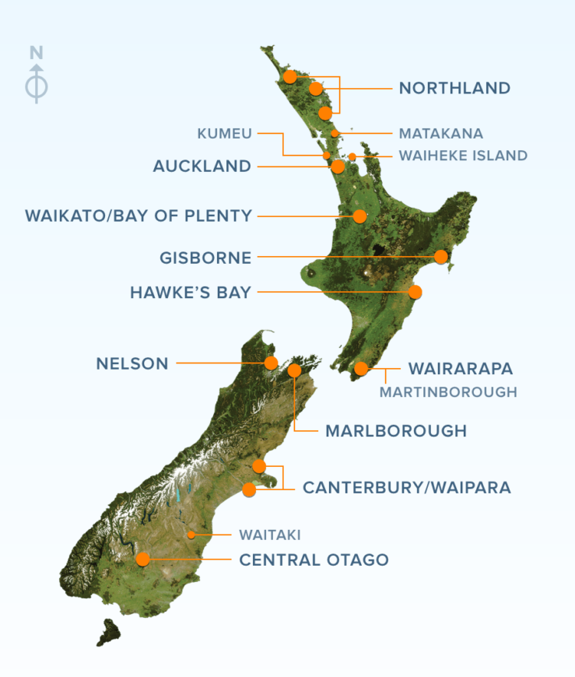
Viticulture
Grapes can be grown on flat to slightly rolling land in many regions in New Zealand. However, the main regions are Hawkes Bay and Marlborough.
These regions have low rainfall, high sunshine hours, well drained soils and access to a reliable water supply for irrigation.

Slide 11
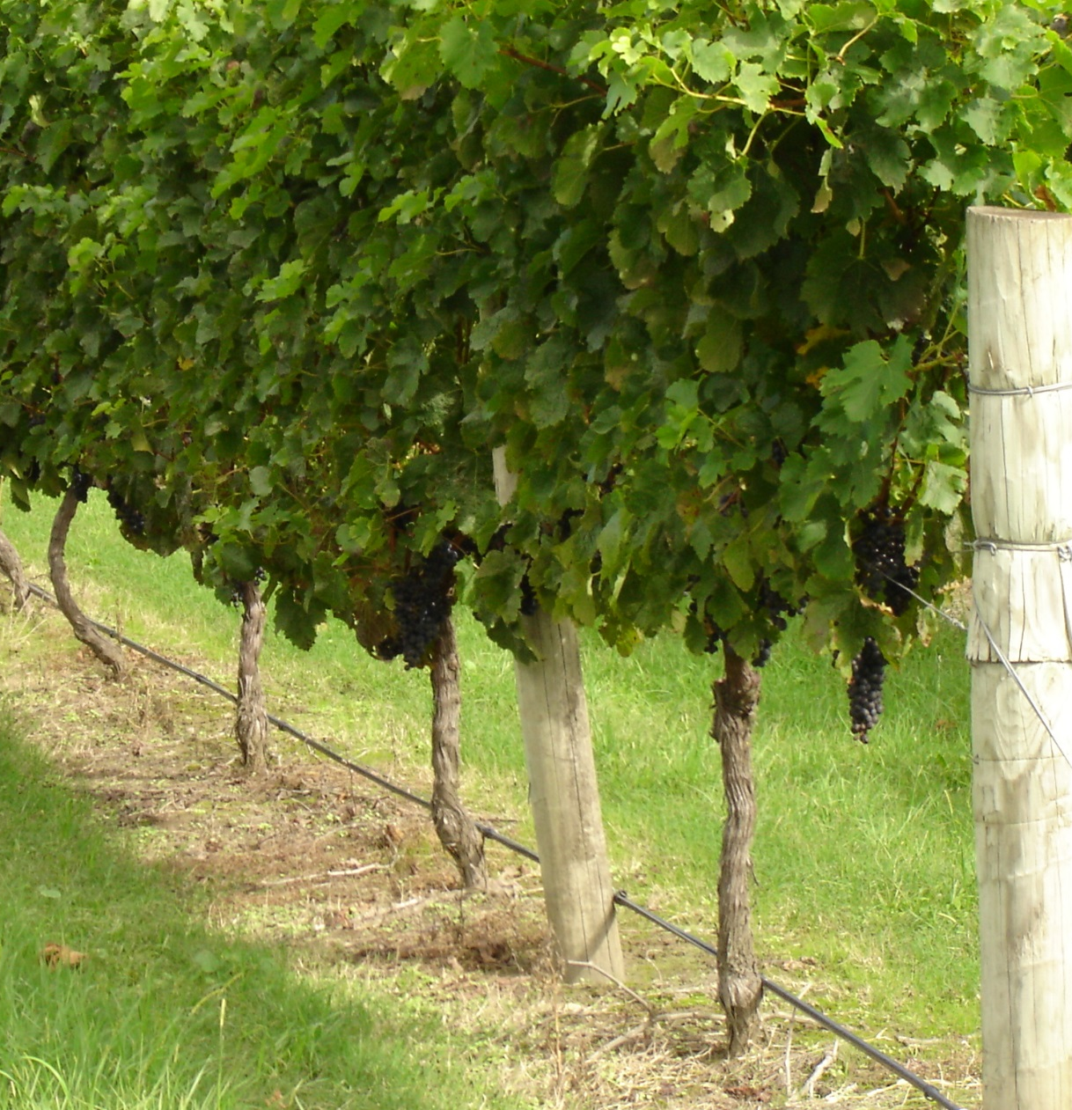
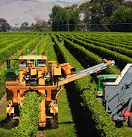
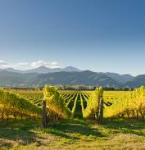
41,806
41, 806 hectares of grapes vines are planted in New Zealand

Slide 12
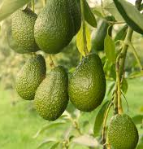
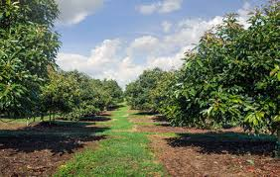
Avocado Production
The New Zealand avocado industry consists of 1,800 orchards, manly in Northland and Bay of Plenty.
Avocados are grown on flat land, in fertile free draining soils. These region has a mean temperature of 14.5⁰C, high sunshine hours and has low risk of frosts and access to water for irrigation.

Slide 13
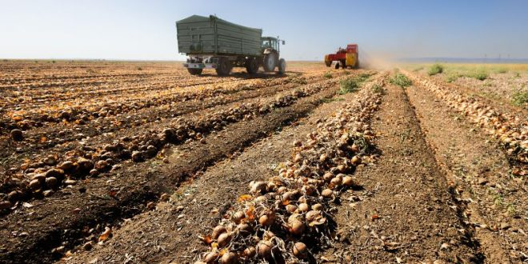
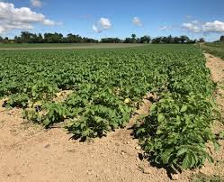
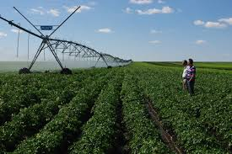
Potatoes
Over 8,400 hectares of potatoes are grown in New Zealand predominantly in Waikato and Canterbury. The land is flat and the soils are tolerant of cultivation. A good water supply is needed to grow high yields of potatoes.

Slide 14
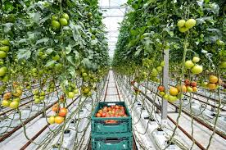
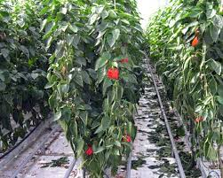
Glasshouse production
Approximately 60 hectares of capsicum is grown under cover
Tomatoes yield 60kg of loose round tomatoes /m², 600t/ha.
1ha = 10,000m²

