Slide 1


Slide 2
Unit 1
Primary Production in New Zealand

Slide 3
Lesson 1
Activity 1- Definitions- set up as a mix and match exercise
Drag the information on the right side to the correct definition column
Agriculture
Horticulture
Aquaculture
Forestry
Fishing
Viticulture
Apiculture
Dairy Farming
Sheep & Beef Farming
Arable farming
Market gardening
Covered crop
Catching fish and other seafood for commercial profit, from wild fisheries.
Commercial vegetable production.
Dairy farming is the production of milk from mammals such as dairy cows, goats or sheep.
Growing commercial crops under glass or plastic e.g. tomatoes, cucumber and capsicums, berry crops.
Is beekeeping – the practice of caring for honeybees and harvesting honey.
Sheep and beef farming is the production of animal meat (protein) and wool.
The science of farming, growing crops, rearing of animals to provide food, wool and other products.
The science of developing, growing and caring for forests, native and exotic.
The science of growing and producing managed plant crops such as fruits, vegetables, flowers, trees, etc.
The science of growing grapes for wine making.
The growing of grain or seed crops for food production for humans and animals.
The science of breeding and growing marine or freshwater fish (salmon and Kingfish); or shellfish (oysters and mussels), under controlled conditions.

Slide 4
Lesson 1
Activity 1- Definitions- set up as a mix and match exercise - Answers
Agriculture | The science of farming, growing crops, rearing of animals to provide food, wool and other products.
Horticulture | The science of growing and producing managed plant crops such as fruits, vegetables, flowers, trees, etc.
Aquaculture | The science of breeding and growing marine or freshwater fish (salmon and Kingfish); or shellfish (oysters and mussels), under controlled conditions.
Forestry | The science of developing, growing and caring for forests, native and exotic.
Fishing | Catching fish and other seafood for commercial profit, from wild fisheries.
Viticulture | The science of growing grapes for wine making.
Apiculture | Is beekeeping – the practice of caring for honeybees and harvesting honey.
Dairy Farming | Dairy farming is the production of milk from mammals such as dairy cows, goats or sheep.
Sheep & Beef Farming | Sheep and beef farming is the production of animal meat (protein) and wool.
Arable farming | The growing of grain or seed crops for food production for humans and animals.
Market gardening | Commercial vegetable production.
Covered crop | Growing commercial crops under glass or plastic e.g. tomatoes, cucumber and capsicums, berry crops.

Slide 5
Lesson 1
Activity 2 - Match the primary products or industries to the correct primary production sector
Drag the names of the primary products or industries on the left side to the correct primary sector column
Primary product or industry
Agriculture | Horticulture | Forestry | Aquaculture
Dairying
Cut flowers
Pip fruit
Pinus radiata
Berries
Sheep and beef
Grapes
Market gardens
Salmon
Salad greens
Pork
Kiwifruit
Wool
Timber mill
Citrus
Poultry
Deer
Oysters

Slide 6
Lesson 1
Activity 2 - Match the primary products or industries to the correct primary production sector - ANSWERS
Agriculture | Horticulture | Forestry | Aquaculture
Dairying Pork Poultry Deer Sheep and beef Wool | Pip fruit Berries Citrus Cut flowers Market gardens Kiwifruit Grapes Salad greens | Pinus radiata Timber mill | Oysters Salmon

Slide 7
Lesson 2
Activity 1 - Record the export earning for the primary sectors
Primary industry | Export earnings
Dairy
Sheep & Beef
Horticulture
Forestry
Viticulture
Arable

Slide 8
Lesson 2
Activity 1 - Record the top 5 export destinations.
Top 5
Export Exporting Primary Industry | Export Markets
Number of people employed in the primary industry.

Slide 9
Lesson 2
Activity 2 Research activity
Lesson 2
Activity 1 - Record regional export earnings.
Name of region-
Primary production system(s) | $ Export earnings

Slide 10
Lesson 2
Activity 2 - Research Writing Activity
Research
Region.
Primary production systems.
Primary production export earnings.
Writing:- Why do you think primary production is important to New Zealand and your region.

Slide 11
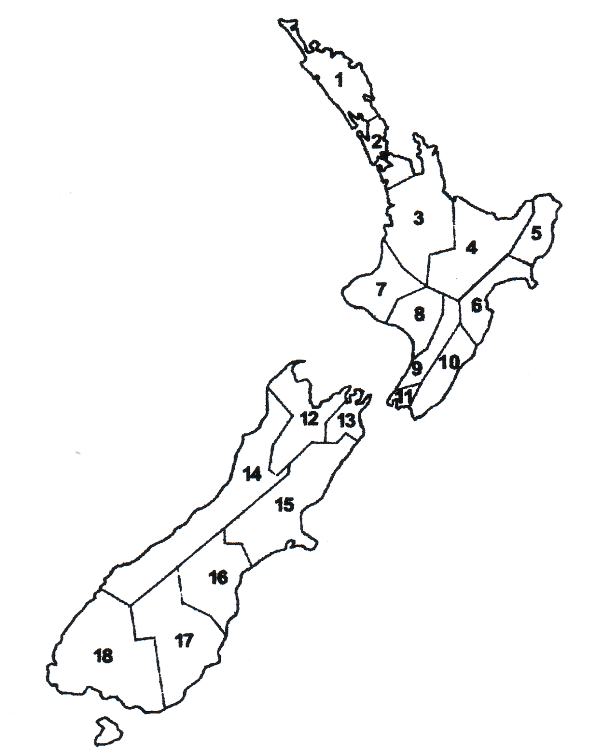
Lesson 3
Activity 1 - Regions of New Zealand
Northland
Auckland
Waikato
Bay Of Plenty
Gisborne / East Coast
Hawkes Bay
Taranaki
Whanganui
Manawatu
Wairarapa
Wellington
Nelson
Marlborough
West Coast
Canterbury
South Canterbury
Otago
Southland
Draw an arrow matching the region with correct number.

Slide 12
Lesson 3
Activity 1 - Regions of New Zealand - ANSWERS
Northland
Auckland
Waikato
Bay Of Plenty
Gisborne / East Coast
Hawkes Bay
Taranaki
Whanganui
Manawatu
Wairarapa
Wellington
Nelson
Marlborough
West Coast
Canterbury
South Canterbury
Otago
Southland

Slide 13
Lesson 3
Activity 2 - Using the data and information in PowerPoint Location of Primary production systems in New Zealand slides 6 and 7, complete the table.
Which region has the | Region
Highest rainfall
Lowest rainfall
Highest mean temperature
Lowest mean temperature
Highest sunshine hours
Lowest sunshine hours
Highest number of days with frosts
Lowest number of days with frost
Biggest temperature difference from very highest to very lowest.
Which Island has the most mountainous country?
Which Island has the most plains (flat land)?
Which Island has the most, easy hill country?

Slide 14
Lesson 3
Activity 3 - Primary production in my region
Activity
My region is-
The mean temperature is-
The mean annual rainfall is-
The sunshine hours are-
The number of frost days are-
The topography is -
The main primary products produced in my region are-

Slide 15
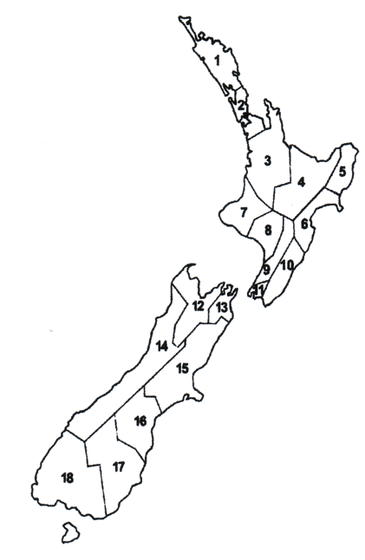
Lesson 3 - Activity 4
Resource PPT Geographic distribution sorting
On the map of New Zealand
Match
The location with the region
The Iwi who settled each of the regions
The main soil types for each region
The topography across each region
The average annual rainfall across each region
The average annual temperature across each region
The average annual sunshine hours across each region
Some of the primary products that are produced in each region
Hint:- each region has a specific colour,/pattern and this continues throughout the activity.

Slide 16
Lesson 4
Activity 2 - Match the words to the right heading
Drag the words on the left side to the correct column
Friesian
Dairy | Beef | Sheep | Arable crop | Forage crop | Fodder crop
Merino
Wheat
Turnip
Romney
Pasture
Kiwi cross
Angus
Lucerne
East Friesian
Barley
Hay
Jersey
Pasture silage
Hereford

Slide 17
Lesson 4
Activity 2 - Answers
Dairy | Beef | Sheep | Arable crop | Forage crop | Fodder crop
Friesian Kiwi Cross Jersey | Angus Hereford Angus Hereford Cross | Merino Romney East Friesian | Wheat Barley | Turnips Lucerne Pasture | Hay Silage

Slide 18
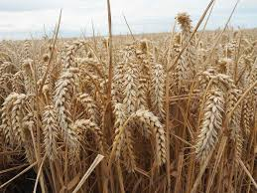
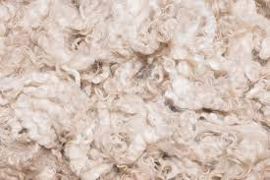
Lesson4
Activity 4 - Research Activity
Find out
1. What wheat, barley and oats are used for?
Wheat is used for-
Barley is used for-
Oats are used for-
2. What is wool from merino sheep used for?
Merino wool is used for-

Slide 19
Lesson 4
Activity 7 - Careers in the pastoral farming sector.
List all the careers you can think of in the agriculture industry?
Watch these videos to help you get started.
Beef + Lamb NZ
Dairy farming On Farm Story
Dairy farming Farm Assistant- Edward
Dairy Go for work you love
Dairy farming Pasifika peoples
Agriscience
Agribusiness
Careers in the agriculture sector
Technology being used in the agriculture industry.

Slide 20
Lesson 5
Activity 1 - Writing
List the factors influencing where horticulture crops are grown in New Zealand.

Slide 21
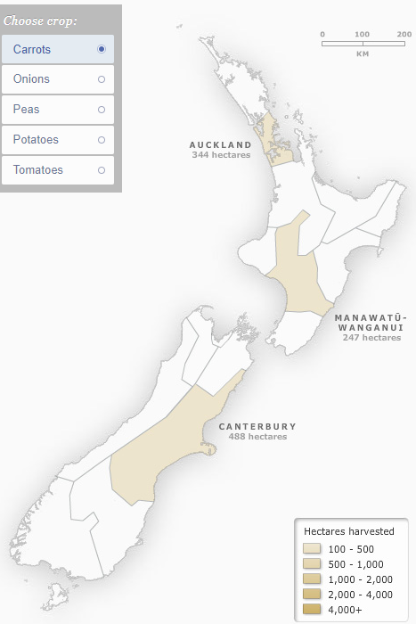
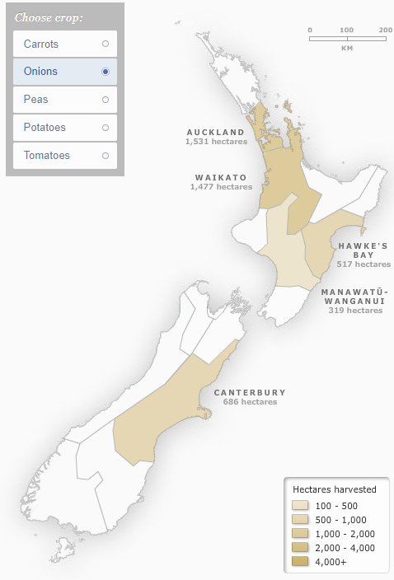
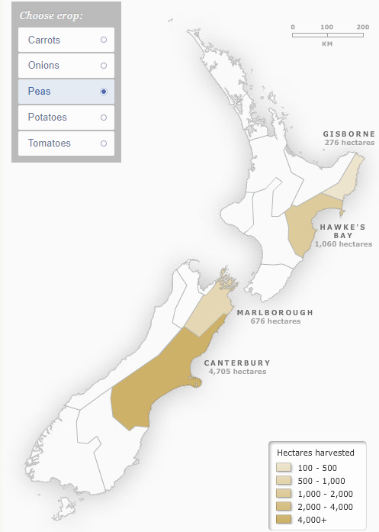
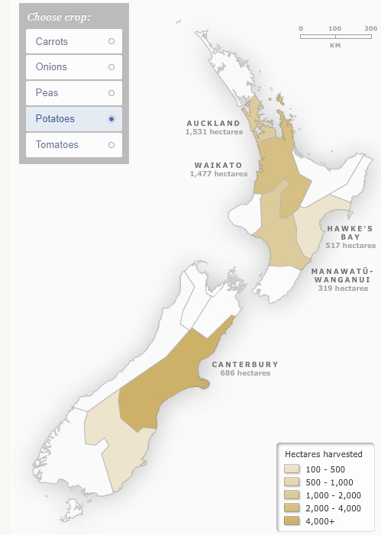
Major vegetable crops grown in New Zealand

Slide 22
Lesson 5
Activity 2 - Recording
Using the maps in slide 21
Record the regions each crop is grown in.
Make a list of the equipment and technology used in growing each crop.
Crops | Regions crops grown | Equipment and technology
Carrots
Onions
Peas
Potatoes

Slide 23
Lesson 5
Activity 3 -Careers in the horticulture sector
List all the careers you can think of in the horticulture sector.
Watch these videos to help you.
Orchard Supervisor
Cheery grower
Control operator https://www.youtube.com/watch?v=mRAILIXiK-A
Just the job - Amenity Horticulture
Careers in the horticulture sector
Technology being used in the horticulture sector

Slide 24
Lesson 6
Activity 3 -Careers in the forestry sector
List as many careers as possible you can think of in the forestry and wood sector.
Watch these videos to help you.
Forestry Industry Big Day Out - Shideen's Story
Future forester videos- there are several great videos of young people working in the forestry industry.
Forestry and Wood - Northland, New Zealand
Careers in the forestry sector
Technology being used in the forestry sector

Slide 25
Lesson 7
Activity 5 - Careers in the seafood sector
List as many careers as possible you can think of in the seafood sector.
Watch these videos to help you.
Aquaculture - Northland, New Zealand
Aquaculture: New Zealand's future.
Seafood New Zealand careers
New Zealand Sustainable Aquaculture
Blue Endeavour - New Zealand King Salmon's open ocean.
Tio aquaculture at Moana New Zealand
Careers in the seafood sector
Technology being used in the seafood sector

Slide 26
Lesson 9
Activity 2 - Careers in the sports turf sector
List as many careers as possible you can think of in the sports turf sector.
Watch this video to help you.
Sports Turf Management Careers
Careers in the sports turf sector.
Equipment and technology being used in the sports turf sector.

