Slide 1


Slide 2
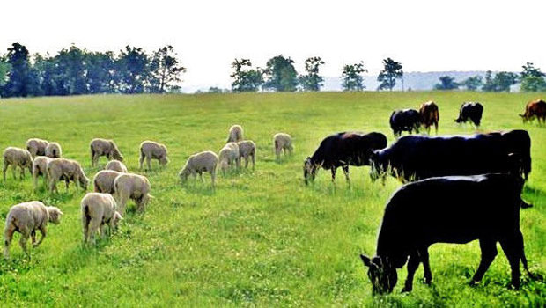
New Zealand
Cattle and Sheep Breeds

Slide 3
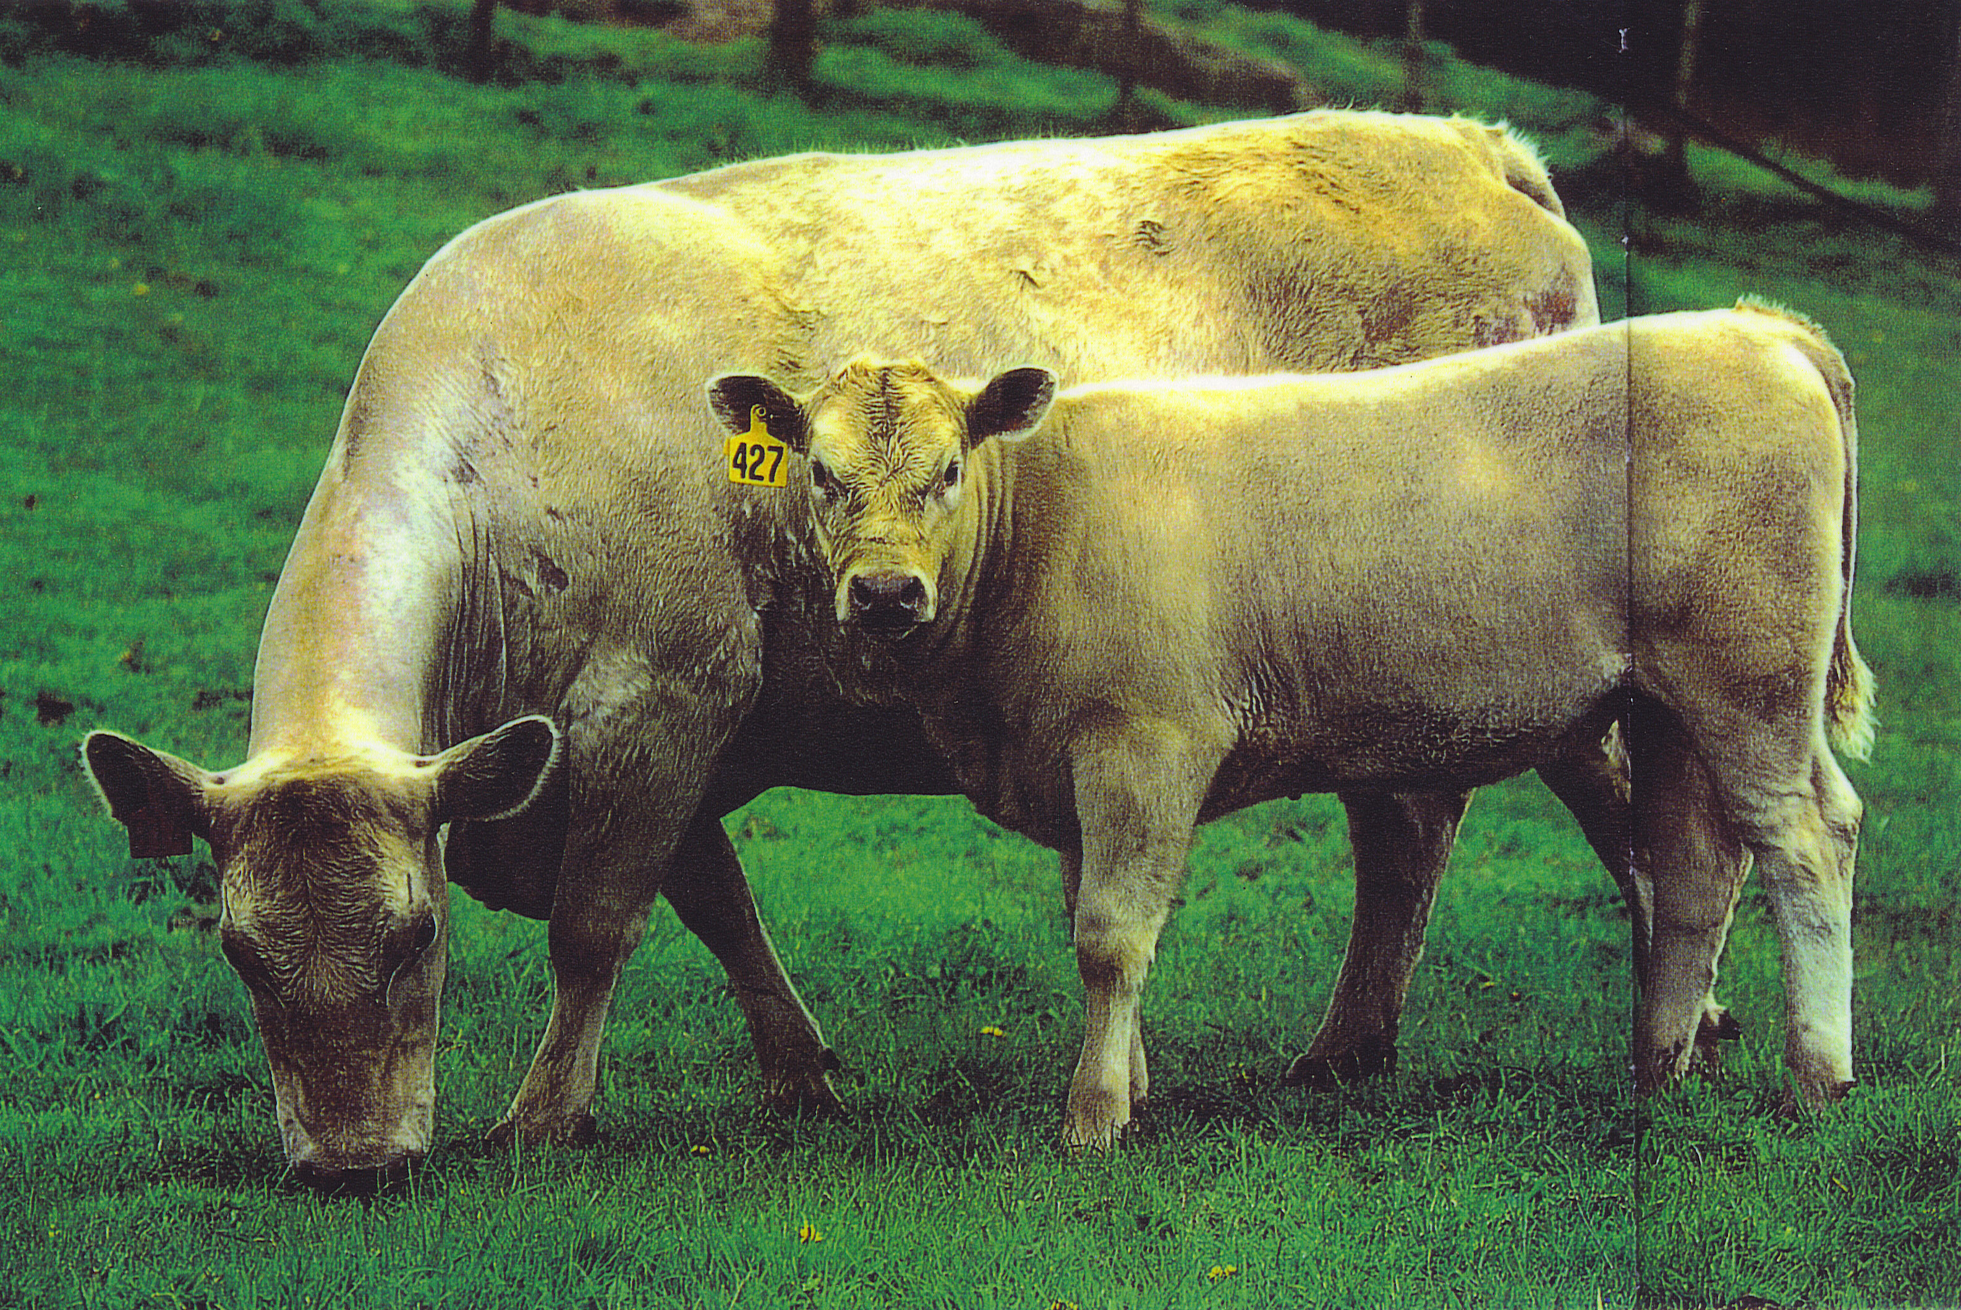
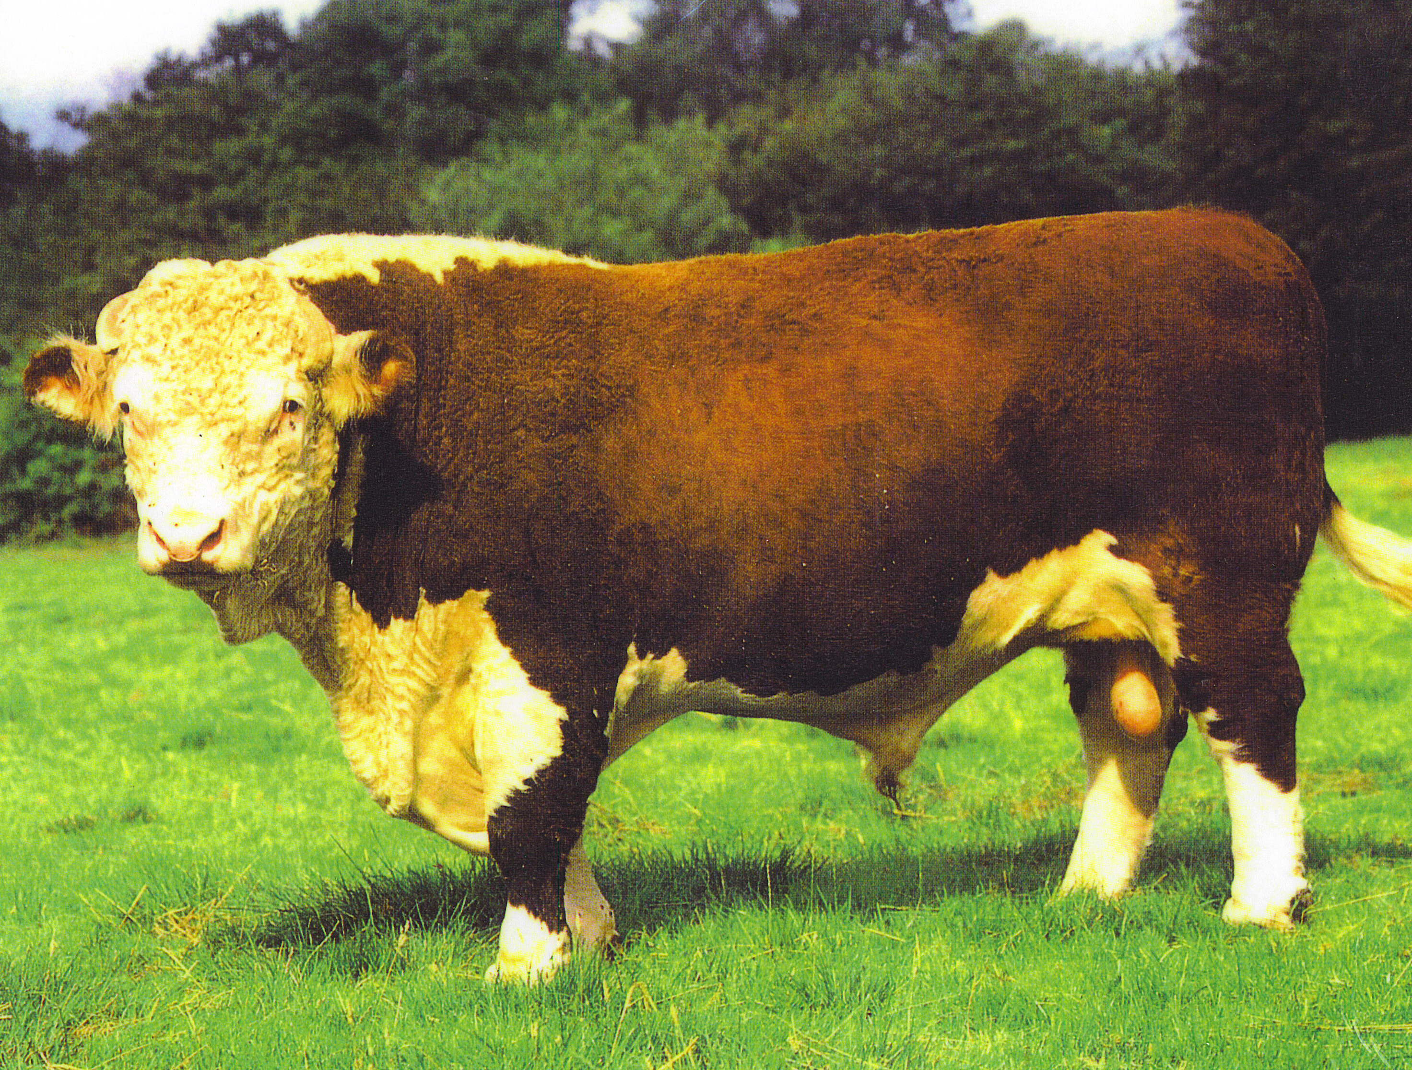
Cattle breeds
Cow & calf
Cattle can be grouped according to the products they have been bred for.
Dairy cattle- convert pasture efficiently into large quantities of milk
Beef cattle- convert pasture efficiently into animal protein- meat. They grow quickly and are well muscled.
Dual purpose- converts pasture well into both milk and meat.
Bull

Slide 4
Cattle Breeds | Dairy | Friesian Jersey Friesian Jersey cross (kiwicross) Ayrshire | Intensive farming system
 | Dual Purpose | Shorthorn | Intensive -Semi- extensive farming system
 | Beef Main | Angus Hereford Angus Herford cross Dairy Beef Friesian cow X Beef bull Speckle Park | Semi- extensive- Intensive farming system
 | Exotic | Murray grey Limousin Belgium blue Simmental Charolais Wagyu | Semi- extensive- Intensive farming system

Slide 5
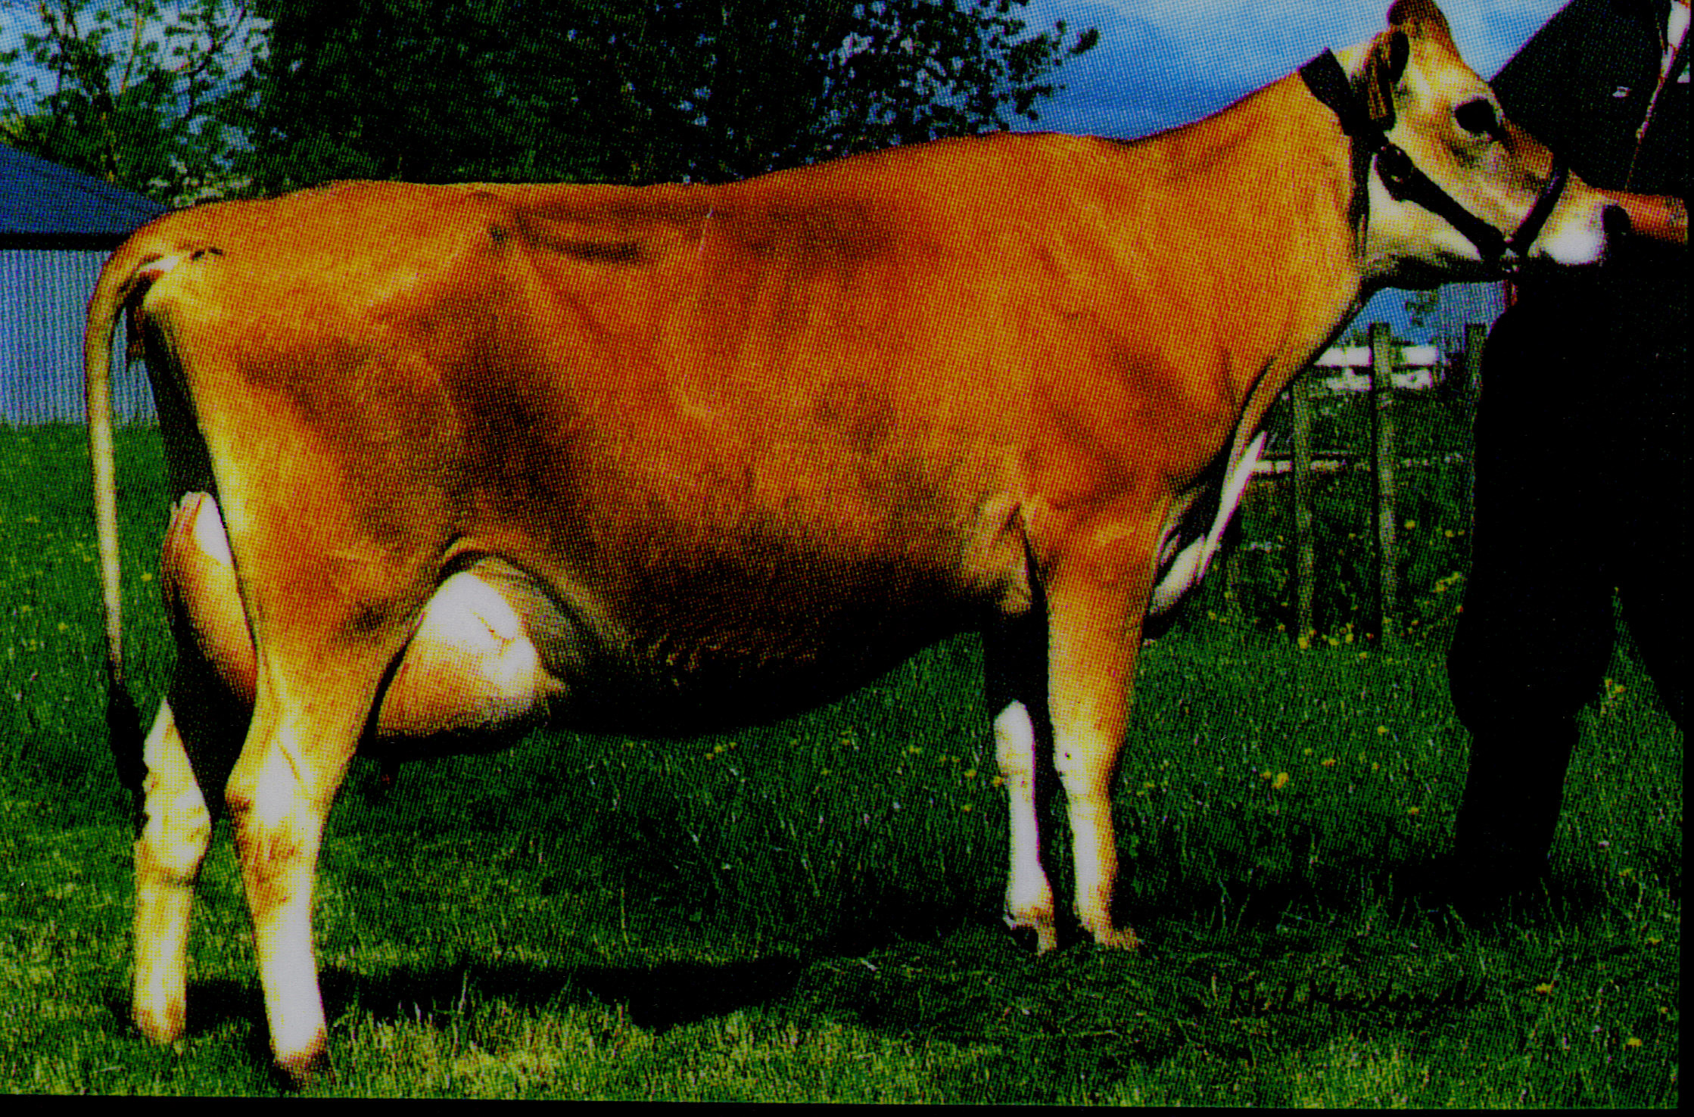
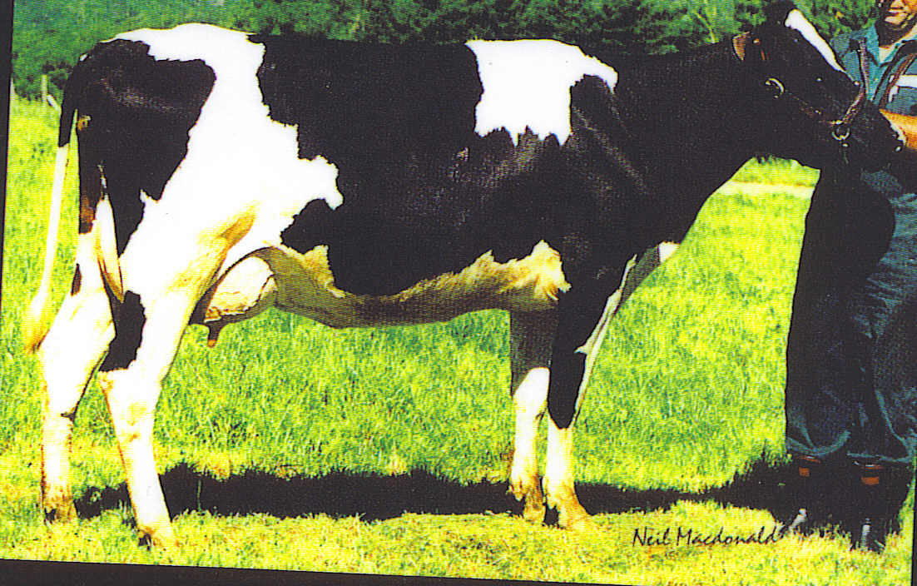
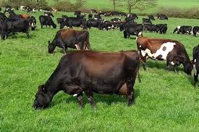
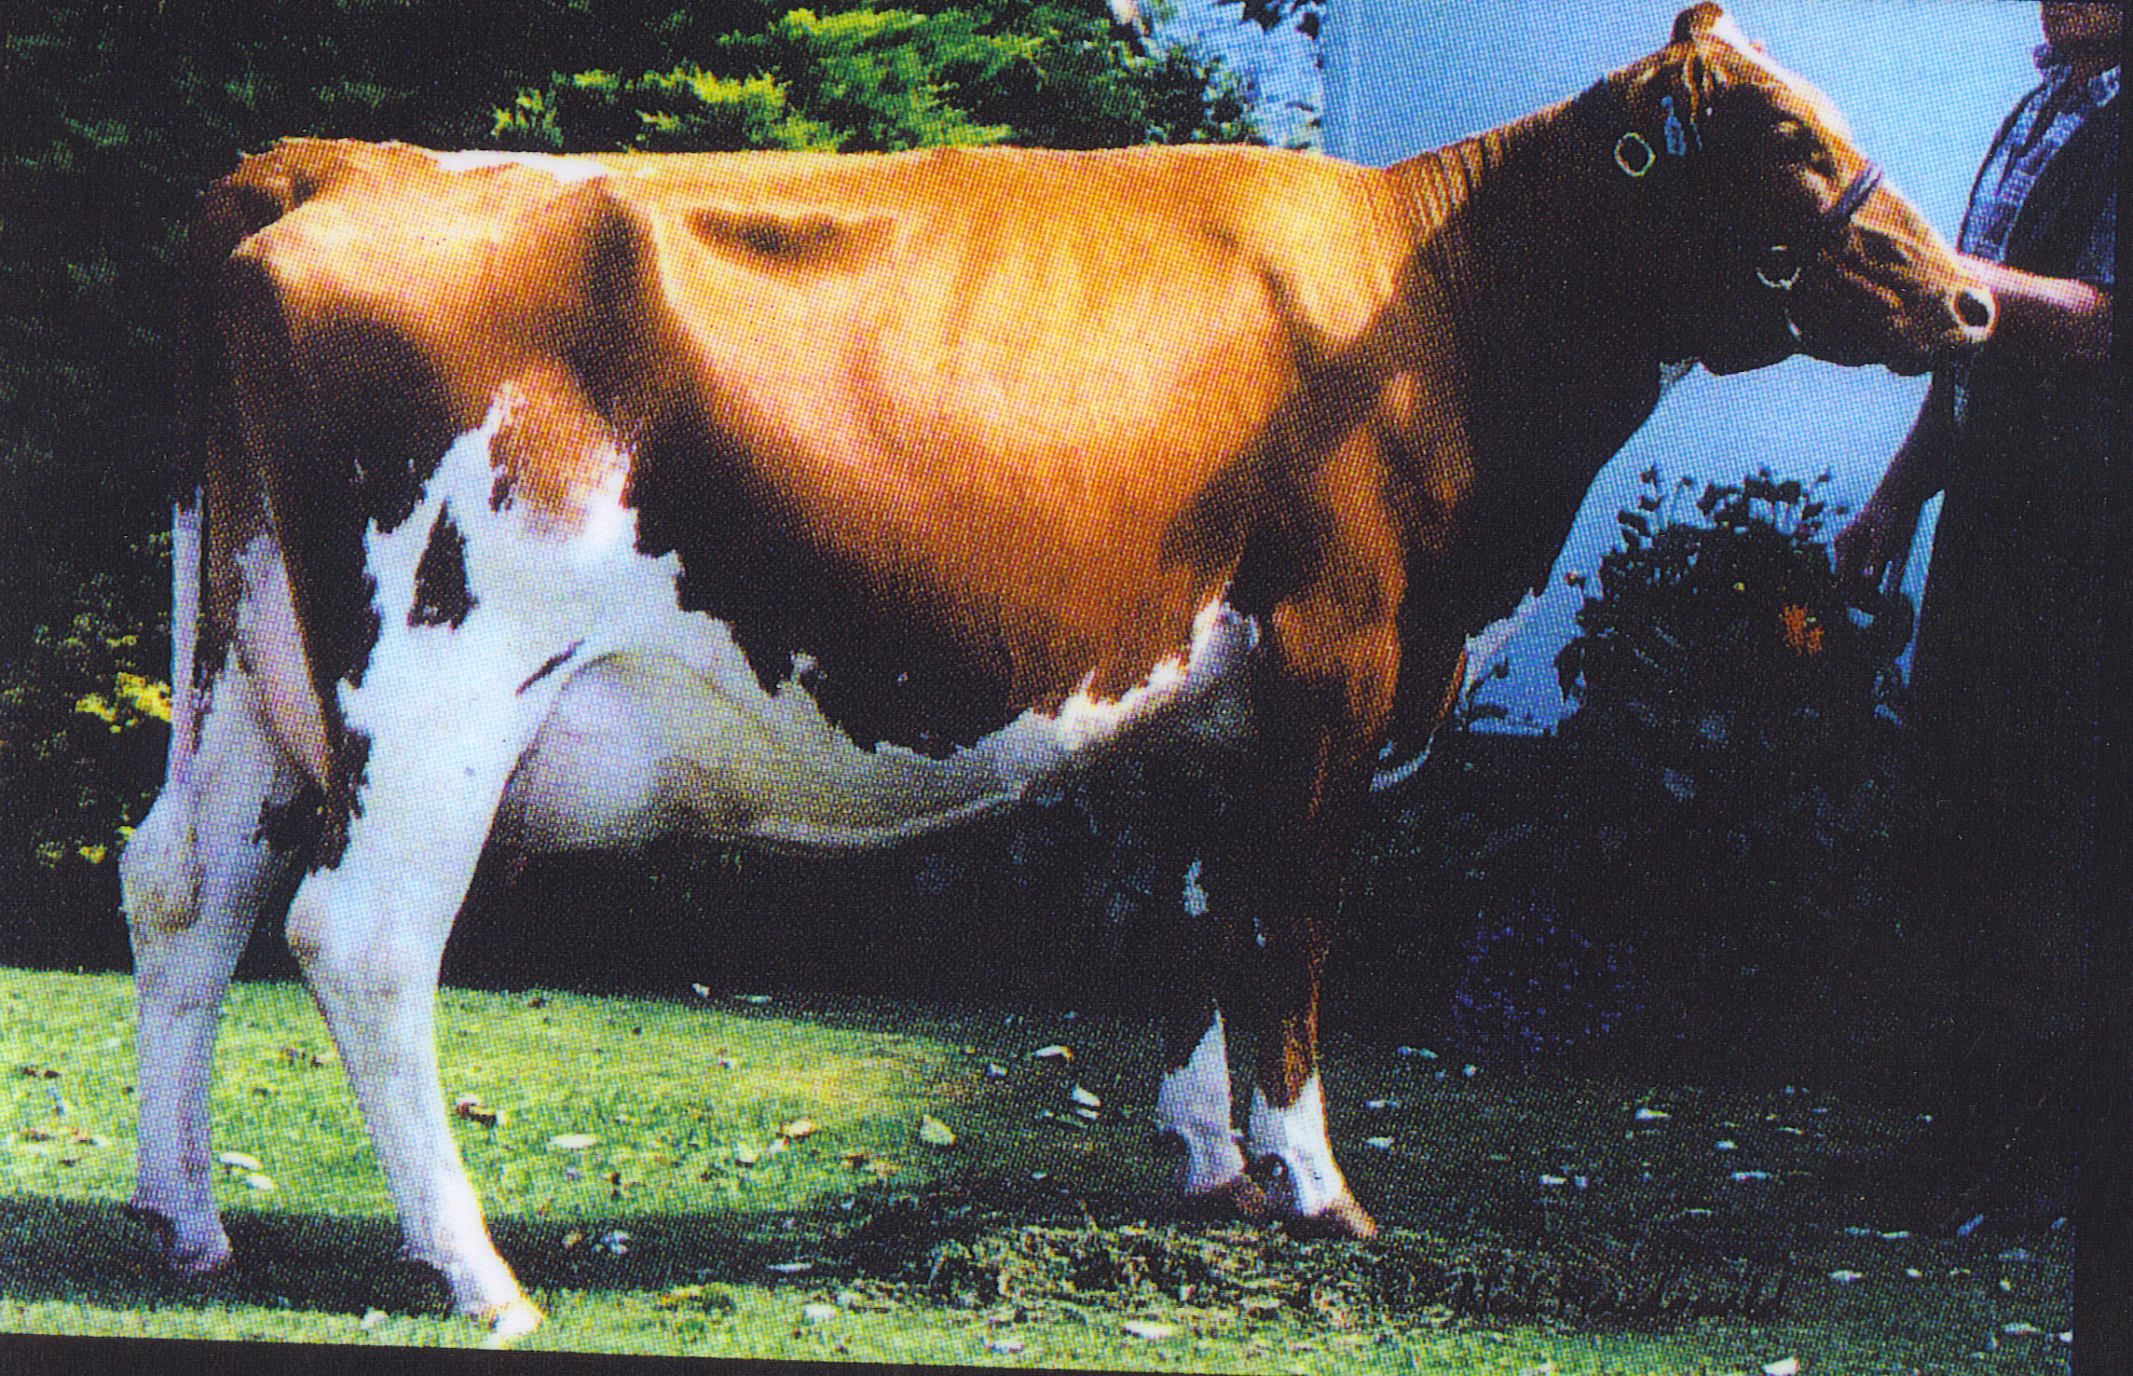
Jersey
Friesian
Dairy cattle breeds
Friesian Jersey X (Kiwi) Cross
Aryshire

Slide 6
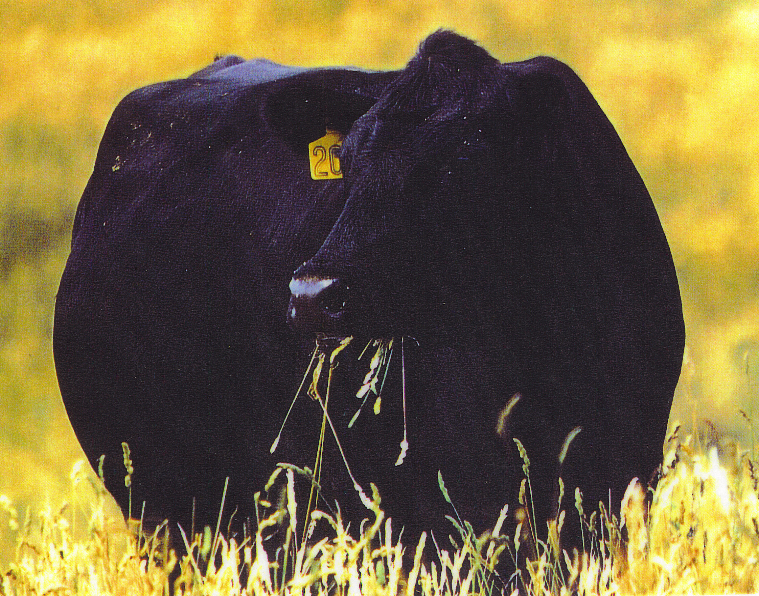
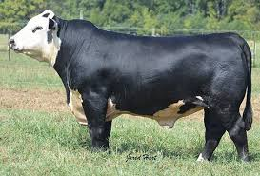
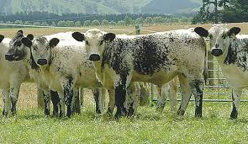
Angus
Hereford
Beef cattle breeds
Angus Hereford X
Speckle park

Slide 7
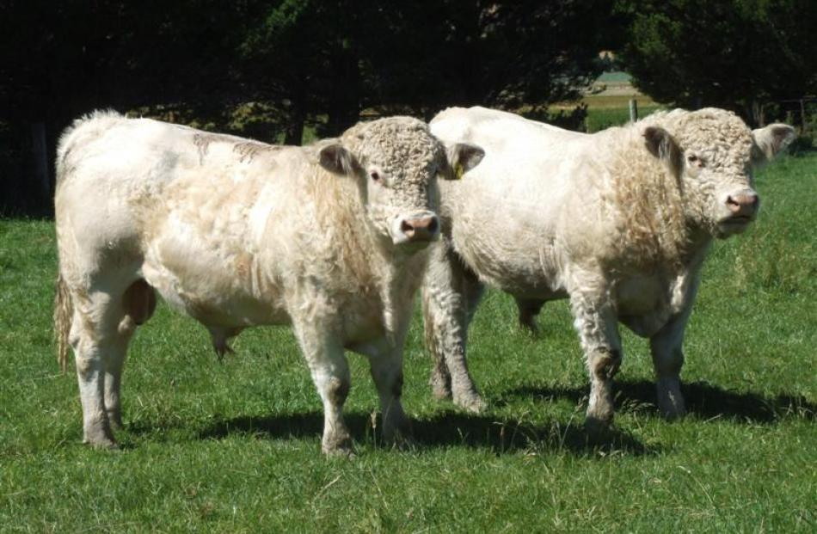
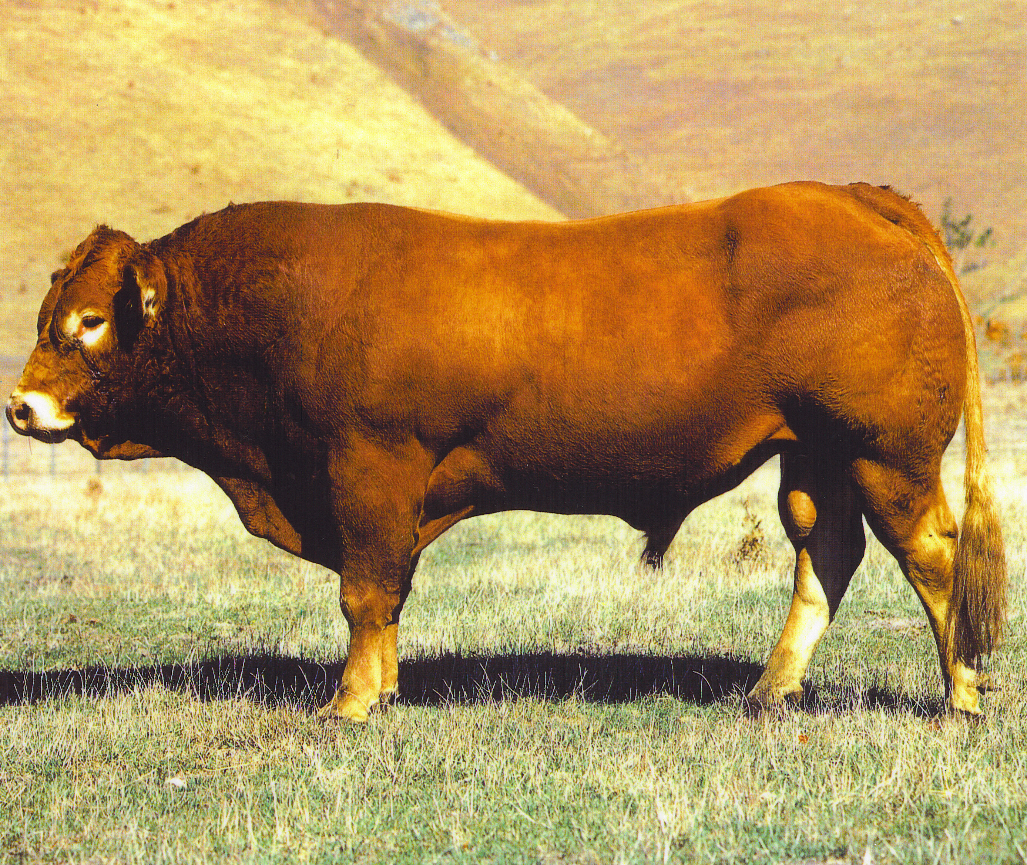
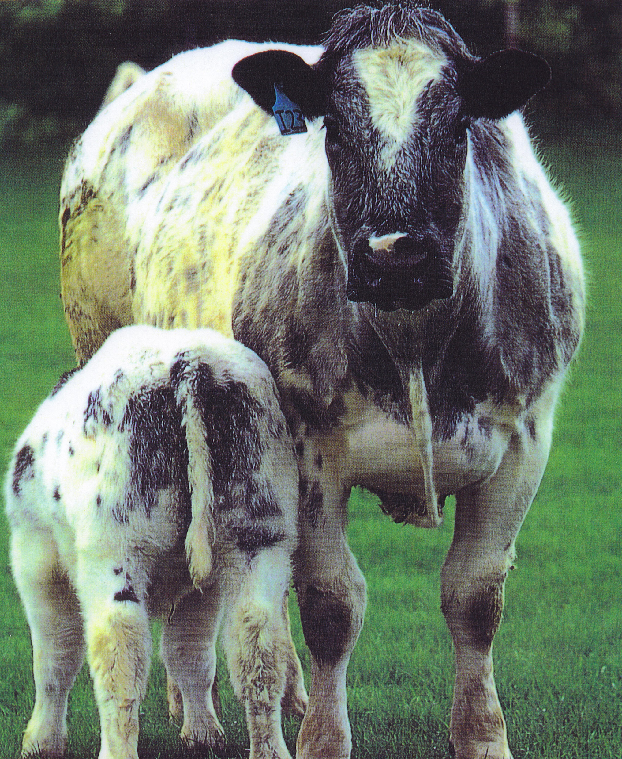
Murray grey
Charolais
Simmental
Belgium blue

Slide 8
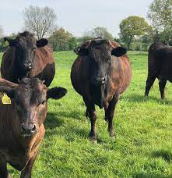
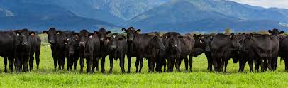
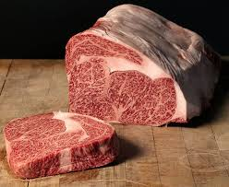
Wagyu

Slide 9
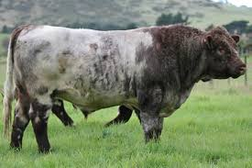
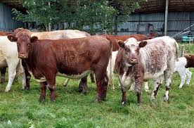
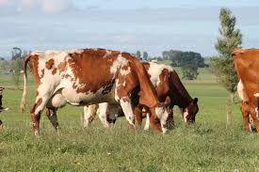
Shorthorn
Shorthorn cattle are a dual purpose breed. They are good milk and meat producers

Slide 10
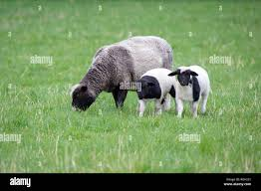
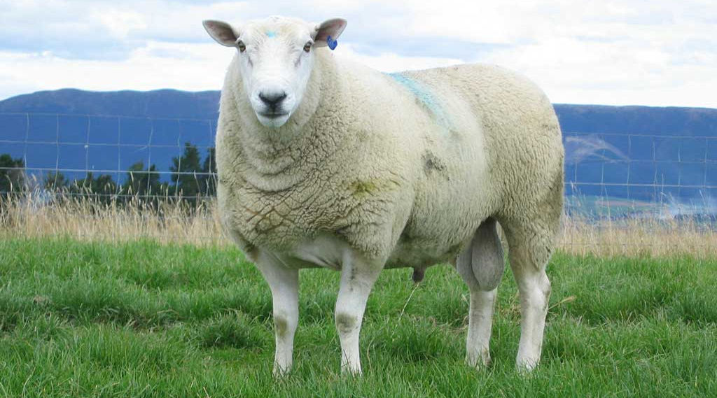
Sheep Breeds
Ewe and lambs
Sheep breeds can be grouped according to the products they produce best.
Wool Breeds, produce high value wool used in clothing or carpet manufacturing
Dual purpose breeds that produce good meat and wool
Meat breed- produce high value meat
Milking breed- produces high quantities of milk
Ram

Slide 11
Sheep Breeds | Wool | Merino Drysdale | Extensive farming system Intensive farming system
 | Dual Purpose | Romney Perendale Coopworth Border Leicester Corridale NZ halfbred | Semi- extensive farming system
 | Meat | Suffolk South Suffolk Dorset horn Polled dorset Texel Wiltshire Dorper | Semi- extensive- Intensive farming system
 | Milk | East Friesian | Intensive farming system

Slide 12
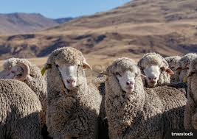
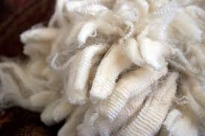
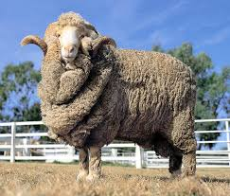
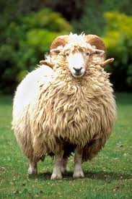
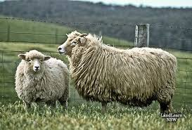
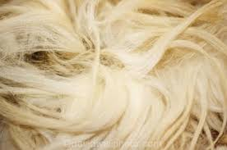
Merino- produces fine wool used for making high value clothing
Wool Breeds
Drysdale- produces a very coarse wool used for making carpets

Slide 13
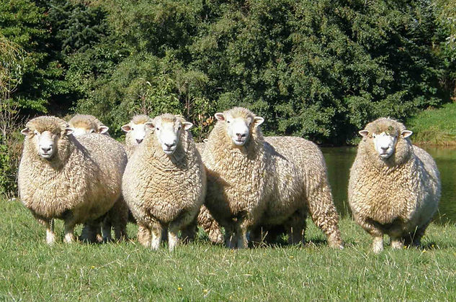
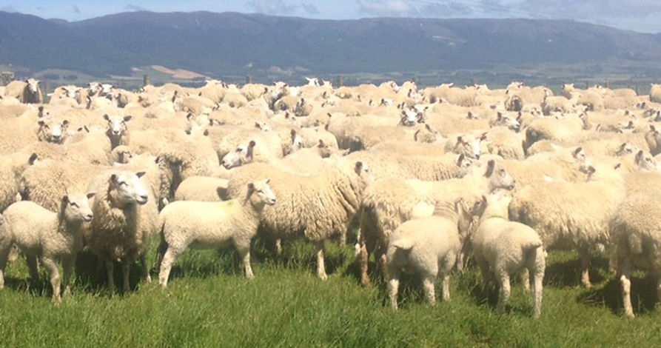
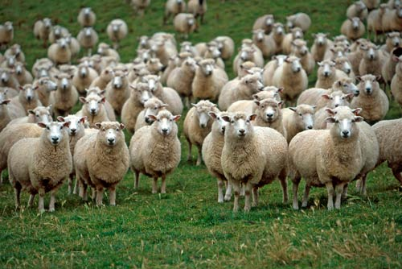
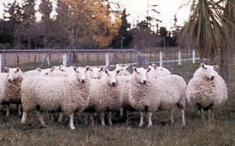
Romney
Perendale
Dual purpose breeds
Coopworth
Border Leicester

Slide 14
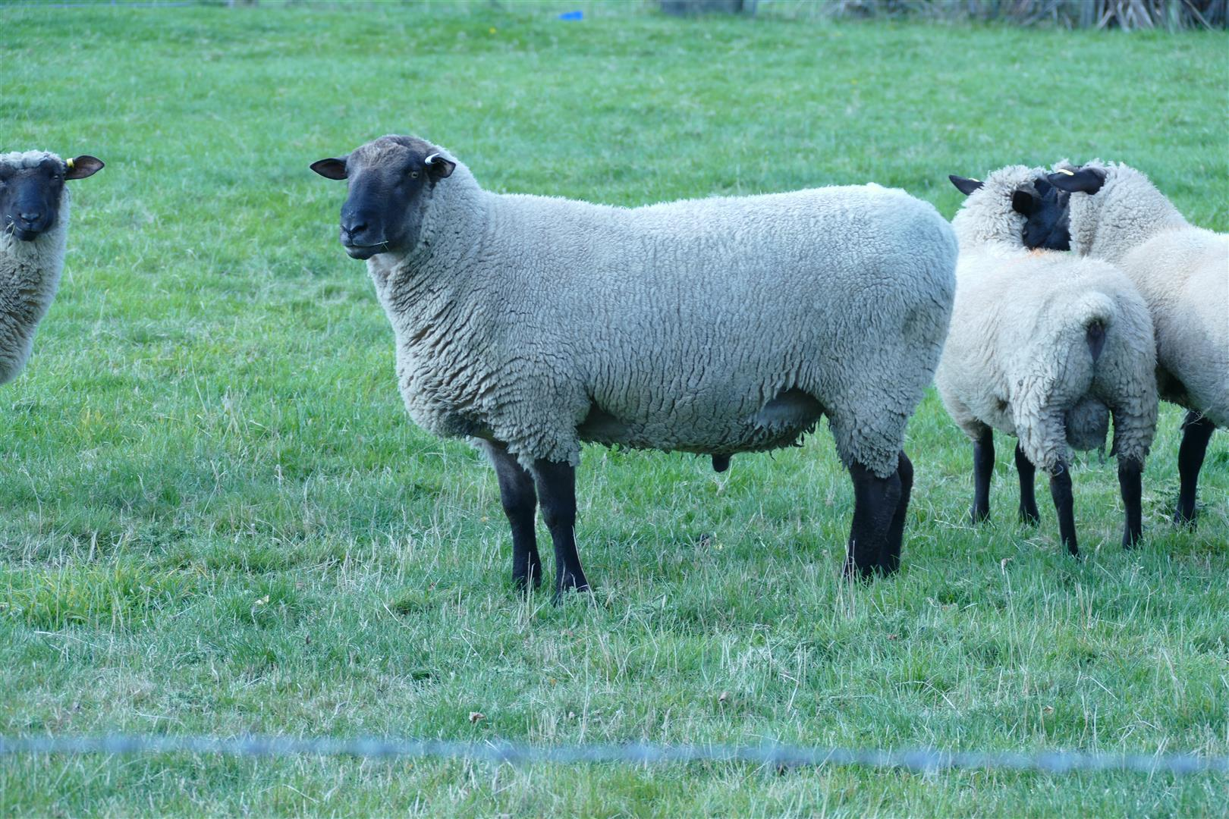
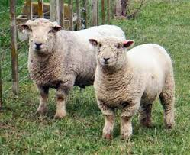
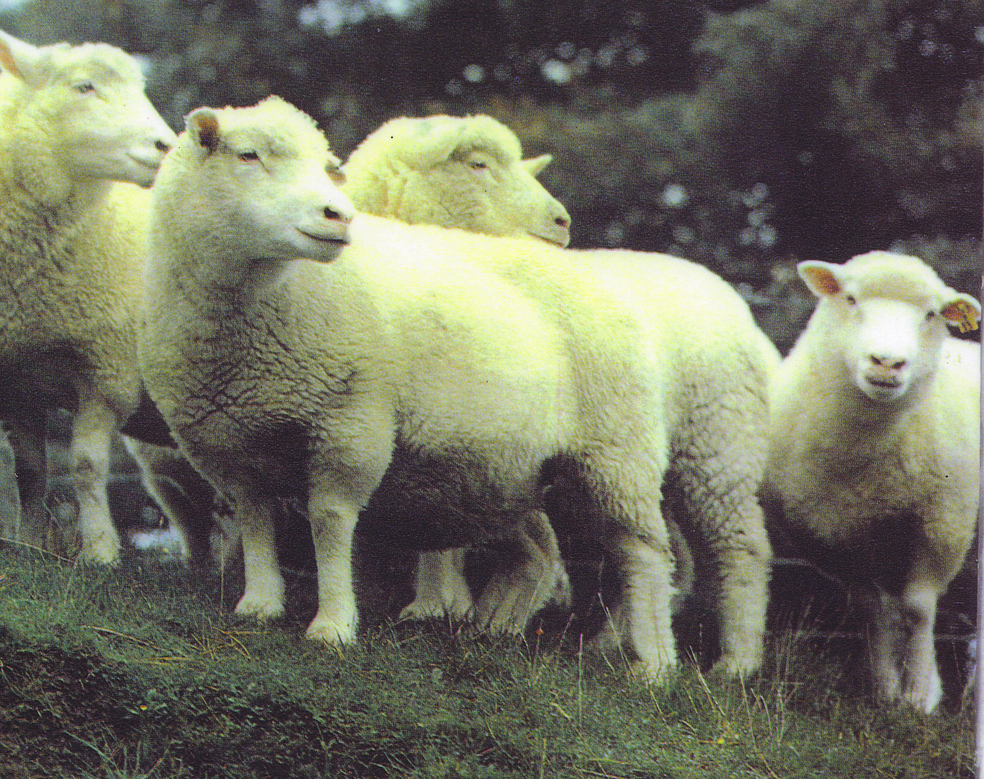
Suffolk
Southdown
Meat breeds
Polled dorset
Texel

Slide 15
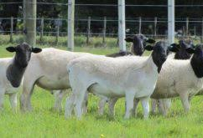
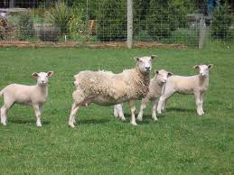
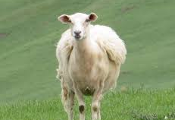
Dorper- meat breed that sheds its wool
Wiltshire- meat breed that sheds its wool

Slide 16
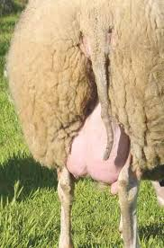
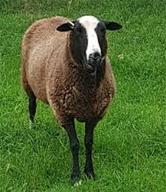
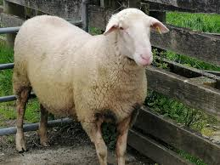
East Friesian- bred for milking

