Slide 1


Slide 2
Unit 5
Careers in the Primary Industry

Slide 3
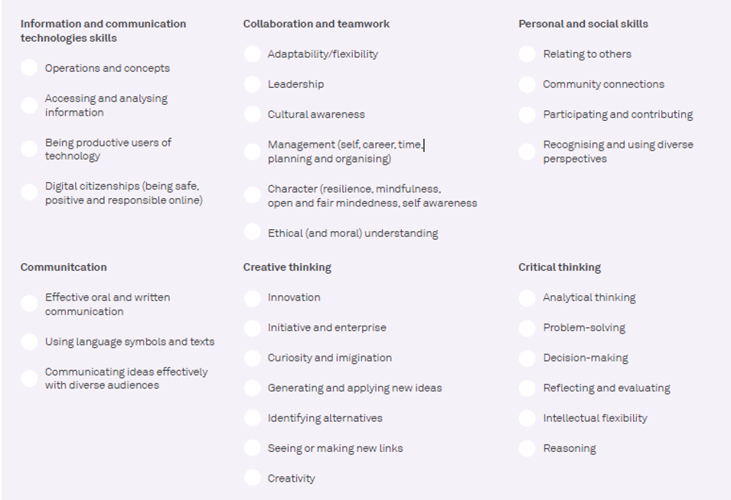
21 Century Skills
Skills of the future.
From AgriFutures “Careers in Agriculture”
The 21st century is marked by rapid technological advancements, globalisation, and changing economic environments. To thrive in this constantly shifting world, young people need to be adaptable and resilient, with the tools to navigate these changes. Developing 21st-century skills is important because they help you succeed in a world that is always evolving. Skills like problem-solving, creativity, communication, and teamwork are essential in almost every job. As technology continues to advance, it's also important to learn how to use new tools and collaborate with people from diverse backgrounds. By building these skills now, you'll be well-prepared to take on new challenges and make a positive impact on your community and the world.

Slide 4
Lesson 2
Activity 2 Career Opportunities in the Primary Industry
Prepare a presentation to present to the class. Include; -
Name of industry.
What the job involves?
Location of the job.
21st century skills needed for the job. Use the 21st century skills list to help you.
Subjects that would be useful to prepare you for this job.
Other information of interest.

Slide 5
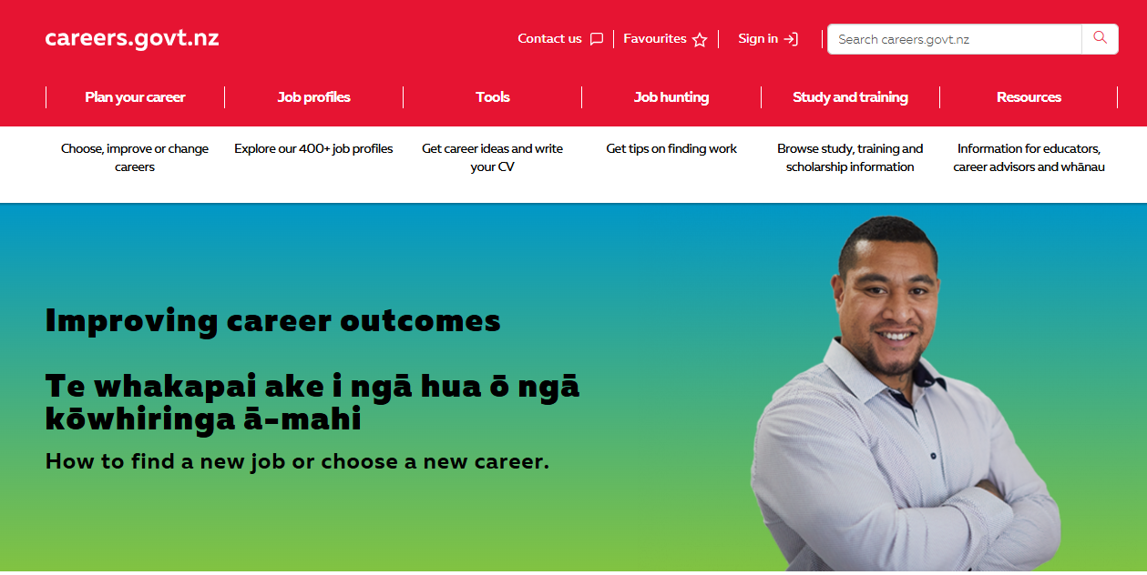
Links to Primary Industry Careers.
Careers NZ
Farming, fishing, Forestry and Mining
Animal care and conservation
Other industries that connected to careers in the primary sector
Business
Engineering, Government, law and safety
Manufacturing
Science
Transport and logistics.

Slide 6
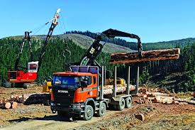
Careers in Forestry
Forestry study and careers | Te Uru Rākau – New Zealand Forest Service
Futures Foresters
Futures Foresters- Drones
Futures Foresters- Innovation & technology

Slide 7
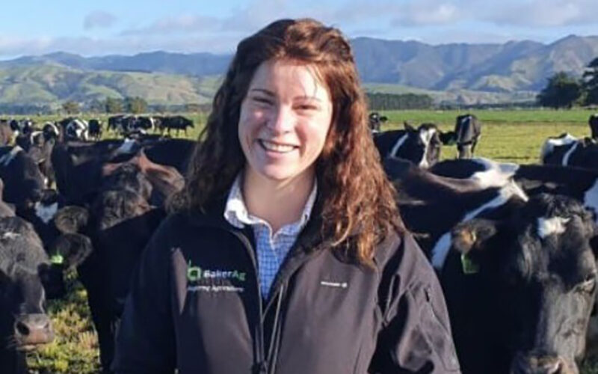
Careers in Dairy
Dairy farm Career Pathway
GoDairy Farm roles
Dairy farming Farm Assistant- Edward
GoDairy Careers in dairy
Technology Halter, Cow collars
GoDairy Agribusiness
GoDairy Agriscience
Dairy farming On Farm Story

Slide 8
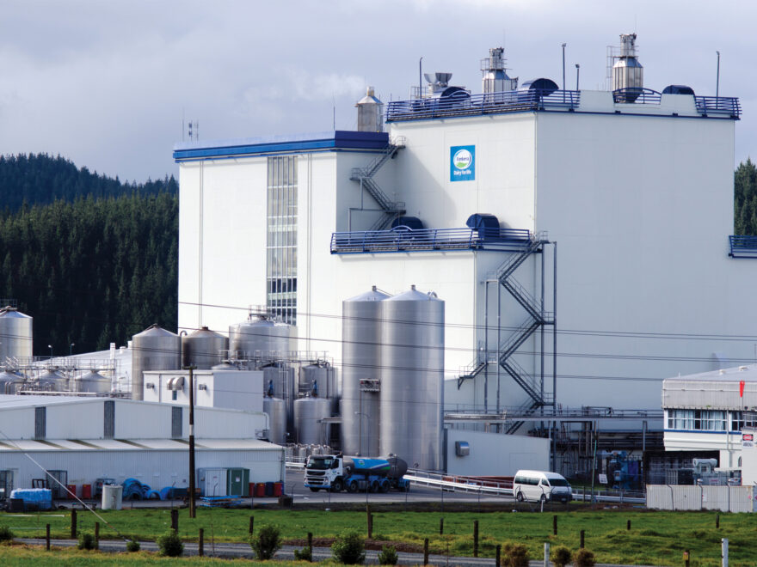
Careers in Dairy Processing
Fonterra Chemical and mechanical engineering
Fonterra Processing & Packing Career https://www.youtube.com/watch?v=gEMbG7bKzoU
Fonterra Graduate roles

Slide 9
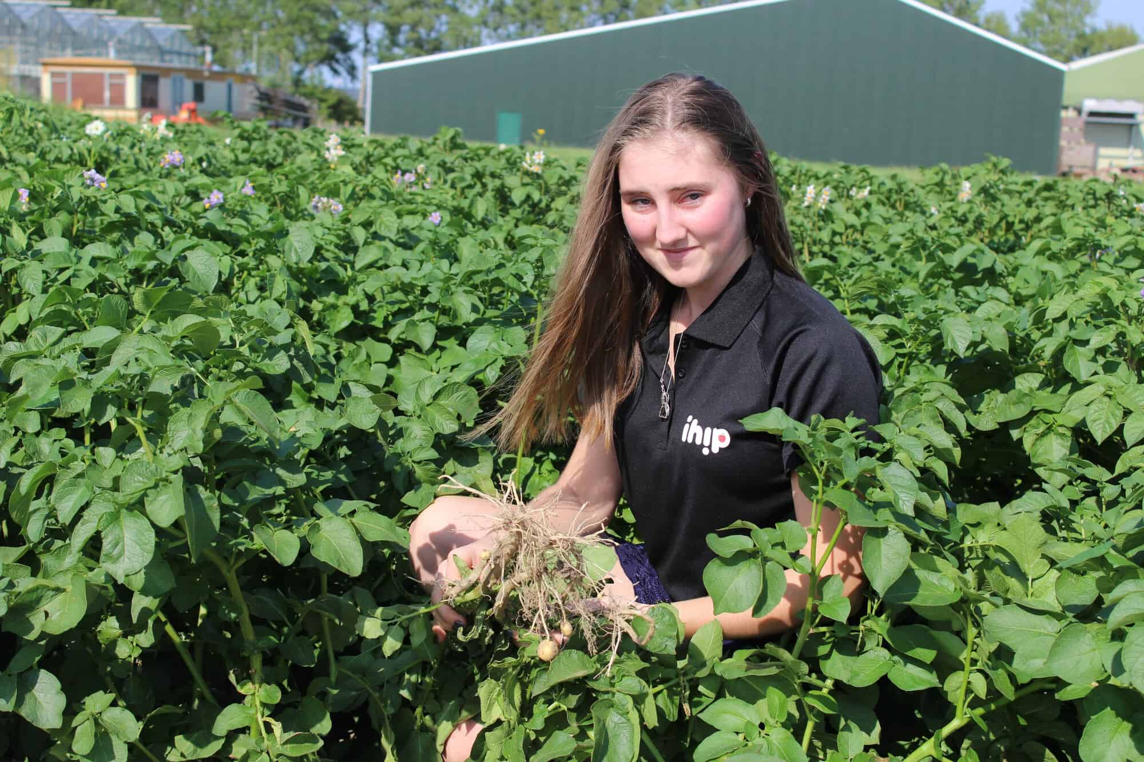
Careers in Horticulture
GoHort Horticulture careers
Careers in Horticulture- Central Otago
Just the job – Council Horticulture Careers
Just the job – Horticulture careers - Amenity
Science careers Entomologist
Pipfruit careers Karla Bradley

Slide 10
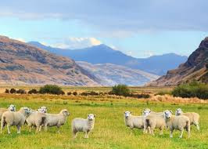
Careers in Sheep and Beef
Beef + Lamb NZ Rural professional
Beef, sheep and arable farming in the Wairarapa- Mark Guscott
Living the Dream in the Taihape High-Country | On Farm Story - Mairi Whittle

Slide 11

Careers in Meat Processing
Join MPI’s verification services team. Hear Ju-Young's story
Silver Fern farms Career Story – Sam Pike
Silver Fern Farms Apprenticeship
Meat Your Career
Butcher-Just the Job- Butcher Careers
Stock Agent-Carrfields Livestock

Slide 12
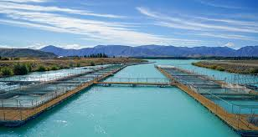
Careers in Fishing and Aquaculture
Fishing for a new job?
Seafood New Zealand careers
Just the Job Fishing Careers
Innovation in Fishing
Aquaculture Careers - Mussel Farming in New Zealand

Slide 13
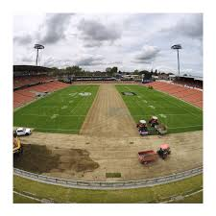
Careers in the Sports Turf Industry
A glimpse inside New Zealand's sports turf industry
Just the Job - A Career in Sports Turf Management
Sports Turf Management Careers

Slide 14
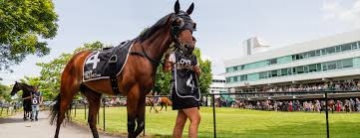
Careers in the Equine Industry
NZ Through Bred Racing Academy
Explore Careers in the Horseracing Industry

Slide 15
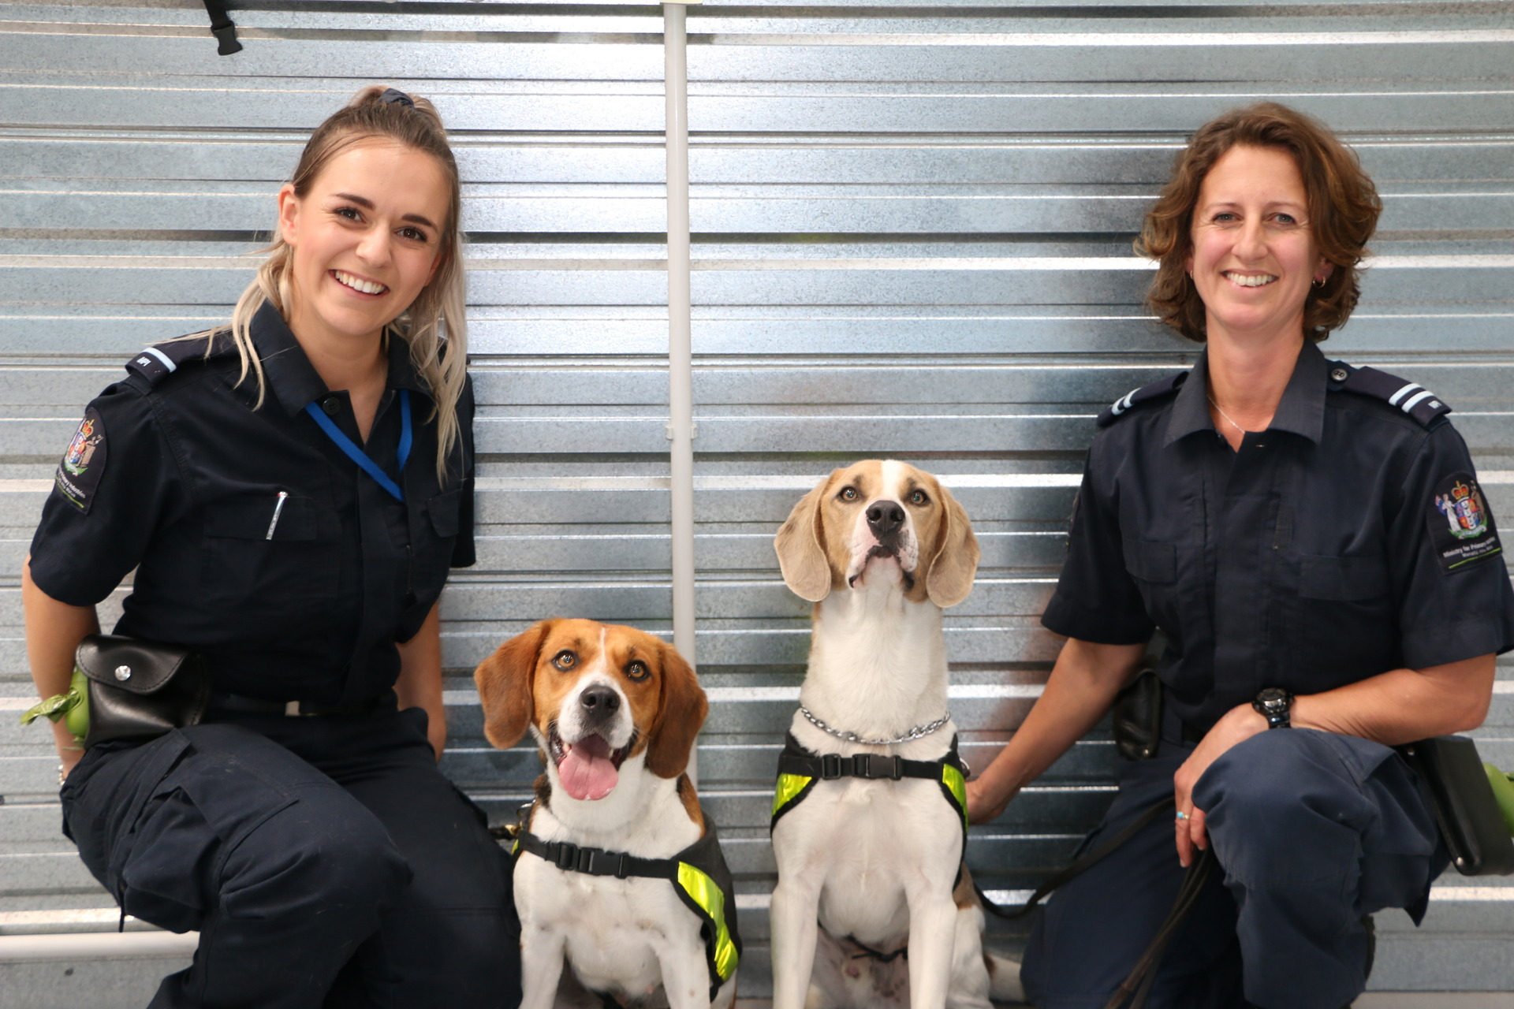
Careers in Biosecurity
Biosecurity – Protecting to grow New Zealand
What is it like to work in Biosecurity/Biodiversity?

Slide 16
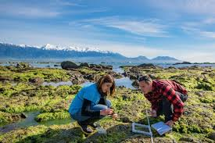
Careers in Environmental Science
Drones and wilding pines
Environmental consultant

Slide 17
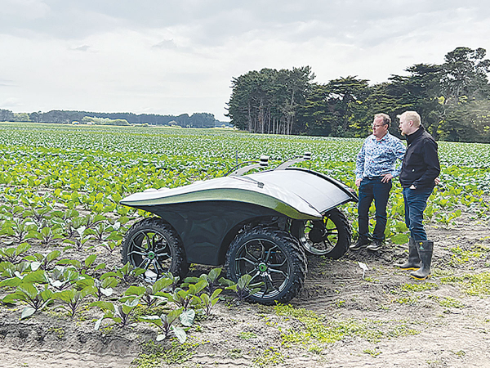
Careers in Agri-technology
Drones and wilding pines
Irrigation technology
Robotics technology
Technology Halter, Cow collars

Slide 18

Careers in the Food Industry
Quality control
Global account manager

Slide 19
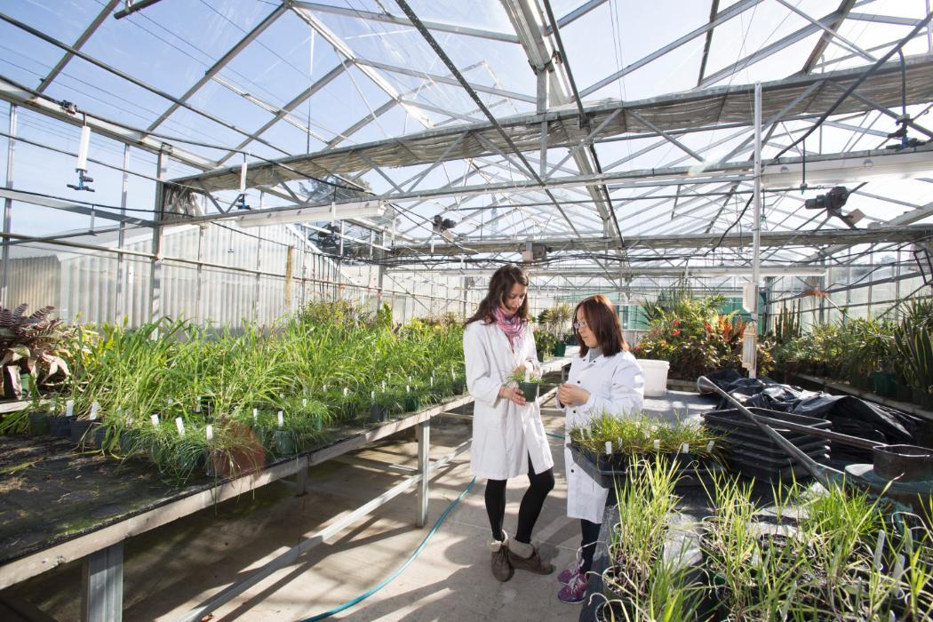
Careers in Soil Science
Careers in soil science
Engineering geologist
Social scientist
Soil Chemist

