Slide 1


Slide 2
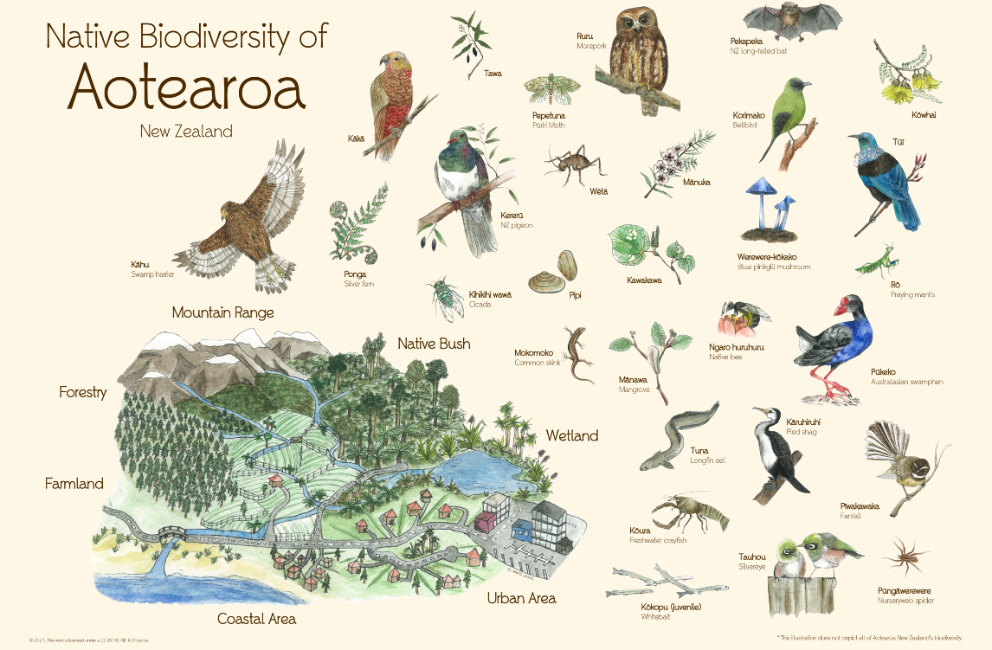
Unit 4
Biodiversity
Activities
https://eco-index.nz/biodiversity

Slide 3
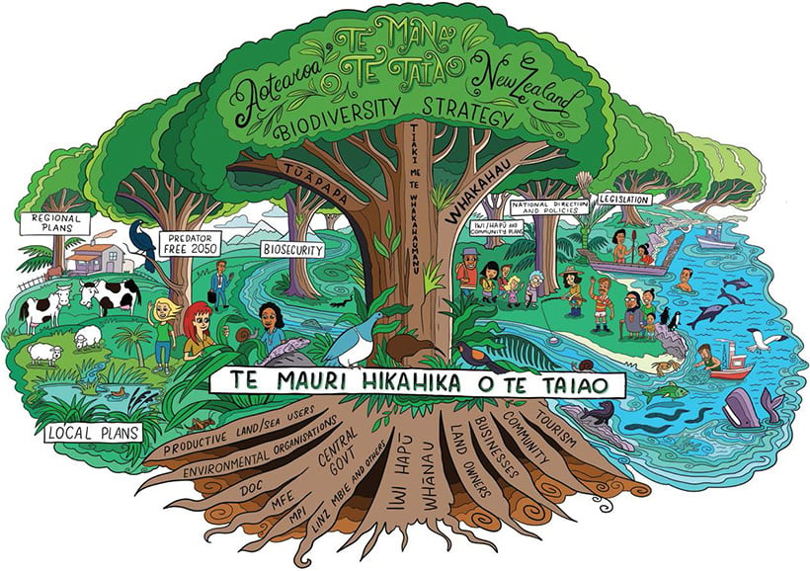
Lesson 1
Activity : Writing activity.
Biodiversity is__
Biodiversity is important because ____
Biodiversity is important for farming because _____
Download image (JPG, 293K).

Slide 4
Lesson 1
Activity 2: Mapping Activity.
Starting Location________________
Destination | Distance in Km
New York
Sydney
Beijing
Singapore
Jakarta
Tokyo
London
Use Google to find out the distance from the town or city your school is in e.g. Nelson to major cities around the world.
Find out the distance to New York, Sydney, Paris, Beijing, Singapore, Jakarta, Tokyo and London.
Choose two other cities in countries New Zealand exports primary products to.

Slide 5
Lesson 1
Activity 3: New Zealand’s Native Taonga
Native plants (flora) and animals (fauna). | Pest harming native plants (flora) and animals (fauna). | Other factors that are negatively affecting native plants (flora) and animals (fauna).

Slide 6
Lesson 2
Activity 1: Predator control
Watch the video’s
Why New Zealand needs predator control
This is “impossible”, but New Zealand is trying anyway
Students
Why do we need to control predators?
Write down questions you have about
  Biodiversity
  Controlling predators
What do you think is being done to protect New Zealand biodiversity?
Write down and discuss ideas you think can be done to help protect and improve biodiversity?

Slide 7
Lesson 2
Activity 2: Biodiversity monitoring photo point sight
Record photos of your biodiversity monitoring sight so you can check back to see the changes.
Things you could do.
Count the number of different plants
Count the number of insects and birds
Measure the height of a native tree

Slide 8
Lesson 2
Activity 3: Guest speaker
Questions to ask the guest speaker
Reflection and writing
Name of guest speaker.
What does the guest speaker do?
What did you learn from the guest speaker?
Writing activity- Write an article or speech about what you learnt from the guest speaker about biodiversity in your area and what they are doing to protect biodiversity.

Slide 9
Lesson 2
Activity 4- Research activity
Select a plant or animal pest to research.
Suggestions to help direct your research.
  Find or take a photo of your animal/plant pest.
  Find out why the animal/plant you have selected is a pest.
  Find out how the animal/plant pest is harming biodiversity?
  Find out how this animal/plant pest is being controlled?
  Other interesting facts about you animal/plant pest.
Other research topics
How a pest in your region/area is causing loss of biodiversity and what can be done to stop this pest?
How fencing off and planting a waterway or wetland in native plants can improve biodiversity?
How planting native plants can improve biodiversity?
Investigate what your school could do to improve biodiversity.
Design a plan for your, school or local bush area to monitor and control pests.
New Zealand has a goal to be pest free by 2050. What needs to be done to achieve this?

Slide 10
Lesson 2
Activity 5: Monitoring pollinators
Objective:
To study the attraction of pollinators to different flowers, highlighting the importance of different plant species for supporting biodiversity.
How to set this up?
Choose a spot in the school grounds that has a variety of plants. These could be native trees and flowers such as Kowhai, Manuka, Harakeke or Hebe but any flowering plants will do.
Set up observation station so you can observe the insects or birds visiting the flowers. Take the handout “Pollinators in New Zealand” to help you identify the pollinators.
Observe and record the types and number of pollinators (e.g. bees, butterflies, birds) visiting the flowering plants over a specific time period e.g. 3 minutes for 5 days
Analyse the data to determine which flowers attract the most diverse and abundant pollinator populations.
Discuss the crucial role of flowering plants in providing food and habitat for pollinators.

Slide 11
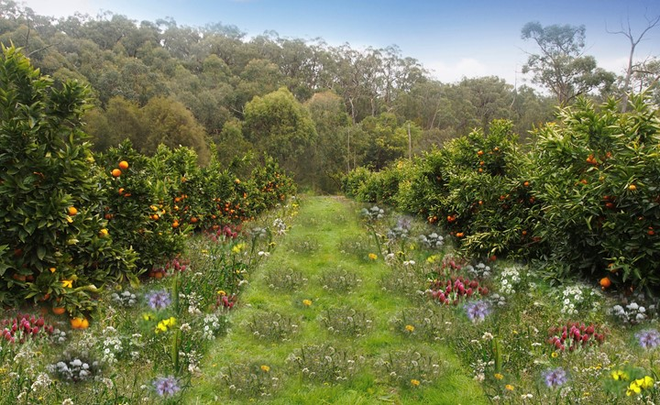
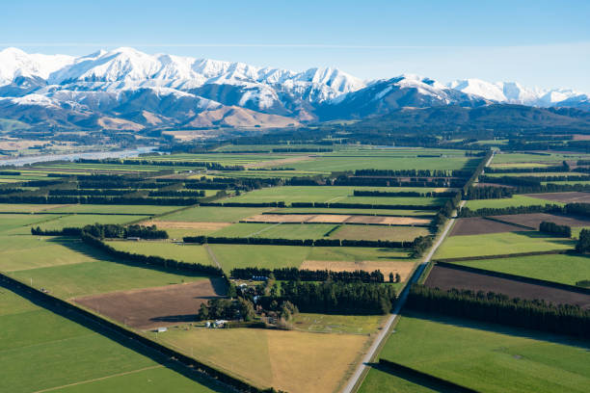
Lesson 3
Activity 3: Primary production and biodiversity
In your group discuss
How the land is being used?
What can you see that is good or not so good for supporting biodiversity?
Report back to the whole class on you land use and how it is influencing biodiversity.
https://a-lighter-touch.co.nz/cover-cropping-initiative-citrus-nz/

Slide 12
Lesson 3
Activity 4:-Biodiversity Scenarios
Read your scenario and discuss the questions and the challenge.
Record your answers and ideas.
Student presentations guide
Students plan, develop and present their solutions to the class.
Students can present in any format however; all students must participate.
Students must refer to their specific scenario.
Presentation must include at least TWO effects on crops and/or animals and
ONE solution
And the answer to the challenge.

Slide 13
Activity 5: Reflection question
Now you know what biodiversity is, why it important, what farmers, growers, iwi and organisations are doing to improve and protect our precious biodiversity.
Make a list or a plan about what you can do to help protect and improve biodiversity where you live?

