Slide 1


Slide 2

Rural Safety

Slide 3
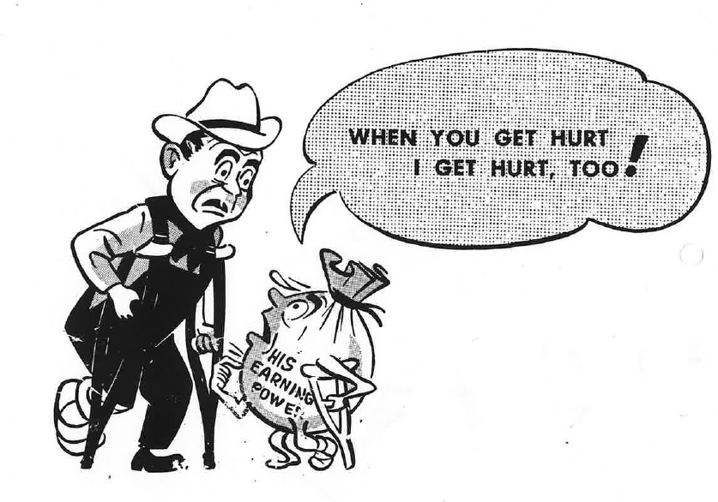
Workplace accidents - injuries and fatalities
People working in agriculture and horticulture are
exposed to extreme weather conditions.
Work
with large animals,
with chemicals,
with heavy machinery
at heights
in confined spaces
with heavy loads
often work alone and in remote locations.
The aim is for all people working and living rurally is to get Safe Home Every Day (SHED). However, accidents do happen causing injuries and fatalities.
Organisations like WorkSafe, Safer Farms, Farm Without Harm and others are working hard to reduce workplace accidents and get people Safe Home Every Day (SHED
A farmer employee on crutches has low earning power.

Slide 4
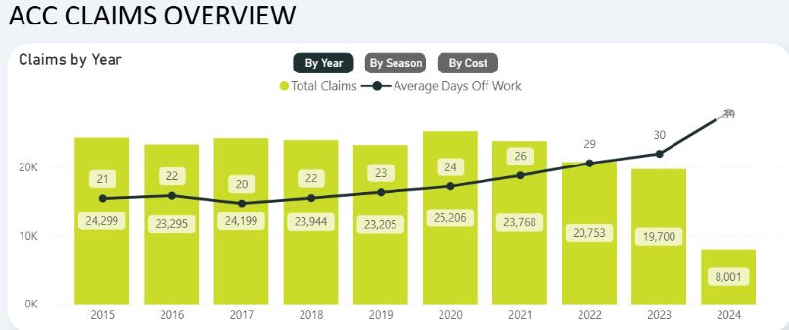
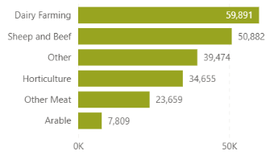
Injuries
In 2023, 19,700 working in agriculture and horticulture made an ACC claim. Claim for injuries was highest for dairy farming, followed by sheep and beef farming then other farm types.
Many claims averaged over 30 days off work?
  What is the cost of this?
$ Claim by sector

Slide 5
Fatalities
There are a wide variety of hazards present on farms and rural properties that are not present in urban homes.
Children Fatalities
Common Agents of Fatality | Statistics on Farm Child (0-14yrs) Fatalities (between 2011-2023)*
Total | 20 fatalities
Water Bodies | 2 fatalities
Quad Bikes | 5 fatalities
Car | 1 fatality
Tractors | 3 fatalities
Motorbikes | 1 fatality
Utes | 3 fatalities
Horses | 0 fatalities
Other Animals | 1 fatality
Others (including firearms, chemicals, machinery, tools, and equipment) | 3 fatalities

Slide 6
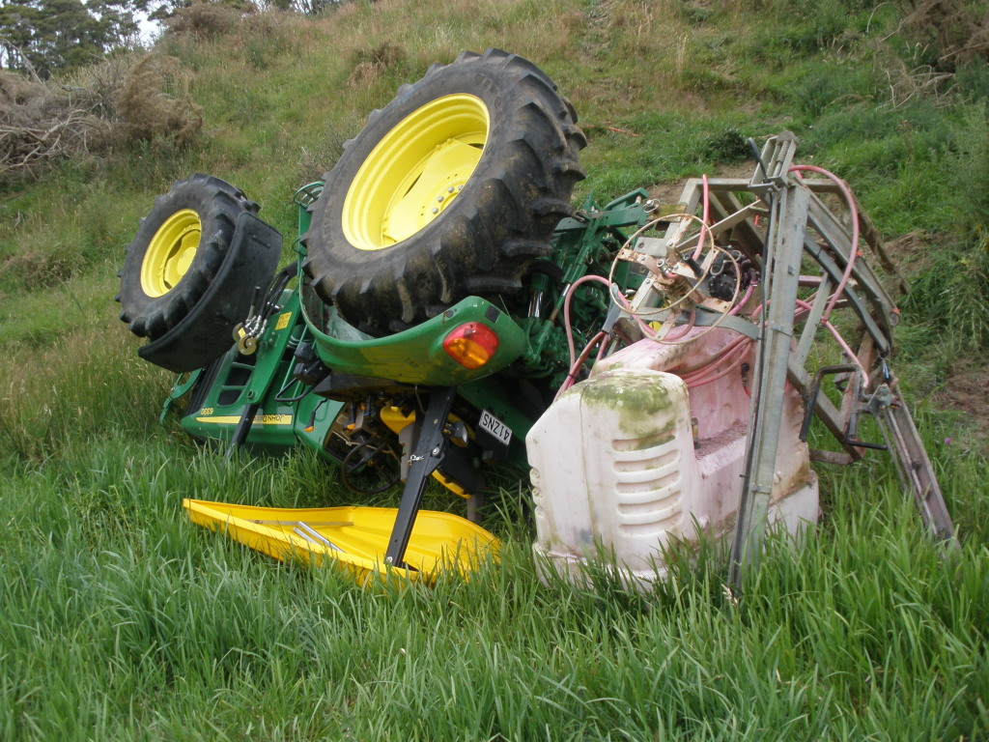
Safe use of tractors
Key risks with tractors:
tractors rolling over
people being run over
people being tangled in implements and machinery.
Other risks are:
tractor fires
working under raised loads
touching overhead power lines
noise-induced hearing loss
slips, trips and falls while getting on and off the tractor.
What do you think happened?
The person had a few minor injuries but survived this accident. What saved them?

Slide 7
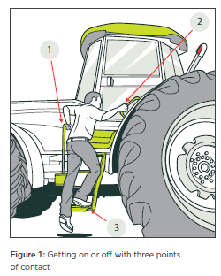
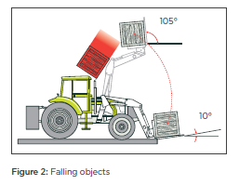
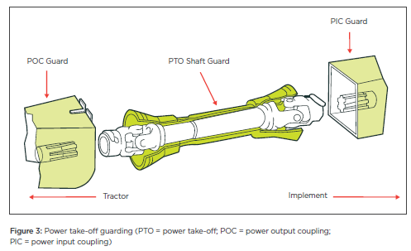
Questions
How should you get on and off a tractor?
What could cause a load to fall on someone?
What protects the driver?
How could this risk be minimised?
What is a PTO and why are they dangerous?
What should be done to minimise risks with PTOs?
Notes:
When climbing on and off a tractor, always keep three points of contact (eg two hands and one foot) with the tractor or ground.
Get off facing towards the tractor, the same as you do when getting on.
Never jump on or off a moving tractor.
Use the right attachment for the job
Use a hay spike for hay and a grab for wrapped silage. Do not use flat forks or buckets.
Carry bales slowly and as low as possible to the ground.
Check the tractor’s lift capacity.
Use a counterbalance if necessary.
Do not carry bales stacked higher than the back frame of the forks
Be careful not to turn the implement upwards, letting the bales slip down the lift arms
PTO- Power Take-Off Shaft
The PTO shaft is found at the rear of a tractor and uses a tractor’s engine to drive tools or equipment attached to the tractor – such as post drivers, mowing equipment, boom spraying equipment.
PTO shafts must be appropriately guarded.
Keep clear of the PTO and attached equipment when it is running.
Make sure everyone is clear before engaging the PTO. Keep them away when using PTO-driven equipment.
Never step across or lean over a rotating power shaft. Always walk around the tractor.
Always disengage the PTO before you get off the tractor.

Slide 8
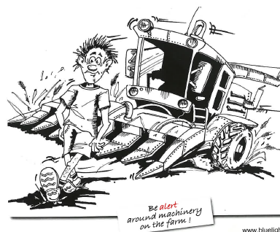
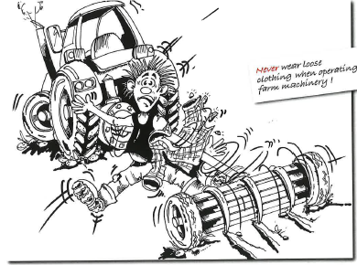
Rules
What happens next?
Why are these rules important?

Slide 9
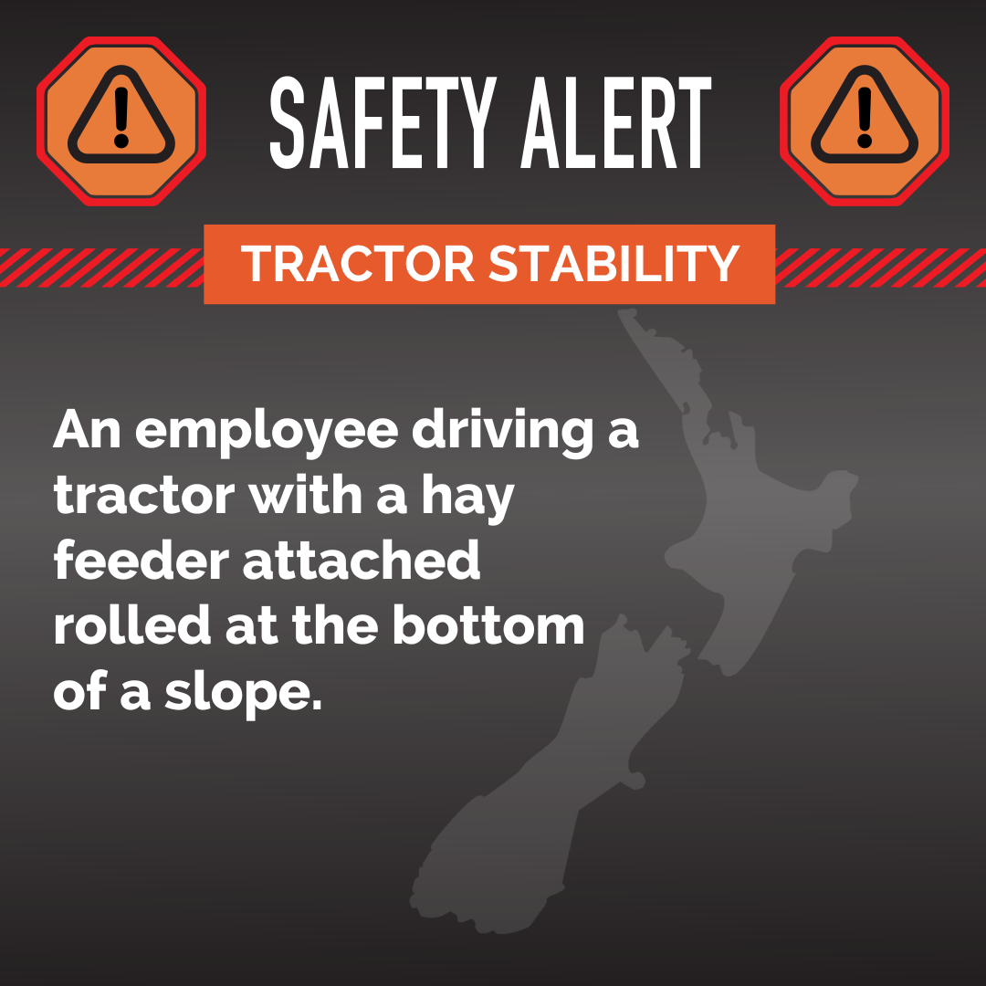
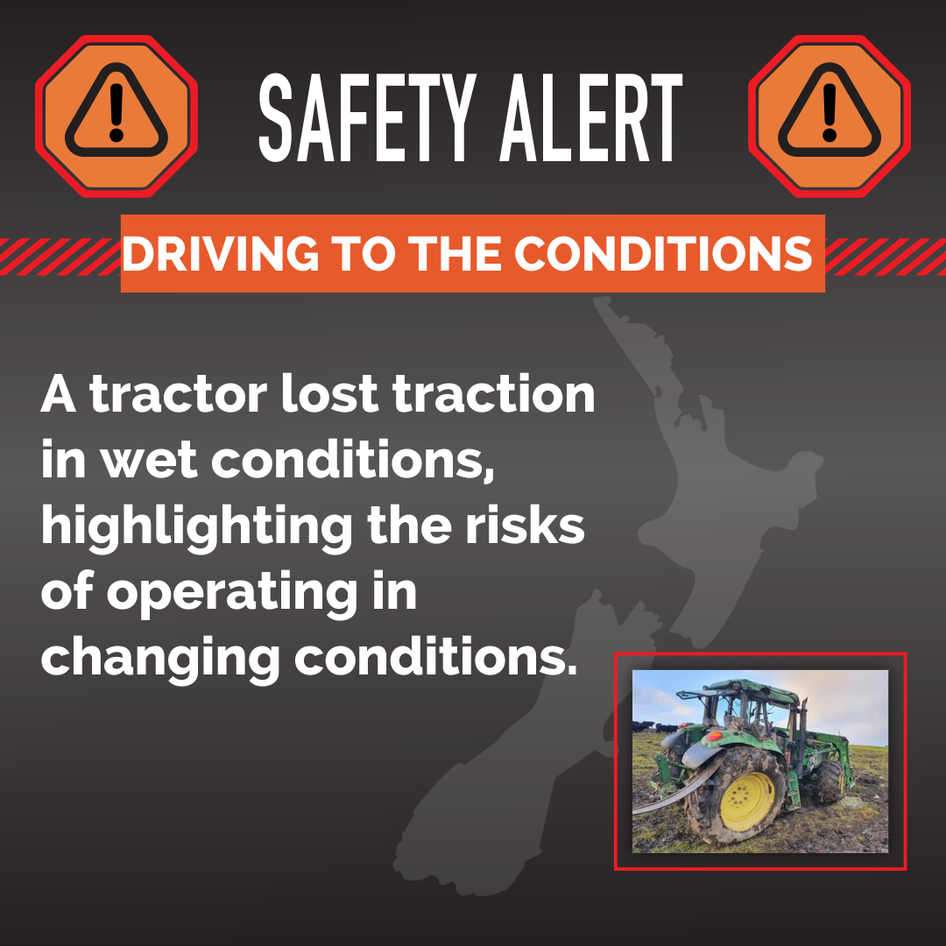
Safety Alert
What do you think happened?
How could these accidents have been avoided?
Write your own safety alert for an incident with a tractor.

Slide 10
Summary of tractor safety key points
People must be trained / experienced enough to do the job
Always wear a seatbelt if the tractor has a Roll-Over Protective Structure (ROPS)
Do not carry passengers on tractors that do not have instructor seats, ROPS, and safety belts
Ensure PTO shafts and connections are guarded and keep clear when it is engaged
Never jump on or off a moving tractor

Slide 11
Safe use of quad bikes
On average, five people are killed on New Zealand farms each year in work-related quad bike incidents. In addition, there are more than 100 serious injuries each year on New Zealand farms.

Slide 12
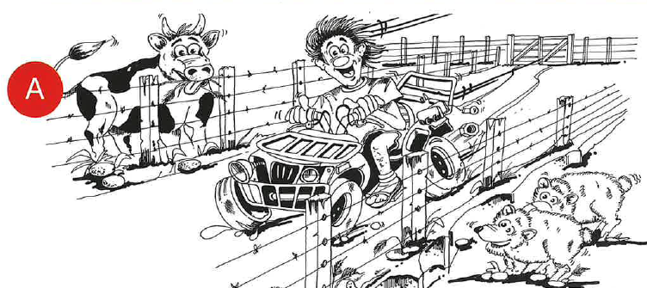
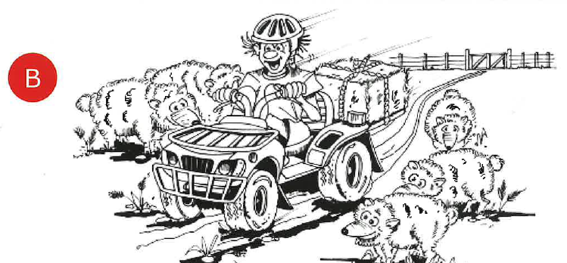
Questions
Which of these two picture are showing the correct way to ride a quad bike?
List three things that different between pictures A & B.

Slide 13
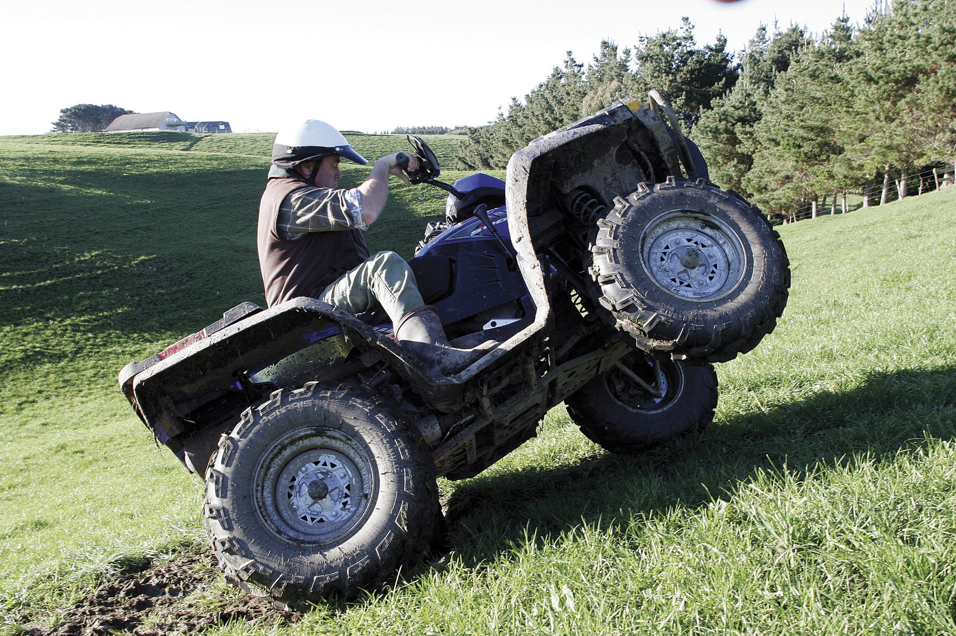
Safety Alert
What happens next?
Make a list of what could be done to avoid this?

Slide 14
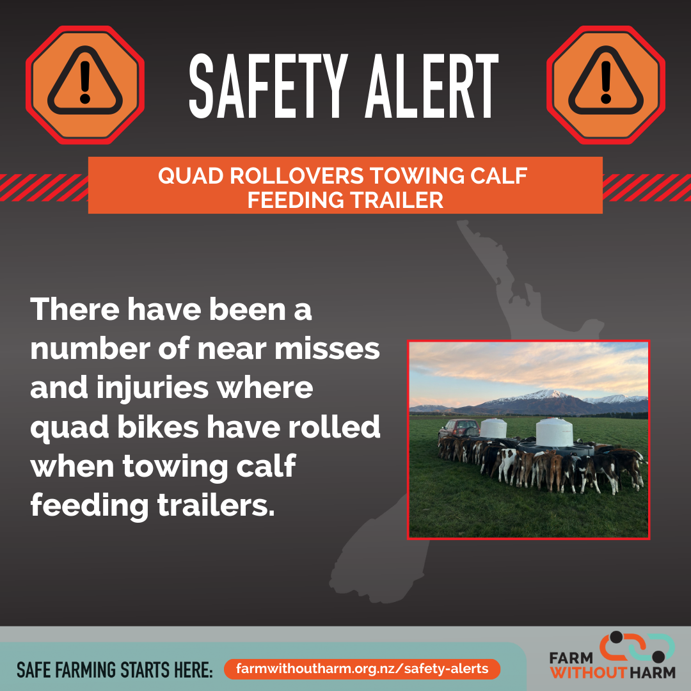
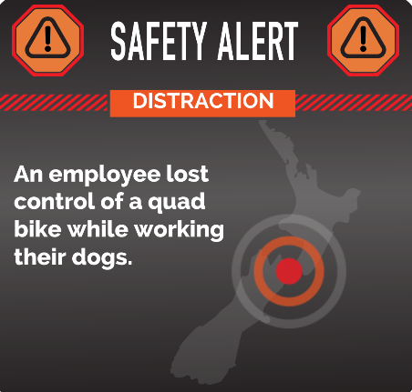
Safety Alert
Why do you think quad bikes have rolled when towing calf feeding trailers?
How could these accidents be avoided
Why do you think the employee lost control of the quad bike?
What should have the employee done?
Write your own safety alert for an incident with a quad bike.

Slide 15
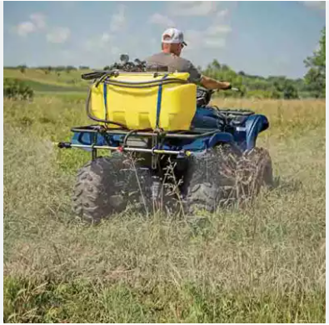
Scenario
Todd is about to go spraying in a paddock that contains several hills that he will need to go across. Todd is planning on using a quad bike fitted with a rear-mounted spray tank.
What things should Todd check before he uses the quad bike for this activity, and why should he check them?

Slide 16
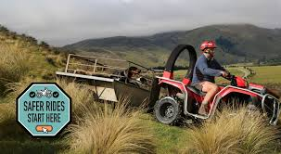
Summary of quad bike safety key points
Choose the right vehicle for the job
Riders must be trained / experienced enough to do the job
Always wear a helmet
Don't let kids ride adult quad bikes
Only carry a passenger if there is no reasonable alternative.

Slide 17
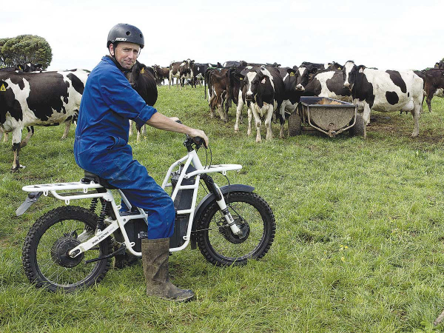
Safe use of two-wheeler motorbikes
Why do you think there are less fatal accidents on 2-wheelers compared to quad bikes?

Slide 18
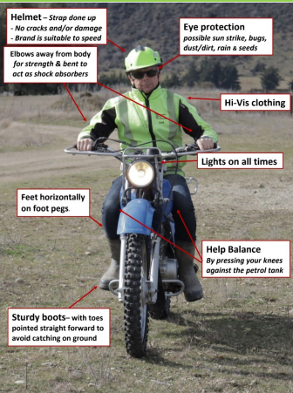
Safety gear
List the safety gear this farmers is wearing.
How will gear protect the farmer?

Slide 19
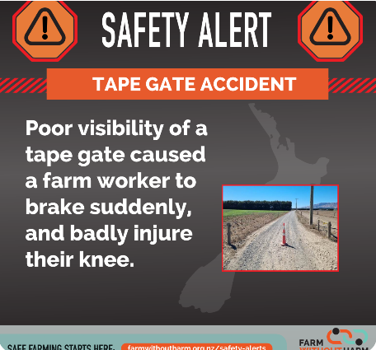
Accident on a Two- Wheeler motorbike
How could this accident have been avoided?

Slide 20
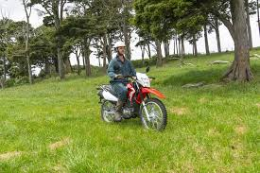
Summary of two-wheeler motor bike safety key points
Learn to ride two-wheeler motorbike safely
Choose the right vehicle for the job.
Always wear a helmet.
Don’t allow children to ride adult-sized farm bikes.

Slide 21
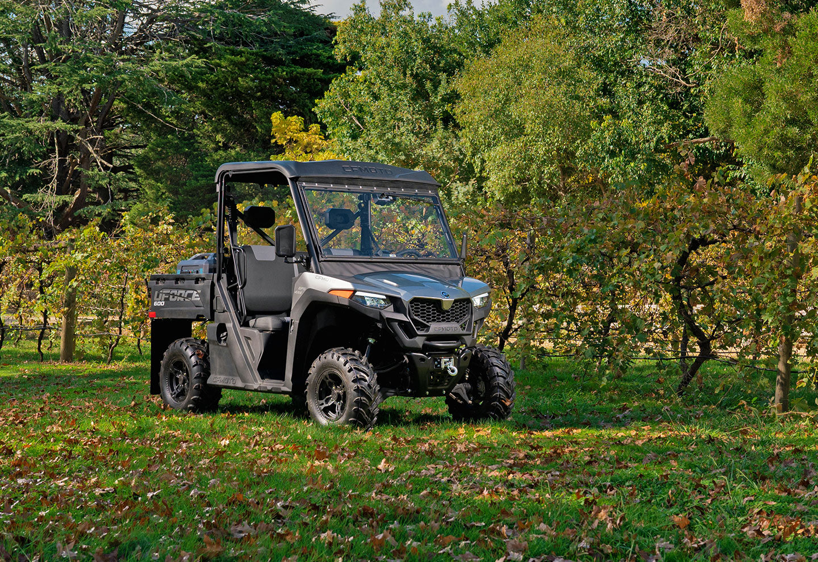
Safe use of Side-by-Side Vehicles
A side-by-side vehicle (SSV) is a small, four-wheel drive vehicle designed primarily for off-road use.
When equipped with seatbelts and a certified roll-over protective structure (ROPS), and used within the limits for which it was designed, the side-by-side offers better protection in an off-road environment such as a farm or orchard than unenclosed vehicles like quad bikes or two-wheelers.

Slide 22
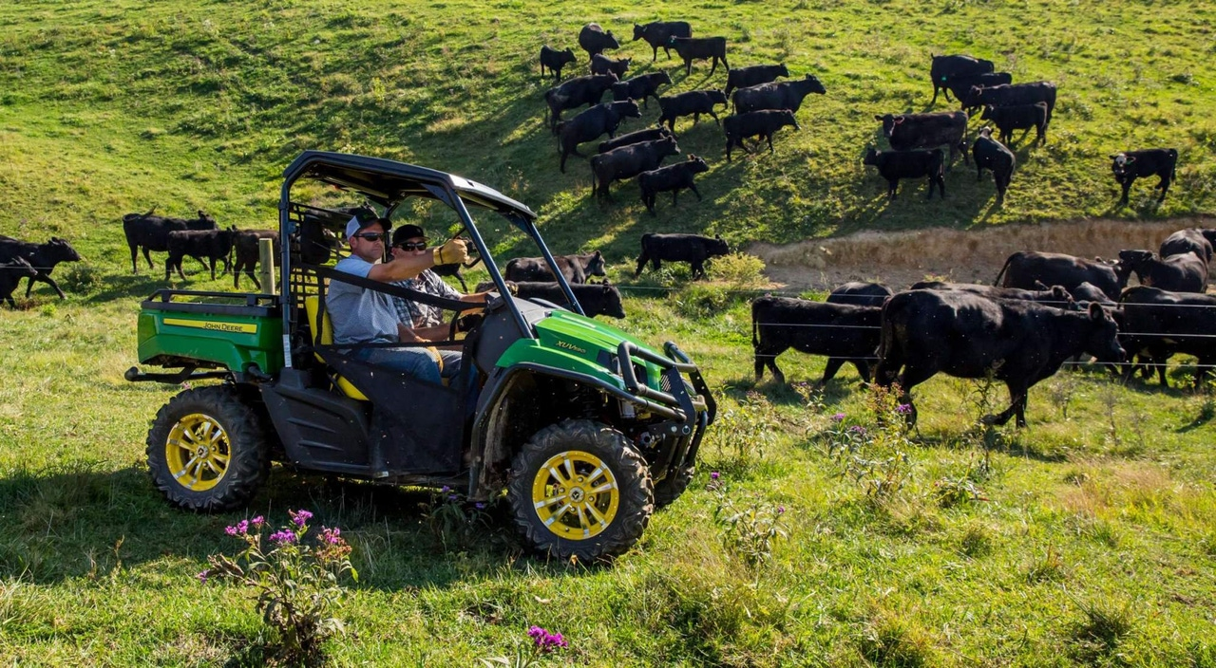
Identify the safety concerns in this photo.

Slide 23
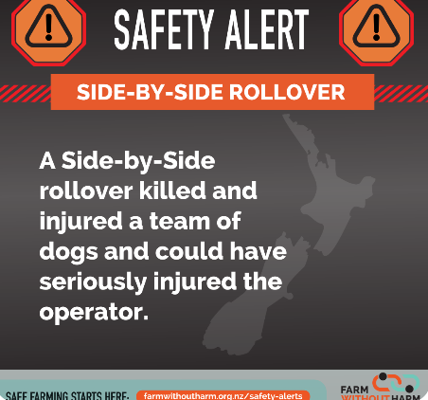
Safety Alert
What do you think could have caused this accident?
How could this accident have been avoided?
Why do you think the operator was not seriously injured?

Slide 24
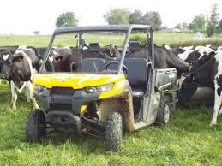
Summary of Side-by Side Safety
Key points
Learn to ride side-by-side vehicle safely
Choose the right vehicle for the job.
Always wear a helmet.
Don’t allow children to drive side-by-side vehicles

Slide 25
Safe handling of large animals
Many farmers sustain minor injuries while working with livestock. Common injuries include cuts, bruises, fractures, sprains and strains. Serious injuries cost farmers in lost time, and financially.
ACC has paid out millions in cattle related claims. That’s not counting the minor kicks and bruises considered as part of the job.

Slide 26
The components of good livestock handling
Animal Factors
Arousal state
Unpredictability
Size
Speed
Behaviour
Experience
Sex
Physiological state
Human Factors
Awareness
Confidence
Fitness
Calmness
Factors to consider when working with livestock
Environmental Factors
Shade
Drinking water
Weather conditions
Facilities
Race and yard design
Lighting
Time
Sufficient time

Slide 27
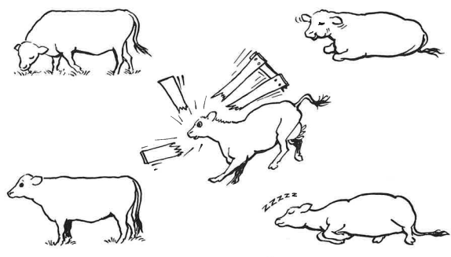
Animal Behaviour

Slide 28
Drag and drop the statements below into the table under the correct heading
Noise, shouting
Familiarity
What can make cattle flighty? | What can calm cattle?
Dogs barking or biting
Beating
Electric prods
Stroking
Low light
Pain
Music
Strange things
Hunger
Low- frequency sounds
Silence
Rhythmical sounds
Familiar people
Sexual activity

Slide 29
ANSWERS Drag and drop the statements below into the table under the correct heading
What can make cattle flighty? | What can calm cattle?
Noise, shouting
Familiarity
Dogs barking or biting
Low light
Beating
Stroking
Electric prods
Music
Pain
Low- frequency sounds
Hunger
Rhythmical sounds
Strange things
Silence
Sexual activity
Familiar people

Slide 30
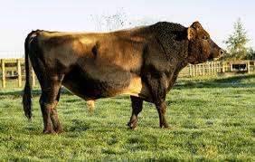
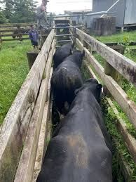
Test your cattle knowledge.
True or False
Beef cows are more flighty than dairy cow
Friesian cows are more flighty than Jersey cows
European breeds are more flighty than British breeds
Dairy bulls are more dangerous than beef bulls
Jersey bulls are more dangerous than Friesian bulls
Angus cattle move more quickly through yards than Herefords

Slide 31
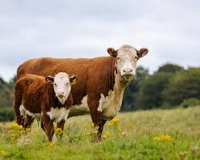
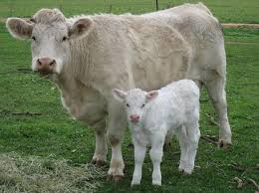
Test your cattle knowledge. Answers
Beef cows are more flighty than dairy cow - True
Friesian cows are more flighty than Jersey cows - True
European breeds are more flighty than British breeds - True
Dairy bulls are more dangerous than beef bulls - True
Jersey bulls are more dangerous than Friesian bulls - True
Angus cattle move more quickly through yards than Herefords - True

Slide 32
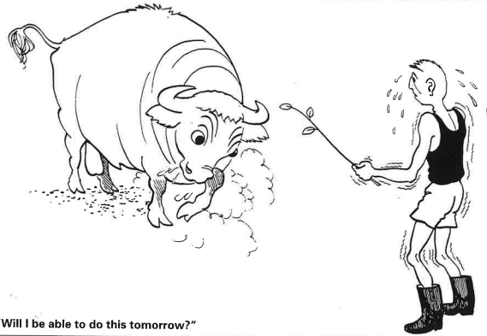
Points to consider for safe handling of cattle
Cattle are social animals.
Cattle are easier to work in groups.
Aggressive cows should be culled.
Gentle handling of calves will improve their temperament as adults.
Breed is only one factor influencing temperament.
Cattle remember bad experiences.
Bulls, and cows with newborn calves, may be dangerous.
Make sure the cattle know you are the boss.
Cattle don’t see like we do.
Music may reduce the likelihood of sudden noises startling cattle.
Use your voice to let cattle know where you are.
Keep cattle calm. Overexcited cattle are difficult to handle.
Use your voice to soothe and calm cattle.
Keep your distance while moving cattle.
Beating cattle will overexcite them.
Give cattle time to settle when they come into yards.

Slide 33
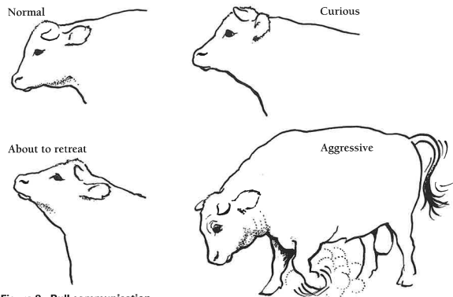
Bull communication
Match the word to the correct behaviour
Normal
Aggressive
Curious
About to retreat

Slide 34
Bull communication - ANSWER
Curious
Normal
Aggressive
About to retreat

Slide 35
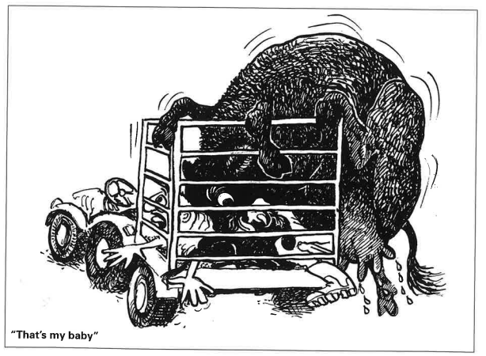
Cow with calves
How could this be prevented?

Slide 36
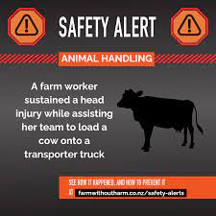
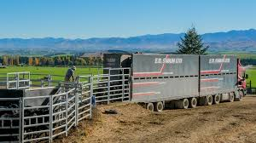
Safety Alert
How do you think this happened?
What should the farm worker have done to prevent this injury

Slide 37
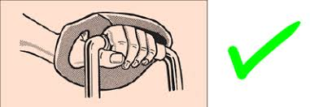
Safe use of chainsaws
True or False
You should operate a chainsaw above shoulder height or in a tree only if you are qualified and experienced.
It's safe to work alone when using a chainsaw, as long as you're careful.
You should never operate a chainsaw if you're under the influence of alcohol or drugs.
It's okay to use your chainsaw when you’re fatigued, as long as you take breaks.
You should always stay alert and take breaks when using a chainsaw to stay in control.
A chainsaw is designed to cut wood, so you should never use it to cut anything else or for levering or digging.
Always match the size of the chainsaw and bar with the material you are cutting, like using a small chainsaw for a big tree.
You can operate a chainsaw that is damaged, as long as the damage is minor.
It's okay to adjust chainsaw parts while the motor is running.
You should always turn your chainsaw off before handling the chain, guide bar, or sprocket.
It’s safe to drop start a chainsaw.

Slide 38
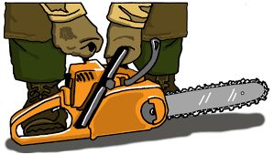
Answers-Safe use of chainsaws
True or False
You should operate a chainsaw above shoulder height or in a tree only if you are qualified and experienced. True
It's safe to work alone when using a chainsaw, as long as you're careful. False
You should never operate a chainsaw if you're under the influence of alcohol or drugs. True
It's okay to use your chainsaw when you’re fatigued, as long as you take breaks. False
You should always stay alert and take breaks when using a chainsaw to stay in control. True
A chainsaw is designed to cut wood, so you should never use it to cut anything else or for levering or digging. True
Always match the size of the chainsaw and bar with the material you are cutting, like using a small chainsaw for a big tree. False
You can operate a chainsaw that is damaged, as long as the damage is minor. False
It's okay to adjust chainsaw parts while the motor is running. False
You should always turn your chainsaw off before handling the chain, guide bar, or sprocket. True
It’s safe to drop start a chainsaw. False

Slide 39
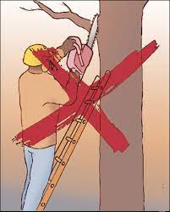
Safety Alert
What is the risk?
What could happen?
What is the safe way to cut off the branch.

Slide 40
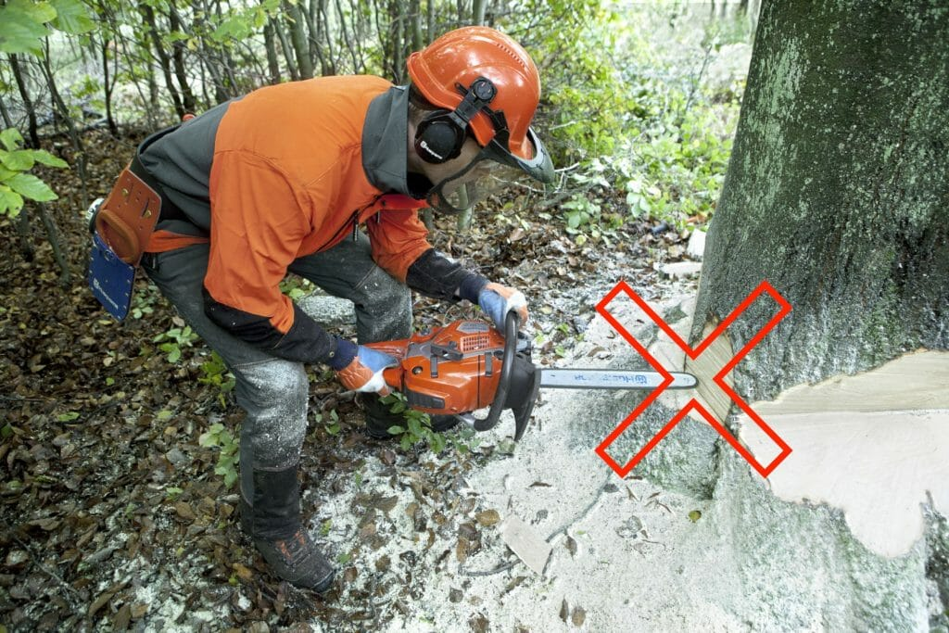
Safety Alert
The chainsaw kicked back
What caused this to happened?
The operator was lucky and not badly injured. What protected him?

Slide 41
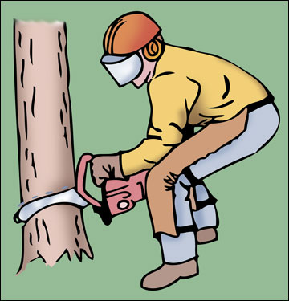
Safety rules for operating a chainsaw
Wear protective gear
Inspect the chainsaw before use
Start the chainsaw on flat ground, holding it firmly with both hands
Always grip the chainsaw with both hands
Stand in a balanced, stable position with your feet shoulder width apart
Never cut above shoulder height
Don’t overreach
Be Aware of kickback
Cut in small and controlled steps
Take breaks
Don’t operate alone
Shut off when not in use
Watch for hazards

Slide 42
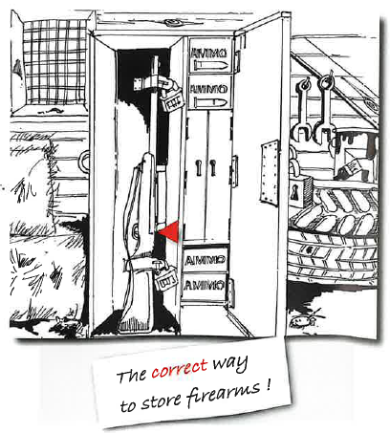
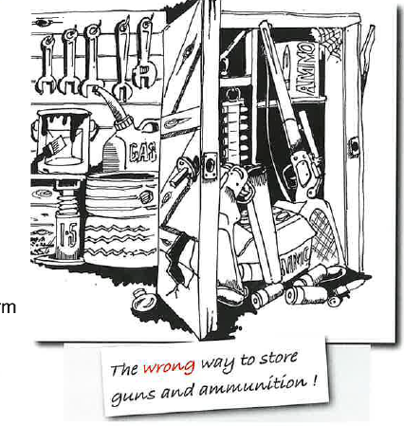
Safe use of Firearms Safety Alert
Why is this a risk?
How should firearms be stored?

Slide 43
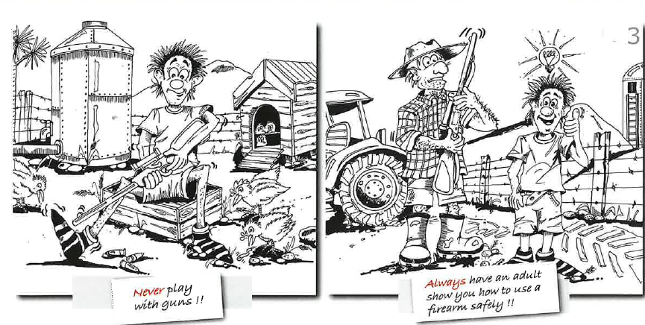
True or False
You have to be 16 to have a firearm license.
Always treat a firearm as loaded.
Never point a firearm at a person.
Best practice is to always store the ammunition, bold and firearm in a separate place.
Always identify your target before you shoot.
Chamber a cartridge only when ready to fire.

Slide 44
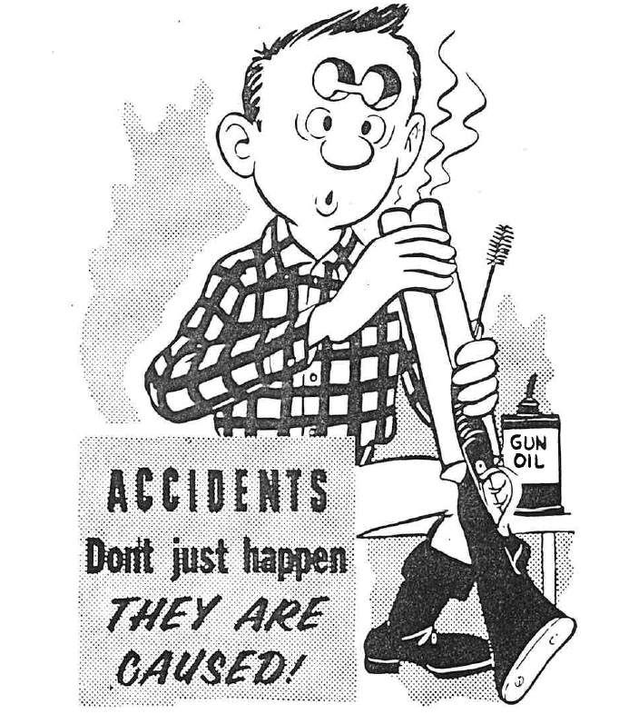
7 Rules for safe use of firearms
Answers - All True
Treat every firearm as being loaded
Always point firearms in a safe direction
Chamber a cartridge only when ready to fire
Identify your target beyond doubt
Check your firing zone
Store and transport firearms and ammunition safely
Avoid alcohol or drugs when handling firearms

Slide 45
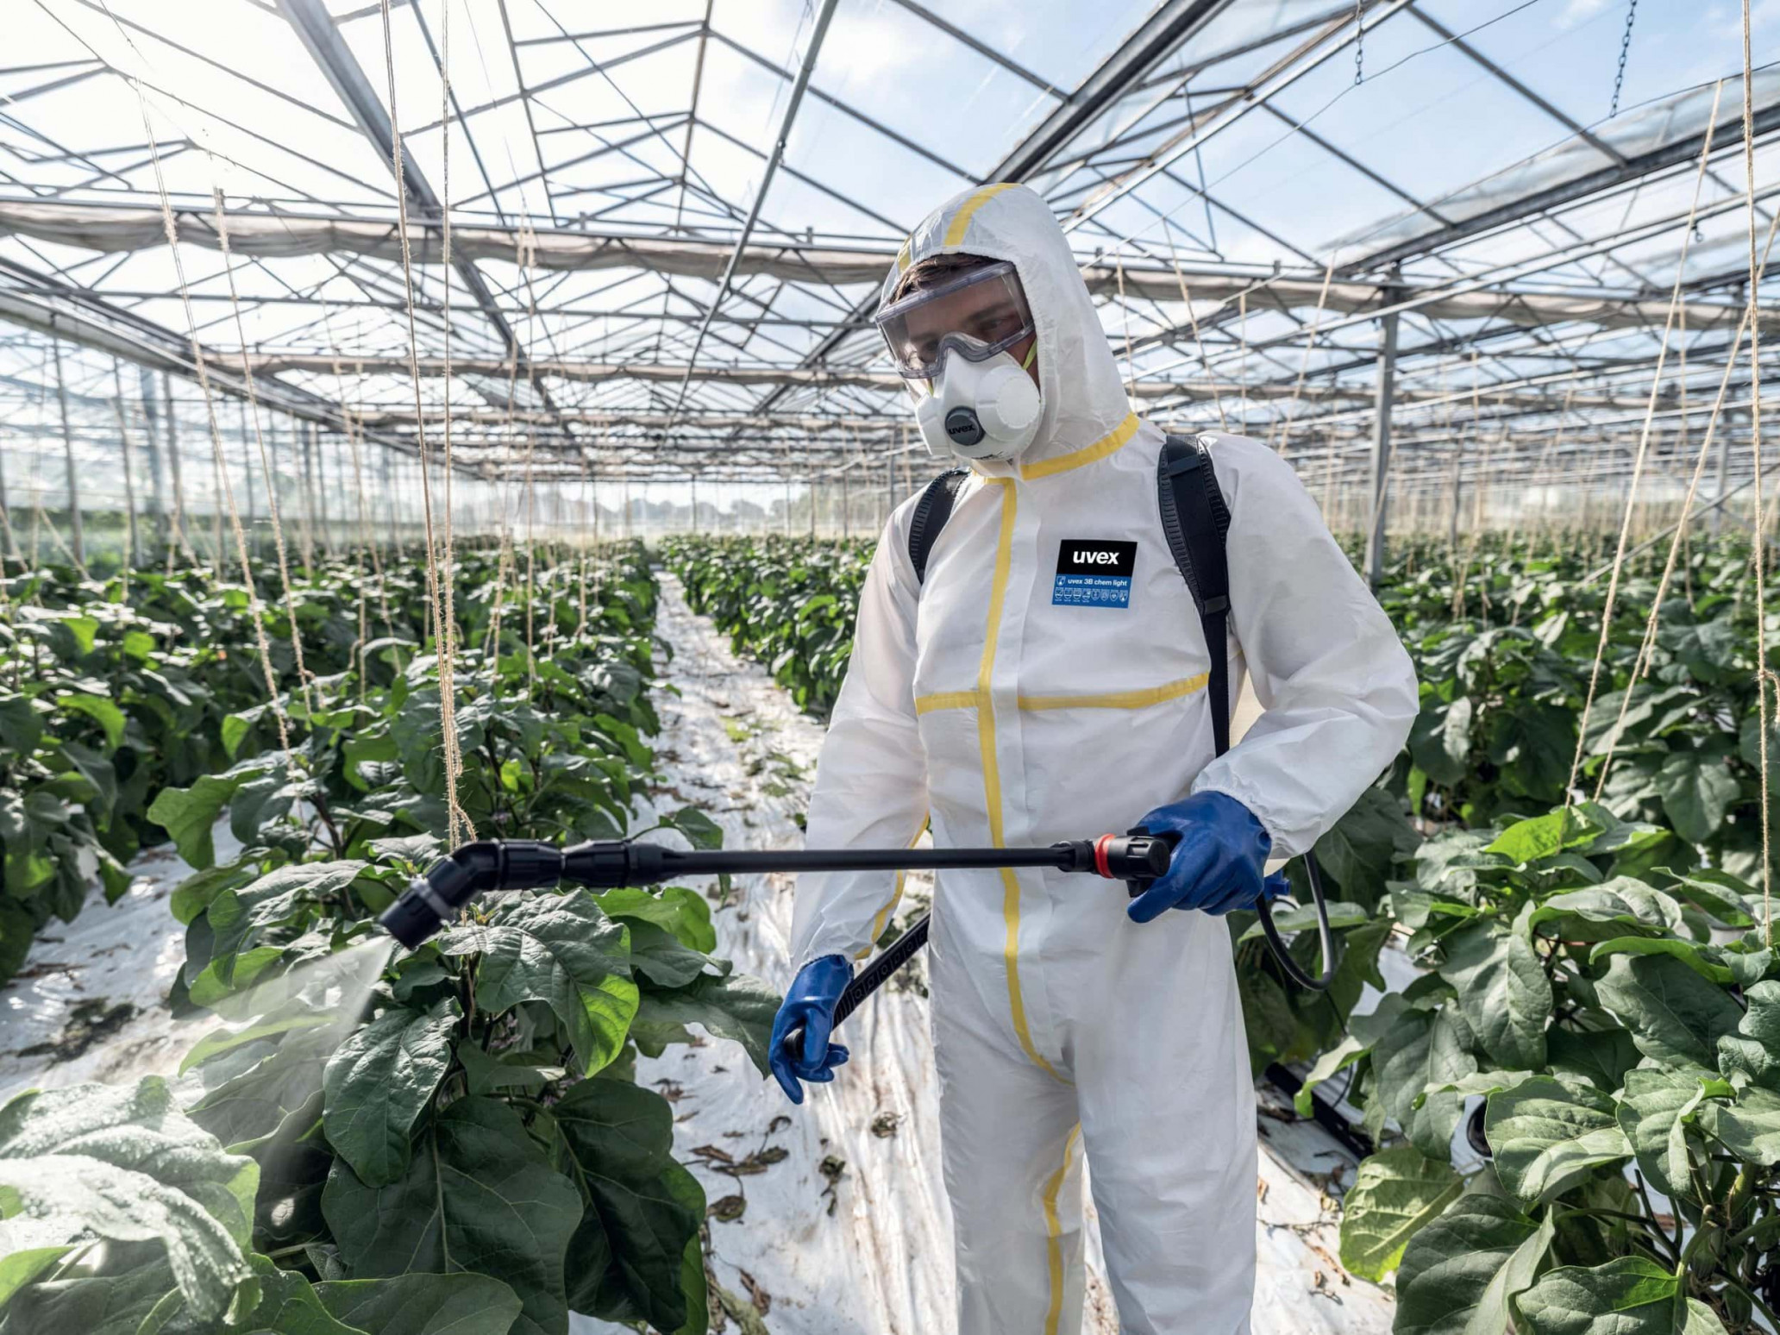
Safe use of agrichemicals
Agrichemicals are useful as weedkillers, insecticides and fungicides but they can be dangerous.
If used incorrectly, some farm chemicals can cause illness and death to people and livestock and kill or damage crops and cause harm the environment.
Toxic agrichemicals can be used without harming people, livestock and crops when the proper precautions are taken.

Slide 46
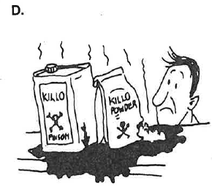
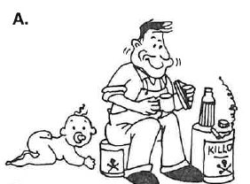
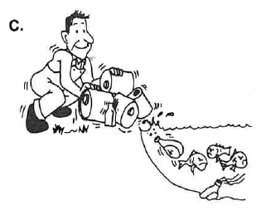
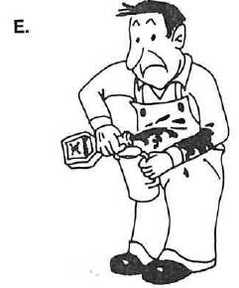

Is this safe?
For each cartoon,
identify what is unsafe
recommend what the safe practice should be.

Slide 47












Drag and drop the pictogram to the meaning
1. Wear gloves | 7. Wear full body clothes
2. Wear protective glasses | 8. Harmful to animals
3. Wash after using pesticides | 9. Harmful to fish, keep away from waterways
4. Wear protective clothes | 10. Keep under lock, out of reach of children
5. Wear boots | 11. How to handle the liquid
6. Wear protective mask covering mouth and nose | 12. How to apply the product

Slide 48

Answers

Slide 49

Drag and drop the words to match the symbols
Environment
Health (chronic toxicity)
Chemicals under pressure
Explosive
Corrosive
Acute toxicity
Oxidising
Exclamation mark
Flammable

Slide 50
Answers

Slide 51


Safety Alert
Which farmer did not feel very well at the end of the day?
Why?
What do you think the farmer should have done ?

Slide 52

Safety Alert
What is the risk?
What should the farmer or grower do to stop this risk?

Slide 53

Summary of
10 commandments for safe handling of agrichemicals
Read the label: Always read and follow the label instructions for safe use.
Keep away from children and pets: Store pesticides in a locked place outside the home.
Use original containers: Always store pesticides in their original containers and keep them tightly closed.
Wear protective gear: Use protective clothing and masks when the label says to, and avoid breathing in or touching pesticides.
Wash up after use: Wash your hands, face, and change clothes after handling pesticides. Wash clothes daily.
Keep pesticides away from food and animals: Don’t store near food or animal feed and cover containers when spraying near homes or animals.
Check equipment: Calibrate and clean equipment before and after use to prevent harm to plants and the environment.
Dispose of containers safely: Dispose of pesticide containers properly, following local rules (return, recycle, or puncture for landfill).
Follow label instructions for edible plants: Apply pesticides according to the label to keep residue levels safe.
Call Poison Control if sick: If you feel unwell after handling pesticides, call Poison Information immediately (0800 764 766).
Bonus:
Be cautious: Always use pesticides carefully to protect people, animals, plants, and the environment

Slide 54

How much do you know about noise and hearing loss? True/ False
If loud music is destroying my hearing, I'll know because I'll feel pain or notice that I can't hear as well.
If I damage some of my hearing, I can still hear all the music by turning up the volume.
Even if I listen to very loud music now, I won't have a hearing loss until I'm much older.
Permanent hearing loss comes only from listening to music for long periods of time.
The only way to prevent hearing damage is to turn down the volume.

Slide 55
Answers - All statements are false
DAMAGE DEPENDS ON
The noise level
The time you are exposed to it
Noise induced hearing loss is very gradual. While some people may notice they are losing the higher­ pitched sounds, others don't until it starts to inter­fere with normal conversation.
A person with noise-induced hearing loss may still hear the lower-pitched sounds quite clearly while missing all the higher frequencies. Music may sound as loud as before but will be distorted.
Many young adults are now losing their hearing due to over exposure to loud music.
It depends also on how loud the sound is. At a live concert sound levels can easily reach 115dB - enough to cause permanent damage in about 15 minutes.
This is only one way - others include hearing protection and limiting your exposure to loud noises to less than 10-15 minutes at a time.
Noise
dB
115 | 30s
112 | 1 min
109 | 2 min
106 | 4 min
103 | 8 min
100 | 15 min
97 | 30 min
94 | 1 hour
91 | 2 hours
88 | 4 hours
85 | 8 hours

Slide 56


Slide 57
Sound levels - Drag the dB sound level to match the situation
60 dB
85 dB
Noise level is measured in decibels (dB). The louder the noise, the higher the decibels.
NIHL can be caused by exposure to short periods of excessive noise, such as an explosion, or long term exposure to loud sounds. Prolonged exposure to sounds such as loud music, motorcycle engines and heavy machinery can gradually take its toll on your hearing without you even noticing, even causing permanent damage.
Rock concerts
Petrol/Ride on Lawn mower
Tractors with a cab
Tractors without a cab
Quads and side-by-sides
Chainsaws
Firearm
Movie theatre
Normal conversation
115 dB
95 dB
87 dB
125 dB
90 dB
110 dB

Slide 58
ANSWERS
Sound levels - Drag the dB sound level to match the situation
Rock concerts | 115 dB
Petrol/Ride on Lawn mower | 85 dB
Tractors with a cab | 87 dB
Tractors without a cab | 110 dB
Quads and side-by-sides | 95 dB
Chainsaws | 125 dB
Firearm | 140 dB
Movie theatre | 90 dB
Normal conversation | 65 dB
Which of these situations should you wear hearing protection?

Slide 59


Slide 60

HEARING PROTECTOR CLASS
MAX NOISE LEVEL (dB)
Watch Noise exposure
Hearing protection class
Class 1 Less than 90
Class 2 90 to less than 95
Class 3 95 to less than 100
Class 4 100 to less than 105
Class 5 105 to less than 110
Within each class there are various types of hearing protective devices:
earplugs
earmuffs
communication earmuffs
ear muff/helmet combinations

Slide 61



Hearing loss is
Will this protect your hearing?
Lonely
Missing out
How does hear loss affect the social and personal lives of families?

Slide 62

Noise induced hearing loss (NIHL)
Key points
Noise induced hearing loss (NIHL) is one of the most common work-related injuries.
Hearing loss is expensive. It affects the productivity of farm operations and is linked to increased rates of accident and injury.
Keep noise levels below 85dB on average and 140dB at peak.
If possible, replace machinery that creates noise above these levels.
If you can’t replace the machinery reduce exposure to it.
Wear hearing protection if noise levels are still too high.

Slide 63


ACC claims
People working on farms, orchards, in forestry or other primary industries do a wide variety of manual tasks. These tasks often involve using force, repetitive movements, stooping, awkward postures, and continual bending and twisting at the waist while handling heavy objects. These can cause several problems, including serious back injuries.

Slide 64


Slide 65

Protecting your back
Which diagrams show the correct technique for lifting objects off the ground?

Slide 66

Answers

Slide 67



Slips, Trips & Falls
What is the most common way people are hurt on farms, orchards, market gardens?
What are three things you could trip over in your home, dairy shed or tool shed?
Make a list of when slips, trips and falls could happen on a farm or orchard.

Slide 68




Slips, trips and falls
Discuss the good practices in these diagrams that are reducing the risk of slips, trips and falls.

Slide 69

If you are working on a farm or in an orchard, what is your responsibility to get SHED?

Slide 70
Writing
Write a short story describing an accident you almost had on a farm or orchard and how you stayed safe and kept others safe.
This can be a real or imaginary story.
Or
Make a one-minute video clip that young people can watch to warn them of dangers on a farm or orchard or on a piece of farming equipment.
Or
Design a safety pamphlet that focuses on one important safety aspect, making it engaging and easy to read for young people. It should be informative and highlight the importance of rural safety.

