Slide 1


Slide 2
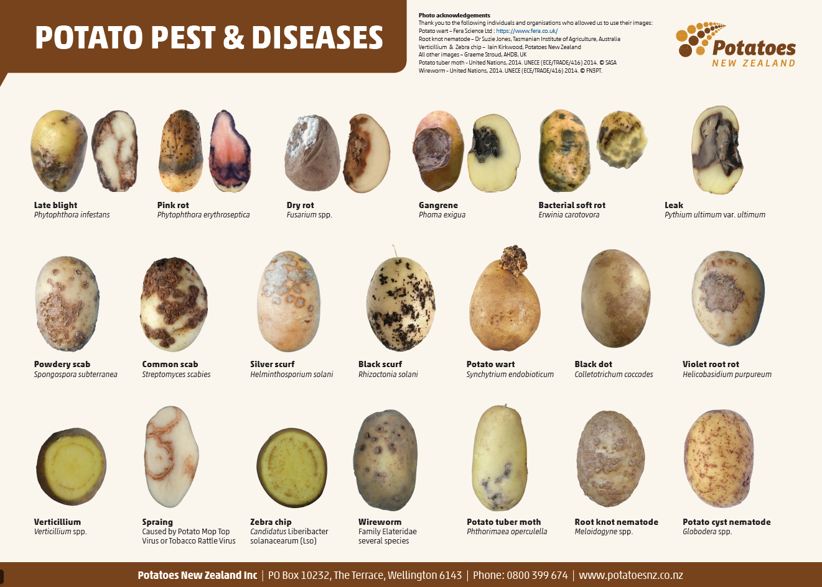
Some Common Potato
Pest and Diseases

Slide 3
Pest and Disease Risks in Potato Production
Growing potatoes involves a range of pest and disease risks.
These can significantly reduce:
  Yield
  Crop quality
  Marketability
This presentation highlights several key pests and diseases affecting potatoes.
These include both biological threats and physiological disorders.
Further Learning
For more detailed information on these and other threats, refer to the listed resources
Potato Pest & disease handbook Master Oct 18_web (2) Bio_Security_Poster_A3_Final_Downloadable-1
PNZ_Diseases_Poster_A2_Web (1)
PCN Things you need to know FINAL
TTP_A5_Booklet_2020_Final_Web
2018-October-Potato-Mop-Top-Virus-fact-sheet
54526-2022-Potato-spindle-tuber-viroid-v2
Powdery-Scab-FINAL

Slide 4
Common Potato Pest and Disease Risks in Potato Production
Pests | Diseases
Potato tuber moth Tomato-Potato Psyllid Aphids Wireworms Potato cyst nematode (PCN) | Late blight Early blight Sclerotinia Black scurf Dry rot Silver scurf Blackleg / Soft rot Common scab Bacterial wilt Zebra chip Powdery scab Potato virus Y (PVY) Potato leafroll virus (PLRV) Potato virus X (PVX)

Slide 5
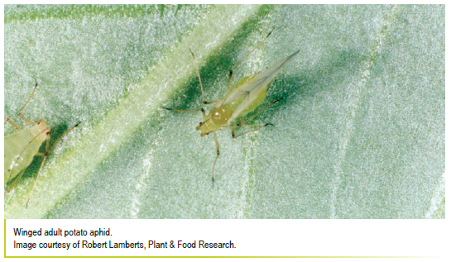
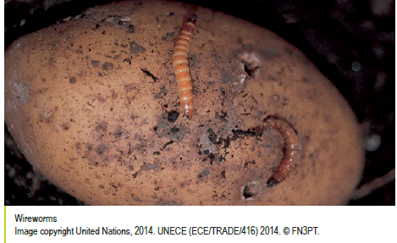
Common pests
Potato tuber moth: larvae tunnel into tubers, causing internal damage and rot
Tomato-Potato Psyllid (TPP):adults suck sap, causing "psyllid yellows," while also transmitting a bacterial pathogen that causes "zebra chip" in tubers.
Aphids: suck sap from plants and can spread plant viruses
Wireworms: larvae of click beetles that bore into tubers, leaving holes and damage
plant establishment
Potato cyst nematode (PCN): microscopic pest that reduces yield and restricts plant growth

Slide 6
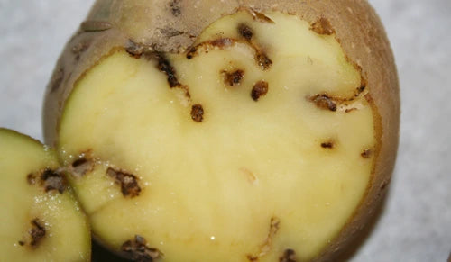
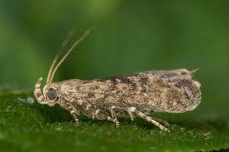
Potato Tuber Moth(PTM)
(Phthorimaea operculella)
A major pest for potato growers in New Zealand
Larvae can mine and damage potato leaves
Biggest problems occur during dry conditions
How damage happens
Dry soil cracks expose potato tubers
Adult moths enter cracks and lay eggs on tubers
Larvae hatch and burrow into potatoes
Effects on potatoes
Tubers become damaged and unmarketable
Increased risk of rot during storage
Reduced crop quality and yield

Slide 7
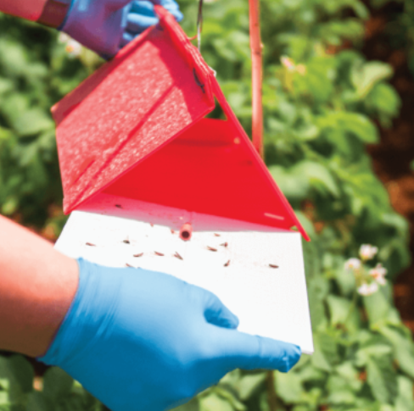
Control measures
Control of potato tuber moth relies on an integrated pest management (IPM) approach.
Effective management includes
using pheromone traps
  to monitor and trap adult males, reducing mating.
use of biological control
  e.g. an egg-larval parasitoid Chelonus blackburnii
destroying volunteer plants and infested tubers from previous crops
deep planting (10–15 cm)
high hilling to protect tubers
prompt irrigation to prevent soil cracking
harvesting immediately after the vines mature or die
targeted use of insecticides when necessary

Slide 8
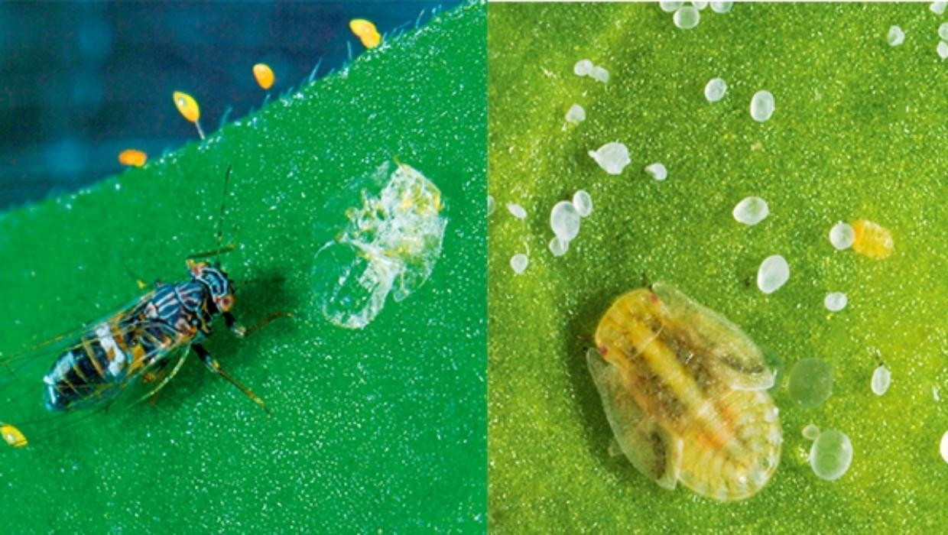
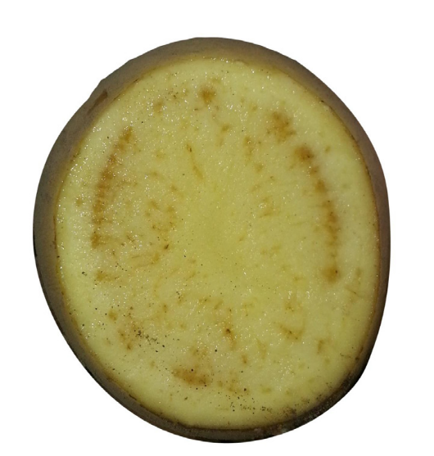
Tomato Potato Psyllid (TPP)
(Bactericera cockerelli)
A serious potato pest in New Zealand
First found in New Zealand in 2006
Small jumping insect about 3 mm long
Feeds by sucking sap from plants
Plant symptoms
Yellowing, curled leaves
Purple leaf colouring
Condition known as psyllid yellows
Disease spread
Spreads the bacterium Candidatus Liberibacter solanacearum
Causes “zebra chip” disease in potatoes
Effects on crops
Produces small, inedible tubers
Causes major quality problems in processing potatoes
Reduces crop value and marketability

Slide 9
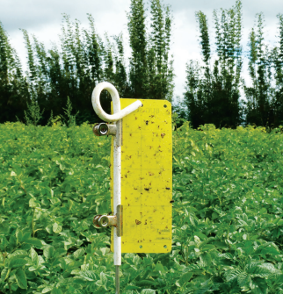
Control measures
Monitoring crops
Check crops regularly for early signs of infestation
Use yellow sticky traps to detect psyllids
Inspect plants
Look under leaves for eggs and nymphs
  Watch for:
  Yellowing or curling top leaves (psyllid yellows)
  Stunted plant growth
  White sugary excreta (“sugar”) on leaves
Management
There are currently no effective biological controls for TPP
Control mainly relies on:
  Careful crop monitoring
  Targeted chemical control when needed

Slide 10
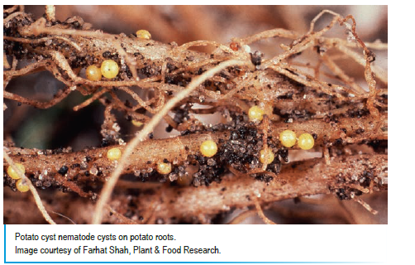
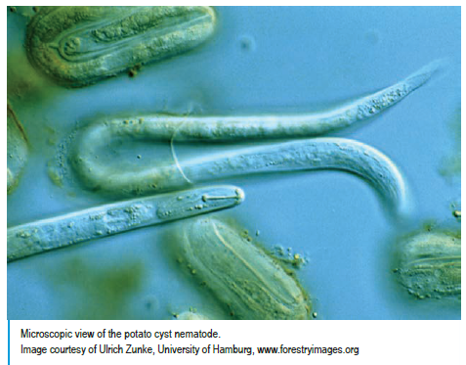
Potato Cyst Nematode (PCN)
(Globodera pallida and Globodera rostochiensis)
A serious soil-borne pest of potatoes
Can greatly reduce potato yields
Persists in soil for many years
Cysts and survival
Forms hard protective cysts in the soil
Each cyst contains hundreds of eggs
Cysts can survive dormant in soil for up to 20 years
How damage occurs
Eggs hatch when moisture and potato roots are present
Nematodes enter and feed on plant roots
Damages the plant’s ability to absorb water and nutrients
Effects on crops
Poor tuber development
Reduced plant growth
Significant long-term yield losses

Slide 11
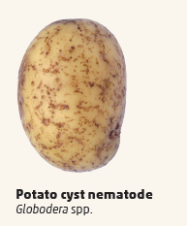
Control measures
Prevention is essential
Use certified seed potatoes
Choose potato cultivars resistant to Potato Cyst Nematode
Crop management
Follow long crop rotations
  Ideally 10 years or more between potato crops in fields with high infestation
Biosecurity and hygiene
Restrict movement of soil between fields
Follow strict on-farm hygiene and biosecurity practices
Processing hygiene
Avoid spreading processing waste onto fields

Slide 12
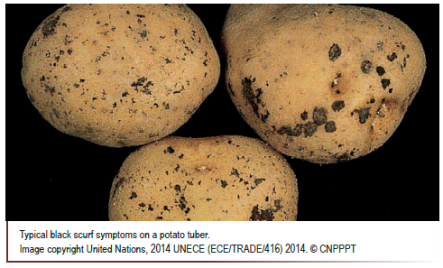
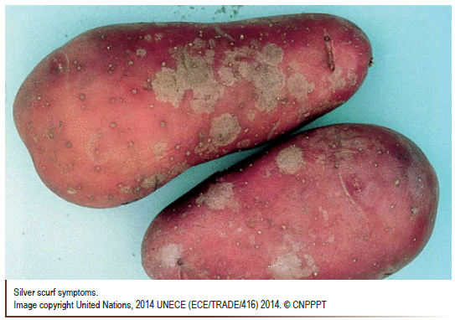
Fungal diseases
Late blight (Phytophthora infestans)
A serious potato disease. Causes rapid leaf collapse and tuber rot, especially in cool, wet weather.
Early blight (Alternaria solani)
Produces dark concentric leaf spots, leading to defoliation and reduced yield.
Sclerotinia White Mold (Sclerotinia sclerotiorum.)
A wide spread damaging soil-borne fungal disease causing stem rot,
plant wilting, and yield loss
Black scurf (Rhizoctonia stem canker)
Affects sprouts, stems, and tubers; causes poor emergence and black crust-like structures on tubers.
Dry rot and Fusarium wilt (Fusarium spp)
A storage disease causing dry, sunken lesions and internal decay in tubers.
Silver scurf (Helminthosporium solani)
Affects tuber skin, reducing market quality rather than yield.

Slide 13
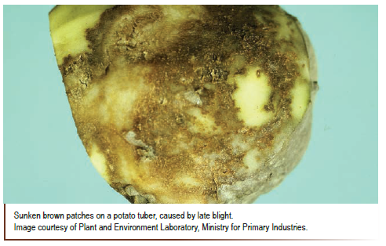
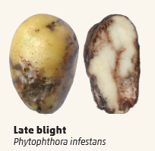
Late Blight
(Phytophthora infestans)
A serious fungal-like disease of potatoes
Thrives in wet, cool-to-warm conditions
Symptoms
Irregular brown or black blotches on leaves
Yellow borders may appear around spots
Severe infections can spread to:
  Stems
  Potato tubers
Tuber infection
Tubers can become infected during harvest
Bruising or wounds allow disease entry
Conditions that increase disease
Plant stress increases susceptibility
Alternating wet and dry conditions encourage disease spread

Slide 14
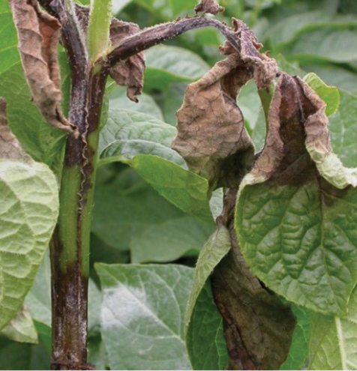
Control measures
Crop Monitoring
Regularly inspect crops for symptoms
Look for:
  Large brown or black leaf lesions
  White, downy growth on leaf undersides
  Sunken reddish-brown spots on tubers
Chemical control
Apply fungicides as part of a preventative and responsive programme
Cultural practices
Remove infected plants, tubers, and volunteer potatoes
Avoid overhead irrigation to keep foliage dry
Increase spacing between plants to reduce humidity and disease spread

Slide 15
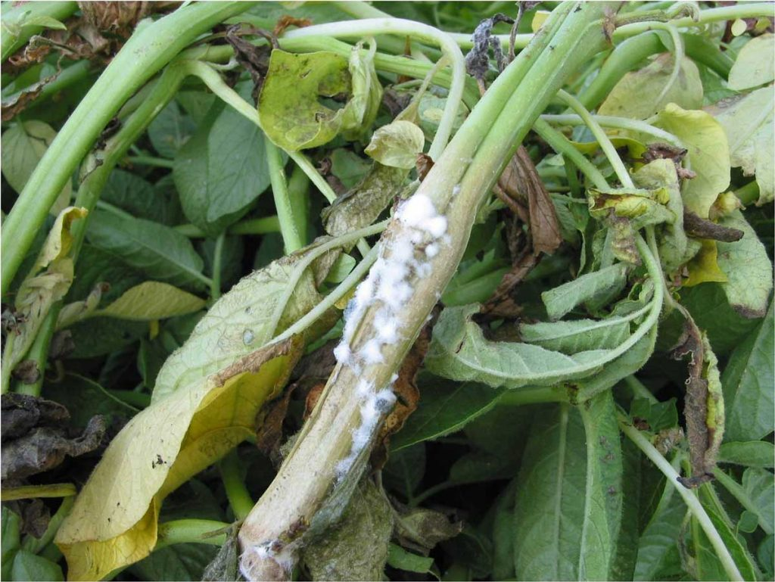
Sclerotinia (White Mold)
Sclerotinia sclerotiorum
Widespread and damaging soil-borne fungal disease
Thrives in wet, humid conditions and dense crop canopies
Causes stem rot, plant wilting, and significant yield loss
Symptoms
Water-soaked spots on stems
Turn grey to light brown
Can girdle stems, restricting water and nutrient flow
Fluffy, cotton-like white fungal growth
Found on infected stems and leaves
Hard, black, irregular resting bodies
Reduced plant vigour
Premature wilting and death
Lower crop yield and quality

Slide 16
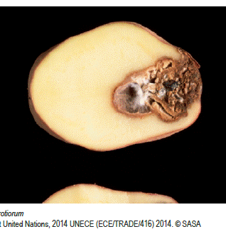
Control measures
An integrated approach combining crop rotation, canopy management, and preventative chemical or biological controls provides the most effective management of Sclerotinia (White Mold) in potatoes.
Crop Rotation
Avoid planting potatoes after susceptible crops such as peas, lettuce, and brassicas.
Rotate with non-host crops (e.g., cereals) to reduce soil-borne inoculum levels.
Canopy Management
Avoid excessive nitrogen applications that promote dense foliage.
Maintain good airflow within the crop canopy.
Manage irrigation carefully to minimize prolonged leaf wetness, especially during cool, humid conditions.
Chemical and Biological Control
Apply fungicides preventatively, particularly during periods of cool, moist weather when disease risk is high.
Use biological control agents such as Trichoderma spp., which are widely researched and used in New Zealand to suppress sclerotia survival in the soil.

Slide 17
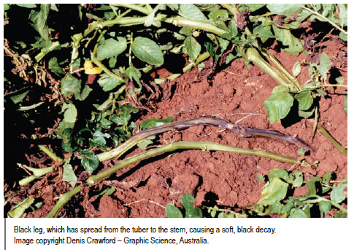
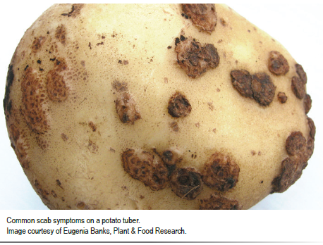
Bacterial diseases
Blackleg / Soft rot (Pectobacterium spp., Dickeya spp.)
Causes stem collapse in the field and wet, foul-smelling rot in storage.
Common scab (Streptomyces scabies)
Creates rough, corky lesions on tuber skin; mostly cosmetic but reduces quality.
Bacterial wilt (Ralstonia solanacearum, brown rot)
A serious soil-borne disease (present in some regions under strict management), causing plant wilting and brown vascular staining.
Zebra chip (Candidatus Liberibacter solanacearum, (Lso))
A serious bacterial disease transmitted by the potato psyllid.
Causes internal tuber browning that becomes dark, “zebra-like”
streaks when fried.
Powdery scab (Spongospora subterranea)
Produces powdery lesions on tubers and can transmit potato mop-top virus.

Slide 18
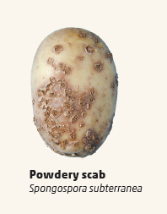
Powdery Scab
(Spongospora subterranea)
A common soil-borne disease in New Zealand
Causes distinctive “volcano-like” pustules on potato skins
Effects on potatoes
Mainly affects appearance and skin quality
Reduces marketability of crops
Potatoes are safe to eat once peeled
Disease survival
Can survive in soil for more than 10 years
Spread through both soil and infected seed potatoes

Slide 19
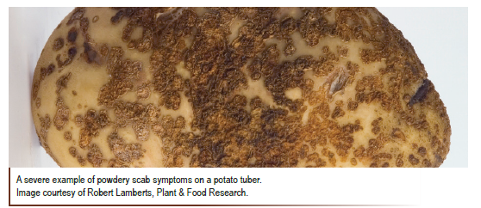
Control measures
Powdery scab is difficult to control once established. An integrated management approach provides the most effective means of disease control.
Key preventative strategies include:
Selecting potato varieties with strong genetic resistance to powdery scab. For example, Moonlight exhibits excellent resistance, whereas Agria is highly susceptible.
Using certified, pathogen-free seed potatoes to prevent the introduction of the pathogen into clean fields.
Maintaining long crop rotations between potato plantings to reduce soil spore populations over time.
Improving soil drainage through hilling, to minimise waterlogging, particularly during early tuber development when infection risk is highest.

Slide 20
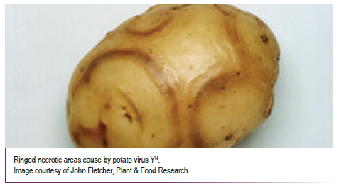
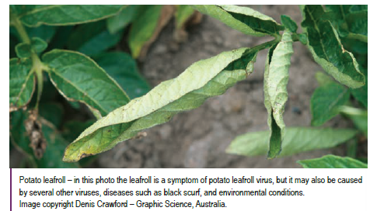
Viral diseases
Many viruses have similar symptoms, therefore difficult to distinguish them in the field.
Potato virus Y (PVY)
Causes mosaic, leaf necrosis, and yield loss; spread by aphids.
Potato leafroll virus (PLRV)
Causes leaf rolling, stunting, and net necrosis in tubers.
Potato virus X (PVX)
Often mild alone but reduces yield in mixed infections.

Slide 21
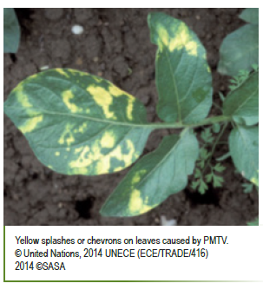
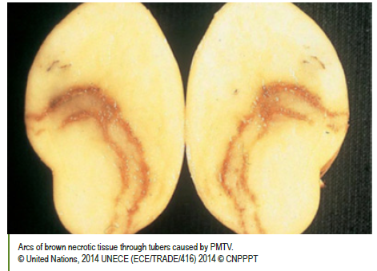
Potato Mop-Top Virus (PMTV)
First detected in New Zealand in 2018
Spread by the fungus that causes Powdery Scab
When established in fields, the virus can survive in the fungus for up to 20 years in soil in the absence of a potato crop.
Symptoms in tubers
Distortions to the skin
Leaves have a yellow
Internal rust-coloured arcs or streaks
Reduced tuber quality and market value

Slide 22
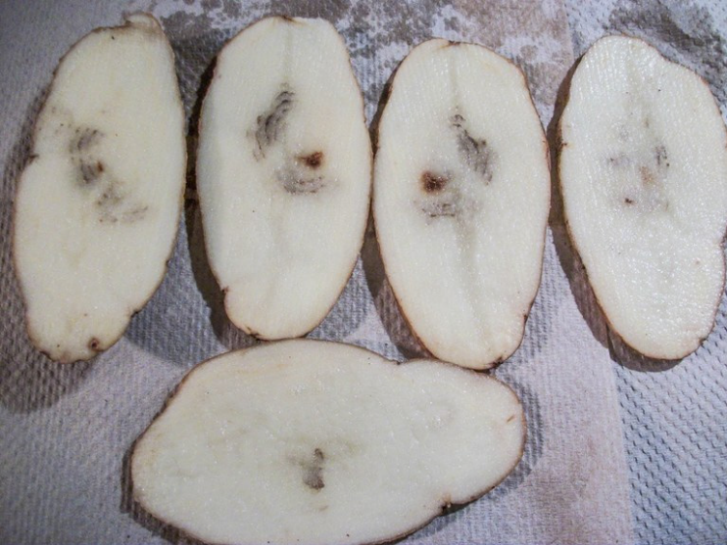
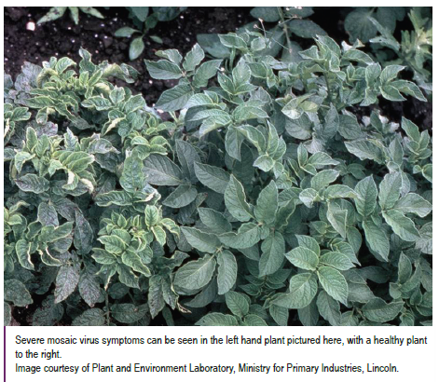
Control measures
Biosecurity & hygiene
Strict cleaning of machinery, boots, and equipment
Remove all soil between properties to prevent spread
Seed management
Use certified, virus-tested seed potatoes
Reduces risk of introducing the virus into clean fields
Crop rotation
Use long crop rotations
Helps reduce levels of the vector Powdery Scab (Spongospora subterranea)

Slide 23
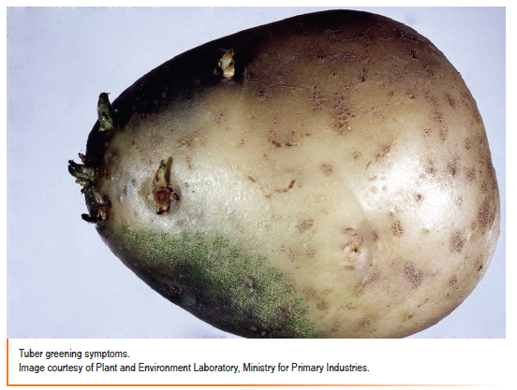
Physiological disorders
Physiological diseases are disorders caused by environmental conditions or growth problems
They are not caused by pests or pathogens
What causes them?
Water stress (too much or too little water)
Temperature changes (too hot or too cold)
Nutrient imbalances in soil
Effects on plants
Changes in growth patterns
Altered colour or appearance
Reduced quality of produce
In potatoes
Can lead to lower yields
Reduced marketability of tubers

Slide 24
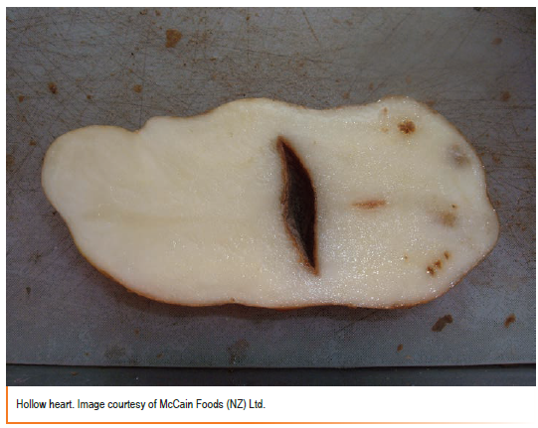
Hollow heart
A physiological disorder, not a disease
Caused by rapid or uneven plant growth
Causes
Sudden changes in growing conditions
Uneven water or nutrient supply
Plants recovering quickly after stress (e.g. drought or cold periods)
What it looks like
Irregular internal cavity in the potato tuber
Can be star-shaped
Found in the centre or one end of the tuber
Inner walls are white or light brown (not rotten)
Impact
Reduces quality of potatoes
Can lower market value, especially for processing crops

Slide 25
Control measures
Water management
Maintain even soil moisture throughout the growing season
Avoid cycles of drought and rapid re-watering
Nutrient management
Avoid excessive nitrogen application
Ensure adequate potassium levels are maintained
Planting practices
Use appropriate planting densities
Prevent overly large tubers, which increases risk of hollow heart

Slide 26
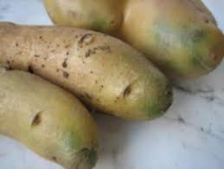
Greening in Potato Tubers
Potato greening
Occurs when potato tubers are exposed to light
Causes green discolouration of the skin
What causes it?
Exposure to:
  Sunlight
  Indirect daylight
  Artificial light
Chlorophyll is produced in the skin
Happens faster at temperatures above 13°C
Impact
Green pigment (chlorophyll) is harmless
Light exposure also increases toxic compounds (e.g. solanine)
Can cause bitter taste and make potatoes unsafe to eat in large amounts

Slide 27
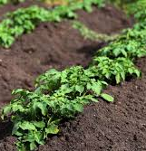
Control measures
Properly earth up (hill) potato plants during growth
Ensure developing tubers remain fully covered with soil
Why
Protects tubers from exposure to:
  Sunlight
  Indirect daylight
  Artificial light
Benefits
Prevents green discolouration of tubers
Reduces formation of bitter, potentially toxic compounds
Improves crop quality and marketability

Slide 28
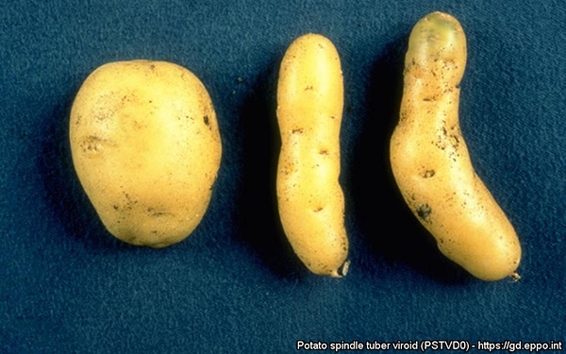
Potato spindle tuber viroid (PSTVd)
Eradicated
A serious plant pathogen that threatens potatoes and other crops
Detected in New Zealand three times and successfully eradicated each time
Host plants
Mainly affects plants in the nightshade family (Solanaceae), including:
  Potatoes
  Tomatoes
  Pepinos
  Capsicums
Can also infect ornamentals such as:
  Dahlias
  Chrysanthemums
  Petunias
Impact
Causes plant disease and yield loss
Can significantly reduce crop quality and production

Slide 29
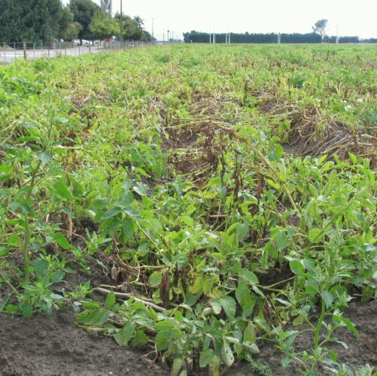
Read: EPA approves new potato disease chemical (WS)
Answer questions

Slide 30
On farm biosecurity
On-farm biosecurity refers to the practices and procedures used to prevent the introduction and spread of pests, diseases, and weeds on a farm.
It is a critical part of modern agriculture and horticulture because once harmful organisms become established, they are often very difficult and expensive to control.
Strong biosecurity helps to:
  Protect crop health
  Maintain farm productivity
  Ensure the quality and marketability of produce
Activity 11: On-farm biosecurity
In groups, brainstorm a list of on-farm biosecurity measures that a commercial potato grower could use to prevent the introduction and spread of pests and diseases.
Share your ideas with the rest of the class.
and/or
Activity 12 : Protecting New Zealand Potatoes – Researching a biosecurity risk

Slide 31
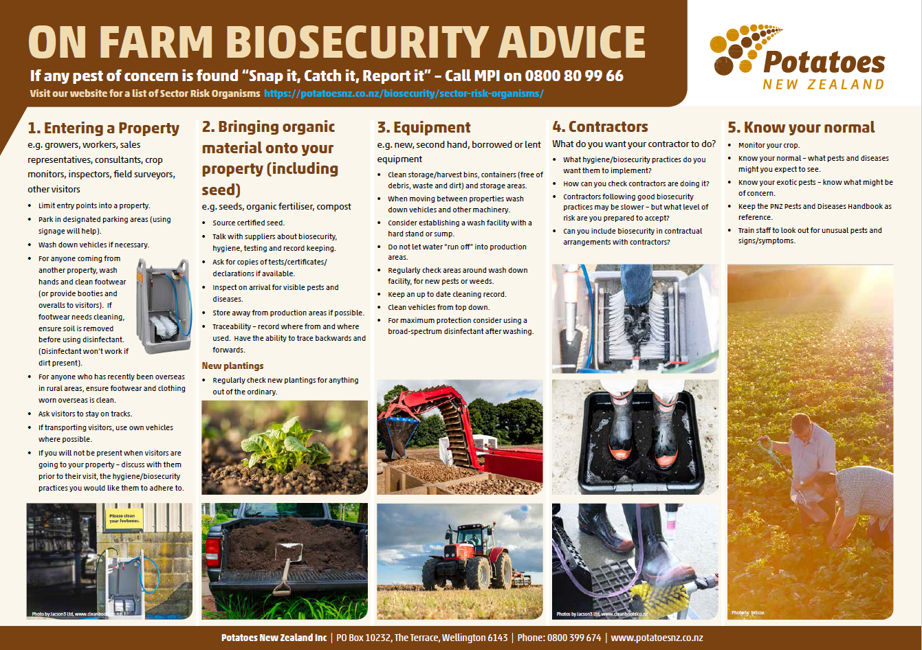

Slide 32
Suggested list of on-farm biosecurity measures for a commercial potato grower
Use certified, disease-free seed potatoes
Clean and disinfect machinery, tools, boots, and vehicles between fields and properties
Ensure contractors follow strict hygiene procedures (e.g., clean equipment before entering the farm)
Restrict movement of soil between paddocks and farms
Control volunteer potatoes and solanaceous weeds (e.g., nightshade)
Manage visitor and contractor access with biosecurity protocols (e.g., restricted entry, signage, and footbaths if required)
Rotate crops for long periods to reduce pest and disease build-up in soil
Safely dispose of cull piles, waste tubers, and infected plant material away from production areas
Avoid spreading untreated processing waste onto fields or using it as stock feed
Regularly monitor crops for early signs of pests and diseases
Keep detailed records of crop history, movements, and disease issues
Train staff and contractors in biosecurity procedures and expectations

Slide 33
References
HANDBOOK of pests and diseases for New Zealand potato growers - 2018 update

