Slide 1


Slide 2
Test Yourself Activities

Slide 3
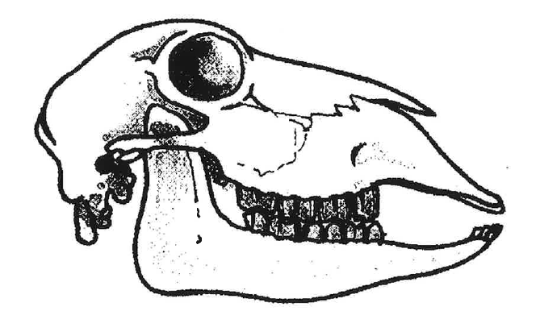
Mouth parts
Identify the skulls A and B and name the mouth parts
A
B
1
1
2
3
2
3

Slide 4
Mouth parts
Identify the skulls A and B and name the mouth parts
A Ruminant
B Monogastric
Dental pad
1
Incisor
1
2
Incisor
3
2
Molar
Canine
3
Molar

Slide 5
Digestive Systems - Drag the animal into the correct column
Monogastric (non-ruminant) Single stomach |  | Ruminant Four parts to the stomach
Monogastric | Monogastric Herbivores Single stomach with a large caecum
Human
Cattle
Sheep
Horse
Pig
Dog
Cat
Goats
Alpaca
Deer
Rabbit

Slide 6
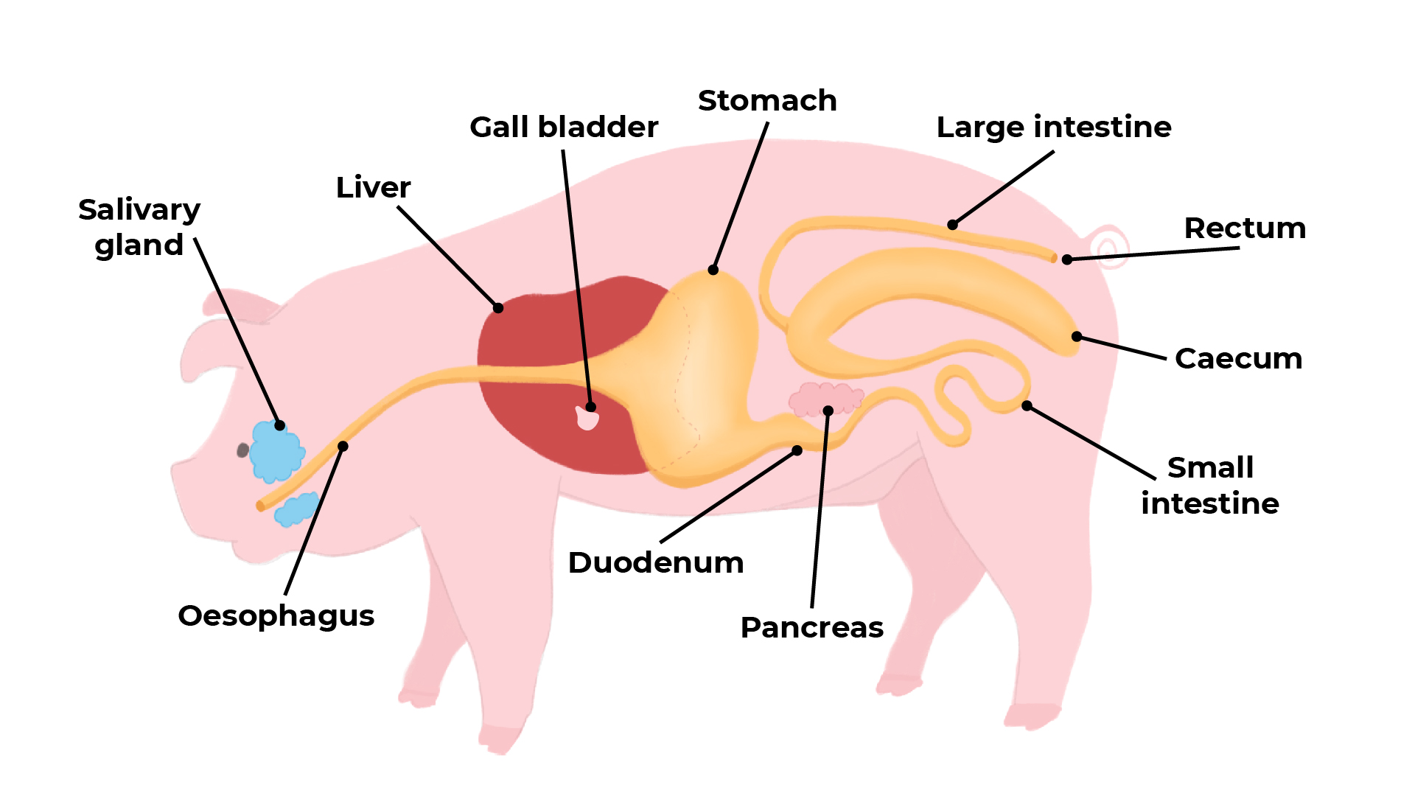
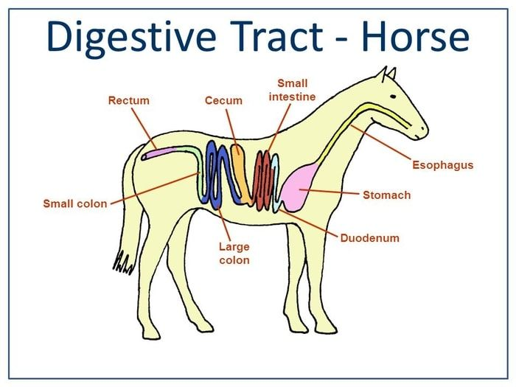
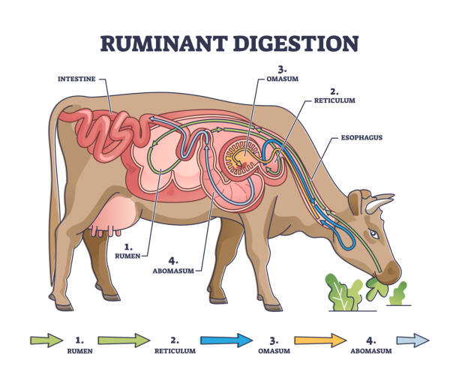
Digestive Systems - Answer
Monogastric (non-ruminant) Single stomach |  | Ruminant Four parts to the stomach
Monogastric | Monogastric Herbivores Single stomach with a large caecum
Human
Horse
Cattle
Pig
Sheep
Rabbit
Dog
Goats
Cat
Deer
Alpaca

Slide 7
Quiz - Drag the definition to match the term.
Calf
Castrated
Polled
Culling
Gestation
Steer
Oestrus
Heifer
Vaccination
Springer
A female older than a calf, from 6 months of age, until she has had a calf herself.
A sign that a cow is approaching calving.
Cattle are given an injection to prevent certain diseases.
A male castrated when young.
The period when a cow is attracted to a bull and will willing to mate.
Period from conception to calving
Removal of an animal from a herd because of age, disease, low production.
A young cattle beast of either sex
Removal of testes from males calves.
An animal with no horns.

Slide 8
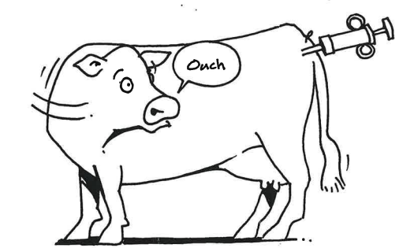
Quiz- Answers
Calf
Castrated
Polled
Culling
Gestation
Steer
Oestrus
Heifer
Vaccination
Springer
A young cattle beast of either sex
Removal of testes from males calves.
An animal with no horns.
Removal of an animal from a herd because of age, disease, low production.
Period from conception to calving
A male castrated when young.
The period when a cow is attracted to a bull and will willing to mate.
A female older than a calf, from 6 months of age, until she has had a calf herself.
Cattle are given an injection to prevent certain diseases.
A sign that a cow is approaching calving.

Slide 9
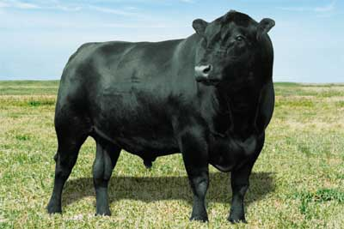
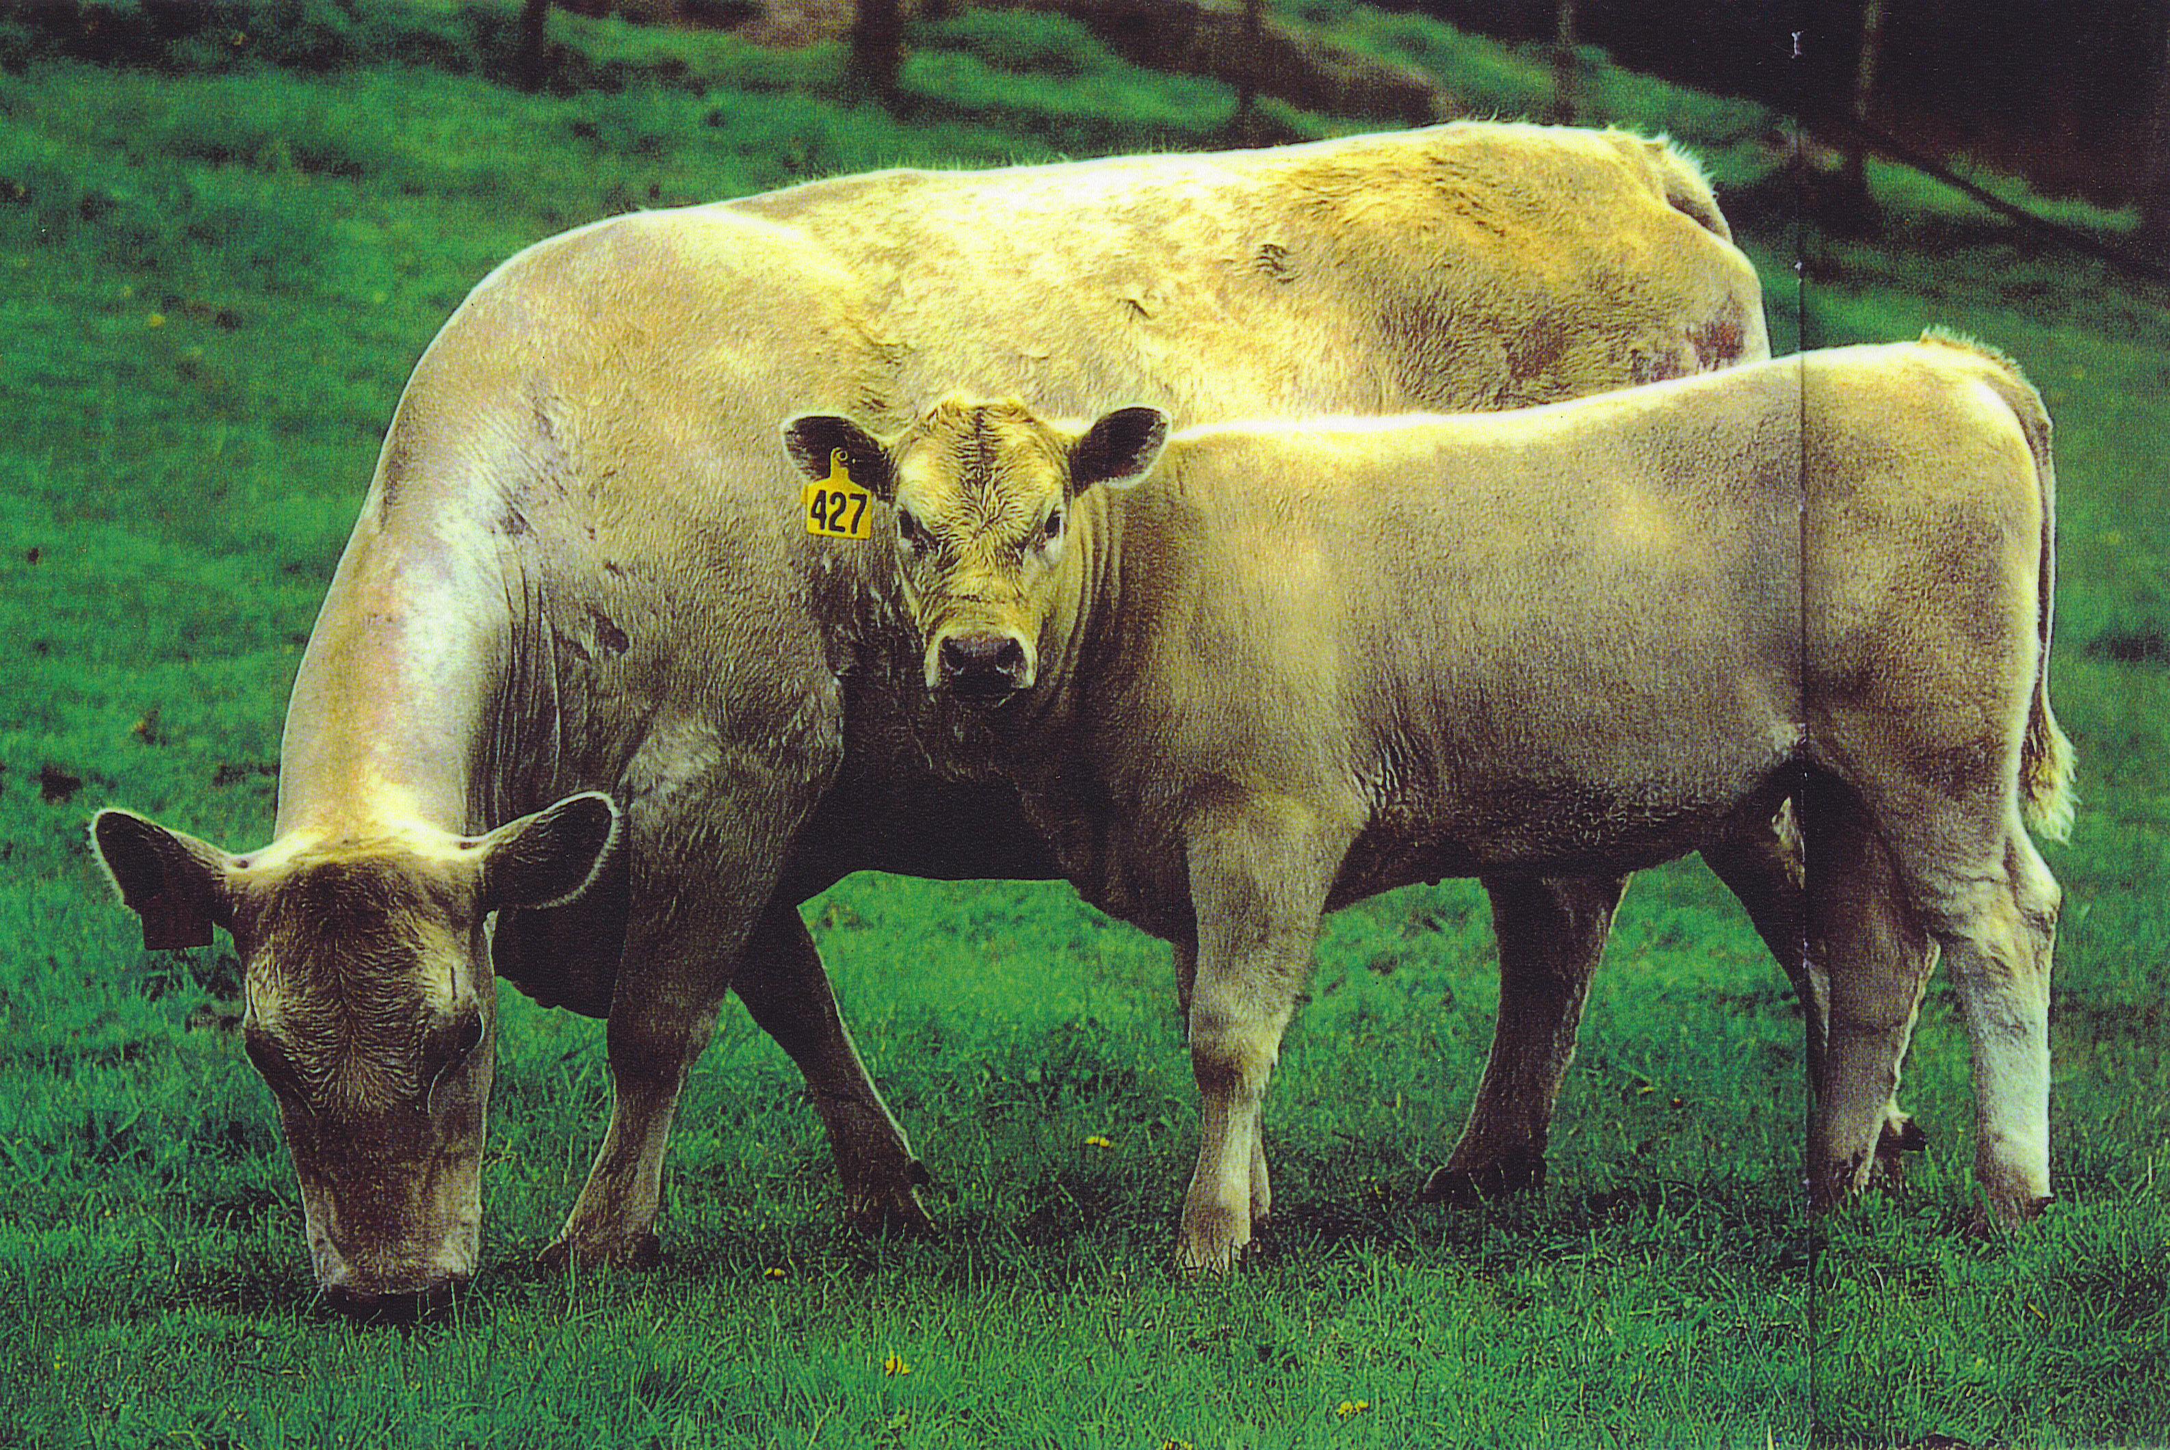
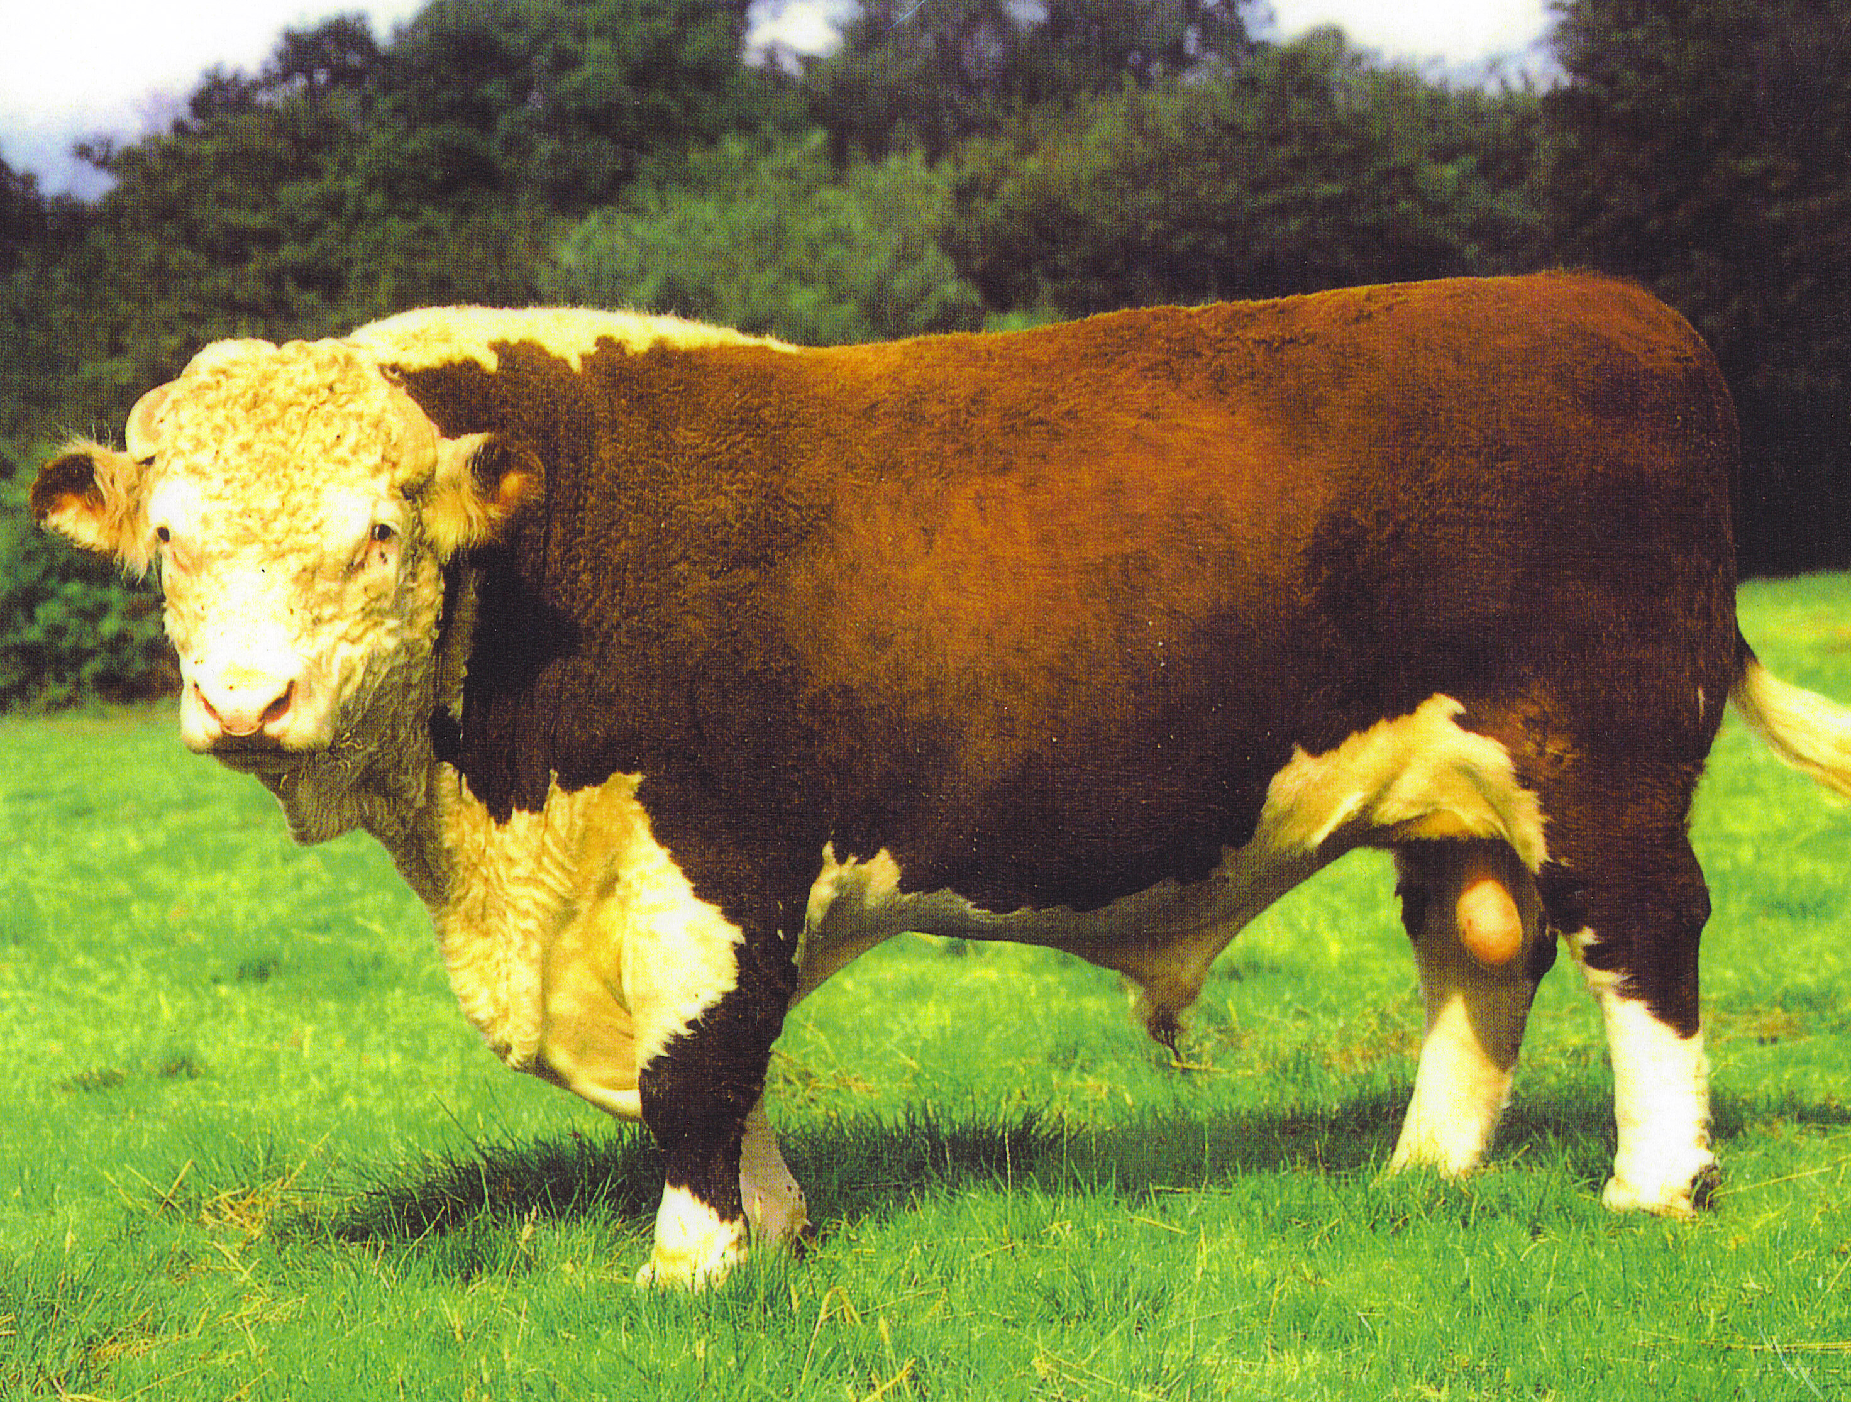
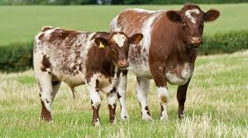
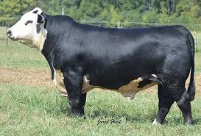
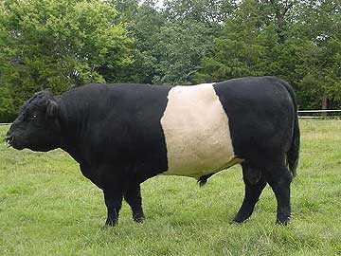
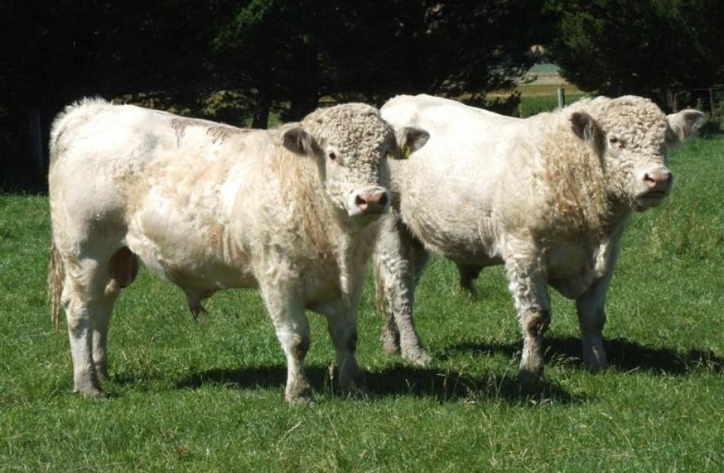
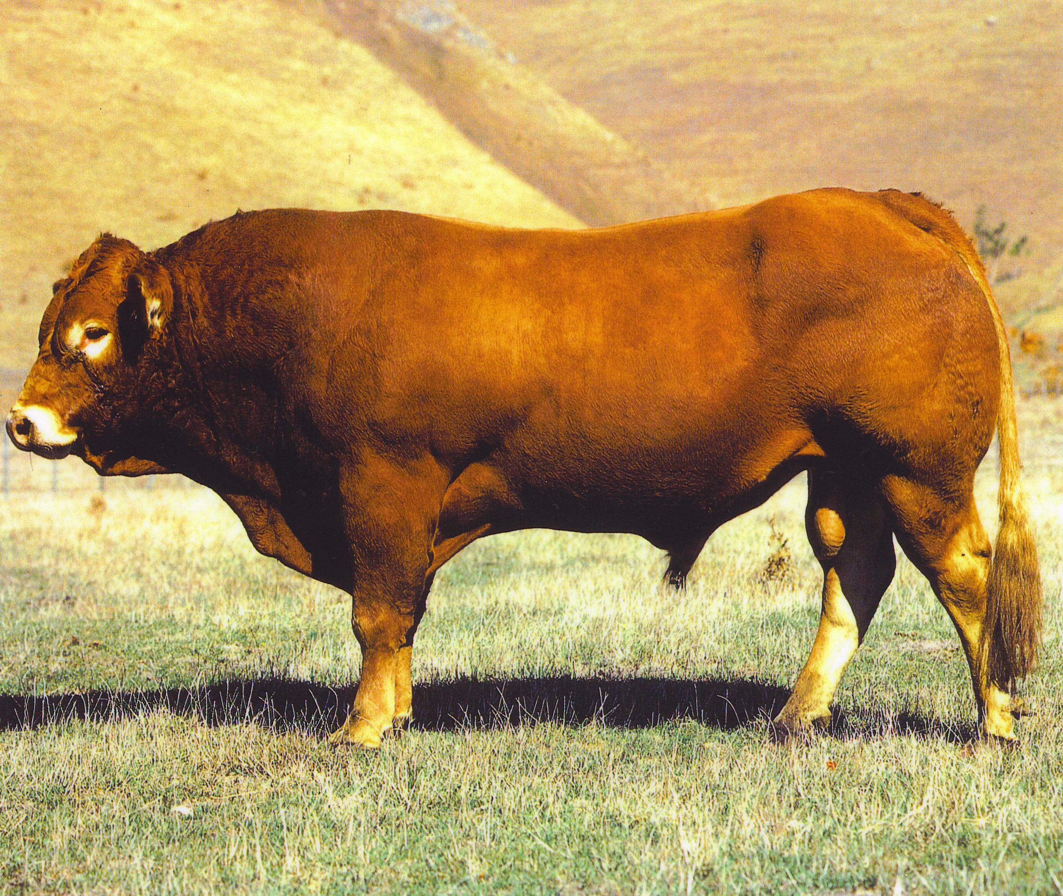
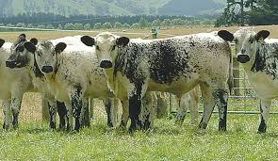
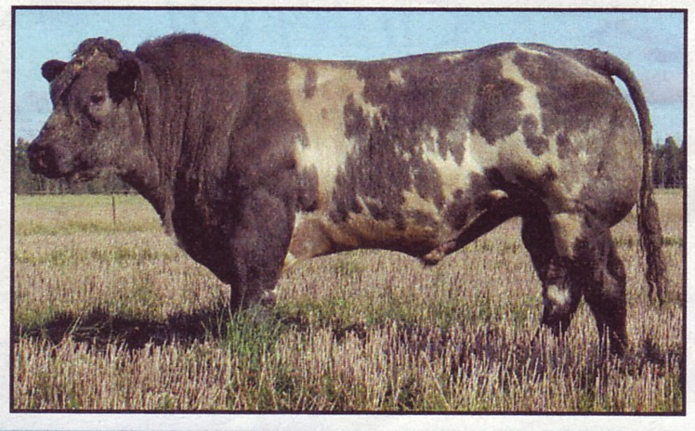
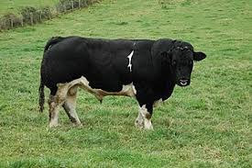
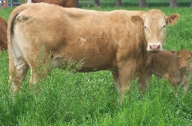
Name these beef breeds
A
B
C
D
E
F
G
H
I
J
K
L

Slide 10
Name these beef breeds
A
B
C
D
Angus
Hereford
Murray Grey
Shorthorn
E
F
Belted Galloway
G
Charolais
H
Angus/Hereford X
Simmental
I
J
K
Friesian
L
Speckle Park
Belgium Blue
Blond d’ Aquitaine

Slide 11
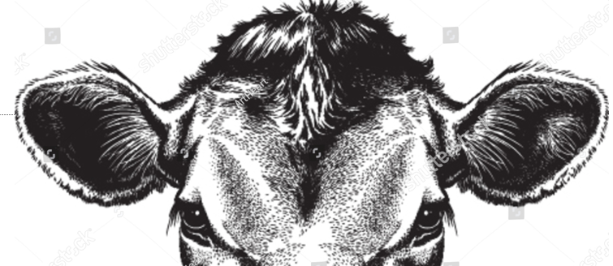
Practice tagging.
Enlarge diagram and print onto card or glue onto cardboard.
Using a ear tagger, tag the cow correctly

Slide 12
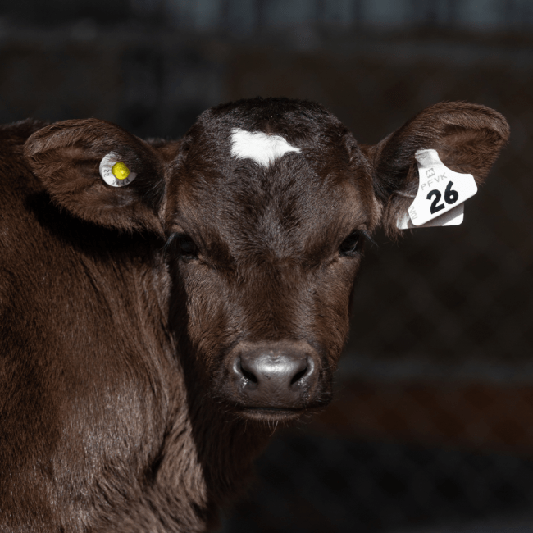
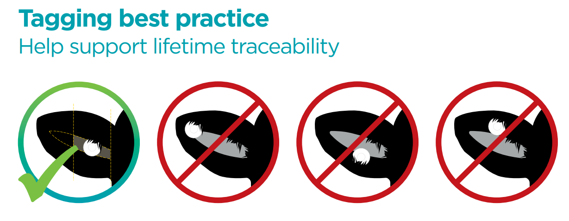

Slide 13
