Slide 1
What is NAIT?
National Animal and Identification Tracing

Slide 2
The National Animal Identification and Tracing (NAIT) scheme links people, property and livestock in New Zealand. Under the scheme, cattle and deer are traced using NAIT approved radio frequency identification device (RFID) ear tags. Once tagged, these animals are registered in a national database and the details recorded include:
  The animal's location
  Movements in the animal's life, and
  Contact details for the person in charge of that animal.
This provides traceability for individual animals, to enhance New Zealand's ability to respond quickly if there is a biosecurity incursion such as a disease outbreak.

Slide 3
3 REASONS WHY THE NEED FOR Nait has arisen
1. Improving consumer confidence
2. Improving disease management
3. Improving food traceability

Slide 4
1. Improving consumer confidence:
There is a growing expectation internationally from importing countries, corporations and consumers for better information about the source of food products.
A traceability system is vital in retaining access to international markets for our exports.
It also allows us to get back to business sooner if there is a biosecurity incursion or food safety concern in the future.

Slide 5
2. Improving disease management:
New Zealand's primary industries are a key element to our economic success.
Cattle (including dairy), deer and sheep account for more than $12 billion in exports every year. Existing disease in New Zealand, such as bovine tuberculosis (TB) can benefit from a traceability scheme.
We can use the information collected to trace back to the originating source and implement testing regimes.
Risk of new exotic disease incursions is increasing as the volume of trade and tourists increase. Overseas countries are demanding better proof of freedom from disease, using evidence based programmes.

Slide 6
3. Improving food traceability:
There is a need to provide evidence of trace back to source, if a food safety risk or animal disease risk is identified.

Slide 7
Tag technology
Low frequency technology is used for NAIT RFID tags (FDX and HDX tags). This is because it is currently the only proven and commercially available RFID technology for animal identification.
There is no proven range of ultra high frequency (UHF) animal tags available locally or internationally. However, the NAIT system is designed to accommodate UHF technology, and would be able to take UHF data in the future.
Any introduction of UHF technology for NAIT tags would follow a consultation period to assess costs and benefits.

Slide 8
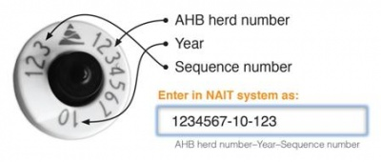

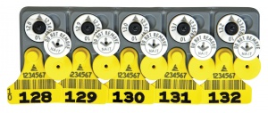
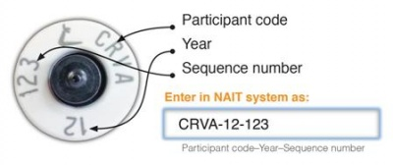
Birth Tags and Birth Tag sets

Slide 9
Tag your animals
Cattle and deer must be tagged with NAIT approved RFID tags. These animals must be tagged within six months of birth, or before they move off farm - whichever is soonest.
NAIT tags are the only tags required by law. Animal health board (AHB) approved tags are no longer compulsory, but you should not remove these tags from existing animals.
Animals only need one NAIT tag each. You don't need to tag an animal with your own NAIT tag if it already has one.
NAIT tags can only be removed with permission from NAIT.
NAIT tags cannot be reused for any reason, as each tag has a unique number that identifies a single animal.

Slide 10
Radio Frequency Identification Device (RFID) technology benefits
RFID technology enables many on farm benefits, including:
automated animal drafting, and recording of individual animal details, such as:
    Weight
    Treatments
    Velvet yield
    Breeding information, and
    Milk production.
Achieving on farm productivity gains through RFID technology requires further investment, such as RFID reading equipment and computer software suitable for your production type and business needs. This is not mandatory under the NAIT scheme.

