Slide 1


Slide 2
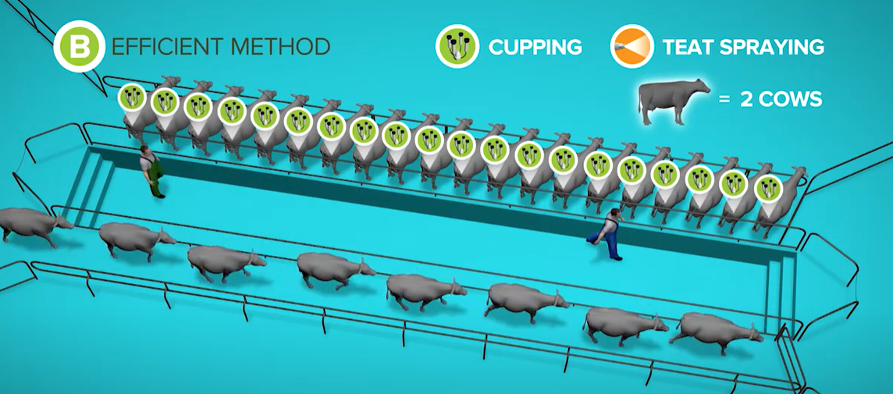
Dairy Sheds

Slide 3
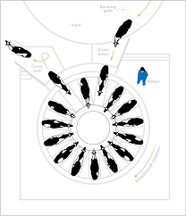
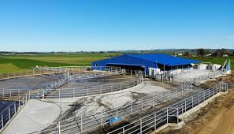
Rotary Shed

Slide 4
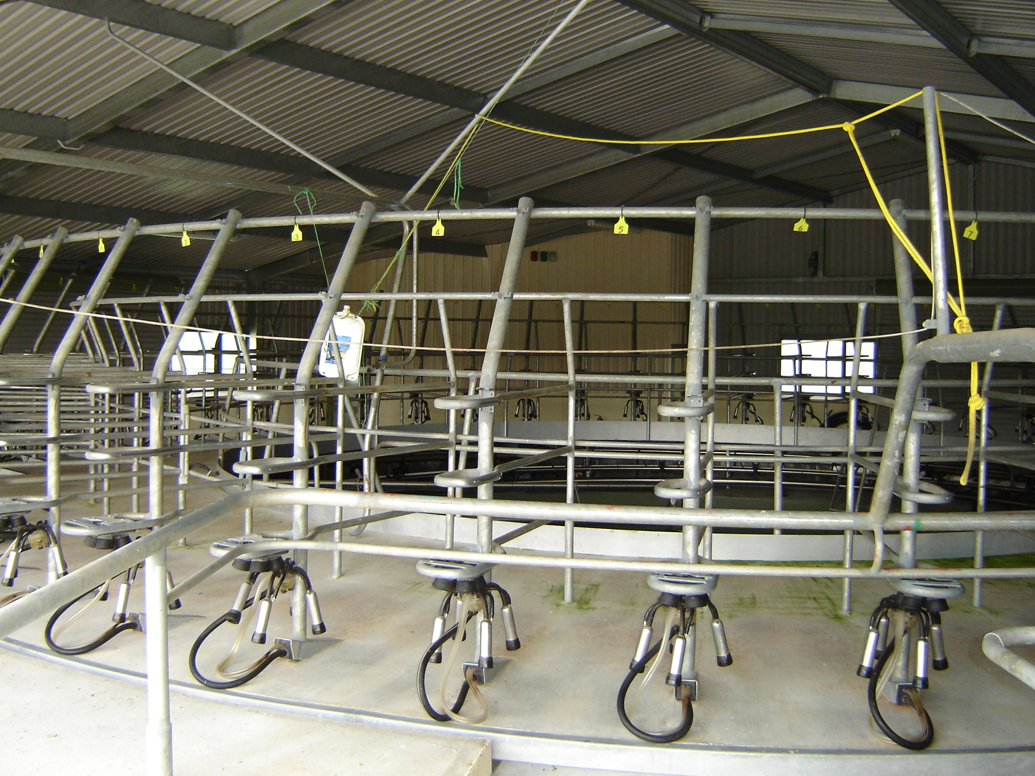
Rotary Platform
Rotary milking systems have become popular due to increased milking efficiency in larger herds and are now used by around 30% of dairy farms in New Zealand.

Slide 5
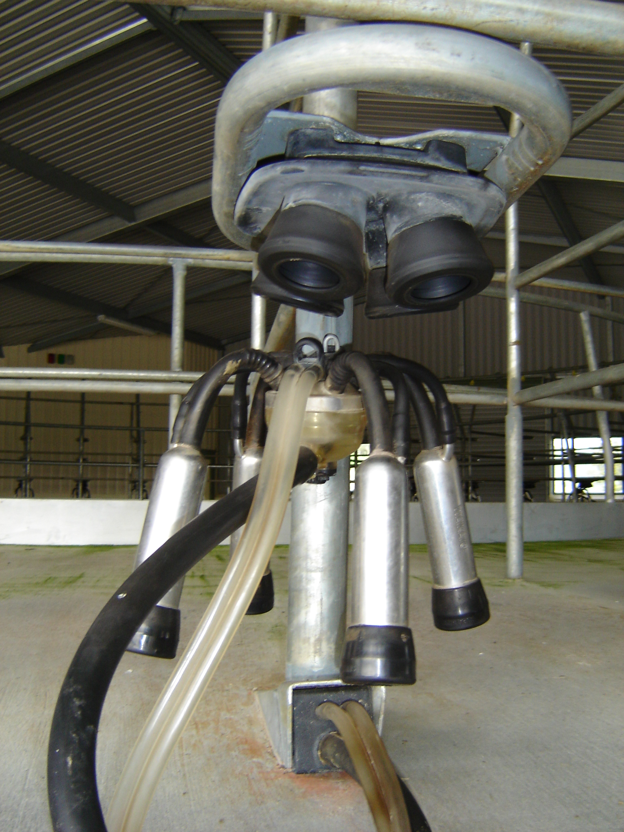
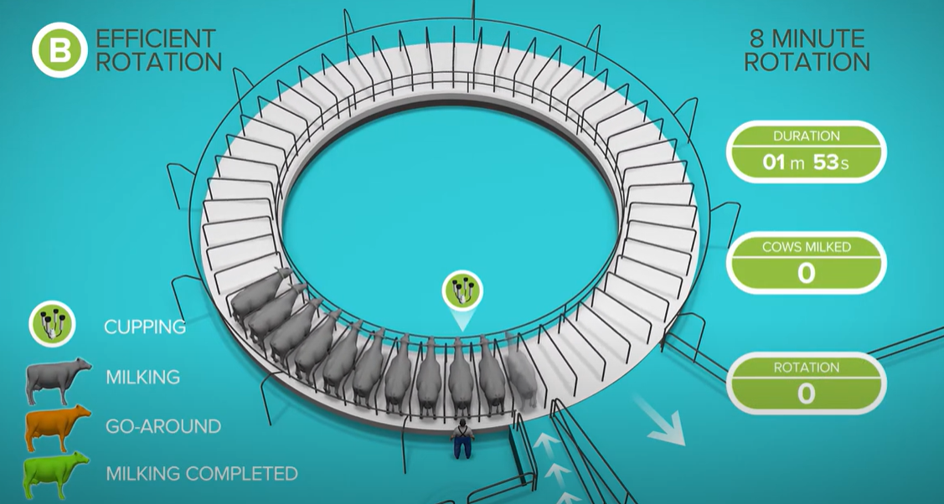
Watch Rotary:- efficient milking routine
Cluster

Slide 6
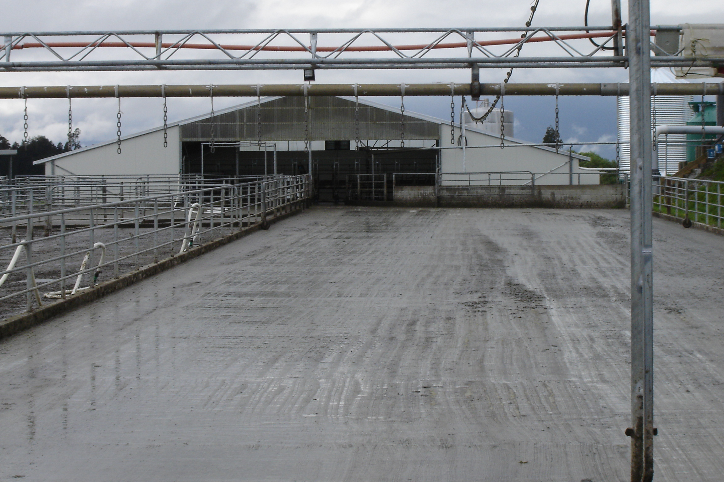
Backing gate

Slide 7
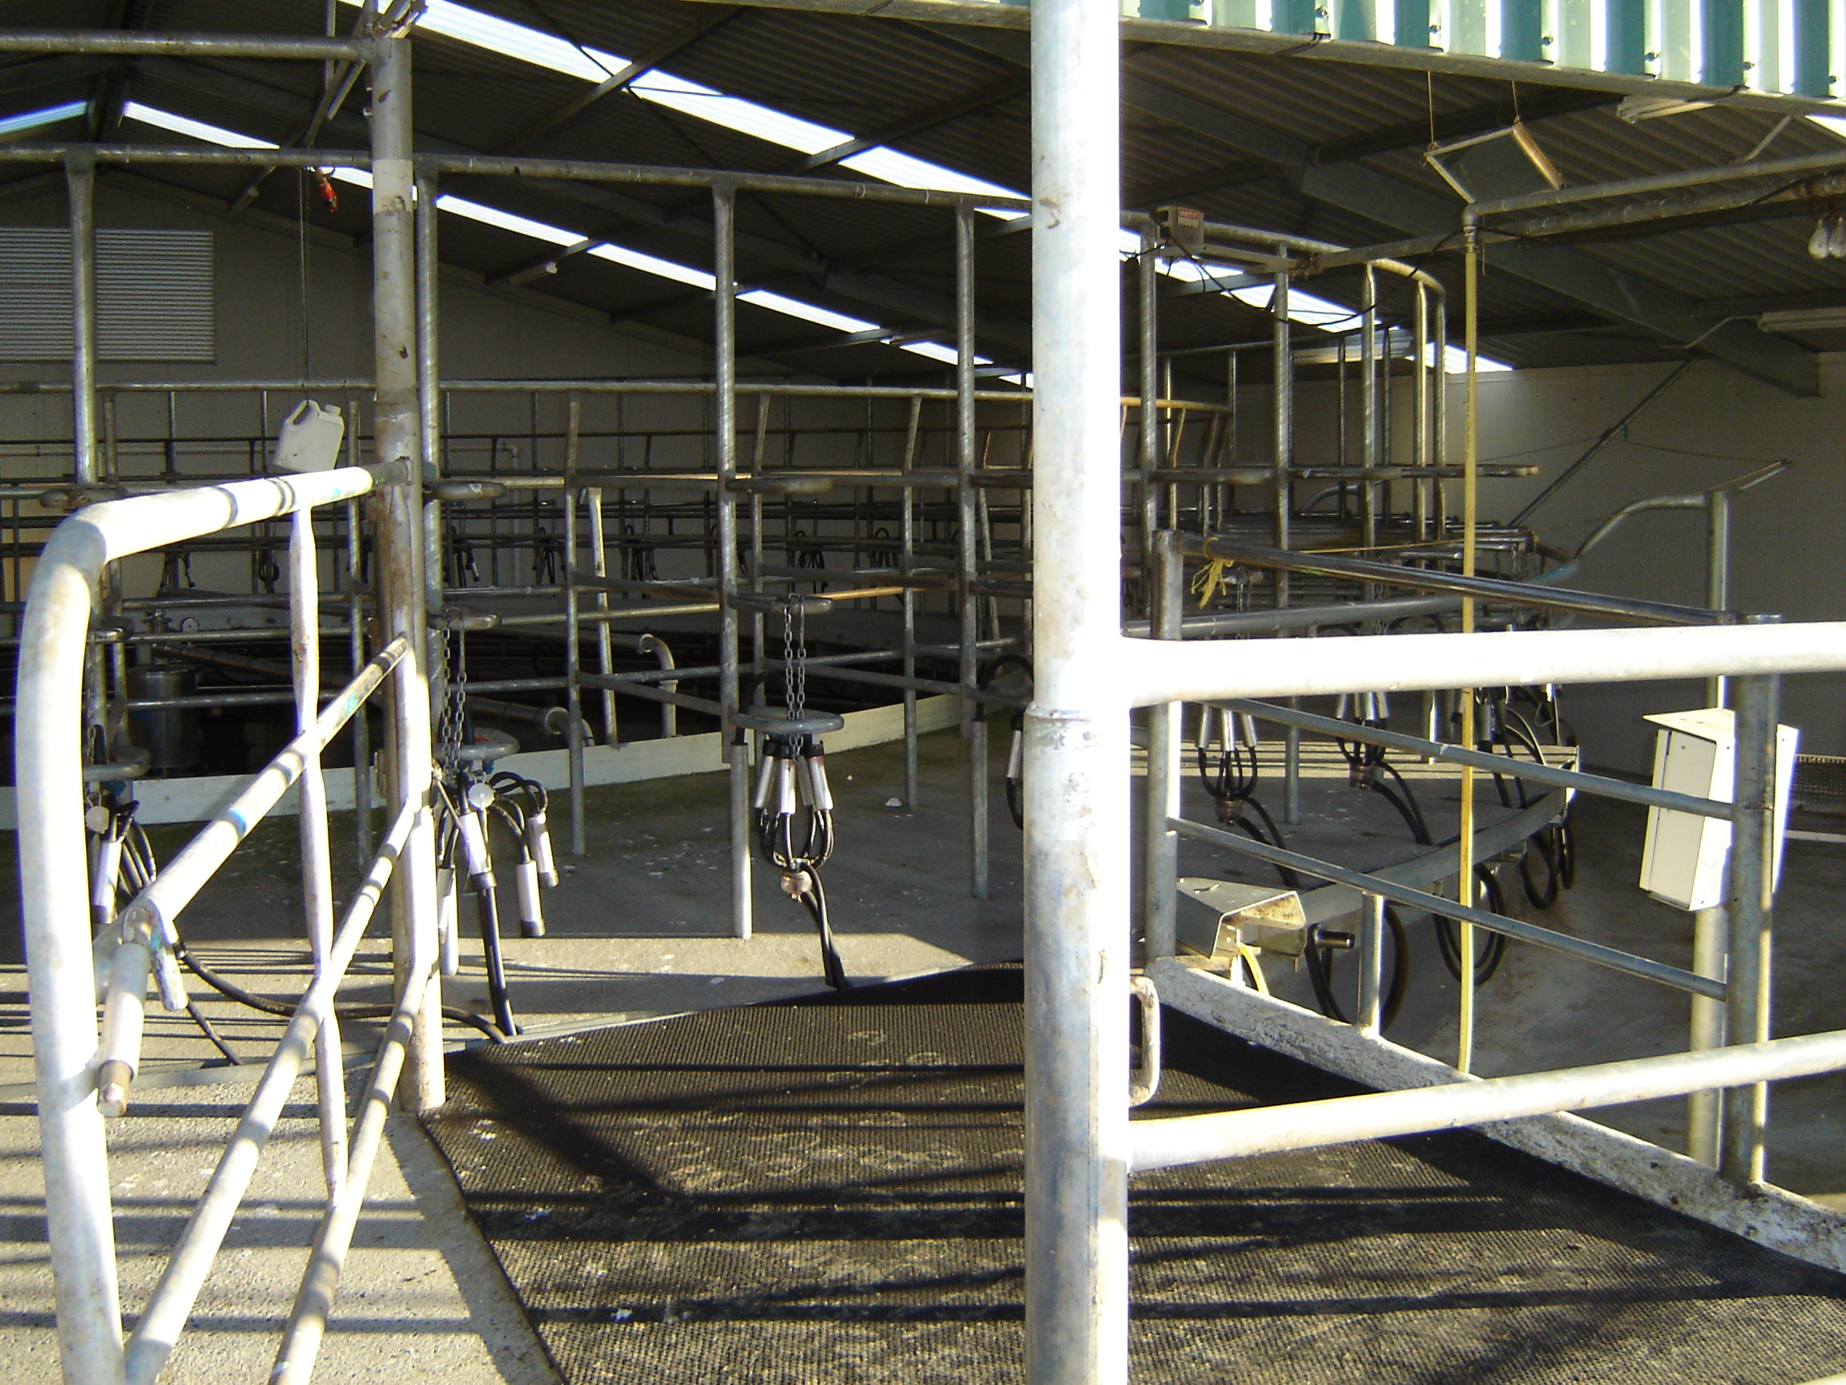
Mats to protect cow's feet as they walk off the rotary

Slide 8
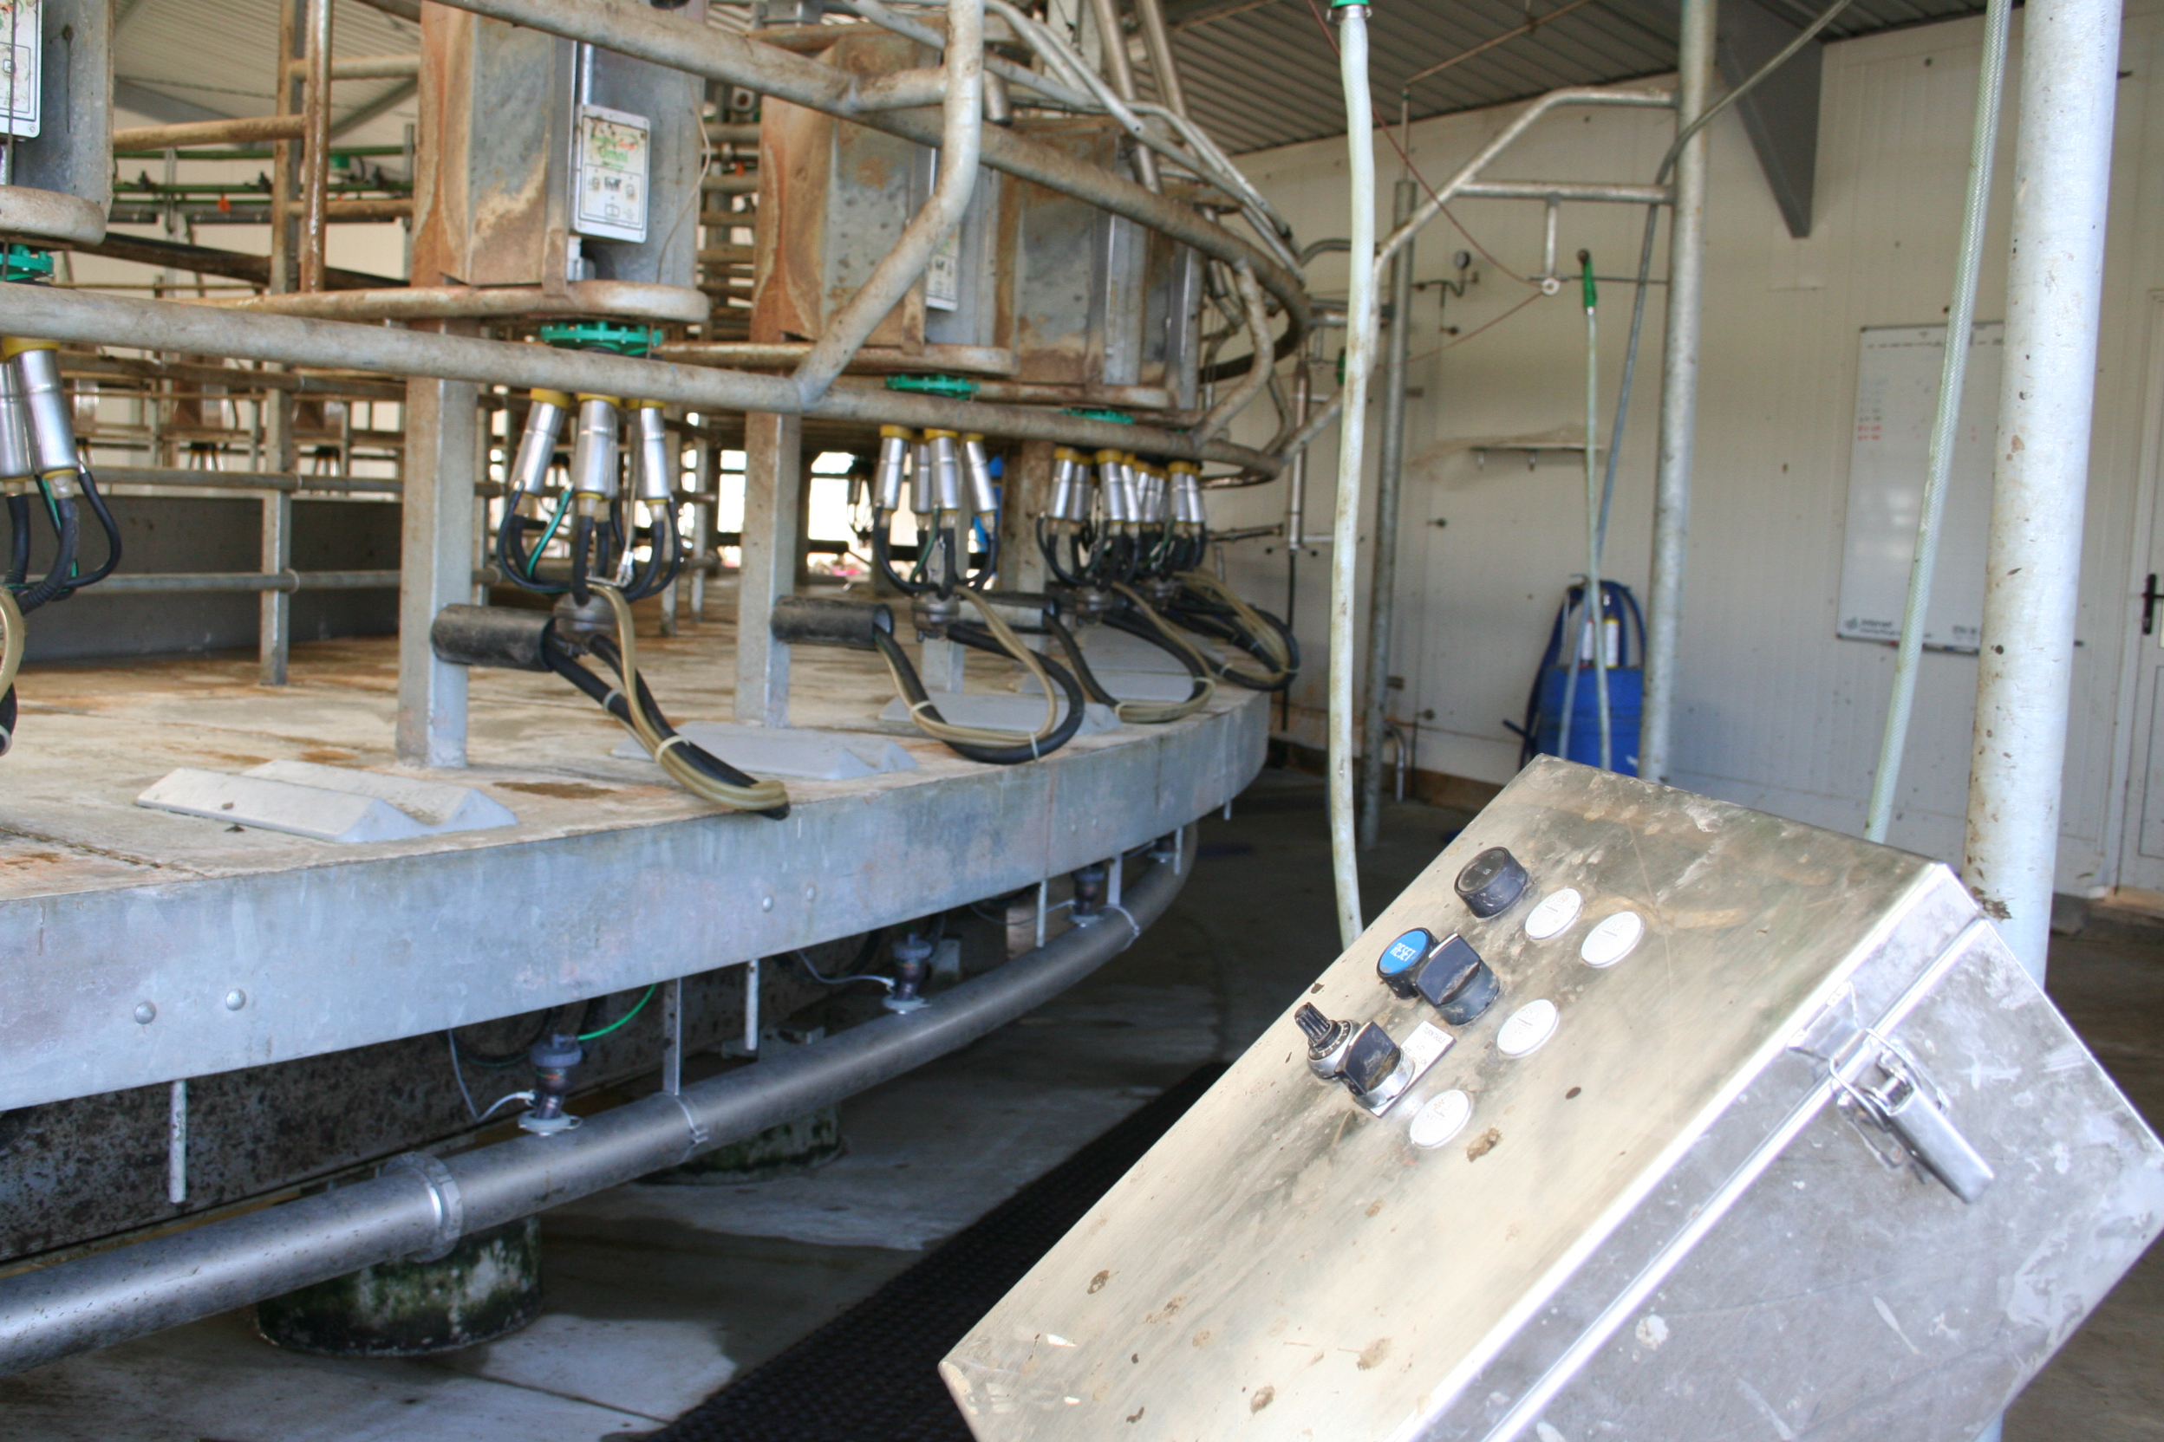
Control Panel

Slide 9
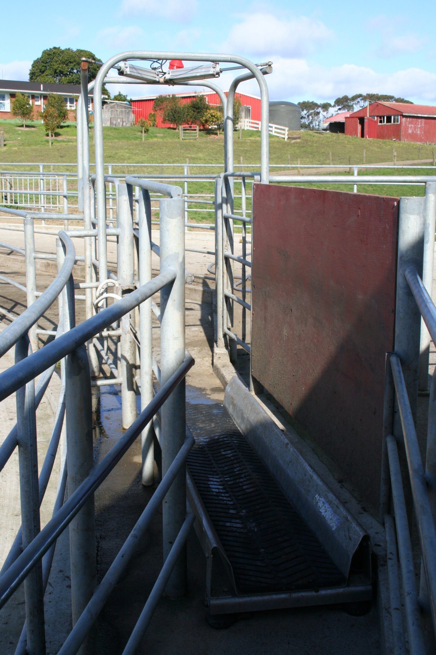
Drafting gate

Slide 10
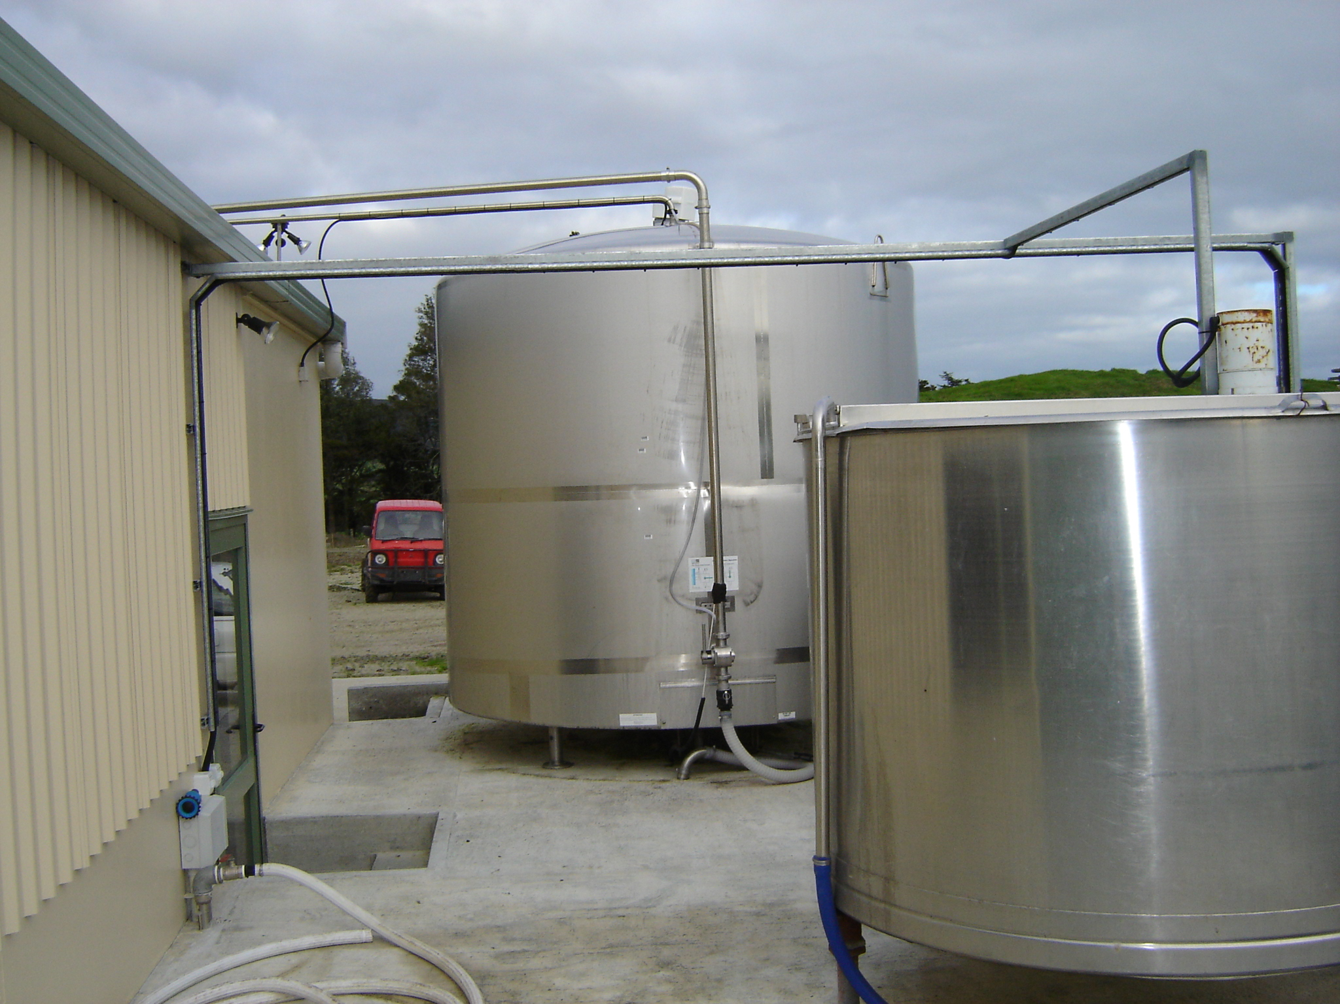
Vats

Slide 11
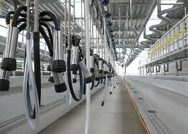
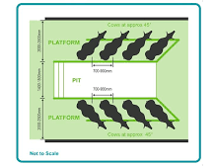
Herringbone Shed

Slide 12
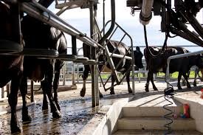
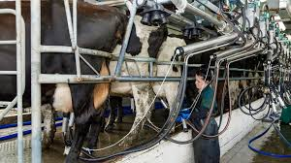
Watch -Herringbone efficient routine
The swing-over herringbone is the most common dairy type in New Zealand, used on 69% of dairy farms.

Slide 13
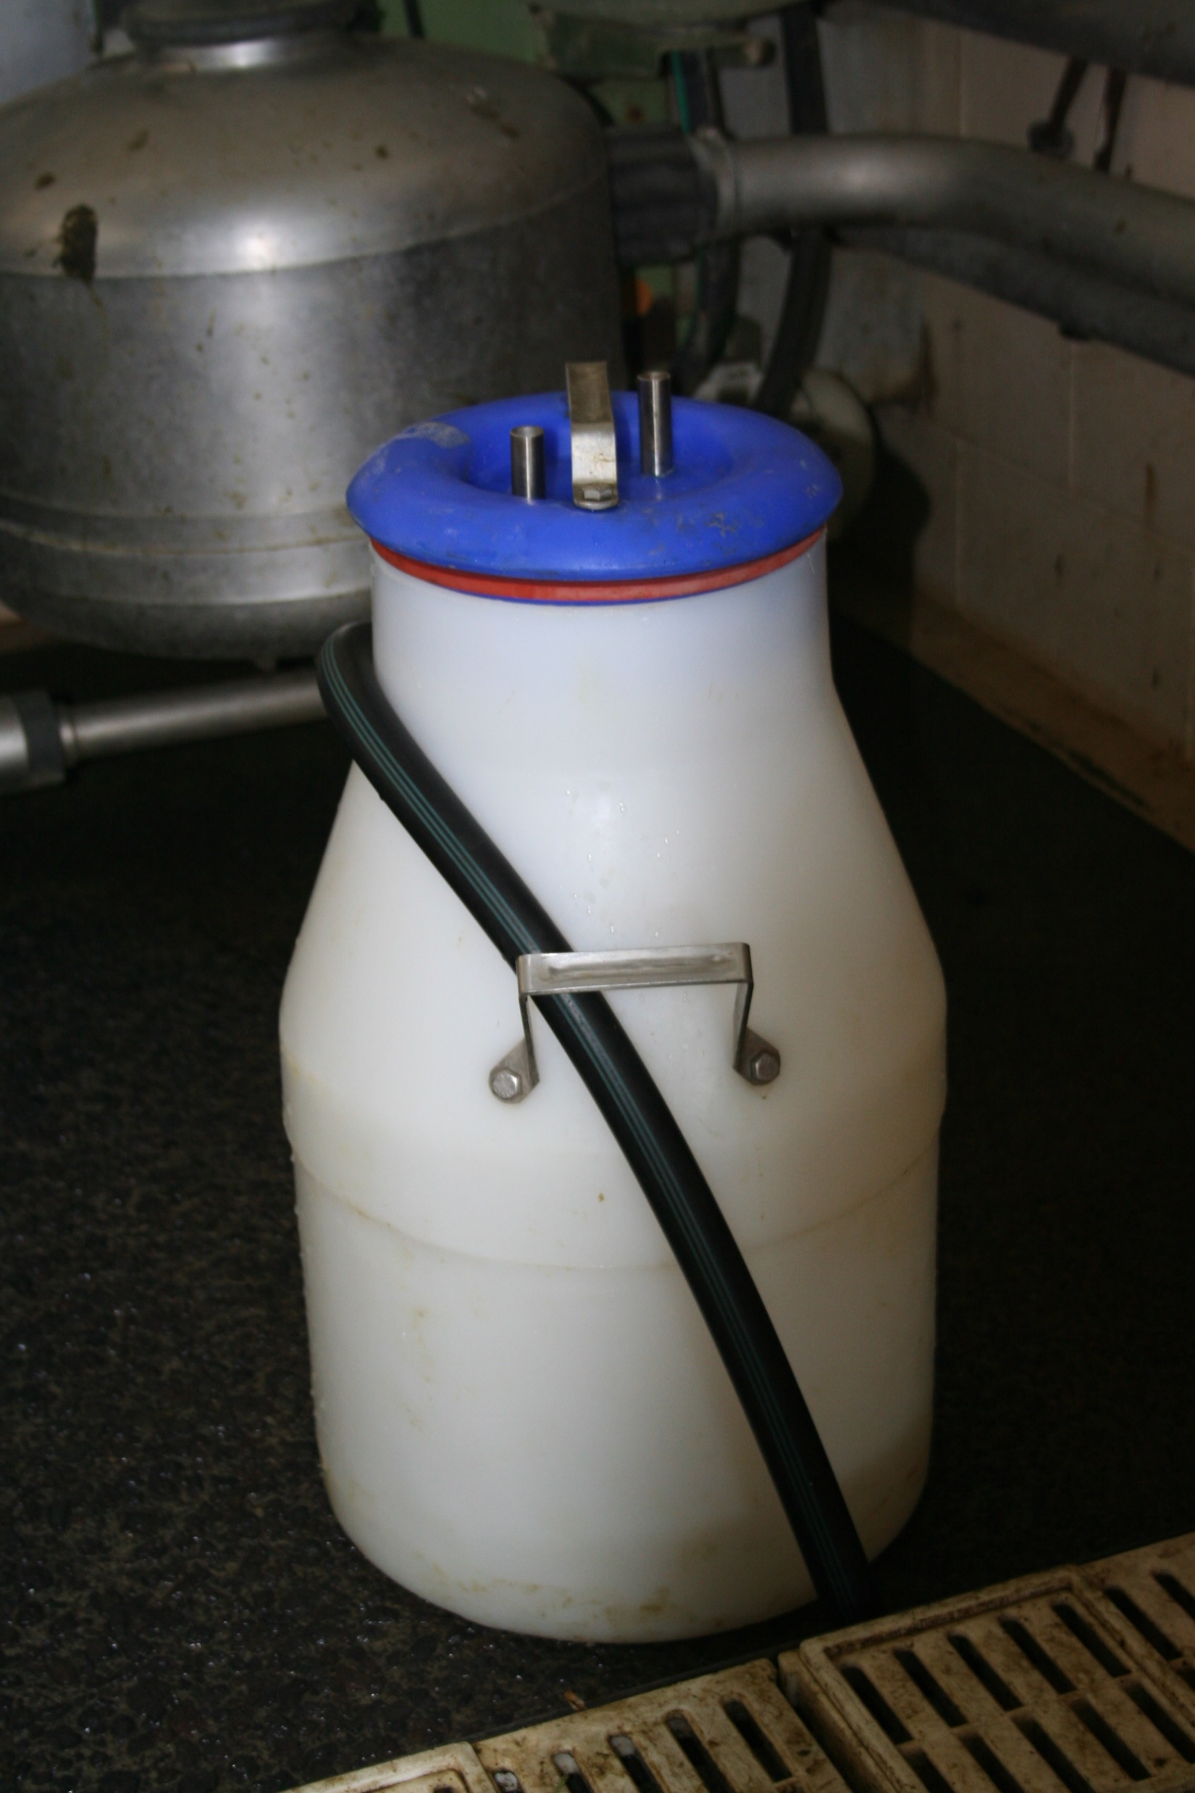
Test bucket
Test bucket connect between milking cluster and milk pipeline.
A Test Bucket intercepts the milk from cow’s whose milk cannot go into the vat for some reason e.g. she has been given antibiotics. This milk is either feed to other animals or dumped.

Slide 14
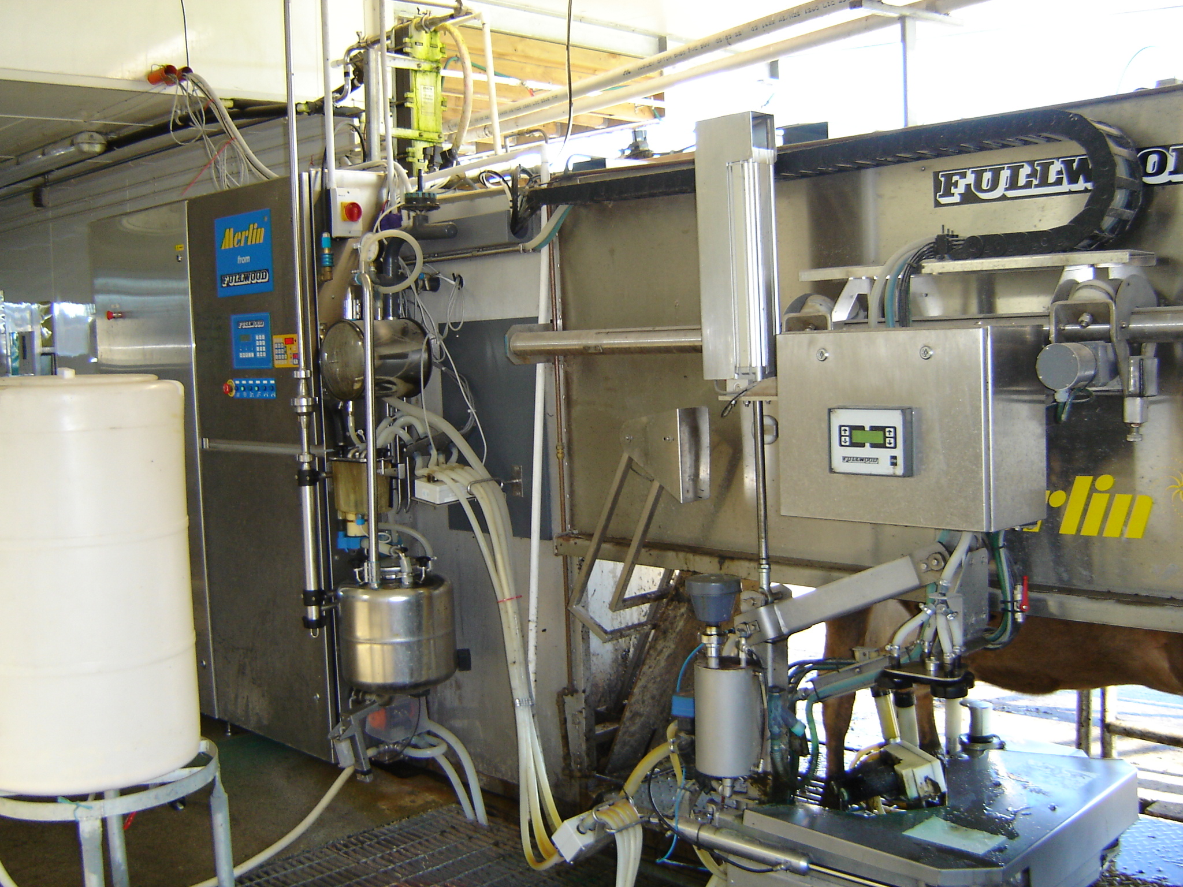
Robotic Milking
Robotic milking systems also known as an Automatic Milking System (AMS) lets cows choose when to be milked by a robotic system without human help. It has a robotic arm and an identification system. When a cow enters, it's checked if she's due for milking. If yes, the machine milks her, collects data and sends the milk to tanks.

Slide 15
Watch
Pasture based Automatic Milking System
Lely Astronaut A5- Rob & Moira Anstis- NZ

