Slide 1


Slide 2
Dairy Facts and Breeds

Slide 3
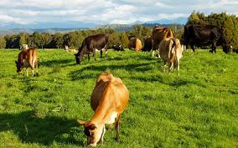
Dairy Facts 2023/24
20.5 billion litres of milk
4.7 million cows
10,485 herds
Average herd size -448
Average litres per cow -4369
Average kg milkfat per cow-225
Average kg protein per cow-179
Average milksolids per cow-400
There are 28 milk processing sties across the country

Slide 4
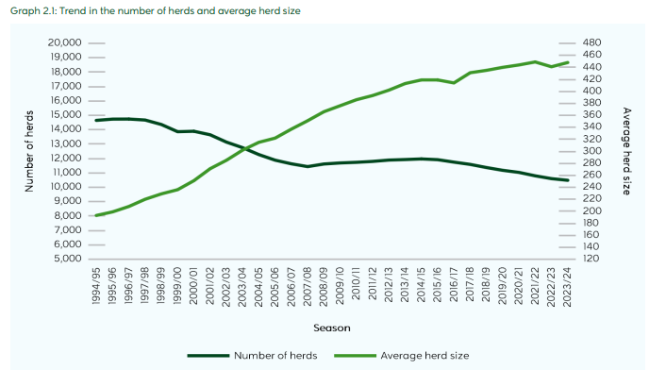
Trends in number of herds and herd size
Notes:
Total cows have fluctuated slightly over the last 10 years, peaking at 5.02 million in 2014/15 before dropping to 4.70 million in 2023/24 (Table 2.2). The average farm size (effective hectares) continued to rise, from 151 in 2017/18 to 162 in 2023/24. Total effective hectares (milking platform with support block excluded) peaked and remained stable between 2014/15 and 2018/19, before decreasing from 1.74 million hectares in 2018/19 to 1.70 million in 2023/24.

Slide 5
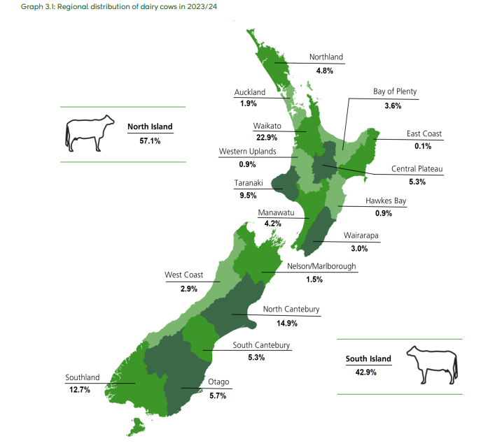
Regional Statistics
57 % of dairy herds are located in the North Island.
43 % of dairy cows are located in the South Island.

Slide 6
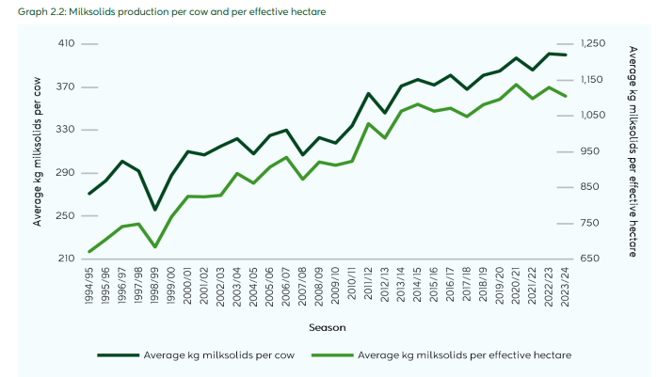
Production per cow and per hectare
Notes:
Average milksolids production per cow varies significantly from farm to farm. This variation is determined by factors such as temperature, rainfall, soil fertility (which influences pasture growth), stocking rate, herd genetic merit, supplementary feed levels, and farm management practices.

Slide 7
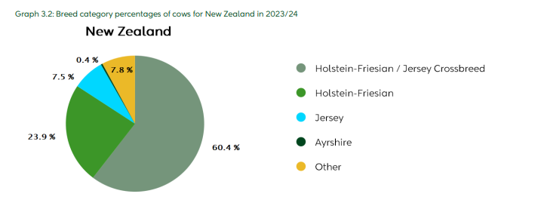
Dairy breeds

Slide 8
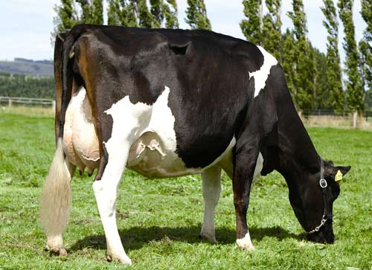
Friesian
23.9 % of New Zealand dairy cows
Milk produced per year (litres) 5,250
Milkfat (kg) 236
Protein (kg) 198
Milksolids (kg) 435
Milkfat (%) 4.5
Protein (%) 3.8
Milksolids (%) 8.4
Average liveweight (kg) 537

Slide 9
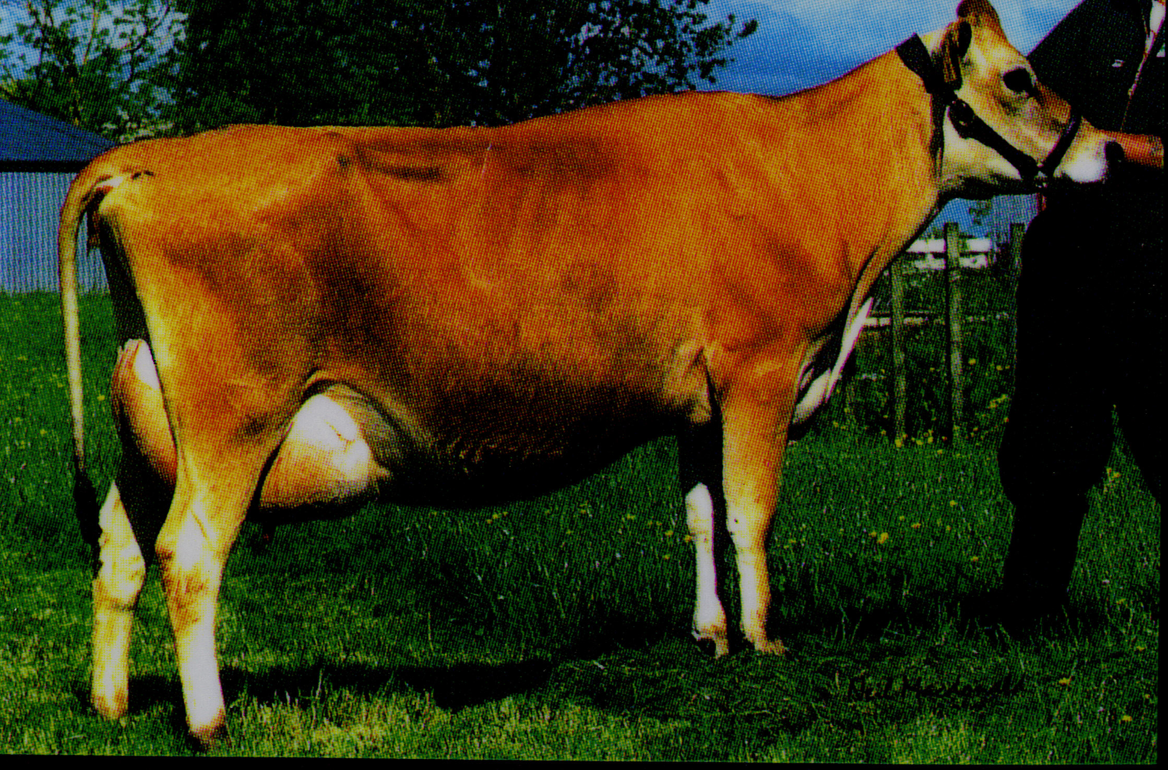
Jersey
7.5 % of New Zealand dairy cows
Milk produced per year (litres) 3,669
Milkfat (kg) 209
Protein (kg) 156
Milksolids (kg) 365
Milkfat (%) 5.7
Protein (%) 4.3
Milksolids (%) 9.98
Average liveweight(kg) 414

Slide 10
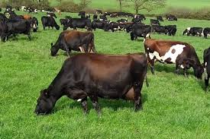
Holstein-Friesian/Jersey crossbreed- Kiwicross
60.4 % of New Zealand dairy cows
Milk produced per year (litres) 4,765
Milkfat (kg) 238
Protein (kg) 191
Milksolids (kg) 430
Milkfat (%) 5.1
Protein (%) 4
Milksolids (%) 9.08
Average liveweight (kg) 492

Slide 11
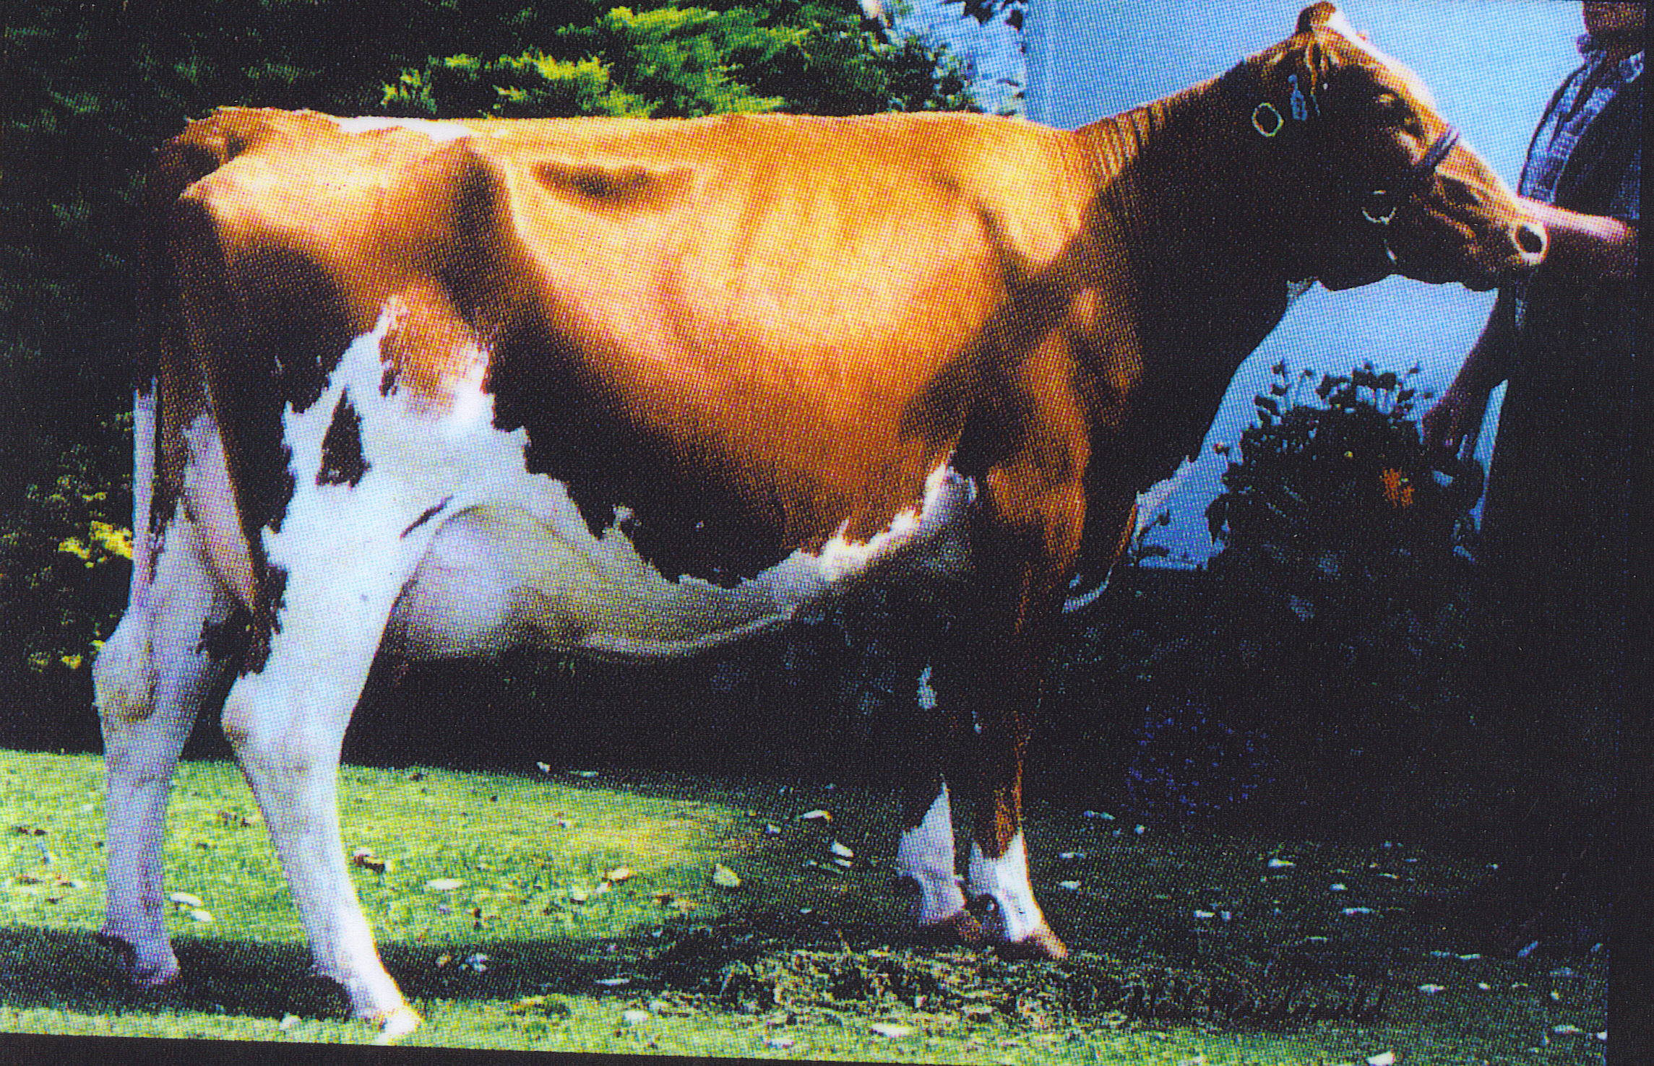
Ayrshire
0.4 % of New Zealand dairy cows
Milk produced per year (litres) 4,766
Milkfat (kg) 209
Protein (kg) 171
Milksolids (kg) 381
Milkfat (%) 4.4
Protein (%) 3.6
Milksolids (%) 8
Average liveweight (kg) 490

Slide 12
Summary
_______of dairy herds are located in the North Island and _____ are located in the South Island.
Holstein-Friesian cows had the ________ production levels in terms of litres, protein, and milksolids (kg).
Jersey cows achieved the _________ percentages for milkfat, protein, and milksolids.
Holstein-Friesian/Jersey crossbred cows produced the __________ milkfat (kg) production.
The three most popular dairy breeds in New Zealand are ____________, ___________________ and ___________. The largest and heaviest breed is the _________________. The ____________ is the smallest breed. The most common breed is the _____________.
Notes:
• Holstein-Friesian cows had the highest production levels in terms of litres, protein, and milksolids (kg).
• Jersey cows achieved the highest percentages for milkfat, protein, and milksolids.
• Holstein-Friesian/Jersey crossbred cows produced highest milkfat (kg) production.

Slide 13
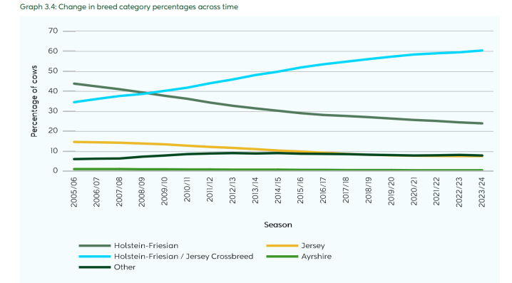
Trends in dairy breeds
Notes:
Over the years, the percentage of Holstein-Friesian and Jersey cows has consistently decreased (Graph 3.4). In contrast, the proportion of Holstein-Friesian/Jersey Crossbreed cows has steadily increased, rising from 34.5% in 2005/06 to 60.4% in 2023/24, indicating a growing preference for crossbreeding over purebred Holstein-Friesian or Jersey cows

Slide 14
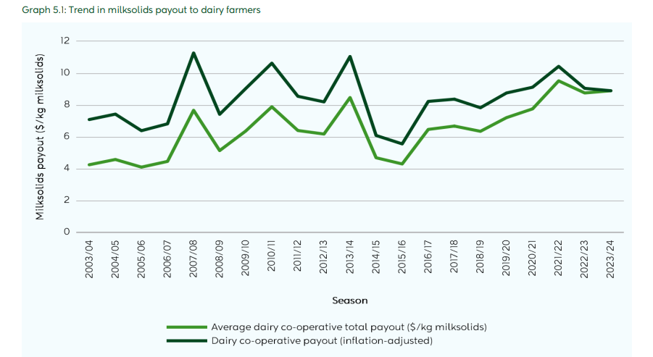
Trend in milksolids payout to dairy farmers

Slide 15
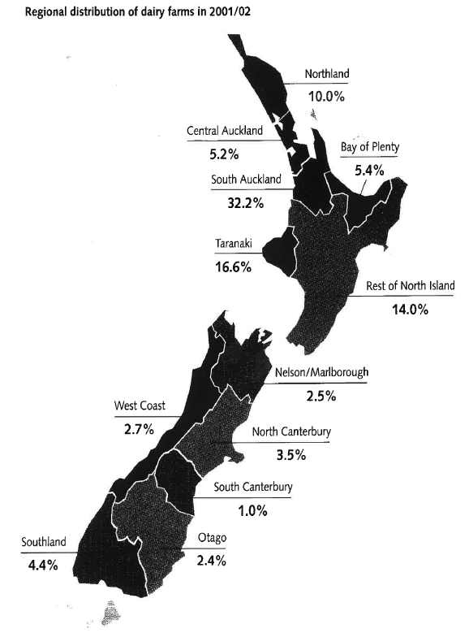
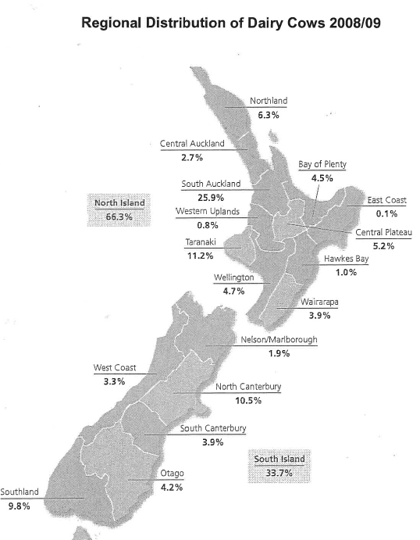
Challenge- Give reasons why the regional distribution of dairy farms has changed between 2001 and 2023

Slide 16
Operating structures on dairy farms in New Zealand
The main operating structures found on New Zealand dairy farms are owner operator, sharemilker and contract milker.
Owner operators is the biggest group 55% of all herds. These farmers who own and operate their own farms, or who employ a manager to operate the farm for a fixed wage.
Contract milkers (15% of herds) are contracted to milk a herd at a set price per kilogram of milksolids produced. The rate is set in part according to the amount of farm work done.
Sharemilking has traditionally been the first step to farm ownership and is the second largest operating structure, accounting for 29% of herds across all types of sharemilkers.
  Herd-owning sharemilkers (also called 50/50 sharemilkers) own the herd and generally any equipment (other than the milking plant) needed to farm the property.
  The variable-order sharemilking agreement involves the farm owner retaining ownership of the herd and bearing more of the farm costs, such as animal health and breeding. The amount of farm work required by the sharemilker is determined by the individual agreement, with responsibility ranging from herd management only to carrying out all farm work.

