Slide 2
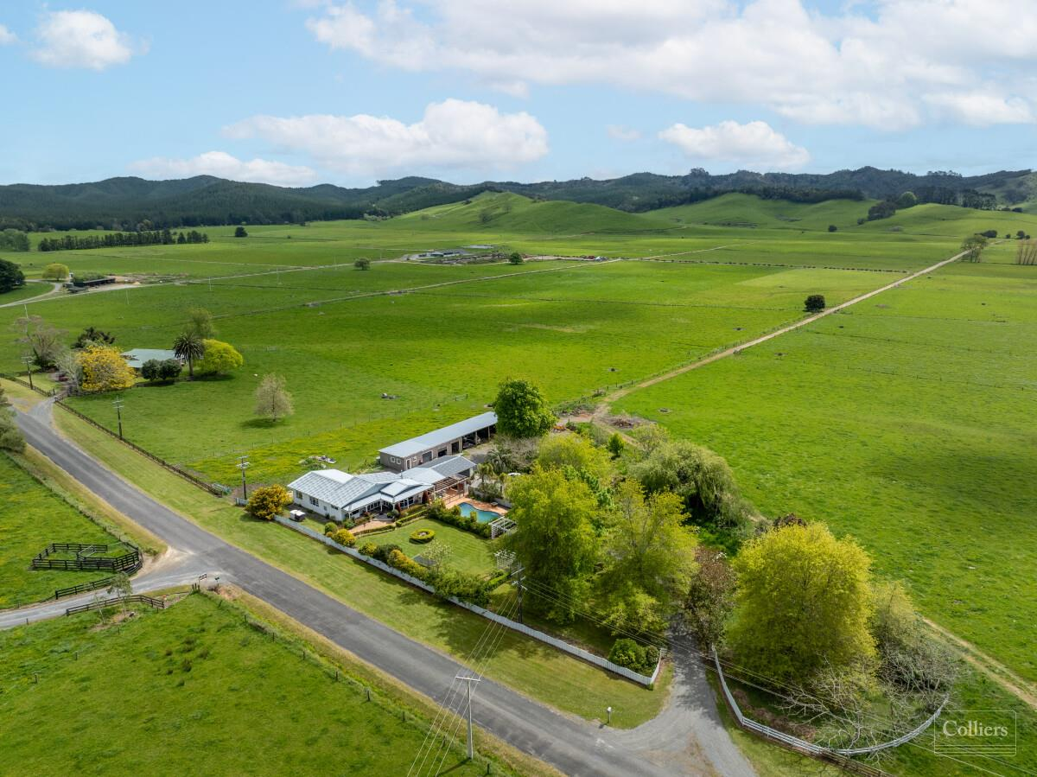
History of New Zealand Dairy Industry

Slide 3
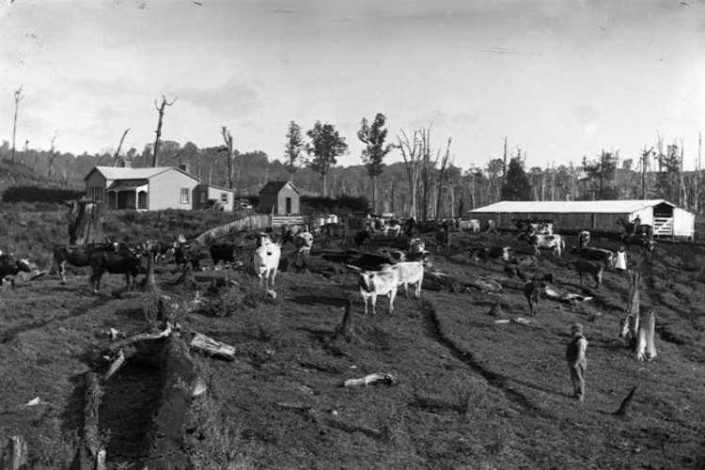
A timeline of dairy in New Zealand
New Zealand climate and terrain make it near perfect for agricultural production. Therefore, our rich history of dairying goes right back to some of the earliest European settlers.

Slide 4
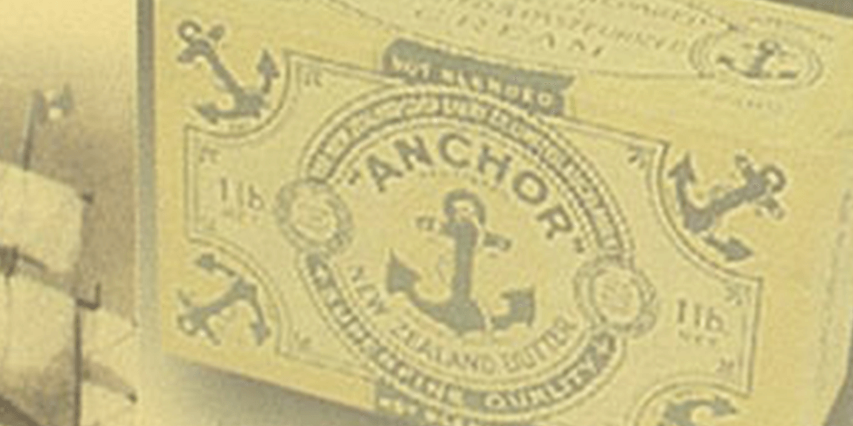
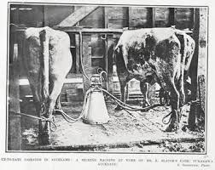
1800’S
1814, Samuel Marsden brings the first cattle, shorthorns (a bull and two heifers) to NZ.
1846, our first dairy product (cheese) is exported.
1871, the first dairy cooperative is formed in Otago.
1882, refrigerated shipping begins. This enabled the export of butter and cheese in larger quantities. This lead to big increases in the number of dairy cattle
1884, the first Holstein Friesian cow is imported to the South Island.
1886, the Anchor brand is created.
1893, the introduction of electricity and a Scottish mechanical milking machine leads to machine milking, which becomes more common in the early 1900s.

Slide 5
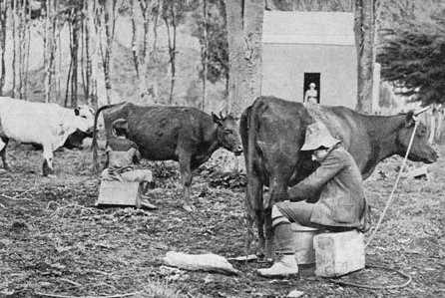
1814 Shorthorns introduced by Samuel Marsden

Slide 6
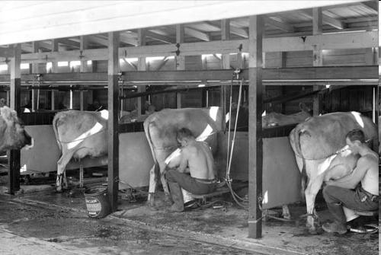
Early Milking Shed Improved Milk Shed-Hygiene conditions

Slide 7
1848-Aryshire introduced to New Zealand

Slide 8
1862- Jersey breed introduced to New Zealand

Slide 9
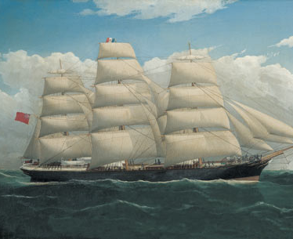
1882 First Refridgerate Ship Dunedin

Slide 10
1886 - Pasteurisation

Slide 11
1890’s-Creamery System-Tuakau Creamery

Slide 12
1884 to 1892 Transport to Dairy Factories

Slide 13
Pigs Feed Whey

Slide 14
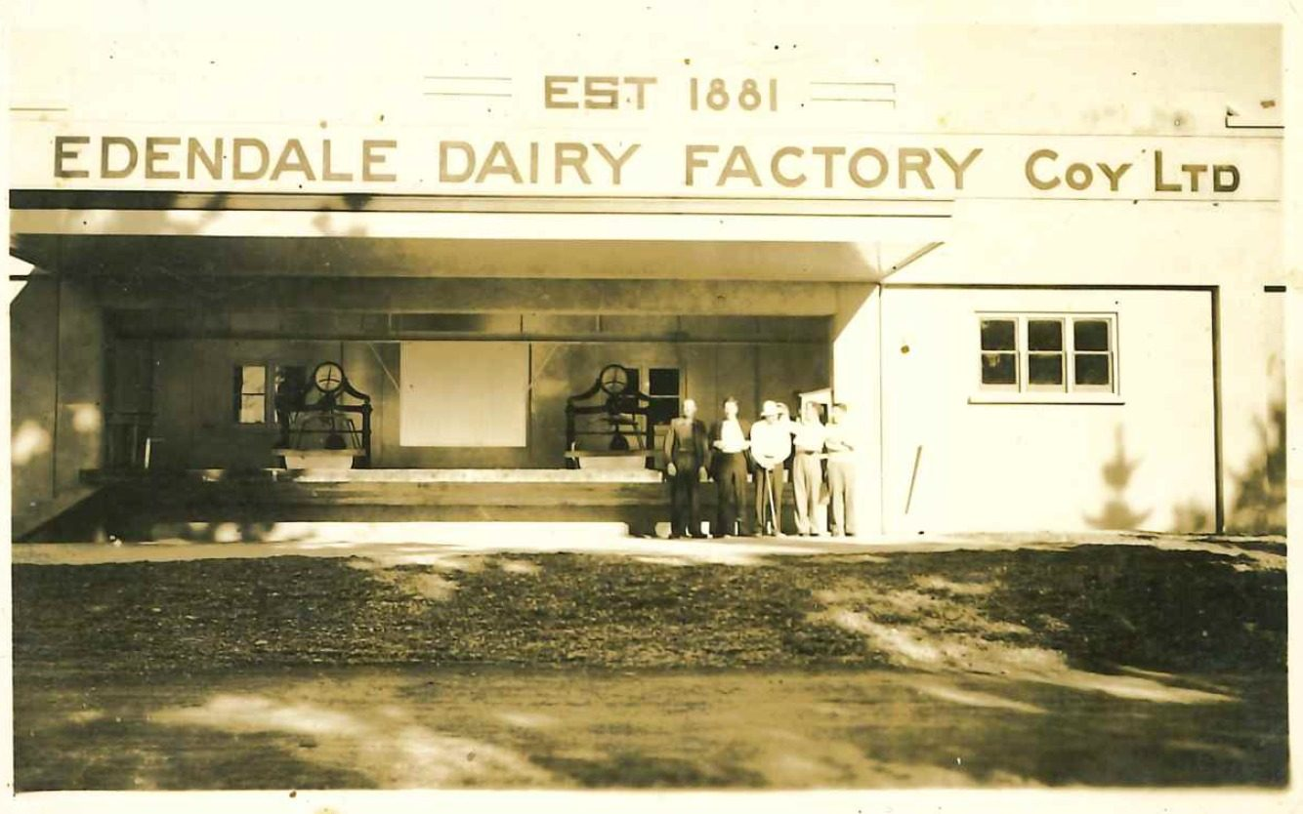
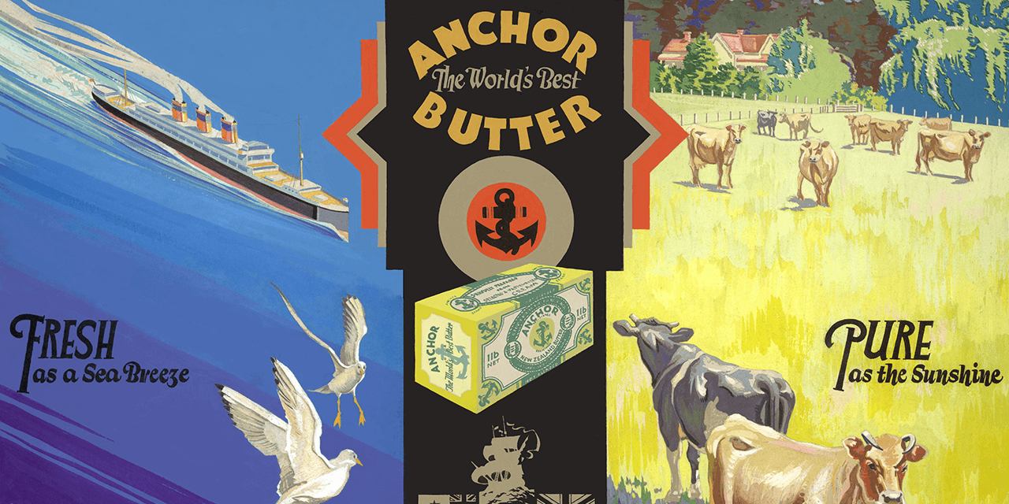
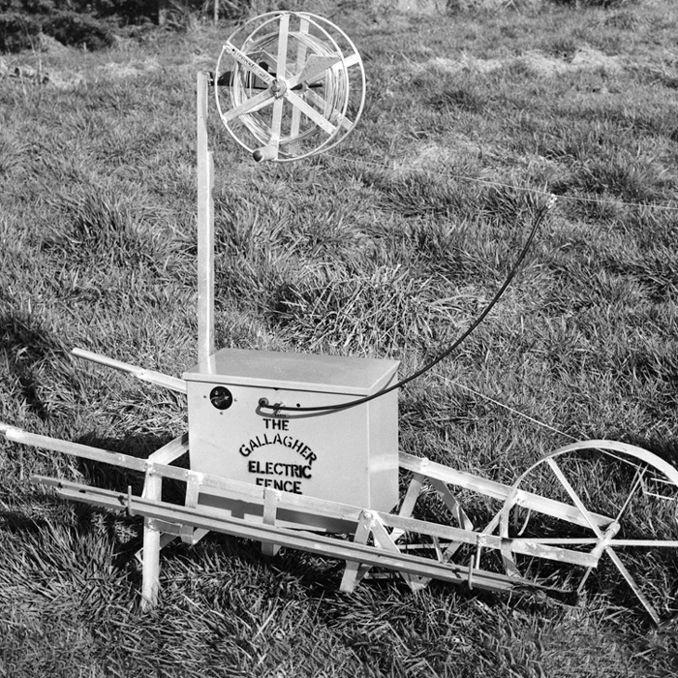
1900-1940
1905, The first systematic herd testing was started.
1913, NZ’s first lactose factory is built at Edendale, Southland.
1915, the government begins a programme under its Discharged Soldiers Settlement Act to provide potential farming land for 9,500 soldiers returning from WW1.
1918, 7600 milking machines have been installed around the country by the end of WW1. And, the New Zealand Dairy Control Board is established to market our dairy products overseas.
1921, The first phosphate fertiliser supplies came to NZ. The development of phosphate fertilisers and aerial topdressing meant pastures improved so that more stock could be carried. Again this lead to further increases in the number of dairy cattle.
1927, Dairy Research Institute is established as NZ’s first specialised research institution.
1930, there are now more than 400 cooperative dairy companies.
1937/38, Bill Gallagher Senior makes his first electric fence and farmers start using them on their farms.

Slide 15
1930’s and 1940’s Cream cans were collected each day by a cream truck

Slide 16
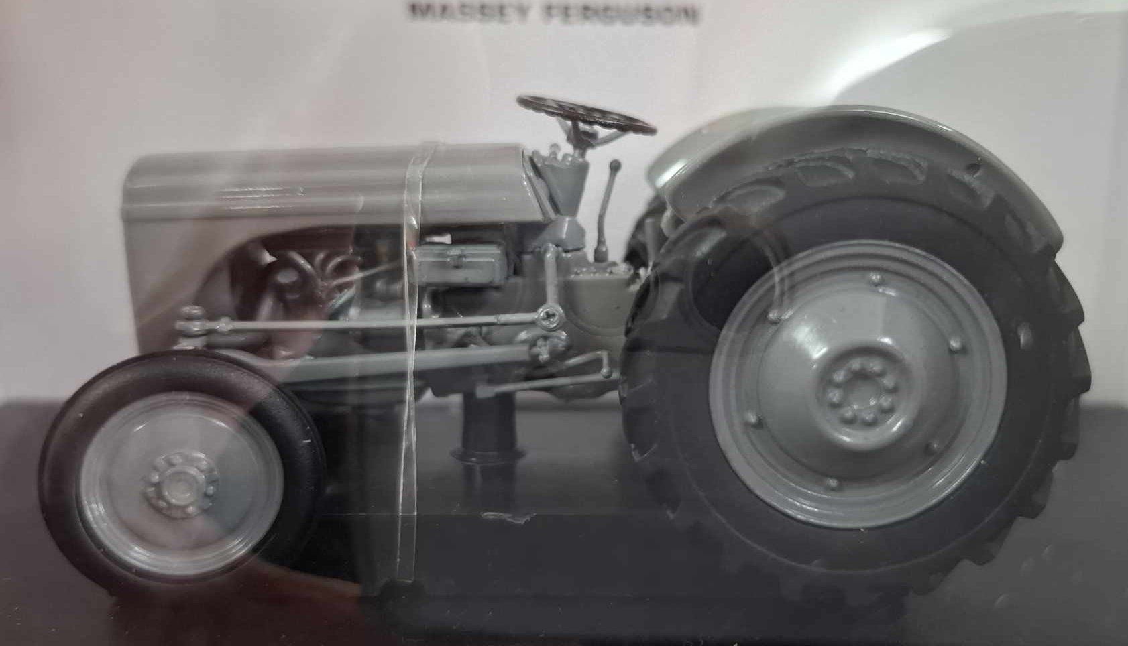
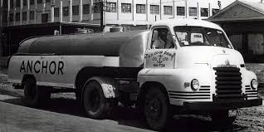
1940-1960
1940s, during this decade the number of New Zealand’s farms using milking machines is over 50%.
1945, NZ has a cow population of 1.7million, 40,000 farmers and 409 dairy factories.
1948, many aspects of farming are revolutionised with the arrival of the first British-made Ferguson tractor.
1951, tanker delivery of whole milk from farms to factory begins.
1952, development of the herringbone dairy by Waikato farmer, Ron Sharp. This new design combined pit parlours with angled stalls on either side and meant twice as many cows could be milked at once.
1957, Britain agrees to allow the free entry of NZ dairy products until 1967.
1959, Jerseys made up about 80% of New Zealand's dairy cattle until the 1960's when the Friesian breed increased in popularity.

Slide 17
1950s- Herringbone Shed Invented

Slide 18
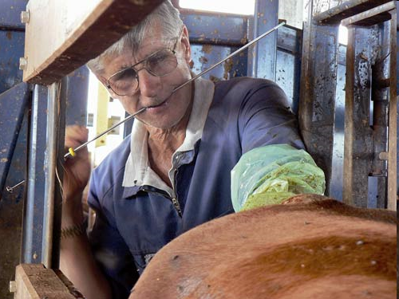
1950’s-Sire Proving Scheme and Artificial insemination

Slide 19
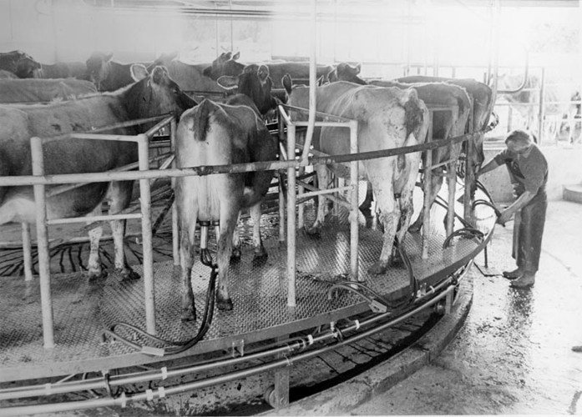
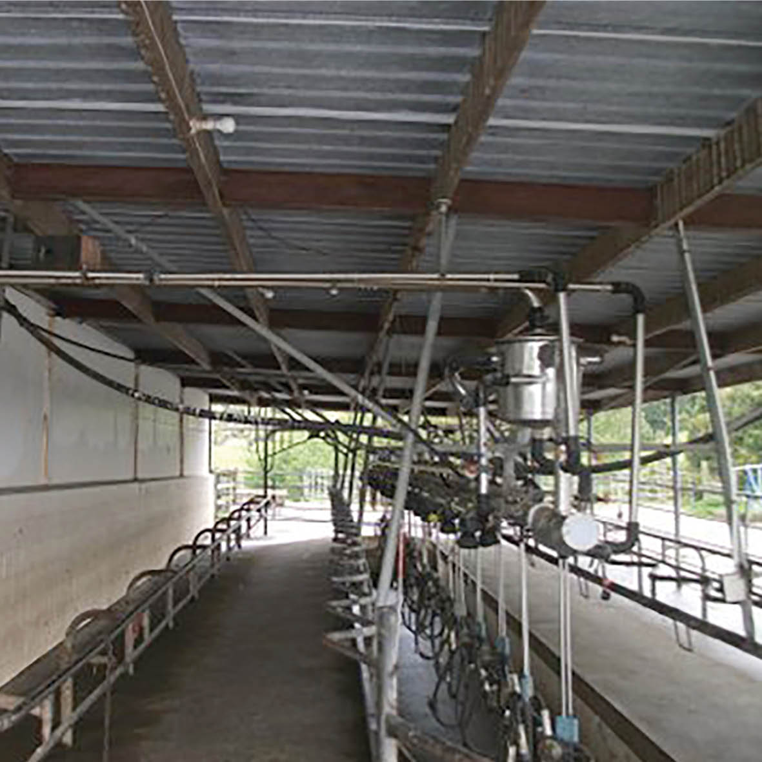
1960-1990
1960, Friesian cattle more popular than Jersey.
1961, New Zealand Dairy Board established to market dairy products.
1969, the first turnstyle dairy is developed by Merv Hicks, a Taranaki dairy farmer improving efficiency by leaps and bounds as a thousand cows could now be milked in by just two people in just a few hours.
1969, there are 2.3 million cows, 25,000 farmers, and now only 229 dairy factories.
1973, dairy exports face troubling times as the UK joins the EEC (European Economic Community).
1978, Supplementary Minimum Price scheme (SMPs) is introduced to guarantee farmers a minimum income.
1980s, during this decade the average herd size is 130 cows.
1984, Labour government begins phasing out agricultural support and subsidies (SMPs).
1985, the Ruakura milk harvester is developed. This system has many of the features we know of modern day milking.

Slide 20
1960’s Friesian became the most popular dairy breed

Slide 21
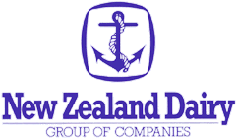
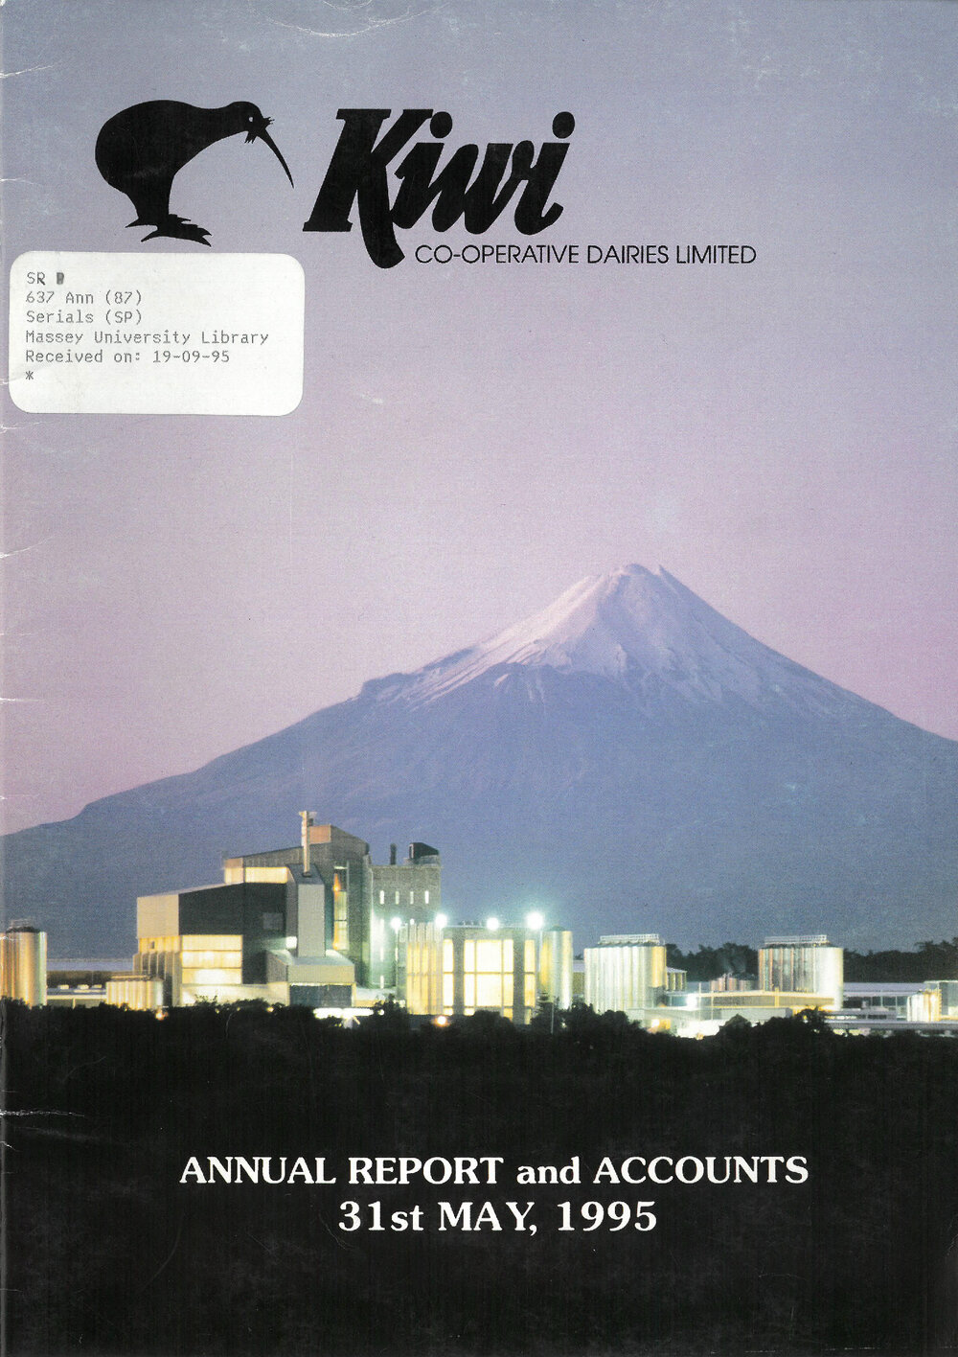
1990-2000
1990, Average farm size - 72ha and 166 cows.
1990s, at the start of this decade only 7% of dairy cows are farmed in the South Island; this has risen to 22% by 1999.
1994, the national herd is 2.7 million strong, we have 15,000 farmers and 27 factories.
1996, only 12 dairy cooperatives remain. The Dairy Board is dissolved with its assets transferred to these companies.
1997, cow population 3 million, average herd size - 308.
2000, more than 95% of the industry is represented by the two largest dairy companies - Waikato-based New Zealand Dairy Group and Taranaki-based Kiwi Co-operative Dairies.

Slide 22
1970’s Kiwi Crosses-Friesian Jersey Cross

Slide 23
2000- present
2001, the dairy industry is deregulated and the two dairy companies (New Zealand Dairy Group and Kiwi Co-operative Dairies merge to form Fonterra. The first cow is milked with an Automatic Milking System. Average farm size - 105ha and 286 cows.
2005, cow population almost 4 million.
2007, 21% of dairies are rotary milking up to 800 cows with two people in two hours. Average herd size - 327 cows.
2008, first commercial farms adopt automatic milking.
2009, cow and people population is around even (just over 4 million).
2011, cow population is increasing at a greater rate than resident people population. Average herd size – 386.
2013, a new dairy industry strategy is launched that focuses on competitive and responsible dairy farming. Average herd size – 402.
2014, 200 years of dairy in NZ. NZ earns a record $18.1 billion of export revenue from dairy farming. National herd - 4.9 million cows. 39% of NZ’s cows are now located in the South Island.
2024 – 4.7 million cows , average herd size is 448

Slide 24
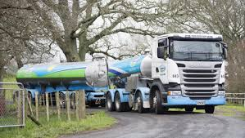
Fonterra
Established on 16th October 2001
Fonterra Co-operative Group Limited is a New Zealand multinational publicly traded dairy co-operative owned by New Zealand farmers.
The company is responsible for approximately 30% of the world's dairy exports.
It is New Zealand’s largest company and the 6th largest dairy company in the world.

Slide 25
2007-First Robotic Milker in New Zealand

Slide 26
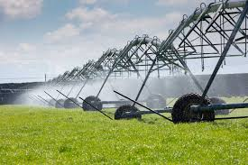
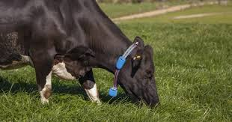
The future of dairying in New Zealand
Technology will play a large part in how our industry operates in the future.
Some farms have also already adopted automatic milking machines run by computer. Cows walk voluntarily to the milking shed once or twice a day and wait for their turn on the robot milker. No human assistance is required.
The integration of technology and innovative advancements such as milk sensors and herd management software have played a big role in driving productivity, enabling farmers to fine tune milk production while also maintaining accurate real-time data about each individual animal.
The biggest challenges facing our dairy industry as we move into the future are around sustainability, both financial and environmental. Check out this article from expert Keith Woodford for his take on how to address these issues here.

Slide 27
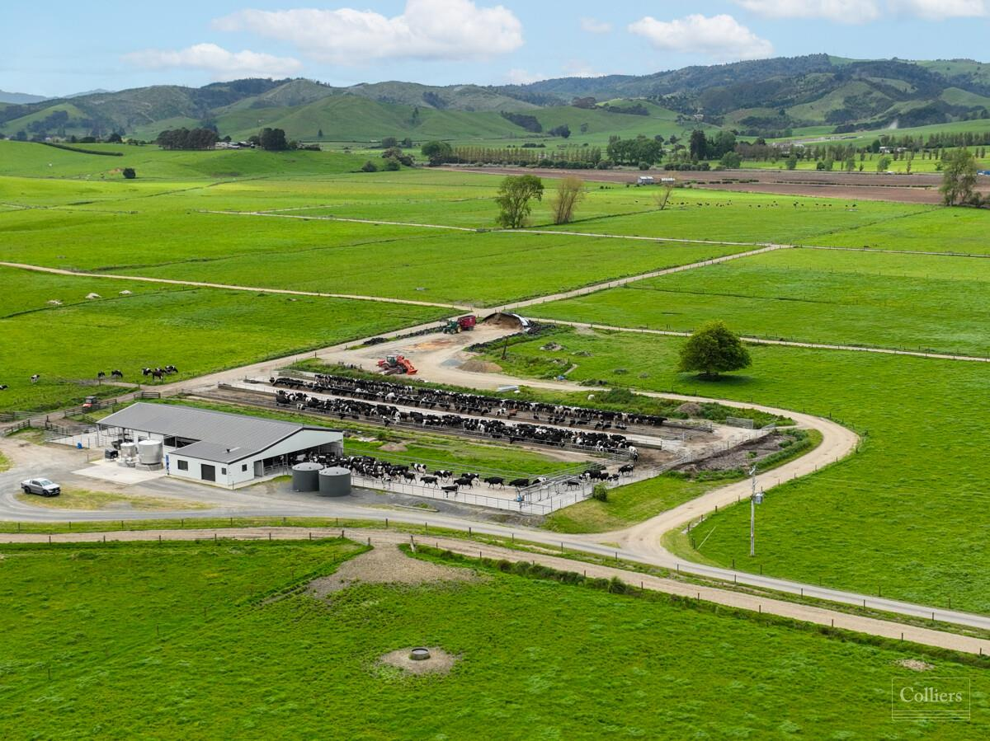
Modern Dairy Farm

Slide 28
Questions
1. Find out what farmers did with milk before refrigeration.
In 2024/25
2. How many dairy cows are there?
3. How many dairy factories are there?
4. How many dairy farms are there?
5. How big is the largest Herringbone and rotary sheds
6. What technology are dairy farmers using?
7. What is the main dairy breed?
8. How has nitrogen fertiliser and irrigation changed the dairy industry?
9. What is the value of dairy exports?
10. What are the key challenges the dairy industry is facing?

Slide 29
Activity
Design a dairy farm.
Make a list of the infrastructure found on a dairy farm.
Design your own modern dairy farm.
Your farm must include a water way and trees to provide shade
Infrastructure.
Rotary Dairy
Tanker race
Races
Effluent ponds
Paddocks
Troughs
Calf and machinery sheds
Center pivot irrigator
Farm houses

