Slide 2
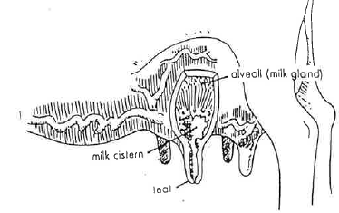
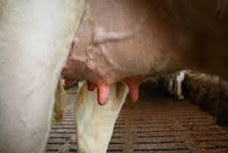
How milk is made

Slide 3
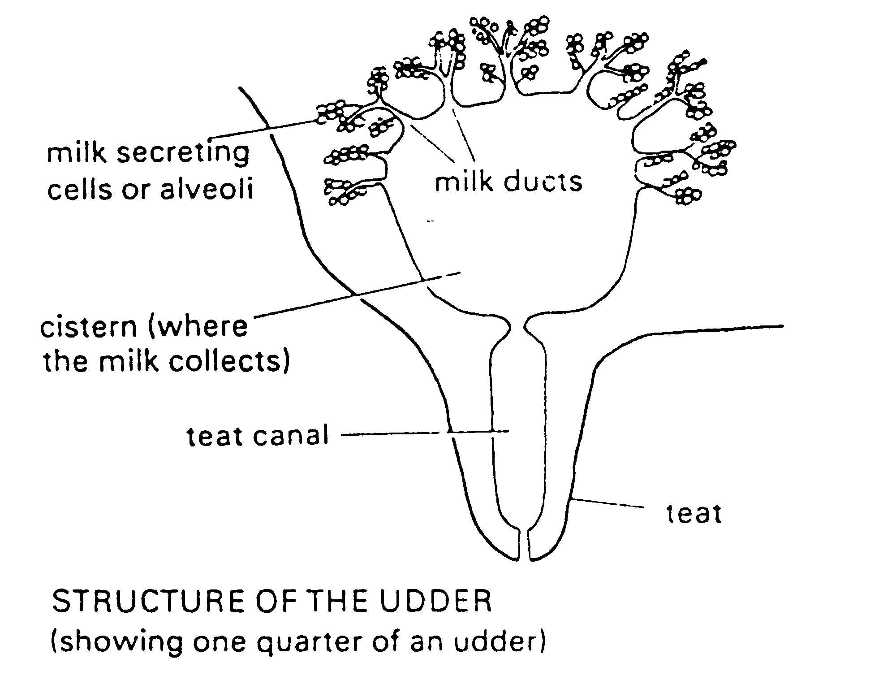
How milk is made
Digested food is carried by the blood into the udder.
Here the blood vessels branch off into tiny capillaries. The food leaves the blood and enters the cells in the upper part of the udder. These are called the milk secreting cells or alveoli. (The blood continues through more capillaries and leaves by two milk veins.)
The milk passes down through the milk ducts, from the milk secreting cells in the upper udder, into four milk chambers or cisterns, found in the four quarters of the udder.
As milk is squeezed out through the teat canals more milk drains down into the cisterns from the upper udder.
Forty litres of blood are needed to carry enough food to the udder to make one litre of milk.

Slide 4
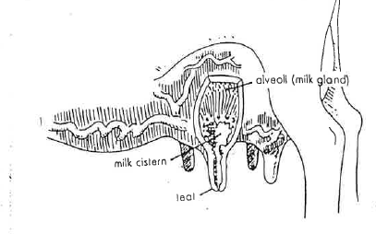
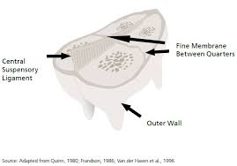
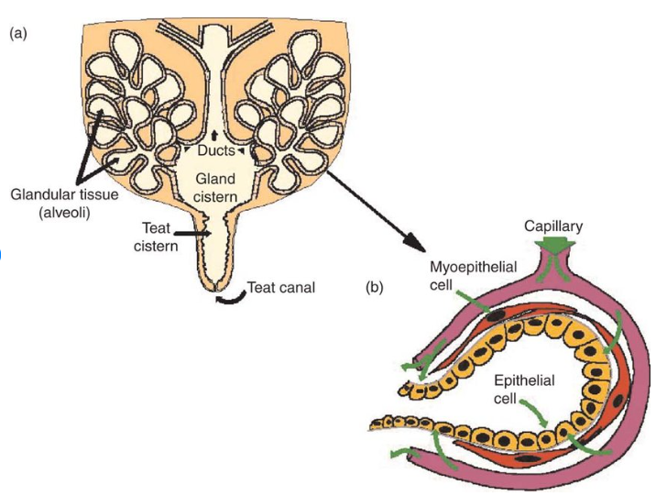
Inside the udder

Slide 5
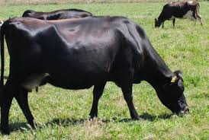
Exercise
Ruby, a Kiwicross cow, produces 17 litres of milk a day.
How many litres of milk do you use on average in your home each day, each week, each month and each year?
How long would a day’s supply of Ruby’s milk keep your family going?
How many litres of milk does your home use a year? If this milk was needed all at once, how many cows would be needed?

Slide 6
Summary of how milk is made.
teat, four, blood, milk, food, alveoli, quarters, one, upper
Digested food is carried by the ­­­_____________into the udder.
Here the blood vessels branch off into tiny capillaries. The__________ leaves the blood and enters the cells in the ________ part of the udder. These are called the ________ secreting cells or___________. The blood continues through more capillaries and leaves by two milk veins.
The milk passes down through the milk ducts from the milk secreting cells in the upper udder, into __________milk chambers found in the four ____________ of the udder.
As milk is squeezed out though the ________ canal more milk drains in to the chambers from the upper udder.
40 litres of blood is needed to carry enough food to the udder to make ______ litre of milk.

Slide 7
Use the words to complete the paragragh.
teat, four, blood, milk udder, let down, quarters, tubes, milk, glands
There are ____________parts or _______________ to an udder. Each quarter consists of thousands of tubes where ____________ is made. Each milk gland has a good ___________ supply. Material to make milk are ___________ to the glands by the blood. Squeezing the milk out of the milk glands is called ________________. Then the milk travels down the milk ______ into the lower part of the _______ and out of the _________.

Slide 8
Composition
Milk
Colostrum
 | %
Water | 86.7
Fat | 4.5
Protein | 3.7
Lactose | 4.7
Salt and minerals | 0.4
 | %
Water | 76.8
Fat | 5.4
Protein | 14.6
Lactose | 2
Salt and minerals | 1,2

Slide 9
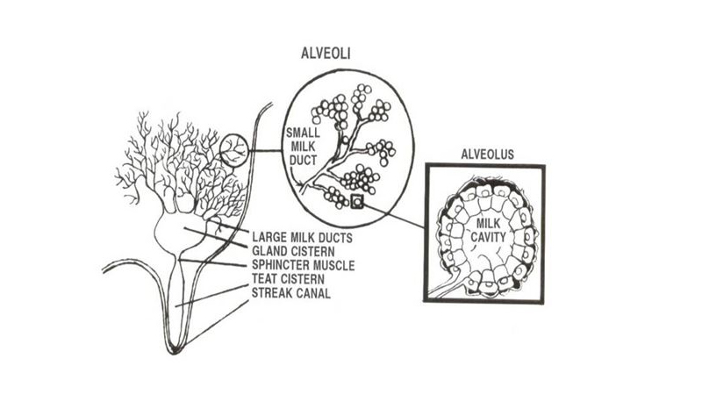
Making Milk
Read the worksheet making milk and answer the questions.
Where in the udder is milk stored?
Name the hormone that is released to “let milk down”
Explain what happens when a calf or a lamb suckles.
Explain how the hormone oxytocin works.
Explain what stimulates dairy cows to “let milk down”
Explain what adrenalin is and the effect it has on “milk let down”

Slide 10
Milking intervals
The traditional milking interval is twice a day.
However
Some farmers
milk once a day for whole or part of the season.
have a flexible milking interval for whole of part of the season.
Flexible milking is a term for milking practices that fall between the traditional once-a-day (OAD) or twice-a-day (TAD) milking
Examples are
milking three times in two days (3-in-2)
ten milkings in seven days (10-in-7)

Slide 11
Reason farmers milk once –a-day of flexible milking
Reasons farmers consider once-a-day milking (OAD)
The advantages depends on it the farm system or layout and can include:
Less time spent milking cows
To reduce staff pressure
Feed shortage (plan to milk OAD before feed runs short rather than be forced into it)
Stock health (lame cows, light cows, heifers, milk-fever prone cows)
Reproduction (non-cyclers, heifers or whole herd in a feed shortage)
Small dairy shed for herd size
Farm layout (walking distance to shed)
Reasons for a flexible milking system
The benefits of flexible milking are improved staff wellbeing and cow health,
but,
there are some challenges, such as grazing and pasture management.

Slide 12
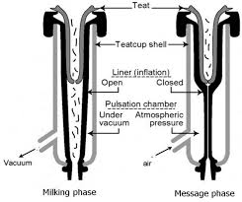
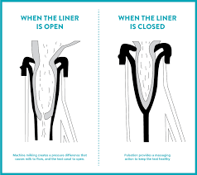
Milking
Read the Milking worksheet
Questions
Describe how to hand milk a cow.
Describe how milk is harvested from a cow by a milking machine.

