Slide 1


Slide 2
New Zealand
Sheep Farming History

Slide 3
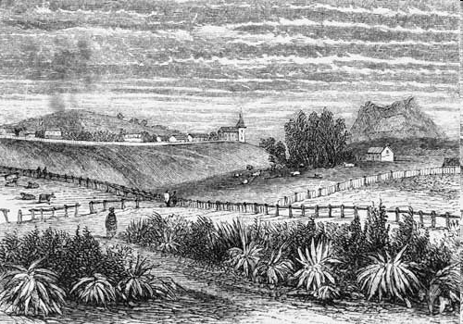
The Start of the New Zealand Sheep Industry
1774
Captain James Cook landed two merino sheep in the Marlborough Sounds
1814
Rev Samuel Marsden introduced sheep to the Bay of Islands.
No sheep survived from these first two importations.
1834
Allen Bell Wright landed the first sheep flock of Merinos on Mana Island Wellington.
Wool exports started in 1835.
1840’s
Dual purpose sheep breed were introduced to New Zealand. Sheep flocks were established in the Wairarapa, Marlborough, Canterbury and Otago.
1840’s

Slide 4
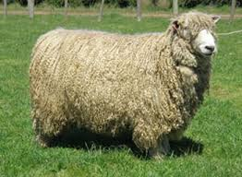
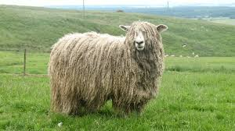
1840’s-
English Leicester
The dual purpose breeds English Leicester, Lincoln and Romney Marsh were introduced.
In 1855 there were less than 1million sheep in new Zealand.
In 1880 there 10 million, largely due to large scale importation of Merino sheep from Australia.
The demand for meat during the 1860’s gold rush led to the increase in dual purpose breeds.
Lincoln

Slide 5
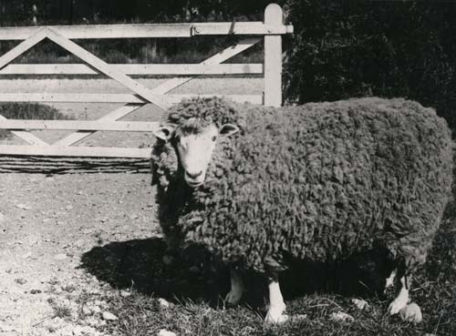
Romney Marsh
The Romney Marsh breed showed good resistance to footrot, a major issue especially in the wetter North Island.

Slide 6
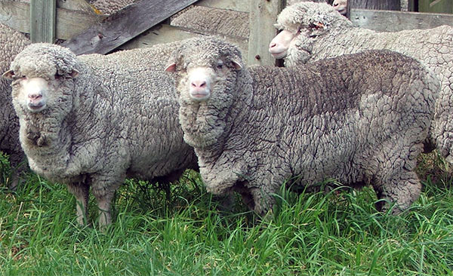
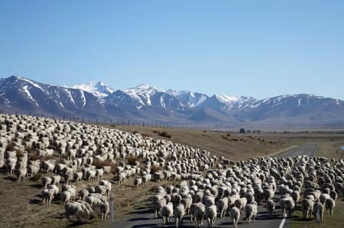
Late19th Century
Merino sheep were the dominant breed. They are a slow maturing fine wool specialist breed. They did not suit the humid North Island climate but thrived in the drier South Island.

Slide 7
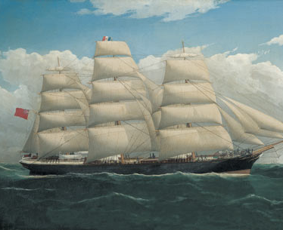
1882
First Refrigerated Ship Dunedin
In 1882, the first shipment of frozen lamb carcasses left Port Chalmers bound for England on the Dunedin.
Due to poor meat characteristics of the Merino, the Romney started to become more popular especially in the North Island.

Slide 8
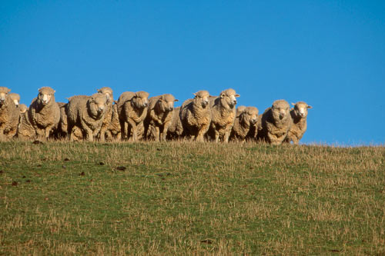
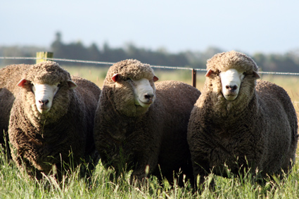
1880’s -1920’s
New Zealand Halfbred
Development of new breeds to suit New Zealand conditions.
English Leicester, Lincoln and Romney crossed with Merino to produce the New Zealand Halfbred.
Corriedale New Zealand’s first breed
Dual Purpose (Fine wool and meat) developed from New Zealand halfbred x New Zealand halfbred.
New Zealand Romney a dual purpose (coarse wool and prime lamb).
Corriedale

Slide 9
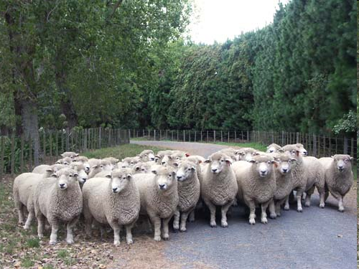
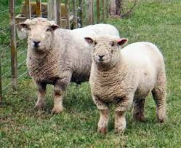
1920’s
70% of the rams were Romney in the North Island. Selected for small compact carcass and good wool growth. The coarse wool was suited for carpets and outer garments.
The Southdown became a popular terminal sire as its crossbred progeny were small compact and early finishing which suited the UK market.

Slide 10
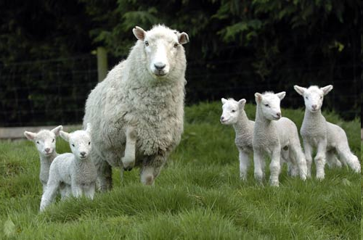
1940’s- 1960’s
Perendale
(suited to hard hill country)
New breeds were developed from the Romney to improve fertility, milk production, wool qualities and growth rates.
Perendale (Romney x Cheviot) smaller hardier breed suited to hill country.
Coopworth (Romney x Border Leicester) higher fertility and milk production.
Drysdale (selectively bred from Romneys with a hairy fleece). Coarse wool breed particularly suited for carpet wool production.

Slide 11
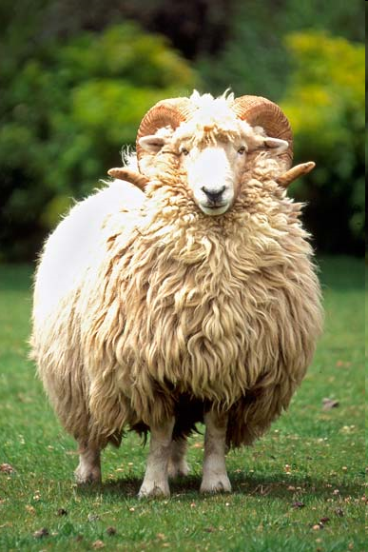
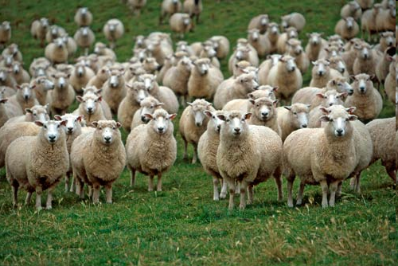
Drysdale
(Coarse wool specialist breed)
Coopworth
High fertility and milk production
(suited to intensive farming)

Slide 12
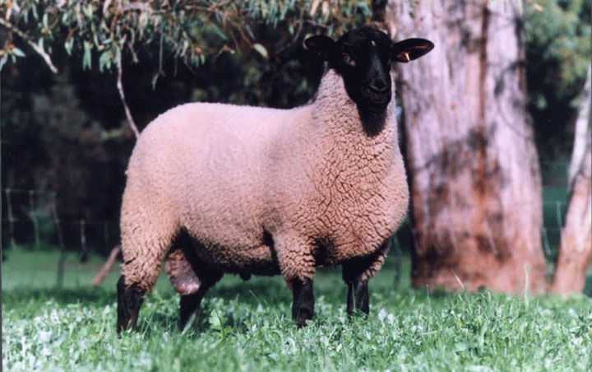
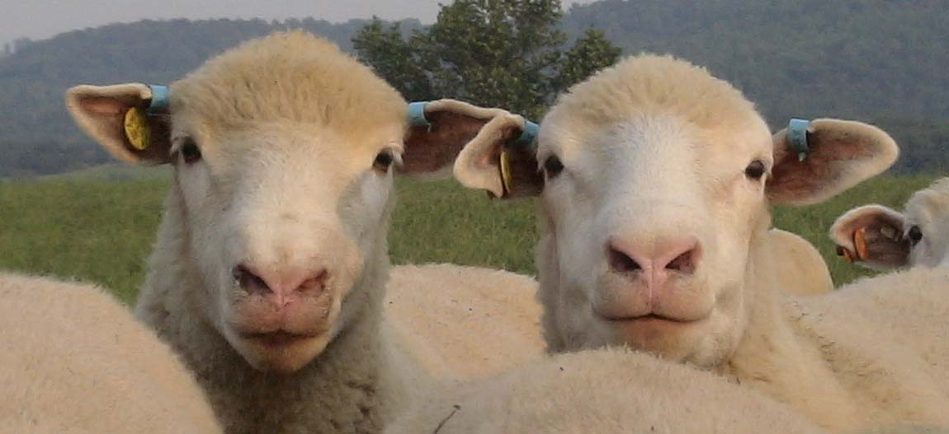
1980’s
Suffolk
Consumers demand leaner meat resulting in the increased use of larger leaner terminal breed such as the Suffolk and Polled Dorset.
Sheep numbers peaked at more than 70 million dominated by the Romney, Perendale and Coopworth.
Sheep numbers starts falling dramatically. A major factor that has contributed to this decline is sheep farming land lost to other purposes such as urban sprawl, dairy farming, and horticulture.
Demand for Romney type wool was declining. To be viable, farmers needed to produce more lambs per ewe with heavier carcases which lead to the importation of the Finnish Landrace, East Friesian and Texels which were had high fertility, milk yield and or better carcass quality.
Polled Dorset

Slide 13
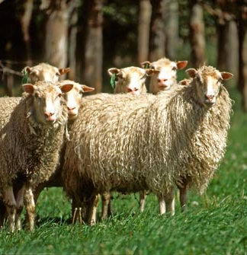
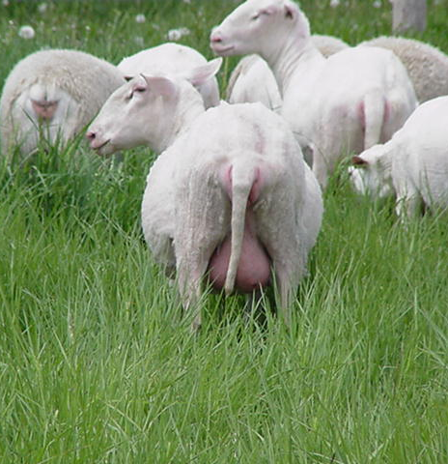
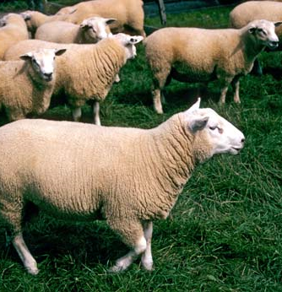
New Breeds
Finnish
High Fertility
East Friesian
High Milk Production
Finnish
Large lean carcass

Slide 14
1990’s-2000’s
 | Sheep Cattle Ratio
1851 | 6 sheep to 1 cattle beast including beef, dairy and draught cattle
1950-1990 | 12-14 sheep to 1 beef cattle beast Sheep numbers peaked in 1982 to 70 million compared to cattle 5 million
2000’s | 9 sheep to 1 beef cattle beast
2020’s | Less than 7 sheep to 1 beef cattle beast
Conversion of easier country traditionally used for sheep farming was converted to dairy, orchards and viticulture. This resulted in the national flock falling to about 30 million mostly farmed on hill country with beef.
There are more than100 breed or composite types of sheep that categorised as dual purpose, terminal meat breeds, fine wool and milk productions.

Slide 15
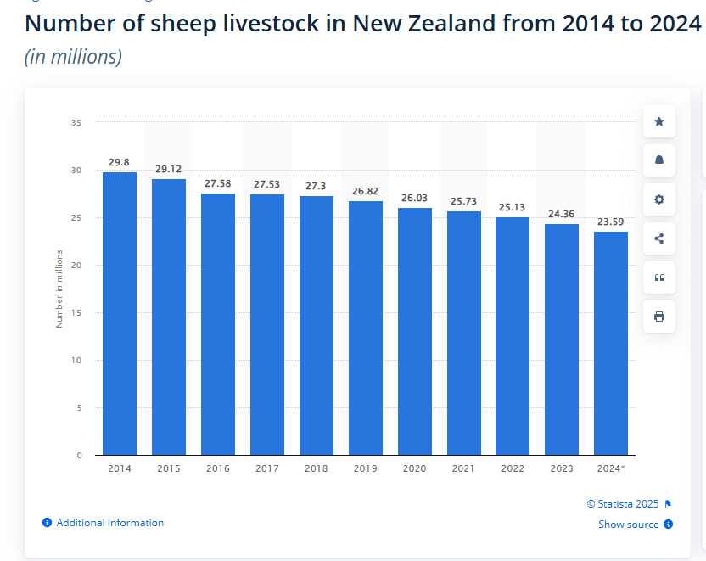
2024
In June 2024, there were approximately 23.59 million sheep in New Zealand, a slight decrease from the previous year in which there were around 24.36 million sheep in the country. The number of sheep in the country has declined over the past decade.

Slide 16
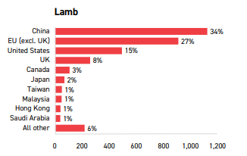
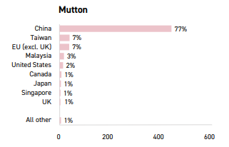
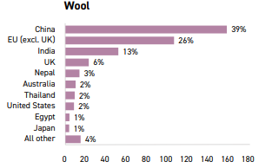
Main Markets

Slide 17
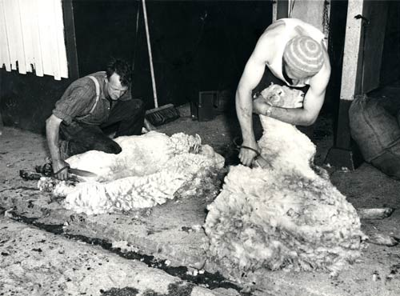
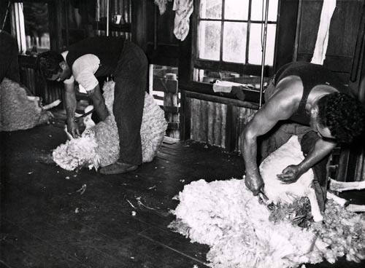
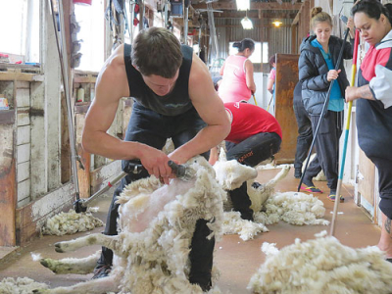
Shearing
Blades
1885 Hand piece
2020’s

Slide 18
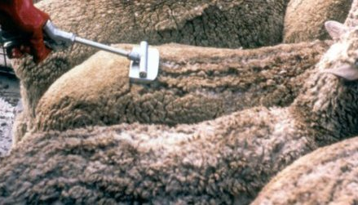
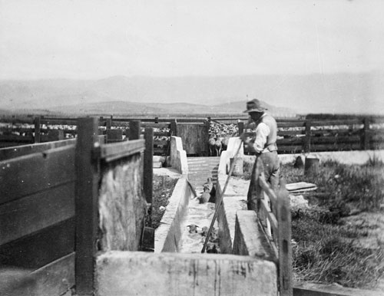
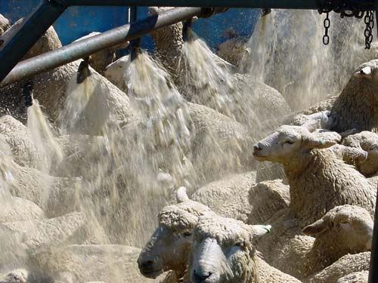
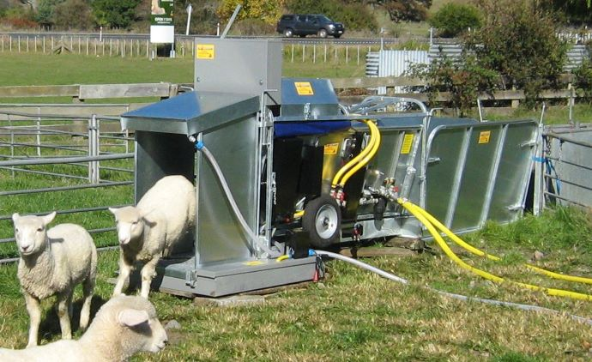
Dipping

Slide 19
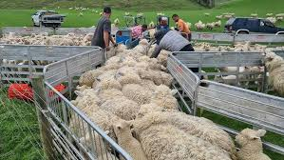
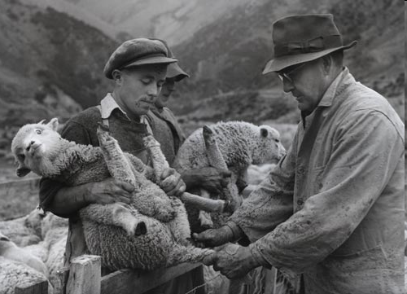
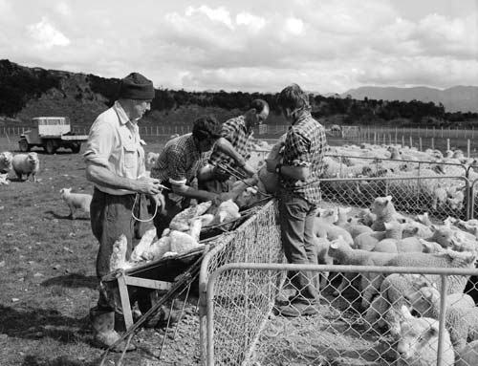
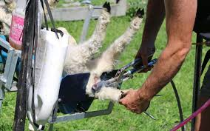
Tailing

