Slide 1


Slide 2
Quiz Time

Slide 3
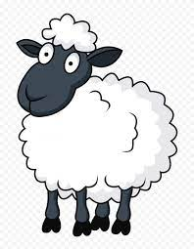
Sheep Terminology
Drag the term to match the definition
Drafting
A sheep which had a lamb
A low quality animal which is drafted to be sold.
A male sheep for breeding
A castrated male sheep
A sheep that is not pregnant
One year old sheep
Sorting sheep into groups
Length of pregnancy 147 days
Feeding ewes on a high level before and during tupping
A sheep that has its first pair of adult teeth
Gestation
Flushing
Wether
Two- tooth
Hogget
Dry ewe
Cull
Ewe
Ram

Slide 4
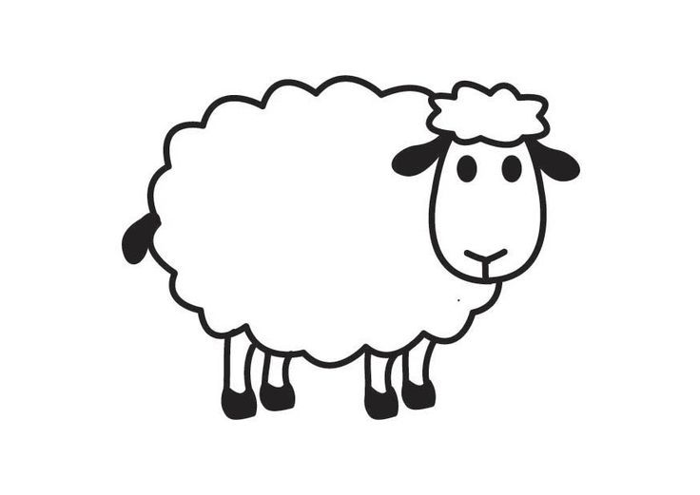
Sheep Terminology
Answers
Ewe
A sheep which had a lamb
A low quality animal which is drafted to be sold.
A male sheep for breeding
A castrated male sheep
A sheep that is not pregnant
One year old sheep
Sorting sheep into groups
Length of pregnancy 147 days
Feeding ewes on a high level before and during tupping
A sheep that has its first pair of adult teeth
Cull
Ram
Wether
Dry ewe
Hogget
Drafting
Gestation
Flushing
Two- tooth

Slide 5
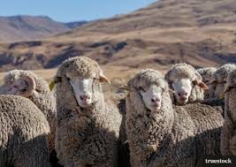
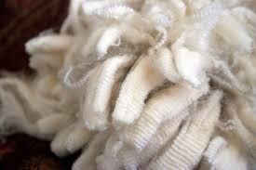
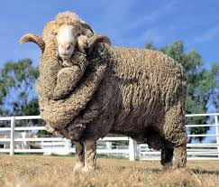
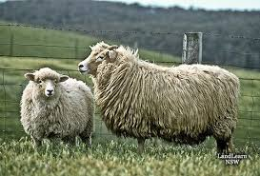
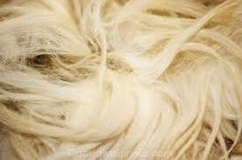
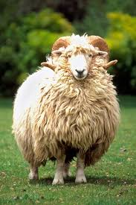
We are wool specialists. Who am I?
1.
2.

Slide 6
I am a
Merino
Drysdale

Slide 7
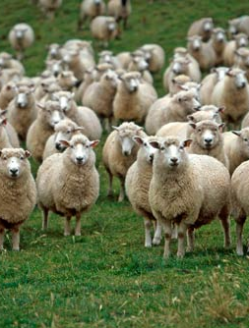
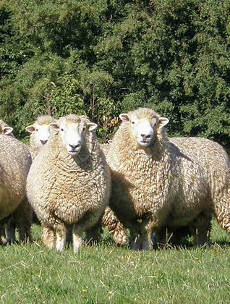
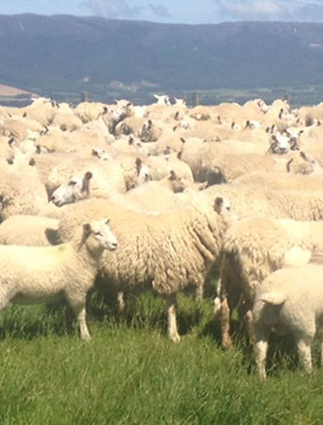
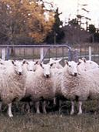
We are dual purpose sheep. Who am I?
1 2 3 4

Slide 8
I am a?
Border Leicester
Coopworth
Romney
Perendale

Slide 9
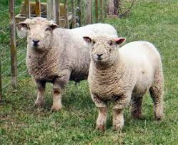
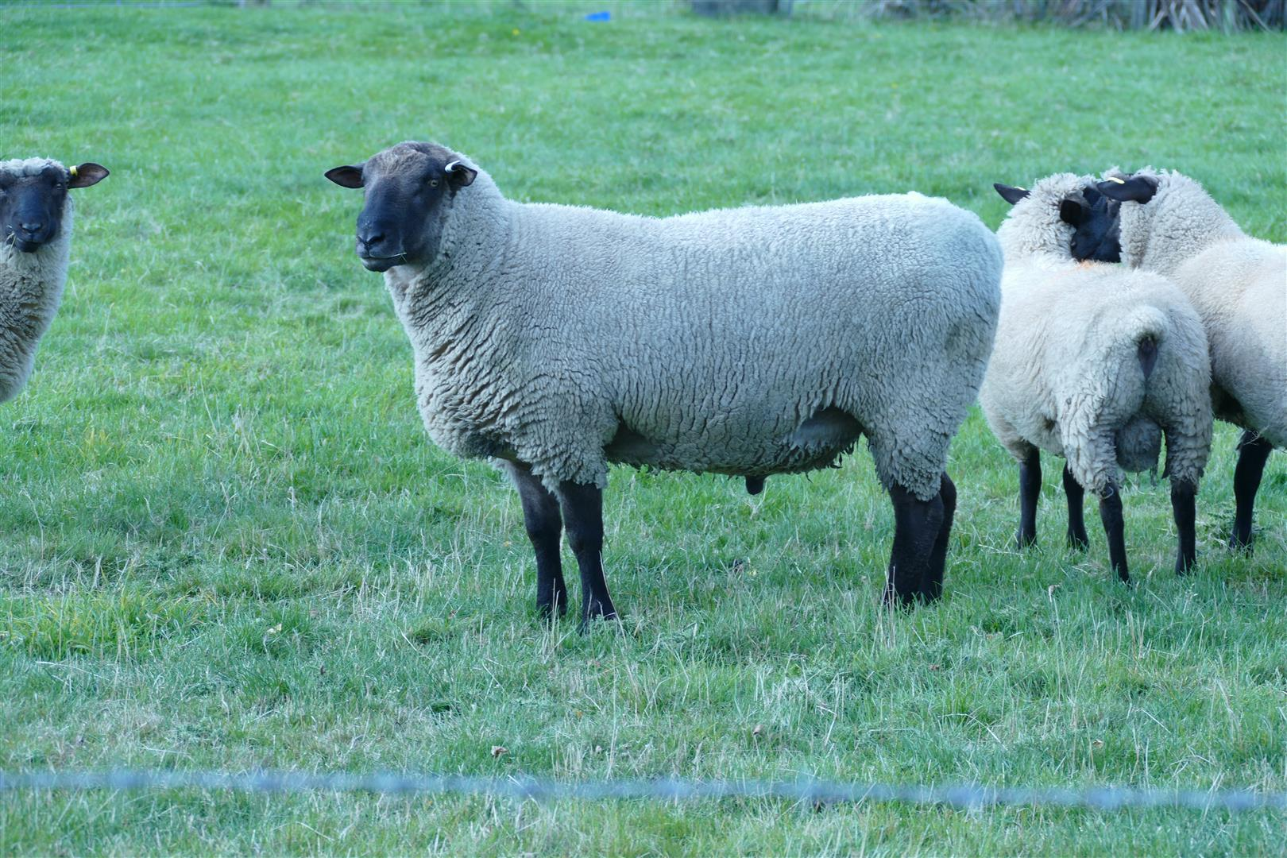
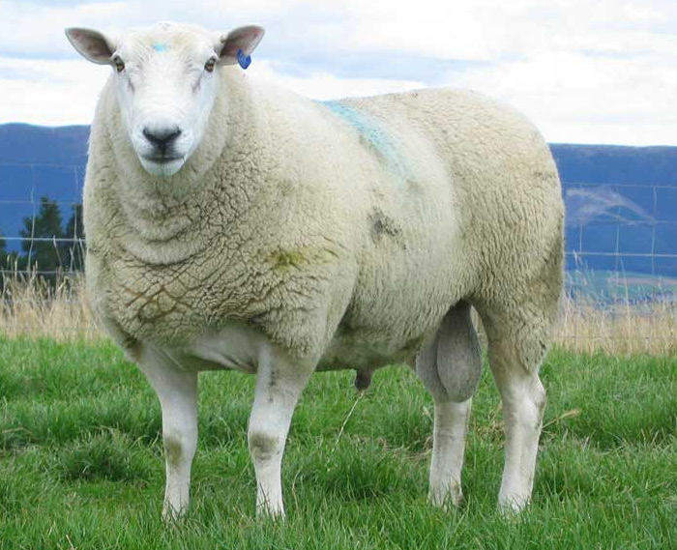
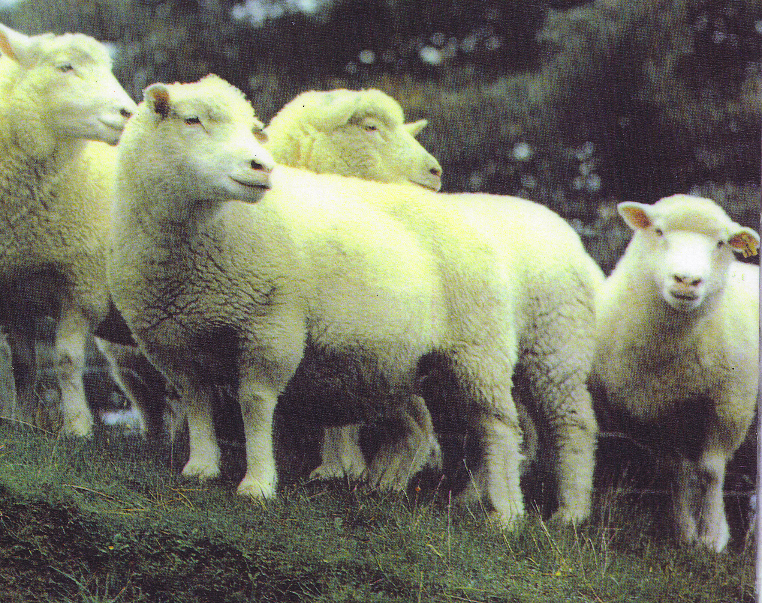
We are terminal sires. Who am I?
1
3
2
4

Slide 10
I am a
Southdown
Suffolk
Polled Dorset
Texel

Slide 11
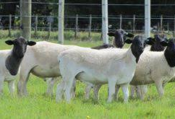
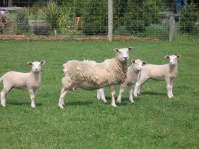
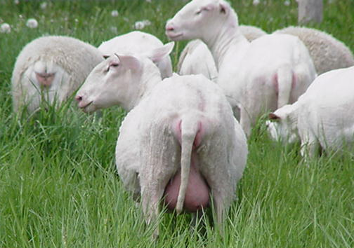
We are new breeds. Who am I?
1
2
3

Slide 12
I am?
Dorper
Wiltshire
East Friesian

Slide 13
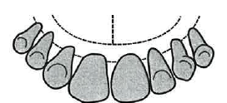
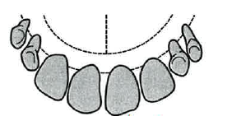
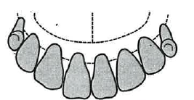
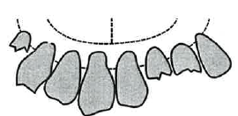
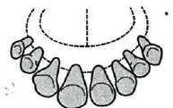
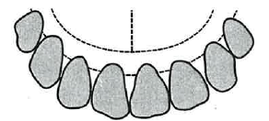
How old is that sheep?
Drag the correct label to match the diagram
8 baby teeth, ¾ year, lamb
2 permanent teeth, 1 year, two tooth
4 permanent teeth, 2 years, four tooth
6 permanent teeth, 3 years, six tooth
8 permanent teeth 4 years^{+,} full mouth
Some permanent teeth broken or missing, over 4 years, broken mouth

Slide 14
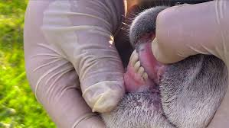
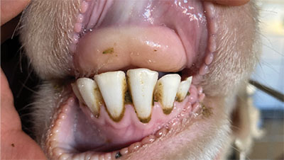
How old is that sheep?
ANSWERS
6 permanent teeth, 3 years, six tooth
2 permanent teeth, 1 year, two tooth
4 permanent teeth, 2 years, four tooth
8 permanent teeth, 4 years^{+,} full mouth
Some permanent teeth broken or missing, over 4 years, broken mouth
8 baby teeth, ¾ year, lamb

Slide 15
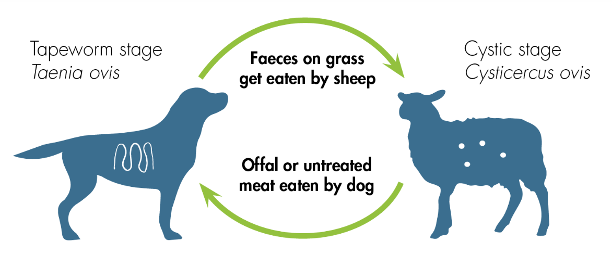
Sheep Measles and Hydatids
True or false
Sheep measles are caused by a tapeworm in dogs.
Sheep measles can be harmful to human health.
Dogs become infected with sheep measles by eating raw sheep meat.
The cysts caused by sheep measles are dangerous to sheep and goats.
To prevent sheep measles, dogs should be treated with tapeworm medication every month.
Hydatids are caused by a tapeworm that infects both dogs and humans.
Humans can become infected with hydatids by eating infected sheep meat.
New Zealand has been declared "provisionally free" from hydatids
To stop the spread of hydatids, dogs should be allowed to roam freely to prevent infection.
Boiling offal for at least 30 minutes or freezing it at -10°C for 10 days kills the hydatid parasite.

Slide 16
Sheep Measles and Hydatids
Answers
Sheep measles are caused by a tapeworm in dogs. True
Sheep measles can be harmful to human health. False
Dogs become infected with sheep measles by eating raw sheep meat. True
The cysts caused by sheep measles are dangerous to sheep and goats. False
To prevent sheep measles, dogs should be treated with tapeworm medication every month. True
Hydatids are caused by a tapeworm that infects both dogs and humans. True
Humans can become infected with hydatids by eating infected sheep meat. False
New Zealand has been declared "provisionally free" from hydatids. True
To stop the spread of hydatids, dogs should be allowed to roam freely to prevent infection. False
Boiling offal for at least 30 minutes or freezing it at -10°C for 10 days kills the hydatid parasite. True

Slide 17
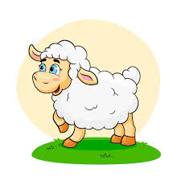
Wool
True or False
All wool is the same thickness and texture.
The crimp in wool fibres helps keep the body warm by trapping air.
Merino sheep produce the coarsest wool.
Wool is naturally water-repellent because of the lanolin it contains.
Fine wool is usually used for high-quality, soft fabrics and yarns.
Wool is biodegradable and renewable, making it an environmentally friendly material.
Wool is more likely to burn quickly than synthetic fibres.
Lanolin is a natural grease found in wool that can be used in lotions and skin care products.
Wool can shrink if washed in very hot water because the fibres can
Wool can help protect your skin from sunburn better than most synthetic fabrics and cotton. mat together.

Slide 18
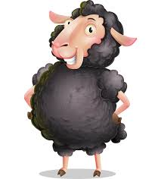
Wool
Answers
All wool is the same thickness and texture. False
The crimp in wool fibres helps keep the body warm by trapping air. True
Merino sheep produce the coarsest wool. False
Wool is naturally water-repellent because of the lanolin it contains. True
Fine wool is usually used for high-quality, soft fabrics and yarns. True
Wool is biodegradable and renewable, making it an environmentally friendly material. True
Wool is more likely to burn quickly than synthetic fibres. False
Lanolin is a natural grease found in wool that can be used in lotions and skin care products. True
Wool can shrink if washed in very hot water because the fibres can mat together. True
Wool can help protect your skin from sunburn better than most synthetic fabrics and cotton. True

Slide 19
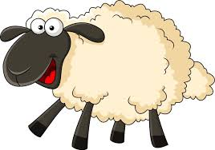
Test yourself
Name the three types of sheep farming systems.
Which sheep breed is best suited to extensive high-country farms?
What is dual-purpose sheep?
Name two breeds used as terminal sires.
What is gestation and what is the gestation for a sheep?
When does lambing start?
How old is a two- tooth?
Name two dual purpose sheep breeds.
What a two good qualities of wool and two negative qualities?
How do farmers prevent sheep from getting internal parasites?
Describe a prime lamb.
Name two markets for lamb and two for wool.
Fun Fact
During processing, lanolin is removed and used in beauty products.

Slide 20
Answers
Fun Fact
Wool fibres grow in tufts (staples) on the sheep’s back with crimps (waves).
Name the three types of sheep farming systems. (Intensive, Semi Extensive, Extensive)
Which sheep breed is best suited to extensive high-country farms? (Merino)
What is a dual-purpose sheep? (A sheep breed that produces good meat and wool qualities)
Name two breeds used as terminal sires. (Polled Dorset, Texel, Suffolk)
What is gestation and what is the gestation for a sheep? (Length of time a ewe is pregnant for. 147 days 5 months – 5days)
When does lambing start? Late winter early spring)
How old is a two- tooth? (1 year)
Name two dual purpose sheep breeds. (Romney, Perendale, Coopworth)
What are two good qualities of wool and two negative qualities? (see notes)
How do farmers prevent sheep from getting internal parasites? (Drenching)
Describe a prime lamb. (Ideal weight and fat cover to get a high price)
Name two markets for New Zealand lamb and two for wool. (Lamb = China and EU) (Wool = China and India)
Notes:
Wool Bounces Back: Wool fibres can stretch and bend thousands of times without breaking. When stretched, wool will return to its original shape.
Water-Repellent: The natural grease in wool, called lanolin, helps keep water away.
Easy to Clean: Wool doesn’t attract dirt easily. The natural grease helps protect it from stains, so wool stays clean longer than many other fabrics.
Naturally Safe: Wool is harder to burn because it contains moisture, which makes it flame-resistant.
Keeps You Comfortable: Wool helps keep you warm in winter by trapping air between its wavy fibres. It also keeps you cool in summer by letting air pass through. Wool can even protect your skin from sunburn better than most synthetic fabrics and cotton. Additionally, wool has anti-static and anti-odour properties.
Disadvantages of wool
Wool fibres can sometimes mat together.
Wool can be discoloured and must be cleaned (scoured).
Wool can shrink or lose its shape if washed in very hot water.
Some people find wool itchy or prickly on their skin.
Some people are allergic to wool

Slide 21
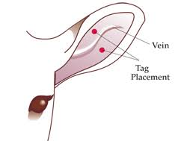
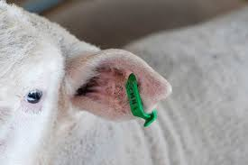
Practice tagging.
Enlarge diagram and print onto card or glue onto cardboard.
Using a ear tagger, tag the lamb correctly

