Slide 1


Slide 2
Sheep Farming
Production Systems

Slide 3
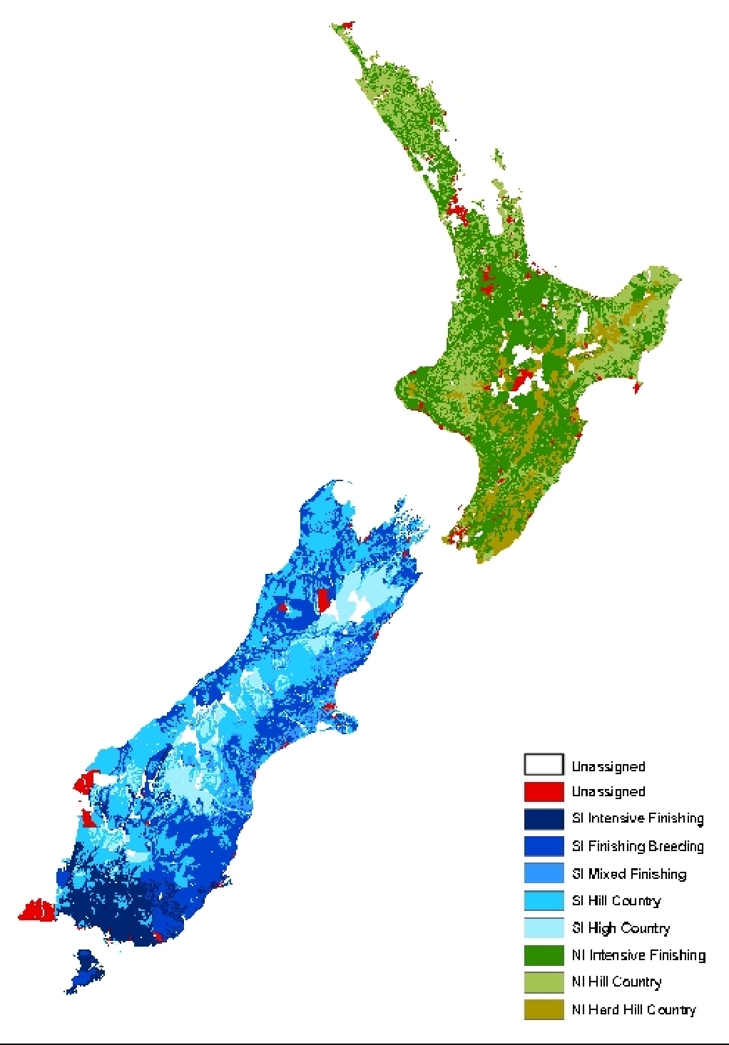
Sheep and Beef Farming Systems
Sheep are usually farmed with beef cattle. Sheep and beef farming still dominates land use in New Zealand. They are farmed on nearly two thirds of land in agriculture.
Sheep and beef farming is found in many regions throughout New Zealand.
They are predominantly found on easy to steep hill country in both islands. The summers are dry and winters are cold, limiting pasture growth.
High country sheep and beef farms are found in the central South Island. The climate is dry in summer, cold in winter with periods of snow.

Slide 4
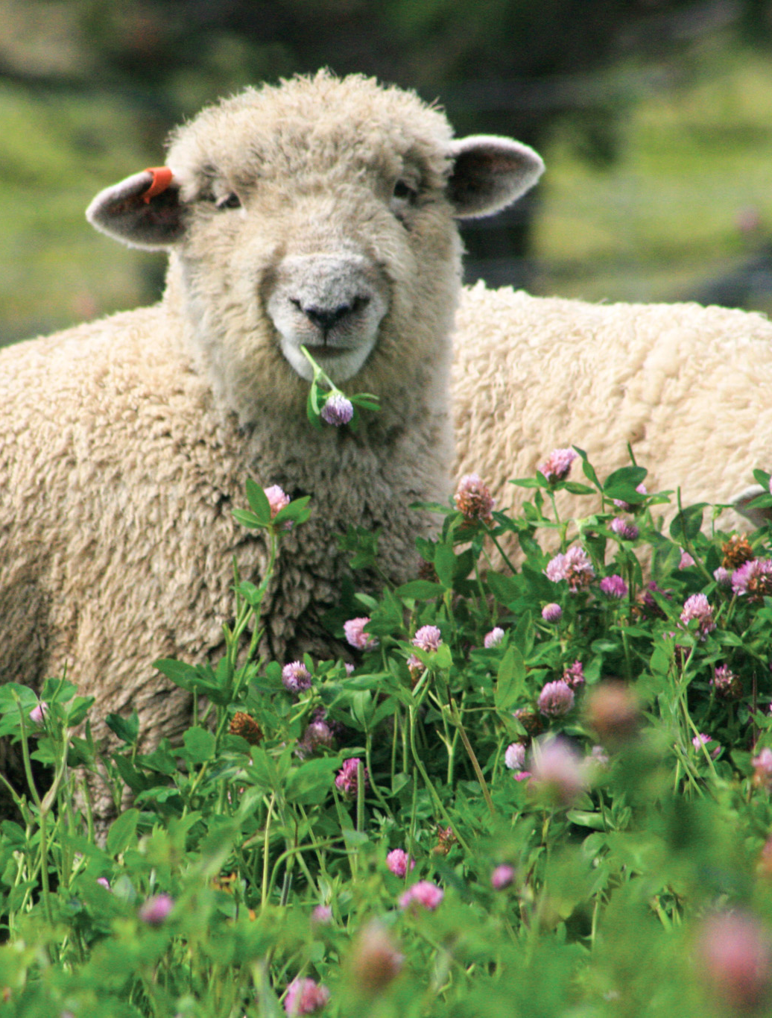
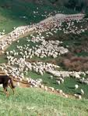
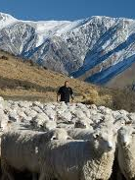
Sheep farming systems
Intensive finishing
Semi-extensive
Extensive

Slide 5
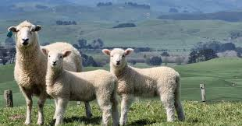
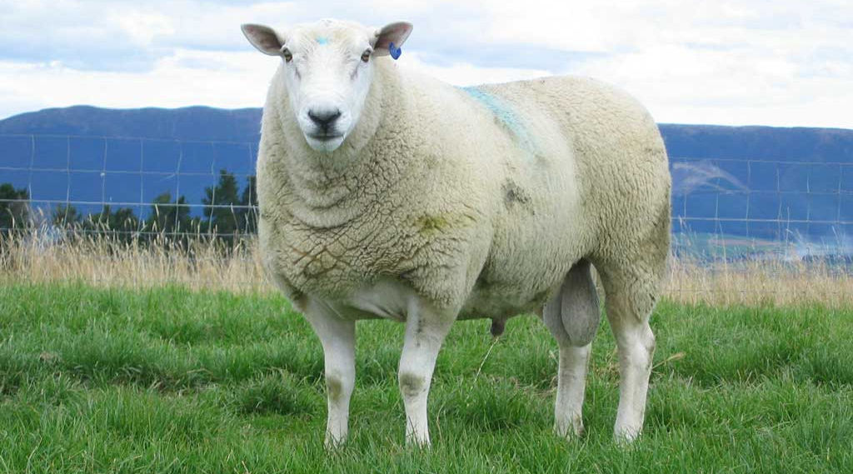
Sheep Breeds
Ewe and lambs
Sheep breeds can be grouped according to the products they produce best.
Wool breeds: Produce high value wool used in clothing or carpet manufacturing.
Dual purpose breeds: Produce good meat and wool.
Meat breeds: Produce high value meat carcases.
Milking breeds: Produces high quantities of milk.
Ram

Slide 6
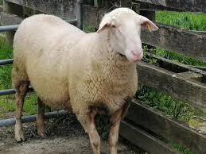
Sheep breeds on pastoral farming systems
Sheep Breeds | Wool | Merino Drysdale | Extensive Intensive
 | Dual Purpose | Romney Perendale Coopworth Border Leicester Corridale NZ Halfbred | Semi- extensive
 | Meat | Suffolk South Suffolk Dorset horn Polled Dorset Texel Wiltshire Dorper | Semi- extensive- Intensive
 | Milk | East Friesan | Intensive
East Friesian - bred for milking

Slide 7
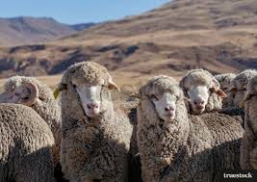
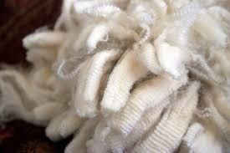
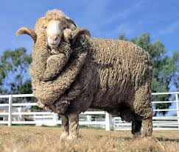
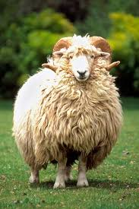
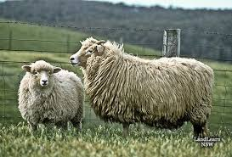
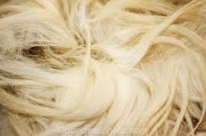
Merino - produces fine wool used for making high value clothing
Wool Breeds
Drysdale - produces a very coarse wool used for making carpets

Slide 8
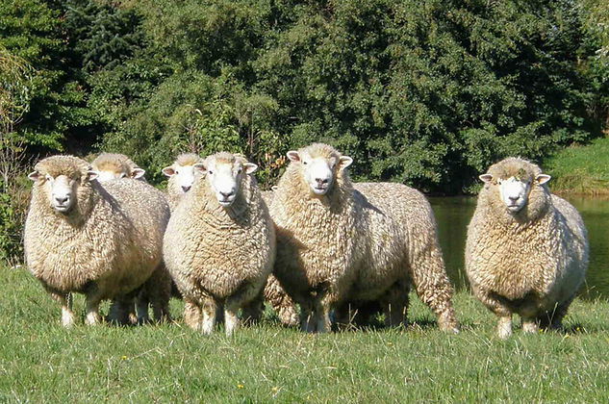
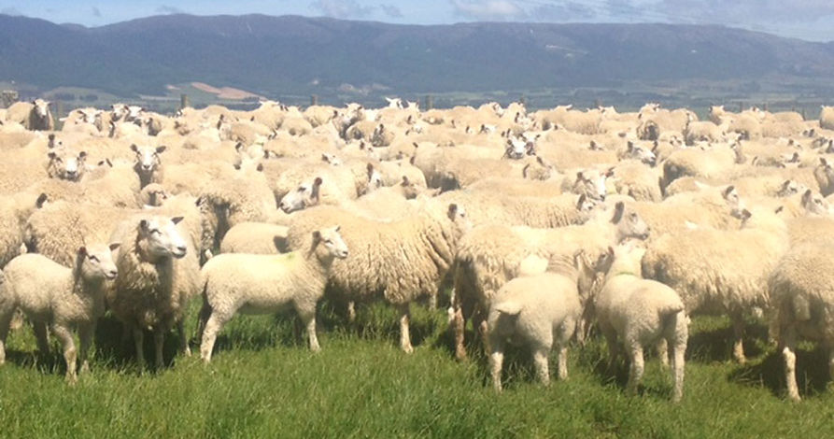
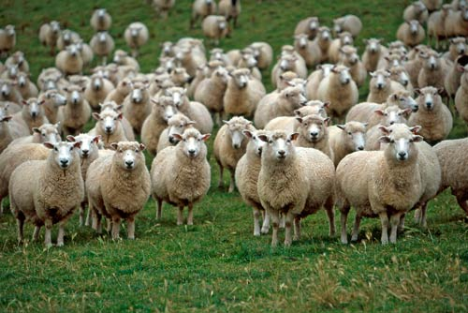
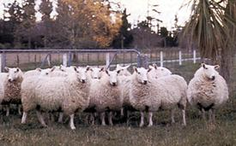
Romney
Perendale
Dual purpose breeds
Coopworth
Border Leicester

Slide 9
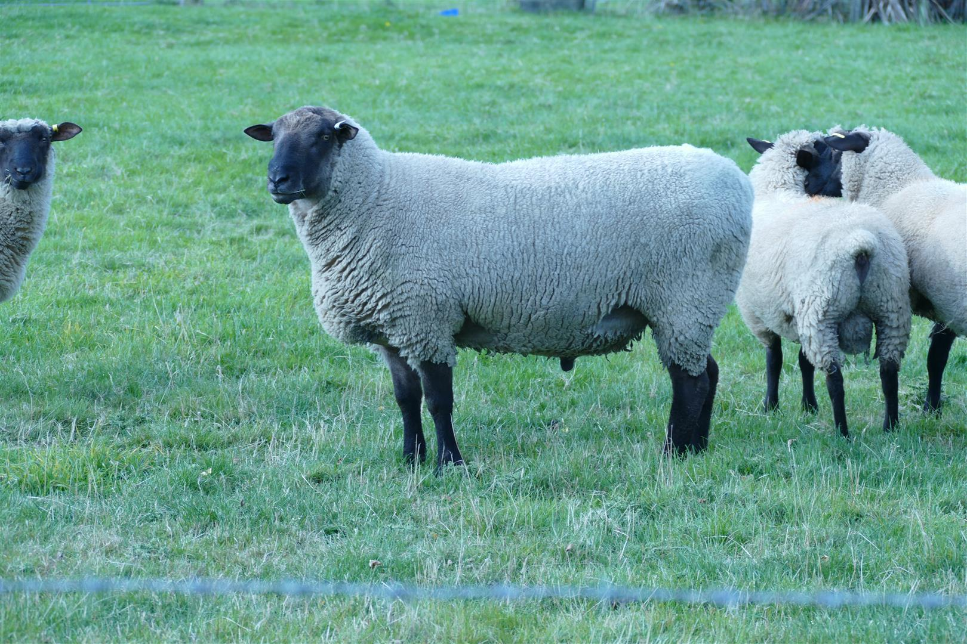
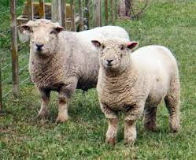
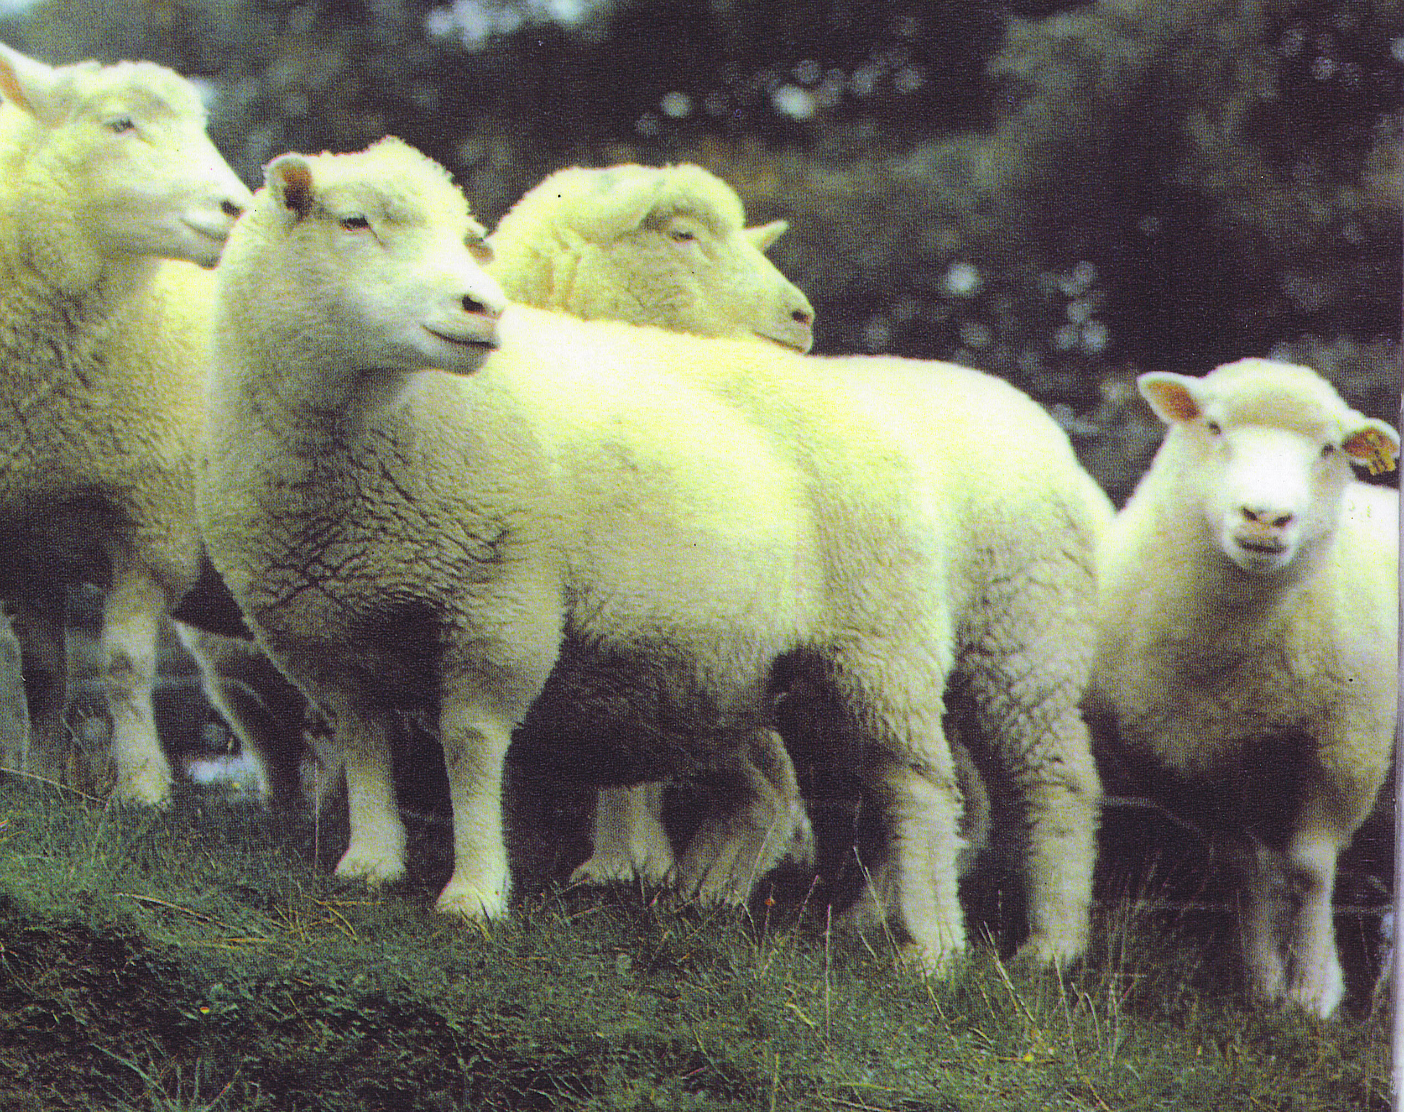
Suffolk
Southdown
Meat breeds
Polled Dorset
Texel

Slide 10
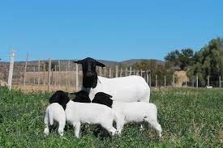
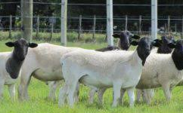
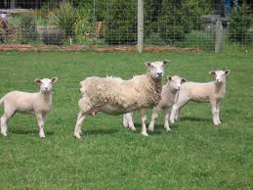
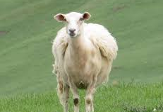
Dorper - meat breed that sheds its wool
Wiltshire - meat breed that sheds its wool

Slide 11
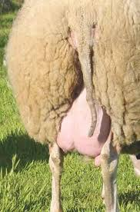
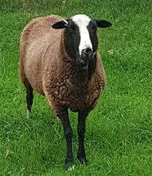
East Friesian - bred for milking

Slide 12
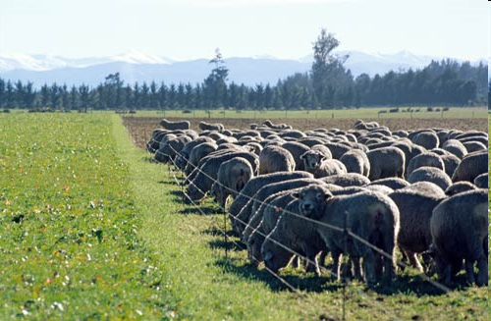
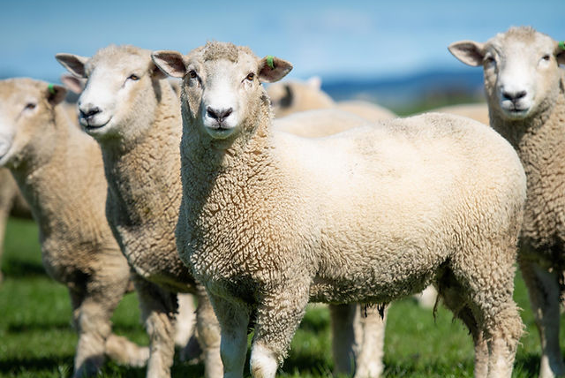
Intensive
Sheep Farming
Prime lamb is the main source of income. These farms are often stud breeding farms and some income will come from the sale of rams for breeding. On some intensive mixed farms, sheep are farmed in combination with cash crops. In this situation, cash crops will be the major source of income.

Slide 13
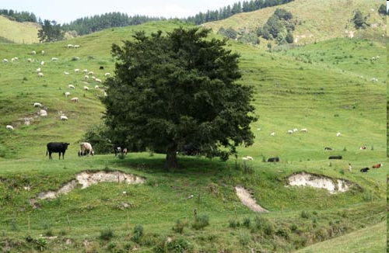
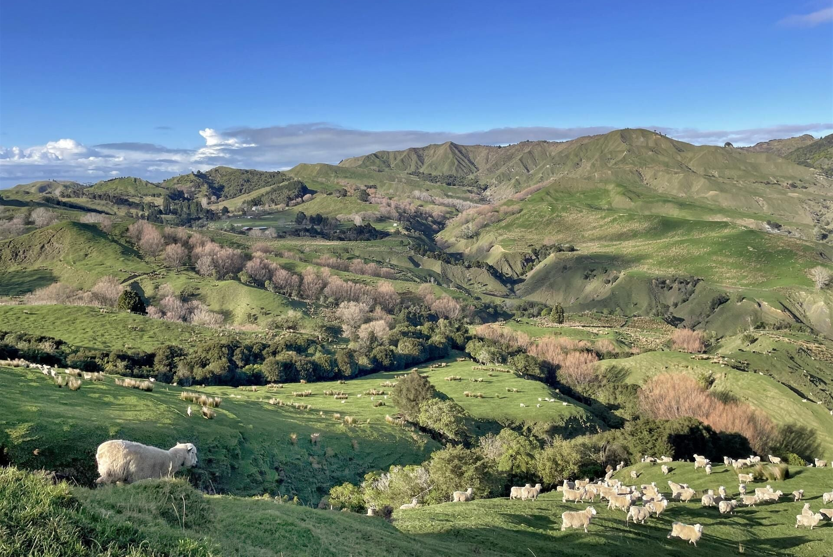
Semi- Extensive
Hill Country Sheep and Beef farming
Income is derived from the sale of some prime but mainly store lambs and cattle and wool.

Slide 14

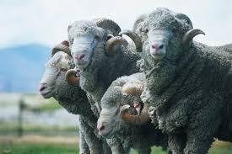
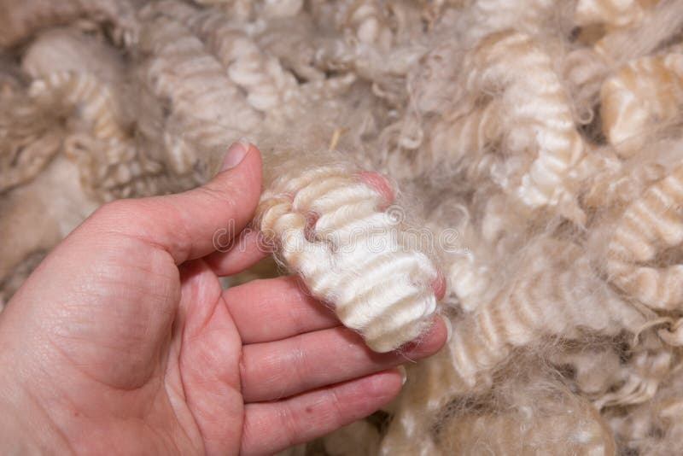
Extensive
High Country Sheep Farming
Merino are the main sheep breed; fine wool is the major source on income.

