Slide 1


Slide 2
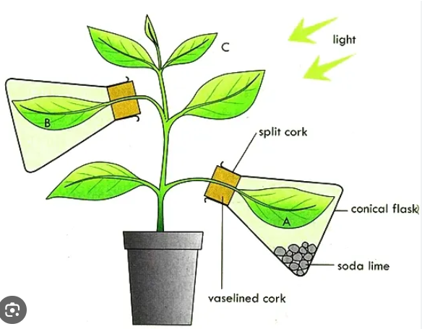
Photosynthesis Experiments

Slide 3
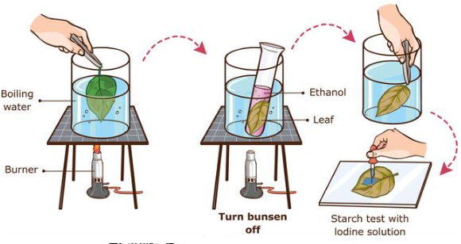
Testing a leaf for starch
Meths

Slide 4
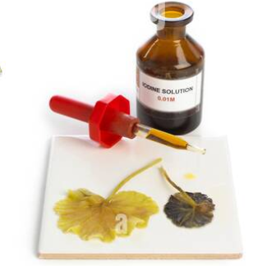
Method
Place leaf in a beaker of boiling water for 2 minutes. Remove with forceps
Turn off the bunsen
Roll up leaf and place in a test tube. Cover leaf with meths.
Place the test tube in the beaker of hot water for 5 minutes.
Remove leave with forceps and wash the whitened leaf.
Spread leaf out in a petri dish and add 5 drops of iodine solution and wait for 3 minutes.
If starch is present the leaf goes blue-black

Slide 5
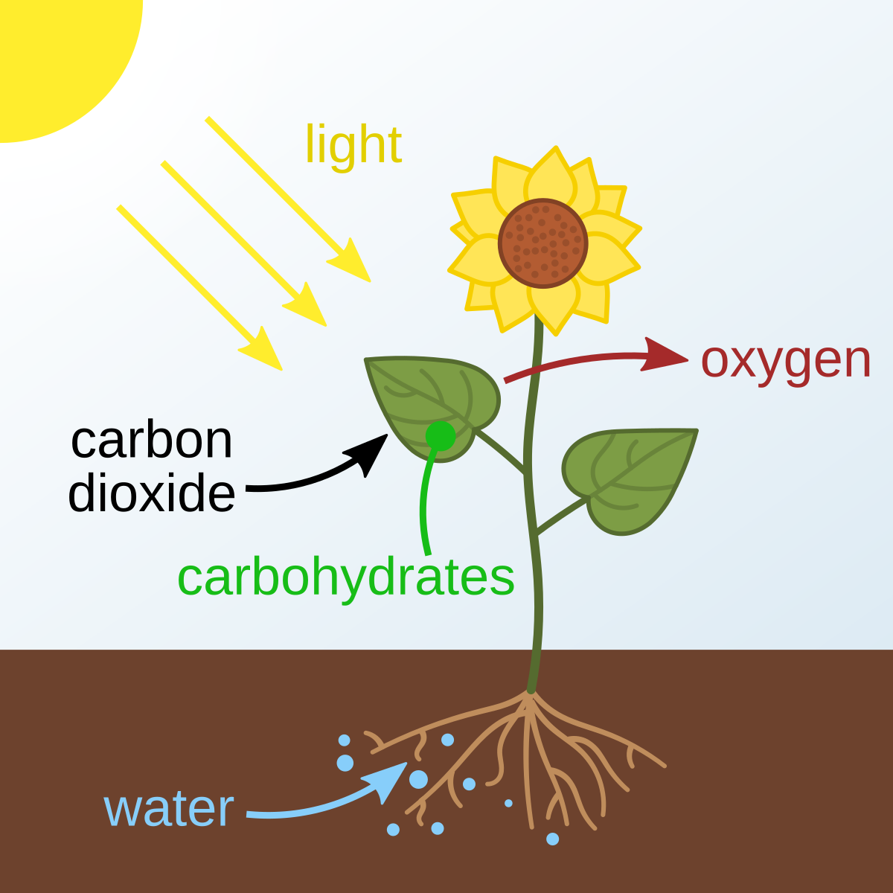
Testing leaves for the presence of starch.
The presence of starch in a leaf is used to indicate photosynthesis has been occurring. A leaf, in the right conditions, will make and store starch from photosynthesis. Iodine can be used to test for starch

Slide 6
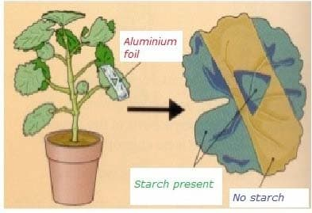
Experiment One: Light and photosynthesis
Aim: to find out if leaves need light to make starch.
Method
Cut a strip of tin foil and place it across a suitable soft leaf on a plant and hold it in place with paper clips.
Leave the leaf on the plant in a sunny place for 48 hours.
Carry out the starch test and record your findings.
Results:
Conclusion:

Slide 7
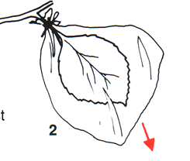
Experiment 2:
Carbon dioxide and photosynthesis
Aim: to find out if plants need carbon dioxide to make starch
Method
Put soda lime in the plastic bag and gently seal a leaf on the plant into the bag.
Leave the plant in a sunny place for 48 hours
Carry out the starch test and record the result
Results:
Conclusion:

Slide 8
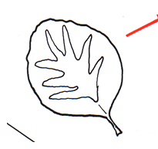
Experiment 3-Chlorophyll and photosynthesis
Aim: to find out if chlorophyll is needed to make starch.
Method
Using a variegated leaf carryout the starch test and record your results.
Results:
Conclusion:

Slide 9
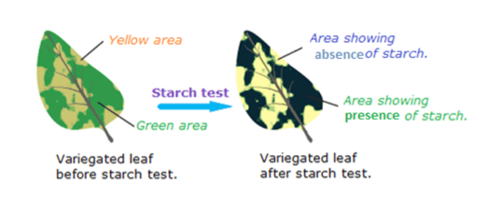
Result

Slide 10
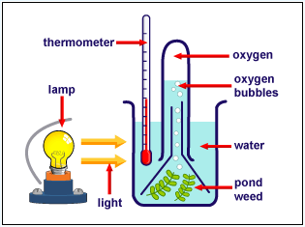
Discussion Activity
Discuss what this investigation in the diagram is testing?

Slide 11
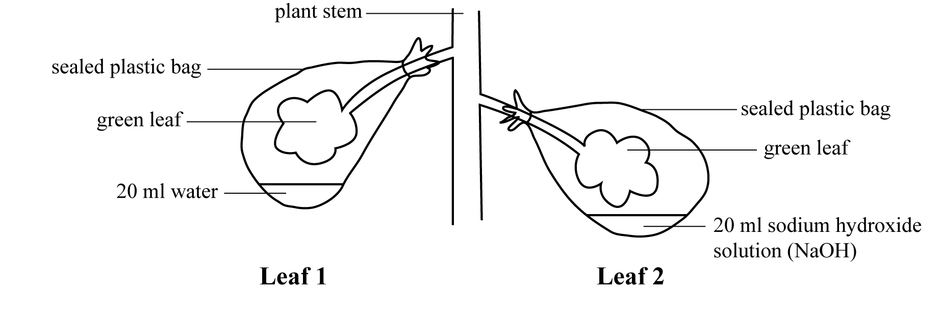
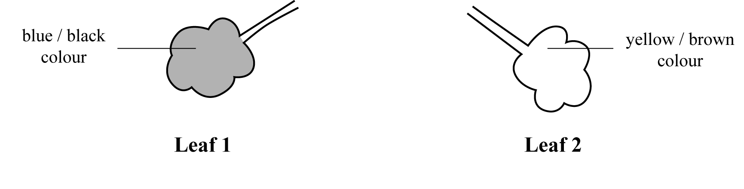
Discussion activity
In an investigation of photosynthesis, leaves of a destarched plant were treated as shown below, and the plant left in a sunny place for 2 days.
After two days an iodine test on both leaves gave the following results:
Result

