Slide 1


Slide 2
Plant Life Cycles

Slide 3
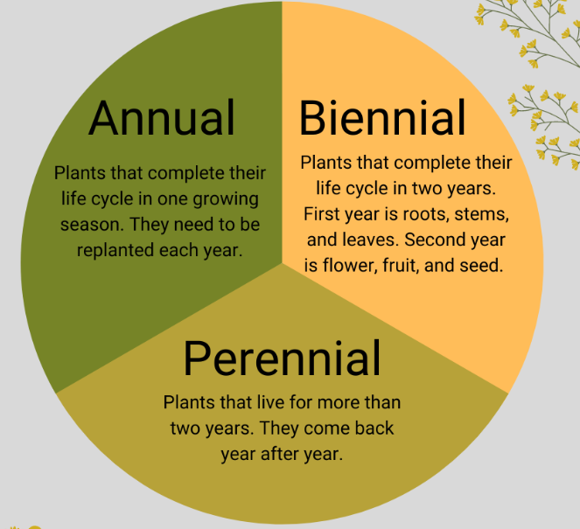

Slide 4
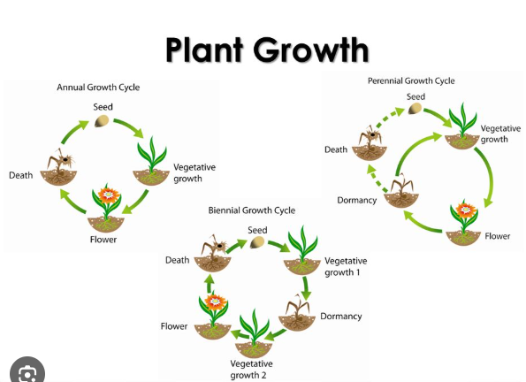

Slide 5
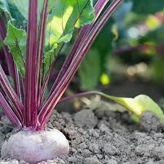
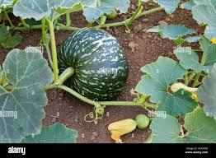
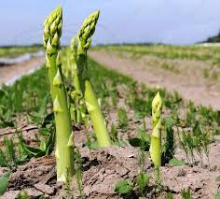
Examples of annual, biennial and perennial crops
Annual | Biennial | Perennial
sweetcorn | beetroot | asparagus
lettuce | carrots | apples
peas | onions | lemons
squash | turnips | Feijoa
wheat |  | strawberries
watermelon |  | blueberries

