Slide 1


Slide 2
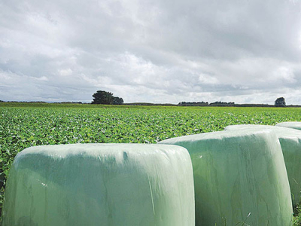
Balage

Slide 3
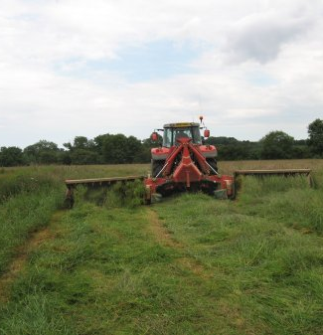
What is balage
Balage, silage, and haylage are names for the same basic product: ensiled grass. It doesn't matter whether the grass is going into a massive silage pit or a plastic-wrapped bale - the process is the same.

Slide 4
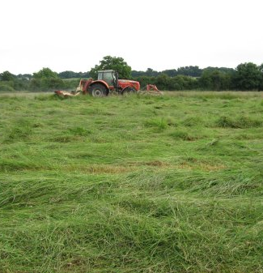
Mowing
Cut mature pasture with not more than10-15% seed head emergence = balage with high nutritional value.
Cut pasture in the middle of the day - high sugar content = good balage.
Cut when dry on a sunny day, not in the rain
Poor quality pasture will always make poor quality balage.

Slide 5
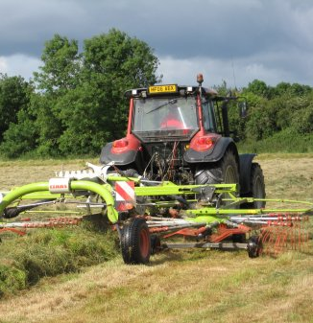
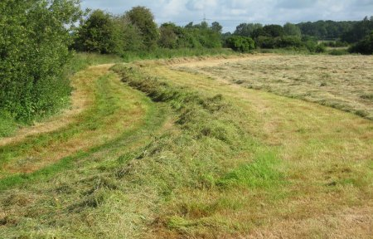
Wilting
Cut the grass later in the day, when the sugar content will be higher.
High plant sugar concentrations improves the fermentation process.

Slide 6
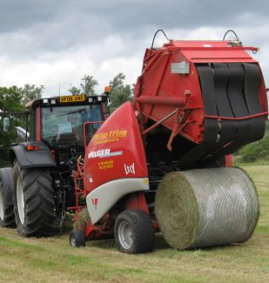
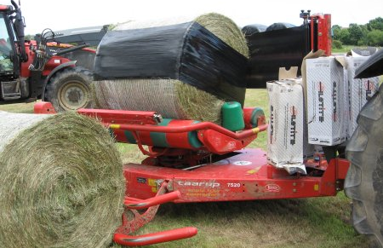
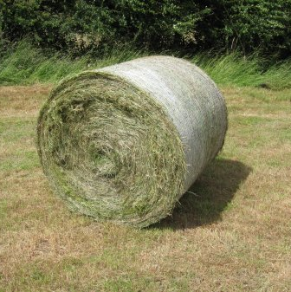
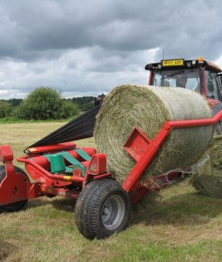
Baling
Bale when pasture reaches 25% drymatter.
Bales should be compressed tightly to get rid of oxygen to stop respiration
Wrap bales as soon as possible sealing the pasture allows lactic acid to build up dropping pH to 4.2

Slide 7
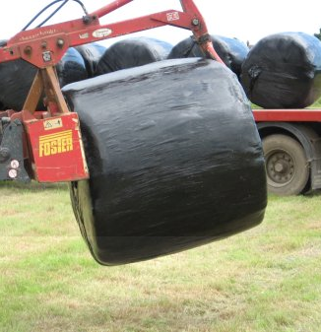
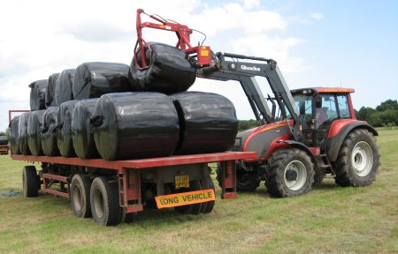
Storage
Move bales as soon as possible after wrapping to their final resting place
Transport bales with care to avoid puncturing the wrap
Check bales regularly for holes and tape them up.

Slide 8
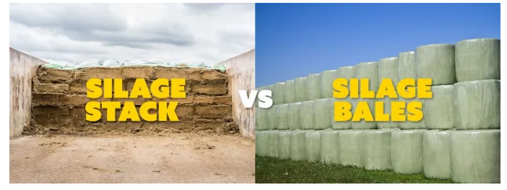
Benefits of balage versus pit silage methods:
Bales are compressed equally by the baler and you’re not reliant on the compactor drivers skill to ensure a traditional stack is packed correctly.
Bales are packed tighter than a silage stack can ever be packed, eliminating air from the silage, ensuring better quality feed.
Capital equipment outlay and maintenance is substantially reduced
Waste from stacking a pit or silage stack is eliminated, by using bales.
There is no waste at the loading site
Most operators can take bales out of a stack without spilling it, driving over it, when loading a wagon, there’s no dirt including in the wagon from a bad operator scraping the ground to get that last bit of silage, nor the waste on the floor or sides of a pit.
An expensive silage shear, that requires frequent sharpening is not required to pull the silage from the stack, and a smooth sealed face to the stack is retained, that is sealed to prevent spoilage, eliminating secondary fermentation.
There’s no need for costly concrete bunkers for storage, to reduce waste, and the risk of running out of space in the bunker.
Stacks can be positioned around the farm to reduce travelling during feedout.
Balage can be bought or sold

Slide 9
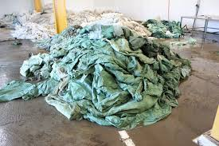
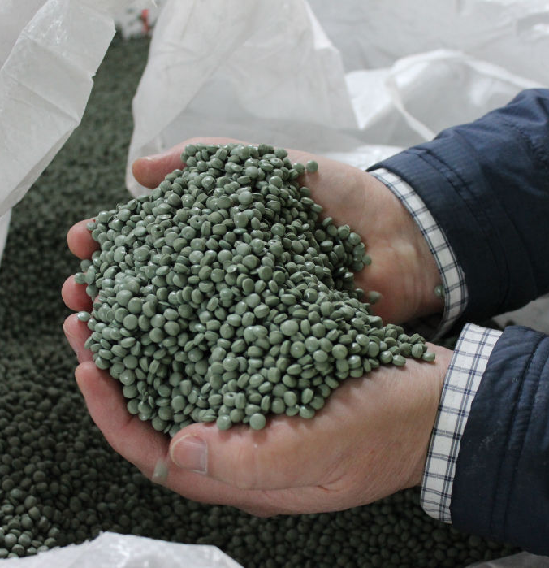
Environmental considerations
The effluent from silage is an environmental hazard and is lethal to wildlife in waterways, as it eats up oxygen.
Silage wrap is now an environmental hazard; it needs to be recycled, not burnt or buried on farm.

Slide 10
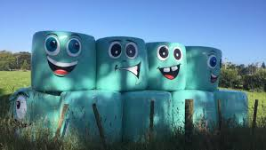
Discussion activity
Why do farmers make balage instead of just letting livestock eat pasture in the paddock all year round?

