Slide 1
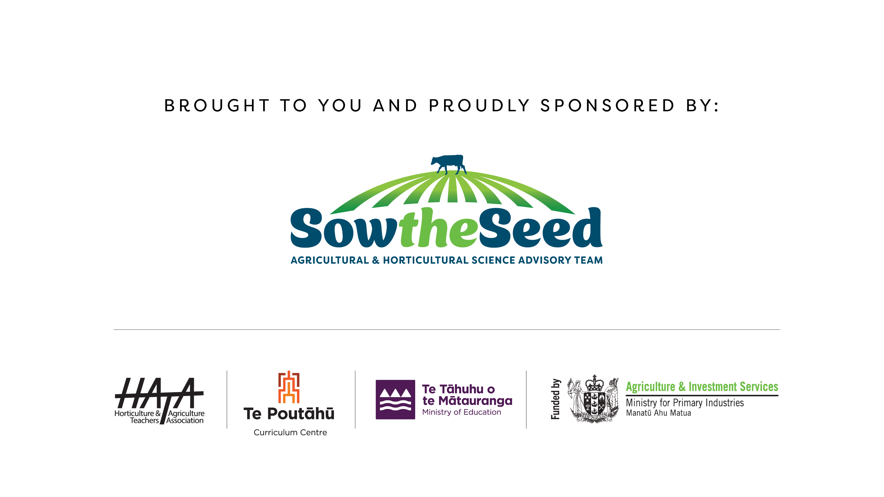

Slide 2
Grazing systems

Slide 3
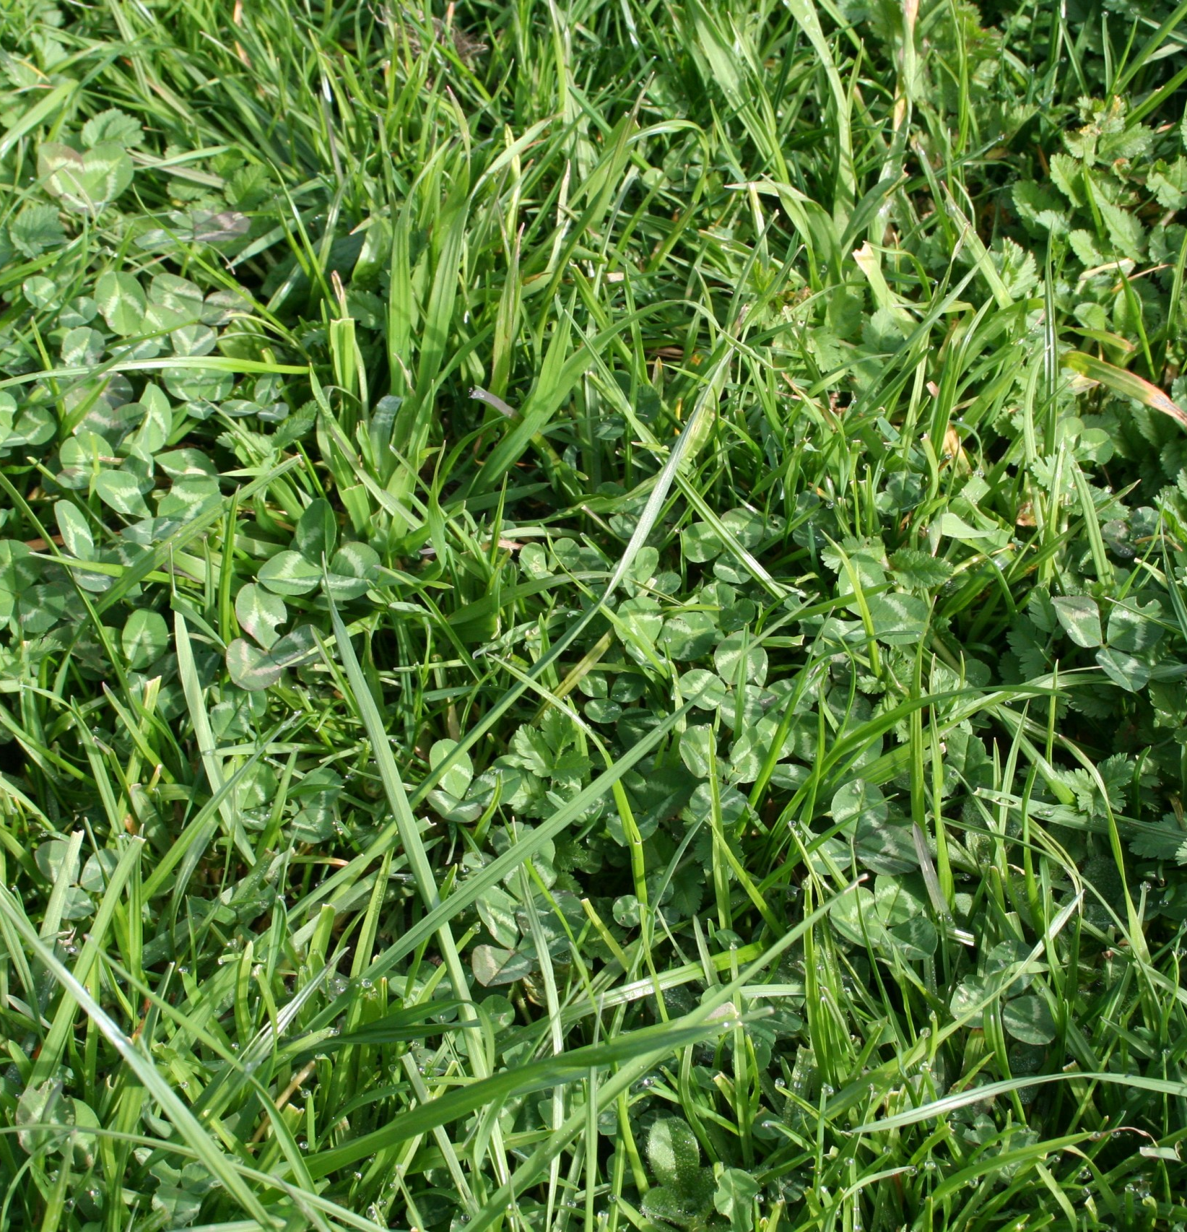
Grazing Management
Grazing intensity and pasture cover directly impact pasture quality and quantity which in turn affects pasture intake. To achieve the best results, grazing management should focus on maximising future pasture growth and quality while supporting livestock production.
Successful pasture management starts with controlling the area grazed.
Farmers use grazing methods that best provide the feed requirements of livestock while at the same time maintaining the pasture quality.

Slide 4
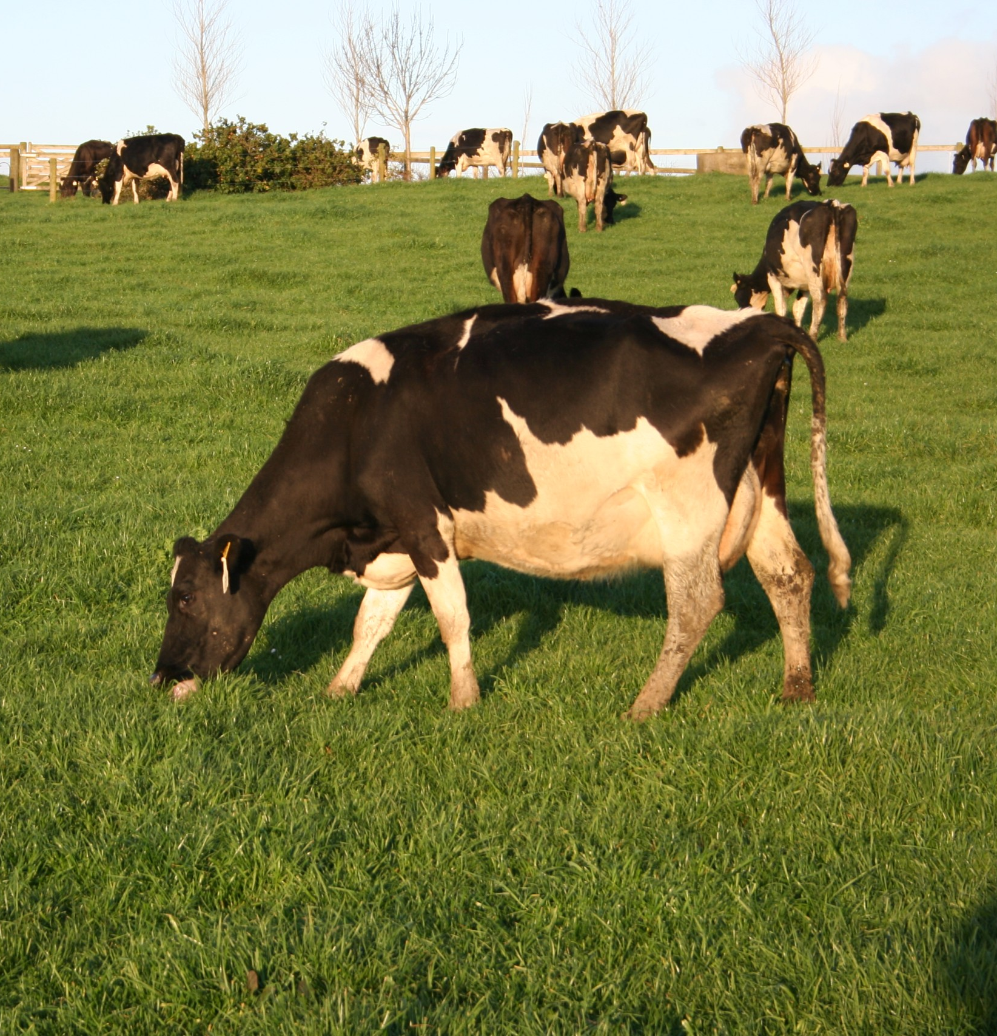
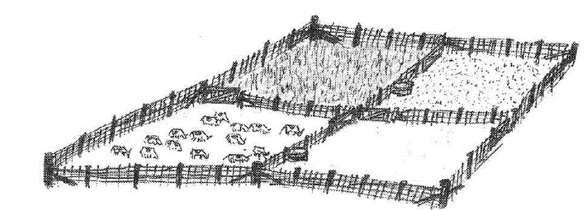
Rotational grazing
Livestock are moved through various paddocks in a systematic rotation.
There are usually several mobs being rotated, as different stock groups have different feed requirements. (e.g. young stock, milking cows).
Livestock should graze the whole pasture allocation to an even residual to maintain pasture quality.
Regular rotation helps keep pastures actively growing and reduces shading of clovers
Overgrazing can damage the pasture and soil health.

Slide 5
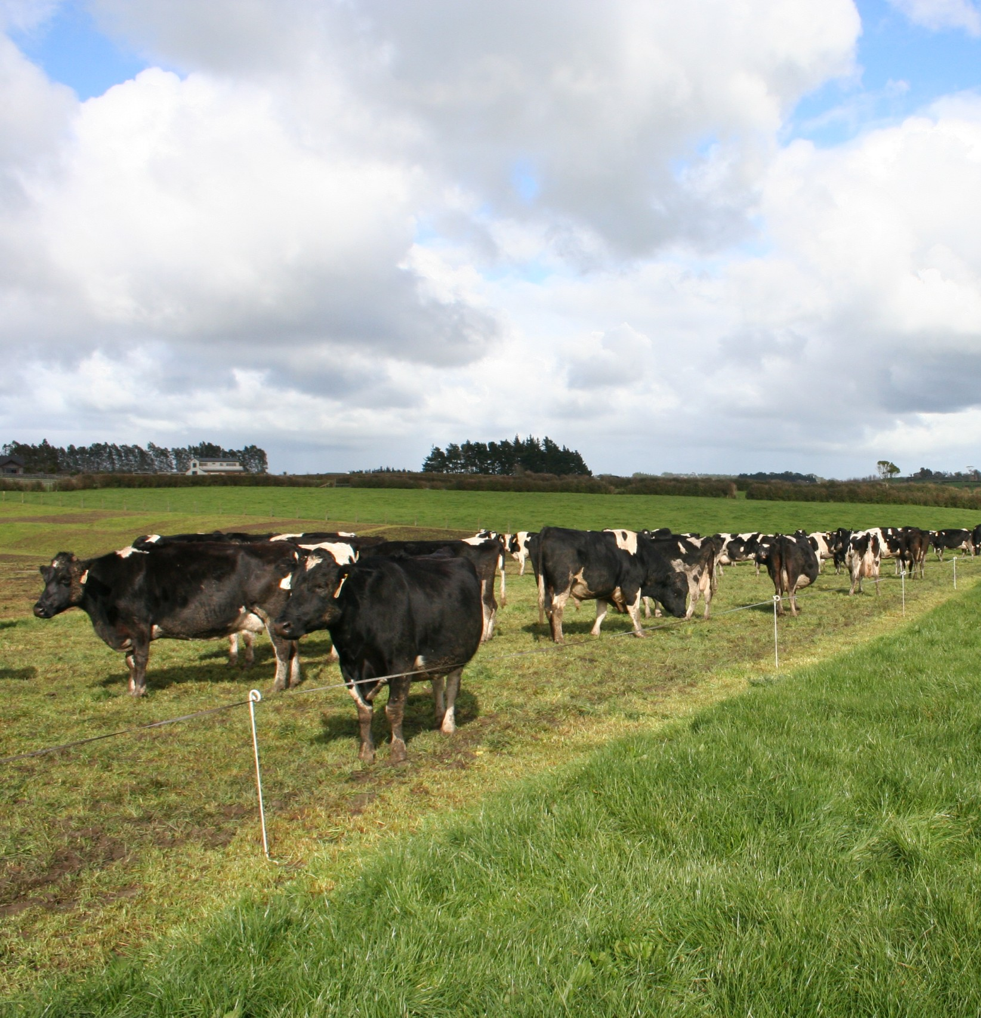
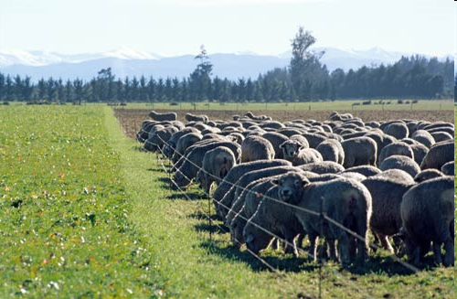
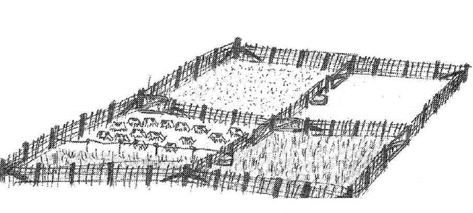
Break feeding / Strip grazing
Break or strip feeding is commonly used on dairy farms and involves subdividing paddocks into smaller sections using electric or invisible fencing with cow collars.
When livestock have grazed the pasture to the required residual they are moved onto the next break.
Break feeding is a very intensive form of rotational grazing.
Break feeding is frequently used for managing forage crops, such as turnips and kale, to ensure optimal utilisation.
Care must be taken to avoid pugging and overgrazing, which can damage both pasture and soil health.

Slide 6
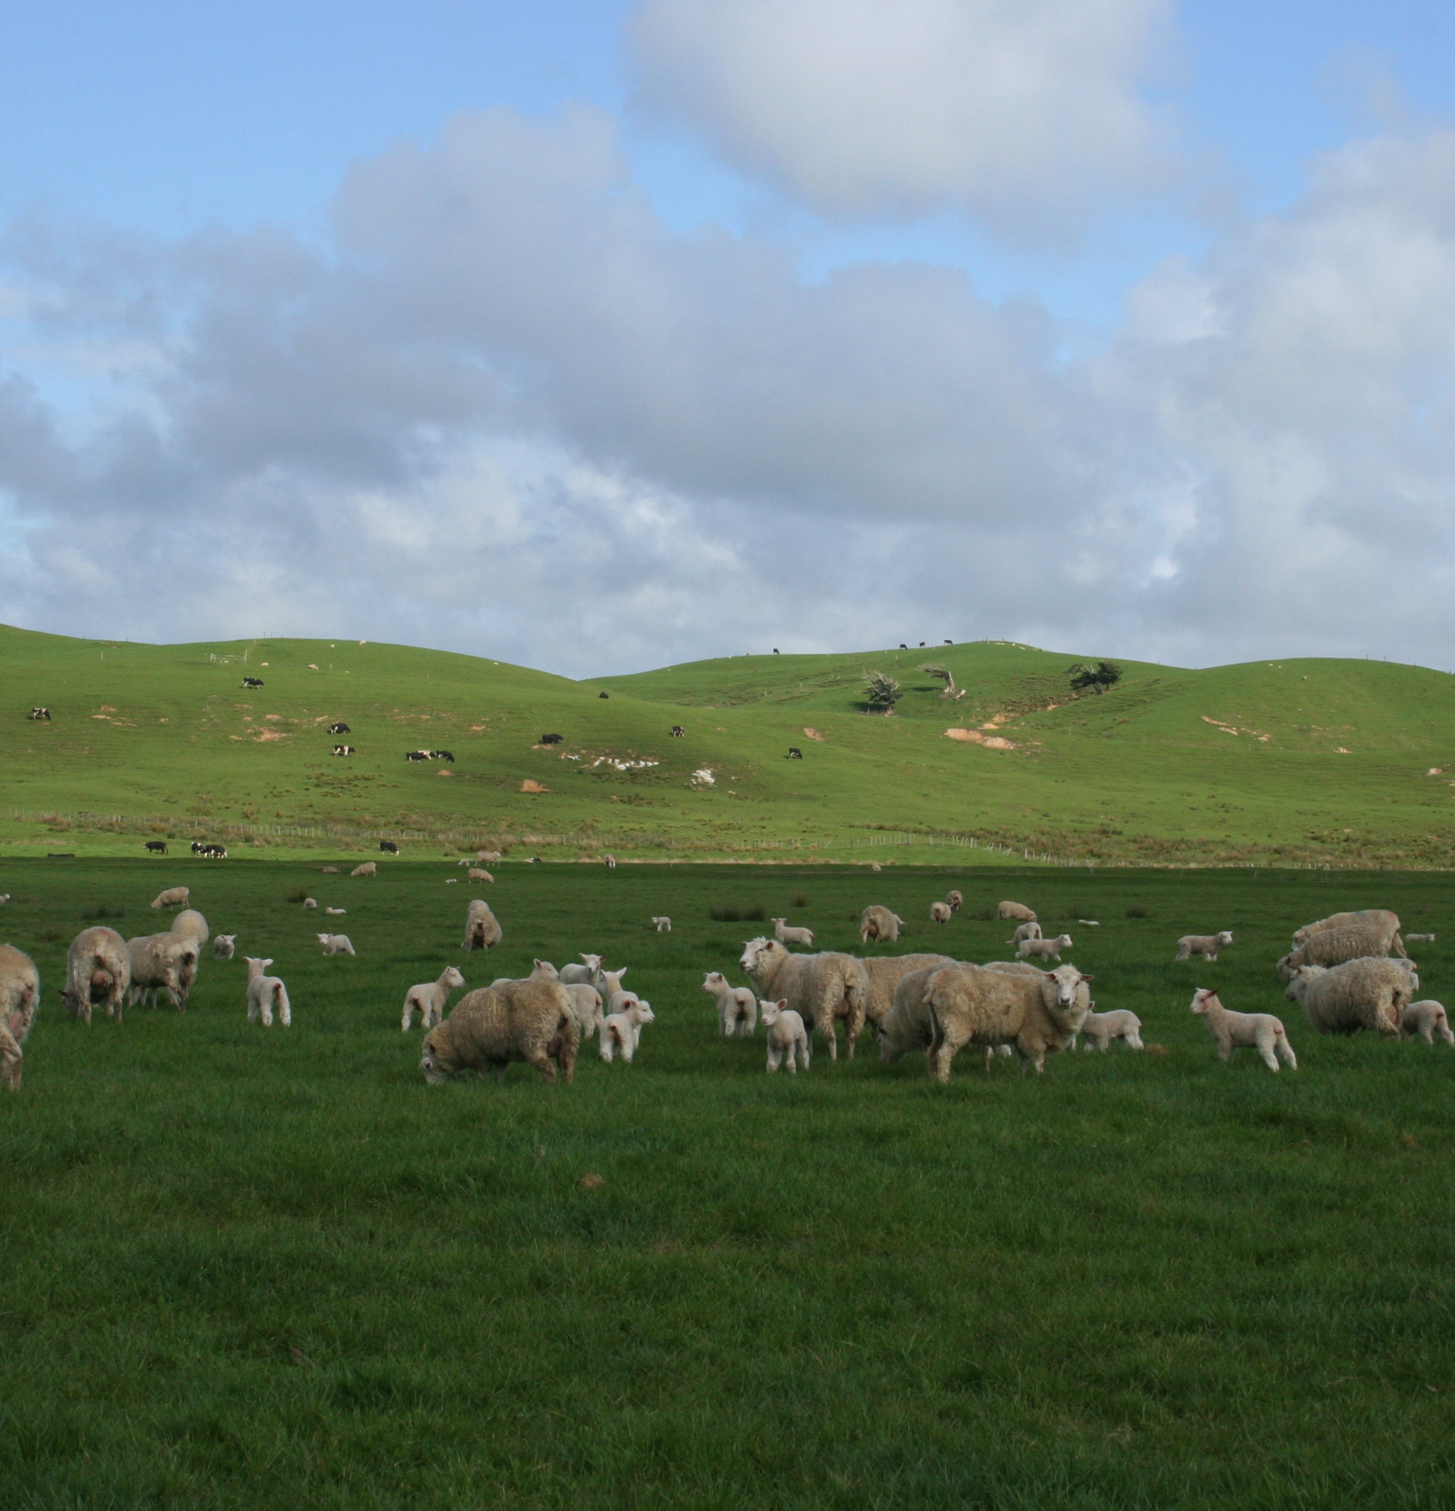
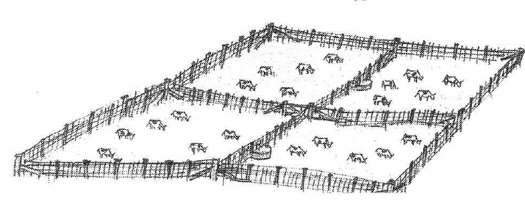
Set stocking
Set stocking involves maintaining a fixed stocking rate where livestock are spread across the farm and remain in their assigned paddocks without regular movement
It is difficult to balance the number of stock in each paddock with pasture growth, therefor under-grazing or over-grazing can occur.
Livestock can also choose what they graze, and tend to eat out more palatable plants, leaving the less palatable plants to become rank uneven growth.
Set stocking is commonly used during specific periods such as lambing.

Slide 7
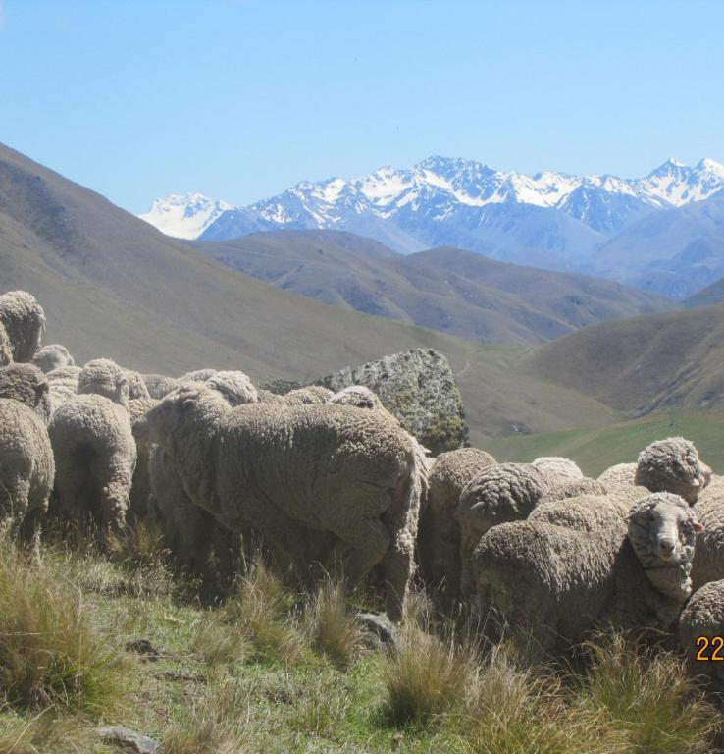
Extensive grazing
Extensive grazing is typically used in large, less fertile areas such as the South Island High Country, where stocking rates are very low and livestock graze with minimal management.

Slide 8
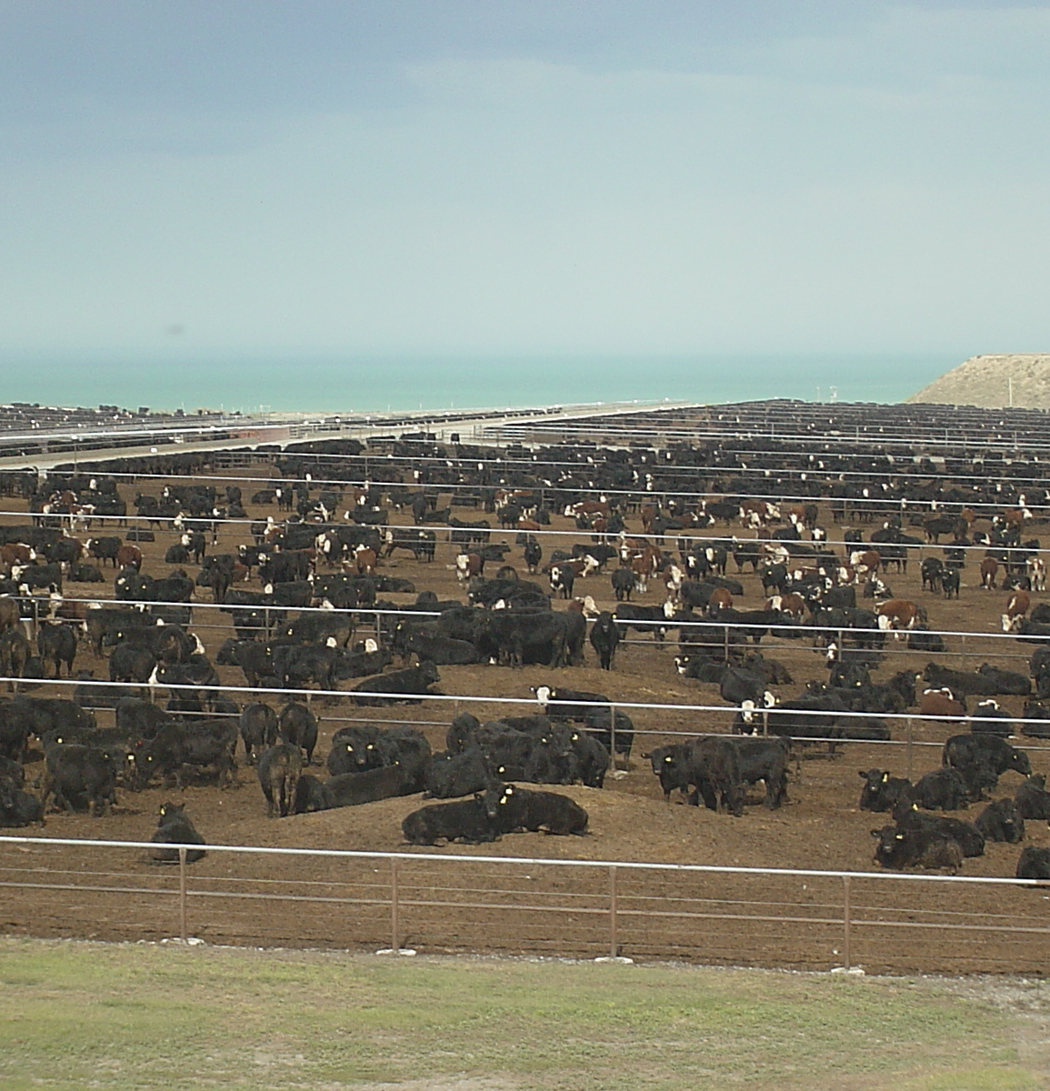
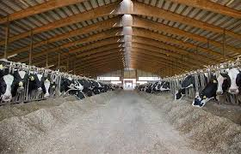
Zero grazing
This system is common overseas where stock are kept in barns and pasture, pasture supplements are cut and carried too them and fed with other concentrate feeds.
Zero grazing occurs on feedlots and is only carried out in a few areas in New Zealand.

Slide 9
Discussion activity
A sheep farmer decides to set stock ewes at lambing until after docking rather than using rotational grazing.
Discuss why a farmer would use a set stocking grazing system with ewes at lambing instead using rotational grazing.

Slide 10
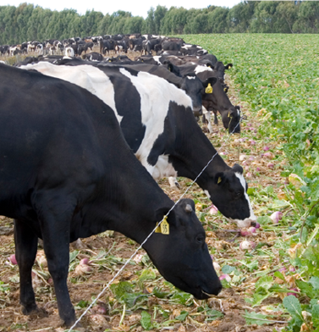
Discussion activity
Discuss why a dairy farmer break feeds turnips to milking cows during the summer.

