Slide 1


Slide 2
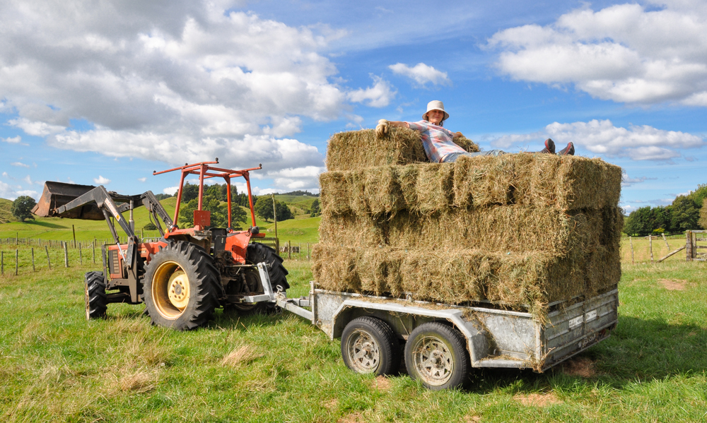
Hay Making

Slide 3
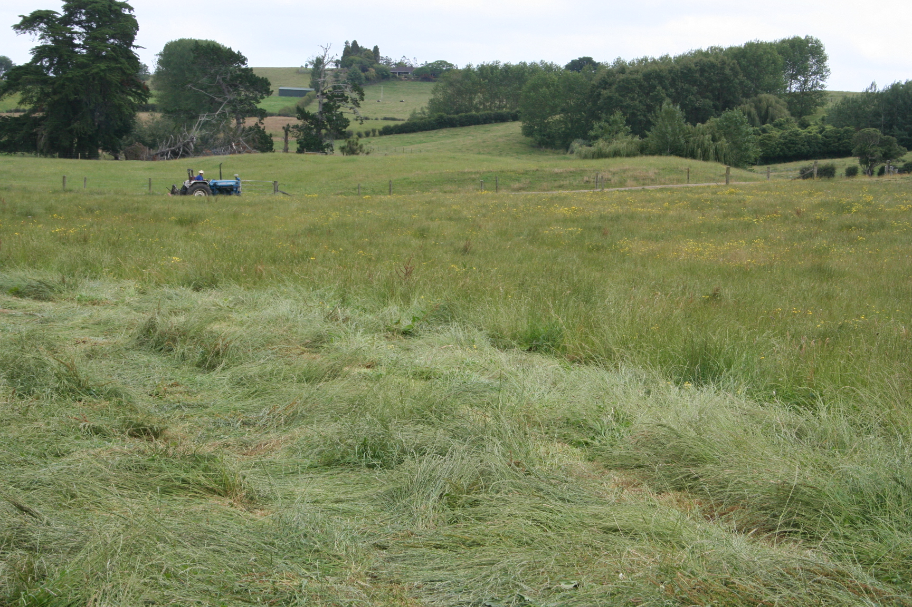
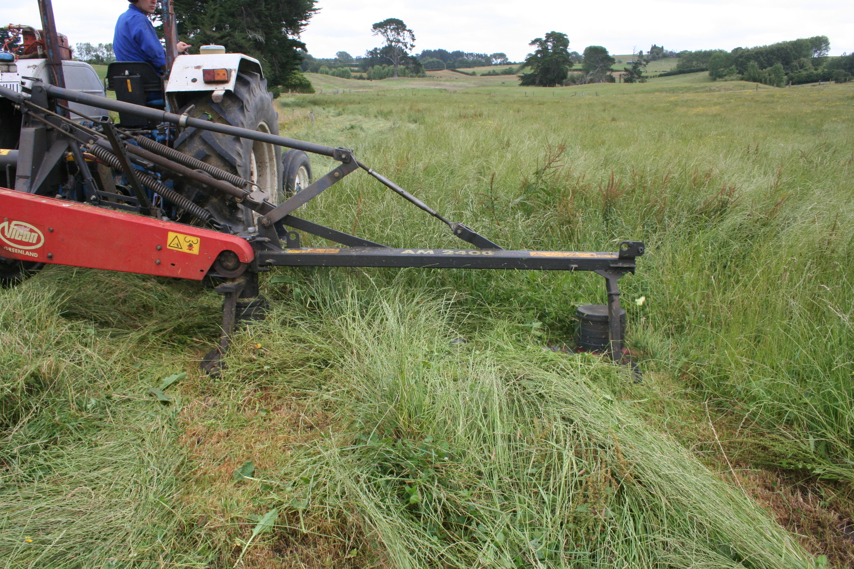
Mowing hay
Pasture hay should be cut when no more than 50% of the grasses are in the early flowering stage. At this stage of growth, the pasture will not be at if maximum weight but close to it. However, the lower weight will be more than compensated for by higher nutritional value and digestibility.
Cut hay in dry conditions (minimum of 3 days), the faster the drying process the less respiration losses and the better the quality of the hay.

Slide 4
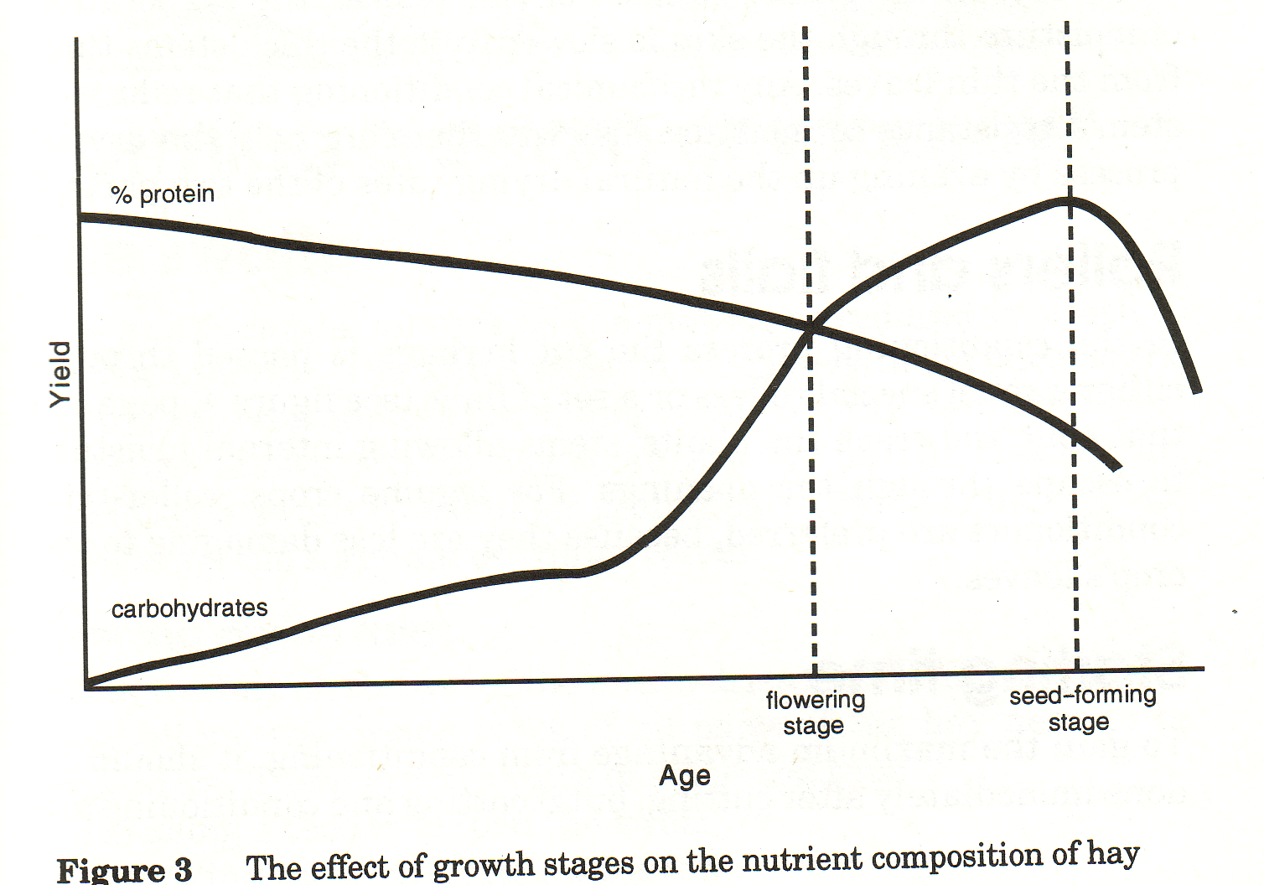
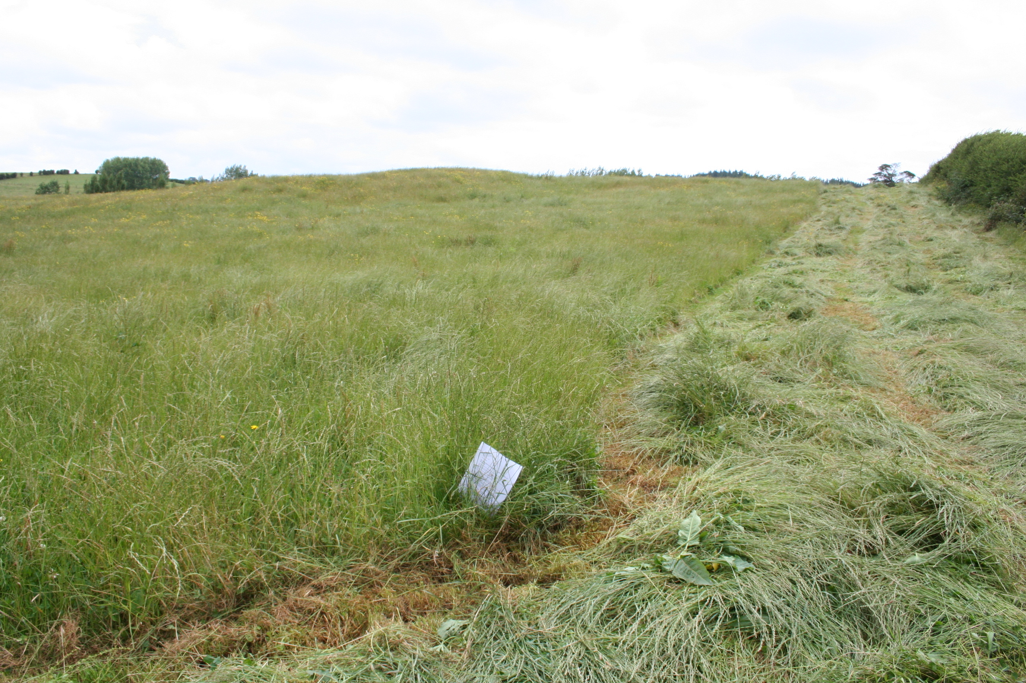
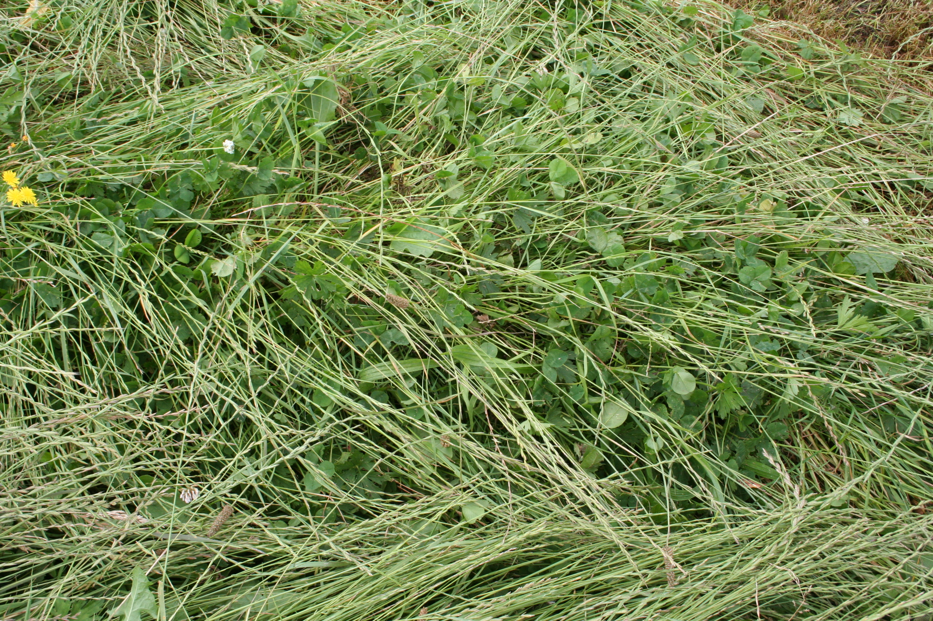
Quality pasture
Pasture high in clover/legumes will have higher nutritive value because they are higher in protein, lower in fibre and more digestible.
Pastures with a high percentage of weeds and grasses with lots of seedheads will make hay with low palatability and digestibility therefore will have a low nutritive value.

Slide 5
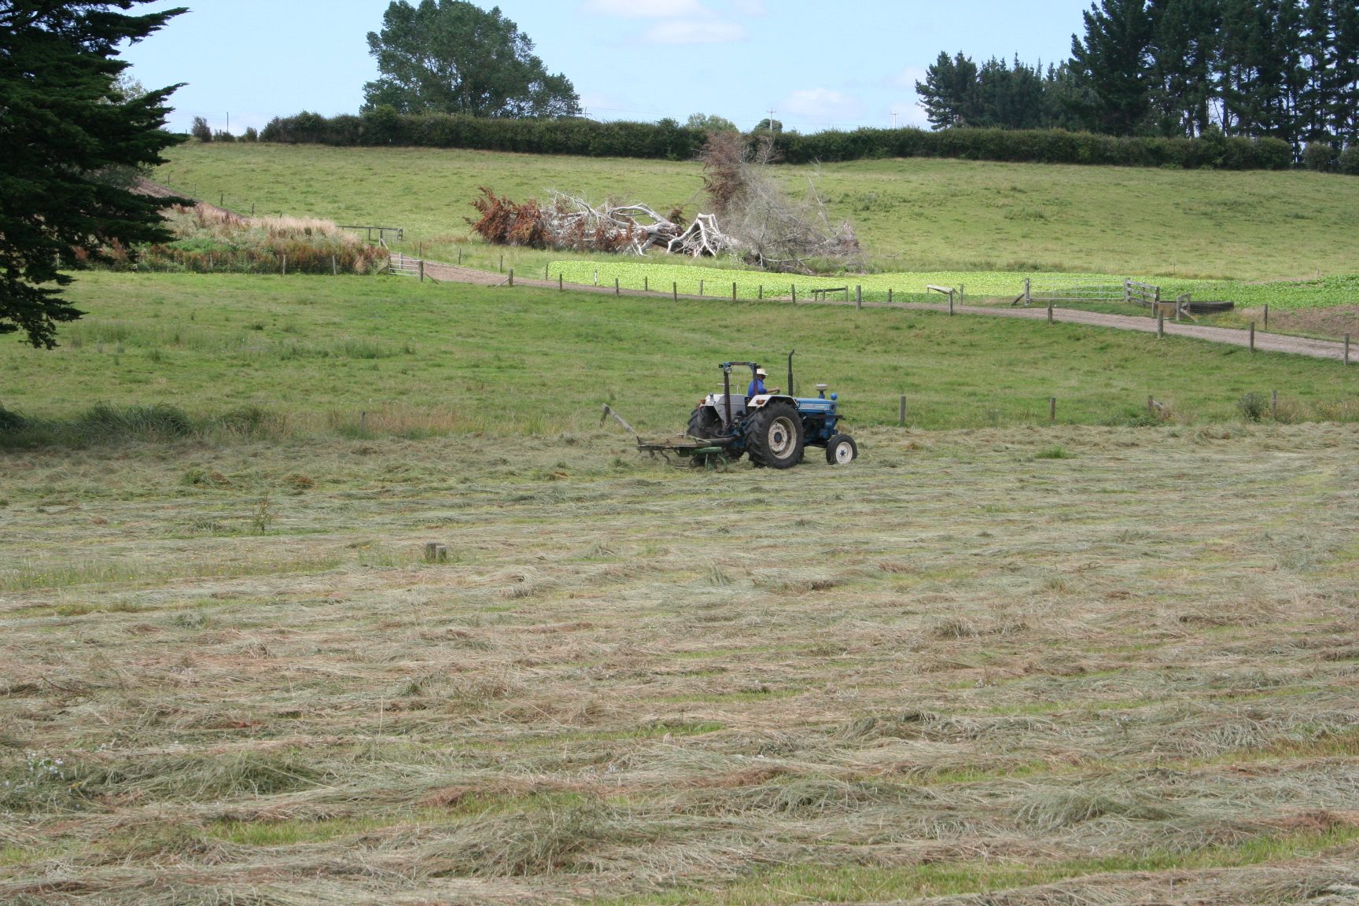
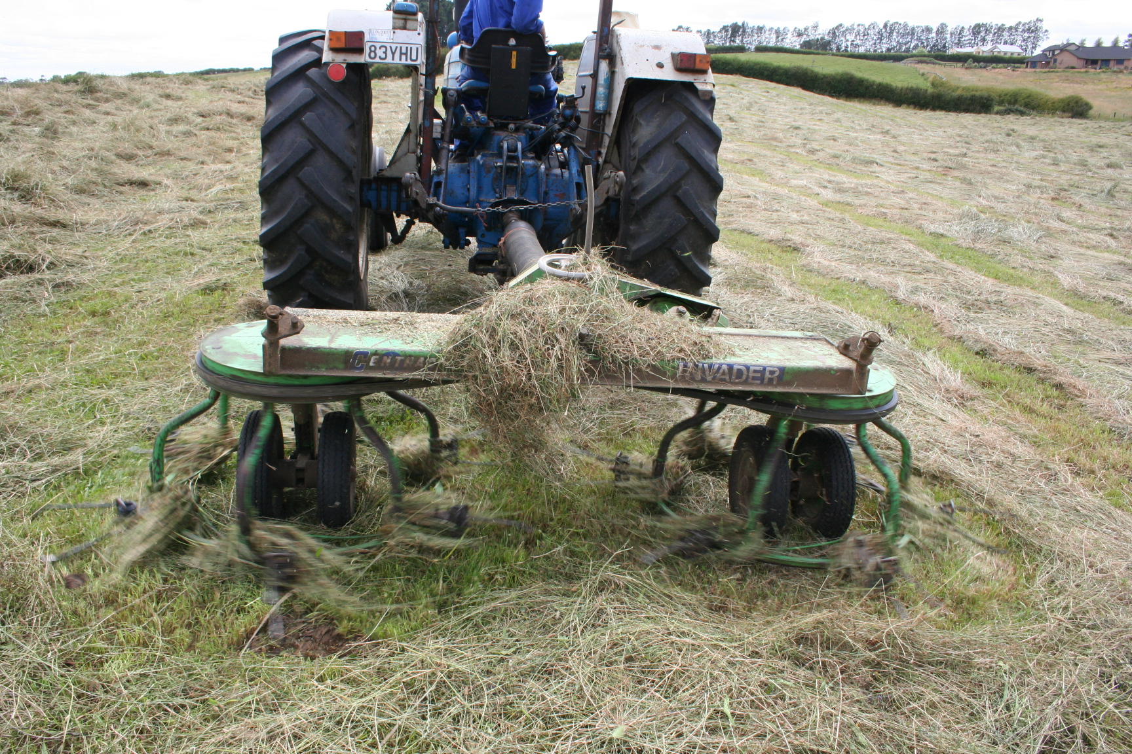
Tedding
A rake is used to turn the cut grass to expose the underside to the sun and air-allows drying to occur. Hay can be turned vigourously during the first three-quarters of the drying period.
To avoid leaf loss gently turning should be carried out after the moisture content has been reduced to 30-35%.
Conditioning the grass crop means bruising, crushing the stems. This process speeds up the rate of moisture loss minimising nutrient loss through respiration.

Slide 6
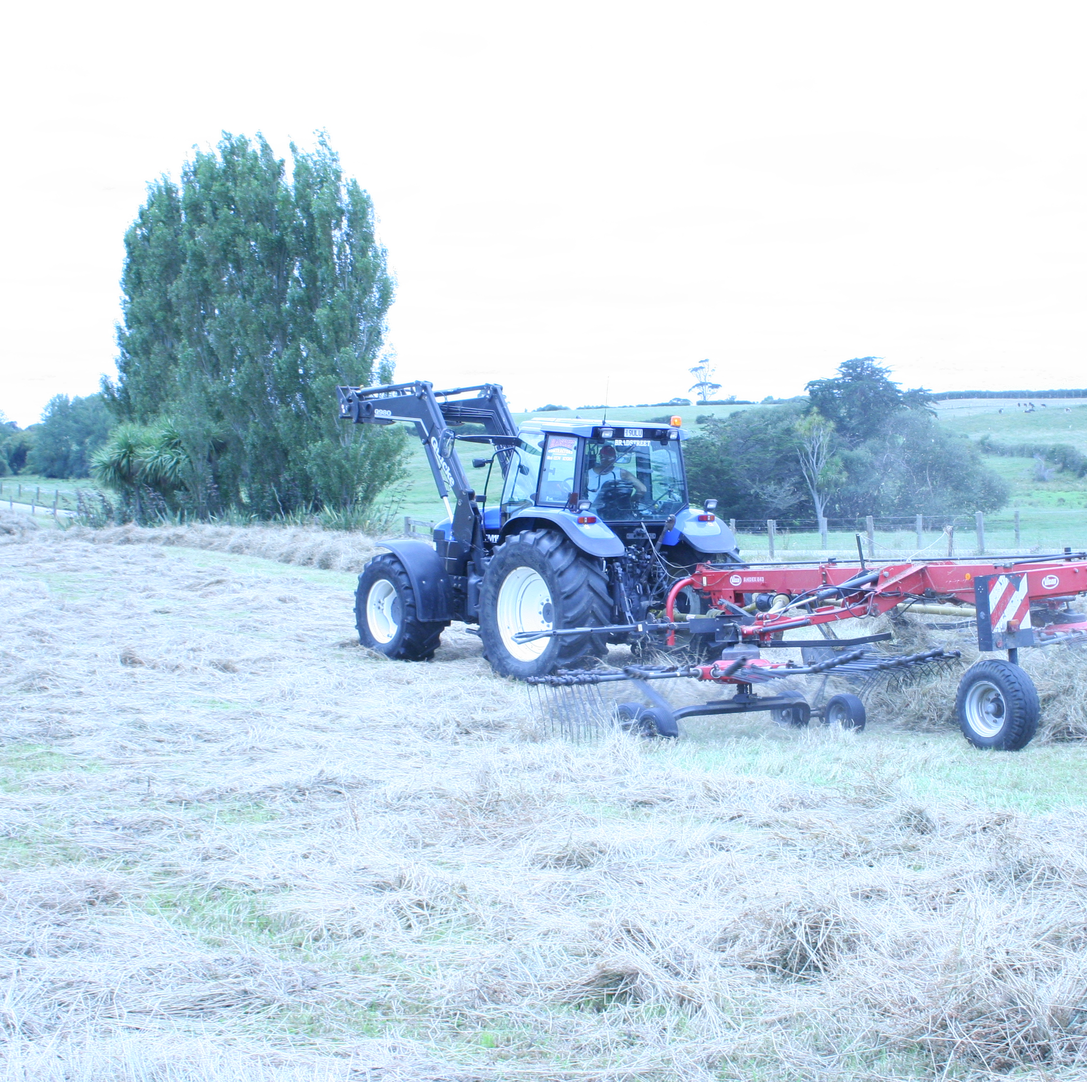
Windrowing
Dry hay as quickly as possible to less than 25% moisture content. Plant respiration stops maintaining the nutritional value of the pasture.

Slide 7
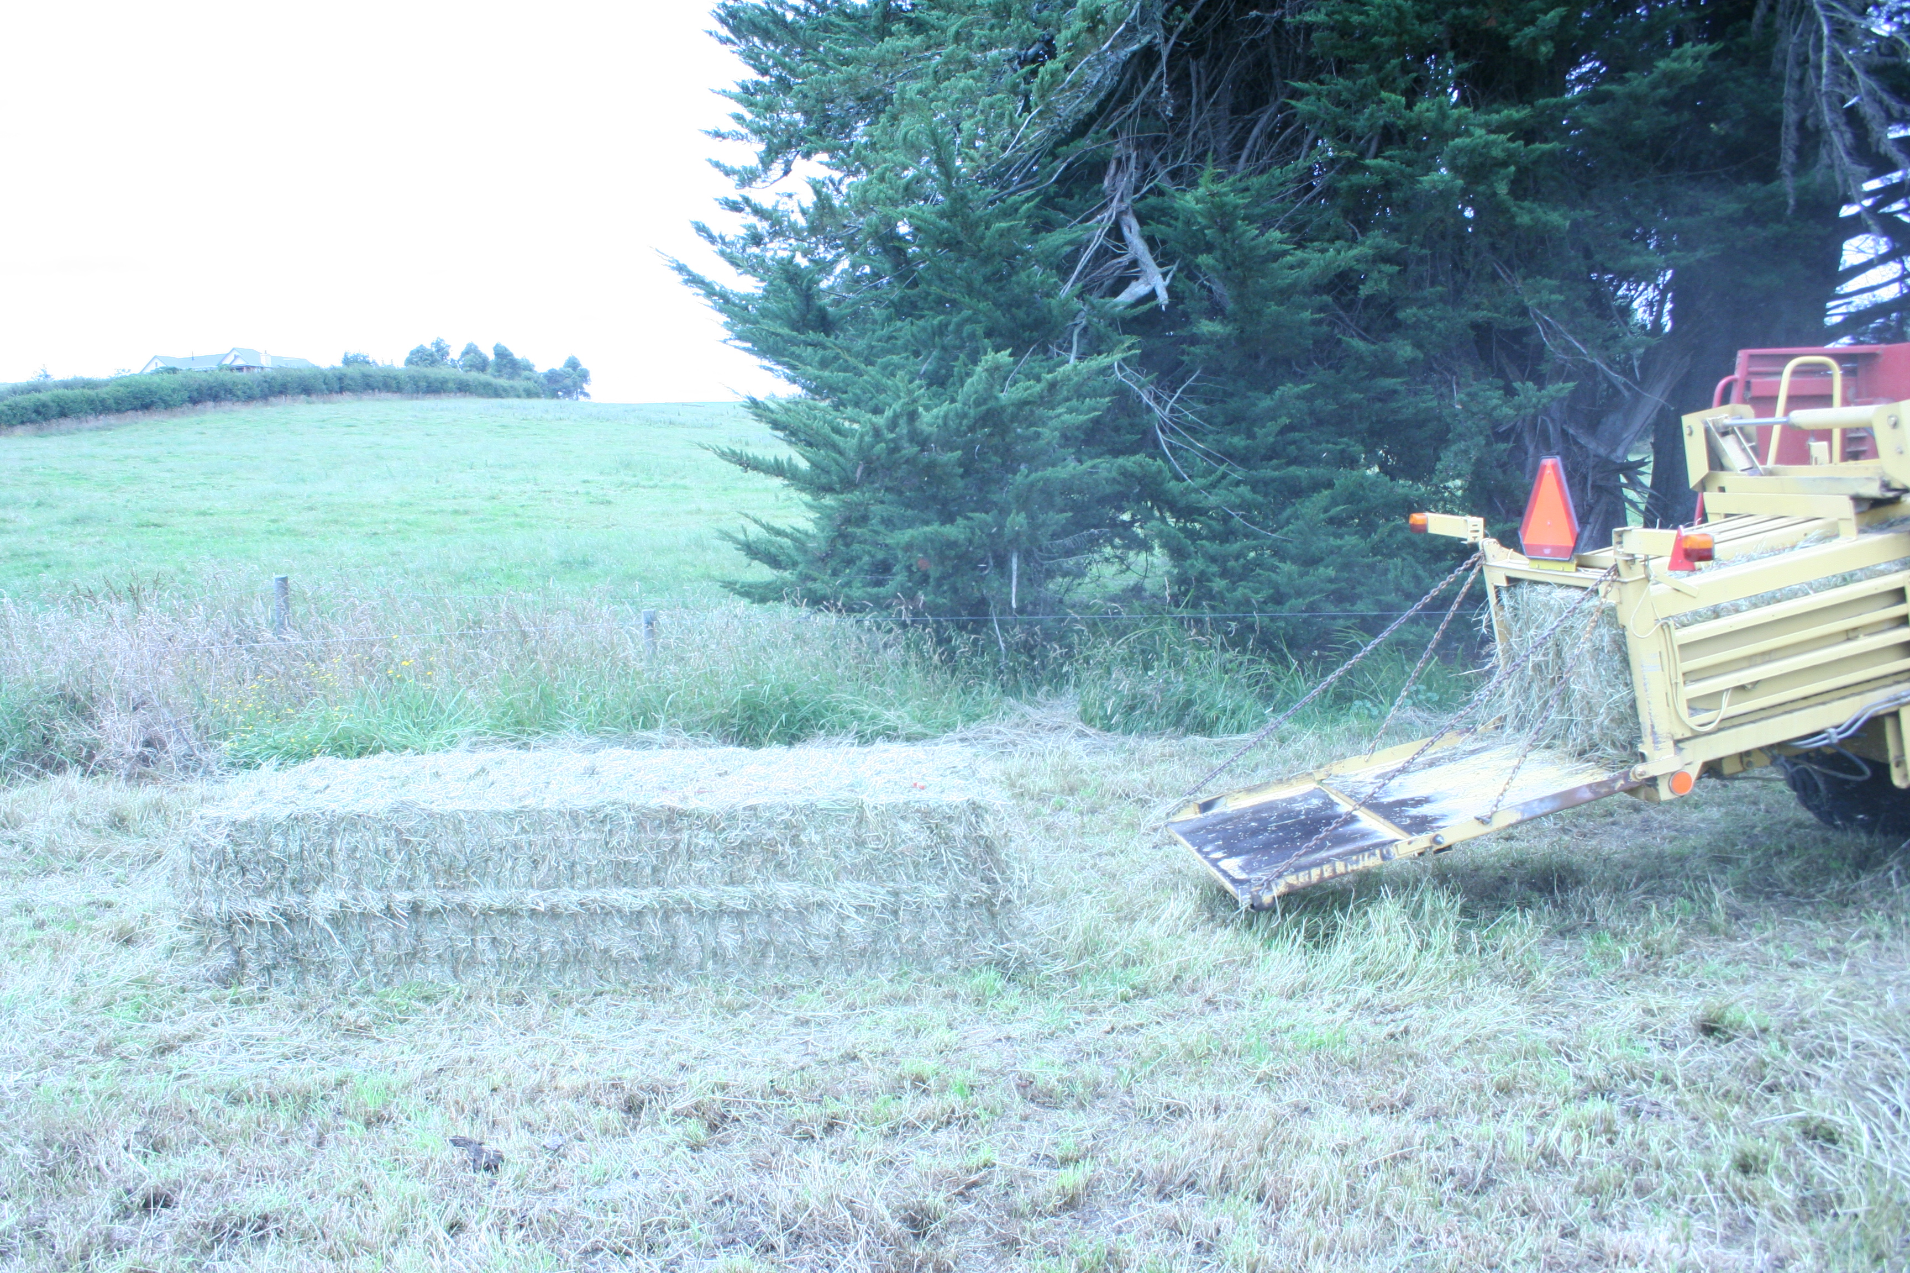
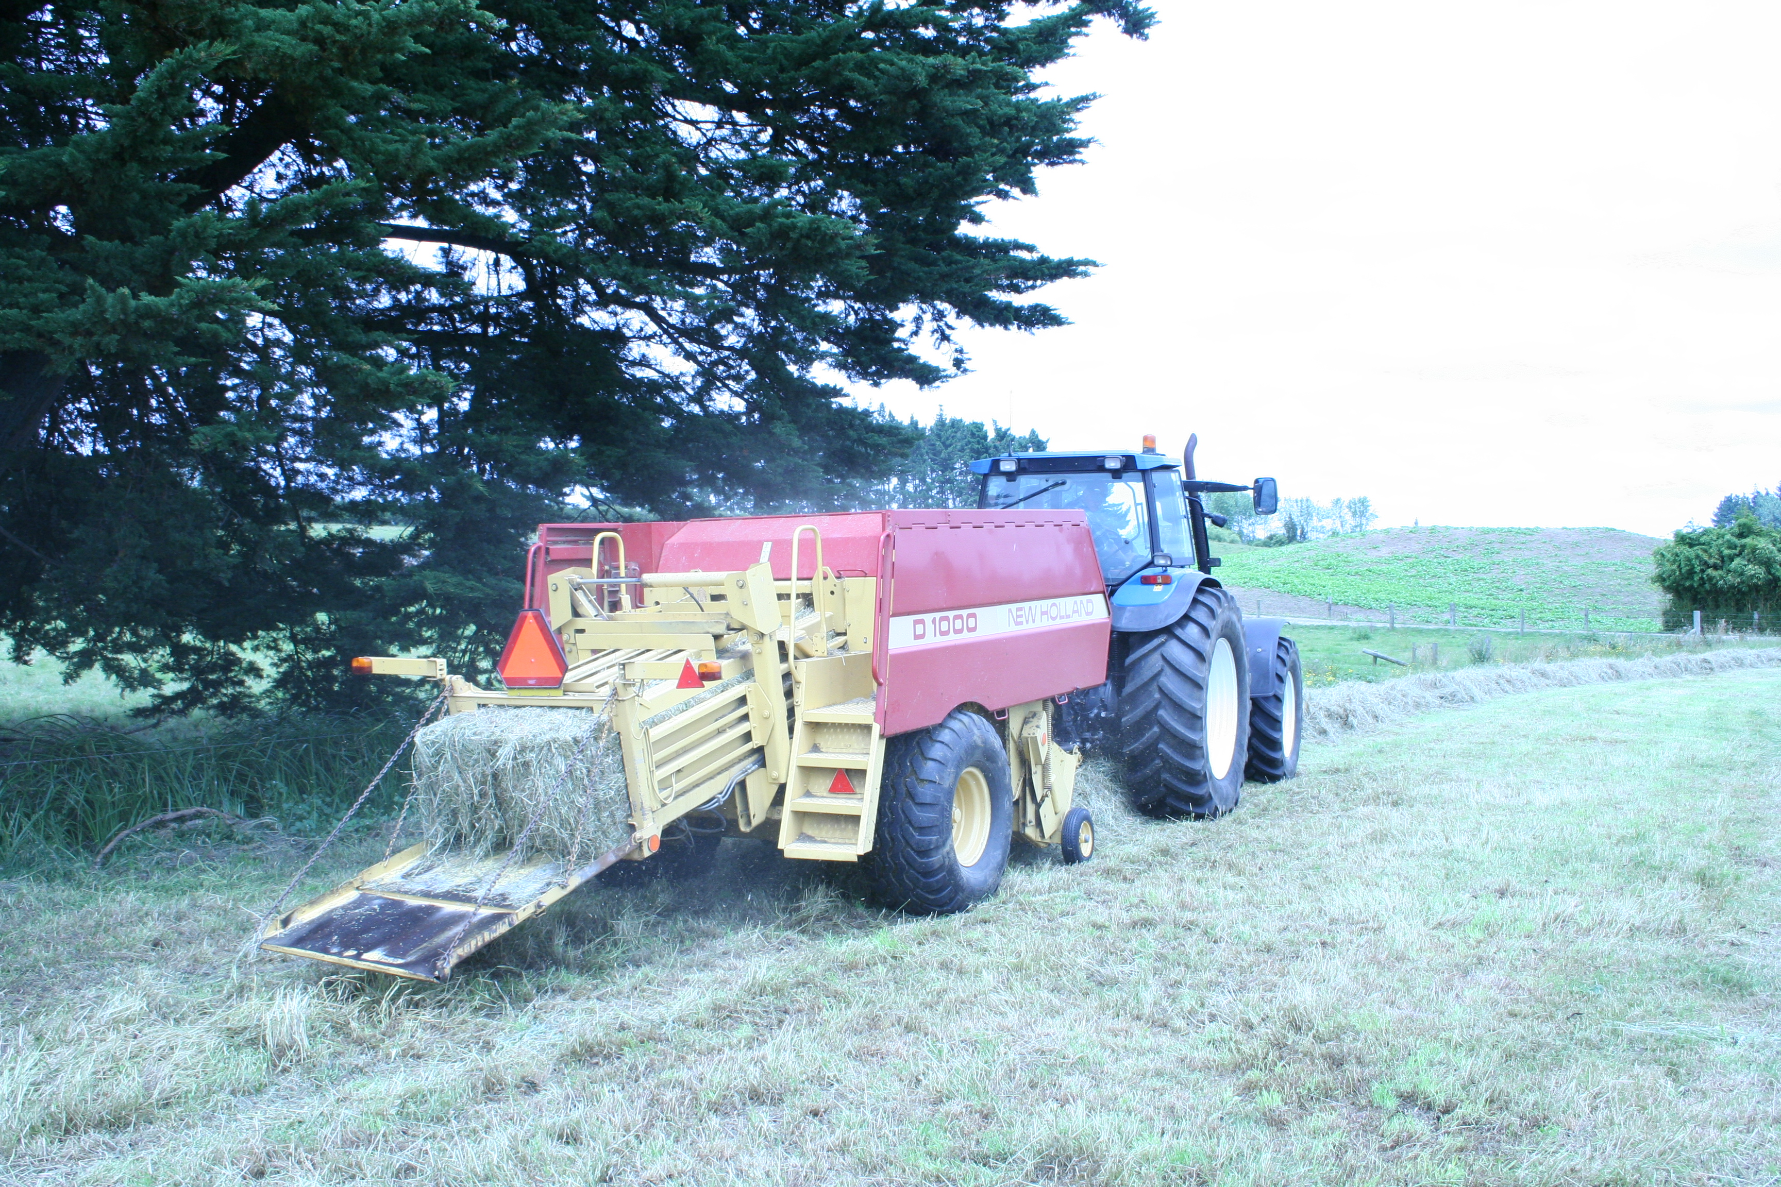
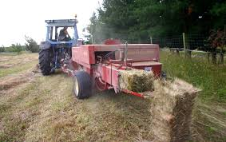
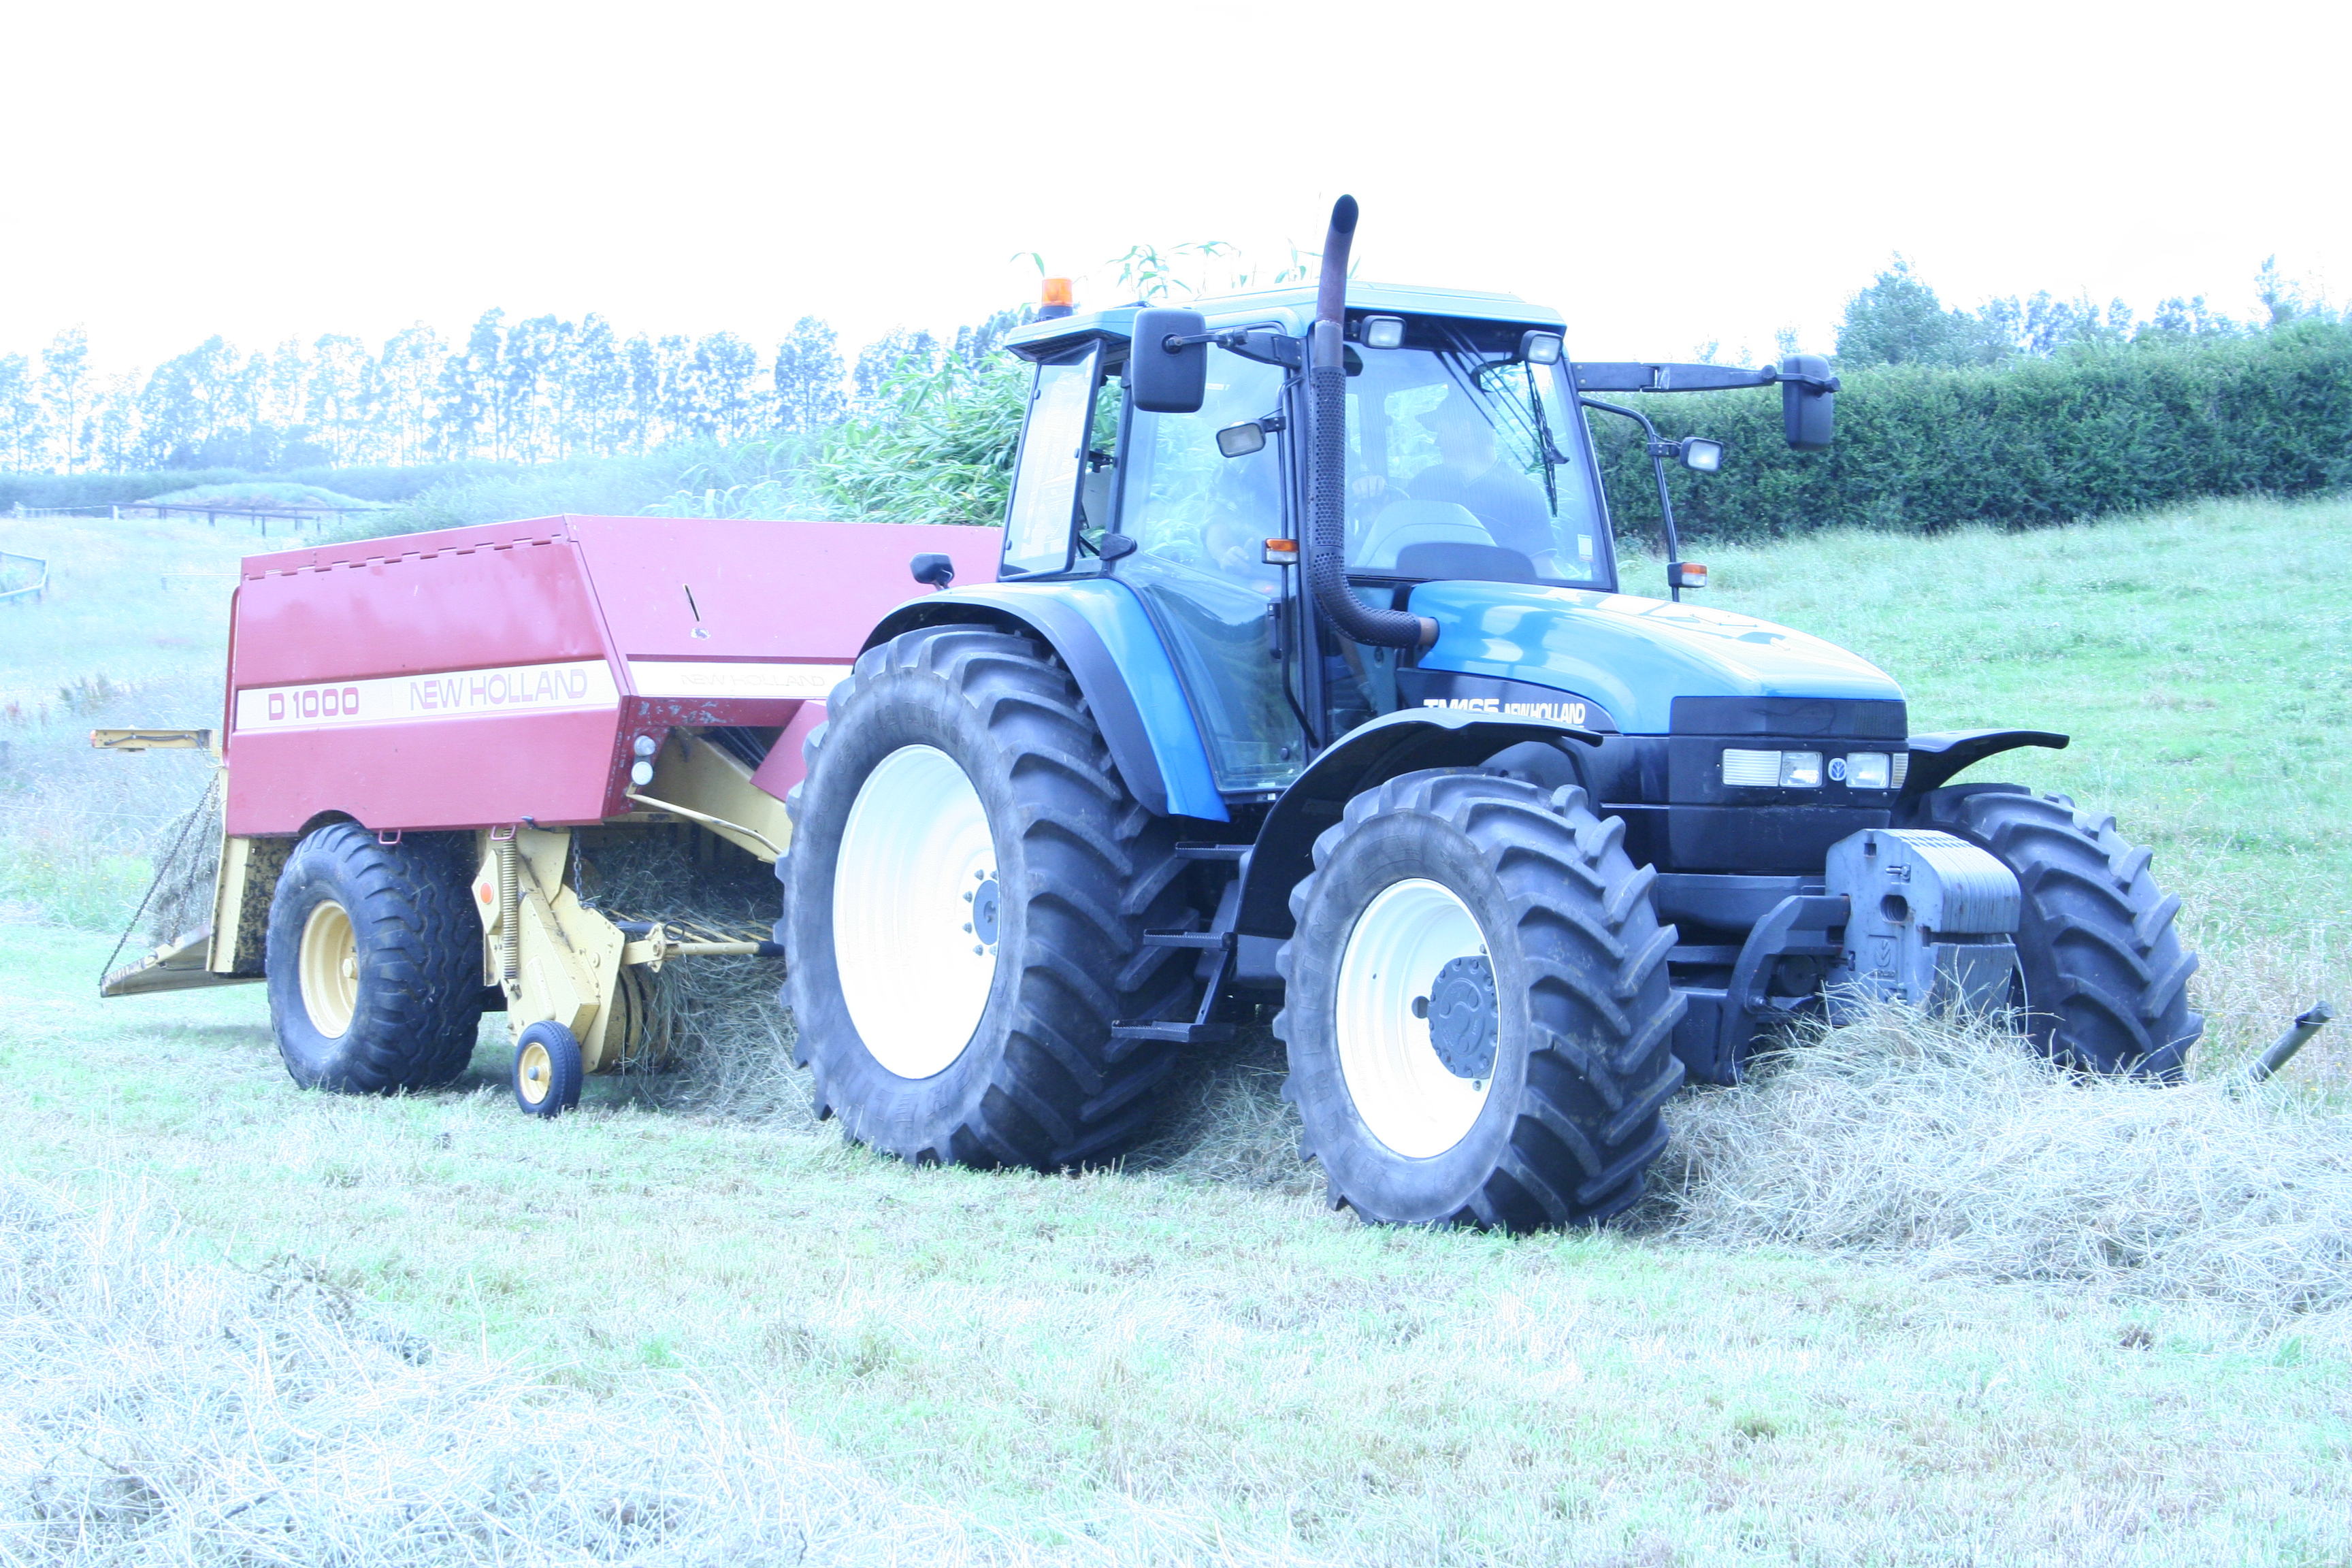
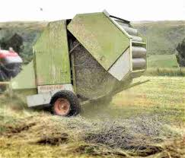
Baling
Bale when moisture content is less than 25%.

Slide 8
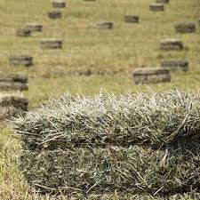
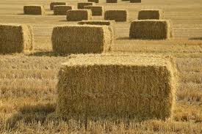
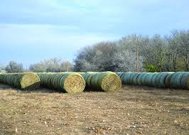
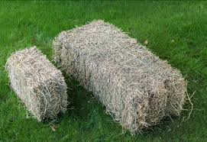
Types of bales
The type of bale made will depend on end use and feeding out equipment.

Slide 9
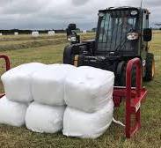
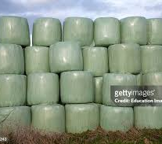
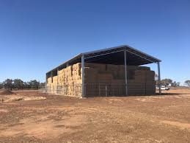
Storage
Once hay is baled it is important to protect if from the weather to maintain its quality by storing it under cover, either wrapped in plastic or in sheds.
If hay is not protected significant losses in nutritive value can occur.
Exposure to rain will cause respiration and leaching losses increase the risk of molding which results in poor palatability and increase incidences of respiratory diseases in the stock eating it.

Slide 10
Discussion activity
Discuss why a farmer would make hay.
Discuss why pasture should be cut for hay when no more than 50% of the grasses are in the early flowering stage.

