Slide 1


Slide 2
Pasture & Crop Weeds

Slide 3
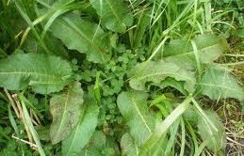
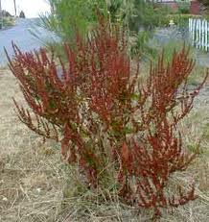
Dock
Dock is a perennial weed that has a large tap-root system
The seeds produced by docks each year are long-lived, so huge banks of dock seeds can build up within the soil
The foliage of docks contains tannins which makes them somewhat unpalatable to some livestock

Slide 4
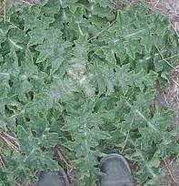
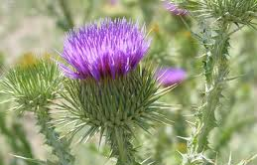
Scotch Thistle
Scotch thistle is a biennial weed with a tap root
The vegetative rosette can tolerate mowing. Stem elongation occurs when the plant produces flowers, mowing removes the stem before flowers are formed.
Each scotch thistle seed is attached to a pappus which allows it to be blown in the wind.
Scotch thistle decreases animal production by reducing the amount of pasture that livestock are prepared to eat as they avoid eating grass beside the spiny leaves.
The spiny vegetation and seed pappus can decrease the quality of wool if they get into the fleeces of sheep.

Slide 5
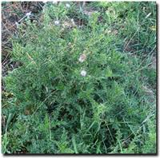
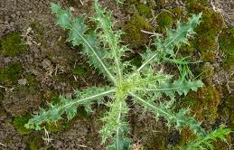
Californian Thistle
Californian thistle is a perennial with a horizontally growing creeping root systems joining plants together
In winter, the foliage of Californian thistle dies off, but the creeping root system is still alive underground making then very difficult to control.
New plants re-establish from these roots in spring, and flowering occurs in summer and autumn.
Livestock do not like grazing too close to the spiny foliage, so pasture plants beside thistle plants don’t get eaten.
The Californian thistle can be very competitive in crops, establishing quickly in a new crop from old root systems.

Slide 6
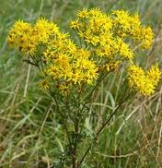
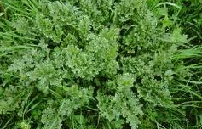
Ragwort
Ragwort is a biennial weed.
Ragwort contains a number of poisonous alkaloids, cattle avoid eating it.
Livestock avoid ragwort and do not eat the grass and clover growing up through ragwort plants and around them. This leads to poor utilisation of the pasture.

Slide 7
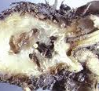
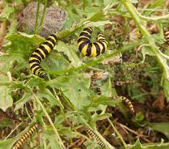
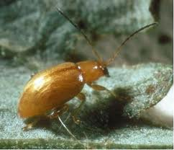
Ragwort Biological Control
Several biological control agents have been released for ragwort control. The most successful of these is the ragwort flea beetle which appears to be reducing the aggressiveness of ragwort in some areas.
The larvae of the cinnabar moth can also defoliate ragwort at some times of the year.

Slide 8
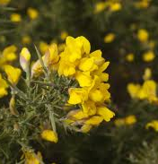
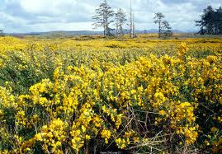
Gorse
Gorse is considered to be New Zealand’s worst scrub weed.
Large quantities of seeds with tough outer coats are formed by gorse each year
Gorse can regrow from dormant buds on stumps if shrubs are cut with chain saws or slashers without prior herbicide treatment
The "leaves" of gorse take the form of sharp spines, which can damage livestock and make them unpalatable,

Slide 9
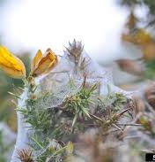
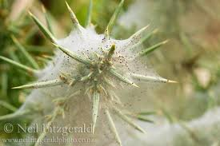
Gorse Biological Control
Gorse spider mite
Has established well in some locations, but predatory insects can reduce its impact
Gorse seed weevil
Has become established in most parts of New Zealand, and reduces seed production, but not so much as to affect gorse population
Gorse pod moth
Well established throughout New Zealand
Caterpillars destroy seeds, with each one eating the contents of 3 – 5 pods.

Slide 10
Research exercise:
Common pasture and crop weeds
Select a common weed found in a pasture or crop production systems.
Using information from https://www.massey.ac.nz/weeds and other sources answer the following questions in your own words.
Describe the type of weed it is.
Describe at least one characteristic that allows the weed to grow well.
Describe why this weed is a problem
Describe how a farmer/grower could prevent and or control this weed.

