Slide 1
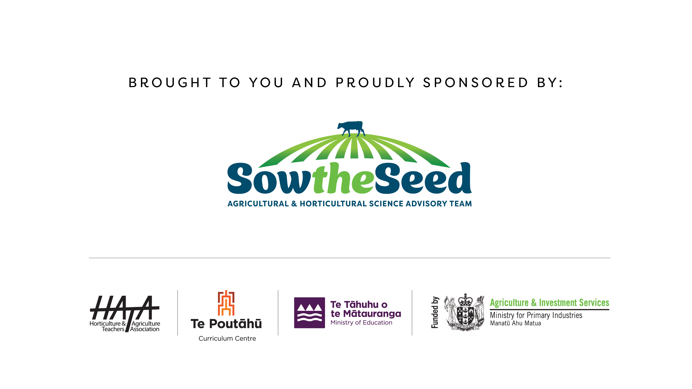

Slide 2
Pasture Growth Curves

Slide 3
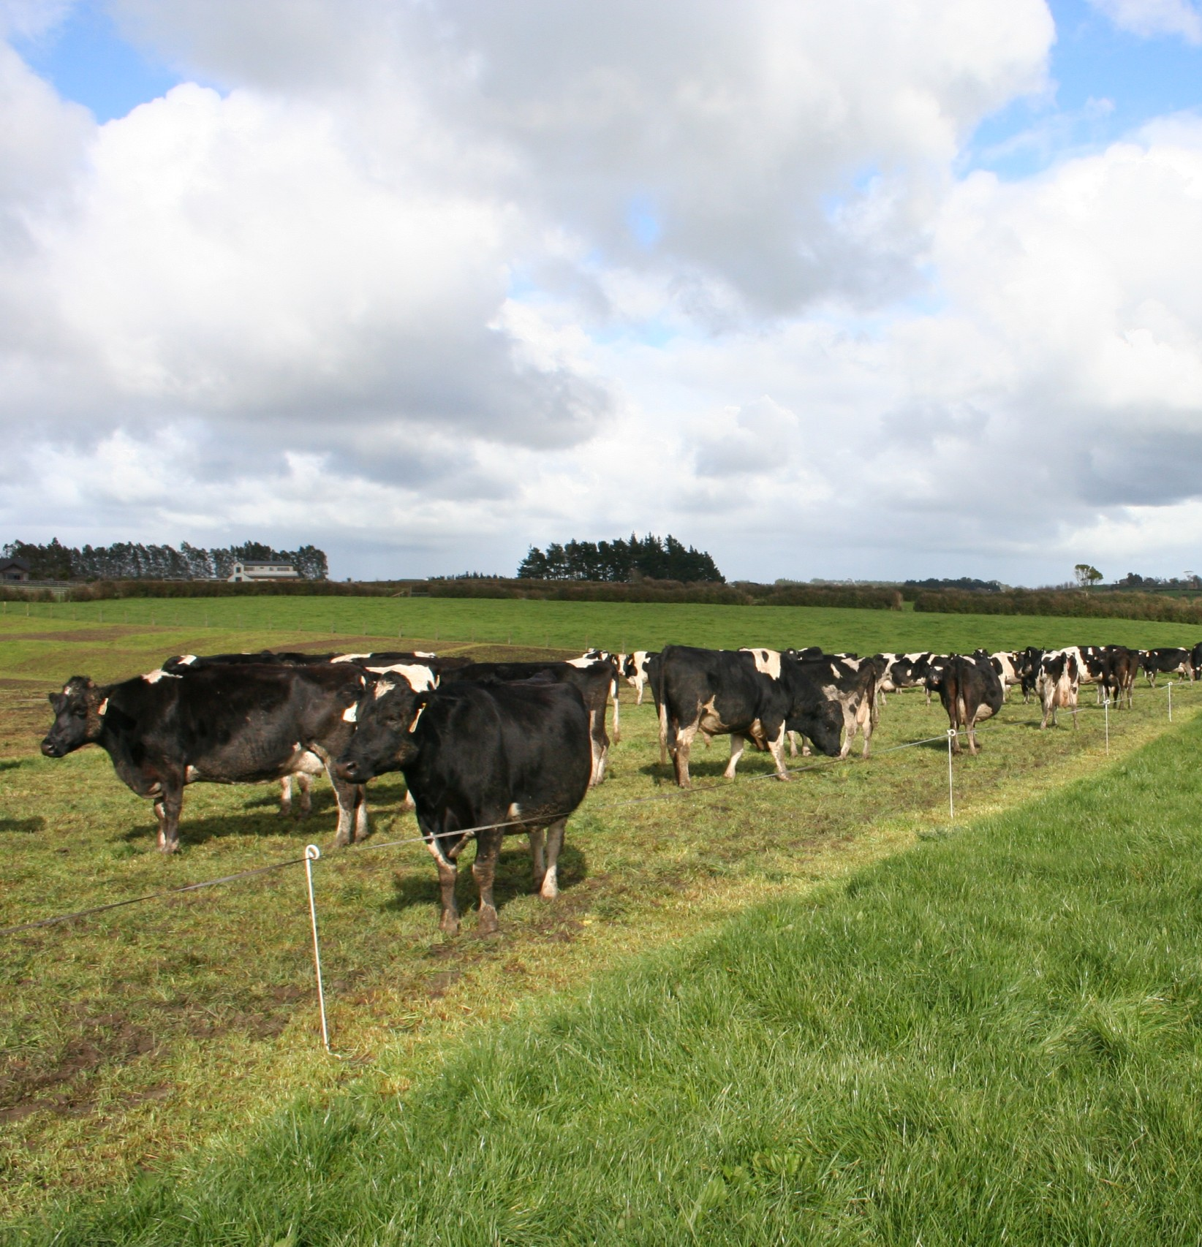
Pasture growth varies in quality and quantity throughout the year.
Knowledge of pasture growth throughout the year helps farmers match feed supply with livestock requirements. It help farmers make management decisions such as when to-:
  lamb or calve
  conserve pasture as hay or silage
  make grazing decisions- restrict intake – break feeding
  sow supplementary feed crops such as Maize, turnips, fodder beet
  sell or buy stock
  dry cows off
  put on fertilisers etc

Slide 4
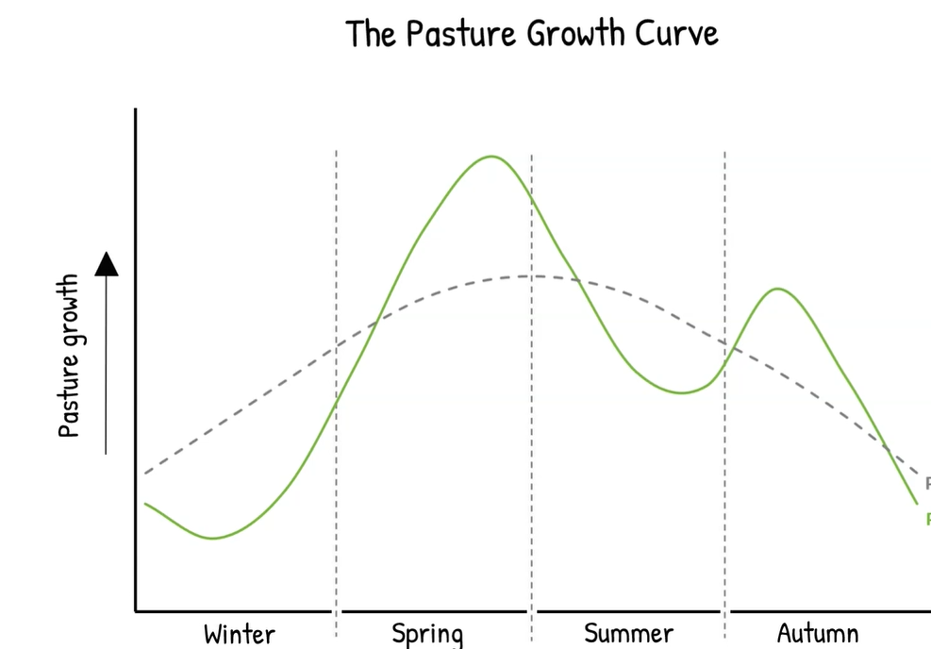


Slide 5
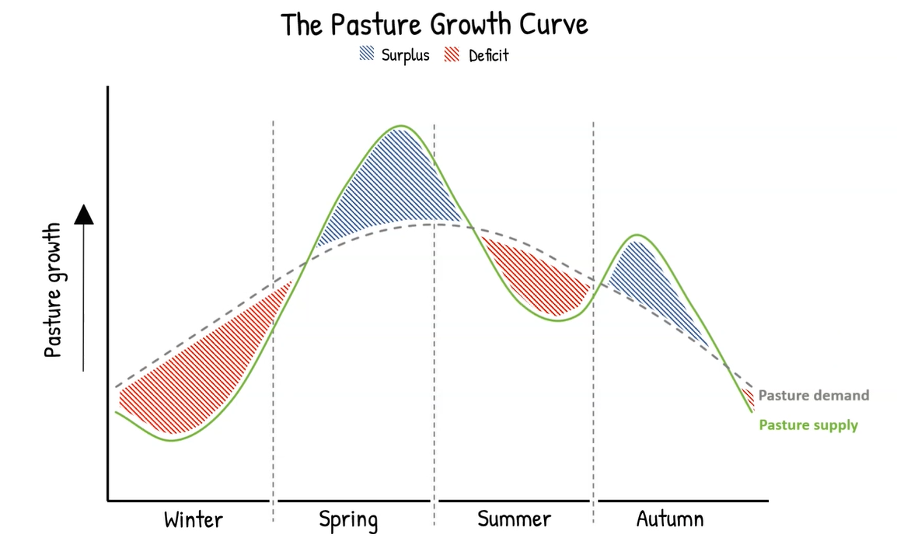

Slide 6
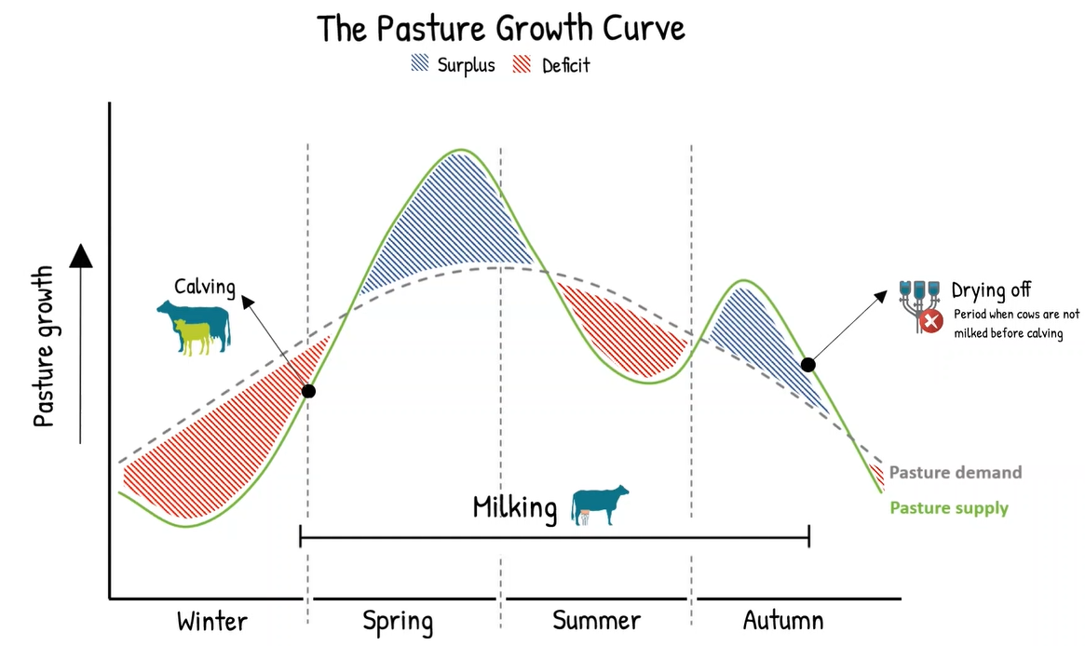

Slide 7
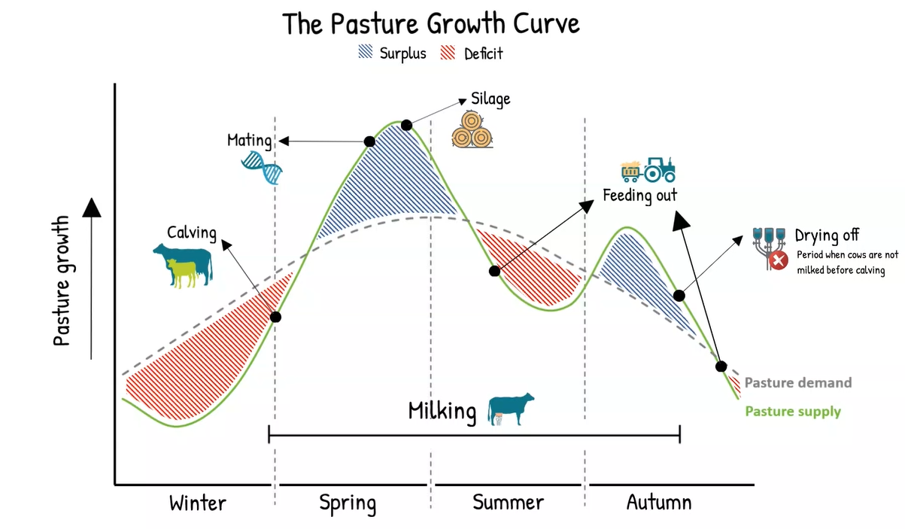

Slide 8
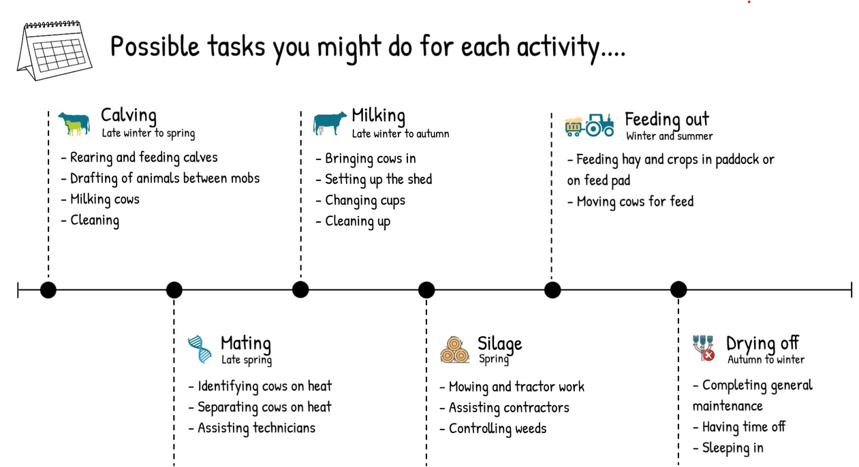

Slide 9
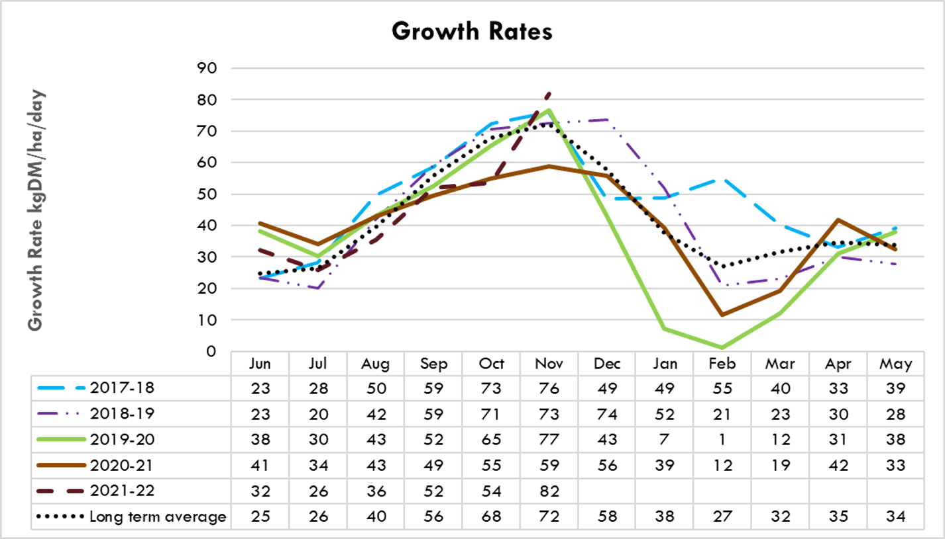
Owl farm pasture growth rates

Slide 10
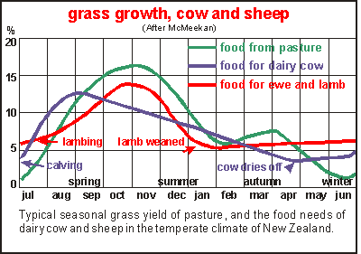

Slide 11
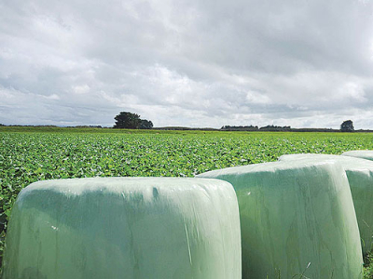
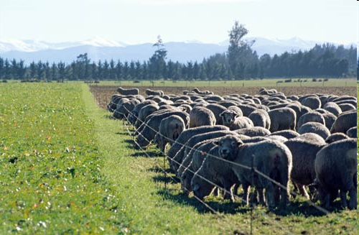
Discussion activity
Why does pasture growth vary throughout the year?
Why do animal feed requirement change throughout the year?
What do farmers do to help match feed supply with animal feed requirements?

