Slide 1


Slide 2
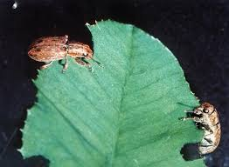
Pasture Pests

Slide 3
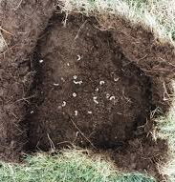
Impact of pasture pests
Pasture pest decrease pasture production by interfering with the normal plant processes carried out in the roots, stems and leaves. This prevents the plants from absorbing sufficient water and nutrients or photosynthesising efficiently.

Slide 4
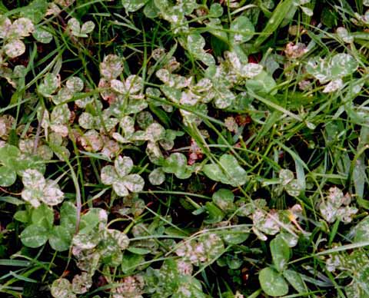
Signs of pasture pests
Plant leaves being eaten.
Poor pasture growth.
Pasture can be pulled out
easily.
Abnormal colour eg yellow brown patches in pasture.

Slide 5
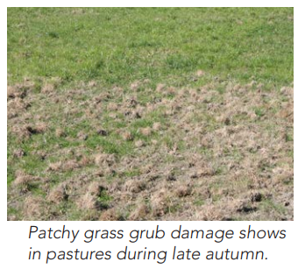
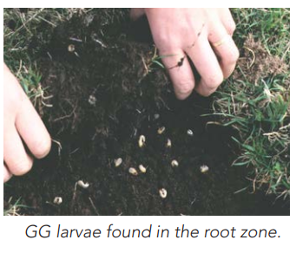
Grass grub
Grass grub is found throughout New Zealand. Larvae graze the roots of grass, plantain and clover causing poor growth and plant death, mainly from March-July. In severe cases, pastures can be rolled back like carpet.
Prevention and control
Treated seed
Cultivation usually drastically reduces GG larval numbers
Mob stocking and heavy rolling when soil is damp can reduce GG populations, but effects are variable

Slide 6
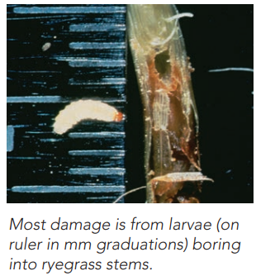
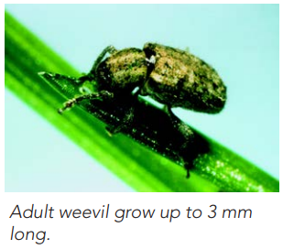
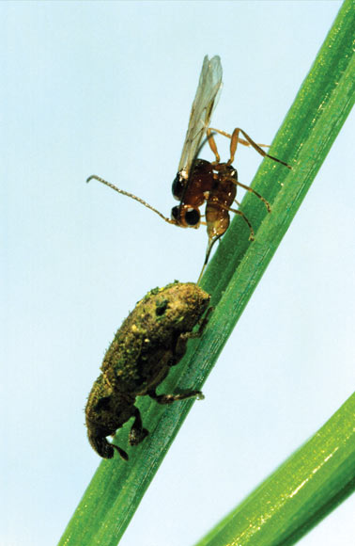
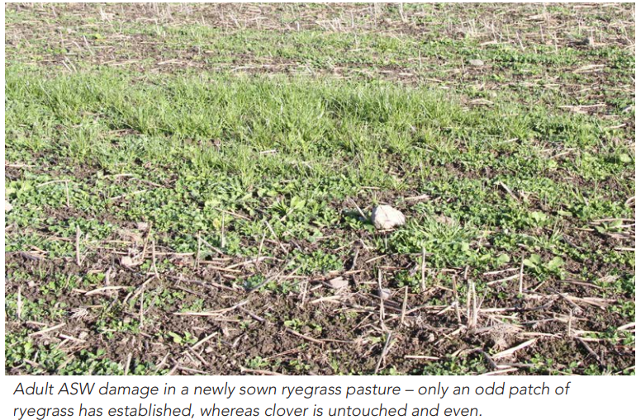
Argentine stem weevil
Argentine stem weevil targets short-term and perennial ryegrass (without endophyte) across New Zealand. The larvae bore into the base of ryegrass stems, destroying tillers and causing substantial pasture damage
Prevention & Control
Treated seed
Biological control
  A parasitoid wasp is now widespread, and helps alleviate damage caused by Argentine stem weevil
  Endophytes such as AR1, NEA2, NEA4, NEA12 and AR37 reduce the impact of ASW damage once ryegrass is established, and typically provide good on-going protection

Slide 7
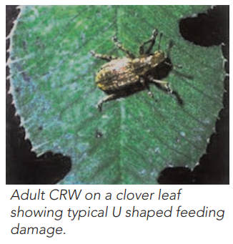
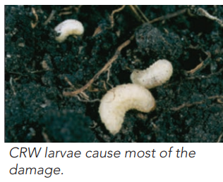
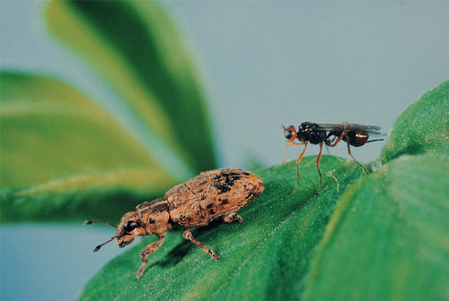
Clover root weevil
Clover root weevil was introduced to New Zealand in the 1990’s and is now present throughout New Zealand. Clover root weevil feeds exclusively on clover. It has a major impact on clover production and nitrogen fixation.
Adult Clover root weevils damage is characterised by U shaped notches on the edges of clover leaves. As clover is adapted to defoliation, the adult weevil rarely kills clover
Larvae are most damaging, feeding on the clover roots, stolons and nodules.
Prevention and Control
Maintaining strong clover in pastures is the best way to reduce the effect of Clover root weevil
Biological control- A parasitoid wasp is now well established throughout most of the North Island and South Island. This wasp won't eliminate CRW, but significantly reduces populations and larval damage

Slide 8
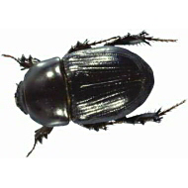
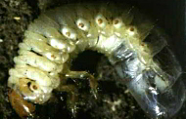
Black beetle
Black beetle are only found in warm areas, including Northland, Waikato, Bay of Plenty, coastal Auckland, Gisborne, coastal Taranaki, Manawatu and Kapiti coast. They live on and in the soil, they are mainly found in free draining, sandy, light ash or loam soils, and do not like heavy clays or poorly drained soils.
Adult Black beetle feed on roots or on the base of plants at soil level during autumn and spring, causing patches of yellowing tillers that easily pull out. They can destroy newly sown grass in autumn.
Black beetle larvae December-March and cause patchy ryegrass death and plant pulling
Prevention & control
Cultivation significantly reduces numbers of adult beetles and larvae
Use lime to improve soil pH to raise the soil pH to 6 resulted in up to 40% less Black beetle larvae
Treated seed
Biological control-Sow ryegrass with the right endophyte

Slide 9
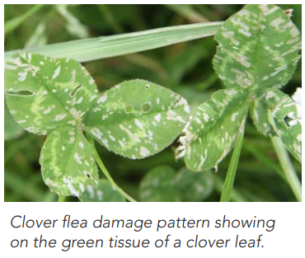
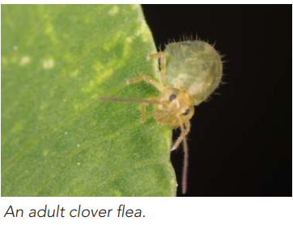
Clover flea
Clover flea is present throughout New Zealand and poses a particular threat to white clover and lucerne. Damage from clover flea appears as leaf flecking, giving a measles-like effect. Severe infestations can result in leaves turning white, as all green tissue is removed, leaving only a transparent skeleton. This damage impairs the legumes' ability to fix nitrogen, which is crucial for soil fertility.
Prevention & control
Clover flea can be successfully controlled using insecticides

Slide 10
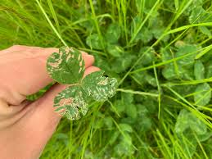
Research exercise
Select a pasture or crop pest that is a significant problem in your local farming region.
Describe the damaged caused by the pest.
Discuss how the pest is pest controlled to minimise the impact on the pasture or crop and farm financial returns.

