Slide 1


Slide 2
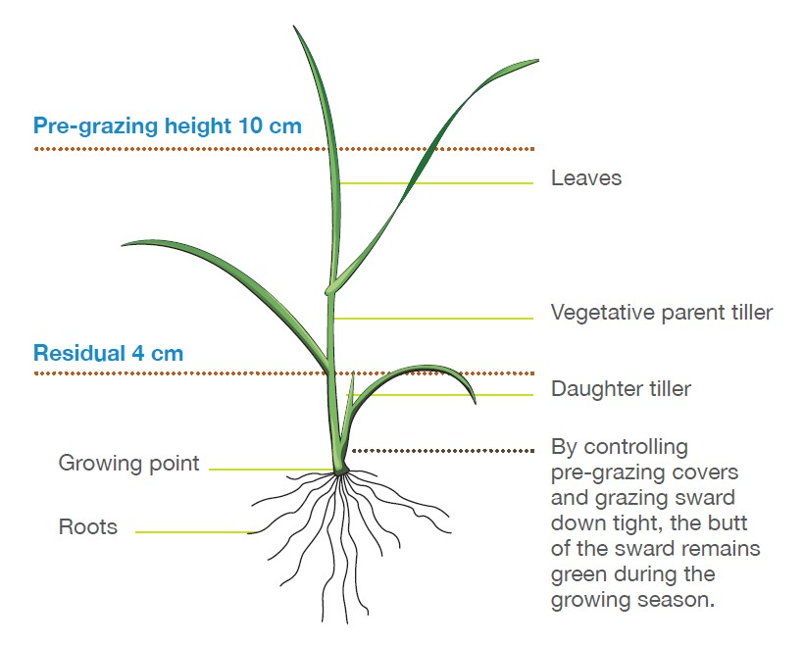
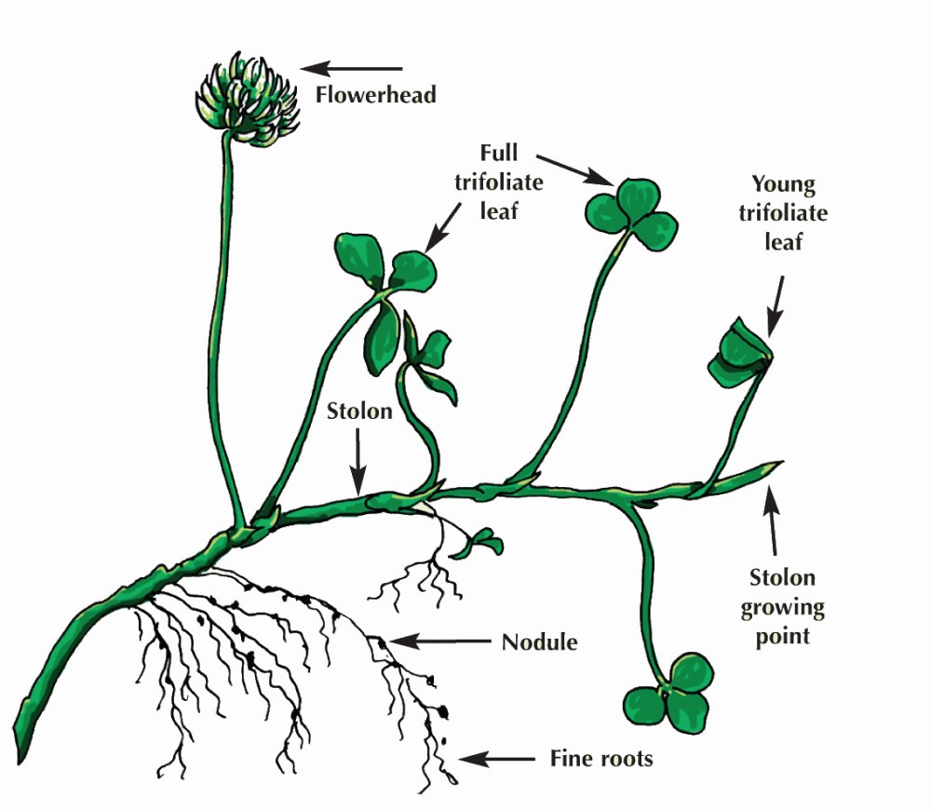
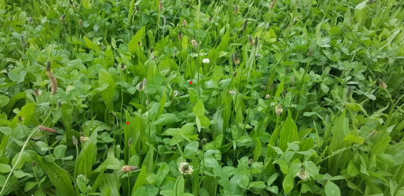
Pasture Production

Slide 3

Pasture- what is it?
Pasture is a mix of different plants grown together to feed grazing animals. It typically includes grasses, clovers, herbs, and sometimes weeds, providing a varied and nutritious diet for livestock.
Pasture is sometimes called a ‘sward”

Slide 4
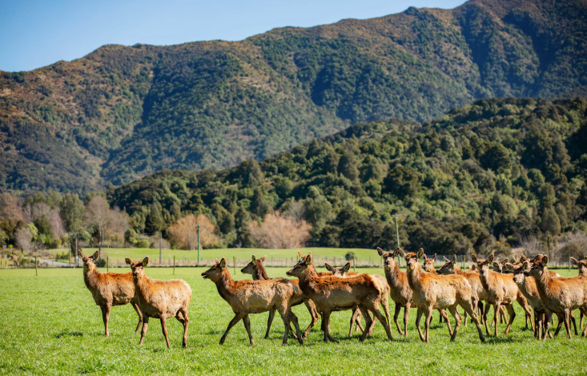
Discussion activity
Why is New Zealand’s agriculture based on pasture?
Why is pasture important?

Slide 5
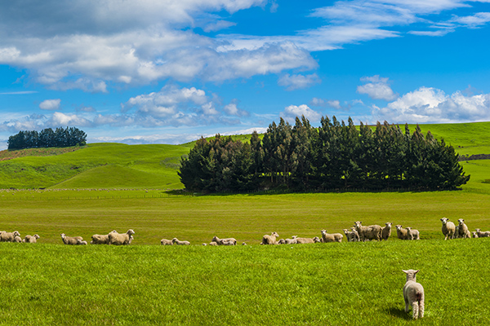
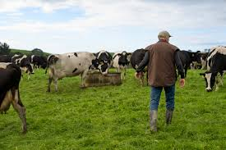
New Zealand’s
Agriculture
New Zealand’s agriculture is largely based on outdoor grazing of sheep and cattle on nutritious, low-cost pasture that grows for most of the year. The country’s mild climate and mostly hilly or mountainous topography, where only about 30% is flat or gently rolling, strongly influences the types of farming that are possible. With just 10% of the land flat enough for cultivation and cropping, pasture-based farming is the most practical and efficient use of the land. Ruminant animals, such as sheep and cattle, are well suited to this system because they efficiently convert pasture into valuable animal products like milk, meat, and wool. As a result, most New Zealand farming systems rely heavily on pasture and pasture supplements.

Slide 6
Why is pasture is important?
51% of land is used for pastoral farming,13.7 million hectares
It’s a low-cost feed for grazing farm animals
Animals like cows and sheep turn pasture into milk, meat, and wool.
These animal products are sold to other countries, helping New Zealand’s economy.
Provides income from small seed such as clover and grasses.
Helps maintains soil fertility via dung and urine return and nitrogen fixation by clovers, thereby reducing the need for fertilisers.
Farms and green pastures and rural landscapes also attract tourists adding value to New Zealand’s economy
Pasture helps cover the soil and protect it from erosion
Healthy pasture absorbs rainwater, which helps reduce flooding and keeps rivers clean.
Well-managed pasture can support native insects, birds, and healthy soil life.

Slide 7
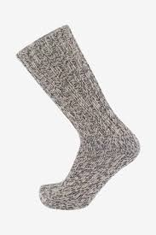
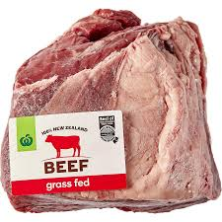
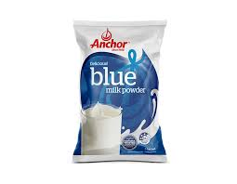
Discussion activity
Make a list of primary products produced from pasture?
Find out how much the following industry contributes to New Zealand's export earnings
Dairy
Meat and wool
Grass seed
Situation outlook 2025

Slide 8
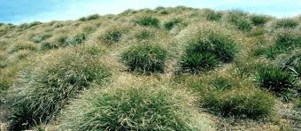
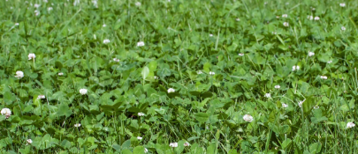
Types of pasture
Native Tussock Pasture
Native tussock pasture is found in New Zealand’s high country and on very steep hill farms where the weather can be extreme. The native grasses that grow here are tough and able to survive harsh conditions like cold, wind, and poor soil. However, they are not very nutritious and are hard for animals to digest. Because of this, these areas can only support a low number of animals, usually just 1 to 2 ewes per hectare.
Improved Pasture
Improved pastures are common on most New Zealand farms today. They are usually made up of perennial ryegrass and white clover, which have been specially developed by scientists to suit New Zealand’s climate and soil. These plants grow well, are highly nutritious, and are easy for animals to digest for most of the year. Because they provide better feed stocking rates of around 20 to 25 ewes or 2.8 to 3 cows per hectare, depending on the farm system can be achieved
Diverse Pastures
Diverse pastures include a mix of at least five different plant species, usually a variety of grasses, clovers, and at least one herb. Some farms in New Zealand grow pastures with more than 30 species, often sowing 10 or more perennial types. The aim of diverse pastures is to improve overall pasture production and help balance things like growth throughout the seasons, animal health and performance, soil quality, resilience to droughts, and reducing the need for extra farm inputs like fertiliser. Diverse pastures can also support better environmental outcomes.

Slide 9
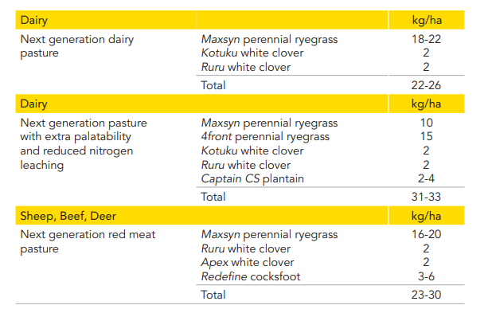
Pasture mix
In New Zealand, improved pastures are mostly made up of perennial ryegrass and white clover, although other grasses and clovers are also included. A typical improved pasture contains about 60–70% grass and 30–40% clover. This mix provides a healthy, balanced diet for grazing animals like sheep and cattle.

Slide 10
Perennial Ryegrass
Perennial ryegrass is the most common grass in improved pastures. It has many benefits:
Fast to grow
Competes well with weeds
Grows well under grazing
Nutritious providing a balanced feed for ruminant animals.
Palatable
Tolerates a range of climatic conditions, pests, and diseases.
Plant breeders continue to develop new perennial ryegrass cultivars to suit New Zealand’s changing conditions.

Slide 11
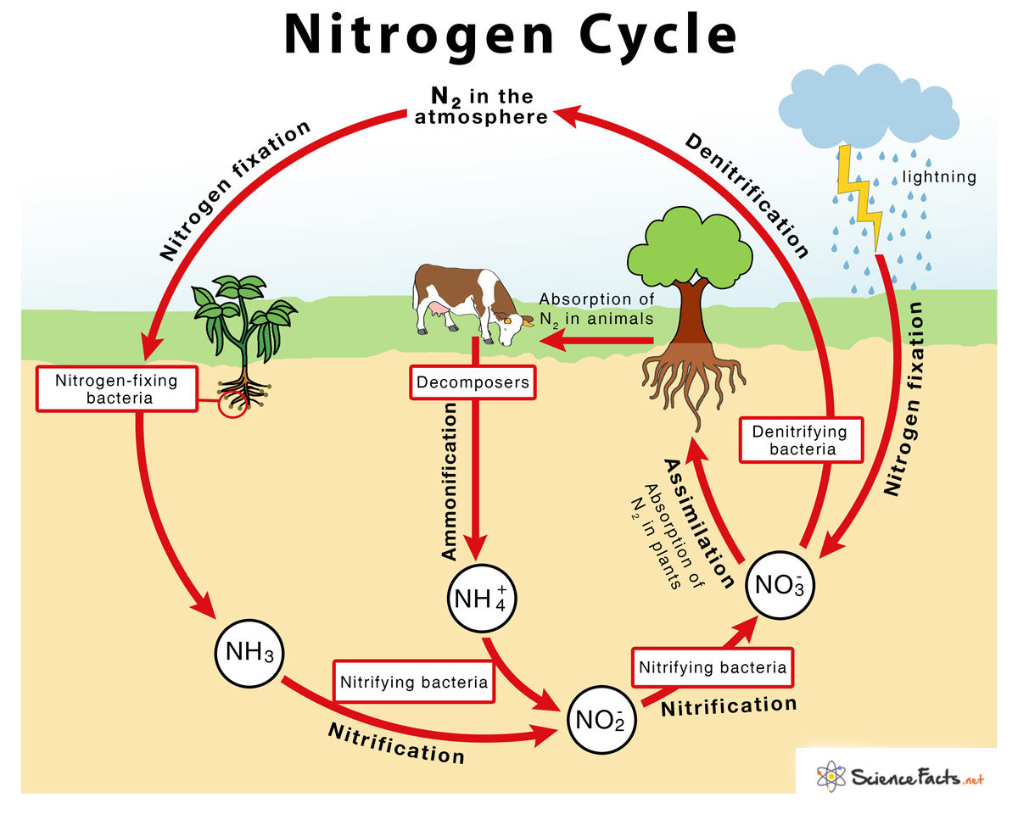
White clover
White clover is a legume and plays an important role in New Zealand pastures. It has many benefits that help both animals and the soil:
It is highly nutritious and palatable. They have more protein and less fribre than grasses so have a high feed value.
It grows well alongside perennial ryegrass, making a strong pasture mix.
It can fix nitrogen from the air into the soil, which helps fertilise the pasture naturally and reduces the need for synthetic fertilisers.
There are many different cultivars of white clover that have been specially developed to suit different climates, soils, and farm systems across New Zealand.

Slide 12
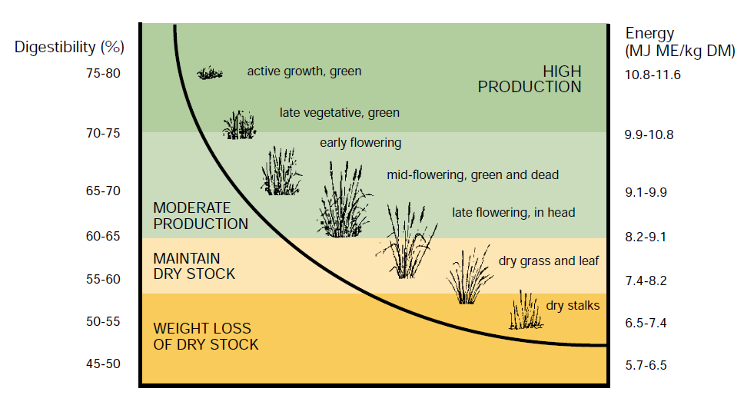
Discussion activity
Why are other plants added into a pasture mix?
What are the advantages and disadvantages of pasture as a feed?
Why do farmers measure pasture?
How do farmers measure pasture?
What is dry matter?
Why is pasture measured in dry matter?

Slide 13
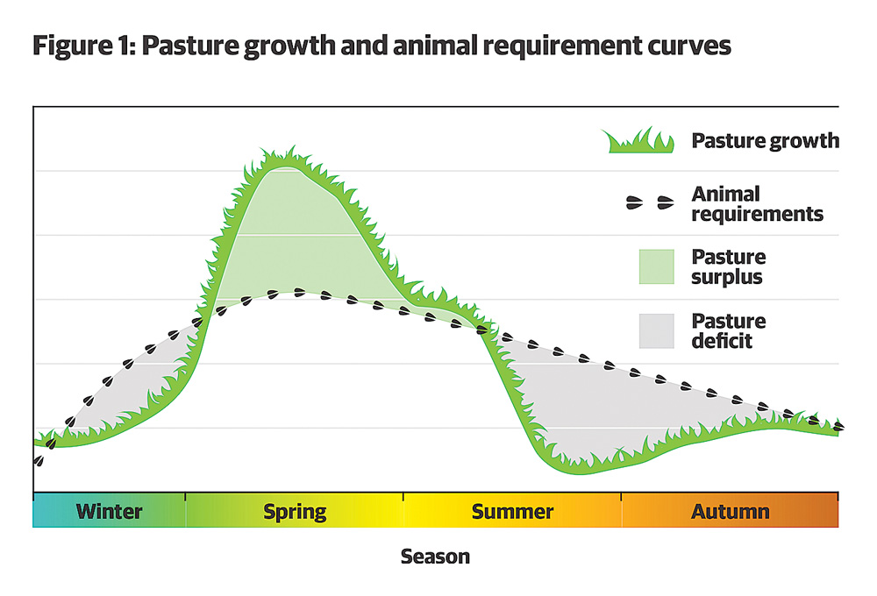
Other Grasses and Clovers in Pasture Mixes
As well as perennial ryegrass and white clover, farmers often add other types of grasses clovers and herbs to their pastures. These extra plants help provide better feed at different times of the year or in tough conditions, like during a drought.
Benefits of adding other pasture species:
They can provide good-quality feed when perennial ryegrass isn’t growing as well.
Some are more palatable than perennial ryegrass when it becomes stalky.
Certain types grow better in dry or poor conditions, like during droughts.
Some are better suited to specific animals or grazing systems, giving farmers more flexibility.

Slide 14
Pasture as a feed for livestock
Advantages | Disadvantages
Low cost Low labour Fed on site, don't have to cut and carry into barns etc Animal wastes returned naturally Potentially easily digested and palatable Has a high nutritional value for most of the year | Seasonal variation in quantity and quality of pasture through the year. Disease risks parasitic worm larvae, facial eczema fungi. Lack nutrients- sometimes pasture can lack some essential nutrients causing diseases such as milk fever (Ca), grass staggers (Mg), Bush sickness (Co.)

Slide 15
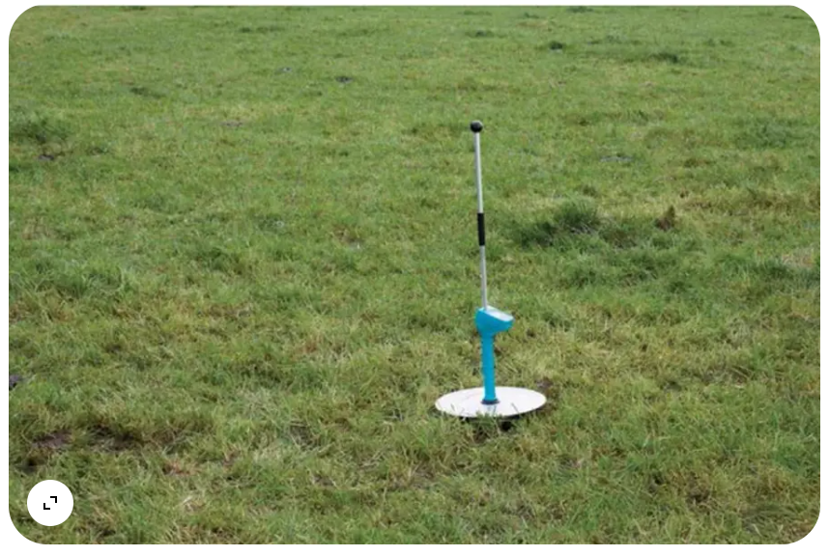
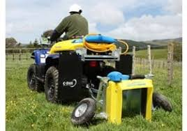
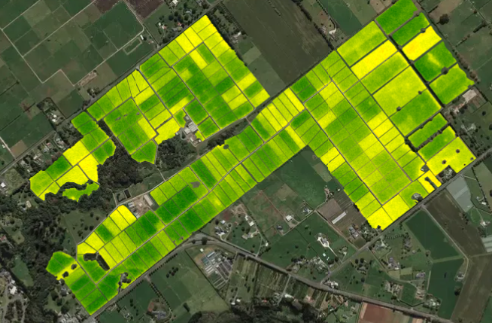
Measuring pasture
Pasture plate meter
C-DAX
Pasture from space
Measuring pasture growth is essential for farmers to make informed management decisions that: -
help match feed supply with animal requirement.
maintain pasture quality.
help plan for seasonal variability in pasture production.
Identify feed surpluses and deficits

Slide 16
Dry matter
DM
DM% = sample dry weight x 100
sample fresh 1
DM/ha= DM % X fresh weight/m² X 10,000
Dry Matter is the fibre and nutrient value of pasture when all the water is removed.
Dry matter is the component of pasture that is used for growth and production in animals hence it is what we need to know when we talk about feeding levels for livestock.
1kg DM is equivalent to about 6.5 kg fresh pasture.
Knowing the DM content of pasture is essential for calculating animal intake and ensuring animals receive adequate nutrition for growth, milk production, or reproduction.

Slide 17
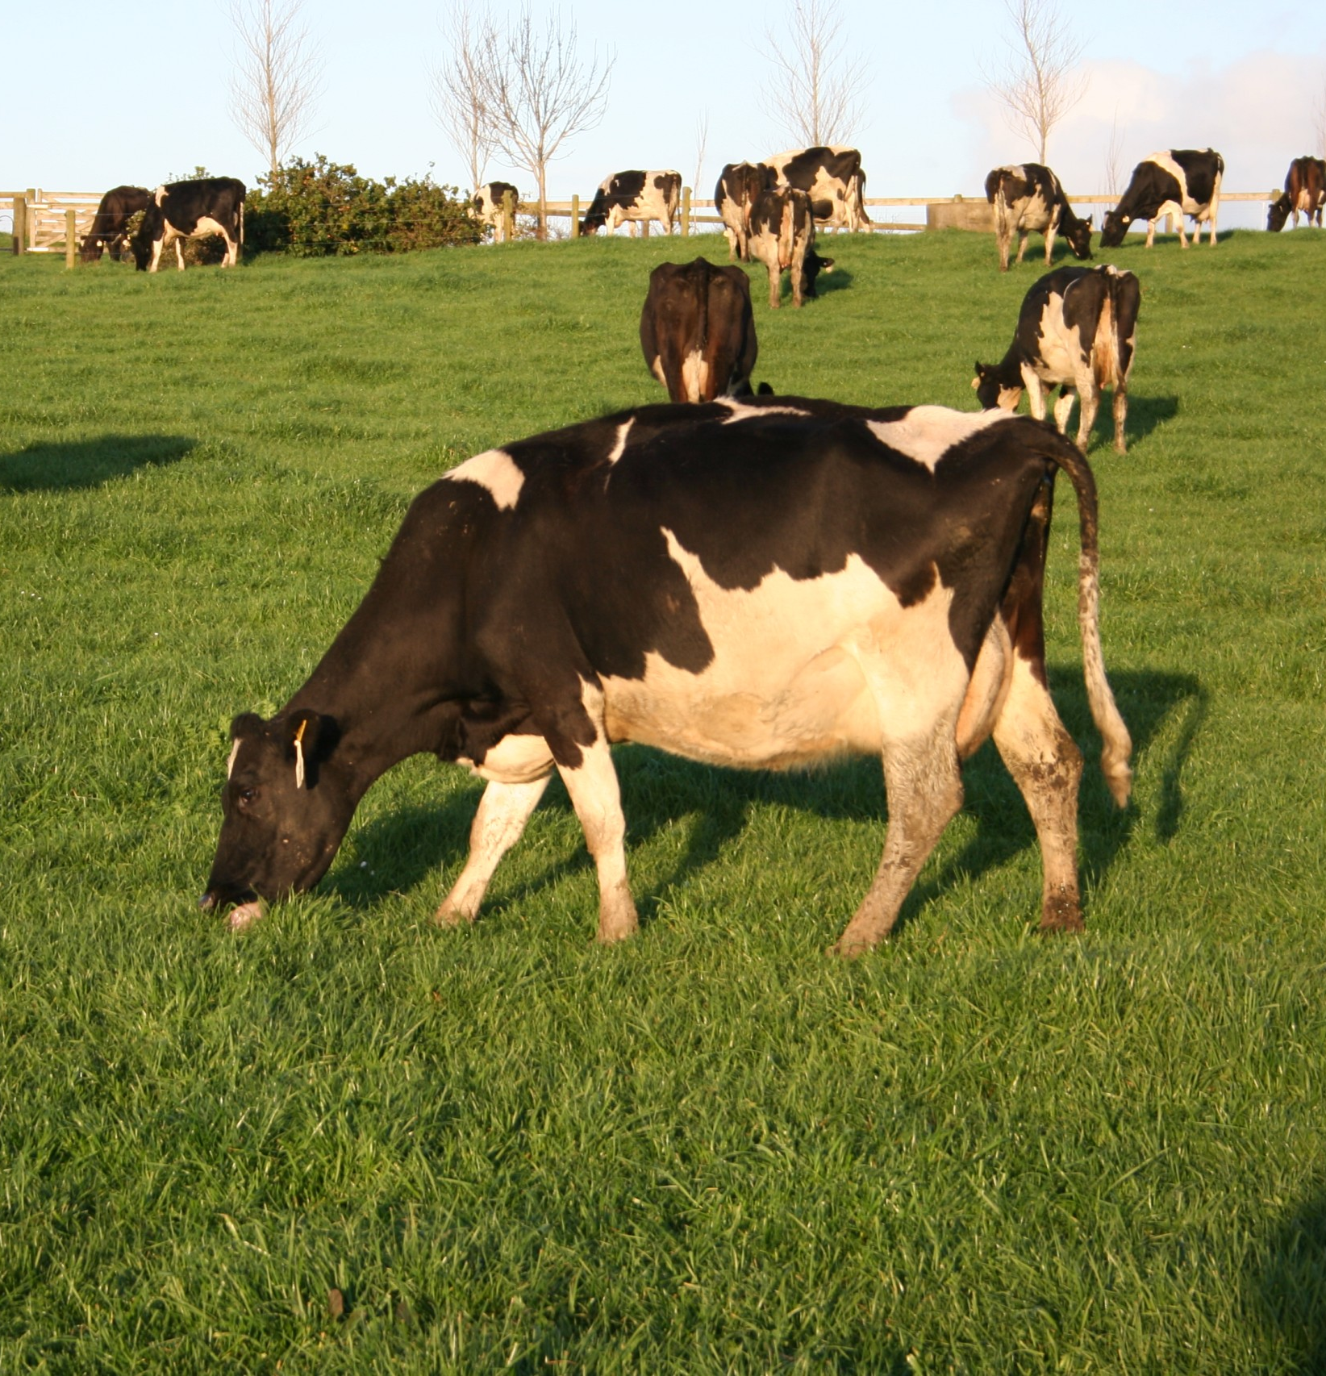
Grazing Management
Good pasture management is really important for getting the best out of both the pasture and the animals.
How much and how often animals graze affects how much pasture grows and how good it is.
If animals eat too much or too little, pasture quality and animal health can both suffer.
Farmers need to manage grazing carefully to keep pasture growing well and to make sure animals get the feed they need.
It all starts with controlling how much area the animals graze and for how long.

Slide 18
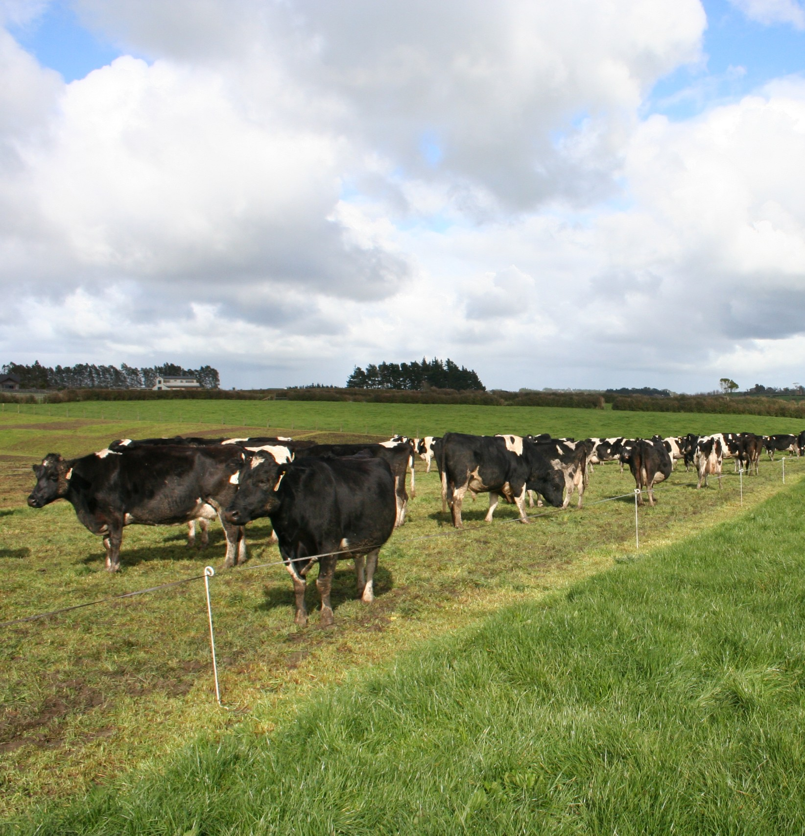
Discussion activity
What are the types of grazing systems?
what are the advantages and disadvantage of each grazing system.
When are they used and why on a-
Dairy farm
Sheep and beef farm
Go through the Power point grazing systems

Slide 19
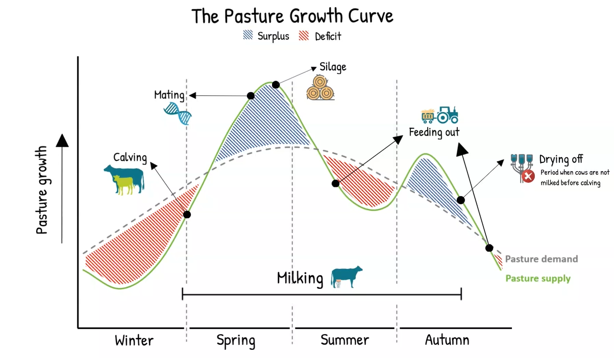
Pasture growth curve
This knowledge of pasture growth throughout the year helps farmers make management decisions such as when to-:
  lamb or calve
  conserve pasture as hay or silage
  sell or buy stock
  dry cows off
  put on fertilisers such as urea on
Work through the
power point “Pasture Growth Curves”
pasture growth rate exercise worksheet

Slide 20
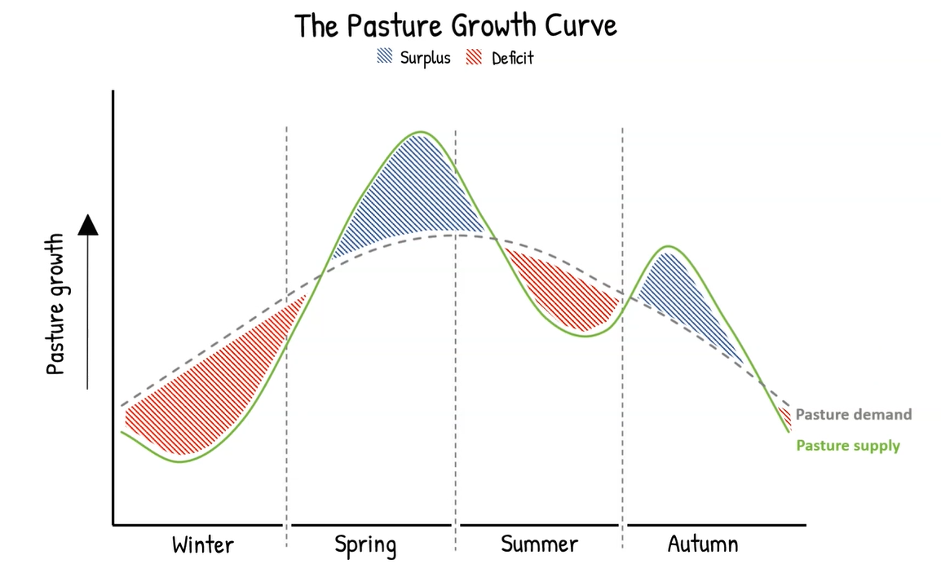
Discussion activity
What is pasture conservation?
What are the methods of pasture conservation?
Why is pasture conservation important?
How is pasture conserved?
Work through the powerpoints on silage, hay and balage

Slide 21
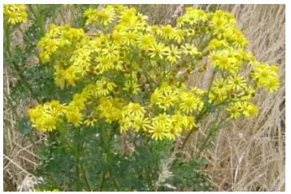
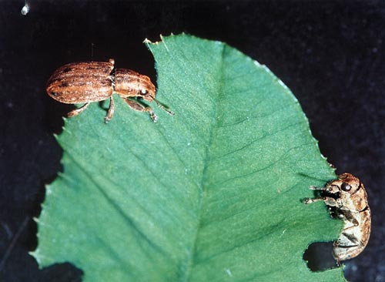
Discussion activity
Pasture weeds and pests
Make a list of pasture weeds and pests?
How do weeds affect pastures and livestock?
How do pasture pests affect pastures?
Work though the powerpoints on pasture weeds and pests.

Slide 22
Pasture Jargon
Make a drag and drop the statement next to the correct term
Persistence
Grows for more than one year and so stays in the pasture
Vigour
Each growing stalk of a grass plant (reproductive)
Establishment
Grows creeping along the ground
Productivity
The amount of leaf that a pasture plant grows, measured in dry matter.
Palatability
A technical term for pasture- a mix of pasture plants
Prostrate
How well a plant competes with other plants in the pasture mix and whether it stays growing in the pasture or dies out
Perennial
Tastes good to stock
Resistant
Growth is not affected by certain pests or diseases or growing conditions e.g. drought
Tillers
Speed and strength of plant growth
Sward
Growth of plants from seed sown to form part of the pasture mix.

Slide 23
Pasture Jargon
AnswersMake a drag and drop
How well a plant competes with other plants in the pasture mix and whether it stays growing in the pasture or dies out
Persistence
Vigour
Speed and strength of plant growth
Establishment
Growth of plants from seed sown to form part of the pasture mix.
Productivity
The amount of leaf that a pasture plant grows, measured in dry matter.
Palatability
Tastes good to stock
Prostrate
Grows creeping along the ground
Perennial
Grows for more than one year and so stays in the pasture
Resistant
Growth is not affected by certain pests or diseases or growing conditions e.g. drought
Tillers
Each growing stalk of a grass plant (reproductive)
Sward
A technical term for pasture- a mix of pasture plants

